Slide 1
Urbanization, Modernization and Class Division in Latin America, 1930-1960

Slide 2
Latin American economies
Rise of populist governments – Lázaro Cárdenas in Mexico, Getulio Vargas in Brazil, Juan Peron in Argentina
During the depression most Latin American governments embraced Import Substitution Industrialization
ISI involved high tariffs on imported goods, support for national industries.

Slide 3
The results:
Impressive industrial growth
E.g. Mexican industry grows at 6 percent per year 1940-1970.
Favoring of new working class.
E.g. Juan Peron 1946 comes to power supported by the General Conference of Labour (CGT)

Slide 4
Urbanization
Focus on industrialization brings huge growth in urbanization.
E.g. Between 1940 and 1968 Mexico moved from being a rural country (60 per cent lived in rural villages) to being an urban country (60 per cent lived in towns or cities)
E.g. Existing cities like Mexico City
1940 Population of Mexico City, 1.67 million
1950 Population of Mexico City, 2.96 million
1960 Population of Mexico City, 5.14 million
1970 Population of Mexico City, 8.88 million
e.g. New cities like Brasilia, founded by Brazilian president, Juscelino Kubitschek, in 1960.

Slide 5
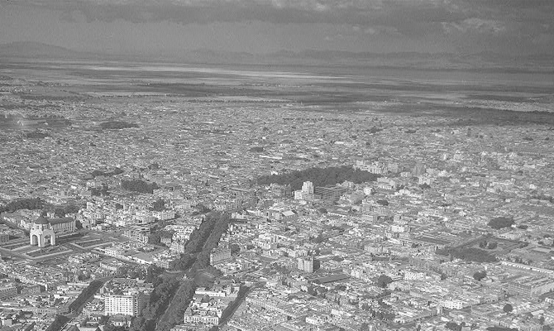
Mexico City 1940

Slide 6
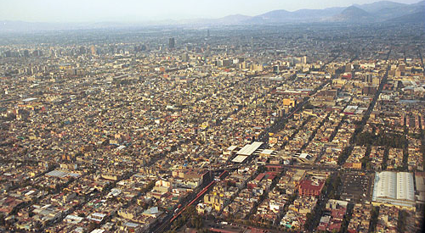
Mexico City 1980

Slide 7
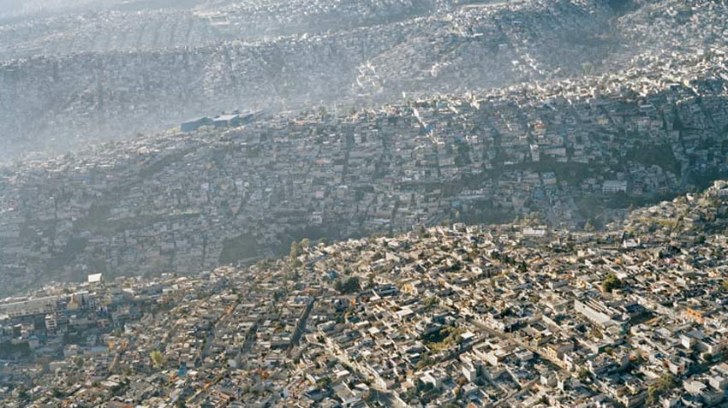
Mexico City 2000

Slide 8
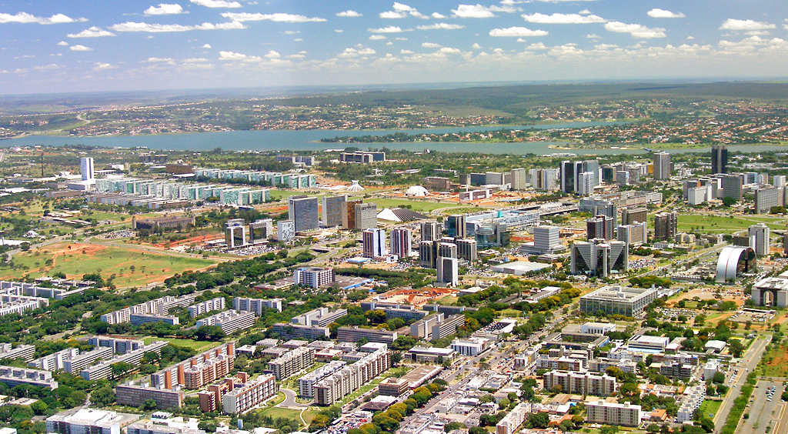
Brasilia

Slide 9
Urbanization and inequality
Although ISI was designed to benefit entire country, in fact, it benefitted certain sectors, especially national industrialists and merchants.
Inequalities mapped over growing cities.
E.g. Foreign and Mexican rich had previously lived in colonial heart of Mexico City.
Increasingly moved out into US style suburban developments.
E.g. Lomas de Chapultepec, constructed in 1920s and 1930s by US landscape artists and engineers. By 1950s Mexican elite dominated market, building Californian styles residences.

Slide 10
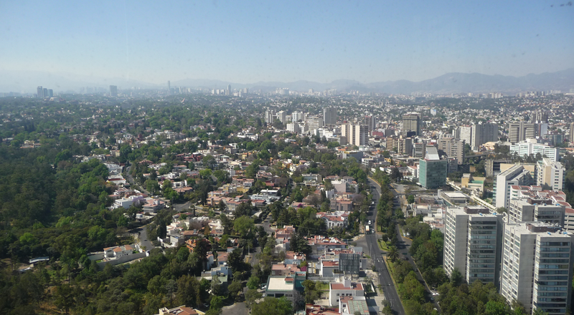
Lomas de Chapultepec

Slide 11
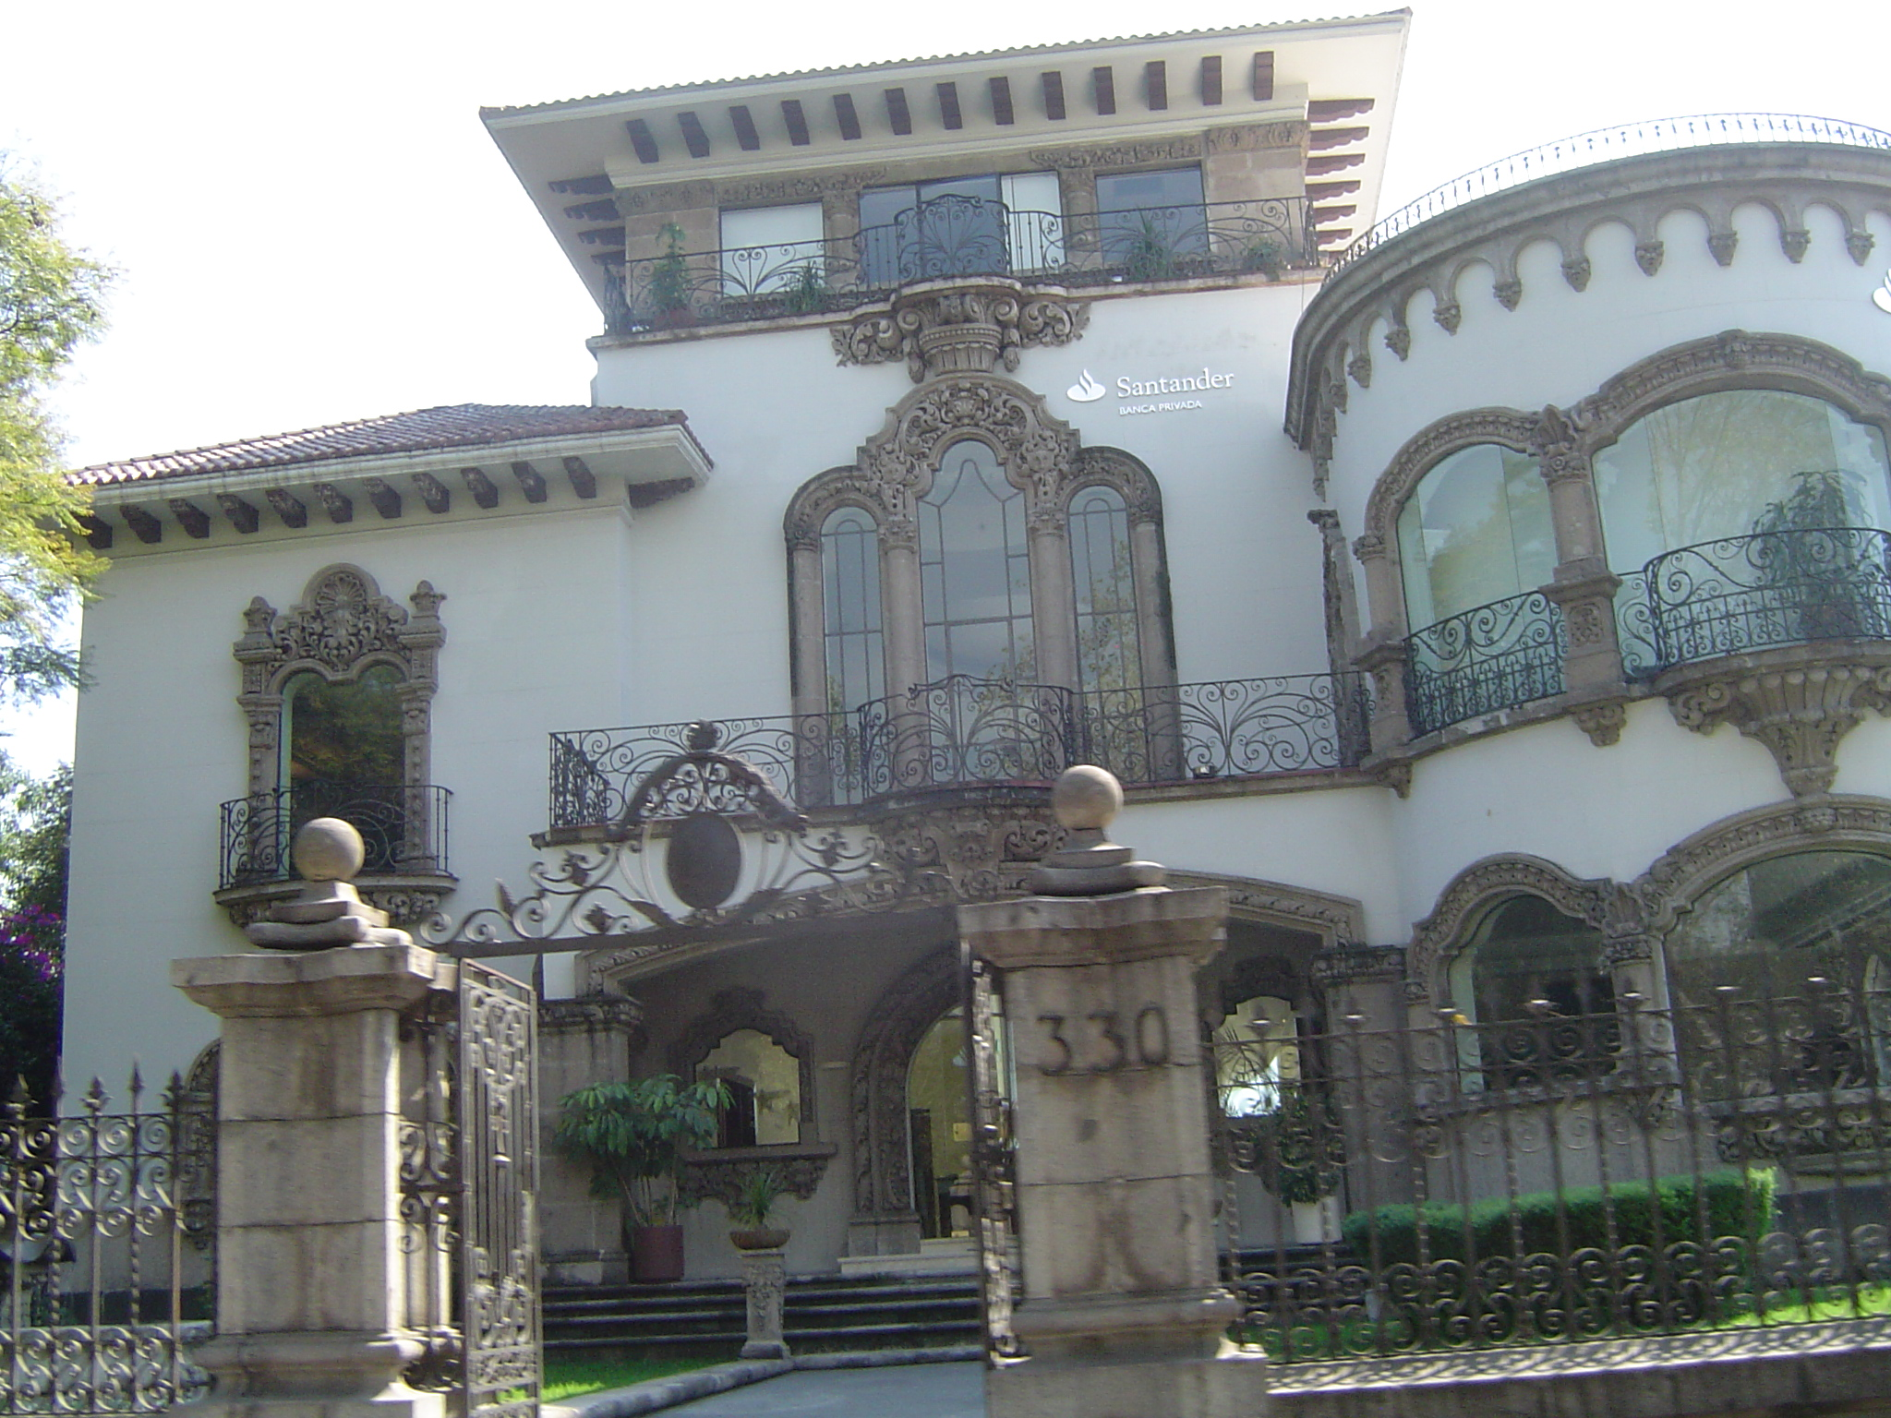
California Style residences

Slide 12
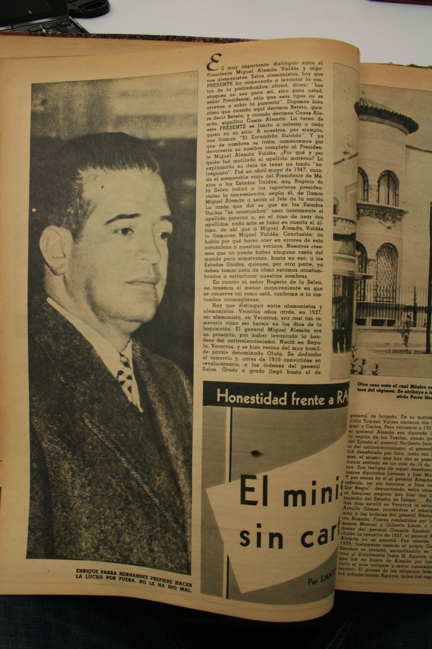
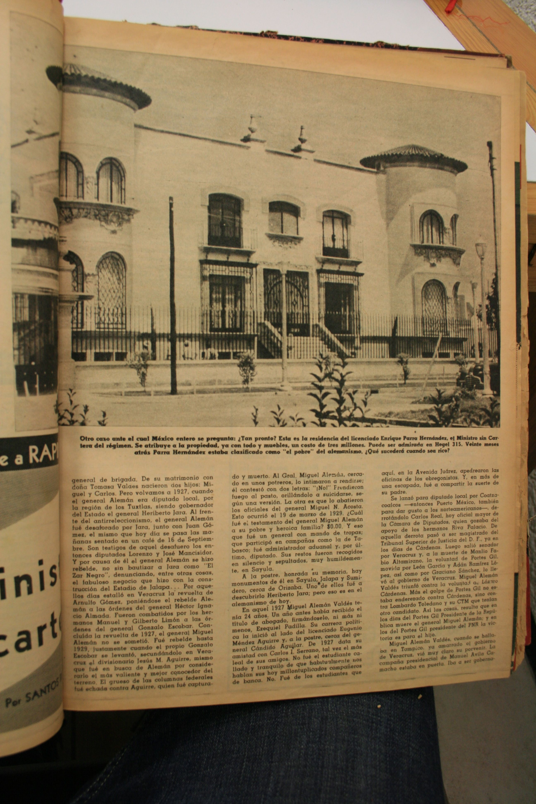

Slide 13
The labor aristocracy and the middle class
From 1940 onwards, populist presidents like Vargas, Peron, and the Institutional Revolutionary Party (PRI) in Mexico attempted to woo labor aristocracy and middle class.
Central to this project was construction of modernist housing projects and sale at below market price to middle class consumers.

Slide 14
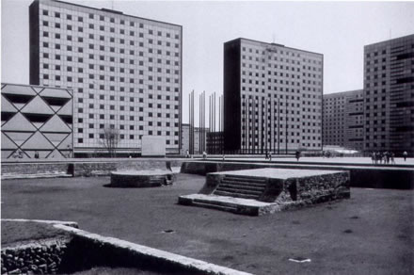
Mexico City - Ciudad Nonoalco-Tlatelolco, 1964

Slide 15
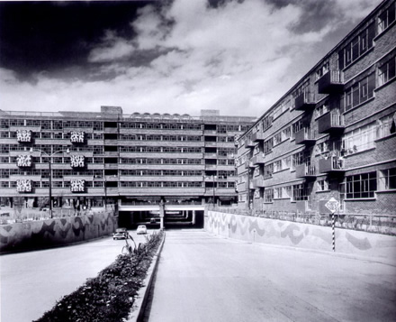
Mexico City - Centro Urbano Presidente Juarez

Slide 16
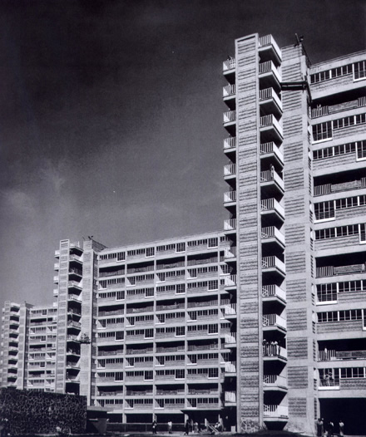
Centro Miguel Aleman, 1949

Slide 17
New Consumption Patterns
Advent of mass media
  Increasing literacy rate and cheap production of radios and televisions = establishment of mass media in Latin America
  1960, 65 per cent of Argentines owned radios
  1970, 40 per cent of Mexicans owned televisions
  Advent of mass advertising
  - Advertising in Latin America dominated by US advertisers like J Walter Thompson Company.
  - Harnessing of Freudian psychological techniques.
  - - Played on Latin American aspirations and insecurities

Slide 18
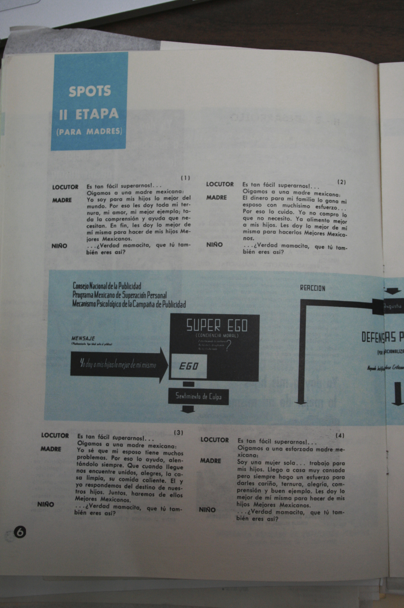
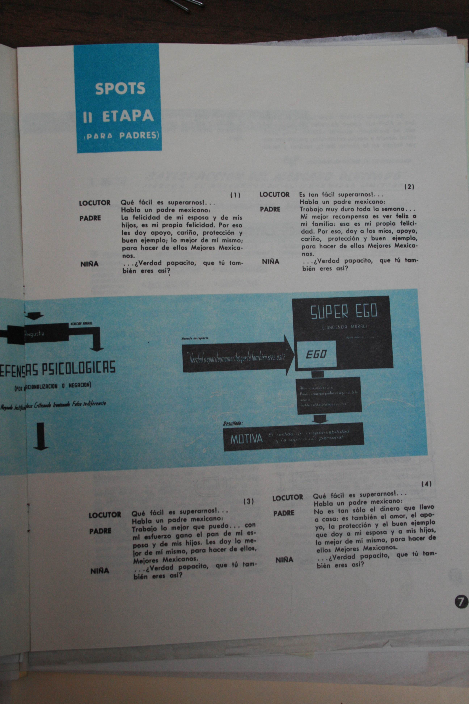

Slide 19
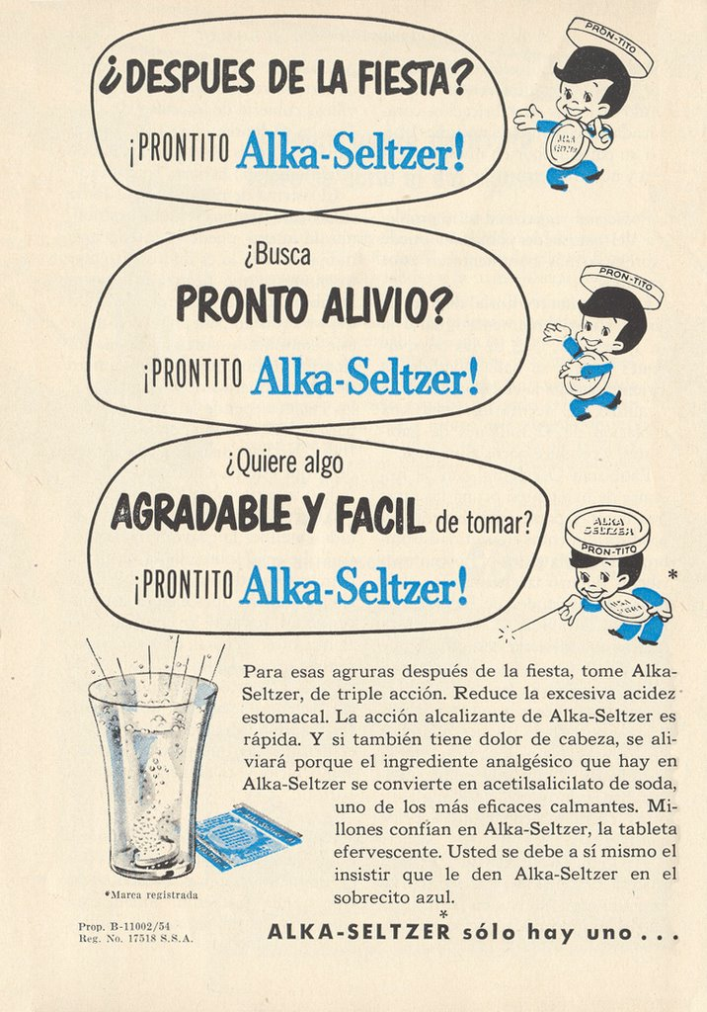

Slide 20
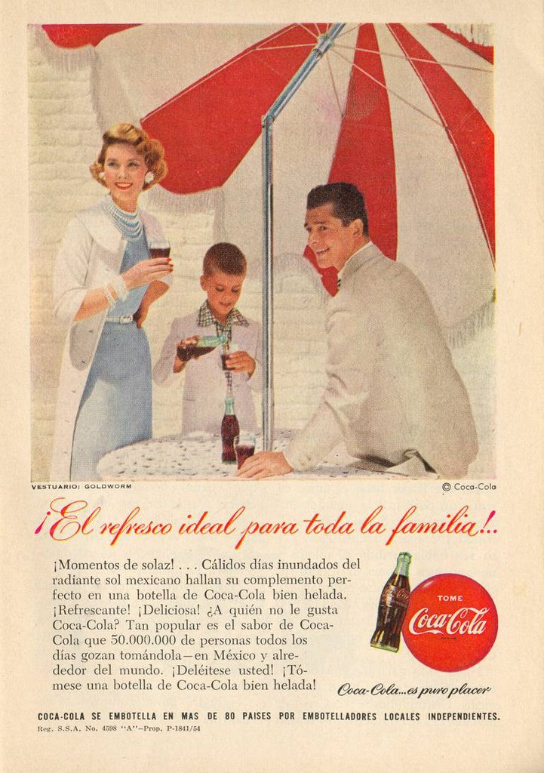

Slide 21


Slide 22
The urban poor
This period of industrialization also saw the establishment of Latin America’s slums, barrios in Spanish Latin America, favelas in Brazil.
Many of the people who flooded into the cities from the countryside faced problems.
  Lack of stable employment in industry (profits of industrial growth went to industrialists and new labor aristocracy)
  Forced to work a series of menial, short-term jobs in the “informal” sector. Low wages, no job security, no social security, no union kickbacks.
  Housing

Slide 23
In Mexico, new immigrants were forced to choose between three options
Vecindades - high rent, converted nineteenth century buildings
Ciudades perdidas - empty, privately owned lots, medium rent, necessary to construct own house.
Paracaidismo – squatting, possibility of no rent, but high risk due to constant threat of eviction.

Slide 24
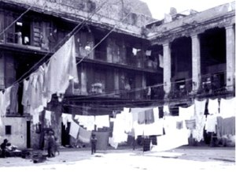
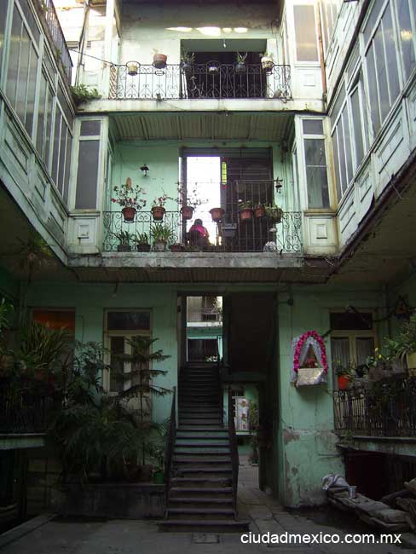
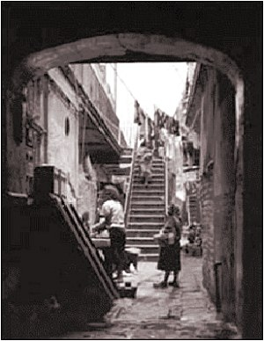
Vecindades

Slide 25
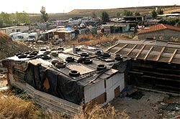
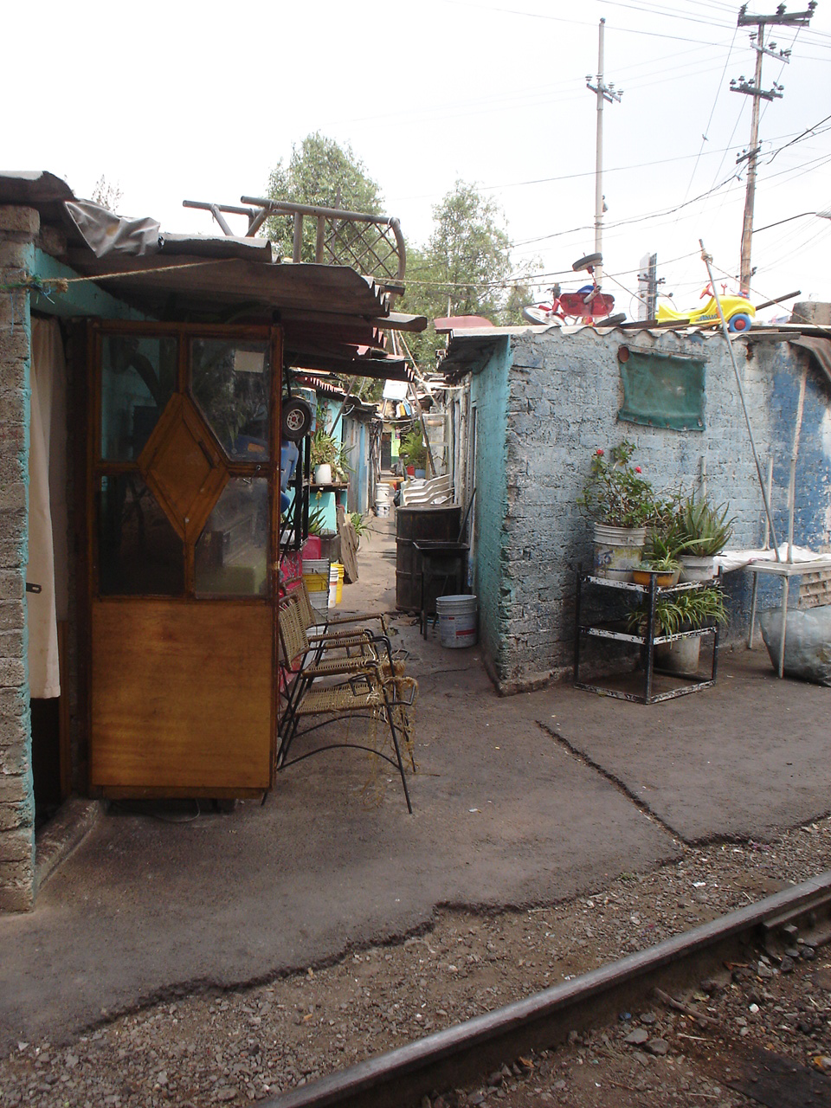
Ciudades Perdidas

Slide 26
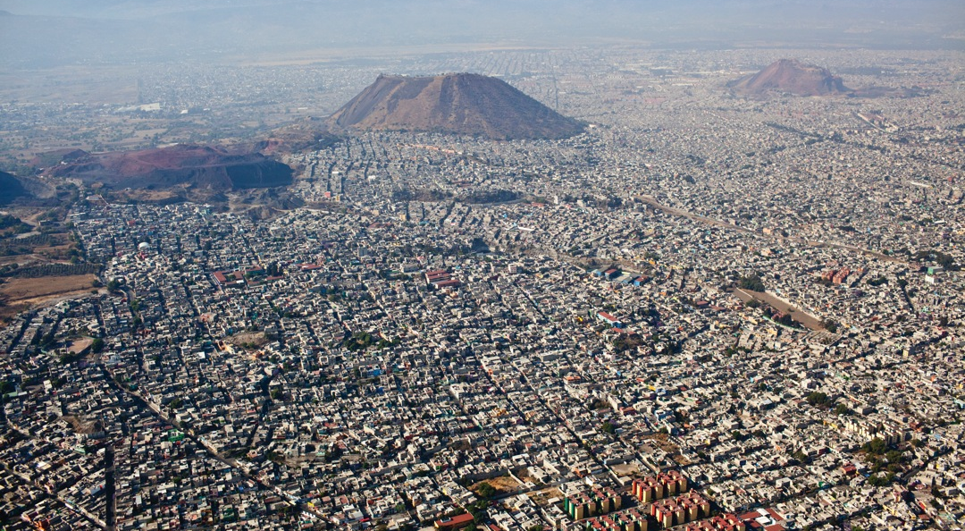
Paracaidismo e.g. Ciudad Nezahualcoyotl

Slide 27
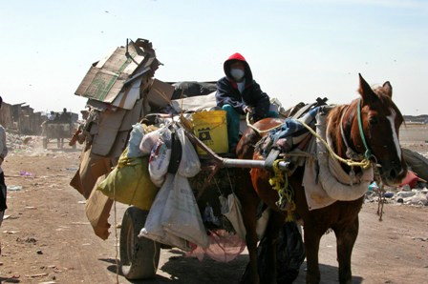
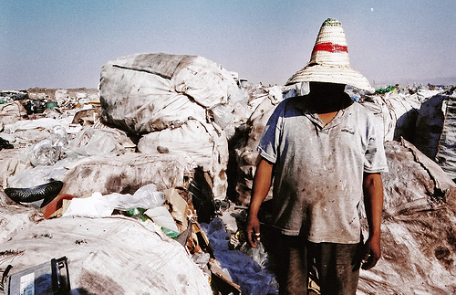
Pepenadores

Slide 28
The favelas
Original favelas established in late 1800s by veteran soldiers.
1937 Introduction of Building Code which set out explicit policies for favelas and attempted to regulate them.
1940s-1950s Vargas’s industrialization policies cause massive expansion of favelas.
Increasing clashes between government and favelas. E.g. 1940s program called Parque Proletário destroyed favelas and push residents outside city to prefabricated social housing.
1940 6% of Rio residents live in favelas, 1970 34% live in favelas

Slide 29
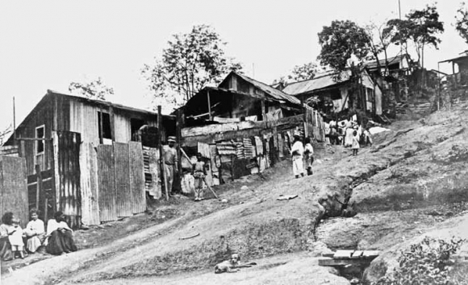
Early C20 housing in Rio de Janeiro

Slide 30
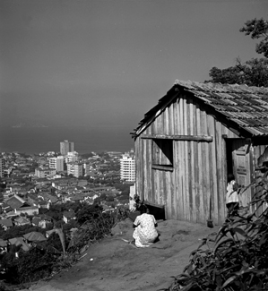
Rio 1960s

Slide 31
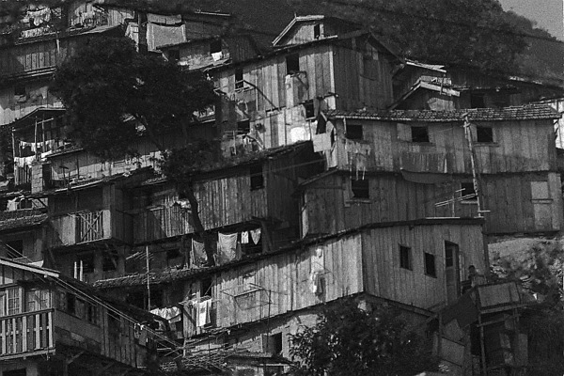
Favelas, 1980s

Slide 32
Impressions of urban poverty
The sudden increase in the urban poor, the dark side of Latin American industrialization, caused both US and Latin American observers considerable disquiet.
E.g. Luis Bunuel, Los Olvidados
http://www.youtube.com/watch?v=HBDgOrB76Rk

Slide 33
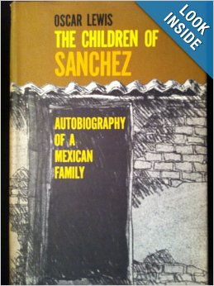
Oscar Lewis, The Children of Sanchez
Anthropology of poor Mexican family, published in 1961.
Causes considerable scandal in Mexico. Presidents Lopez Mateos and Ruiz Cortines criticize the book. Claims that Lewis is a CIA stooge. Book banned until 1965.

Slide 34
Culture of Poverty
More worryingly, Children of Sanchez, also propounds the idea that the poor are poor because of a the “culture of poverty” - “poverty-propagating value system”. This becomes extremely influential in both US and Latin America.
Lewis “The subculture [of the poor] develops mechanisms that tend to perpetuate it, especially because of what happens to the world view, aspirations, and character of the children who grow up in it.”
Aspects of the culture of poverty: “The people in the culture of poverty have a strong feeling of marginality, of helplessness, of dependency, of not belonging. They are like aliens in their own country, convinced that the existing institutions do not serve their interests and needs. Along with this feeling of powerlessness is a widespread feeling of inferiority, of personal unworthiness. This is true of the slum dwellers of Mexico City, who do not constitute a distinct ethnic or racial group and do not suffer from racial discrimination.
People with a culture of poverty have very little sense of history. They are a marginal people who know only their own troubles, their own local conditions, their own neighborhood, their own way of life. Usually, they have neither the knowledge, the vision nor the ideology to see the similarities between their problems and those of others like themselves elsewhere in the world. In other words, they are not class conscious, although they are very sensitive indeed to status distinctions.”
Other aspects of the culture of poverty – lack of trust, lack of neighborliness, lack of sexual morality, fatalism.
Idea feeds into growing campaigns against urban poor.

Slide 35
Problems with Lewis’s culture of poverty
Undervalued structural problems of inequality – low wages, insecure jobs, insecure housing, poor education.
Culture of poverty as relajo?

Slide 36
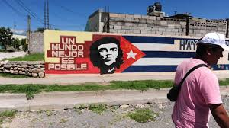
Solutions to Latin America’s housing problems

Slide 37
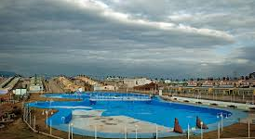
e.g. Tupac Amaru group, Argentina

Slide 38
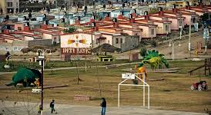

Slide 39
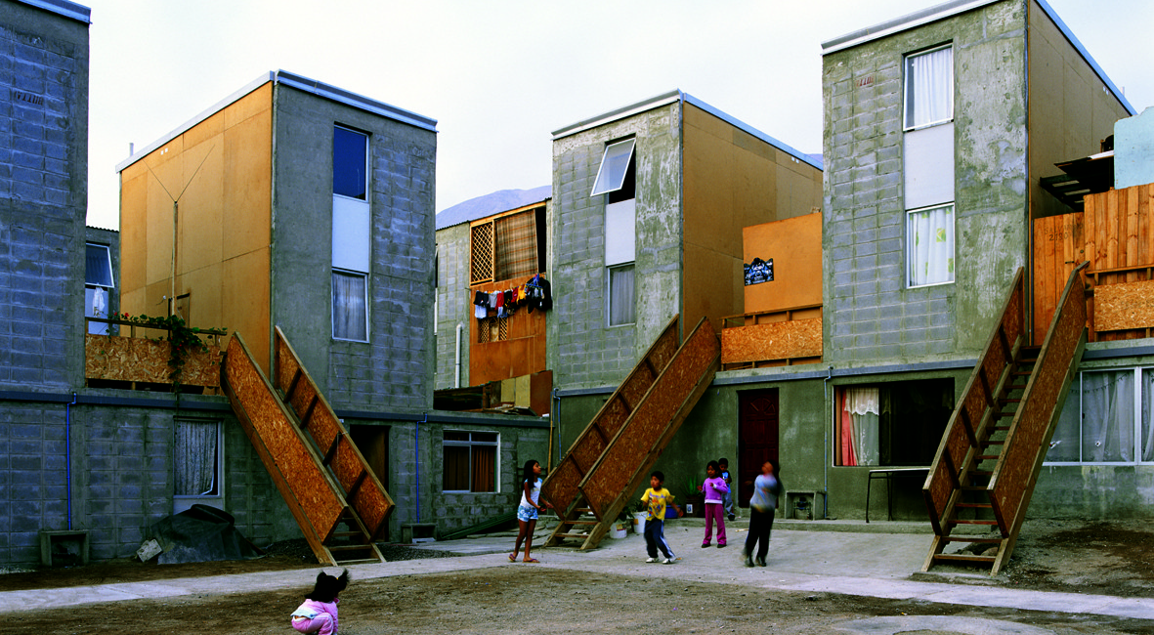
e.g. Quinta Monroy, Chile

