Slide 1
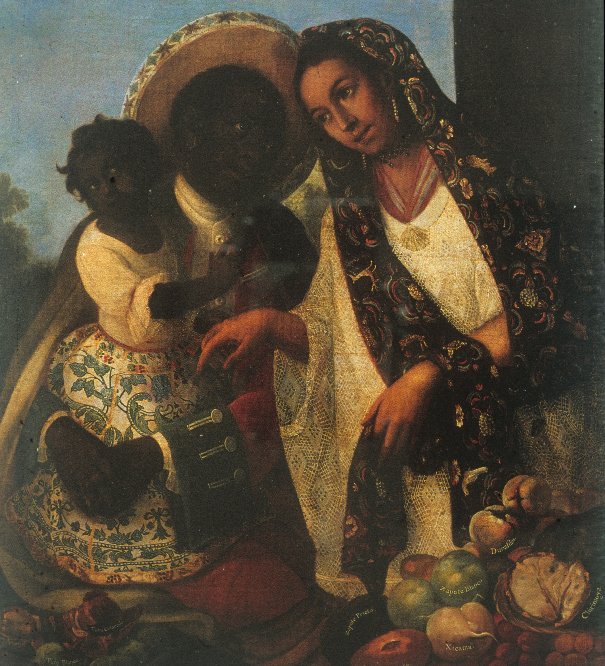
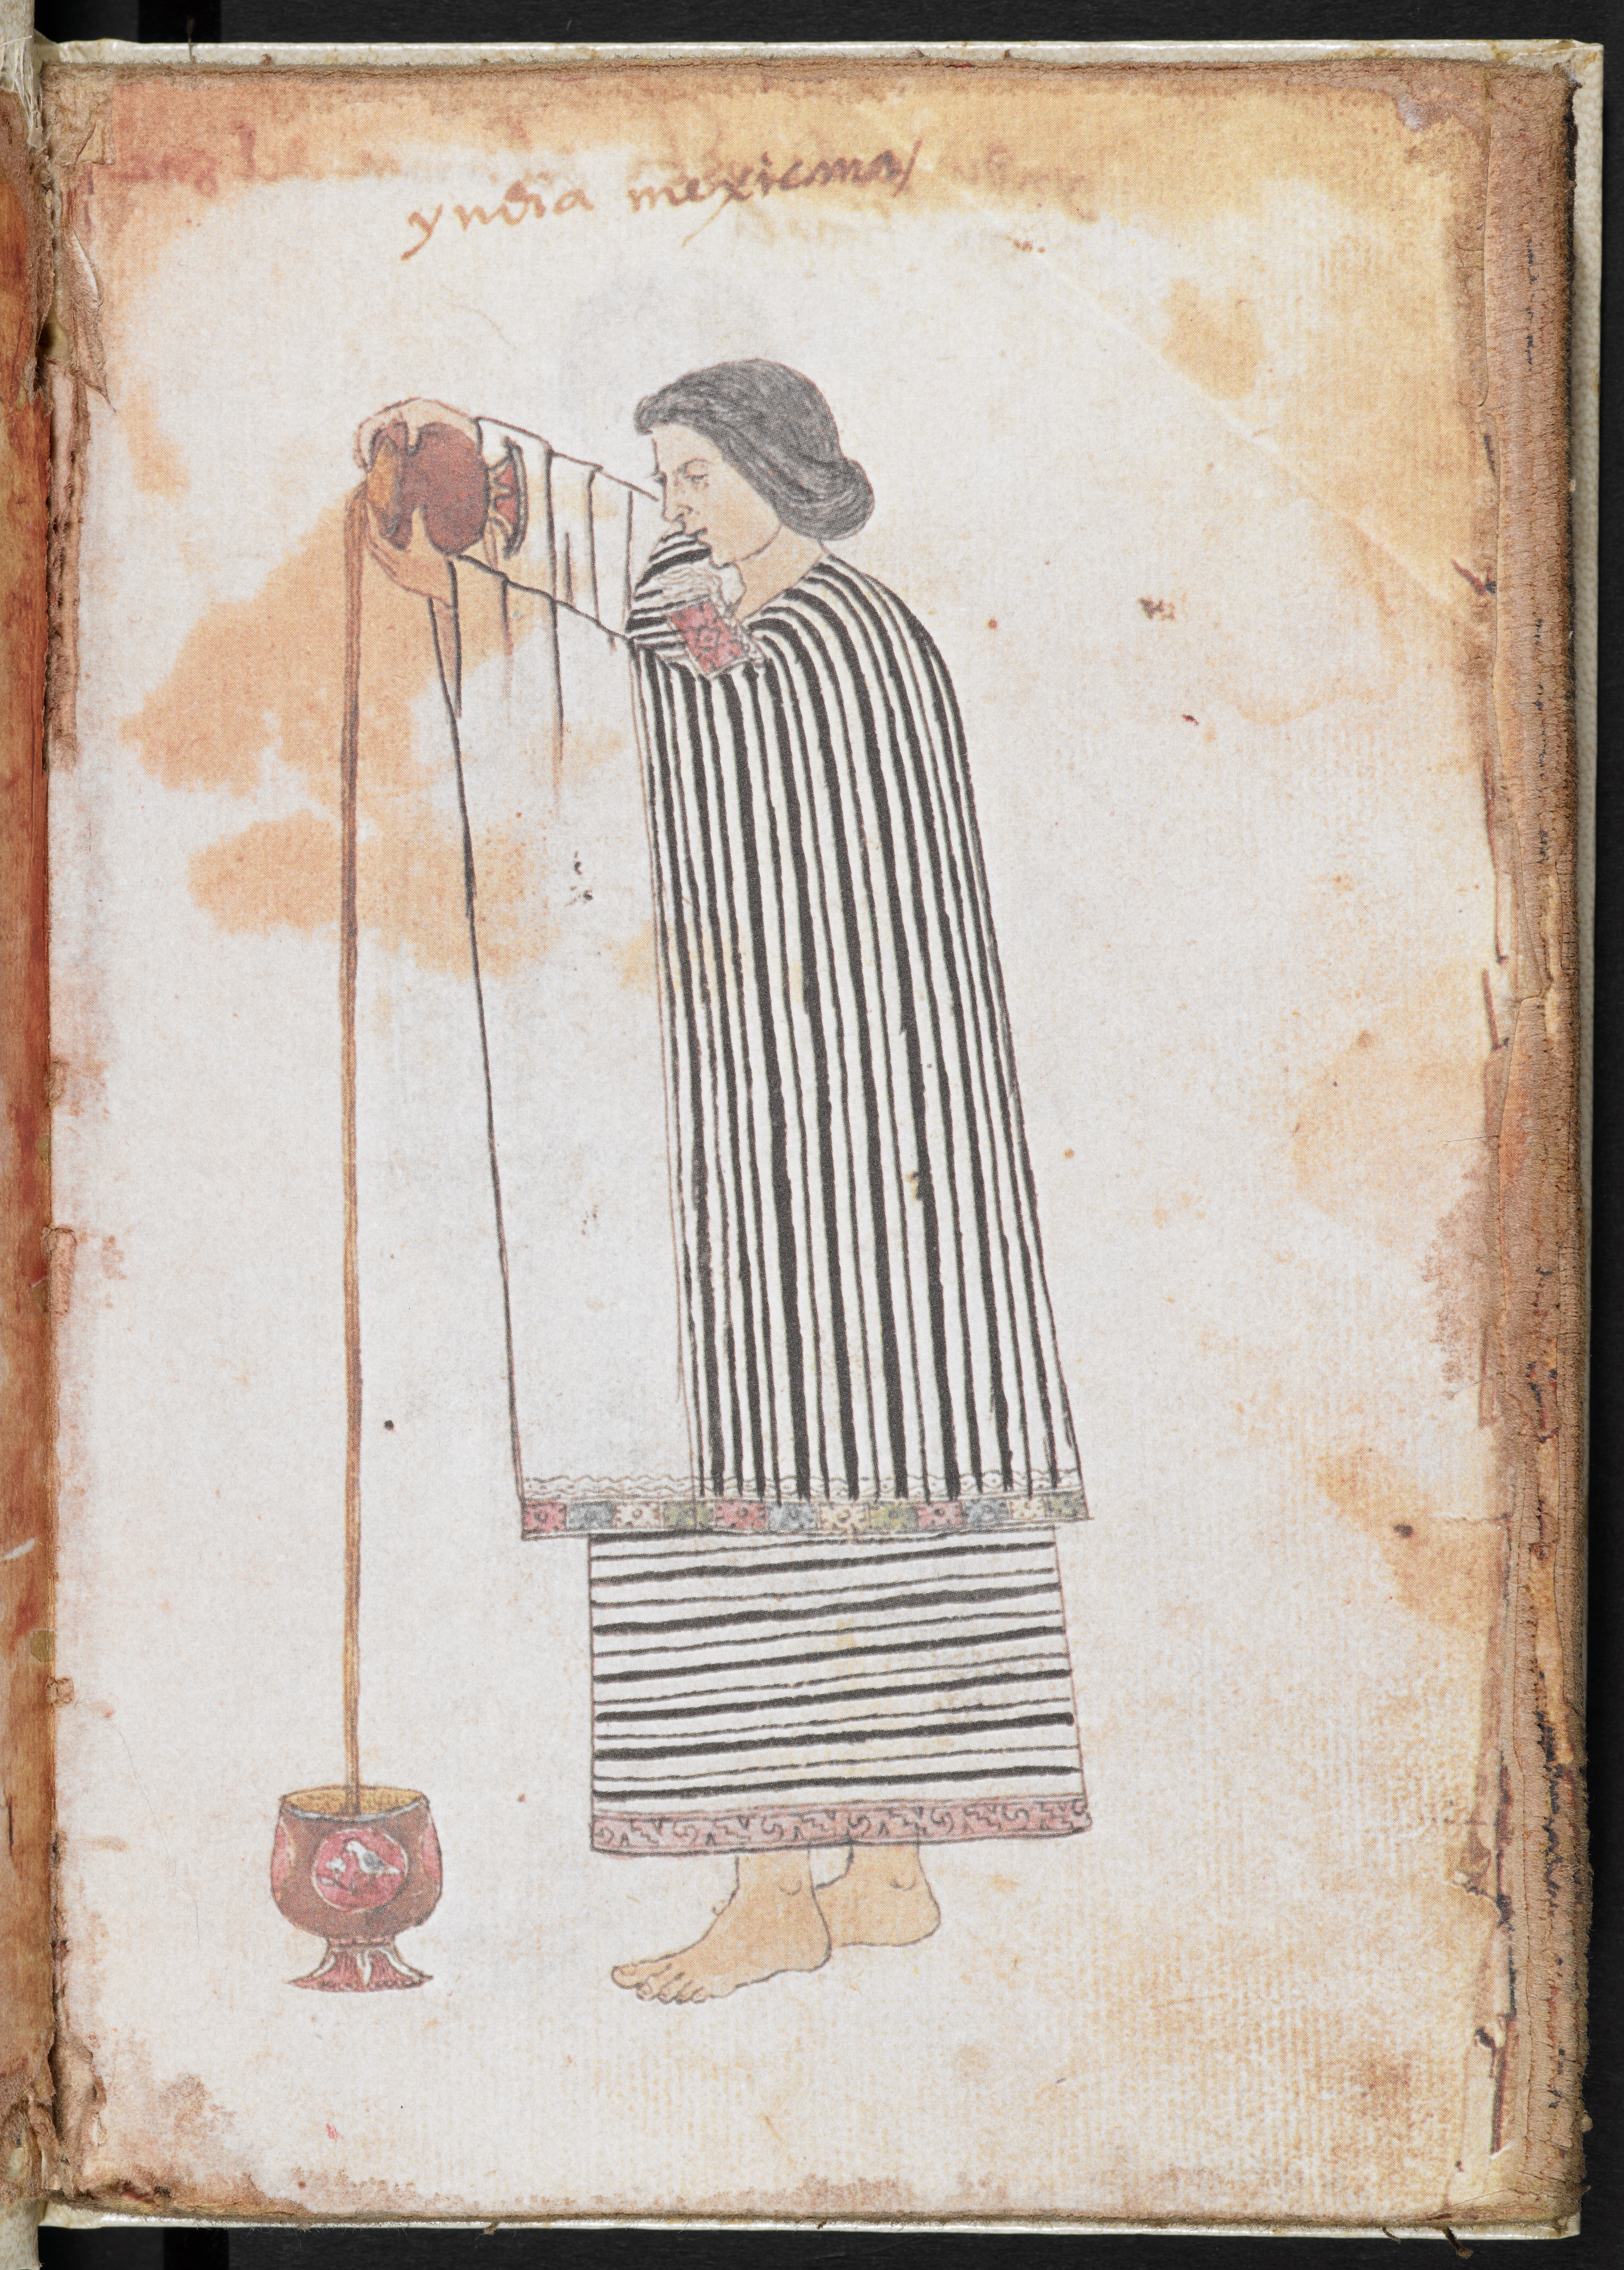
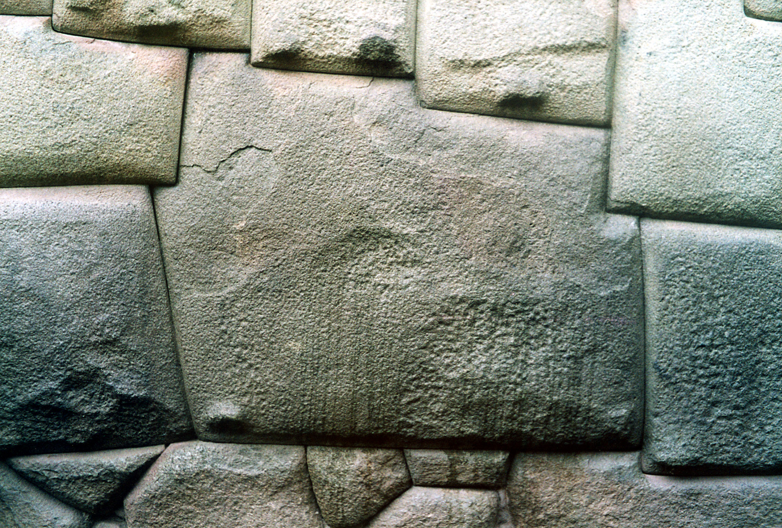
Colonial Society and Culture
1492-1810

Slide 2
Early Colonisation (16th century)
Demography: many indigenous people died (disease? abuse?)
Settlement through the founding of cities and establishment of an administrative structure
Coercive Labour regimes: Encomienda (grants of Indian labour) and slavery.
Hybrid colonial culture

Slide 3
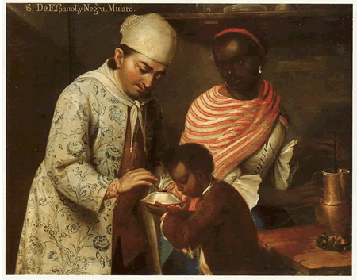
The Formation of a Hybrid Colonial Society
José de Alcíbar (attrib.), From a Spanish Man and a Black Woman a Mulatto is Born (Denver Art Museum, c.1760-70)

Slide 4
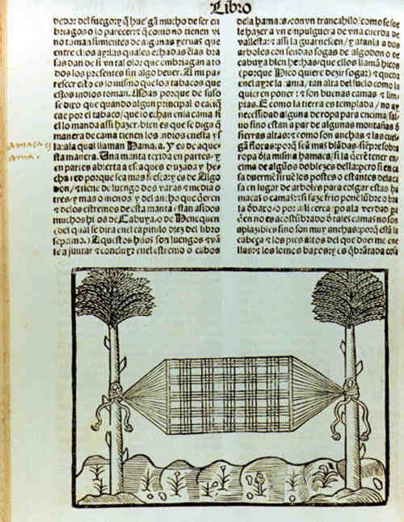
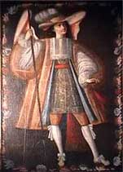
Colonisers and colonised interacted in many ways. This lecture will explore cultural interactions
Everyday life
Religious cultures
Gonzalo Fernández de Oviedo’s image of a hammock (1535)

Slide 5
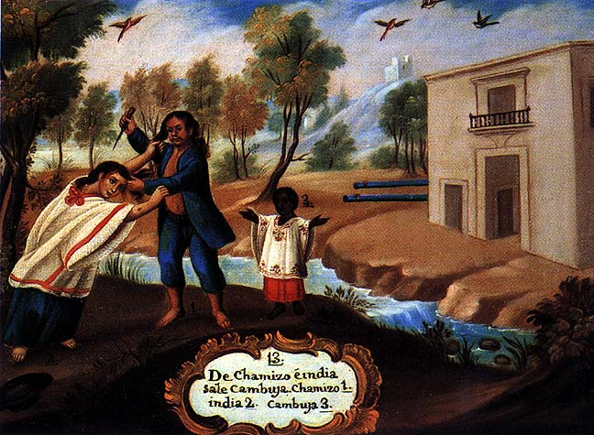
Everyday Life in the Indies
How can we study this?
Some sources:
Court records
Letters
Material culture
‘Casta’ Paintings: 18th-century paintings of colonial families

Slide 6
Court records
Domestic disputes between husbands and wives, conflicts between neighbours (violence, insults, lawsuits . . . Colonial society was very litigious)
Good source of information about gender norms
Honour

Slide 7
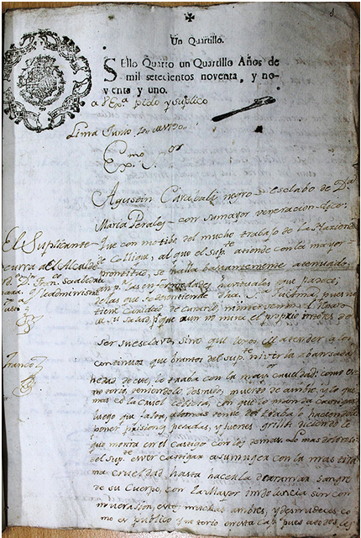
Many people went to court
The first page of a petition by the African-born, nonliterate slave Agustín Carabali submitted to the court in Lima in 1790, charging his owner with abuse.
From Peru’s Archivo General de la Nación.
Notes:
he African-born slave Agustín Carabali, who charged his owner with abuse in civil court, wandered these back alleys. He first paid a popular legal writer—whose name he could not later remember—to pen an opening petition for him. Apparently, the rough language or legal faults of the petition caught the eye of the court receptor when Agustín attempted to submit it, so the receptor told the slave to have the petition rewritten. While the court receptor probably referred him to an official writer, Agustín ended up finding his next legal amanuensis in a tavern. A “negro criollo” named José, who rented a room in the house of one of the city’s licensed attorneys, was a frequent customer in the establishment. Presumably, José’s residence with the lawyer gave him access to legal knowledge. Putting this know-how to use, José rewrote the petition in the third person, signing at the end with squiggles and flourishes that were supposed to replicate the escudo, or coat of arms, a public notary might use to distinguish his signature, as shown in Figures 1 and 2. It appears that the receptor accepted this second, more elaborate but still rough, copy, making a few amendments and grammatical corrections.

Slide 8
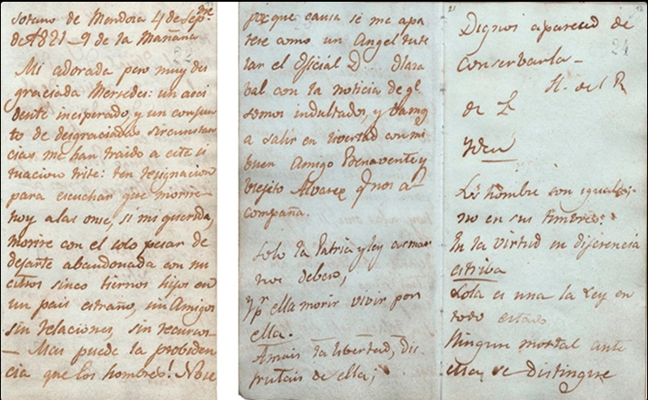
Letters (just for example)
Farewell letter sent by José Miguel Carrera to his wife Mercedes Fontecilla, 4 Sept. 1821 .

Slide 9
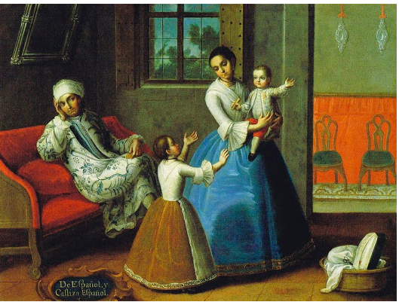
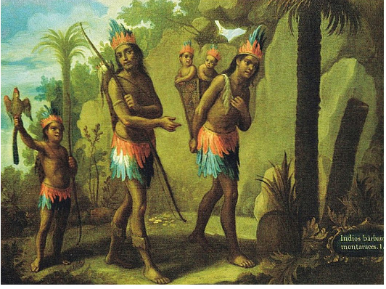
Material Culture (‘stuff’)
‘Civilising goods’
Arnold Bauer, Goods, Power, History: Latin America's Material Culture (Cambridge, 2001).

Slide 10
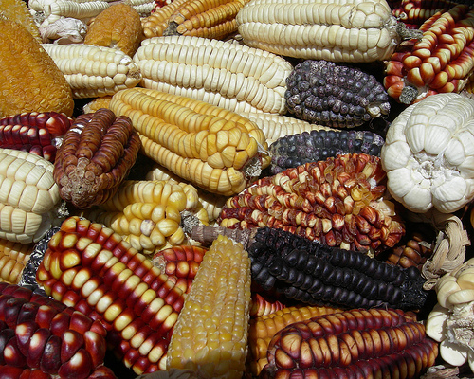
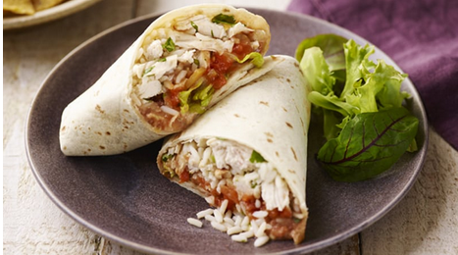
New food cultures

Slide 11
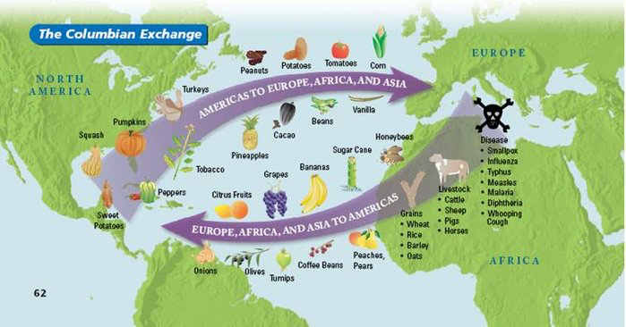
Columbian Exchange
Also manioc (aka cassava)

Slide 12
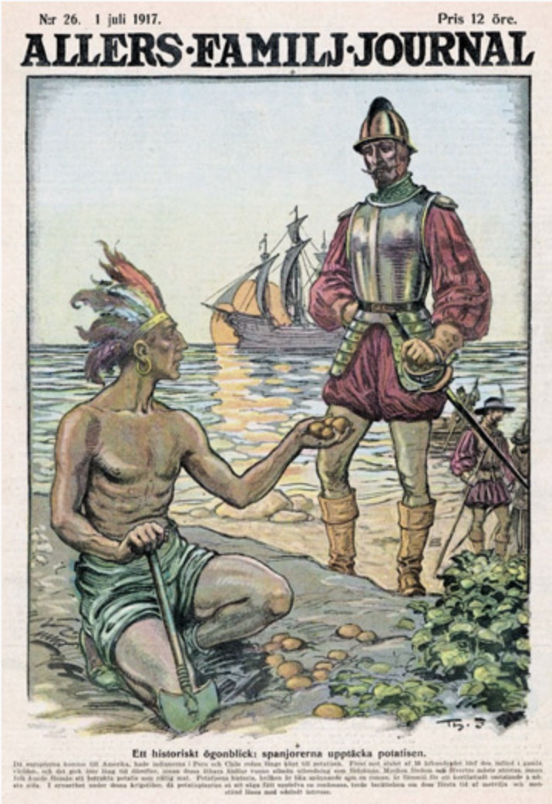
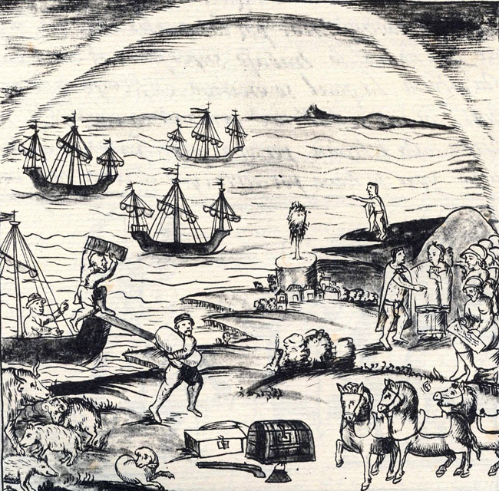
The ‘Columbian Exchange’: Alfred Crosby, The Columbian Exchange: Biological and Cultural Consequences of 1492 (1972).
Meso-Americans encounter European livestock
Florentine Codex (16th century)
Europeans encounter the potato

Slide 13
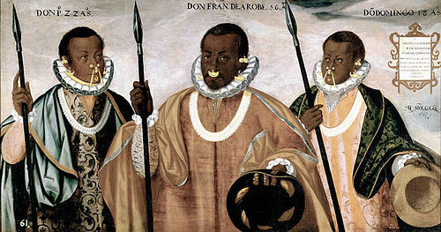
Hybrid Material Cultures
Andrés Sánchez Gallque, The Mulatto Gentlemen of Esmeraldas (1599), Prado Museum.

Slide 14
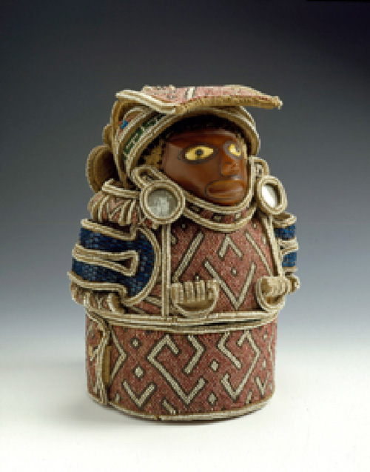
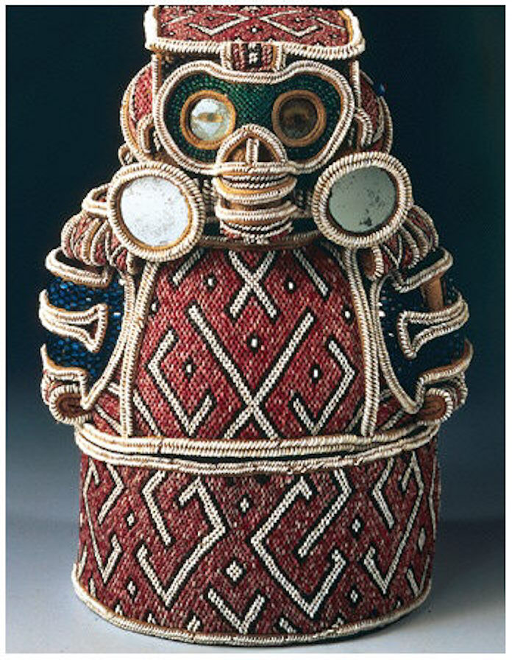
Hybrid Material Cultures a Taino Zemi

Slide 15
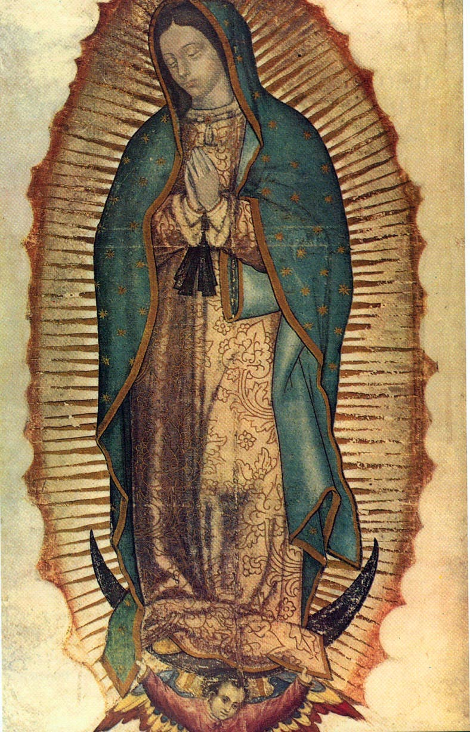
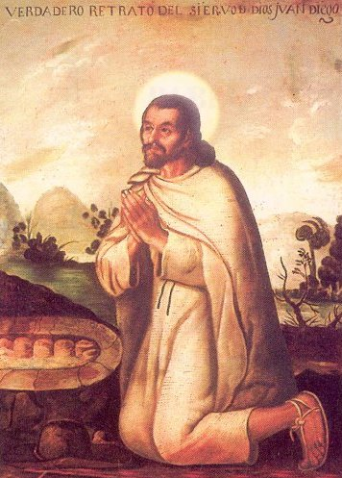
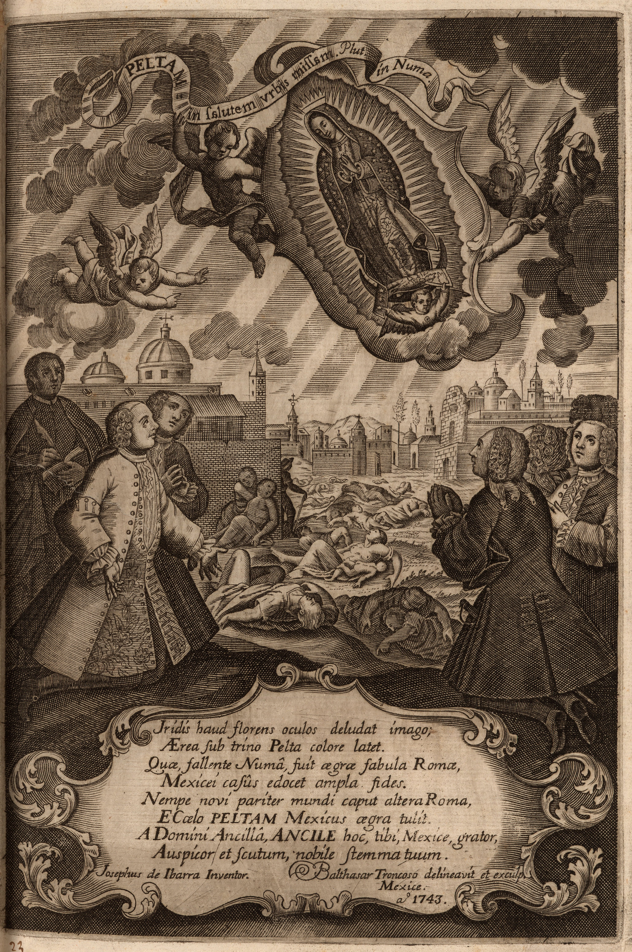
Religion another site of hybridity
Virgin of Guadalupe
Tonantzin
Tepayac
Juan Diego

Slide 16
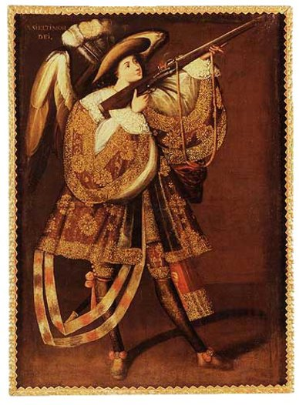
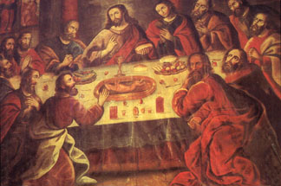
Colonial Catholicism

Slide 17
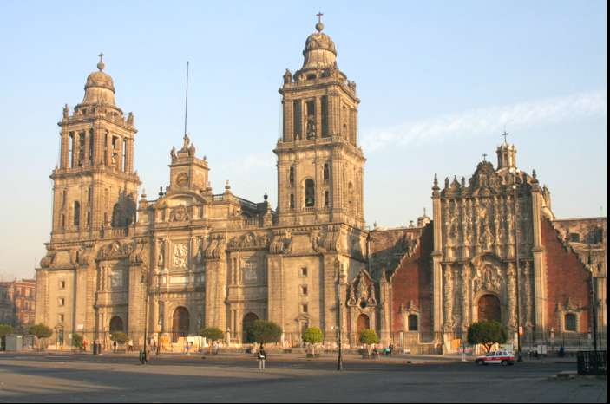
The Colonial Baroque
The Mexico City cathedral (17th century)

Slide 18
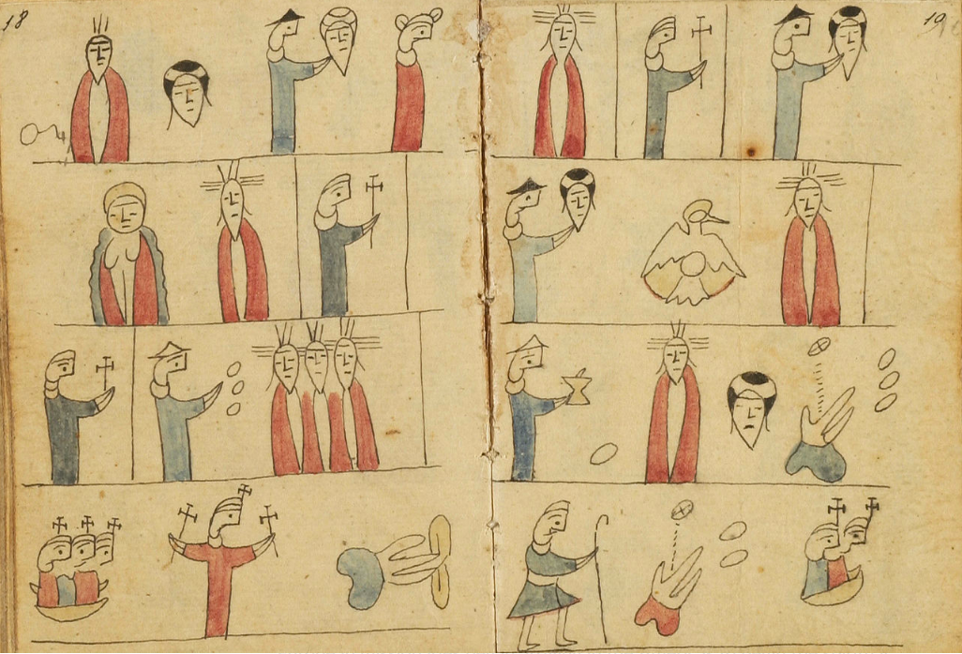
Colonial Catholicism
Otomí catechism (pictorial prayer book), 1775-1825, Mexico.

Slide 19
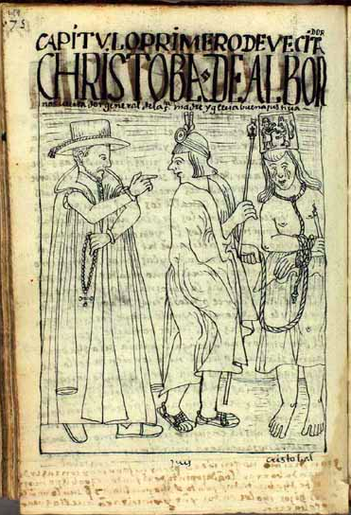
Concerns about ‘idolatry’
Jesuit José de Acosta (1588) on ‘our Indians’ way of life and religiosity’:
‘They give worship to Christ and they serve their gods; they revere the Lord and they do not revere Him; . . . They venerate Him only in word, . . . they venerate Him, in short, only with the appearance of Christianity. They do not venerate Him from deep inside, they do not give true worship nor hold the faith in their hearts as is truly required. But use is there to carry on. [They] continue doing as their ancestors did.’

Slide 20
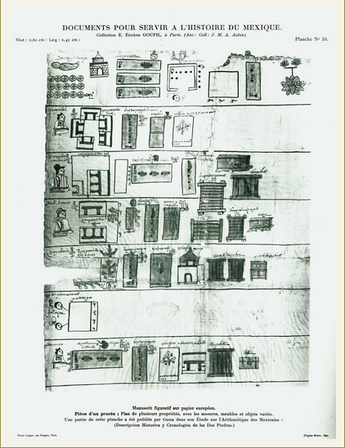
The Will of Don Miguel Damián Ink and watercolor on amatl, 1576
Don Miguel Damián, deceased and wrapped in a shroud, is at the upper left in this list of his goods and heirs. Circles with crosses represent money given to the church for masses and prayers to be said in his name.

Slide 21
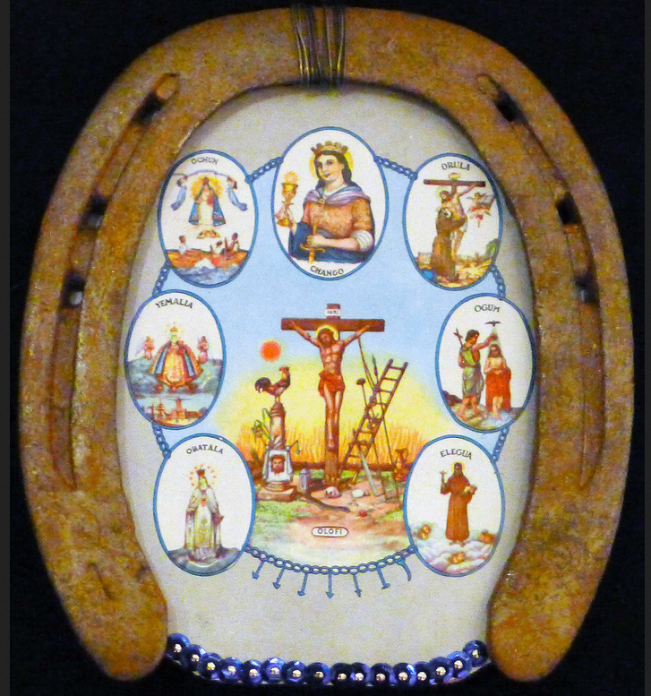
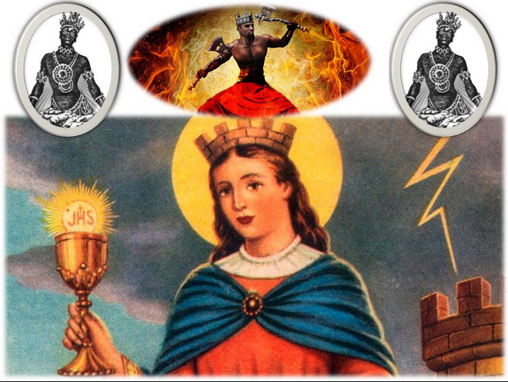
syncretism
‘the seven powers’
Santa Barbara/Shango

Slide 22
Colonial Society
hierarchical, unequal, fluid
hybrid

