Slide 1
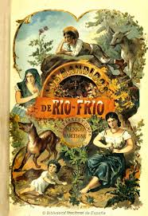
History and Literature

Slide 2
One view of historical practice:
We analyse sources to assess their:
‘reliability’
‘bias’
‘accuracy’

Slide 3
wikipedia: ‘Primary Source’ section on ‘History and historiography’
‘In scholarly writing, an important objective of classifying sources is to determine their independence and reliability. In contexts such as historical writing, it is almost always advisable to use primary sources and that "if none are available, it is only with great caution that [the author] may proceed to make use of secondary sources”.’

Slide 4
From this perspective literature is not really useful as a historical source.
At most it can be used to provide local colour or a good quotation.

Slide 5
What if . . .
We approached historical sources in a different way—in a way that did not focus on ‘reliability’, ‘bias’ and ‘accuracy’ as the key factors.

Slide 6
What if . . .
We instead approached sources to decide what they are good for.

Slide 7
Michel Foucault, The Archaeology of Knowledge (1969)
‘History has altered it relation to the document: it has taken as its primary task, not the interpretation of the document, not the attempt to decide whether it is telling the truth or what is its expressive value, but to work on it from within and to develop it.’

Slide 8
Challenges to the ‘is it accurate’ school of historical analysis
The ‘linguistic turn’
post-structuralism and post-modernism

Slide 9
Another view of historical practice
there is no clear divide between literature and other forms of evidence

Slide 10
Another view of historical practice
there is no clear divide between literature and other forms of evidence
all sources encode some form of narrative

Slide 11
Another view of historical practice
there is no clear divide between literature and other forms of evidence
all sources encode some form of narrative
all sources reflect certain ‘generic’ conventions

Slide 12
Another view of historical practice
there is no clear divide between literature and other forms of evidence
all sources encode some form of narrative
all sources reflect certain ‘generic’ conventions
sources are not ‘good’ or ‘bad’: there are no ‘neutral’ documents

Slide 13
Another view of historical practice
there is no clear divide between literature and other forms of evidence
all sources encode some form of narrative
all sources reflect certain ‘generic’ conventions
sources are not ‘good’ or ‘bad’: there are no ‘neutral’ documents
the question is: ‘what is this source good for?’

Slide 14
Rolena Adorno, ‘Reconsidering Colonial Discourse for Sixteenth- and Seventeenth-Century Spanish America’, Latin American Research Review, vol. 28:3 (1993).
‘Colonial situations offer no shortage of examples from which to argue that archival documents need to be scrutinized with the same skeptical eye turned on work more commonly designated as texts. For example, how straightforward and transparent is the testimony given in a trial . . . ? . . . What is involved in any mundane transaction that we read today as part of the colonial documentary record?’

Slide 15
From this we might conclude . . .
that literature is a useful form of historical data.
Example: Doris Sommer, Foundational Fictions.

Slide 16
But can we go further . . .?
Is fiction itself a form of historical writing (not just a historical source)?

Slide 17
The return of story-telling to historical writing:
SEE Sara Maza, ‘Stories in History: Cultural Narratives in Recent Works in European History’, American Historical Review, 101:5 (1996).

Slide 18
History and Fiction: not so different?
The writing of history is inherently about forming a narrative, about putting things in order, about telling stories.

Slide 19
A question:
If historians can tell stories, can storytellers write history?

Slide 20
Anne Firor Scott, ‘Women in the South: History as Fiction, Fiction as History’, Rewriting the South: History and Fiction, eds. Lothar Hönnighausen and Valeria Gennaro Lerda, Francke Verlag (Tübingen, 1993).
‘From the end of the [US] Civil War until the beginning of the Civil Rights movement the handful of articulate dissenters found it safer to use fiction as a vehicle for their views than to confront the dominant male establishment directly.’

Slide 21
Tomás Eloy Martínez, La novela de Perón (1985).
‘This is a novel in which everything is true. For years I collected thousands of documents, letters, voices of witnesses, pages from diaries, photographs. Many were unknown. In exile, in Caracas, I reconstructed the memoirs that Perón dictated to me between 1966 and 1972 and those read to me by López Rega in 1970, who explained they were the general’s even though he had written them. Later, in Maryland, I decided that the truth of this book could only be told in the language of imagination’.

Slide 22
Gustavo Pellón, Cambridge History of Latin American Literature.
‘The diffident and subtle approach to social and historical objectivity’.

Slide 23
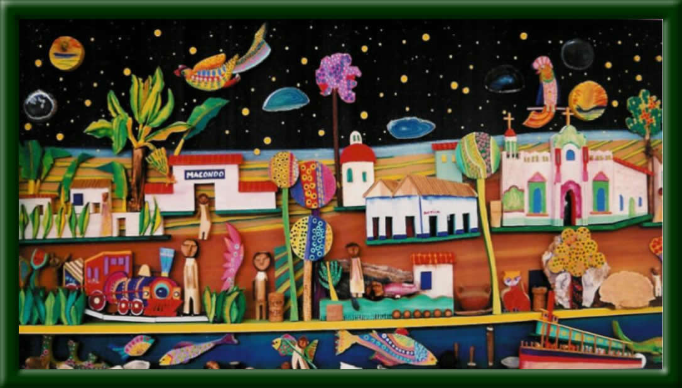
Can even magical realism be a form of historical writing?

Slide 24
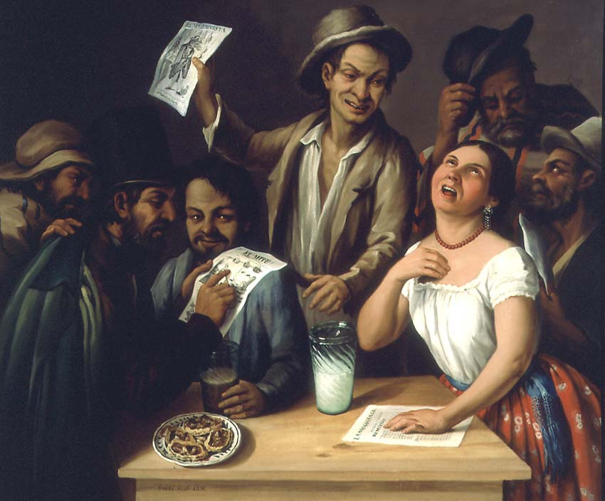
Popular Culture and Literature
Nineteenth Century:
The Lettered City-
Men of Letters-
Serial fiction- Costumbrismo
Twentieth Century:
From 1960s-
Urban and popular culture influence on literature ‘La Onda’ (Mexico), Manuel Puig (Argentina) experimental literature- influence of radio and cinema BUT
Magical realism of the ‘boom’ 1960s and 1970s is canonised
Notes:
José Agustín Arrieta, Tertulia de pulquería, 1851

Slide 25
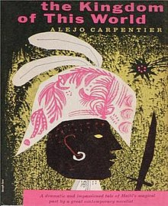
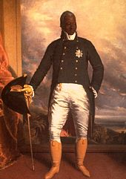
Alejo Carpentier, ‘Marvelous Reality’, from the prologue to The Kingdom of this World, 1949
But what many forget, in disguising themselves as cheap magicians, is that the marvelous becomes unequivocally marvelous when it arises from an unexpected alteration of reality ( a miracle), a privileged revelation of reality, an unaccustomed or singularly favourable illumination of the previously unremarked riches of reality, an amplification of the measures and categories of reality, perceived with peculiar intensity due to the exaltation of the spirit which elevates it to a kind of "limit state".

Slide 26
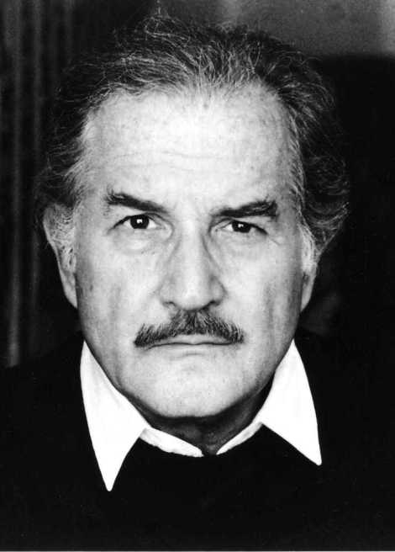
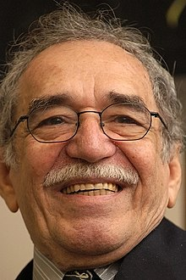
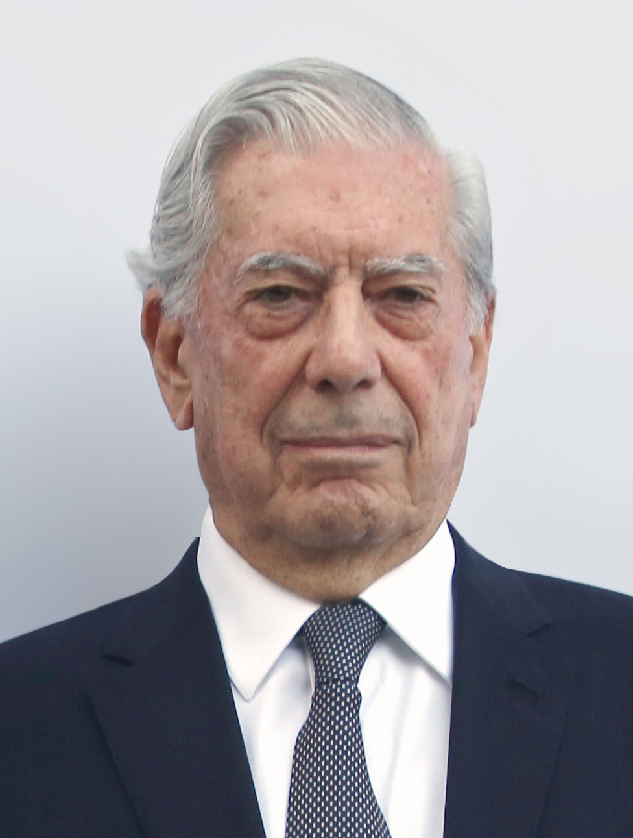
The Boom

Slide 27
Gabriel García Marquéz on Civil Wars
The liberals were determined to go to war. Since Aureliano at that time had very confused notions about the difference between conservatives and liberals, his father-in-law gave him some schematic lessons. The liberals, he said, were Freemasons, bad people, wanting to hang priests, to institute civil marriage and divorce, to recognize the rights of illegitimate children as equal to those of legitimate ones, and to cut up the country into a federal system that would take power away from the supreme authority. The conservatives, on the other hand, who had received their power directly from God, proposed the establishment of public order and family morality. They were the defenders of the faith of Christ, of the principle of authority and were not prepared to permit the country to be broken into autonomous entities.
                One Hundred Years of Solitude

Slide 28
Michael Taussig, The Devil and Commodity Fetishism in South America, University of North Carolina Press (Chapel Hill, 1980), 21.
The opposition between use value and exchange value ‘has inspired some of the greatest literature of our times. The spellbinding fantasy that irradiates the works of Miguel Asturias and Gabriel García Marquez, for example, concerning the United Fruit Company’s banana plantations in Central America and Colombia, provides further testimony to the blending of poetic and political elements that concerns us here. It is precisely this aura of fantasy that so perplexes literary critics and Marxists who cannot understand the coexistence of fantasy and social realism. But as Asturias and García Marquez have repeatedly pointed out, it is this coexistence that constitutes reality in the ‘strong wind’ and ‘leaf storm’ of large-scale capitalist development in the Third World. The magic of production and the production of magic are inseparable in these circumstances.’

Slide 29

The Boom and Beyond

Slide 30
Globalisation and Popular Culture
Globalisation as diluting popular culture
World of consumption affect culture created by the people
But… globalization has also generated new local and transnational groupings: The reaffirmation of localized tradition
For example
Trans-American indigenist movements calling for the recognition of their local culture and identity

Slide 31
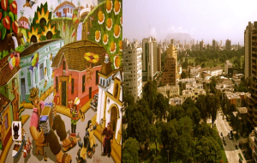
1990s
McOndo group (Chile)
Literary fiction
Mass-mediated codes of pop culture
I am not a magical realist, Alberto Fuguet, 1997

Slide 32

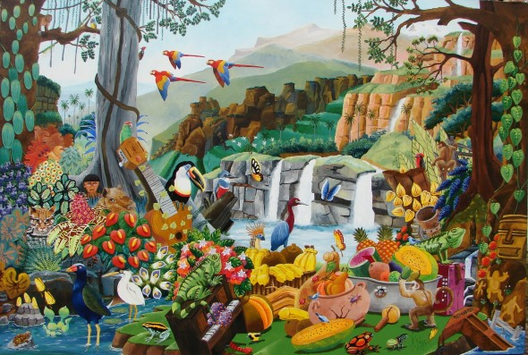

Slide 33
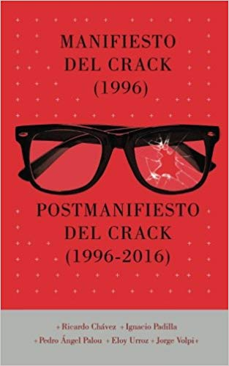
1990s The Crack Generation, Mexico
Magical realism v cosmopolitanism
The Crack Manifesto (Mexico)

Slide 34
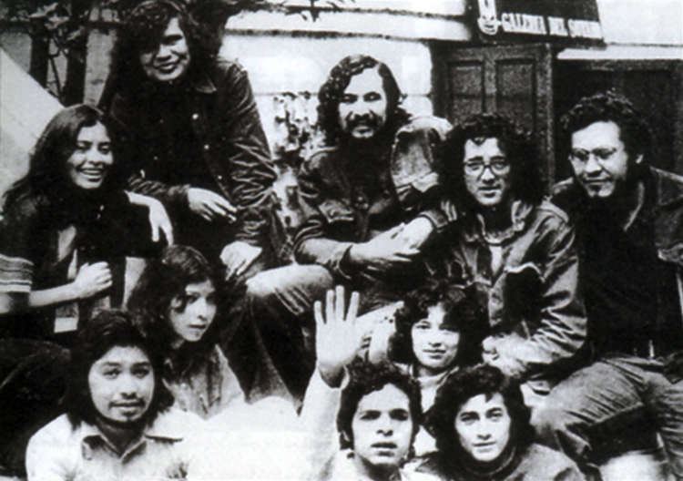
Fiction and Journalism?
Infra-realism and contemporary Latin American violence
1975. Roberto Bolaño and other Mexican poets invented the “infrarealism” poetry movement. The idea was to challenge the literary establishment, their close links to the governing party and their traditional narratives. To do so, they embraced fragmented, visceral poems which better reflected the violence of the modern world.

Slide 35
Fiction and Journalism?
“Automatic writing, exquisite corpse, solo performances with no spectators, contraintes, two-handed writing, three-handed writing, masturbatory writing (we wrote with the right hand and masturbated with the left, or vice versa if we were left-handed), madrigals, poem-novels, sonnets always ending with the same word, three-word messages written on walls (“This is It,” “Laura, my love,” etc.), outrageous diaries, mail-poetry, projective verse, conversational poetry, antipoetry, Brazilian concrete poetry (written in Portuguese cribbed from the dictionary), poems in hard-boiled prose (detective stories told with great economy, the last verse revealing the solution or not), parables, fables, theater of the absurd, pop art, haikus, epigrams (actually imitations of or variations on Catullus, almost all by Moctezuma Rodríguez), desperado poetry (Western ballads), Georgian poetry, poetry of experience, beat poetry, apocryphal poems by by Nichol, John Giorno, John Cage. . . . We even put out a magazine . . . We kept moving . . . We kept moving . . . We did what we could . . . But nothing turned out right.” Savage Detectives

Slide 36
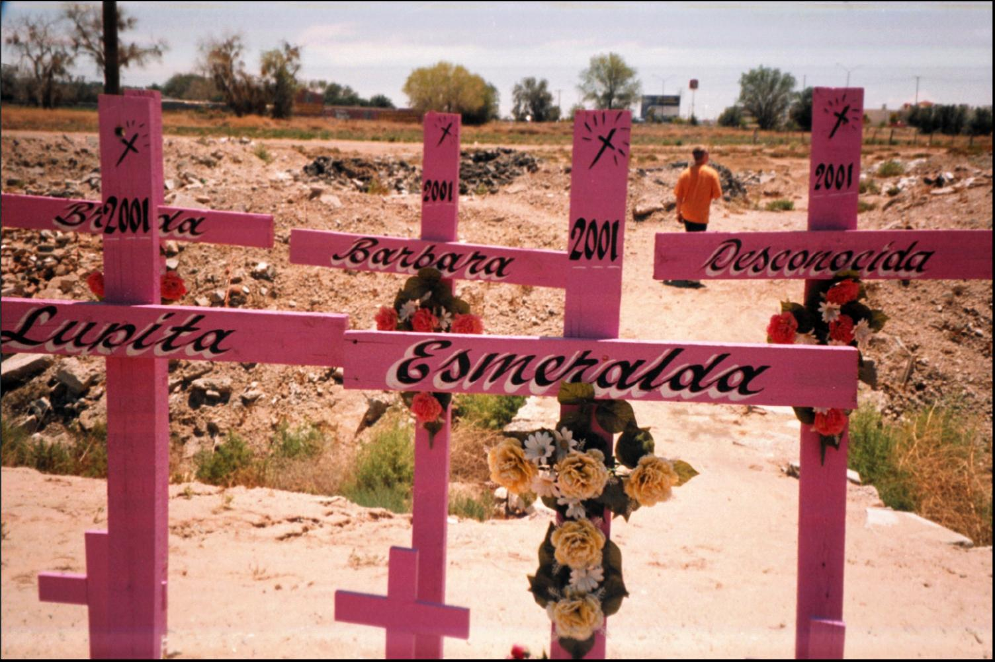
2666
In Bolaño’s last novel, 2666, he applies this approach to the wave of femicides occurring in Ciudad Juárez. Rather than presenting a solution to the murders he presents them as a series of small, broken tales of poor women coming to the city and being murdered. In doing so, he tells a deeper truth about changes wrought by rapid and unconstrained capitalism.

Slide 37
2011 Diego Osorno, The Infrarealist Journalism Manifesto
How to capture the chaos, bloodshed, misery of the drug war?
  Through standard, state-supplied narratives, tales of confrontations between cartels or between cartels and the state.
  But these a) fail to reflect reality or the everyday experiences of people and b) are couched in the terminology of the security industry.
  The Infrarealist Journalism Manifesto (http://www.narconews.com/Issue67/article4489.html ) suggests a journalism, which does not seek to get at big-picture, true narratives but rather reflects the partial, changing, and small-scale reality in which many Mexicans live. In doing so, however, such journalism gets at other, more profound truths.

Slide 38
