Slide 1
Latin America Today

Slide 2
During the 1990s, Latin America became a model for post-Cold War development
Left-wing activists lauded
  Cross-class social movements
  End of military dictatorships
  Movements for indigenous rights
  Growth of the Latin American left (Evo Morales in Bolivia; Hugo Chavez in Venezuela; Luiz Inácio Lula da Silva in Brazil)
Right wing political scientists like Francis Fukuyama lauded
  Eradication of trade barriers (Neoliberalism, NAFTA)
  Establishment of pluralist democracies
  Opening up of media

Slide 3
2000-2014: What happened?
1) Crime and Homicide
  The Latin American and Caribbean region is home to nearly 9% of the global population but accounts for over 30% of the world’s homicides.
  Seven of the 10 countries with the world’s highest homicide rates are in the region
  Of the 50 cities with the highest rates in the world, 43 are in Latin America or the Caribbean. (2017)
  Homicides measured as homicides per 100,000 of population. Cities on list have homicide rates of around 100 per 100,000.

Slide 4
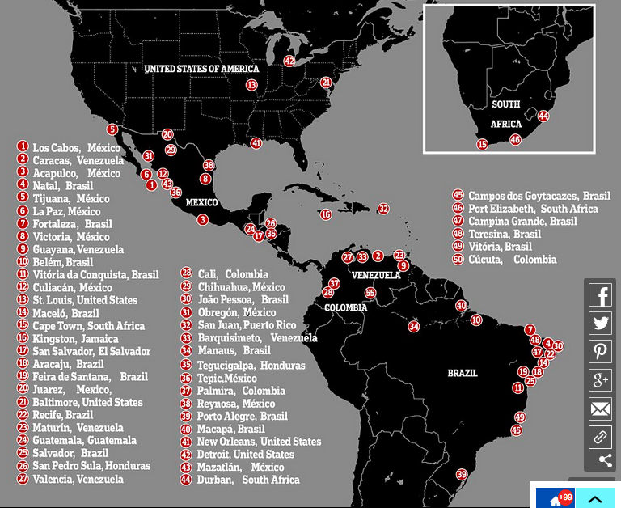

Slide 5
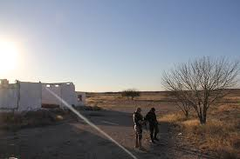
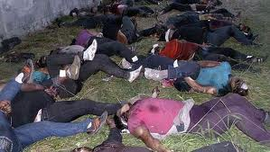
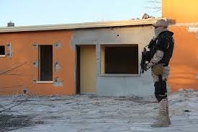
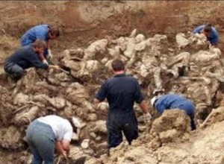
Tip of the iceberg: Disappearances

Slide 6
Why?
Economic factors
  High unemployment
  Low rates of economic growth
  High rates of inequality which generates high consumer demand and limited means to fulfill this demand.

Slide 7
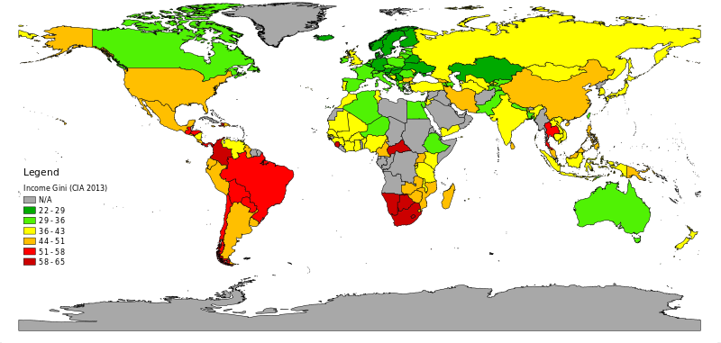
Global GINI Coefficient

Slide 8
2) The Legacy of the Cold War
1) Civil wars left Latin American countries with paramilitary organizations intact (e.g. Kaibiles in Guatemala; United Self-Defense Forces of Colombia)
2) Civil wars also left states with limited state apparatus. Many areas of the countries were simply off limits for state institutions (Colombia under the FARC; Peru under the Sendero Luminoso)

Slide 9
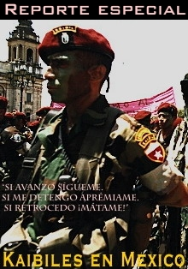
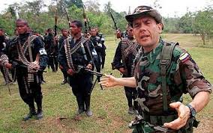

Slide 10
3) Proximity to the United States.
1) United States is still the largest market in the world for illegal narcotics. Despite antidrugs measures, in the last decade, drug use has risen. (Worth an estimated $100 billion)
2) United States is also large exporter of high caliber automatic weapons.

Slide 11
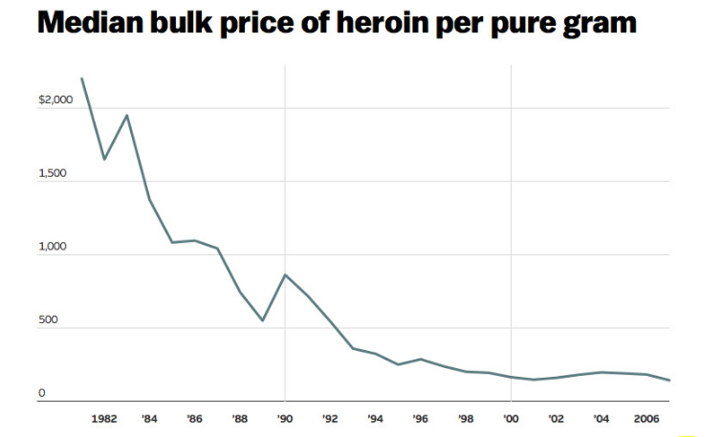
e.g. United state opium epidemic

Slide 12
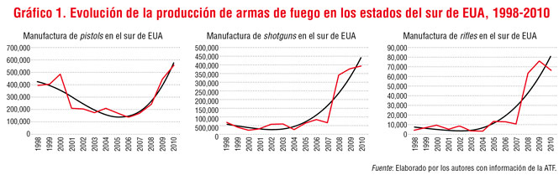
Gun sales vs homicides in northern Mexico

Slide 13
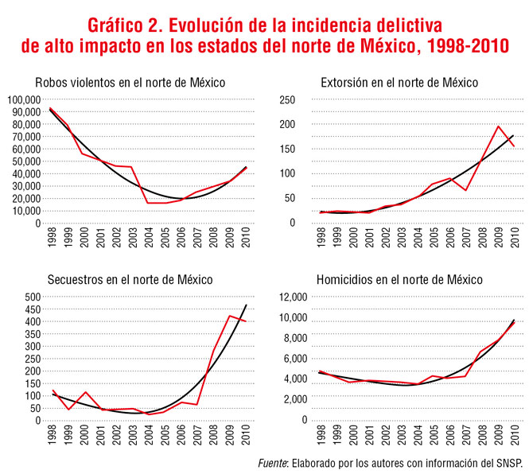

Slide 14
4) Impunity
  Judicial system in many Latin American countries has completely ceased to function.
  In Mexico, impunity for serious crimes runs at around 96 per cent.
  Civilians have increasingly taken law into own hands. (Self Defense Units; Lynching)

Slide 15
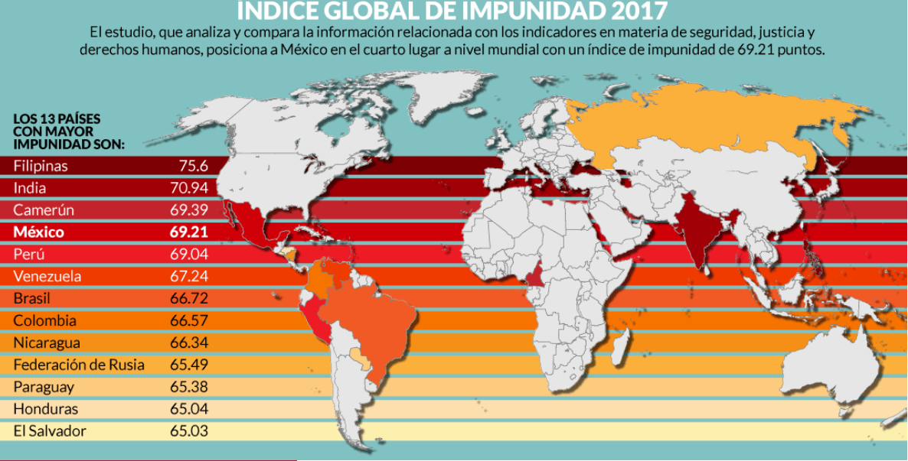

Slide 16
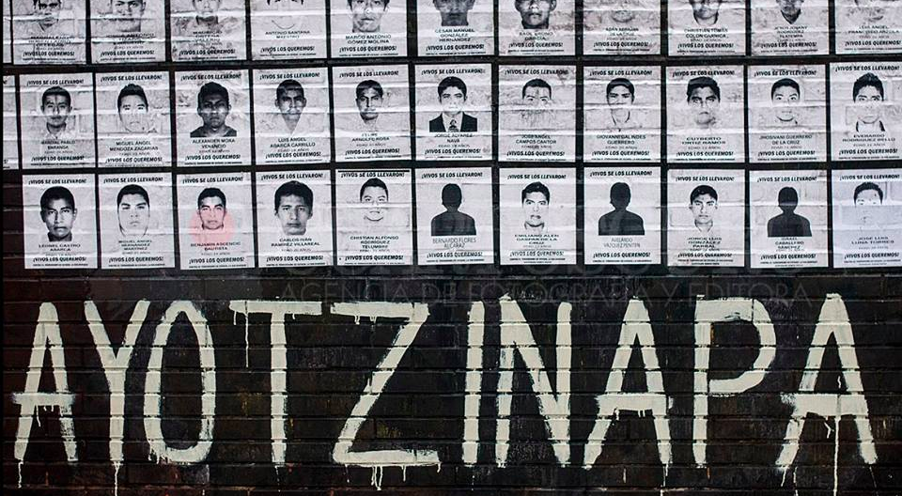
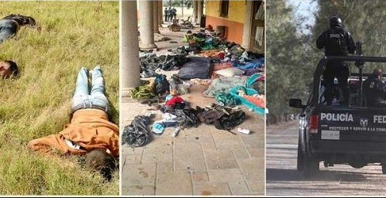
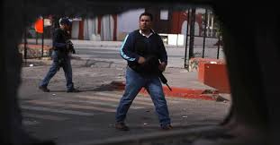
Tlatlaya (2014), Ayotzinapa (2014), Apatzingan (2015), Tanhuato (2016)

Slide 17
State Impunity
Apatzingan Massacre
  http://revolution-news.com/mexico-federal-police-implicated-in-apatzingan-massacre/

Slide 18
Popular justice
Self Defense Units of Michoacán
https://www.youtube.com/watch?v=dzalpuffwFI&t=9s
Lynching?

Slide 19
2) Democracy and Inequality
“Liberal” or “pluralist” ideal of democracy
  Conceives of democracy as free elections
  Unconcerned with equitable distribution of wealth
  Fundamental problem: Massive inequalities in wealth generates massive inequalities in power and media control. As a result, political parties see no need to include demands of the poor.

Slide 20
Two outcomes
1) Mexico/Colombia
Voter disinterest increasing. Voter turnout has dropped from 70-80% in 1990s to 40-50% in 2000s.
Disintegration of inclusive party machinery.
Return of anti-democratic parties e.g. PRI in Mexico
Violent actors have increasing autonomy and act increasingly like the state.

Slide 21
2) Venezuela/Bolivia
- Attempts at redistribution of wealth.
- Increasing polarization of voting public over race/class lines.
- Increasing violent confrontations.

Slide 22
