Slide 1
Nation-building in the Nineteenth Century
Rebecca Earle

Slide 2
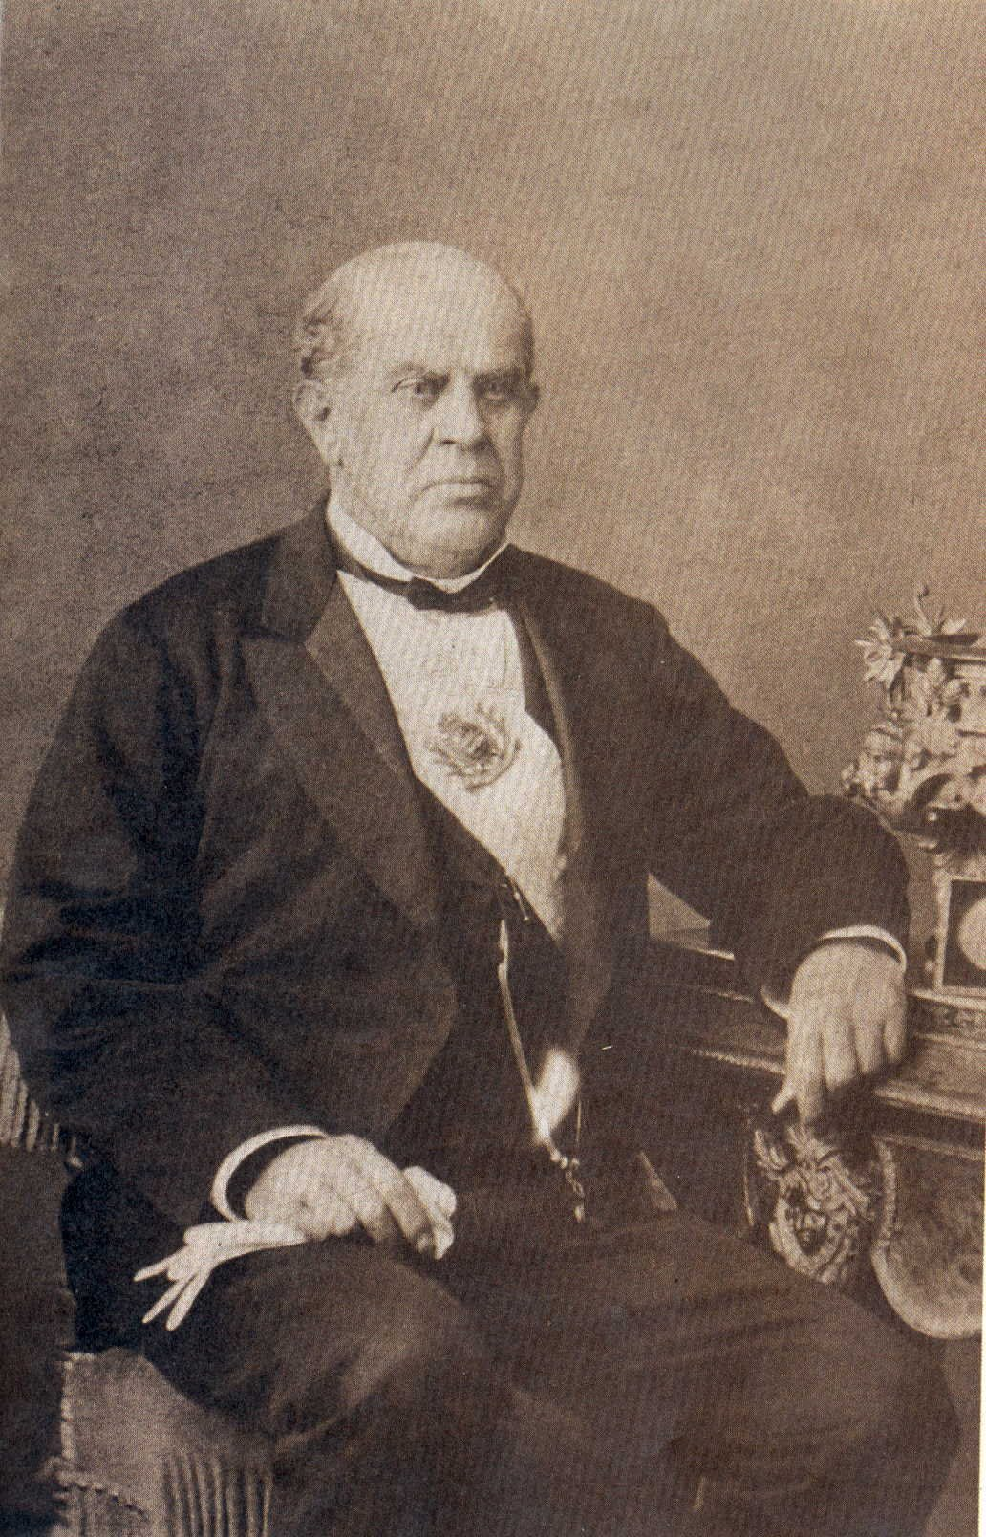
Domingo Faustino Sarmiento (1811-1888)

Slide 3
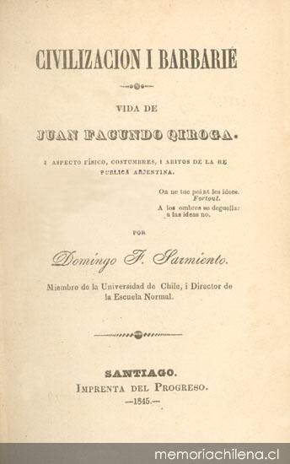
Domingo Faustino Sarmiento, Civilisation or Barbarism: The Life of Juan Facundo Quiroga (1845)

Slide 4
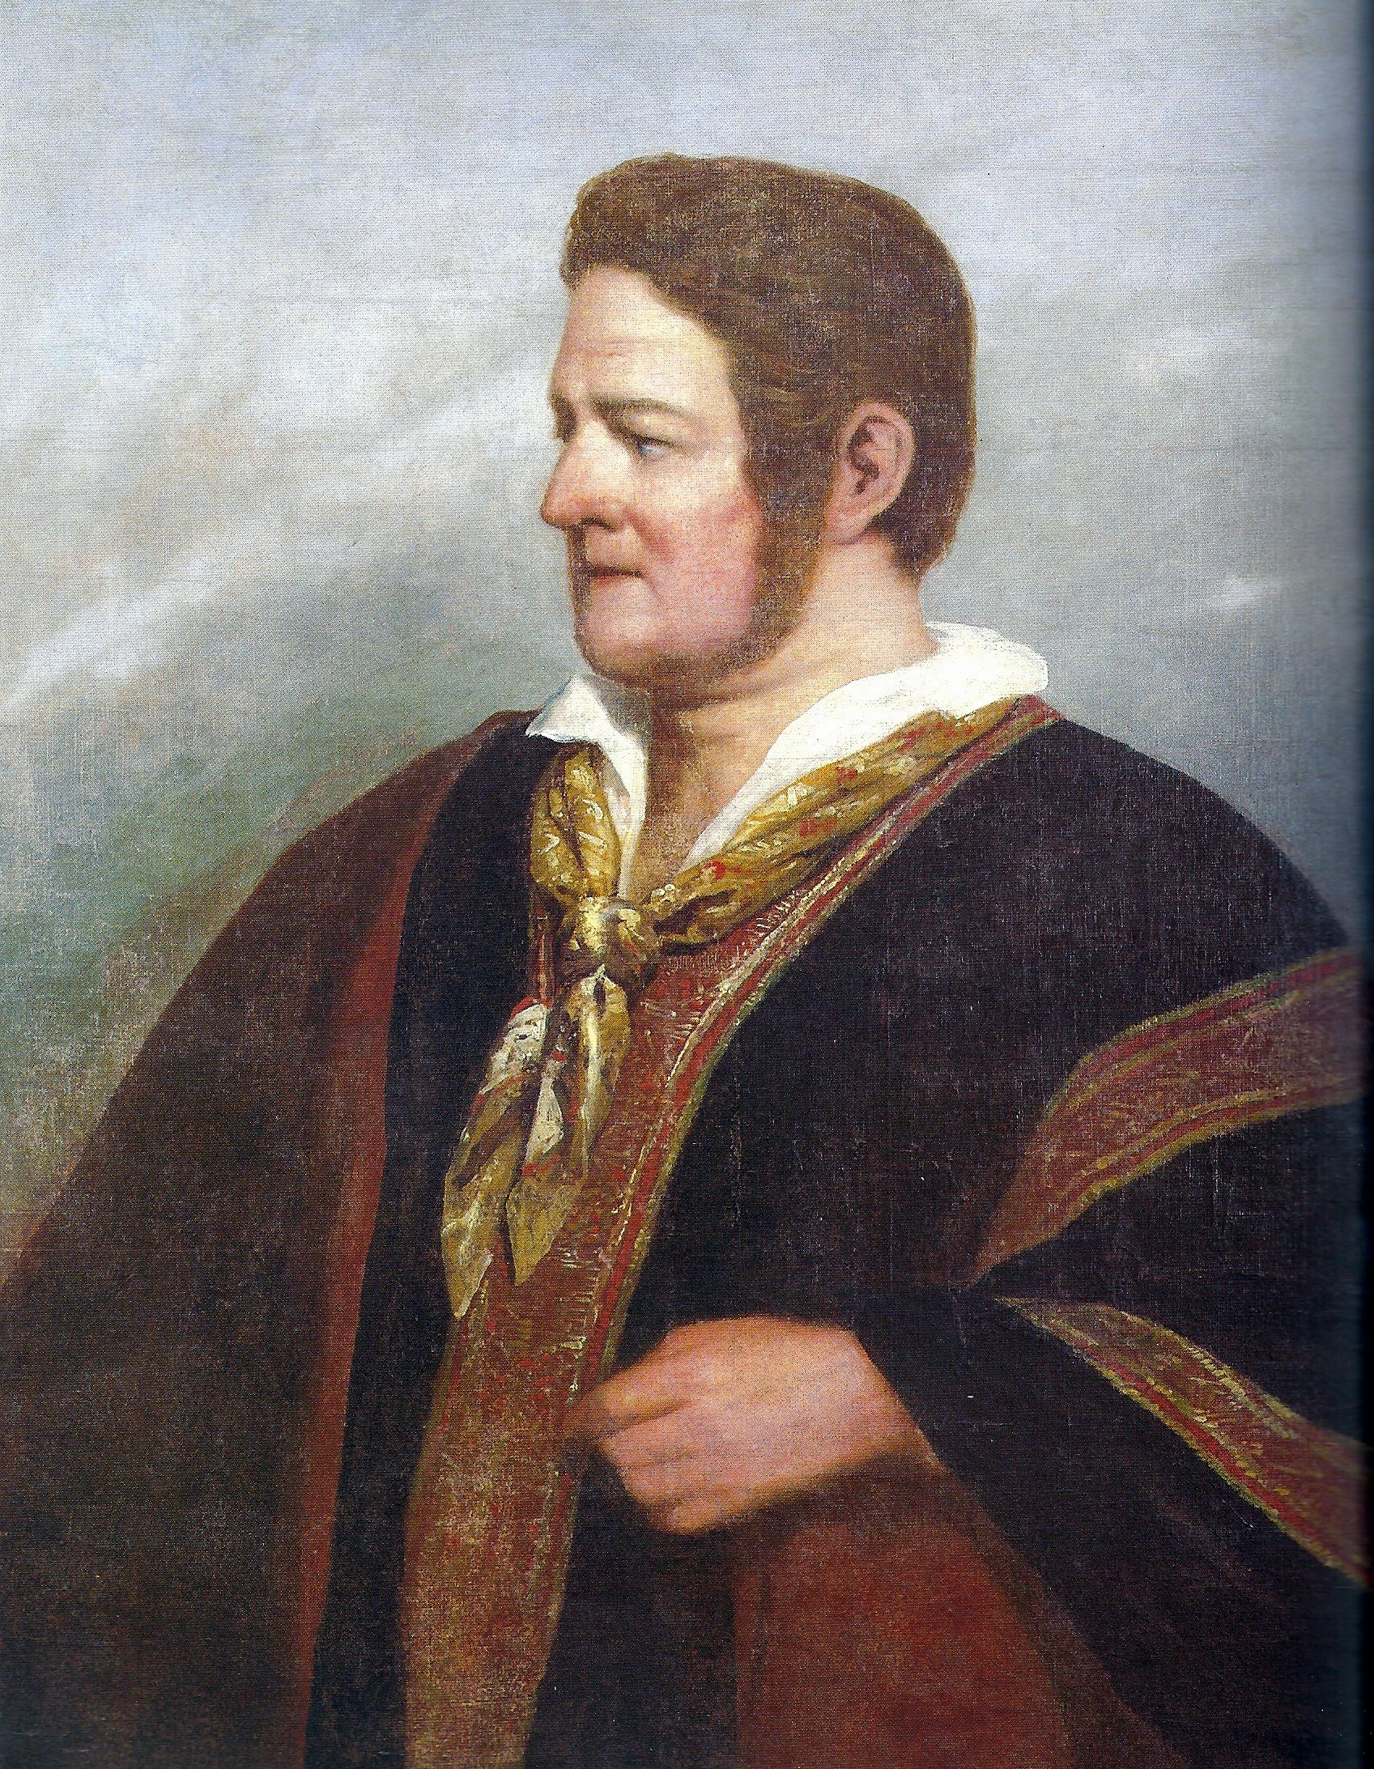
Juan Manuel de Rosas
(1793-1877)
(Portrait by Raymond Monvoisin, 1842)

Slide 5
Domingo Faustino Sarmiento, Facundo, or, Civilization and Barbarism, trans. Mary Mann (London, 1998 [1868]), 54-5.
During the colonial period, ‘two distinct, rival and incompatible forms of society, two differing kinds of civilisation existed. . . : one being wholly Spanish, European and cultivated, the other barbarous, American and almost wholly of native growth’.

Slide 6

Key Words for the 19th Century
Civilisation and Progress
Argentine newspaper called ‘Progress’
Brazilian flag: the motto reads: ‘Order and Progress’

Slide 7
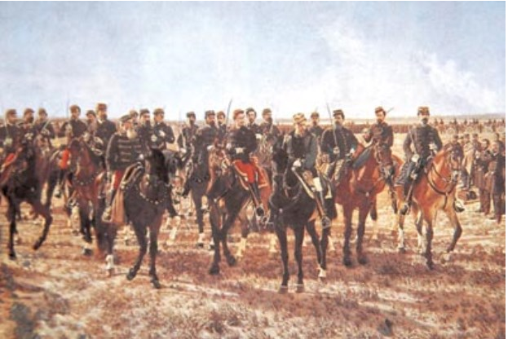
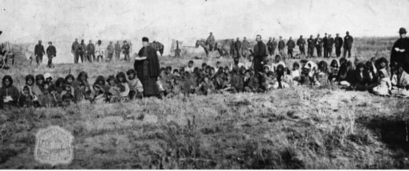
‘Civilisation’
‘Conquest of the Desert’ of 1879
‘If anything justifies our fight against the original owners of this land [the Amerindians], it is the goal of civilising them.’
Argentine Politician Lozana, speaking at the session on 13 Sept. 1878 in the Argentine Congress.

Slide 8
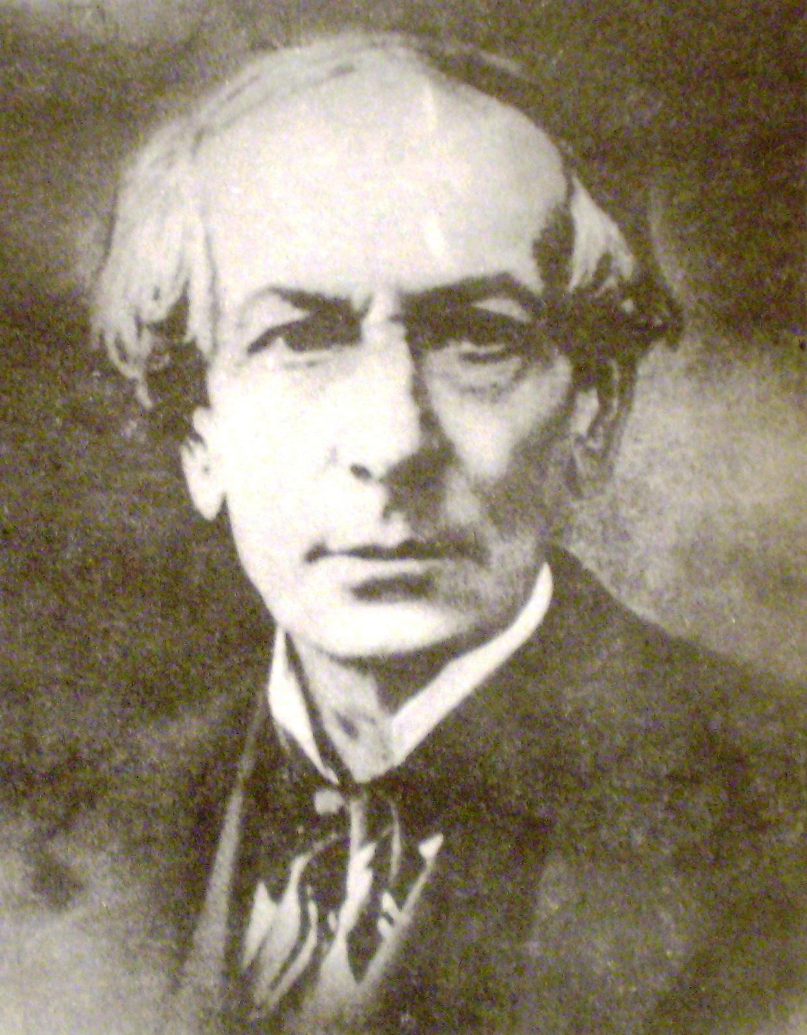
Juan Bautista Alberdi (1810-1884)

Slide 9
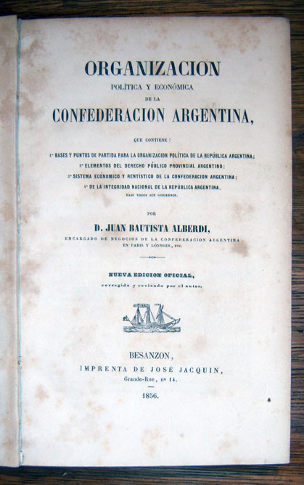
Juan Bautista Alberdi, Political and Economic Organisation of the Argentine Confederation
(1856 edition)

Slide 10
Juan Bautista Alberdi, Bases y puntos de partida para la organización política de la República Argentina (Buenos Aires, 1966 [1852]), 60-2.
‘All the civilisation in our land is European. . . In America everything that is not European is barbarous: this is the only distinction that matters.’

Slide 11
El Aguila Mexicana, Mexico City, 3 April 1826.
Native peoples are ‘a powerful . . . obstacle to the progress of our institutions’.

Slide 12
Gaceta de Guatemala, 1848.
Amerindians have been called ‘to participate in the splendid banquet of citizenship, whose delicacies they are unable to digest, and we attempt to govern them with laws that they neither want nor understand’.

Slide 13
More Key Words
citizenship
nation

Slide 14
Subaltern Nationalisms;
Popular Liberalism
The indigenous villagers of Ixtacamaxtitlán (Mexico):
1871 petition written in the name of
‘the resident citizens of Iztacamastitlan’.

Slide 15
Subaltern Nationalisms;
Popular Liberalism
Indigenous groups in the Colombian Cauca Valley insisted that they were:
‘free citizens, like any other civilized Caucano’.

Slide 16
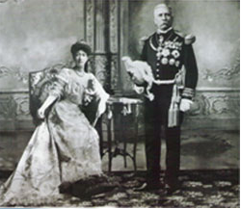
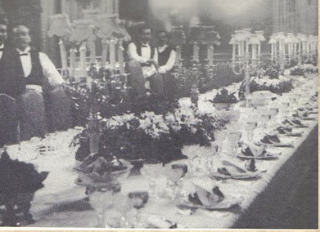
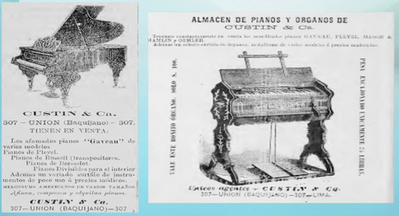
Civilisation as a material condition

Slide 17
Victor Bulmer-Thomas, The Economic History of Latin America since Independence (Cambridge, 1994), 28.
‘Political independence gave the new republics the right to change many aspects of the colonial economy. The prime candidate was the external trade monopoly, which had deprived Latin America of the chance to sell in the best-paying market and buy in the least expensive.’

Slide 18
total value of British exports to Latin America
1804-1806
£1,125,000
1824-1826
£5,009,000

Slide 19
John Miers, Travels in Chile and La Plata, 2 vols. (London, 1826), vol., p. 159.
General José de San Martín’s study in Mendoza was ‘very neatly furnished in the European manner; the furniture was all English: he had handsome commodes, tables, &c. of rose-wood, inlaid with brass, neat chairs to match, and a Brussels carpet’.

Slide 20
Vocabulary
‘civilising goods’
‘modernising goods’

Slide 21
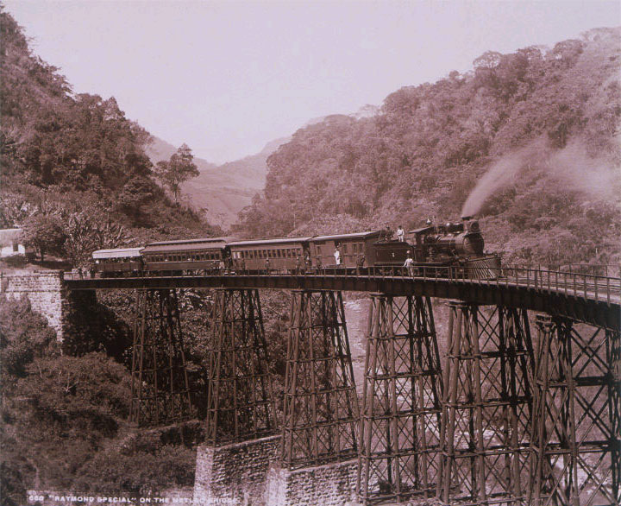
‘Civilisation’ ? :
The Bridge over the Metlac Canyon, Veracruz State, Mexico built in 1873
The Raymond Special on the Metlac Bridge, Veracruz, Mexico, ca. 1897. Charles Burlingame Waite. Gelatin silver print. Getty Research Institute.

Slide 22
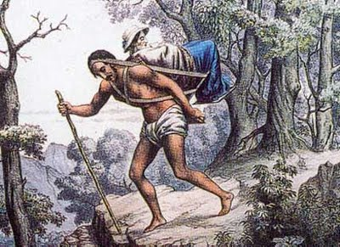
‘Barbarism’ ?:
Crossing the Quindío Pass in the Colombian Andes

Slide 23
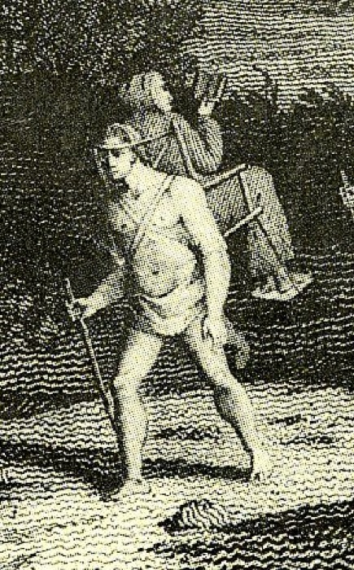
Barbarism vs. civilisation?
Crossing the Quindío Pass in the Colombian Andes
The Bridge over the Metlac Canyon, Veracruz State, Mexico

