Slide 1
Lecture: Slavery and Abolition in Spanish America and Brazil
Wednesday 7 January 2015
12-1pm
AM 101

Slide 2
Slavery and Abolition in Spanish America and Brazil
Slavery and the ‘Second Slavery’
2. The rise of Abolition in Spanish Caribbean
Puerto Rico
Cuba
3. The Rise of Abolition in Brazil

Slide 3
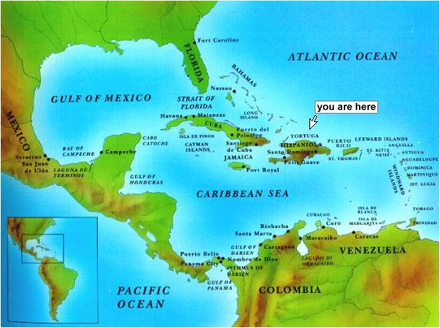

Slide 4
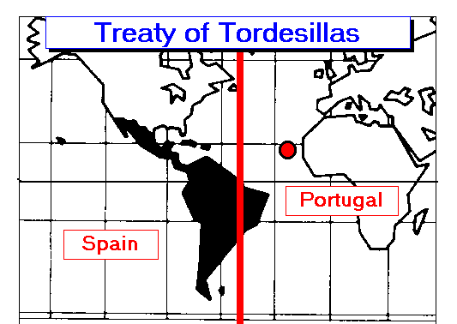
Treaty of Tordesillas (1494)

Slide 5
Enslaved Africans disembarked in the Americas, 1501-1866
Destination | Number | % of Caribbean sub-total | % of total for the Americas
British Caribbean | 2,318,252 | 48.32% | 22.00%
French Caribbean | 1,120,216 | 23.35% | 10.63%
Spanish Caribbean | 805,424 | 16.79% | 7.64%
Dutch Caribbean | 444,728 | 9.27% | 4.22%
Danish Caribbean | 108,998 | 2.27% | 1.03%
Caribbean sub-total | 4,797,618 | 100.00% | 45.53%
Brazil | 4,864,374 |  | 46.16%
Spanish Mainland | 487,488 |  | 4.63%
North America | 388,747 |  | 3.69%
The Americas - total | 10,538,227 |  | 100.00%
Total of enslaved Africans taken to the Americas = 12,331,637

Slide 6
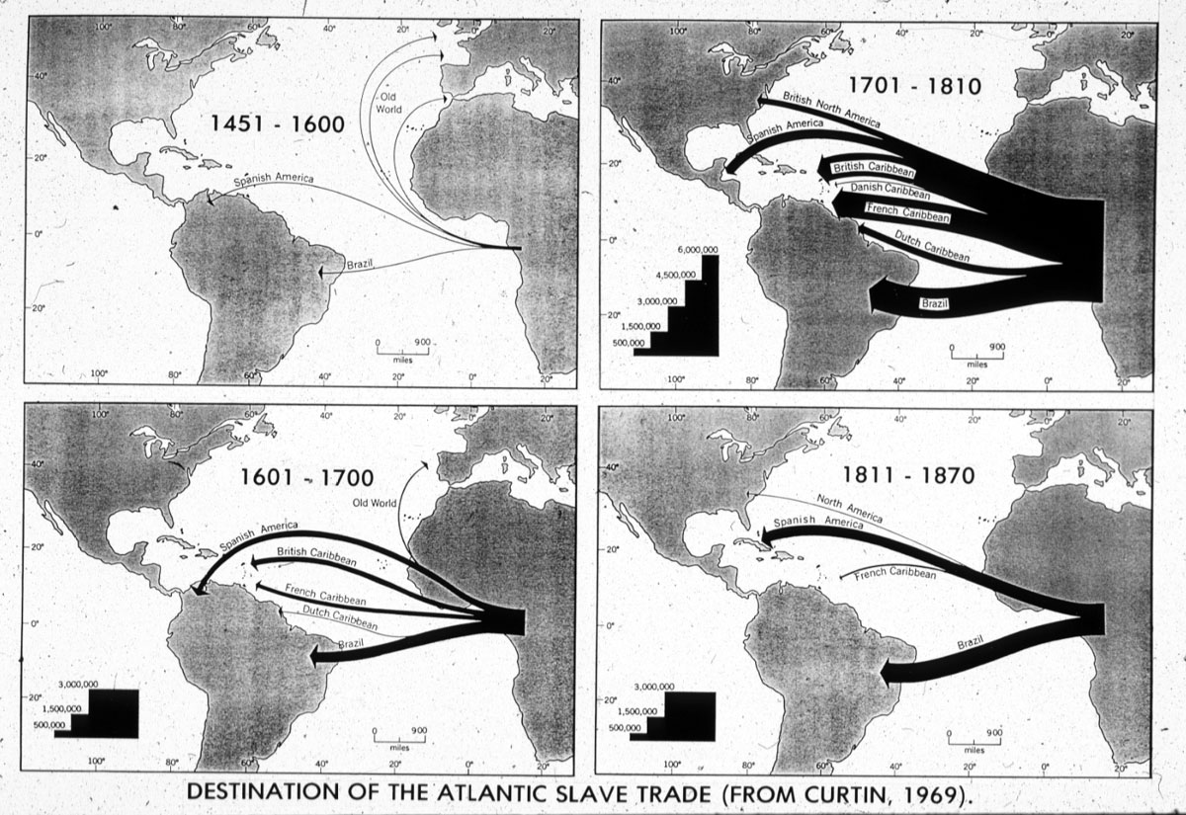
Volume and Direction of the Transatlantic Slave Trade

Slide 7
The ‘second slavery’
Spanish Crown deregulated African slave trade at end of 18th century (increase in number of enslaved Africans in the Americas...800,000 Africans disembarked until 1867)

Slide 8
The ‘second slavery’
Spanish Crown deregulated African slave trade at end of 18th century (increase in number of enslaved Africans in the Americas...800,000 Africans disembarked until 1867)
The Haitian Revolution creates opportunities to for other sugar-producers on world sugar market

Slide 9
The ‘second slavery’
Spanish Crown deregulated African slave trade at end of 18th century (increase in number of enslaved Africans in the Americas...800,000 Africans disembarked until 1867)
The Haitian Revolution creates opportunities to for other sugar-producers on world sugar market
The revolutions that tore apart the Spanish American empire in the 1810s and 1820s left Cuba as the main focus for Spanish investors and merchants

Slide 10
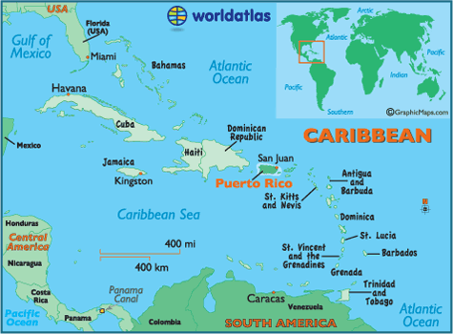

Slide 11
The ‘second slavery’
Spanish Crown deregulated African slave trade at end of 18th century (800,000 Africans disembarked until 1867)
The Haitian Revolution creates opportunities to for other sugar-producers on world sugar market
The revolutions that tore apart the Spanish American empire in the 1810s and 1820s left Cuba (and to a lesser extent, Puerto Rico) as the main focus for Spanish investors and merchants
This was part of the ‘second slavery’ (Dale W. Tomich), different from the first in its technological sophistication, industrial scale and location

Slide 12
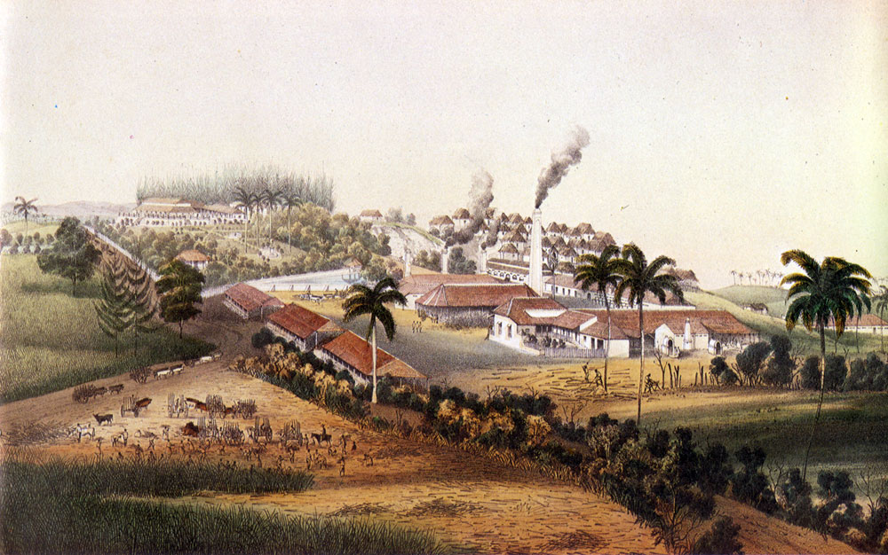
Mid-19th century Cuban plantations

Slide 13
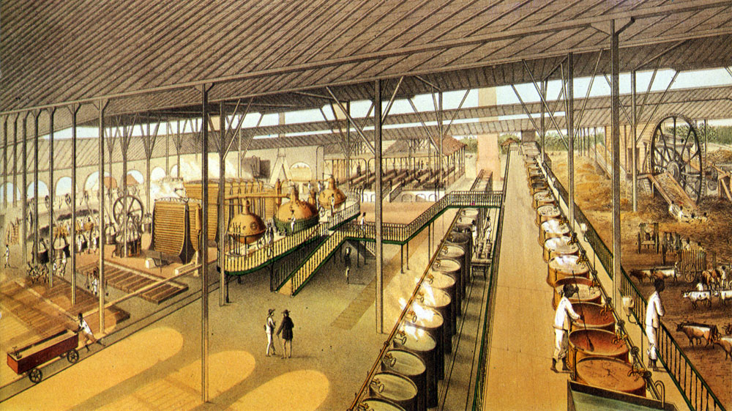
Mid-19th century Cuban plantations

Slide 14
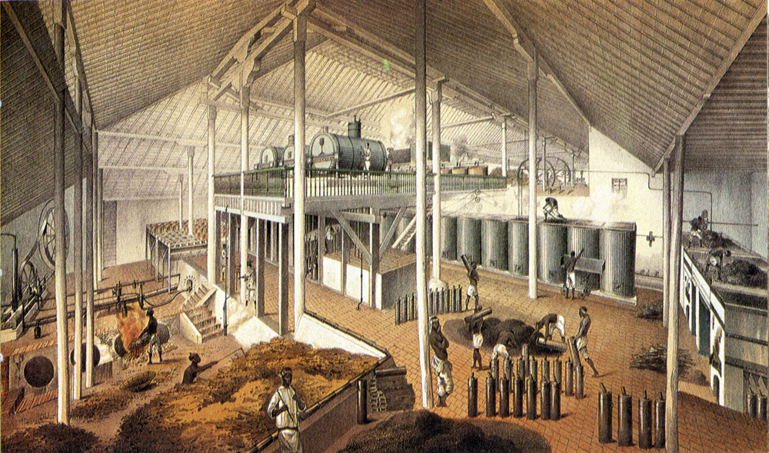
Mid-19th century Cuban plantations

Slide 15
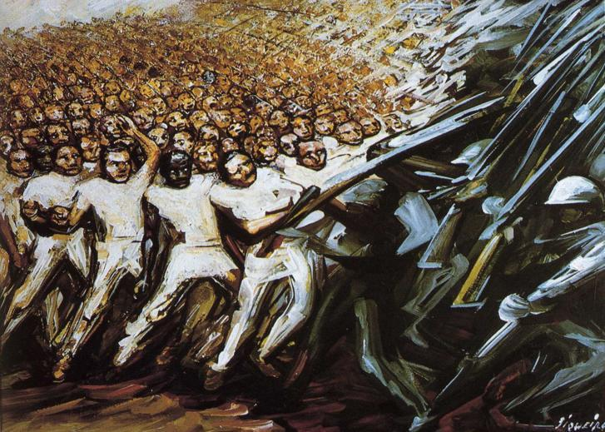
Emancipation
‘Struggle for Emancipation’, David Alfaro Siqueiros (1961)

Slide 16
Attempts to Curb Anti-Slavery and Independence
Royal Decree of Graces: In 1815 the Spanish government issued the Royal Decree of Graces to attract European immigrants from non-Spanish countries to the colonies
May 1848, the Governor of Puerto Rico passed the a series of laws called ‘El Bando contral La Raza Africana’ (The Proclamation Against the African Race).

Slide 17
Year of Crisis: Puerto Rico, 1868
23 September 1868 El Grito de Lares (Cry of Lares) in Puerto Rico
Diverse revolt against Spanish rule and slavery

Slide 18
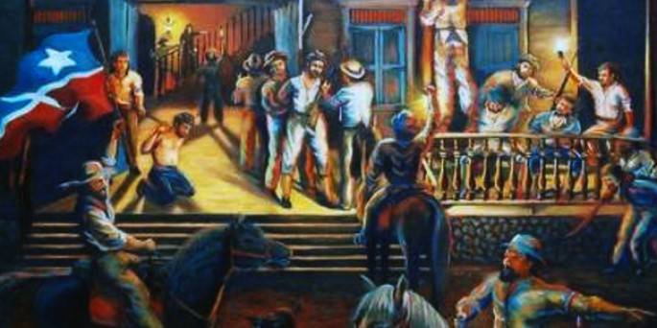
El Grito de Lares 1868

Slide 19
Year of Crisis/Cries: 1868
23 September 1868 El Grito de Lares (Cry of Lares) in Puerto Rico
Diverse revolt against Spanish rule and slavery
Put down by spring 1869
Leaders imprisoned, executed or exiled
Inspired revolt in Cuba

Slide 20
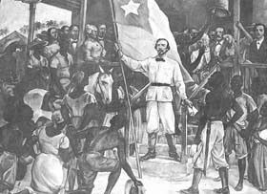
El Grito de Yara (1868)

Slide 21
Year of Crisis: Cuba, 1868
10 October 1868 El Grito de Yara (The Cry of Yara)
Diverse group of rebels—enslaved, free people and indentured labourers
Began the Ten Years War (1868-1878)
Ended in stalemate, signing of the Treaty of Zanjon

Slide 22
Steps towards abolition in the Spanish Caribbean
The Moret Law 1870
Spanish Cortes ends slavery in Puerto Rico in 1873
Treaty of Zanjon 1878
Spanish Cortes ends slavery in Cuba (1880)
End of system of Patronato in Cuba (1886)

Slide 23
Characteristics of Spanish Abolition
Gradual in nature
most often occurred following or in connection to independence movements and revolts
Slave owners compensated for freed slaves
System of patronato instituted

Slide 24
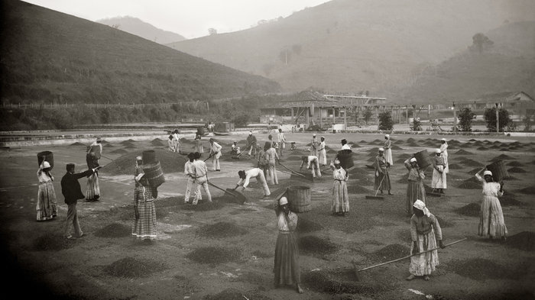
Slaves at a coffee yard in a farm. Vale do Paraiba, Sao Paulo, 1882.

Slide 25
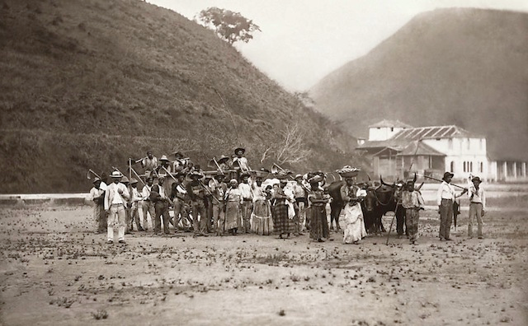

Slide 26
Enslaved Africans disembarked in the Americas, 1501-1866
Destination | Number | % of Caribbean sub-total | % of total for the Americas
British Caribbean | 2,318,252 | 48.32% | 22.00%
French Caribbean | 1,120,216 | 23.35% | 10.63%
Spanish Caribbean | 805,424 | 16.79% | 7.64%
Dutch Caribbean | 444,728 | 9.27% | 4.22%
Danish Caribbean | 108,998 | 2.27% | 1.03%
Caribbean sub-total | 4,797,618 | 100.00% | 45.53%
Brazil | 4,864,374 |  | 46.16%
Spanish Mainland | 487,488 |  | 4.63%
North America | 388,747 |  | 3.69%
The Americas - total | 10,538,227 |  | 100.00%
Total of enslaved Africans taken to the Americas = 12,331,637

Slide 27
Steps towards abolition Brazil
Eusébio de Queirós law
Paraguayan War 1864-1868
-Enlisted slaves manumitted 1866
-Mass marronage
The Rio Branco Law (Free Womb Law) 1871
1877-78 Grande Seca (Great Drought) in the cotton-growing northeast, led to major turmoil, starvation, poverty and internal migration
Peripheral Provinces in Brazil declare abolition of slavery (ie. Ceara 1884)
The Sexagenarian Law (1885)

Slide 28
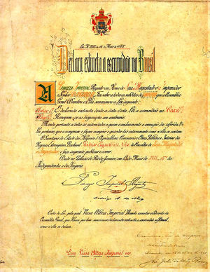
The Golden Law (1888)

Slide 29
Abolition in Brazil 1886
Immediate abolition
No compensation
No period of apprenticeship

