Slide 1
Slavery and Emancipation in Latin America
Dr Liana Beatrice Valerio

Slide 2

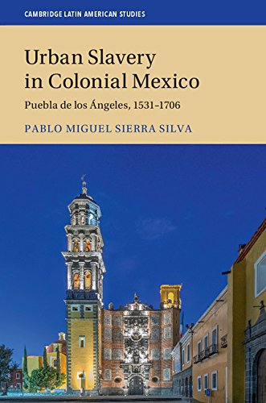

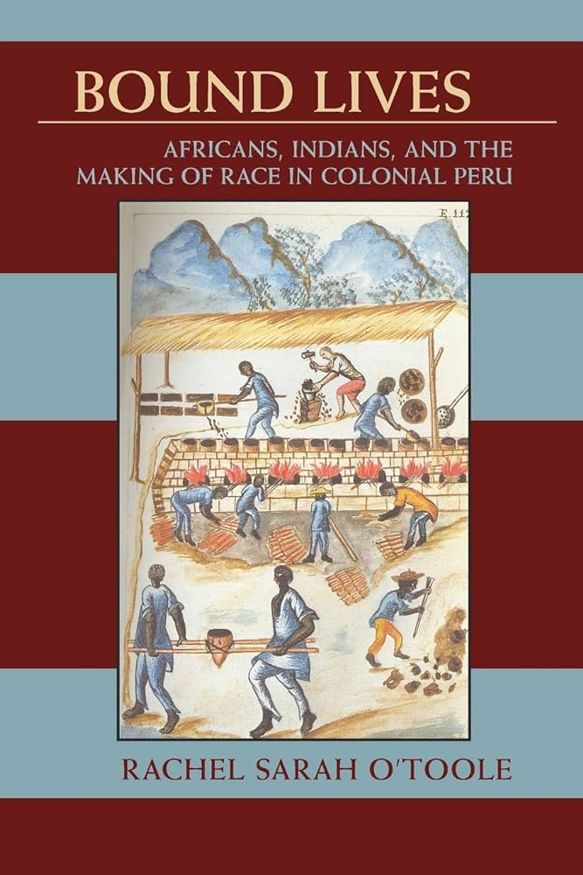
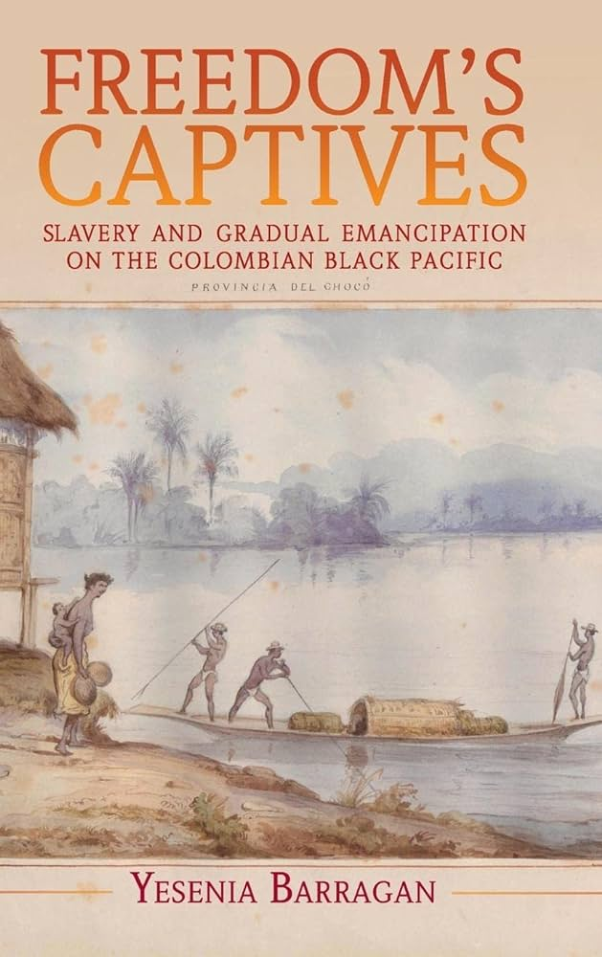

Slide 3
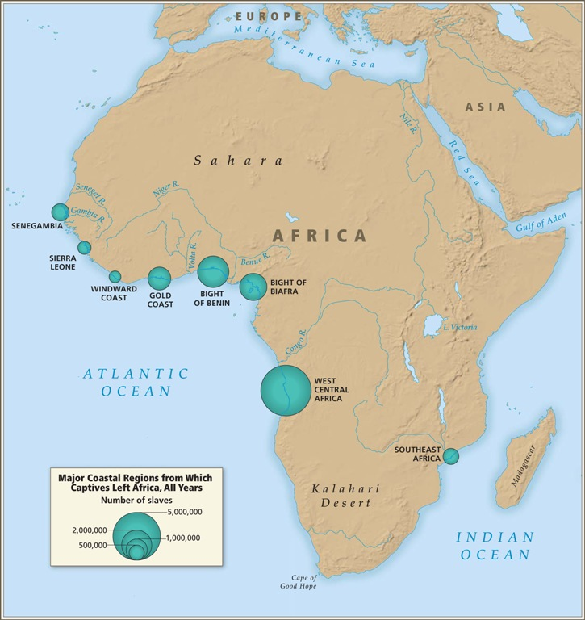

Slide 4
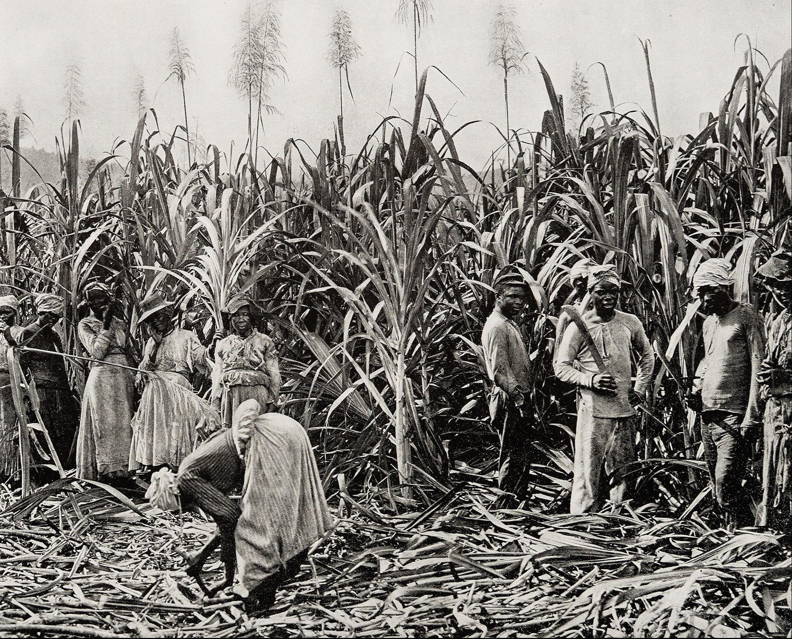

Slide 5



Slide 6
Defining Characteristics of Iberian Slavery
High turnover: high rates of new arrivals, enormous number of deaths, and imbalance in sexual ratio among enslaved people
Legal access to manumission for enslaved people. Laws also existed to allow enslaved people some redress or negotiation about their conditions [Iberian legal tradition influenced by Roman Law]
For Hispanic Latin America, slave codes and laws were drafted in Spain, as the metropole = less control in the colonies (unlike in the U.S. & Brazil later)
Huge populations of free people of colour and free black people

Slide 7

Alejandro de la Fuente, “Slave Law and Claims-making in Cuba: The Tannenbaum Debate Revisited.” Law and History Review, 22:2 (Summer 2004): 339-67.

Slide 8
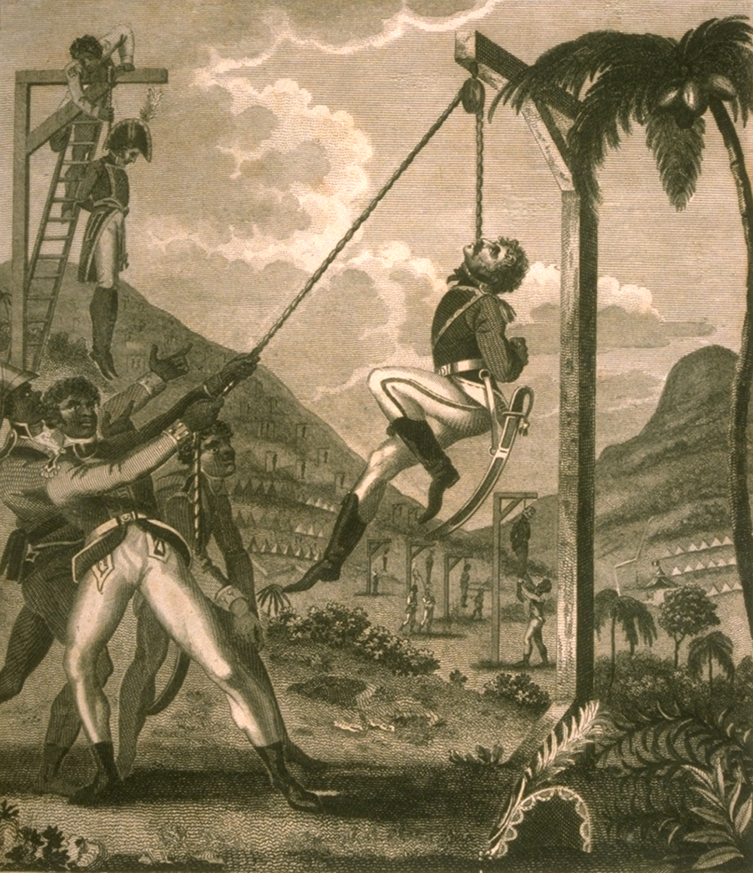
Nineteenth Century:
Abolition & Intensification of Slavery

Slide 9
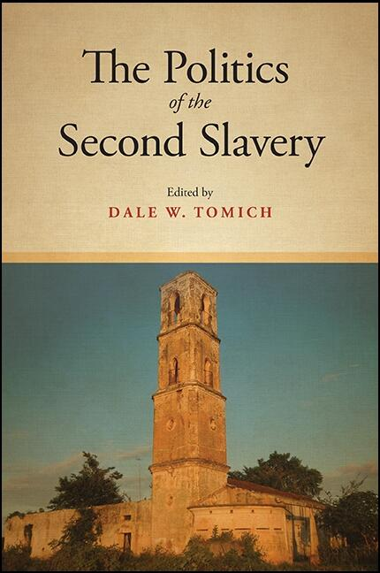
The Second Slavery: US, Brazil, & Cuba
Slavery not pre-capitalist: plantations themselves were being industrialised.
Linked to industrializing economies in Europe and the U.S. North (slave societies were both markets for goods produced in those areas, but also supplied those economies with raw materials and products as a result of slave labour (cotton from the U.S. South, coffee from Brazil, and sugar from Cuba)
Increase in the Atlantic Slave Trade
Slavery became much more profitable during this period

Slide 10
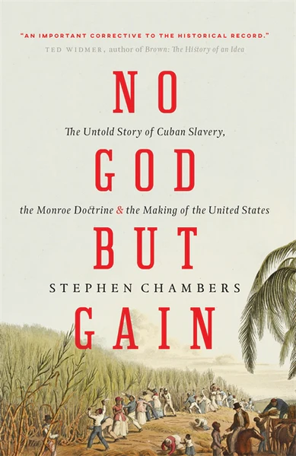
Anti-Slave Trade Treaties
Spain: 1817 (ratified in 1820) and 1835.
Portugal: 1815 (but couldn’t search Portuguese ships until 1839)
Brazil: 1826 (North of the equator)
Observed comprehensively from 1850 onwards
Meanwhile, in the US…

Slide 11
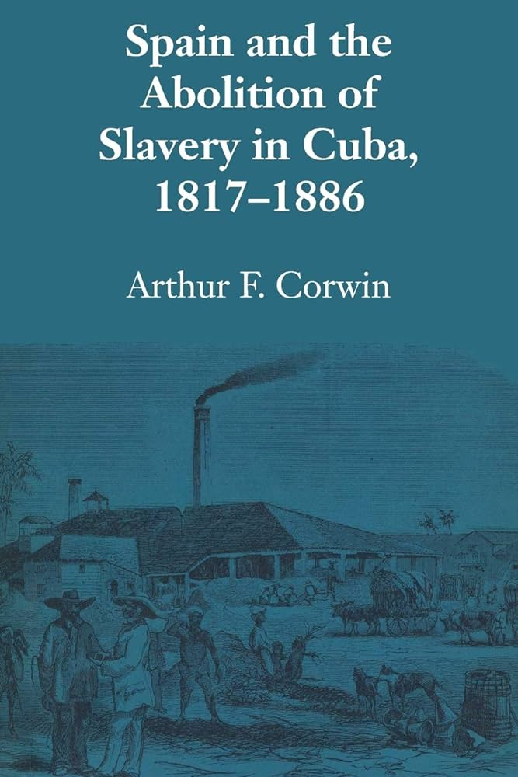
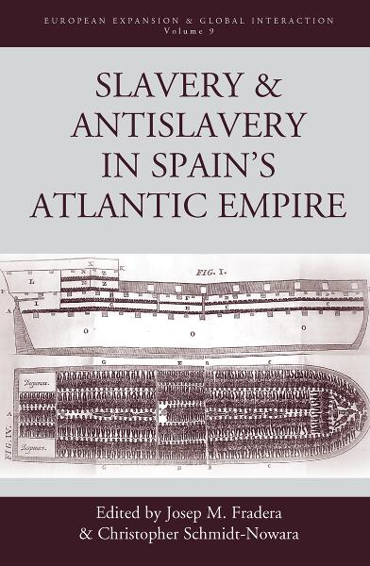


Slide 12
African history doesn’t begin in the Americas
African history begins in Africa

Slide 13



Slide 14

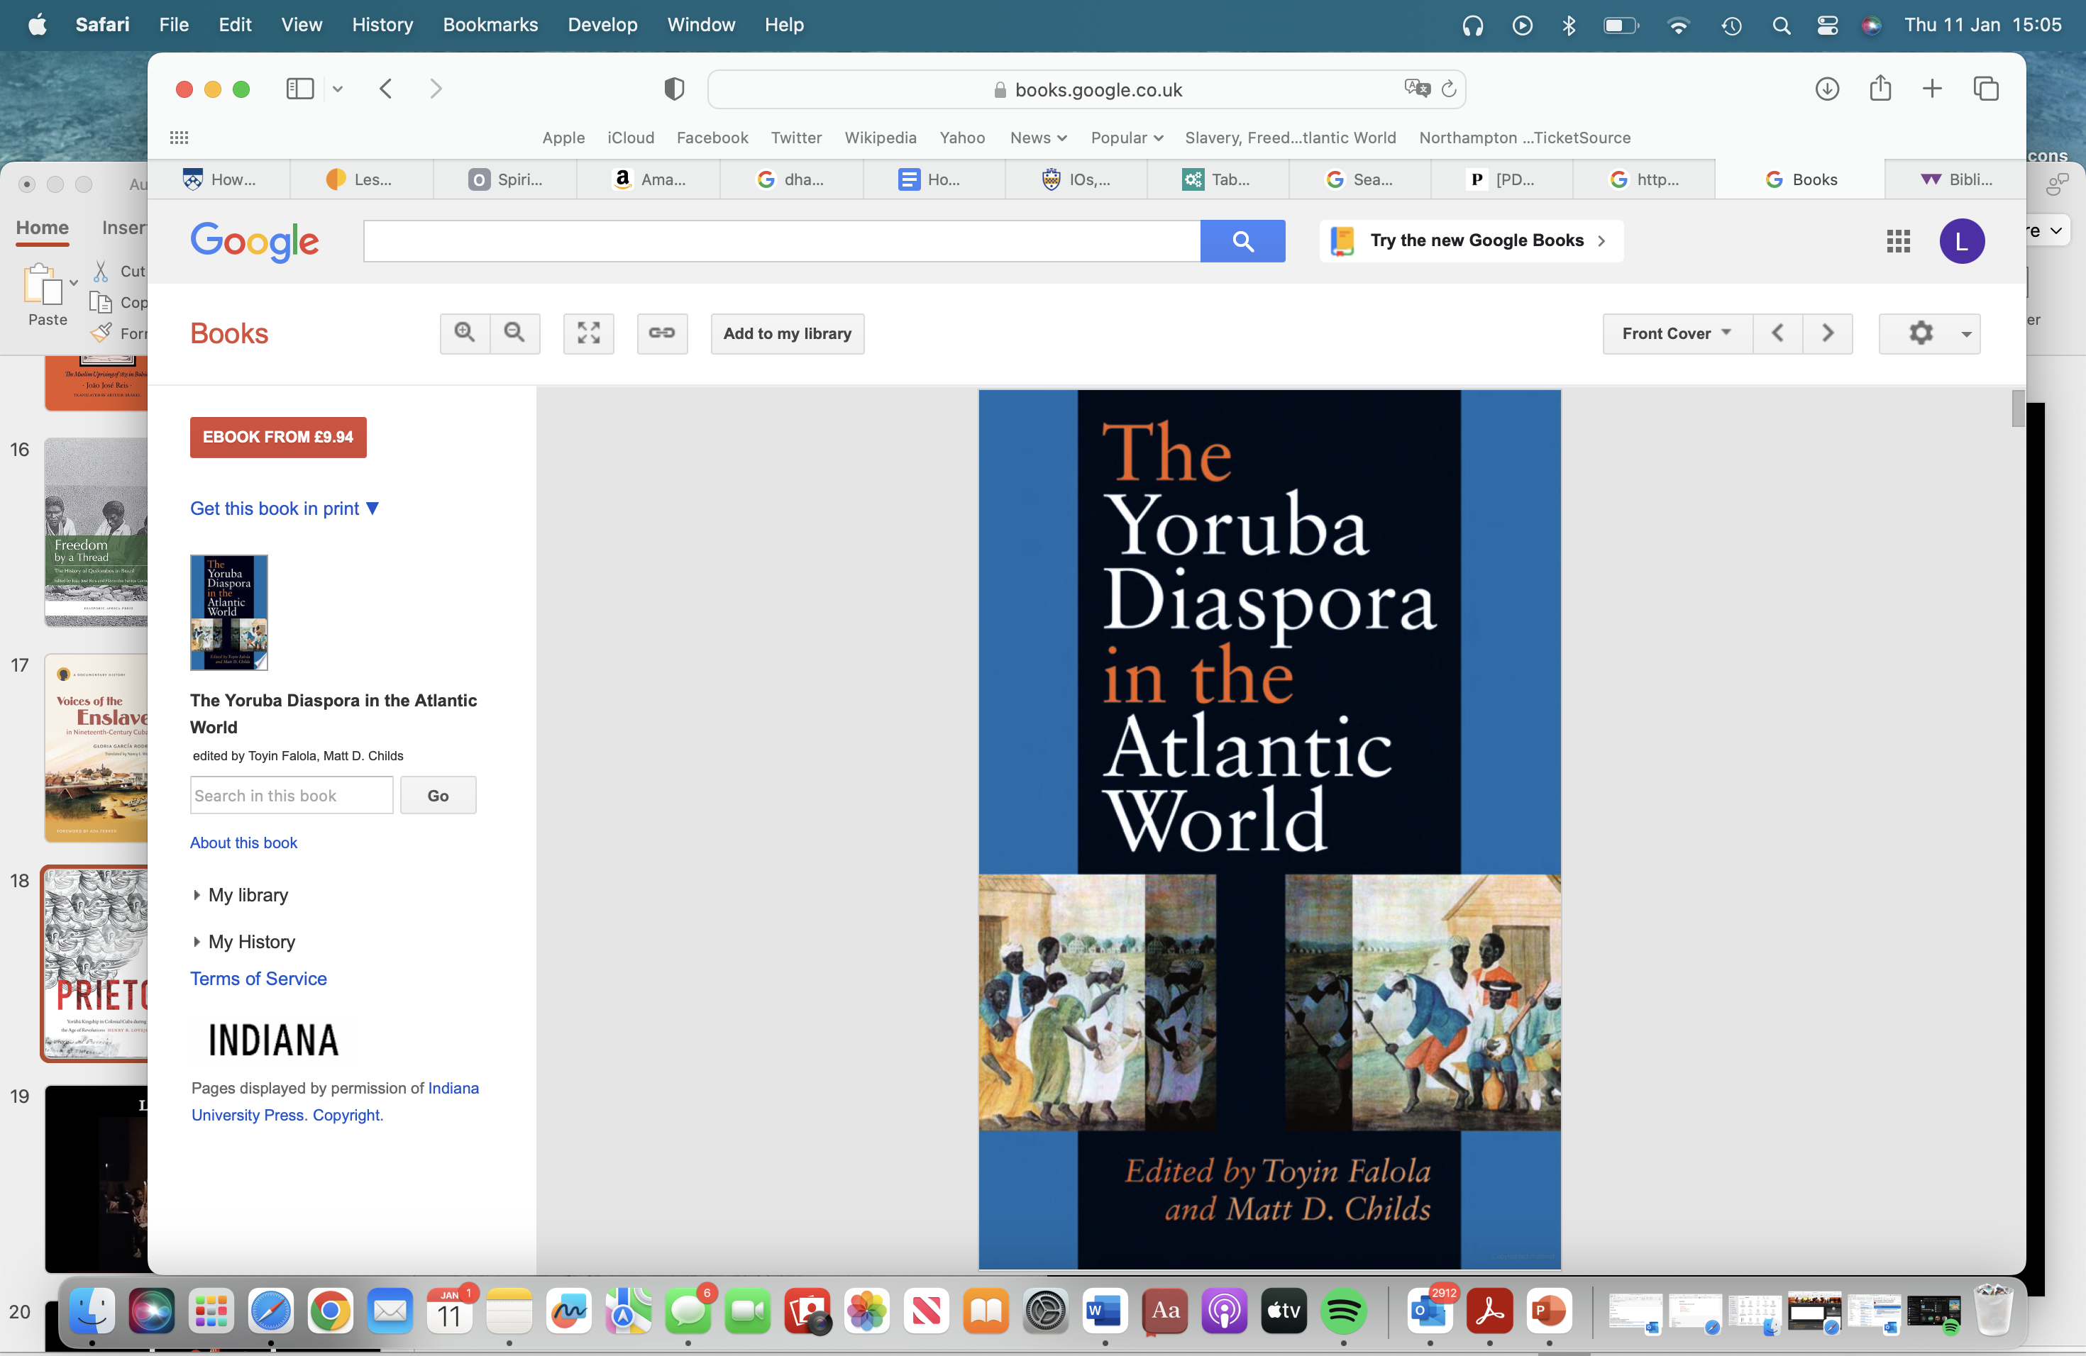

Cofradías & Cabildos

Slide 15
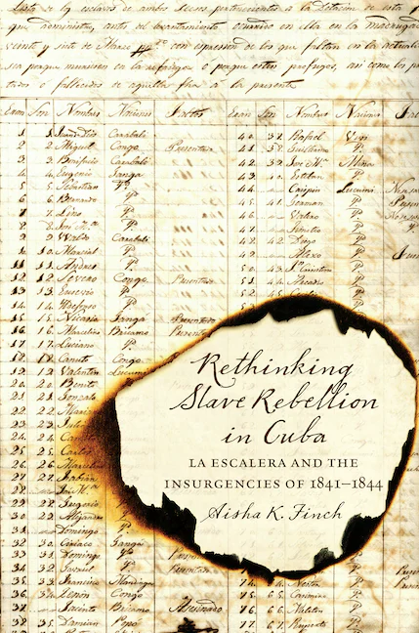
The Conspiracy of
La Escalera

Slide 16

The Malê Revolt

Slide 17
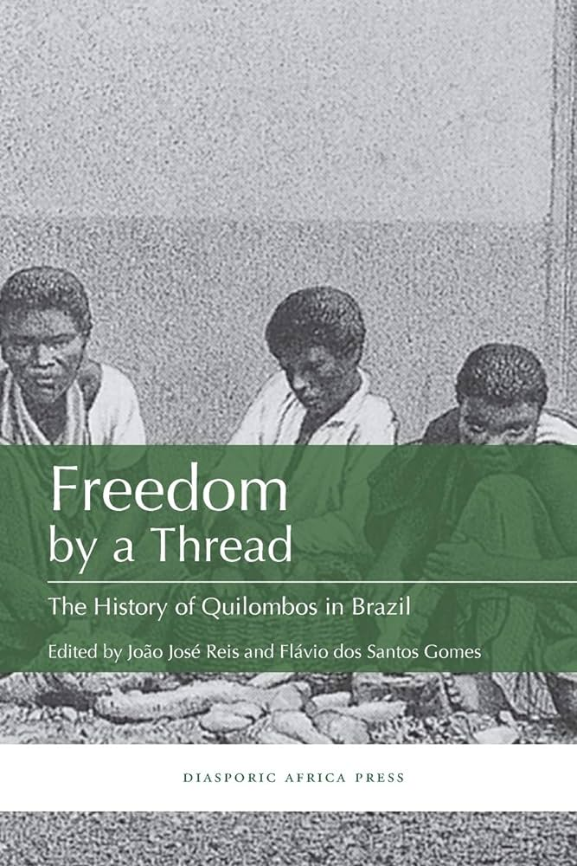
Quilombos

Slide 18
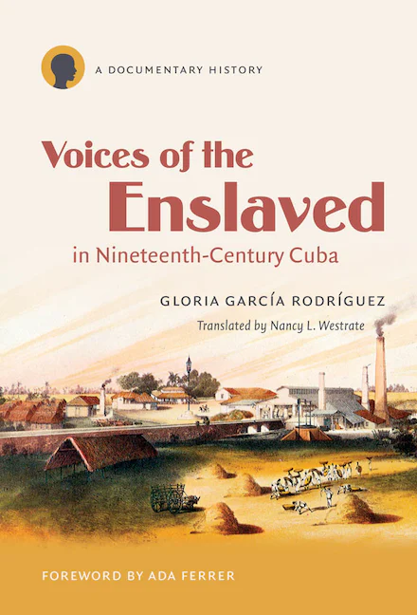
Legal Petitions For Freedom

Slide 19
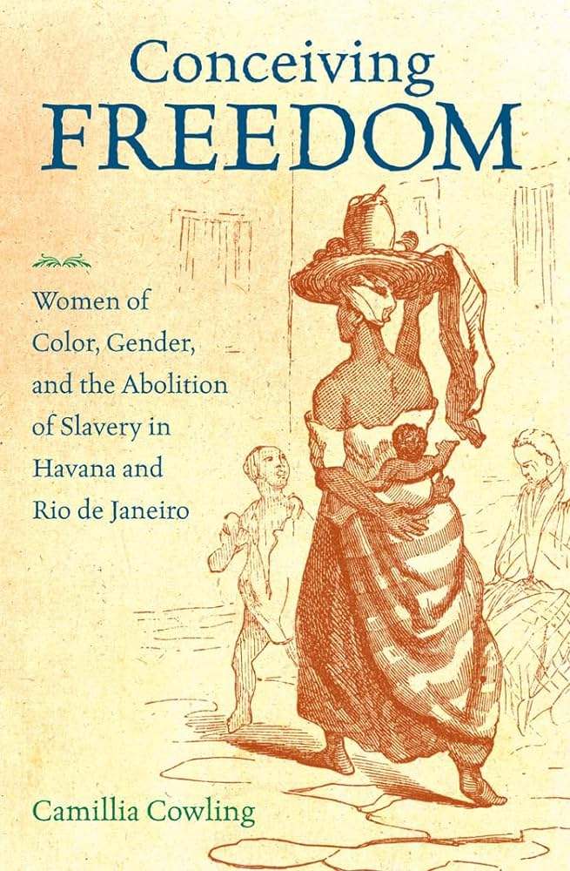
Abolition

Slide 20
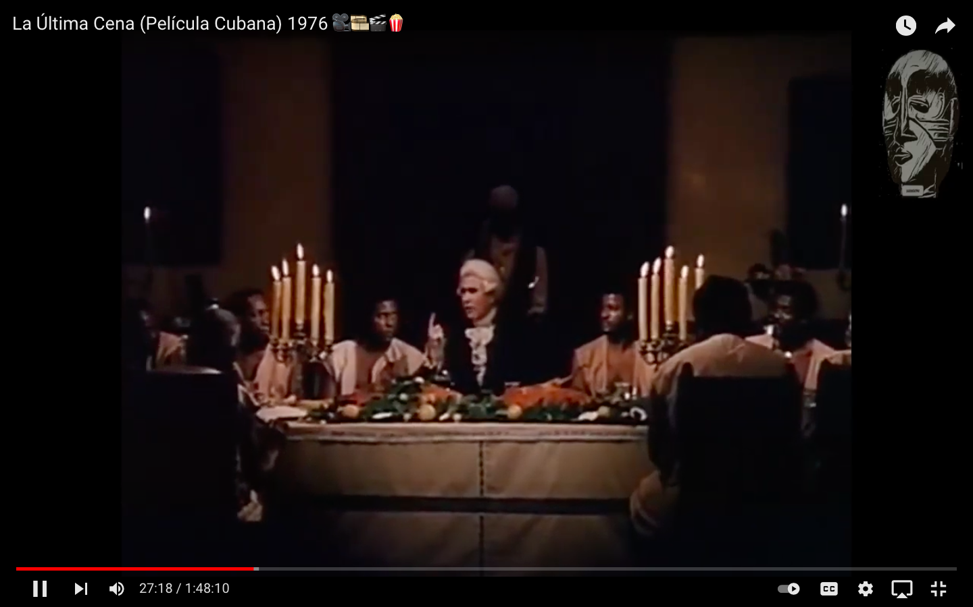
La Ultima Cena (1976)

Slide 21


