Slide 1
Welcome back!
Week 1: Slavery and Emancipation in Latin America

Slide 2
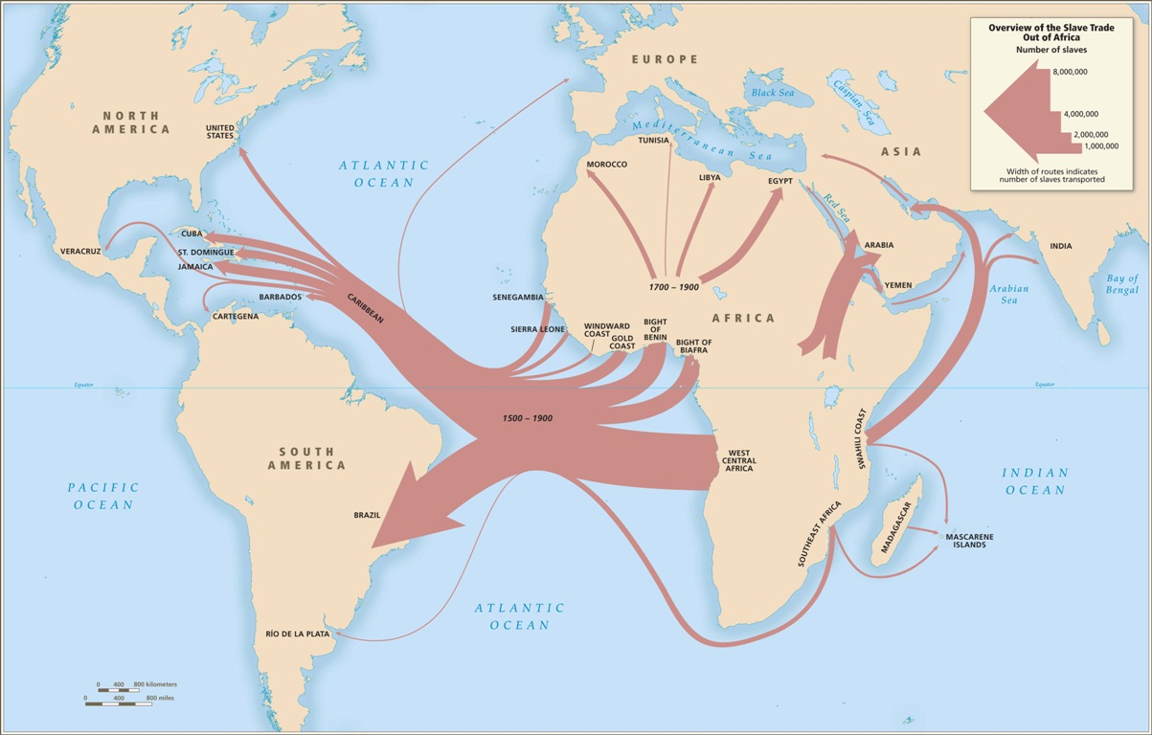

Slide 3
The Transatlantic Slave Trade Database
http://www.slavevoyages.org/

Slide 4
African arrivals in the Americas: in numbers
About 9.5 million Africans arrived in the Americas from 1500-1900
Nearly 15% (1.2 million people) went to Spanish Americas
About 42% went to Brazil
Less than 4% went to British North America
Two or three times as many Africans as Europeans arrived in the Americas before 1820

Slide 5
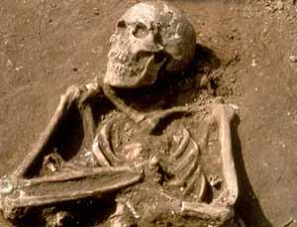
Excavation in Dominican Republic: Columbus’s African shipmates

Slide 6
Africans in the Americas
Presence from earliest Spanish and Portuguese voyage (pre-existing contacts with Africans in Spanish and Portuguese early modern world)
Not all Africans in the New World or their descendants were slaves
In fact, more Africans and their descendants were FREE than enslaved at most times and in most places: significant FREE POPULATIONS OF COLOUR (e.g. Brazil, Cuba)
Some (a minority) ended up wealthy;
Many Afro-Latin Americans owned slaves of their own
But, the majority of Africans newly-arrived in the New World were enslaved on arrival.

Slide 7
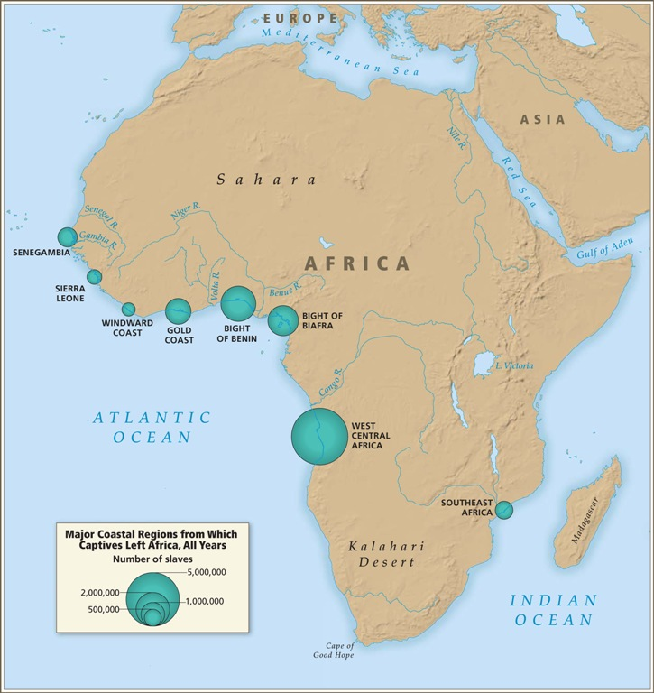

Slide 8
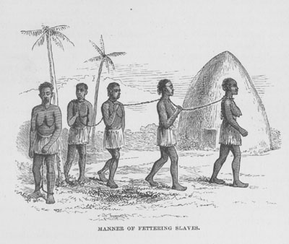
Capture and forced marches in Africa

Slide 9
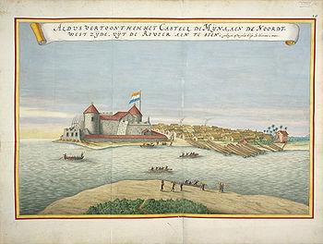
El Mina, slave trading fortress on West African coast (today’s Ghana)

Slide 10
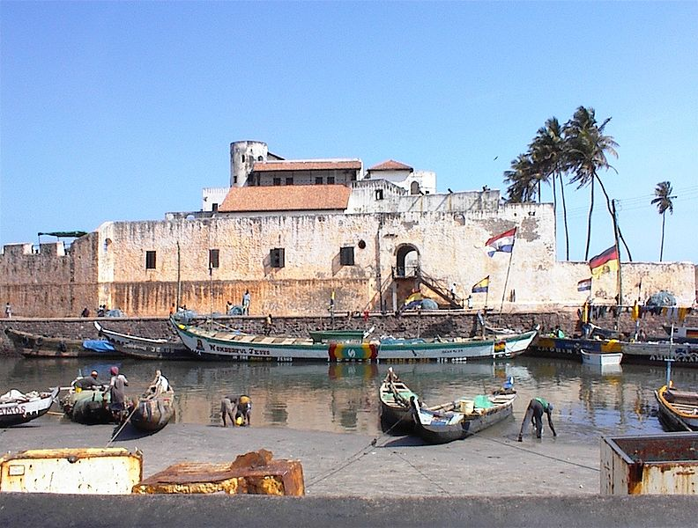
El Mina castle in Ghana today

Slide 11
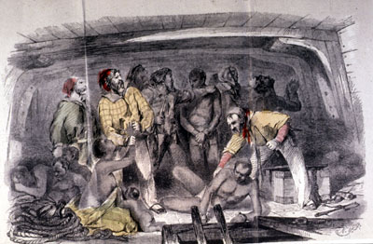
Loading the “cargo”

Slide 12
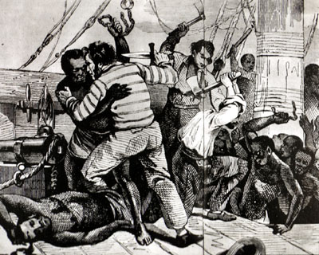
Slave ship revolt

Slide 13
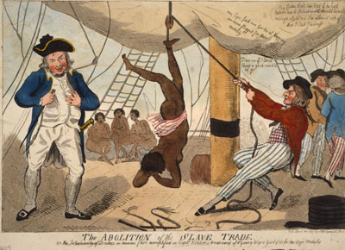
Punishment on board

Slide 14
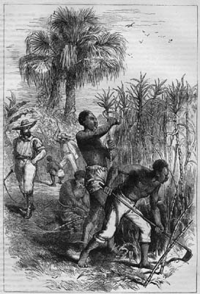
Sugar and slavery in the Americas: a bloody history
Working in the sugarcane fields
- About 90% of all Africans who came to the Americas before about 1800 end up working in sugar
- Places that cultivated sugar (tropical, coastal areas) import most Africans
Coasts of Peru and Mexico
Northern Colombia and Venezuela
Especially: BRAZIL
And in C19: CUBA
Average lifespan of slave on Cuban sugar plantation in C19 from arrival = 7 years

Slide 15
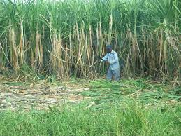
Sugarcane

Slide 16
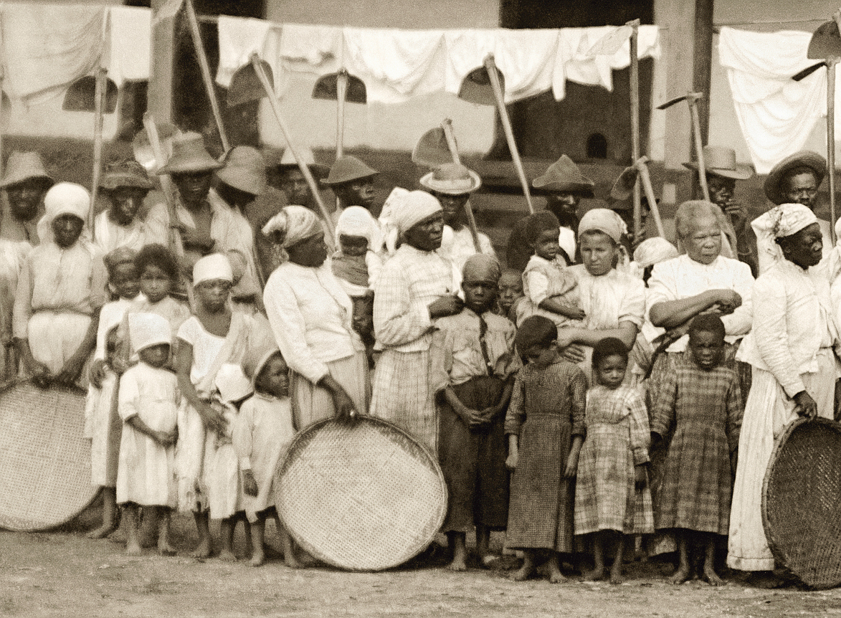
Notes:
Marc Ferrez/ Coleção Gilberto Ferrez/ Acervo Instituto Moreira Salles
Partida para colheita do café | Vale do Paraíba, c. 1885
From: http://www.blogdoims.com.br/ims/emancipacao-%E2%80%93-por-lilia-schwarcz-maria-helena-machado-e-sergio-burgi/

Slide 17
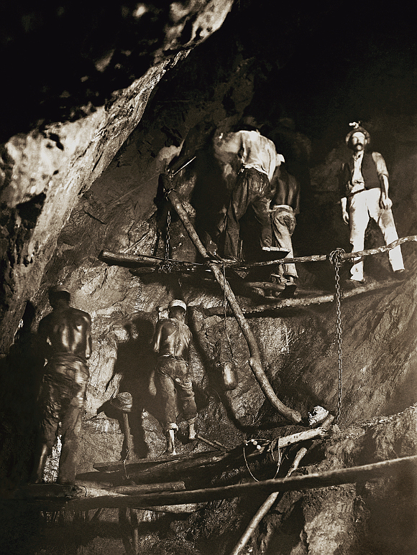
Notes:
Marc Ferrez/ Coleção Gilberto Ferrez/ Acervo Instituto Moreira Salles
Primeira foto do trabalho no interior de uma mina de ouro | Minas Gerais, 1888

Slide 18
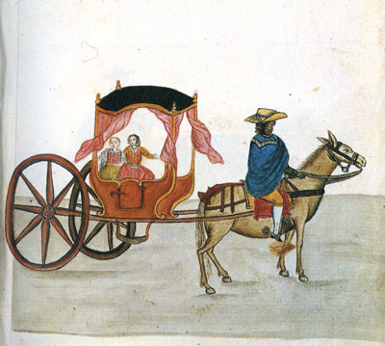
Coachman, Peru, 1780s

Slide 19
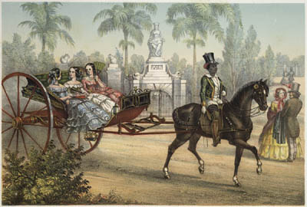
Coachman with horse and carriage, nineteenth-century Cuba

Slide 20
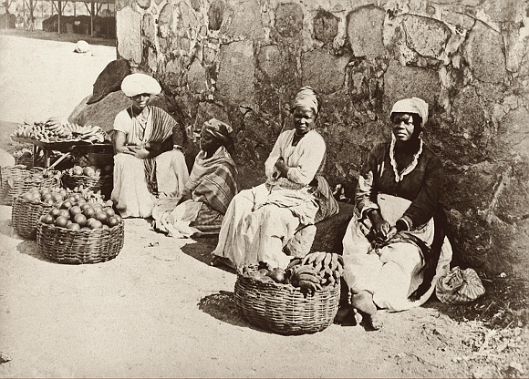
Notes:
Marc Ferrez/ Acervo Instituto Moreira Salles
Quitandeiras | Rio de Janeiro, RJ, c. 1875

Slide 21
Features of Iberian slavery in the Americas
Harsh, short lives in brutal conditions; no natural reproduction; rape and sexual exploitation
But: some access to manumission (legal freedom); large free populations of colour
Laws that allowed enslaved people minimal negotiation about their conditions
Incorporation of enslaved into cultural and religious life; religious guilds, and therefore:
Syncretic, mixed African/ Catholic religions (e.g. candomblé in Brazil, santería in Cuba) develop
Africans contribute to most aspects of Latin American culture: language, dance, song, food

Slide 22
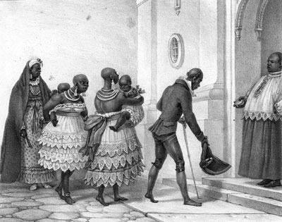
Baptism in a Catholic church in nineteenth-century Brazil

Slide 23
Emancipation in Latin America
Most Hispanic countries abolish after independence from Spain
Afro-Latin Americans fight for independence and embrace Enlightenment ideas
But… creole and slaveholding elites try to backtrack in many areas
Slavery abolished in Chile 1823, Mexico 1829…
But only in 1853 in Argentina, 1854 in Venezuela and Peru

Slide 24
Important exceptions to the rule (I): Brazil
Independence from Portugal in 1822
But African trade only abolished 1850
1.7 million slaves imported in first half of nineteenth century
Abolition: due to abolitionist movement; enslaved agency and actions; isolation as last American slaveholding nation
Gradual emancipation process: law of “free womb,” 1871, passed by Brazilian parliament; law to free elderly in 1885;
slavery finally abolished in 1888 (last country of Americas to abolish)

Slide 25
Important exceptions to the rule (II): Cuba
Independence from Spain only in 1898
Sugar cultivated intensively from late C18; Cuba is Americas’ largest sugar producer for most of C19
700,000 slaves imported in C19 (up to late 1860s)
Anticolonial war in Eastern Cuba from 1868 intersects with antislavery struggle
Meanwhile enslaved people, especially women, seek freedom through the courts and gradually help erode slavery…
Gradual legal emancipation process initiated by Spain: 1870 (“free womb” law); 1880 patronato law; 1886 slavery abolished.

Slide 26
Image credits
http://hitchcock.itc.virginia.edu/Slavery
http://www.blogdoims.com.br/ims/emancipacao-%E2%80%93-por-lilia-schwarcz-maria-helena-machado-e-sergio-burgi/
http://www.slavevoyages.org/tast/assessment/intro-maps.faces

Slide 27
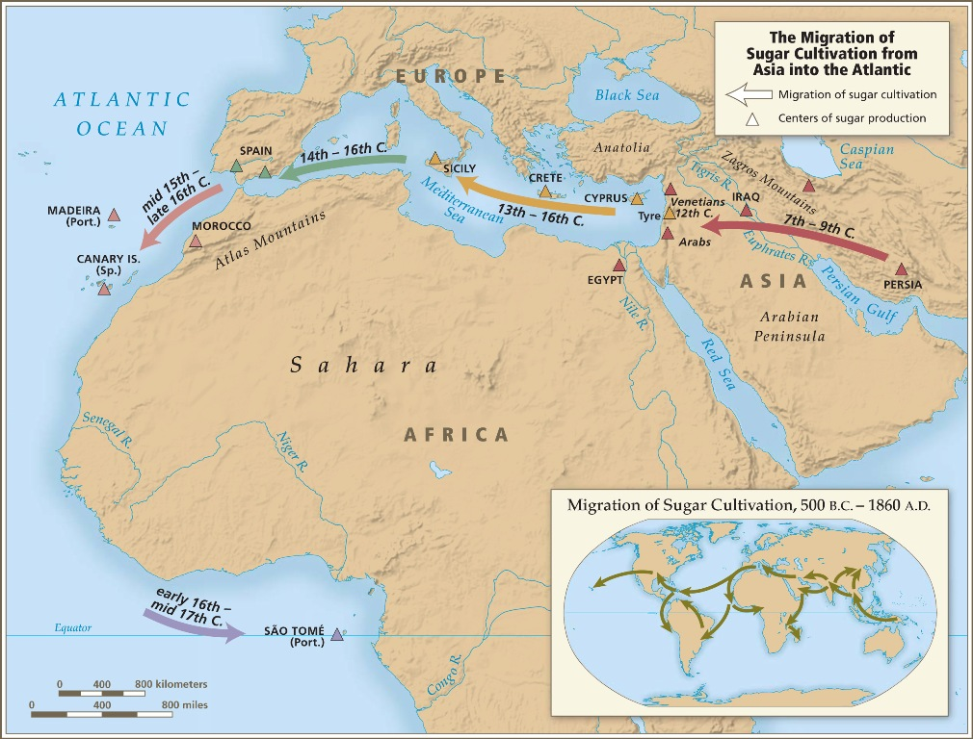

Slide 28
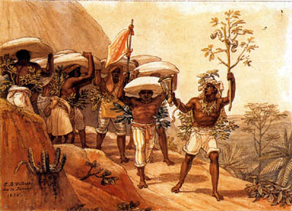
Enslaved porters carrying coffee (Brazil)

Slide 29
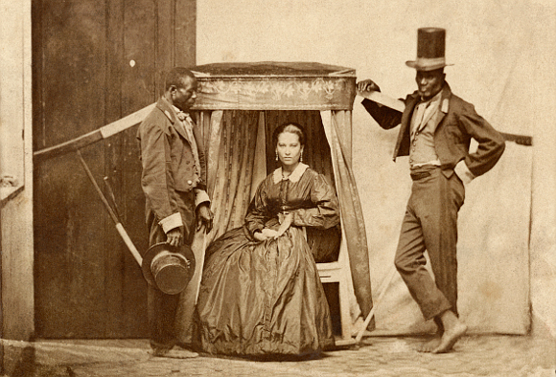
Notes:
Fotógrafo não identificado / Acervo Instituto Moreira Salles
Senhora na liteira com dois escravos | Bahia, c. 1860

Slide 30
A useful documentary series:
Henry Louis Gates Jr presenting Black in Latin America, PBS 2011
https://www.youtube.com/watch?v=-tvFAFUbRyQ

