Slide 1
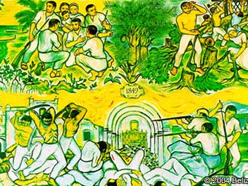
Popular Democracy, Caste Wars and State Formation in Nineteenth- Century Latin America

Slide 2
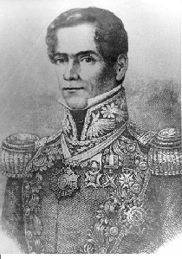
A few terms:
Caste War
Liberalism (nineteenth-century variety)
Syncretism
Creole
Peasant
Caudillo

Slide 3
After Independence, Latin American countries enjoyed certain political advantages:
Freedom to choose an array of political systems - Empire in Mexico under Agustín Iturbide (1821-24); constitutional monarchy in Brazil (Brazil, 1824-1889); dictatorship in Paraguay under Dr. Francia (1814-1841).
Liberated form Spain’s commercial monopoly
Enormous territories and comparatively small populations
Comparatively unthreatening international environment. In 1823 President Monroe warned Europe off adventures in the New World.

Slide 4
Latin America also enjoyed certain social advantages
Fairly stable social system
Creole elites were relatively unchallenged (Spanish had been expelled e.g. in Mexico in 1826)
Limited urban working class
Vast mass of population were peasants, often divided into different ethnic groups (Mexico had 62 ethnic groups at the time)

Slide 5
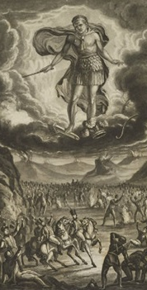
Latin America also enjoyed certain cultural advantages
Culturally homogenous
Catholicism was still the principal religion, very little Protestant influence
Enlightenment ideas were limited
Literacy was still extremely low

Slide 6
Yet, despite these advantages peace, stability, and prosperity were elusive
Average annual growth in Latin America remained around 0.1 to 1 per cent form 1820-1860. In comparison, US growth was around 2.0-2.6 per cent.
Political instability was rife. Mexico had 48 presidents between 1824 and 1858.
Social instability was also rife. Border disputes, Indian wars, caste wars and banditry were common. (e.g. In 1846-8 Mexico underwent the caste wars of Tehuantepec, Huasteca, and Yucatán, and US occupation)

Slide 7
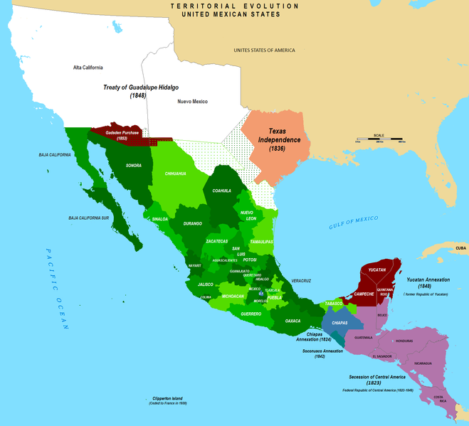

Slide 8
Why?
No clear form of government. After Independence, most creole elites wanted a variant of constitutional liberalism.
Yet, each element of constitutional liberalism had its weakness
Popular sovereignty. If sovereignty resided in the people, who comprised the people? The individual, the town, the state, elites or commoners?
Constitutions. These became symbols of political legitimacy. But they were often debated, revised, and abolished. E.g. in Argentina Juan de Rosas ruled through “state of emergency” from 1827-1851
Elections. Who was to vote? How to stop electoral fraud?
Politicians. Democracy necessitated professional politicians, men that could communicate with the people. During the period, there was the rise of the “caudillo” or professional, charismatic politician. E.g. Antonio Lopez de Santa Ana in Mexico, Juan de Rosas in Argentina, Rafael Carrera in Guatemala

Slide 9
“Civilisation” and “barbarism”
Tradition/ Old Order
Absolutism
Subjects
People relate to their ruler through local chieftains
Legitimacy of the ruler is inherited and God given
Contract between ruler and ruled
Corporatism (Brotherhoods, guilds, church, army)
Communal land
Church power
Modernity/ New Order
Constitutionalism
Citizens-elections, laws, constitutions, division of powers
Constitutional and electoral legitimacy
Social contract
Individualism
Private property
Secularism

Slide 10
Federalism v Centralism
Centralism
A natural step, replicating colonial structures?
keep the provinces under control
No disputes over powers of national and provincial governments
Federalism
Best reflects diverse nature of large territories
Liberal like the 1787 U.S
Federalism not secessionism; unity not uniformity; allow divergence to avoid secessionism

Slide 11
Caudillos of Latin America
Antonio Lopez de Santa Anna of Mexico

Slide 12
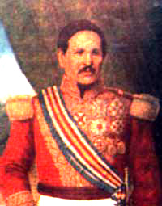
Rafael Carrera of Guatemala (1837-1865)

Slide 13
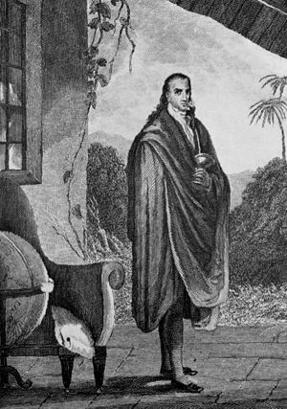
José Gaspar Rodríguez de Francia of Paraguay (1809-1840)

Slide 14
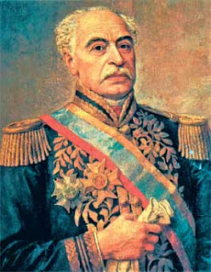
José Antonio Páez of Venezuela (1830-1863)

Slide 15
The beginning of mass politics
Constitutional liberalism introduced a new language of politics – fraternity, liberty, equality, citizenship.
Most creole elites did not think that these concepts should be extended to the lower classes.
However, many ethnic and peasant groups did cotton on and press for fulfillment of the promises of constitutional liberalism.
E.g. Mexico 1820s had widest franchise in the world. Every man over 21 could vote.

Slide 16
Repeated clashes between creole and popular notions of citizenship
E.g. 1815, 1820 Quiché Maya Indians in Guatemala rose up in the name of the liberal Constitution of Cadiz, which had promised the vote to all citizens of Spanish America
E.g. 1830-2 Afro-Mexican and nahuatl speaking Mexicans rose up to defend the election of Vicente Guerrero, their chosen leader.
E.g. Caste war of Yucatan (1848-1907). Maya peasants rose up to defend lands and assert control over local politics.

Slide 17
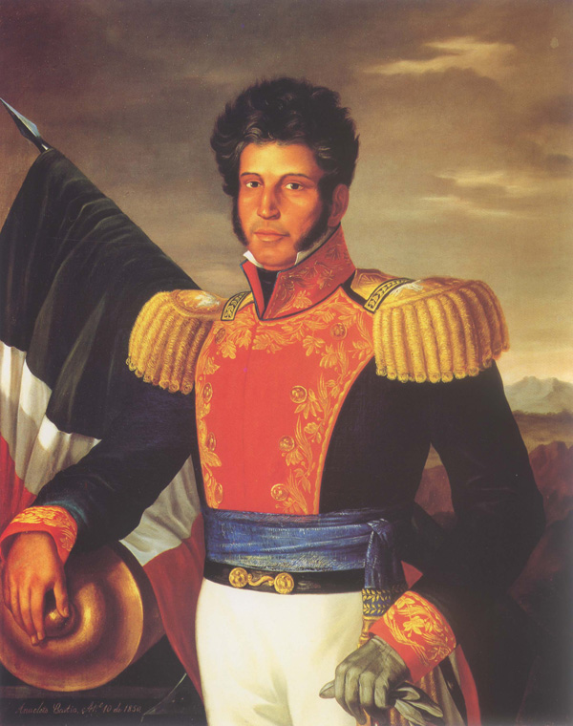
Vicente Guerrero

Slide 18
Economic problems
Independence wars had often destroyed sources of wealth (silver mines in Bolivia, Peru and Mexico)
Without new technologies, Latin American countries found it hard to replace the advantage of Spanish trading monopoly. (Only with arrival of railways in 1870s were Latin American countries able to compete globally)
Split over economic policy
Liberals and foreign countries favored trade liberalization
Conservative landowners and artisans in provincial capitals like Puebla (Mexico), Bogata (Colombia), Quito (Ecuador) favored protectionism

Slide 19
Territorial integrity
Although they had large territories, countries like Mexico and Peru did not have the people to govern them effectively.
Both countries were racked by Indian wars during the early nineteenth century, which they neither had the manpower nor the cash to fight.
At the same time, US became territorially aggressive e.g. 1846 Invaded Mexico and at treaty of Guadalupe-Hidalgo seized nearly half Mexico’s territory.
A week after the territory was seized, US prospectors found gold in California.

Slide 20
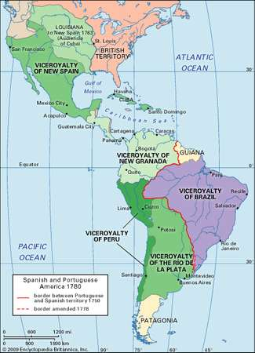
Mexico

Slide 21
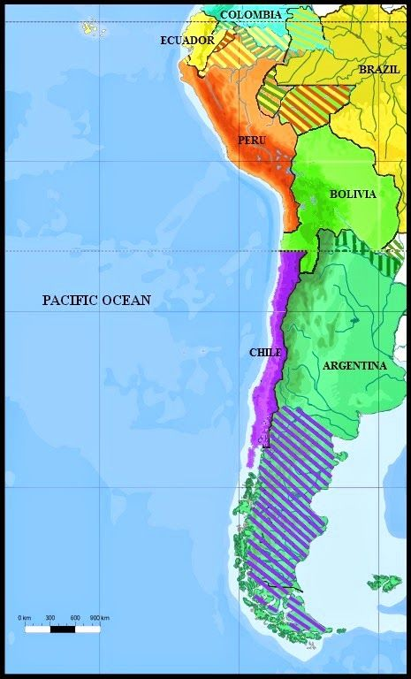
Peru

Slide 22
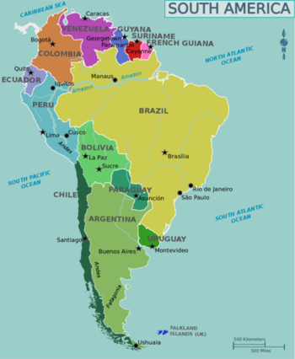
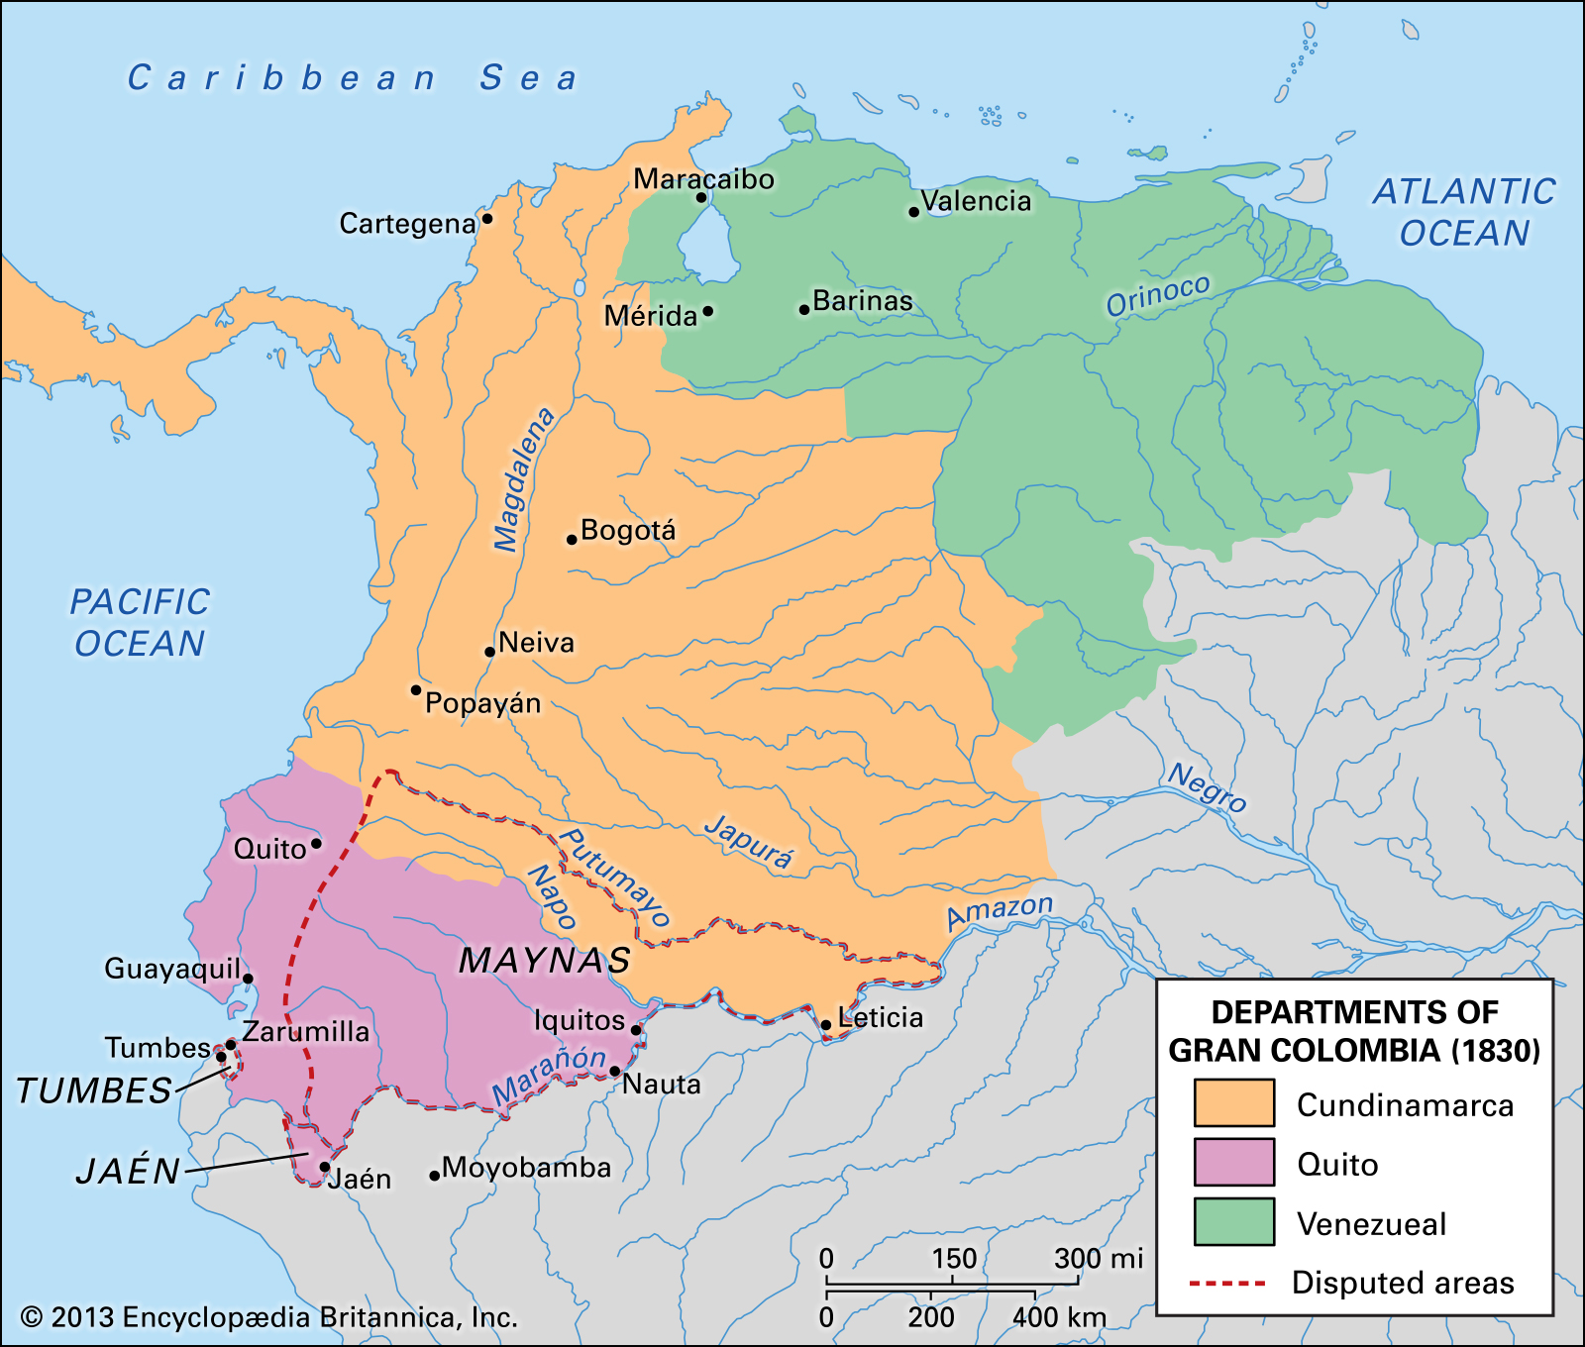
Gran Colombia

Slide 23
International environment
In theory, US hemispheric power was to negate European interests. When countries were united, this was the case.
However, divisions caused increasing international involvement as one side harnessed European powers to help them gain control of the country.
E.g. Argentine exiles used Chilean and Brazilian support to invade Argentina and bring an end to Rosas’s regime in 1852 at battle of Pavón.
E.g. 1862 Mexican conservatives invite Napoleon III to establish Mexican Empire. Napoleon sends Maximilian Habsburg to rule
E.g. Paraguayan exiles in Argentina encouraged Argentine president to invade Paraguay. The resulting war, the War of Triple Alliance (Argentina, Uruguay, and Brazil vs. Paraguay), which was fought between 1864 and 1870 caused the death of 9/10th of Paraguay’s adult males.

Slide 24
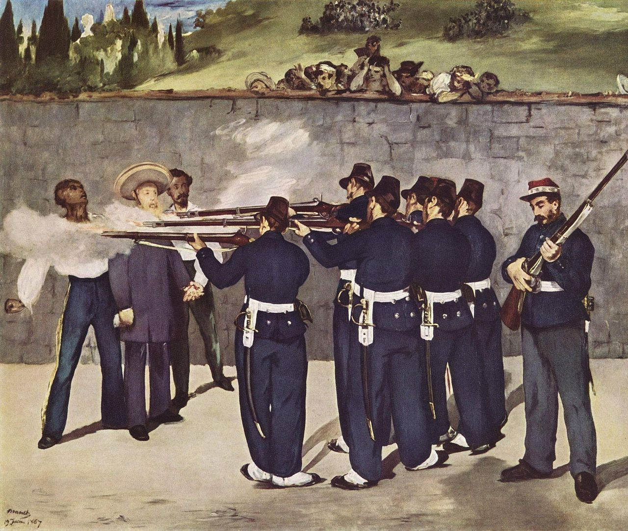
The French Intervention in Mexico
Édouard Manet’s Execution of Emperor Maximillian(1868–1869). One of five versions of his representation of the execution of the Austrian-born Emperor of Mexico, on June 19, 1867. (See Goya's, The Third of May 1808)

Slide 25
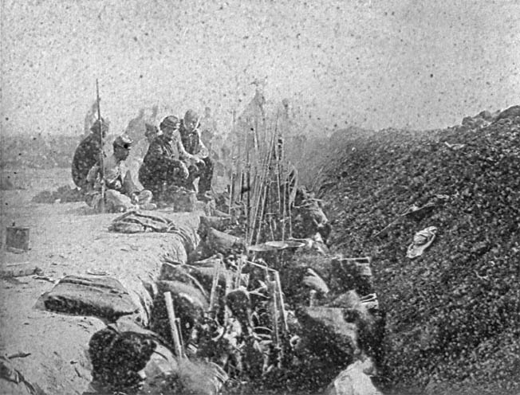
Uruguayan Troops at the Battle of Tuyuti in the Paraguayan War

Slide 26
Social stability?
Latin America was not as socially stable as it seemed.
1) Politicization of lower classes.
a) Peasant and indigenous groups, often trained in both warfare and politics during the Independence wars, were remarkably adept at using new political rhetoric.
b) New breed of populist creole leaders (federalists and liberals in Mexico, 1830s-1860s e.g. Benito Juárez) were keen to harness crowds to gain power.
2) Increasing inequality.
a) Gradual economic recovery initiated series of laws designed to privatize indigenous lands (in Mexico, Guatemala, and Peru).
b) These laws often transferred lands from indigenous villages to private, non-indigenous investors, causing inequality and social problems

Slide 27
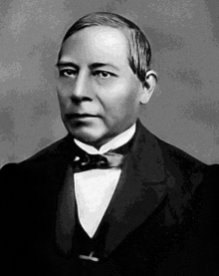
Benito Juárez, the first indigenous president of Mexico

Slide 28
Cultural harmony?
Post-Independence Catholicism was weak.
Pope refused to acknowledge Latin American independence and did not start appointing bishops until 1830s.
Priests were divided between between republicans and those who wished the return of Spanish colonialism
Without priests or bishops many indigenous groups had re-embraced a less formal, orthodox brand of Catholicism,
This was less connected to the clerical hierarchy e.g. Yucatán’s speaking cross, Tatu Chu of the Triquis.
Against the interference of the clerical hierarchy and especially payment of tithes, baptism and marriage fees etc.

Slide 29
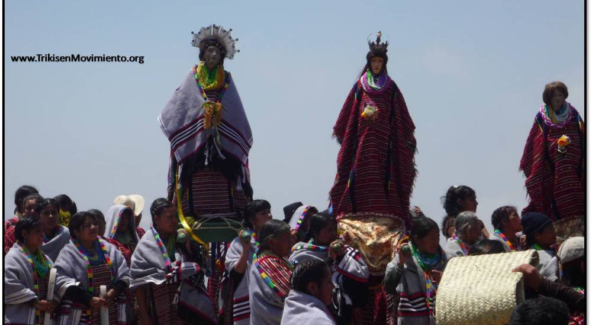
Triqui versions of the Virgin Mary today

Slide 30
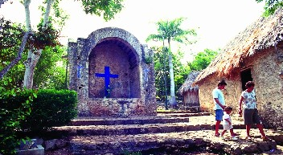
Shrine to the speaking cross, Yucatán

Slide 31
Anticlericalism
By 1830s, enlightenment anticlericalism had started to spread among the creole elite and merged with popular anticlericalism.
E.g. José María Luis Mora, a former priest from western Mexico, introduced anticlerical statutes in Michoacán 1834. In 1857-9, his followers banned foreign priests, church landowning, and introduced civil marriage.

Slide 32
Religious conflicts
Thus, often political and socio-economic conflicts took on a particular religious edge as liberals, in league with popular groups, attacked conservatives in league with the church and some Catholic believers.
E.g. Mexican Reform War(1858-1861), Colombian Thousand days war (1899-1902), Central American Civil War (1863)

Slide 33
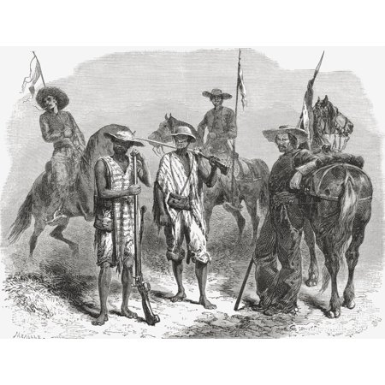
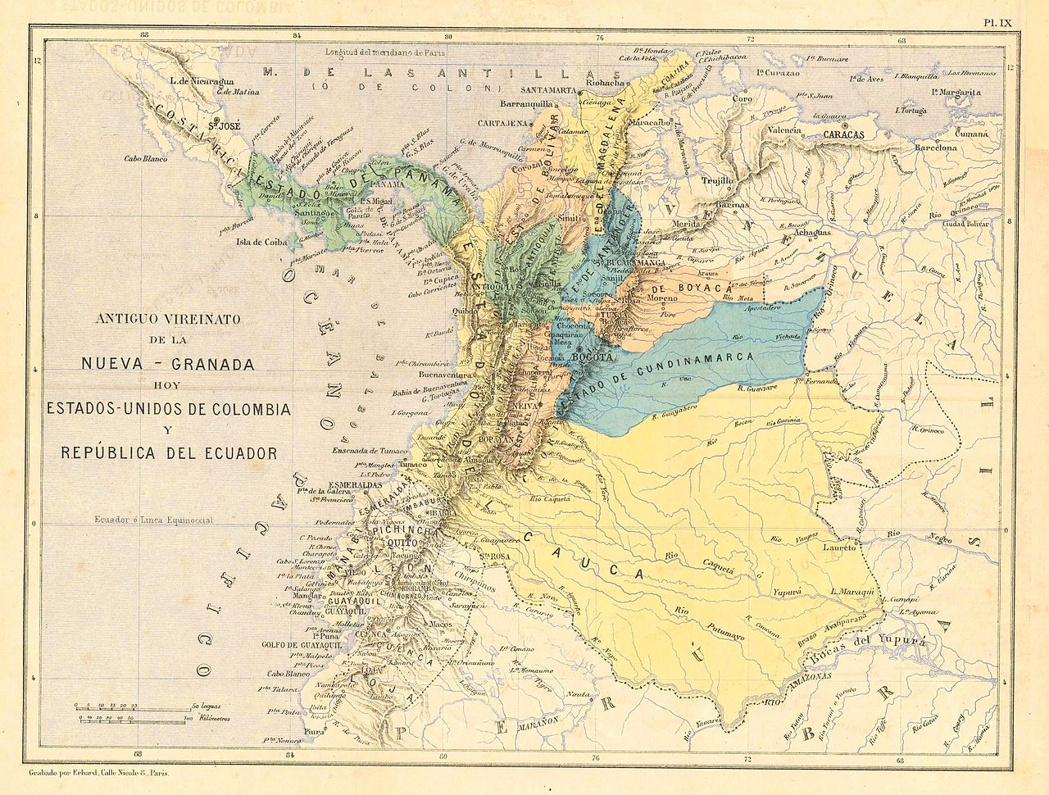
Afro-Colombians of the Cauca and the Liberal Party

Slide 34
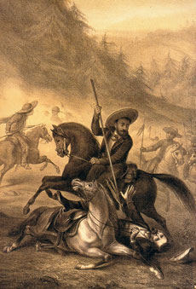
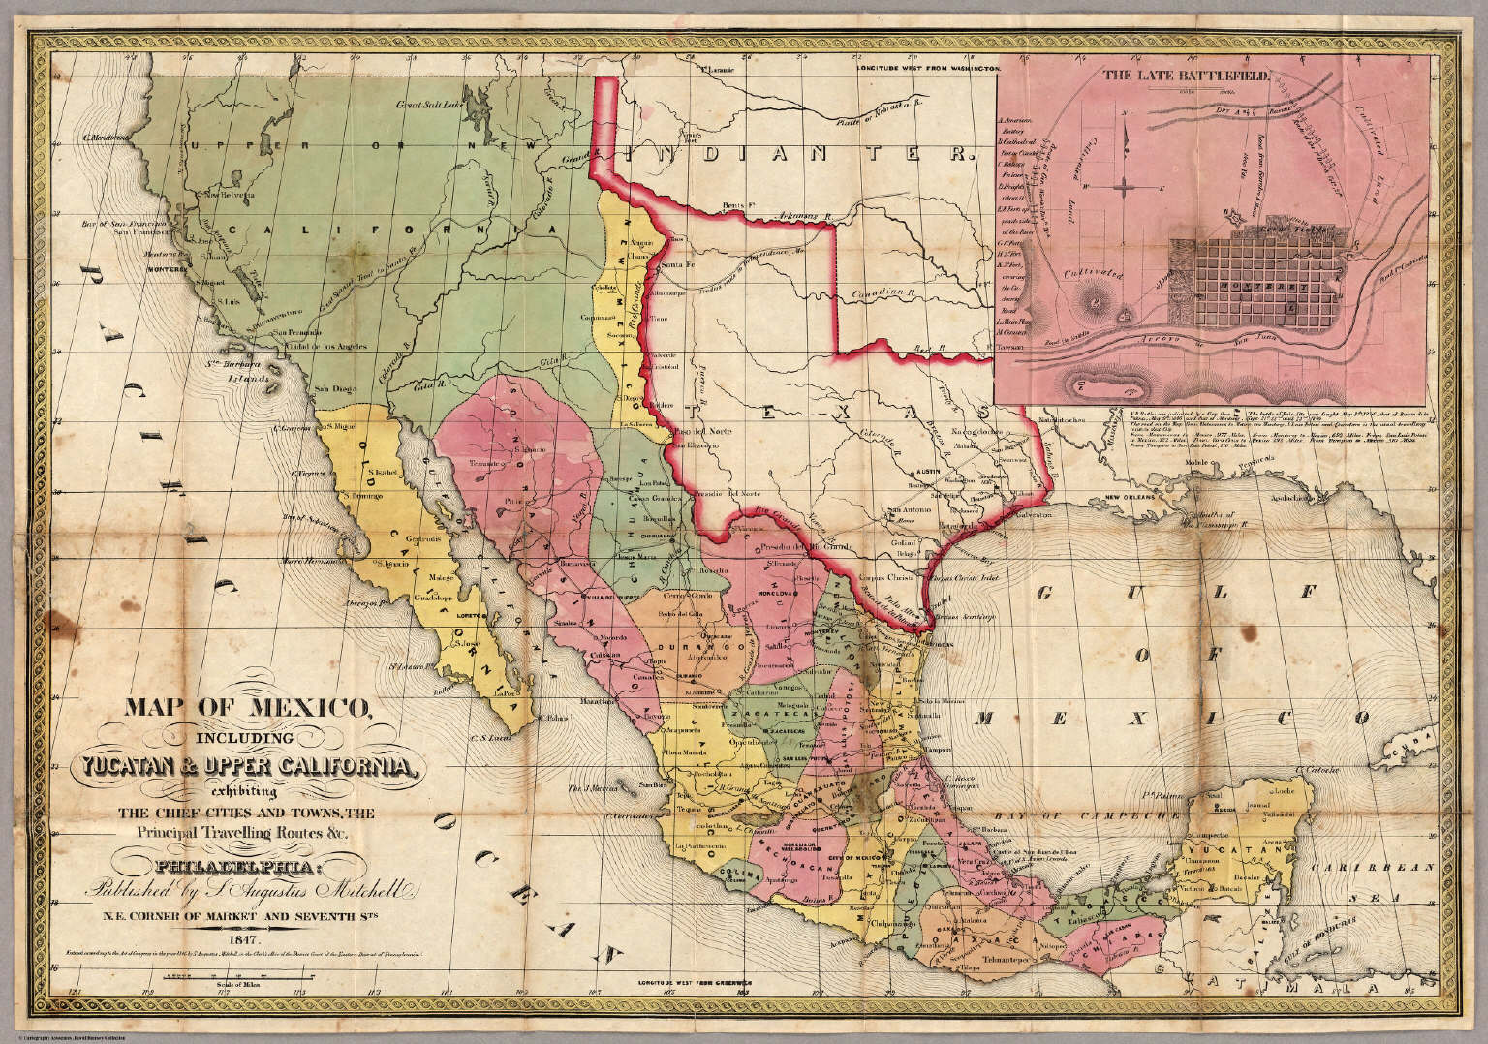
Peasants from Southern Mexico, National Politics and Republican Law

Slide 35
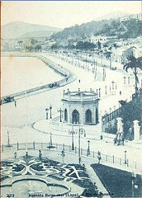
Brazil
Liberal government introduces a new LITERACY qualification to a largely illiterate country (1881)
Reduces suffrage from about 50% of free adult men (10% of total population) to less than 1% of the total population; from over a million voters to 150,000
Positivism (Auguste Comte)
“Progress” (economic, technical)
But, combined with “order”: a small elite group will lead the way; NOT democratic
This generation: abolishes slavery (1888) and topples the monarchy in 1889

Slide 36
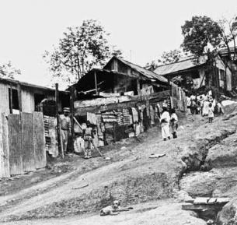
“Scientific” racism and “whitening”
Many abolitionists are also racists (anti-slavery but also anti-slave)
Whiteness is equated with social and economic progress; “whitening” remains the aim until the 1930s; embarrassment/ confusion about how to deal with Brazil’s history of race mixture.

Slide 37
Conservative Liberalism
new post-independence generation of Liberals, around mid-century: urban professionals, some mixed race;
New liberal order
Associación de Mayo in Argentina: Bartolomé Mitre, Domingo Sarmiento, Juan Bautista Alberdi;
The “desert campaigns” in Argentina; exterminations of indigenous people elsewhere, e.g. the Selk’Nam genocide in Tierra del Fuego (Argentina/ Chile)
In Mexico: Benito Juárez and the Lerma de Tejada brothers, architects of La Reforma but mainly Porfirio Diaz and the Porfiriato (1884-1911)
A narrowing of the suffrage in some places: e.g. Colombia 1886

Slide 38
Questions
How democratic were Latin America’s post-Independence nations?
Who participated in politics, and in what ways?
What was liberalism and how did it change over the century?
How did issues of race and slavery affect the development of Latin America’s post-Independence nations?

