Slide 1
Week 3: “Popular democracy” and “conservative liberalism”: the practice of politics in the nineteenth century

Slide 2
Today’s lecture
An overview: the “practice of politics” in Lat Am, from independence to the last decades of the C19. Different approaches to governance; hierarchy
“Popular democracy”: the participation of ordinary people in political life
What is Latin American liberalism?! “Conservative liberalism” of the second half of the century
Case study: Brazil

Slide 3
Section 1: The post-independence context, c.1820s-1850s

Slide 4
What next after independence in the 1820s?
Independence influenced by enlightenment thinking (liberal ideas: political sovereignty, individual liberty…)
But “nations” still under construction: political project, shaped by power relations
Enormous territories; small populations
Firmly-entrenched racial and social hierarchies;
Alliances between elite and popular groups during Wars of Independence: but what next?
Hierarchy is one useful lens through which to see post-independence political struggles.

Slide 5
Economic and social context
Low literacy levels: implications for politics/ citizenship claims
Mostly agricultural and rural populations; low levels of urbanisation and industrialisation (starts to change in latter decades for some countries)
Low economic growth: 0.1% to 1% average from 1800-1860
Instability: civil wars, “caste wars,” border disputes, some external threats / invasions
So: elites turn from theories that allow them to gain independence, to theories that allow for stable governance and economic prosperity…

Slide 6
But who benefits from “stability” and prosperity”?
Land privatisation/ capitalisation (haciendas, latifundias): benefits elite at expense of communally-held lands e.g. ejidos
Small private peasant farms swallowed up; peasants become landless workers with few rights or options

Slide 7
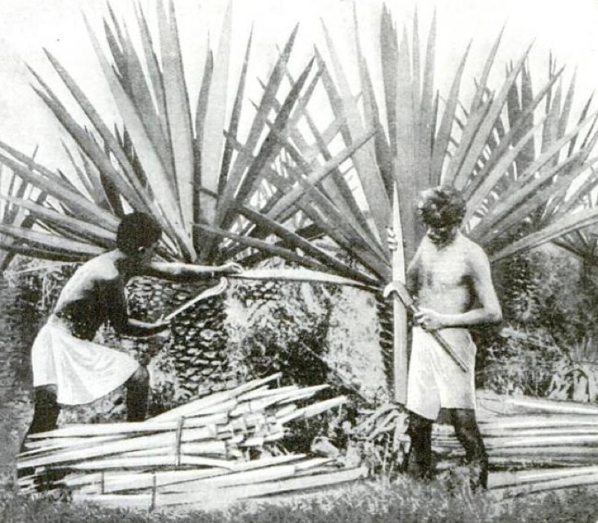
Harvesting henequen to make paper: Yucatan, Mexico, 1922
“How natives of Yucatan, Mexico, harvest henequen, the abundant Sisal hemp that promises to relieve our depleted pulpwood forests in supplying America's enormous demand for newspaper print. The mature plants yield from 12 to 20 stiff, pulpy leaves, which the harvesters cut with sickle shaped knives. About an ounce of marketable fiber is obtained from one leaf.” [1922]
Notes:
Harvesting henequen to make paper. 1922. Wikipedia Commons. Original caption from book: How natives of Yucatan, Mexico, harvest hanequen, the abundant Sisal hemp that promises to relieve our depleted pulpwood forests in supplying America's enormous demand for newspaper print. The mature plants yield from 12 to 20 stiff, pulpy leaves, which the harvesters cut with sickle shaped knives. About an ounce of marketable fiber is obtained from one leaf.

Slide 8
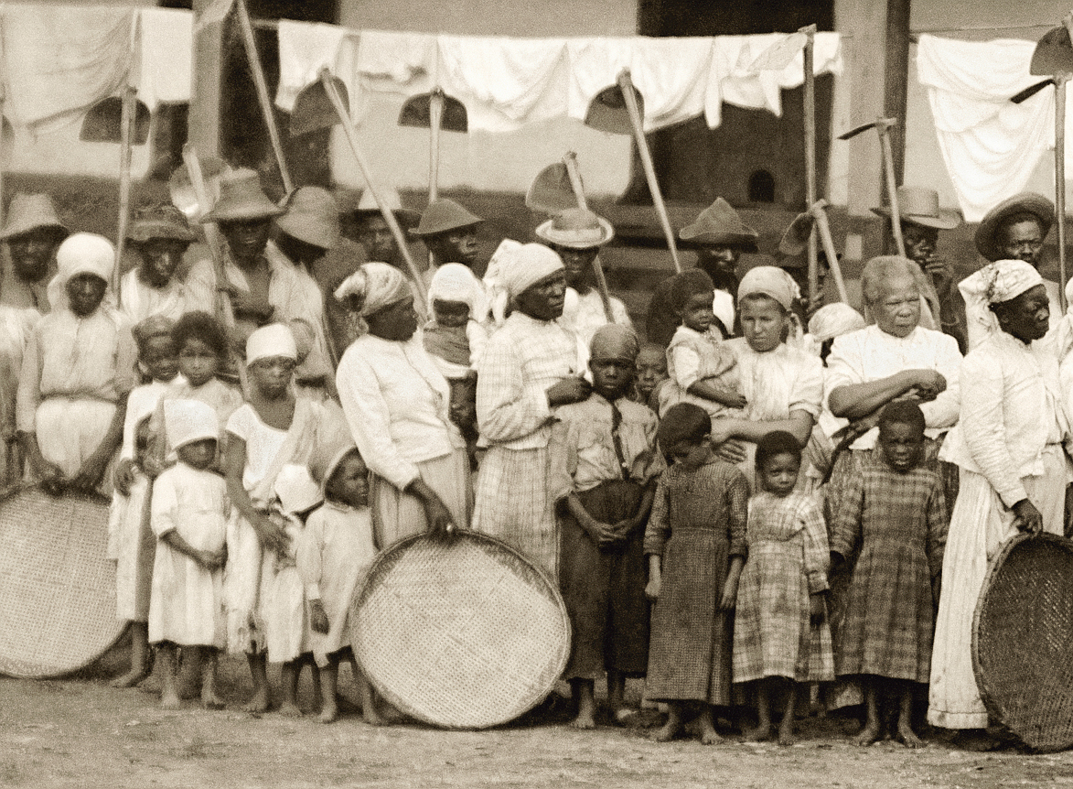

Slide 9
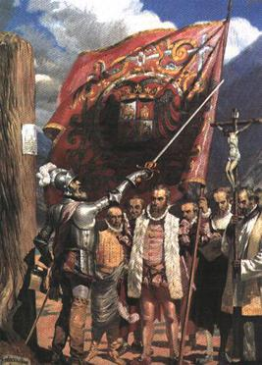
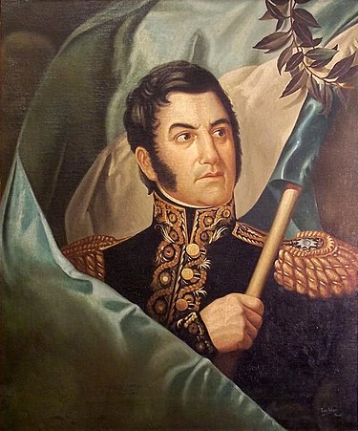
San Martín’s changing views of Peruvian conquistador Francisco Pizarro’s flag
1822:
“the standard that Pizarro carried to enslave the Inca Empire”
1844:
“the standard that the brave Don Francisco Pizarro carried during the conquest of Peru”
Notes:
Earle, “Sobre heroes y tumbas,” 392-3.

Slide 10
“Civilisation” and “barbarism”
Tradition/ Old Order
Absolutism
Subjects
People relate to their ruler through local chieftains
Legitimacy of the ruler is inherited and God given
Contract between ruler and ruled
Corporatism (Brotherhoods, guilds, church, army)
Communal land
Church power
Modernity/ New Order
Constitutionalism
Citizens-elections, laws, constitutions, division of powers
Constitutional and electoral legitimacy
Social contract
Individualism
Private property
Secularism

Slide 11
Federalism v Centralism
Centralism
A natural step, replicating colonial structures?
keep the provinces under control
No disputes over powers of national and provincial governments
Federalism
Best reflects diverse nature of large territories
Liberal like the 1787 U.S
Federalism not secessionism; unity not uniformity; allow divergence to avoid secessionism

Slide 12
Section 2: “Popular democracy”

Slide 13
Popular democracy
The idea that politics isn’t only practised, or influenced, by the elite. Non-elite groups also act “politically”.
Non-elites might include: indigenous and mestizo people; afro-latin americans, enslaved and then free(d); but also poor white people…
Not just a reaction to specific local issues
Not just in thrall to specific individuals e.g. caudillos, coronéis
Concerned with citizenship, constitutions, party politics and platforms

Slide 14
Peter Guardino on peasant unrest in Guerrero, Mexico 1820-46:
Elite writer (Nicolas Bravo) felt that “Indian peasants’ ignorance and passionate hatred of their betters disqualified them from participation in Mexican politics”
Mexico’s elite are “haunted by images of race or ‘caste’ warfare formed first by the Haitian War of Independence and later by Hidalgo’s armies in Mexico itself”
But: “in contrast, the rebels themselves framed their goals in the same constitutional language that defined the national politics of Mexico’s literate upper classes.”
Rebels proclaim: “We understand that our liberty lies in law… The people’s sovereignty asks that republican law rule, not whims.”

Slide 15
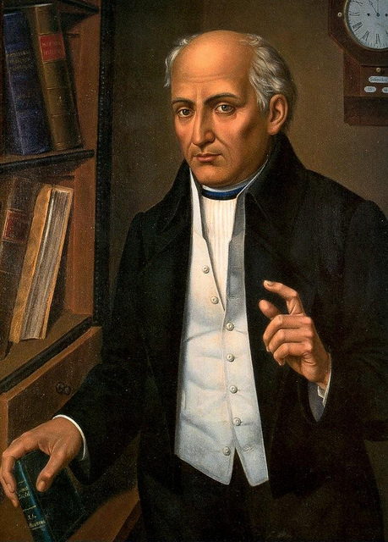
Miguel Hidalgo

Slide 16
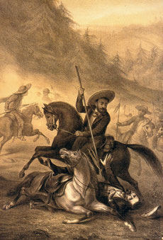
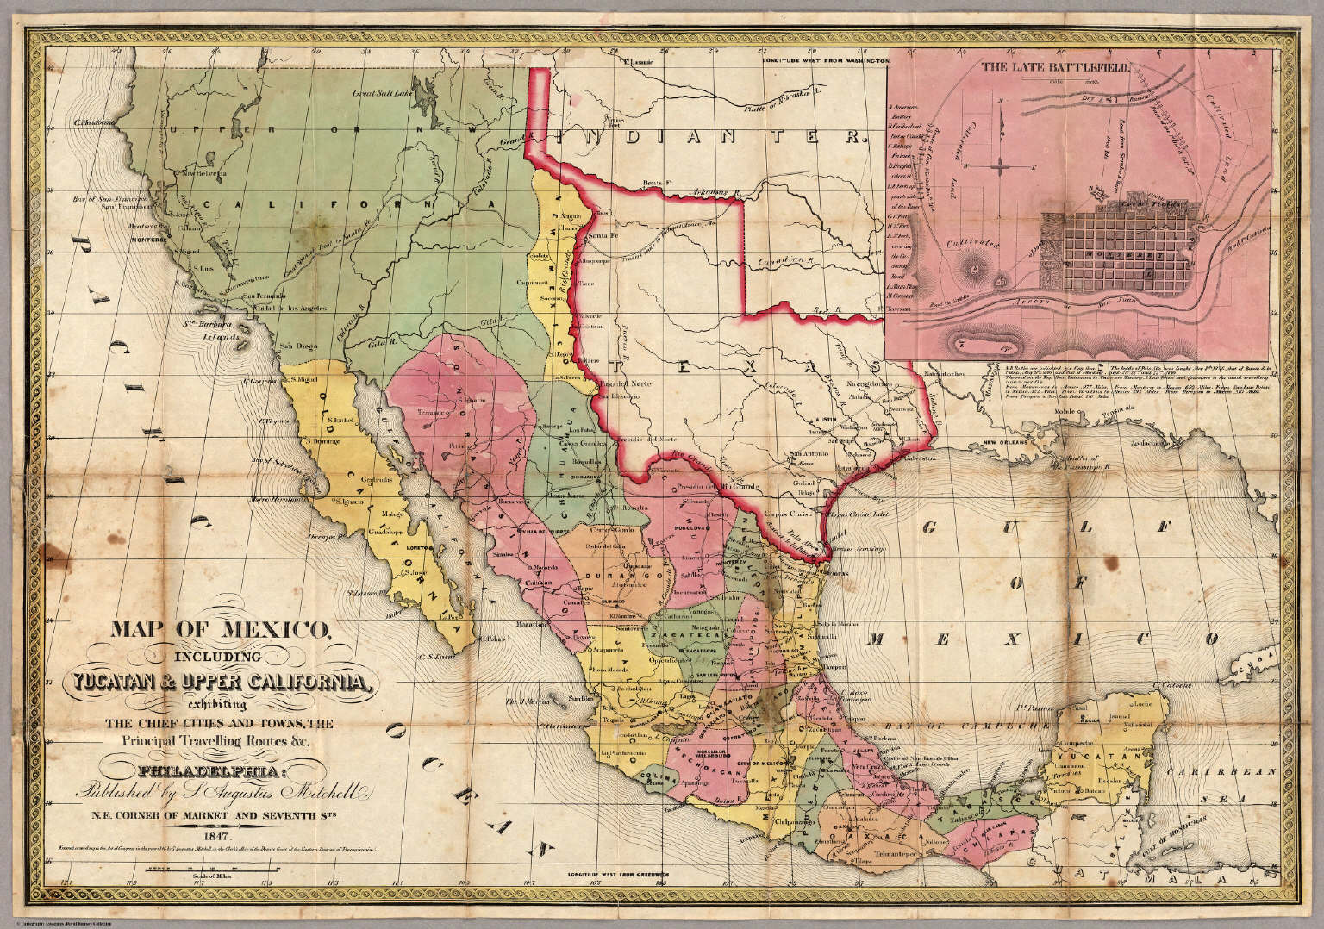
Peasants from Southern Mexico, National Politics and Republican Law

Slide 17
James Sanders on the Cauca region of south-west Colombia, 1820s-1860s:
Liberal Party on national scene is controlled by powerful, white, elite men…
Yet, locally in the Cauca, “Afro-Colombians and other lower-class people transform elite political organisations (the Liberal Party” into ‘their’ party”
Not just exploited for votes or to serve in civil wars, but transformative of the party’s agenda overall.

Slide 18
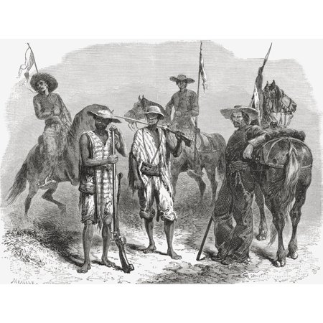
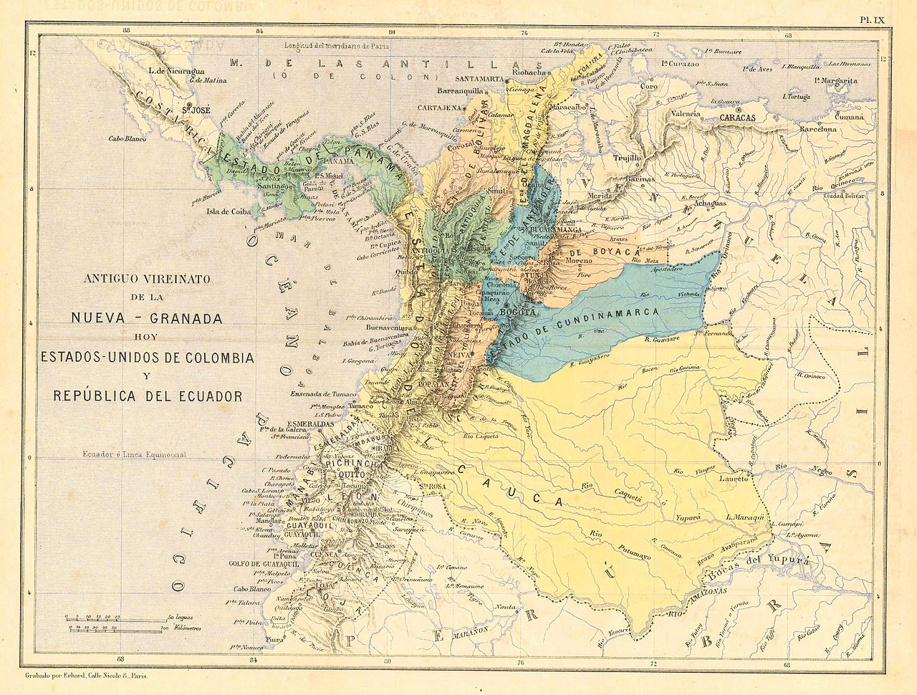
Afro-Colombians of the Cauca and the Liberal Party

Slide 19
“Conservative” liberalism, 1850s-1890s: a contradiction in terms?

Slide 20
1850s onwards: “modernisation”?
Latin American countries are pulled into trade relationship with Europe (some much more than others) (especially Britain; “informal empire”)
European (especially British) demand for:
goods (raw materials for industry/food for cities)
markets for manufactures

Slide 21
Results of new export economies
concentration of land in fewer hands >
- massive loss of traditional Indian land
- growth of latifundios
wage labour and marginalisation of former peasants
urbanisation (e.g. Rio de Janeiro has 275,000 inhabitants by 1872) New urban elite/ middle class/ small proletariat
immigration (to some countries much more than others – Brazil, southern cone, especially Argentina)

Slide 22
Liberalism in Latin America
Meant different things to different people, and changed over time.
A different vision of government/ society than the Catholic monarchy did;
In theory: ideas about individual freedoms and rights; secularism
Potential for democratic change. Liberals generally attack slavery
Liberals enact anticlerical measures across region when in power
Independence era: justifies separation from colonial, monarchical rule. What next?
Growing ‘claims’ made on liberal ideas from ‘below’: democracy; suffrage; economic and social citizenship…?

Slide 23
A conservative turn
new post-independence generation of Liberals, around mid-century: urban professionals, some mixed race;
These people build new liberal order in some Lat Am countries
Asociación de Mayo in Argentina: Bartolomé Mitre, Domingo Sarmiento, Juan Bautista Alberdi;
In Mexico: Benito Juárez and the Lerma de Tejada brothers, architects of La Reforma
BUT these people are often ALSO supporters of, e.g.:
The “desert campaigns” in Argentina; exterminations of indigenous people elsewhere, e.g. the Selk’Nam genocide in Tierra del Fuego (Argentina/ Chile)
A narrowing of the suffrage in some places: e.g. Colombia 1886

Slide 24
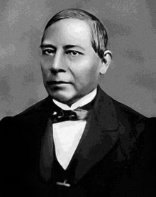
Benito Juárez, the first indigenous president of Mexico

Slide 25
Conservative liberalism (positivism) in Brazil
Liberal government introduces a new LITERACY qualification to a largely illiterate country (1881)
Reduces suffrage from about 50% of free adult men (10% of total population) to less than 1% of the total population;
from over a million voters to 150,000
Development of positivism (derived from European philosopher, August Comte)
New emphasis on “progress” (economic, technical)
But, combined with “order”: a small elite group will lead the way; NOT democratic
This generation: abolishes slavery (1888) and topples the monarchy in 1889

Slide 26

“Order and progress”: the Brazilian flag (from 1889)

Slide 27
Useful reading about positivism
Todd Diacon, Stringing Together a Nation: Candido Mariano da Silva Rondon and the Construction of Modern Brazil, 1906-1930 (Duke University Press, 2004) Introduction & chapter 4 (library scans page)

Slide 28
“Scientific” racism and “whitening”
Many abolitionists are also racists (anti-slavery but also anti-slave)
Whiteness is equated with social and economic progress; “whitening” remains the aim until the 1930s; embarrassment/ confusion about how to deal with Brazil’s history of race mixture.

Slide 29
Liberal Silvio Romero, writing in 1880:
“...future victory in the life struggle among us will belong to the white. ... the white type will continue to predominate by natural selection until it emerges pure and beautiful as in the old world… when it has totally acclimatized on this continent. Two factors will contribute to this process: on the one hand the abolition of the slave trade and the continuous disappearance of the Indians, and on the other hand European immigration!”
Quotation from: Thomas Skidmore, Black into White: Race & Nationality in Brazilian Thought, pp.36-7]

Slide 30
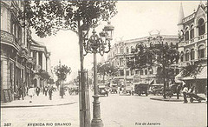
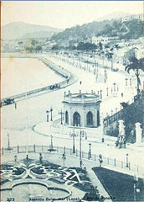
Notes:
Avenida Central and Passeio Publico, c.1905

Slide 31
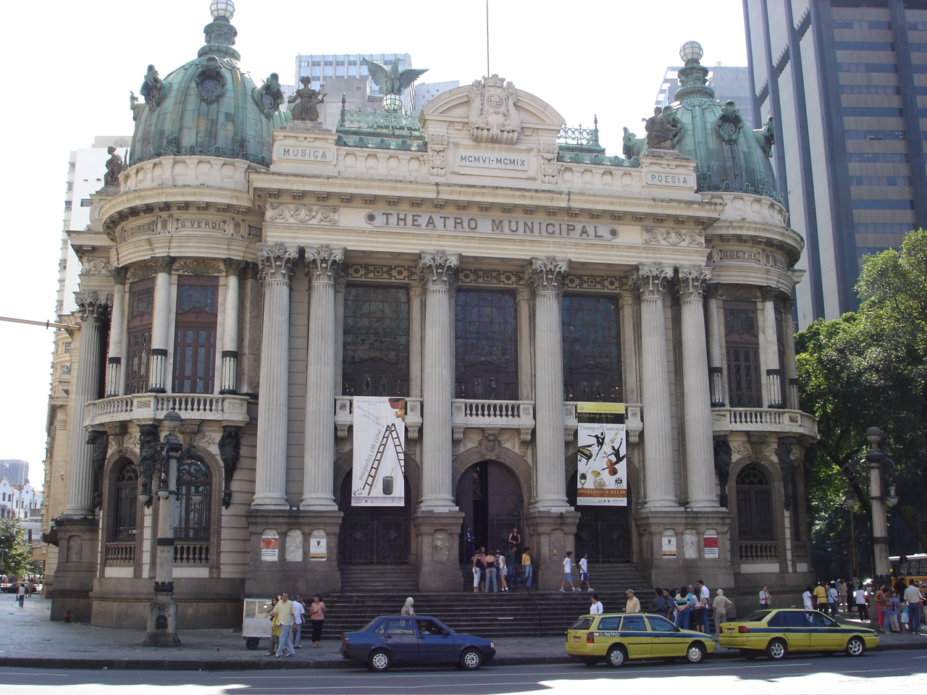

Slide 32
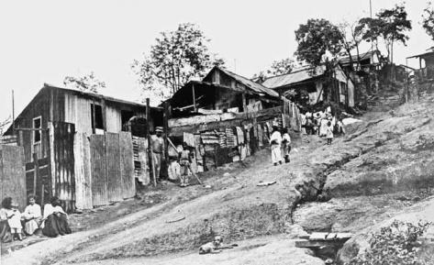
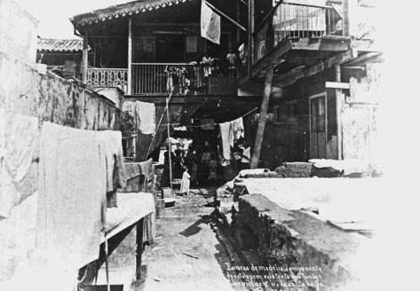
Notes:
Favela Morro do Pinto, Rio de Janeiro, 1912; Augusto Malta, interior de um cortico, 1906, Rio

