Slide 1
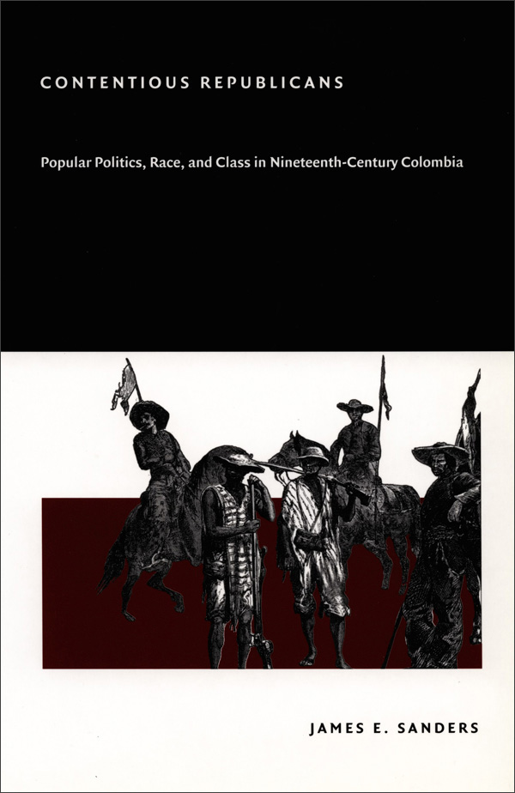
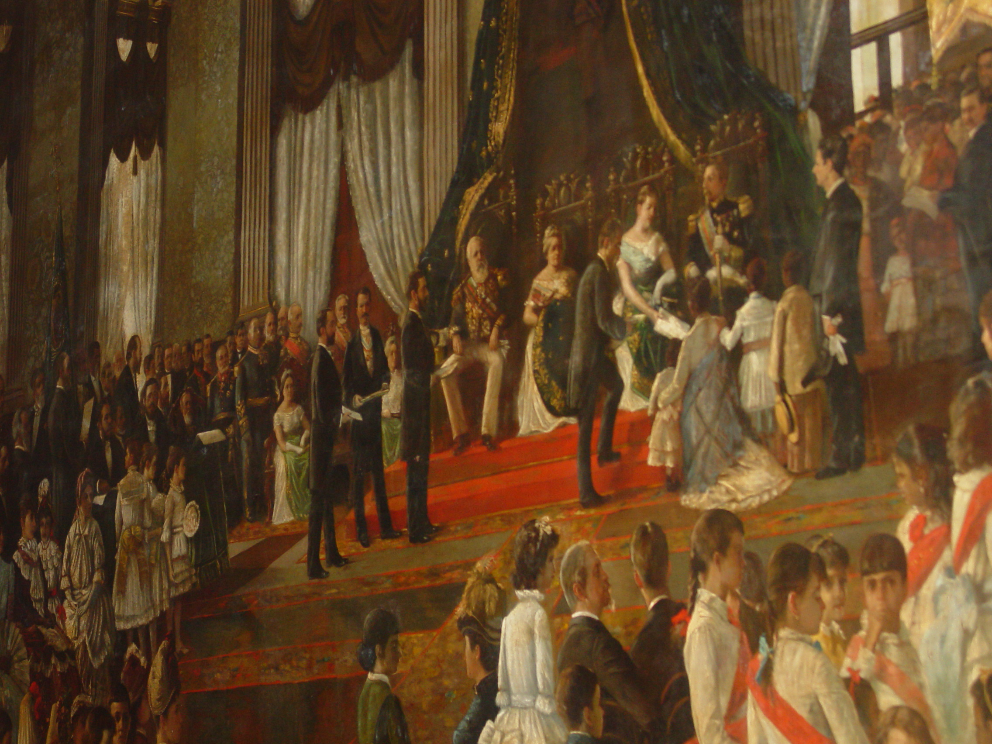
Week 3: The Practice of Politics in Nineteenth-Century Latin America

Slide 2
Readings
Camillia Cowling and Celso Castilho, "Funding Freedom, Popularizing Politics: Abolitionism and Local Emancipation Funds in 1880s Brazil," 2010
Peter Guardino, “Barbarism or Republican Law? Guerrero's Peasants and National Politics, 1820-1846,” Hispanic American Historical Review (Mexico)
James E. Sanders, "Citizens of a Free People": Popular Liberalism and Race in Nineteenth-Century Southwestern Colombia, 2004 (Colombia)

Slide 3
Questions
How democratic were Latin America’s post-Independence nations?
Who participated in politics, and in what ways?
What was liberalism and how did it change over the century?
How did issues of race and slavery affect the development of Latin America’s post-Independence nations?
How did 'your' adopted country compare to these general trends?
How do you think historians' interpretations of popular political participation have changed over time?

