Slide 1
The USA and Latin America
An overview

Slide 2
U.S. influence in Latin America
Economic influence.
U.S. ownership of Latin American companies, lands, raw materials.
U.S. as source of most Latin American imports and exports.
U.S. control of country-specific Latin American economic policies.
Political influence.
Use of variety of strategies – economic, cultural, political, media, dirty tricks – to aid groups, parties or leaders deemed favorable to U.S. economic or political interests.
Use of armed military force in order to overturn regimes deemed unfavorable to the United States.

Slide 3
US President James Monroe's seventh annual message to Congress 2 December 1823 (the ‘Monroe Doctrine’)
‘The occasion has been judged proper for asserting, as a principle in which the rights and interests of the United States are involved, that the American continents, by the free and independent condition which they have assumed and maintain, are henceforth not to be considered as subjects for future colonization by any European powers.’

Slide 4
US President James Monroe's seventh annual message to Congress 2 December 1823 (the ‘Monroe Doctrine’)--continued
‘. . . We owe it, therefore, to candor and to the amicable relations existing between the United States and those powers [the Holy Alliance in Europe] to declare that we should consider any attempt on their part to extend their system to any portion of this hemisphere as dangerous to our peace and safety. With the existing colonies or dependencies of any European power we have not interfered and shall not interfere. But with the Governments who have declared their independence and maintained it, and whose independence we have, on great consideration and on just principles, acknowledged, we could not view any interposition for the purpose of oppressing them, or controlling in any other manner their destiny, by any European power in any other light than as the manifestation of an unfriendly disposition toward the United States.’

Slide 5
Economic Influence
Particularly after 1850, increasing U.S. ownership of Latin American companies and resources.
Concentrated particularly on northern Mexico (mining, agriculture, oil), Central America and the Caribbean (tropical fruits e.g. Standard and United Fruit, sugar, tourism), and Venezuela (oil).
E.g. 1910 A third of northern Mexico belongs to U.S. investors; 1929 U.S. investments account for 67% per cent of Cuba’s agricultural investments; 1930 United Fruit owned 3.5 million acres of Central American land and was the largest landowner in Guatemala (around 1/10 of all the lands in the country)

Slide 6
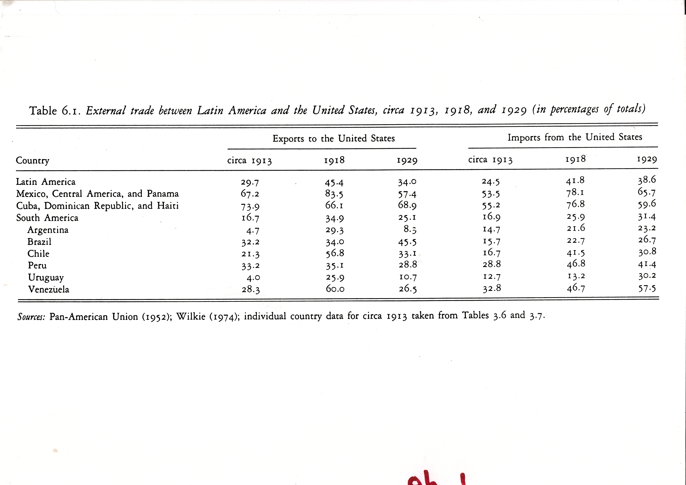
External Trade between Latin America and the USA

Slide 7
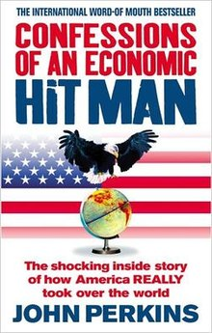
Economic influence
U.S. influence on L.A. countries’ internal
economic policies.
a) Diplomacy.
b) Pressure from international organizations (IMF, World Bank).
c) Dirty tricks.
d) Armed force.

Slide 8
Political Influence
U.S. political influence has been a consistent pressure on Latin American politics going back to the 1820s.
However, U.S. approaches to Latin American have changed in tone and strategy if not overall aim.

Slide 9
U.S. Interventions in Latin America
1846-1900: Expansion and filibustering
1846 U.S. invades Mexico and ends up with a third of Mexico's territory.
1850, 1853, 1854, 1857: U.S. interventions in Nicaragua.
1855: Tennessee adventurer William Walker and his mercenaries take over Nicaragua, institute forced labor, and legalize slavery.
1856: First of five U.S. interventions in Panama to protect the Atlantic-Pacific railroad from Panamanian nationalists.
1898 U.S. declares war on Spain, blaming it for destruction of the Maine. (In 1976, a U.S. Navy commission will conclude that the explosion was probably an accident.) The war enables the U.S. to occupy Cuba, Puerto Rico, Guam, and the Philippines.
! 1948
José Figueres Ferrer wins a short civil war to become President of Costa Rica. Figueres is supported by the U.S., which has informed San José that its forces in the Panama Canal are ready to come to the capital to end "communist control" of Costa Rica.
1954
Jacobo Arbenz Guzmán, elected president of Guatemala, introduces land reform and seizes some idle lands of United Fruit-- proposing to pay for them the value United Fruit claimed on its tax returns. The CIA organizes a small force to overthrow him and begins training it in Honduras. When Arbenz naively asks for U.S. military help to meet this threat, he is refused; when he buys arms from Czechoslovakia it only proves he's a Red.
Guatemala is "openly and diligently toiling to create a Communist state in Central America... only two hours' bombing time from the Panama Canal." --Life
The CIA broadcasts reports detailing the imaginary advance of the "rebel army," and provides planes to strafe the capital. The army refuses to defend Arbenz, who resigns. The U.S.'s hand-picked dictator, Carlos Castillo Armas, outlaws political parties, reduces the franchise, and establishes the death penalty for strikers, as well as undoing Arbenz's land reform. Over 100,000 citizens are killed in the next 30 years of military rule.
"This is the first instance in history where a Communist government has been replaced by a free one." --Richard Nixon
1957
Eisenhower establishes Office of Public Safety to train Latin American police forces.
! 1959
Fidel Castro takes power in Cuba. Several months earlier he had undertaken a triumphal tour through the U.S., which included a CIA briefing on the Red menace.
"Castro's continued tawdry little melodrama of invasion." --Time, of Castro's warnings of an imminent U.S. invasion
1960
Eisenhower authorizes covert actions to get rid of Castro. Among other things, the CIA tries assassinating him with exploding cigars and poisoned milkshakes. Other covert actions against Cuba include burning sugar fields, blowing up boats in Cuban harbors, and sabotaging industrial equipment.
1960
The Canal Zone becomes the focus of U.S. counterinsurgency training.
1960
A new junta in El Salvador promises free elections; Eisenhower, fearing leftist tendencies, withholds recognition. A more attractive right-wing counter-coup comes along in three months.
"Governments of the civil-military type of El Salvador are the most effective in containing communist penetration in Latin America." --John F. Kennedy, after the coup
1960
Guatemalan officers attempt to overthrow the regime of Presidente Fuentes; Eisenhower stations warships and 2000 Marines offshore while Fuentes puts down the revolt. [Another source says that the U.S. provided air support for Fuentes.]
1960s
U.S. Green Berets train Guatemalan army in counterinsurgency techniques. Guatemalan efforts against its insurgents include aerial bombing, scorched-earth assaults on towns suspected of aiding the rebels, and death squads, which killed 20,000 people between 1966 and 1976. U.S. Army Col. John Webber claims that it was at his instigation that "the technique of counter-terror had been implemented by the army."
"If it is necessary to turn the country into a cemetary in order to pacify it, I will not hesitate to do so." --President Carlos Arana Osorio
1961
U.S. organizes force of 1400 anti-Castro Cubans, ships it to the Bahía de los Cochinos. Castro's army routs it.
1961
CIA-backed coup overthrows elected Pres. J. M. Velasco Ibarra of Ecuador, who has been too friendly with Cuba.
1962
CIA engages in campaign in Brazil to keep João Goulart from achieving control of Congress.
1963
CIA-backed coup overthrows elected social democrat Juan Bosch in the Dominican Republic.
1963
A far-right-wing coup in Guatemala, apparently U.S.-supported, forestalls elections in which "extreme leftist" Juan José Arévalo was favored to win.
"It is difficult to develop stable and democratic government [in Guatemala], because so many of the nation's Indians are illiterate and superstitious." --School textbook, 1964
1964
João Goulart of Brazil proposes agrarian reform, nationalization of oil. Ousted by U.S.-supported military coup.
! 1964
The free market in Nicaragua:
The Somoza family controls "about one-tenth of the cultivable land in Nicaragua, and just about everything else worth owning, the country's only airline, one television station, a newspaper, a cement plant, textile mill, several sugar refineries, half-a-dozen breweries and distilleries, and a Mercedes-Benz agency." --Life World Library
1965
A coup in the Dominican Republic attempts to restore Bosch's government. The U.S. invades and occupies the country to stop this "Communist rebellion," with the help of the dictators of Brazil, Paraguay, Honduras, and Nicaragua.
"Representative democracy cannot work in a country such as the Dominican Republic," Bosch declares later. Now why would he say that?
1966
U.S. sends arms, advisors, and Green Berets to Guatemala to implement a counterinsurgency campaign.
"To eliminate a few hundred guerrillas, the government killed perhaps 10,000 Guatemalan peasants." --State Dept. report on the program
1967
A team of Green Berets is sent to Bolivia to help find and assassinate Che Guevara.
1968
Gen. José Alberto Medrano, who is on the payroll of the CIA, organizes the ORDEN paramilitary force, considered the precursor of El Salvador's death squads.
! 1970
In this year (just as an example), U.S. investments in Latin America earn $1.3 billion; while new investments total $302 million.
1970
Salvador Allende Gossens elected in Chile. Suspends foreign loans, nationalizes foreign companies. For the phone system, pays ITT the company's minimized valuation for tax purposes. The CIA provides covert financial support for Allende's opponents, both during and after his election.
1972
U.S. stands by as military suspends an election in El Salvador in which centrist José Napoleón Duarte was favored to win. (Compare with the emphasis placed on the 1982 elections.)
1973
U.S.-supported military coup kills Allende and brings Augusto Pinochet Ugarte to power. Pinochet imprisons well over a hundred thousand Chileans (torture and rape are the usual methods of interrogation), terminates civil liberties, abolishes unions, extends the work week to 48 hours, and reverses Allende's land reforms.
1973
Military takes power in Uruguay, supported by U.S. The subsequent repression reportedly features the world's highest percentage of the population imprisoned for political reasons.
1974
Office of Public Safety is abolished when it is revealed that police are being taught torture techniques.
! 1976
Election of Jimmy Carter leads to a new emphasis on human rights in Central America. Carter cuts off aid to the Guatemalan military (or tries to; some slips through) and reduces aid to El Salvador.
! 1979
Ratification of the Panama Canal treaty which is to return the Canal to Panama by 1999.
"Once again, Uncle Sam put his tail between his legs and crept away rather than face trouble." --Ronald Reagan
1980
A right-wing junta takes over in El Salvador. U.S. begins massively supporting El Salvador, assisting the military in its fight against FMLN guerrillas. Death squads proliferate; Archbishop Romero is assassinated by right-wing terrorists; 35,000 civilians are killed in 1978-81. The rape and murder of four U.S. churchwomen results in the suspension of U.S. military aid for one month.
The U.S. demands that the junta undertake land reform. Within 3 years, however, the reform program is halted by the oligarchy.
"The Soviet Union underlies all the unrest that is going on." --Ronald Reagan
1980
U.S., seeking a stable base for its actions in El Salvador and Nicaragua, tells the Honduran military to clean up its act and hold elections. The U.S. starts pouring in $100 million of aid a year and basing the contras on Honduran territory.
Death squads are also active in Honduras, and the contras tend to act as a state within a state.
1981
The CIA steps in to organize the contras in Nicaragua, who started the previous year as a group of 60 ex-National Guardsmen; by 1985 there are about 12,000 of them. 46 of the 48 top military leaders are ex-Guardsmen. The U.S. also sets up an economic embargo of Nicaragua and pressures the IMF and the World Bank to limit or halt loans to Nicaragua.
1981
Gen. Torrijos of Panama is killed in a plane crash. There is a suspicion of CIA involvement, due to Torrijos' nationalism and friendly relations with Cuba.
1982
A coup brings Gen. Efraín Ríos Montt to power in Guatemala, and gives the Reagan administration the opportunity to increase military aid. Ríos Montt's evangelical beliefs do not prevent him from accelerating the counterinsurgency campaign.
1983
Another coup in Guatemala replaces Ríos Montt. The new President, Oscar Mejía Víctores, was trained by the U.S. and seems to have cleared his coup beforehand with U.S. authorities.
1983
U.S. troops take over tiny Granada. Rather oddly, it intervenes shortly after a coup has overthrown the previous, socialist leader. One of the justifications for the action is the building of a new airport with Cuban help, which Granada claimed was for tourism and Reagan argued was for Soviet use. Later the U.S. announces plans to finish the airport... to develop tourism.
1983
Boland Amendment prohibits CIA and Defense Dept. from spending money to overthrow the government of Nicaragua-- a law the Reagan administration cheerfully violates.
1984
CIA mines three Nicaraguan harbors. Nicaragua takes this action to the World Court, which brings an $18 billion judgment against the U.S. The U.S. refuses to recognize the Court's jurisdiction in the case.
1984
U.S. spends $10 million to orchestrate elections in El Salvador-- something of a farce, since left-wing parties are under heavy repression, and the military has already declared that it will not answer to the elected president.
1989
U.S. invades Panama to dislodge CIA boy gone wrong Manuel Noriega, an event which marks the evolution of the U.S.'s favorite excuse from Communism to drugs.
1996
The U.S. battles global Communism by extending most-favored-nation trading status for China, and tightening the trade embargo on Castro's Cuba.

Slide 10
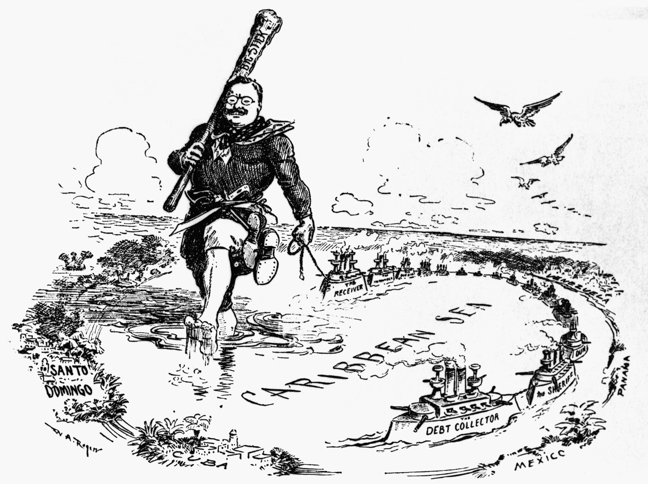
1900-1930s: ‘the big stick’
Teddy Roosevelt

Slide 11
US President Theodore Roosevelt (1904)
‘If a nation shows that it knows how to act with decency in industrial and political matters, if it keeps order and pays its obligations, then it need fear no interference from the US. Brutal wrongdoing, or an impotence which results in a general loosening of the ties of civilized society, may finally require intervention by some civilized nation, and in the Western Hemisphere the US cannot ignore this duty.’

Slide 12
After the U.S.-Spanish war, U.S. armed forces openly intervene in Latin America
1903: The Platt Amendment inserted into the Cuban constitution grants the U.S. the right to intervene.
1903: U.S. sends warships to acquire land for Panama Canal from Colombia.
1904: U.S. sends customs agents to take over finances of the Dominican Republic to assure payment of its external debt.
1905: U.S. troops invade Honduras for the first of 5 times in next 20 years.
1906: Marines occupy Cuba for two years in order to prevent a civil war.
1907: Marines intervene in Honduras to settle a war with Nicaragua.
1908: U.S. troops intervene in Panama for first of 4 times in next decade.
1909: U.S. forces President Zelaya of Nicaragua to resign for suggesting that U.S. companies pay taxes. The new president is former treasurer of U.S. mining company.
1910 U.S. Marines occupy Nicaragua to help support the new regime.
1911: U.S. backs overturning of Honduran government by U.S. mercenaries and U.S. banana company.

Slide 13
1912: U.S. Marines intervene in Cuba to put down a rebellion of sugar workers.
1912: Nicaragua occupied again by the U.S.
1914: U.S. occupies Mexican port of Veracruz.
1915: U.S. Marines occupy Haiti to restore order, and establish a protectorate which lasts till 1934. The president of Haiti is barred from the U.S. Officers' Club in Port-au-Prince, because he is black.
1916: Marines occupy the Dominican Republic, staying till 1924.
1917: U.S. troops invade Mexico to pursue Pancho Villa.
1917: Marines intervene in Cuba, to guarantee sugar exports during WWI.
1918: U.S. Marines occupy Panamanian province of Chiriqui for two years to maintain public order.
1925: U.S. Army troops occupy Panama.
1926: Marines occupy Nicaragua again.
"There is no room for any outside influence other than ours in this region. We could not tolerate such a thing without incurring grave risks... Until now Central America has always understood that governments which we recognize and support stay in power, while those which we do not recognize and support fall. Nicaragua has become a test case. It is difficult to see how we can afford to be defeated." --Undersecretary of State Robert Olds
1932: The U.S. rushes warships to El Salvador in response to a communist-led uprising.

Slide 14
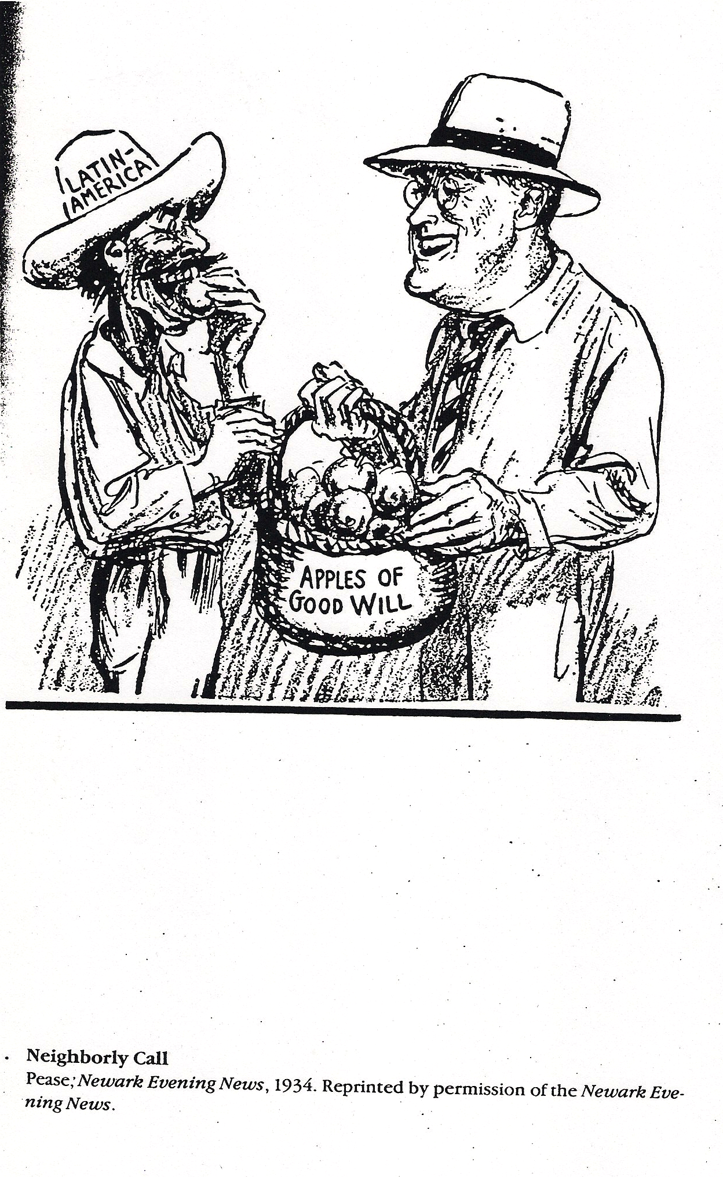
1930s: the ‘good neighbor’
‘Neighborly Call’ (1934)
‘Neighborly Call’ (1934)

Slide 15
US Secretary of State Cordell Hull (1934)
‘It has for many years been said that the United States has sought to impose its own views upon the Central American states, and that to this end it has not hesitated to interfere or intervene in their affairs. . . We therefore desire not only to refrain in fact from any interference, but also from any measure which might seem to give the appearance of such interference.’

Slide 16
During the Good Neighbor years, the U.S. does allow a degree of social and political reform within Latin American societies.
E.g. Mexico nationalizes petroleum industry (1938) and expropriates U.S.-owned lands (1936-1940); Platt Amendment removed from Cuban Constitution (1934); Marines leave Nicaragua; Guatemala, Peru, and Brazil all elect left-leaning, nationalist governments.

Slide 17
BUT, in some areas interference continues:
1933 U.S. refuses to recognize Cuban government as too left-wing. Backs coup by Fulgencio Batista who becomes US backed dictator.
1934: Nicaraguan freedom fighter, Sandino, is murdered by US trained military dictator, Somoza. U.S. allow Somoza to become president of Nicaragua.
1941: Military coup in Panama. Military leader, Ricardo Adolfo de la Guardia, clears coup with US ambassador.
1944: Police chief of El Salvador ousts left-leaning government in a coup. U.S. immediately recognizes government as legitimate.

Slide 18
Cold War
‘Where the concepts and traditions of popular government are too weak to absorb successfully the intensity of the communist attacks, then we must concede that harsh government measures of repression may be the only answer.’
George Kennan (US historian and cold war diplomat) 1950

Slide 19
Woodrow Wilson Foundation at Harvard University 1955
‘The real threat of communism is the economic transformation of the Communist powers in ways which reduce their willingness and ability to complement the industrial economies of the West.’

Slide 20
Cold War
School of the Americas established 1946 in the US-controlled zone within Panama. Currently located in Georgia. Has trained over 57,000 Latin American military officers.
‘National Security Doctrine’: only the military can be trusted to defend Latin America against communism—democracy was seen as unreliable and inefficient.

Slide 21
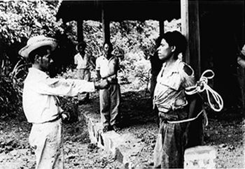
1954
US-supported overthrow of the democratically-elected government of Jacobo Arbenz in Guatemala
https://www.youtube.com/watch?v=uVkthJcKQxg

Slide 22
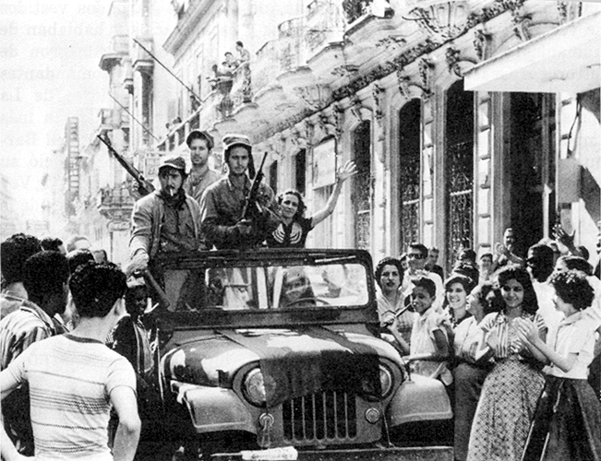
The Cuban Revolution (1959)
Cuban revolutionaries ride into Havana on 1 January 1959

Slide 23
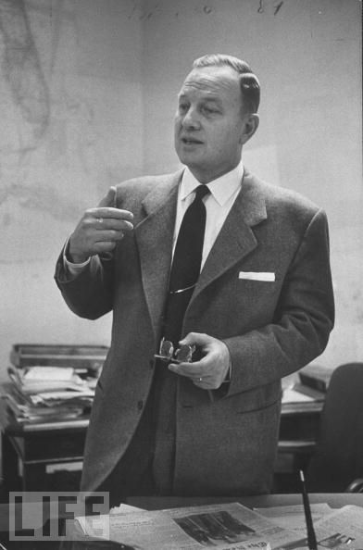
Roy Rubottom, Assistant Secretary for Inter-American Affairs (1960)
‘In June we had reached the decision that it was not possible to achieve our objectives with Castro in power.’

Slide 24
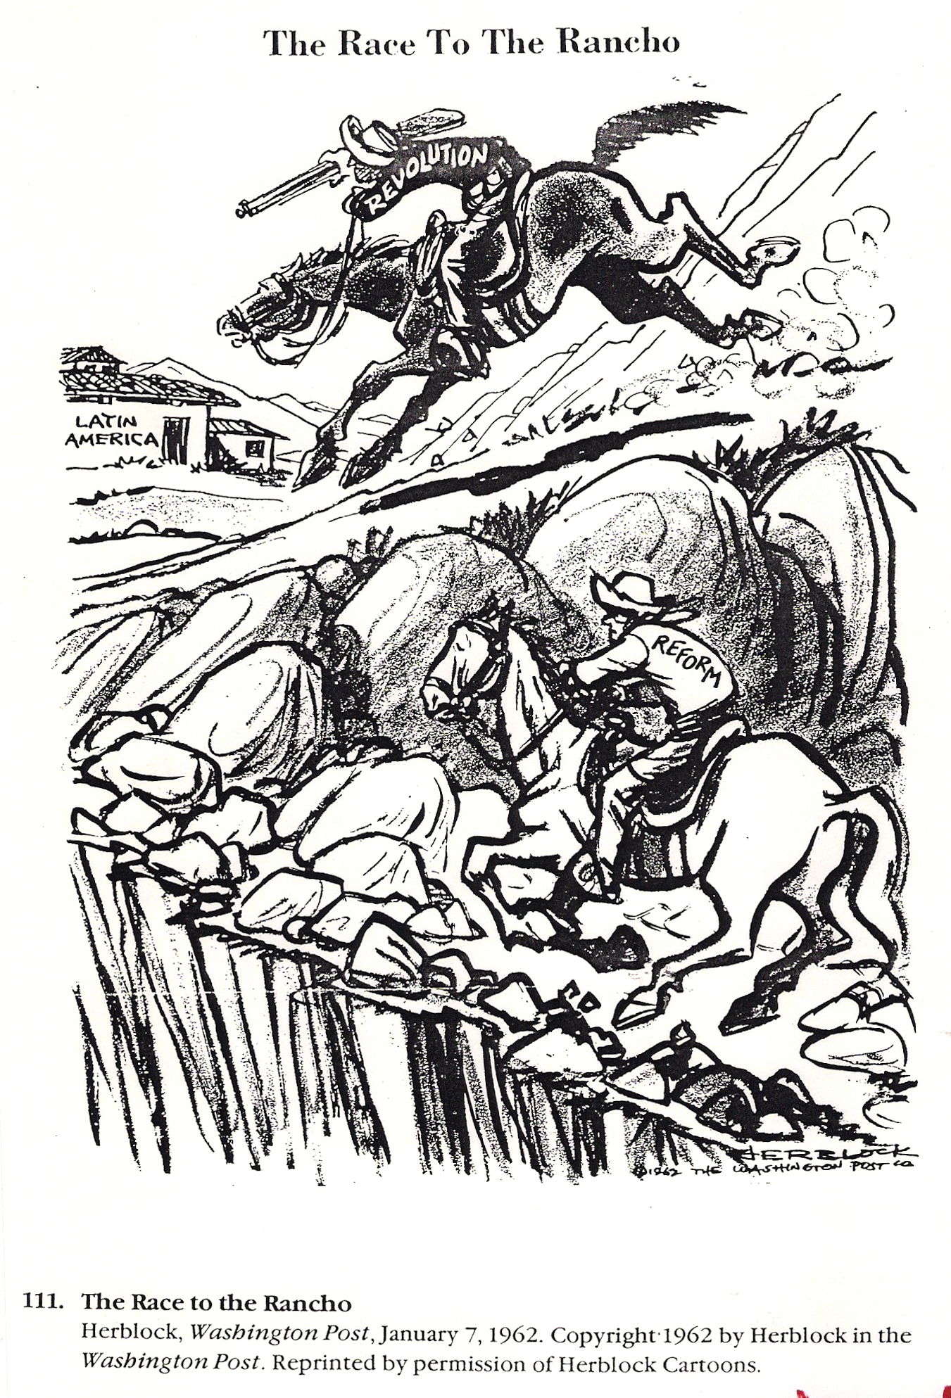
1961 Alliance for Progress formed
‘The Race to the Rancho’ (1962)

Slide 25
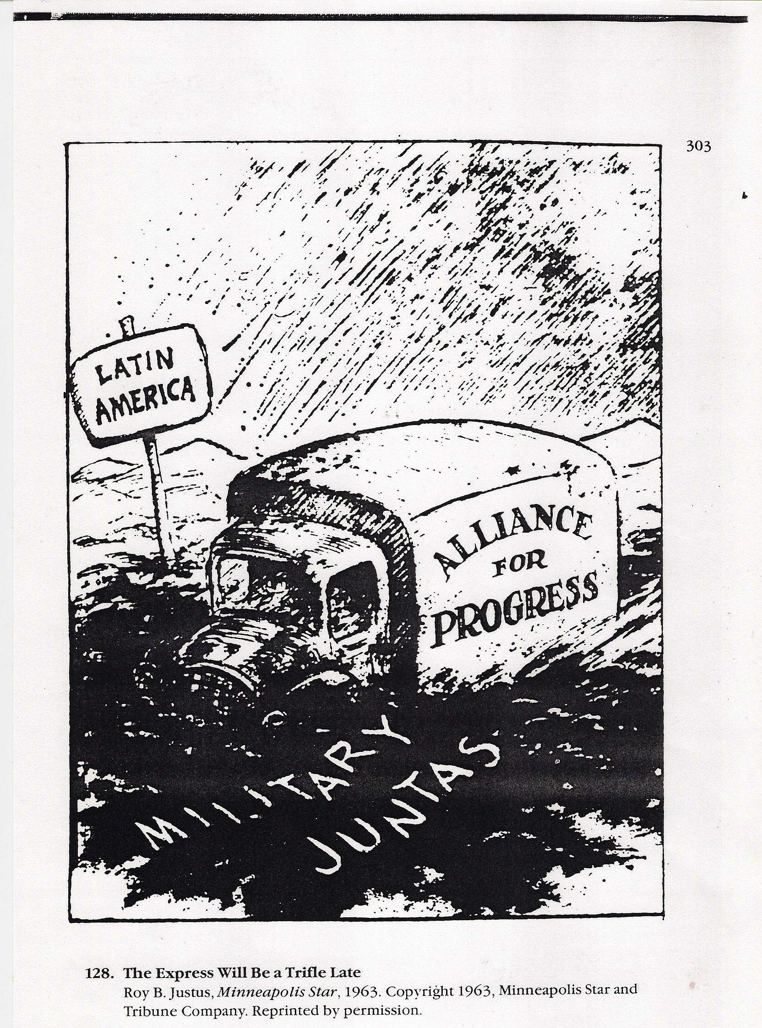
‘The Express Will Be A Trifle Late’ (1963)

Slide 26
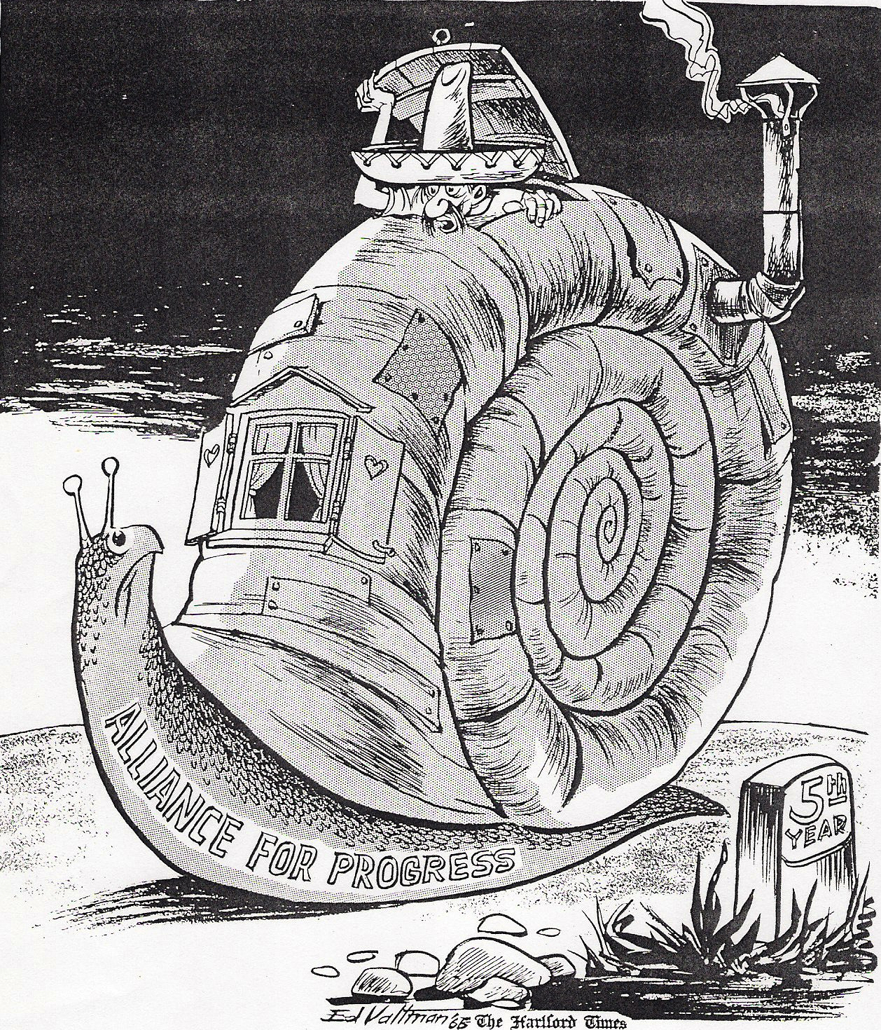
‘Were Are We?’ (1968)

Slide 27
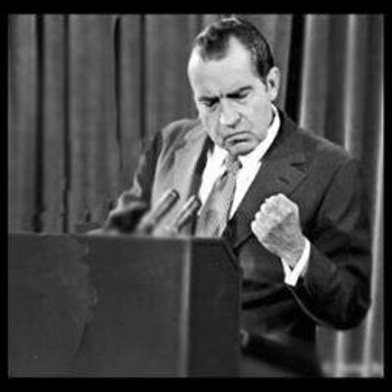
Richard Nixon on Latin America (1968)
‘Don’t trust them, you can’t trust them. They’re all a bunch of kooks.’

Slide 28
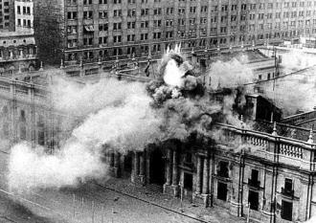
Rise of Military dictatorships: 1970s
1973 military coup in Chile
Chilean military attack the presidential palace

Slide 29
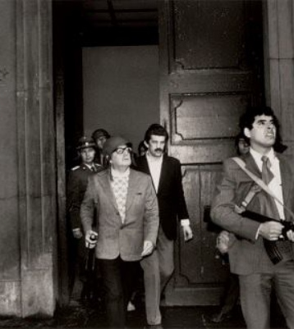
Rise of Military dictatorships: 1970s
1973 military coup in Chile
President Dr. Salvador Allende in the Chilean capital during the coup.

Slide 30
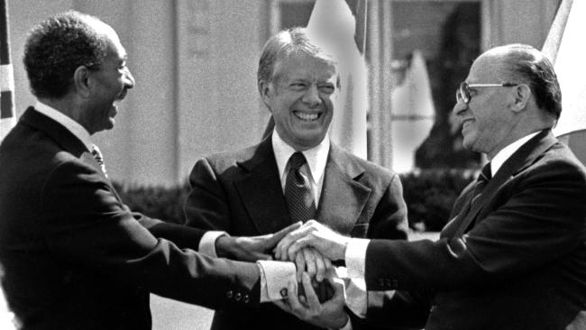
US President Jimmy Carter 1977 (‘human-rights based foreign policy’)
‘You will find the United States eager to stand beside those nations which respect human rights and promote democratic ideals.’
Camp David agreements between Israel and Egypt, 1978

Slide 31
1900s Teddy Roosevelt and the ‘big stick’
1930s Franklin Delano Roosevelt and the
‘good neighbor’ policy
1944-
1950s Cold War
1960s Alliance for Progress
(launched 1961)
1970s-
1980s Return of Aggressive Cold War Policies
regular US military intervention on Latin America
US cooperation with dictators
1954 coup in Guatemala
Cuban Revolution
1970s military dictatorships
(eg. 1973 military coup in Chile)
1980s US-backed contra-revolutionaries in
Nicaragua

Slide 32
“Dependency Theory”
Radical economists, using Latin America as an example, argue that certain “core” economic countries keep the world’s “peripheral” countries underdeveloped by
extracting raw materials at a low price,
developing these raw materials into manufactured goods in the core countries,
then selling them back to peripheral countries.
Often aided by certain economically elite groups in these peripheral countries.

Slide 33
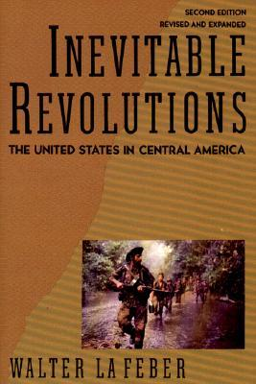
Walter LaFeber’s idea of ‘inevitable revolutions’
‘Unable to deal with the products of its own system, reconcile the contradiction between its professed ideals and its century-old foreign policy, or work with other nations to resolve these dilemmas, the United States, from Eisenhower to Bush, has resorted to force. The result has been more revolution.’

