Slide 1
The USA and Latin America
An overview

Slide 2
US President James Monroe's seventh annual message to Congress 2 December 1823 (the ‘Monroe Doctrine’)
‘The occasion has been judged proper for asserting, as a principle in which the rights and interests of the United States are involved, that the American continents, by the free and independent condition which they have assumed and maintain, are henceforth not to be considered as subjects for future colonization by any European powers.’

Slide 3
US President James Monroe's seventh annual message to Congress 2 December 1823 (the ‘Monroe Doctrine’)--continued
‘. . . We owe it, therefore, to candor and to the amicable relations existing between the United States and those powers [the Holy Alliance in Europe] to declare that we should consider any attempt on their part to extend their system to any portion of this hemisphere as dangerous to our peace and safety. With the existing colonies or dependencies of any European power we have not interfered and shall not interfere. But with the Governments who have declared their independence and maintained it, and whose independence we have, on great consideration and on just principles, acknowledged, we could not view any interposition for the purpose of oppressing them, or controlling in any other manner their destiny, by any European power in any other light than as the manifestation of an unfriendly disposition toward the United States.’

Slide 4
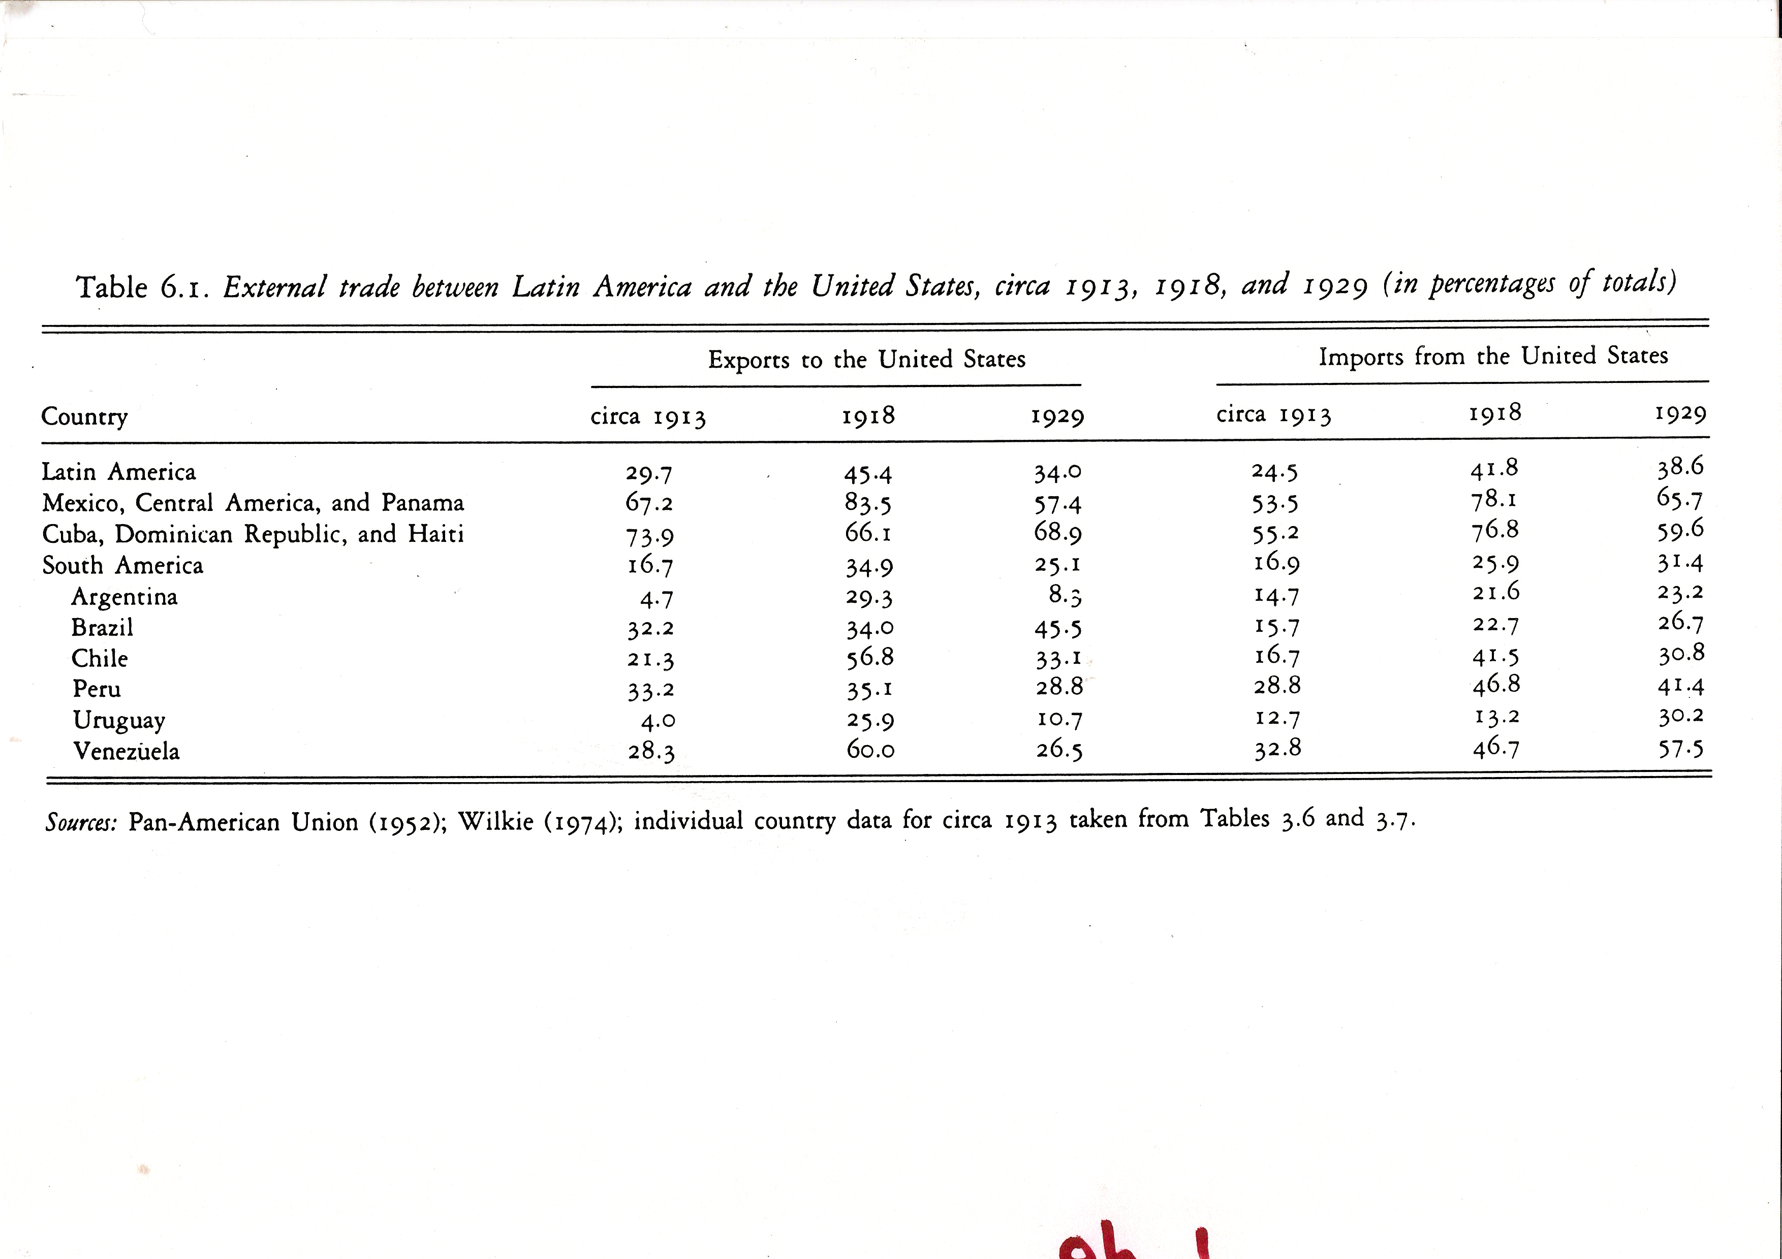
External Trade between Latin America and the USA

Slide 5
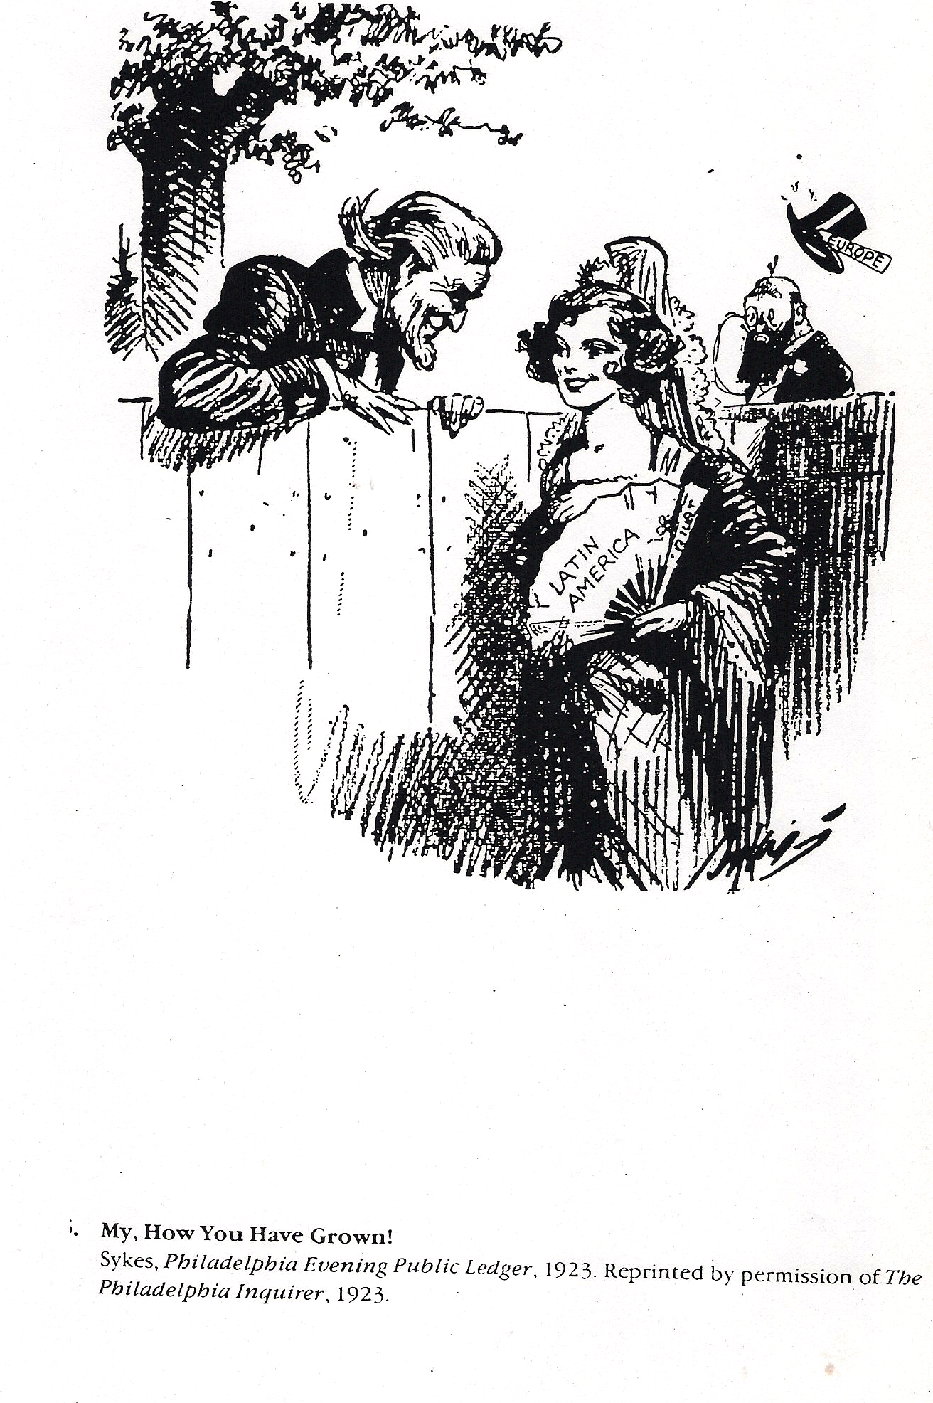
‘My, How You Have Grown!’ (1923)

Slide 6
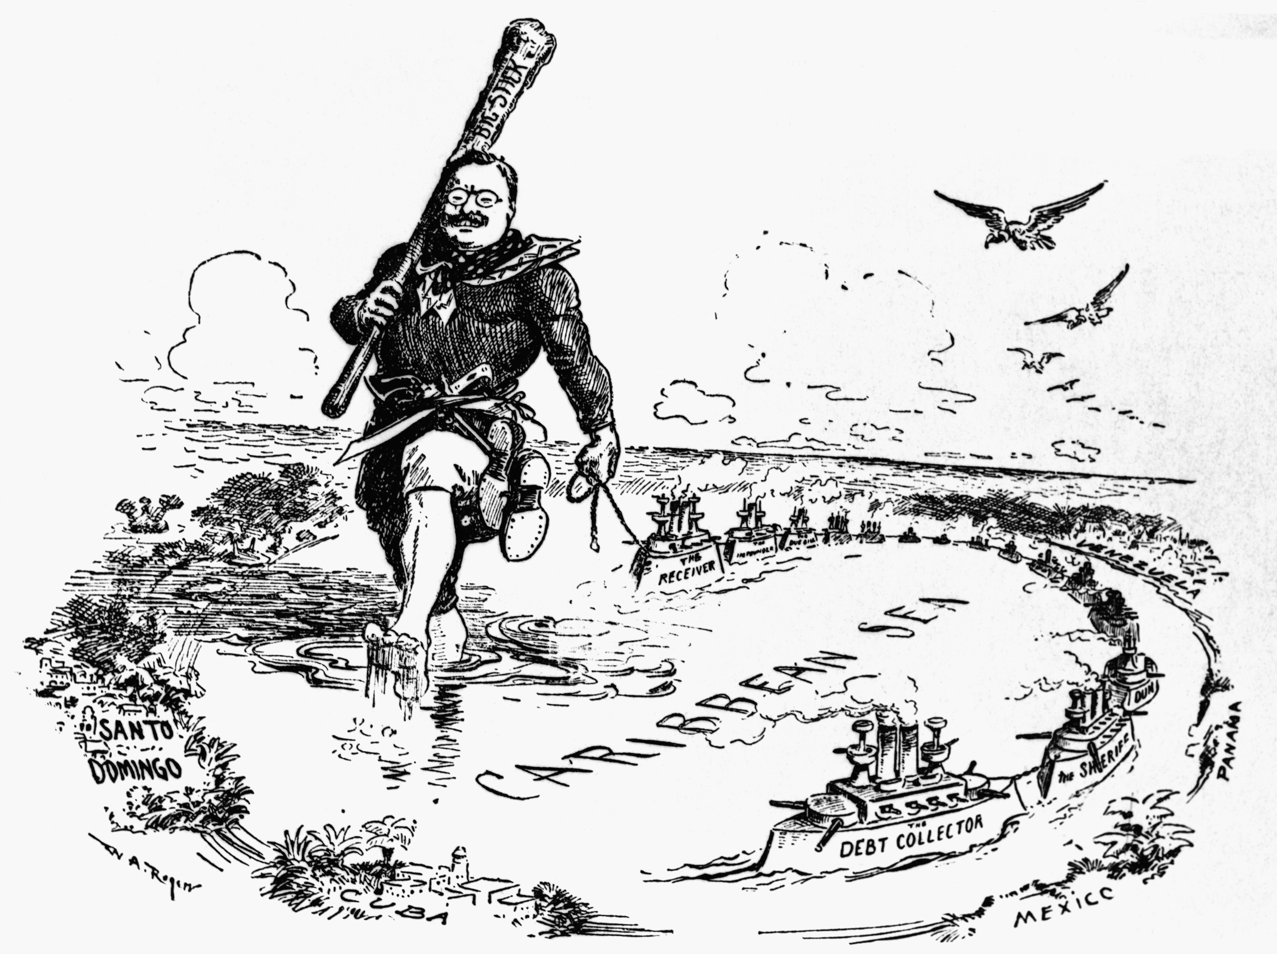
1900-1930s: ‘the big stick’
Teddy Roosevelt
http://www.yachana.org/teaching/resources/interventions.html

Slide 7
US President Theodore Roosevelt (1904)
‘If a nation shows that it knows how to act with decency in industrial and political matters, if it keeps order and pays its obligations, then it need fear no interference from the US. Brutal wrongdoing, or an impotence which results in a general loosening of the ties of civilized society, may finally require intervention by some civilized nation, and in the Western Hemisphere the US cannot ignore this duty.’

Slide 8
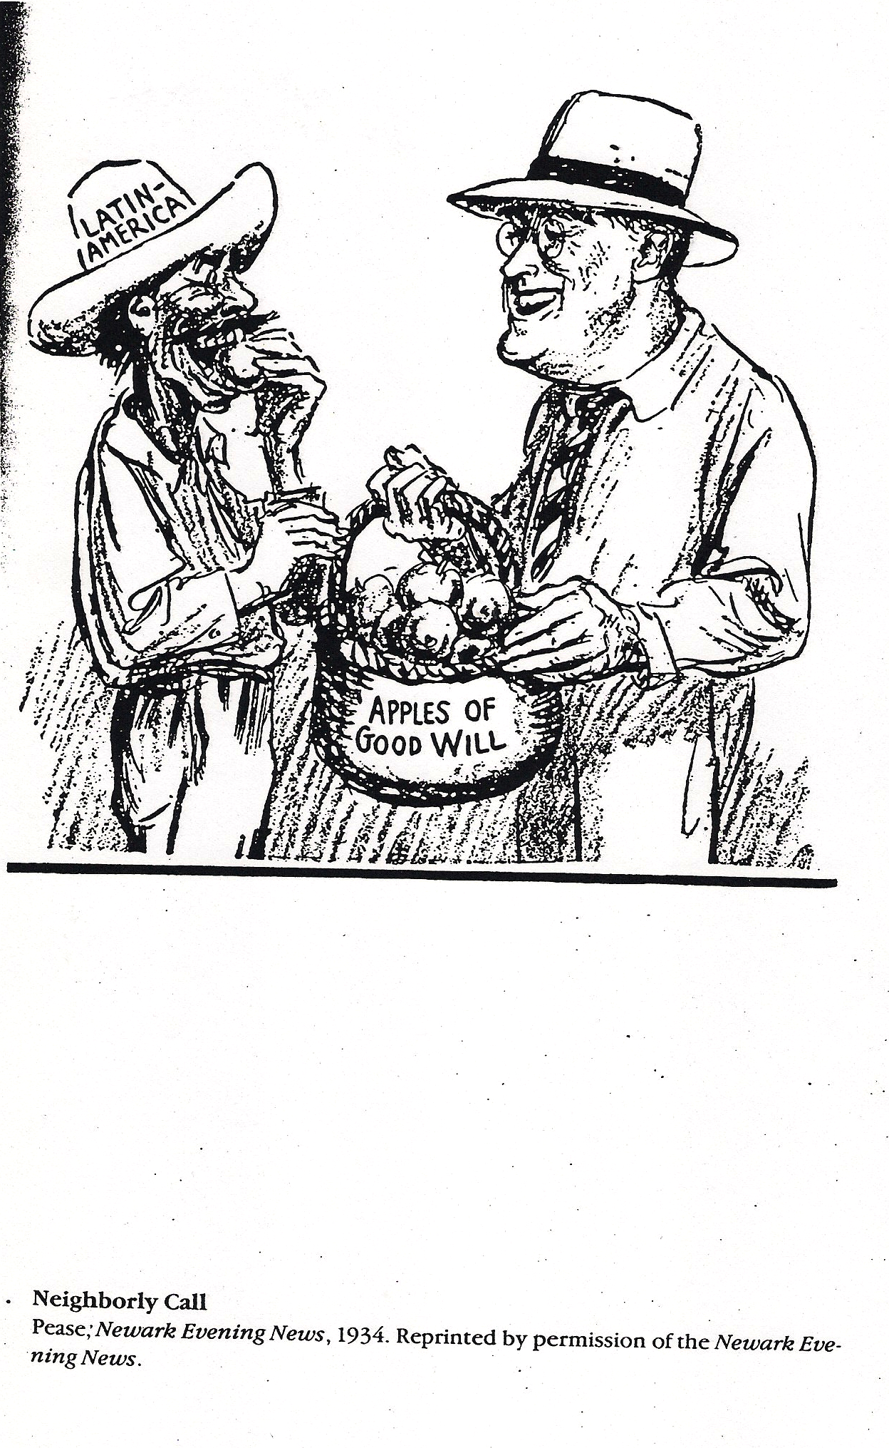
1930s: the ‘good neighbor’
‘Neighborly Call’ (1934)
‘Neighborly Call’ (1934)

Slide 9
US Secretary of State Cordell Hull (1934)
‘It has for many years been said that the United States has sought to impose its own views upon the Central American states, and that to this end it has not hesitated to interfere or intervene in their affairs. . . We therefore desire not only to refrain in fact from any interference, but also from any measure which might seem to give the appearance of such interference.’

Slide 10
Cold War
Organization of American States
https://www.youtube.com/watch?v=_Q5Ml-MlHQw
Carlos Puebla, ‘La OEA es cosa de risa’: ‘How can I help laughing at the OAS, since it’s such a horrible thing, so horrible it makes you laugh: ha ha ha ha ha’

Slide 11
George Kennan (US historian and cold war diplomat) 1950
‘Where the concepts and traditions of popular government are too weak to absorb successfully the intensity of the communist attacks, then we must concede that harsh government measures of repression may be the only answer.’

Slide 12
Woodrow Wilson Foundation at Harvard University 1955
‘The real threat of communism is the economic transformation of the Communist powers in ways which reduce their willingness and ability to complement the industrial economies of the West.’

Slide 13
Cold War
School of the Americas established 1946 in the US-controlled zone within Panama. Currently located in Georgia. Has trained over 57,000 Latin American military officers.
‘National Security Doctrine’: only the military can be trusted to defend Latin America against communism—democracy was seen as unreliable and inefficient.

Slide 14
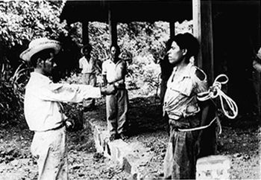
1954
US-supported overthrow of the democratically-elected government of Jacobo Arbenz in Guatemala
https://www.youtube.com/watch?v=uVkthJcKQxg

Slide 15
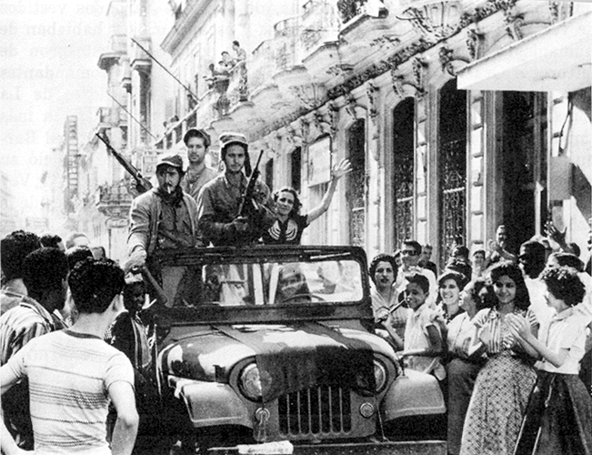
The Cuban Revolution (1959)
Cuban revolutionaries ride into Havana on 1 January 1959

Slide 16
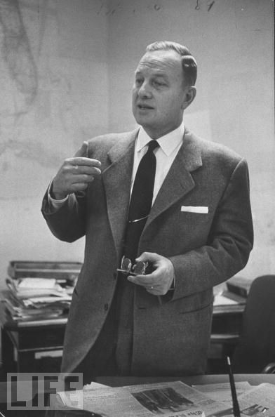
Roy Rubottom, Assistant Secretary for Inter-American Affairs (1960)
‘In June we had reached the decision that it was not possible to achieve our objectives with Castro in power.’

Slide 17
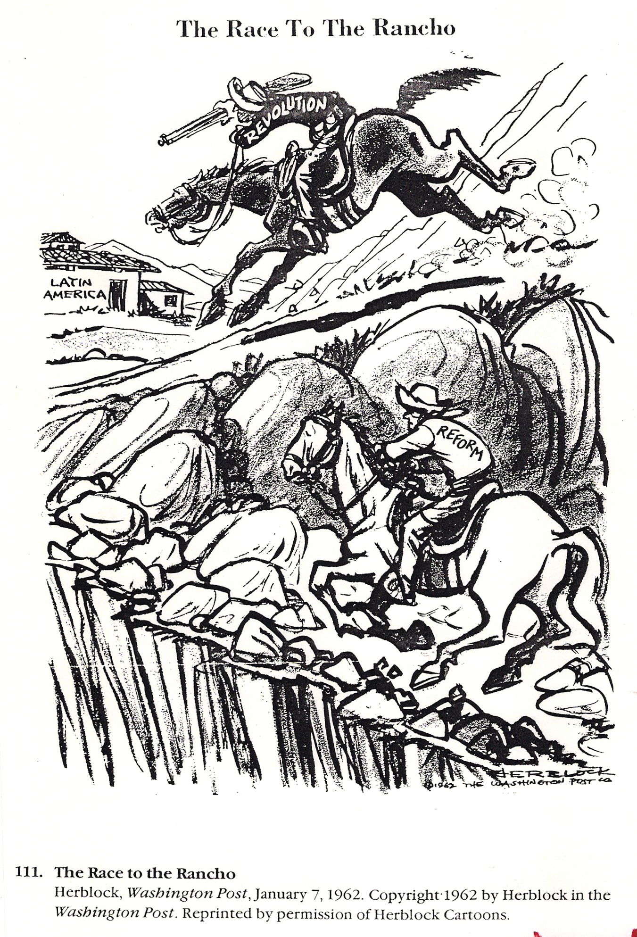
1961 Alliance for Progress formed
‘The Race to the Rancho’ (1962)

Slide 18
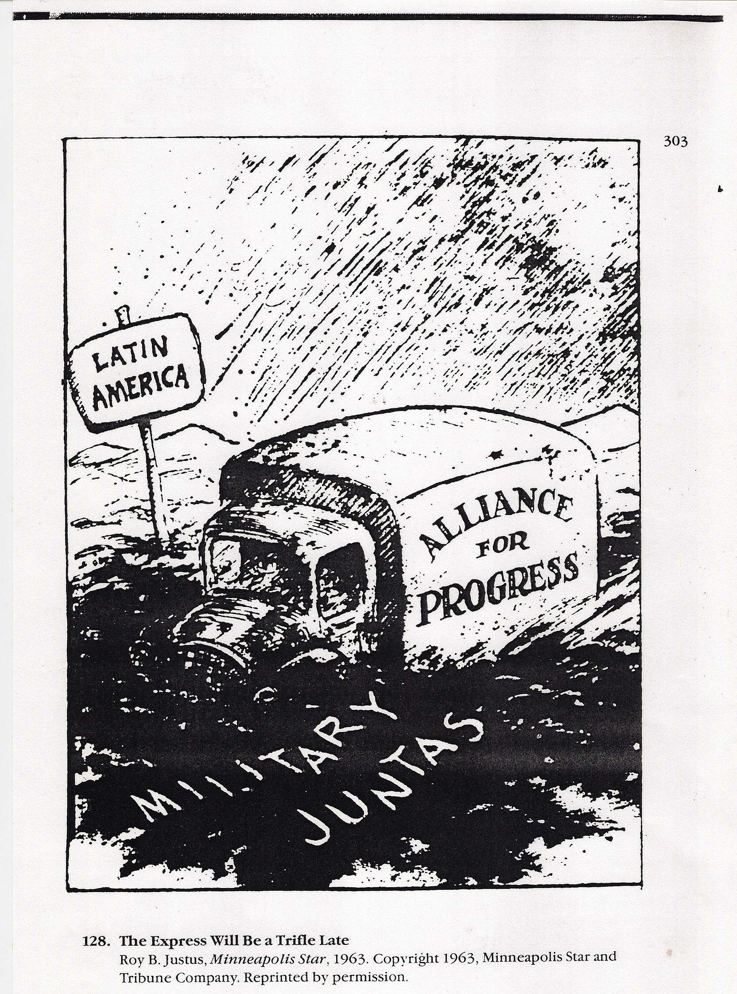
‘The Express Will Be A Trifle Late’ (1963)

Slide 19
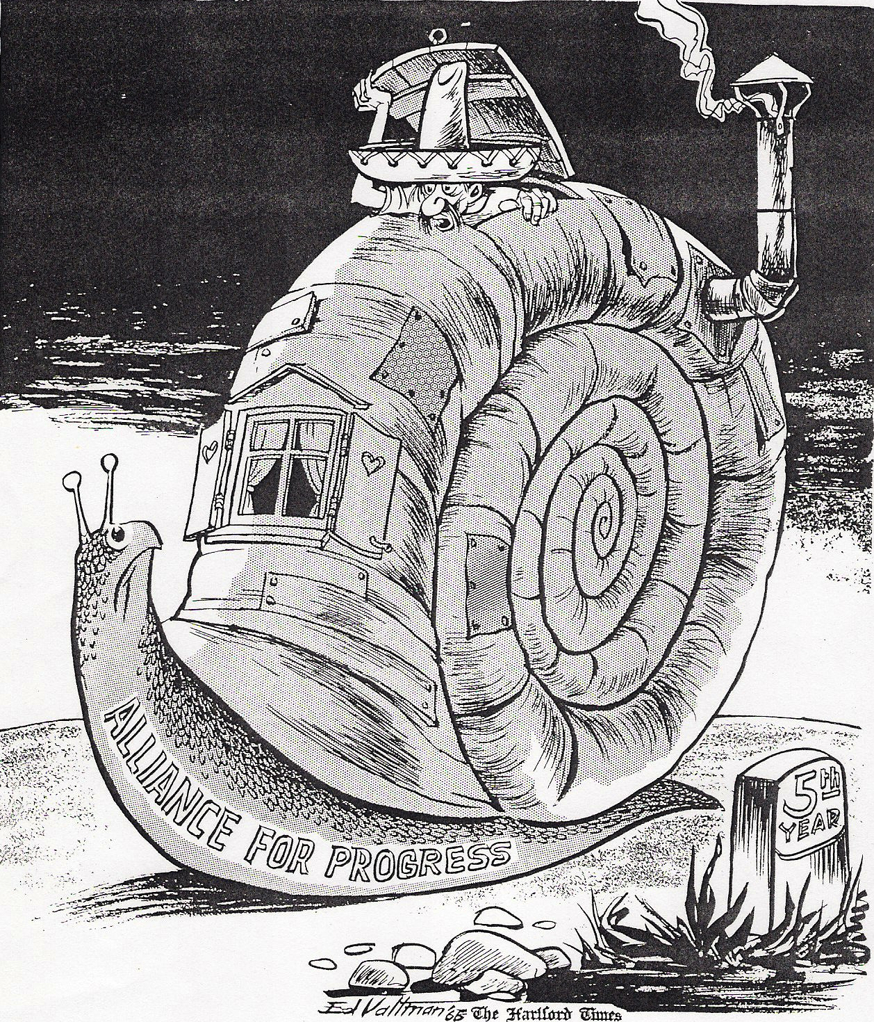
‘Were Are We?’ (1968)

Slide 20
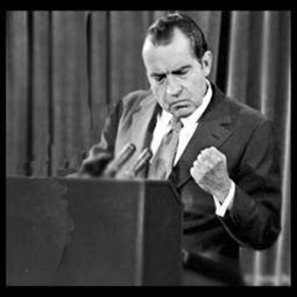
Richard Nixon on Latin America (1968)
‘Don’t trust them, you can’t trust them. They’re all a bunch of kooks.’

Slide 21
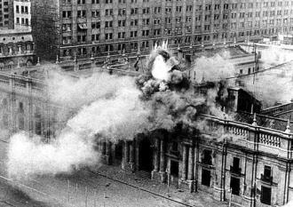
Rise of Military dictatorships: 1970s
1973 military coup in Chile
Chilean military attack the presidential palace

Slide 22
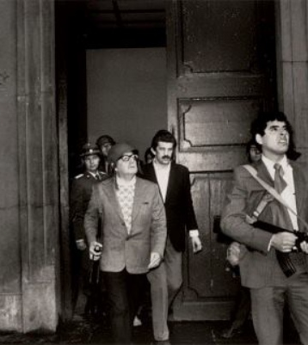
Rise of Military dictatorships: 1970s
1973 military coup in Chile
President Dr. Salvador Allende in the Chilean capital during the coup.

Slide 23
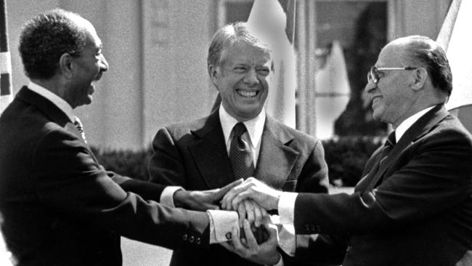
US President Jimmy Carter 1977 (‘human-rights based foreign policy’)
‘You will find the United States eager to stand beside those nations which respect human rights and promote democratic ideals.’
Camp David agreements between Israel and Egypt, 1978

Slide 24
1900s Teddy Roosevelt and the ‘big stick’
1930s Franklin Delano Roosevelt and the
‘good neighbor’ policy
1944-
1950s Cold War
1960s Alliance for Progress
(launched 1961)
1970s-
1980s East-West or North-South?
regular US military intervention on Latin America
US cooperation with dictators
1954 coup in Guatemala
Cuban Revolution
1970s military dictatorships
(eg. 1973 military coup in Chile)
1980s US-backed contra-revolutionaries in
Nicaragua

Slide 25
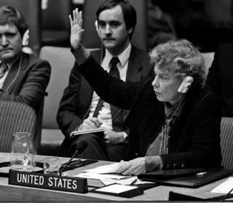
Jeane Kirkpatrick (US ambassador to the United Nations under Ronald Reagan) 1981
The USA intends ‘to normalize completely its relations with Chile in order to work together in a pleasant way.’

Slide 26
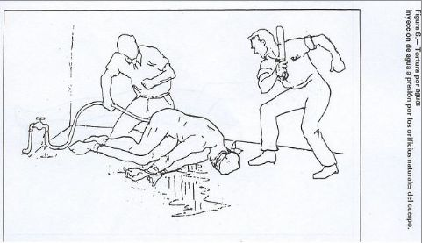
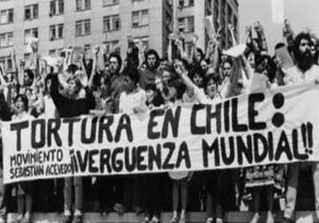
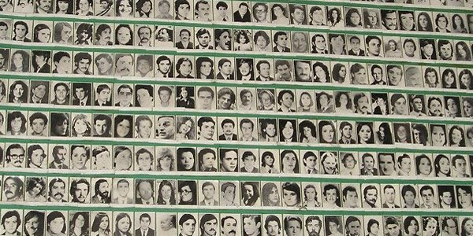
Chile under Pinochet: torture
Chile under Pinochet: the disappeared

Slide 27
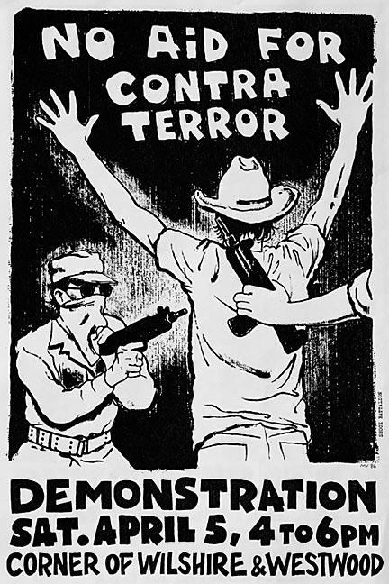
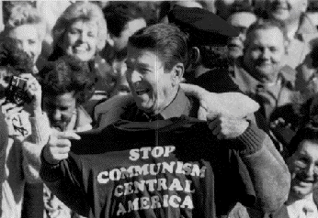
1980s Central America guerrillas, democracy, dictatorships and civil war
US-backed ‘Contras’ fought the government of the Sandinistas (Nicaragua)-- ‘Iran-Contra’ scandal

Slide 28
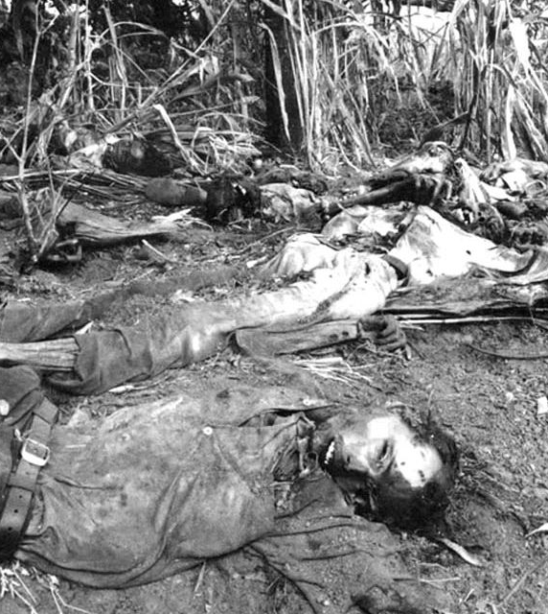
Death Squads in El Salvador
‘US complicity in the dark and brutal work of El Salvador’s death squads is not an aberration. Rather, it represents a basic bipartisan, institutional commitment on the part of six American administrations—a commitment to guard the Salvadoran regime against the prospect that its people might organize in ways unfriendly to that regime or to the US.’
Alan Nairn (US journalist) 1984
On 11 December 1981, units from the Salvadoran Army killed 800 civilians, over half of them children, in the village of El Mozote.
More than 75,000 civilian deaths overall.85% killed by the Salvadoran military.

Slide 29
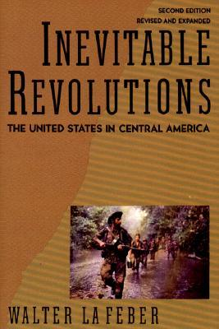
Walter LaFeber’s idea of ‘inevitable revolutions’
‘Unable to deal with the products of its own system, reconcile the contradiction between its professed ideals and its century-old foreign policy, or work with other nations to resolve these dilemmas, the United States, from Eisenhower to Bush, has resorted to force. The result has been more revolution.’

Slide 30
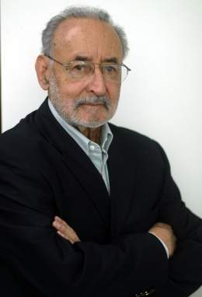
Edelberto Torres Rivas (Guatemalan sociologist)
US policies have supported ‘authoritarian regimes for strategic reasons, economic advantages, or ideological affinity’.

