Slide 1
US Foreign Policy
HI115

Slide 2
Sources
What do the Monroe Doctrine and the Platt Amendment tell us about the aims of US foreign policy in Latin America?
In what ways does the Platt Amendment conform to the Monroe Doctrine?
https://loveman.sdsu.edu/docs/1903PlattAmendment.pdf

Slide 3
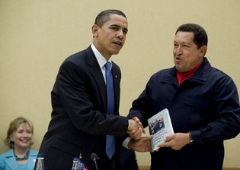
Eduardo Galleano, The Open Veins of Latin America: Five Centuries of the Pillage of a Continent, 1971
Hugo Chávez, president of Venezuela, handing President Obama a copy of Eduardo Galeano's "The Open Veins of Latin America" in 2009.
Credit Matthew Cavanaugh/European Pressphoto Agency
How does the article effect the way you would consider this book as a source for your research?
https://panoramas.secure.pitt.edu/news-and-politics/eduardo-galeanos-criticism-his-open-veins-taken-lightly

Slide 4
Latin America After the Wall St Crash
Economic Nationalism
Inward looking economies: Import Substituting Industrialisation (ISI) Central America and the Caribbean, Import Substituting Agriculture (ISA)
Authoritarian regimes/ Dictatorships
Military dictatorships with fascist tendencies-Dominican Republic, El Salvador, Guatemala, Argentina Civilian governments with fascist tendencies- Chile Reformist, socialistic, authoritarian governments Brazil, Mexico, Bolivia

Slide 5
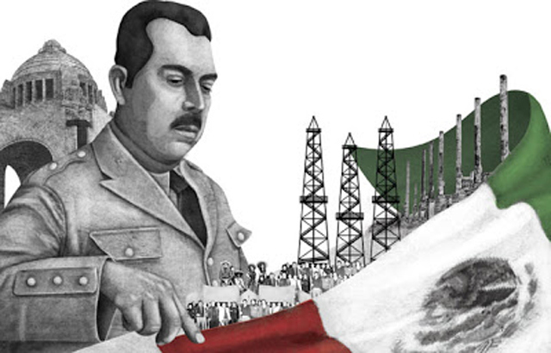
Economic Nationalism
1932- Roca-Runciman Treaty Britain-Argentina
18 March 1838: Mexican Oil Nationalised under President Lázaro Cárdenas. PEMEX
1 October 1952: Act of Bolivia’s Economic Independence-Nationalised tin mines. COMIBOL

Slide 6
Economic Nationalism
Argentina under the Government of Juán Domingo Perón 1946-55
Declaration of economic independence (1947): ‘to break the chains of domination that have bound ... [Argentines] to foreign capital, and to recover their right to control the sources of their national wealth’
Justicialismo Nationalisation of railways, grain production, telecommunications

Slide 7


Slide 8
Dependency Theory
Radical economists, using Latin America as an example, argue that certain “core” economic countries keep the world’s “peripheral” countries underdeveloped by
extracting raw materials at a low price,
developing these raw materials into manufactured goods in the core countries,
then selling them back to peripheral countries.
Often aided by certain economically elite groups in these peripheral countries.

Slide 9
Questions
What explains the US’s persistent involvement in Latin American politics?
How did US involvement in Latin America change over time? Why?
Was there a gap between the aims of the US and the results? Why (or why not)?
Do you think that political or economic influence was more significant? (or did this change over time/ place - e.g. think about your "adopted" country)?

Slide 10
Essay Questions
The US was a neo-colonial power. Discuss.
How effective was the US foreign policy in stopping the spread of communism between 1945 and 1991?
Assess the influence of the US in Latin America post-independence.
Assess the influence of US popular culture in Latin America during the Cold War.

