Slide 1
Vocab
Caudillo – an ex-military general who has claimed civilian power. (This happens a lot in the C19th!)
Hacienda – a huge estate/plantation.
Hacendado – the man who owns that estate/plantation.
Mestizaje – the idea of the national population being a “melting pot” of Europeans and indigenous people. Used with positive connotations.

Slide 2
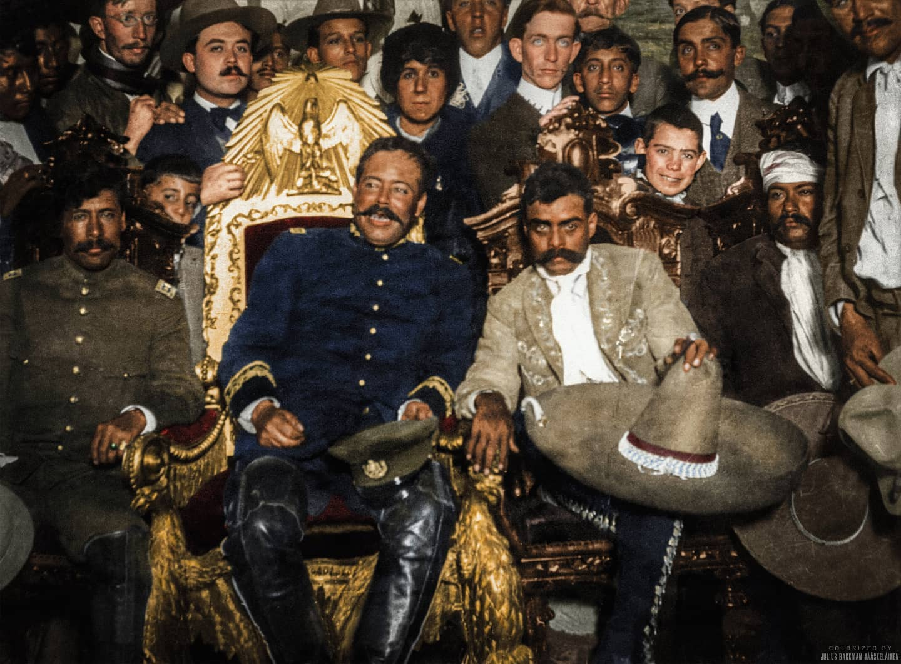
The Mexican Revolution
1910 – 1920
Dr Liana Beatrice Valerio

Slide 3
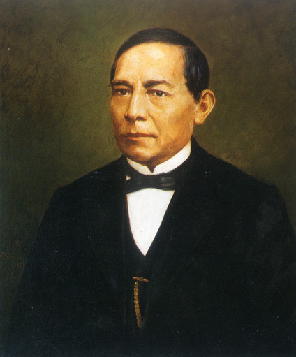
Nineteenth Century Mexico
Benito Juárez 1858 – 1872 (almost)
Defends 1857 Liberal Constitution, which includes secularism (breaks power of Church), individual rights, pro-democracy.
Liberal: ‘Progress’ is about civil society, but also capitalist economy
Against foreign influence: civil war breaks out, Liberals vs Conservatives (& Maximilian III of France)
Of indigenous origin (Zapotec)

Slide 4
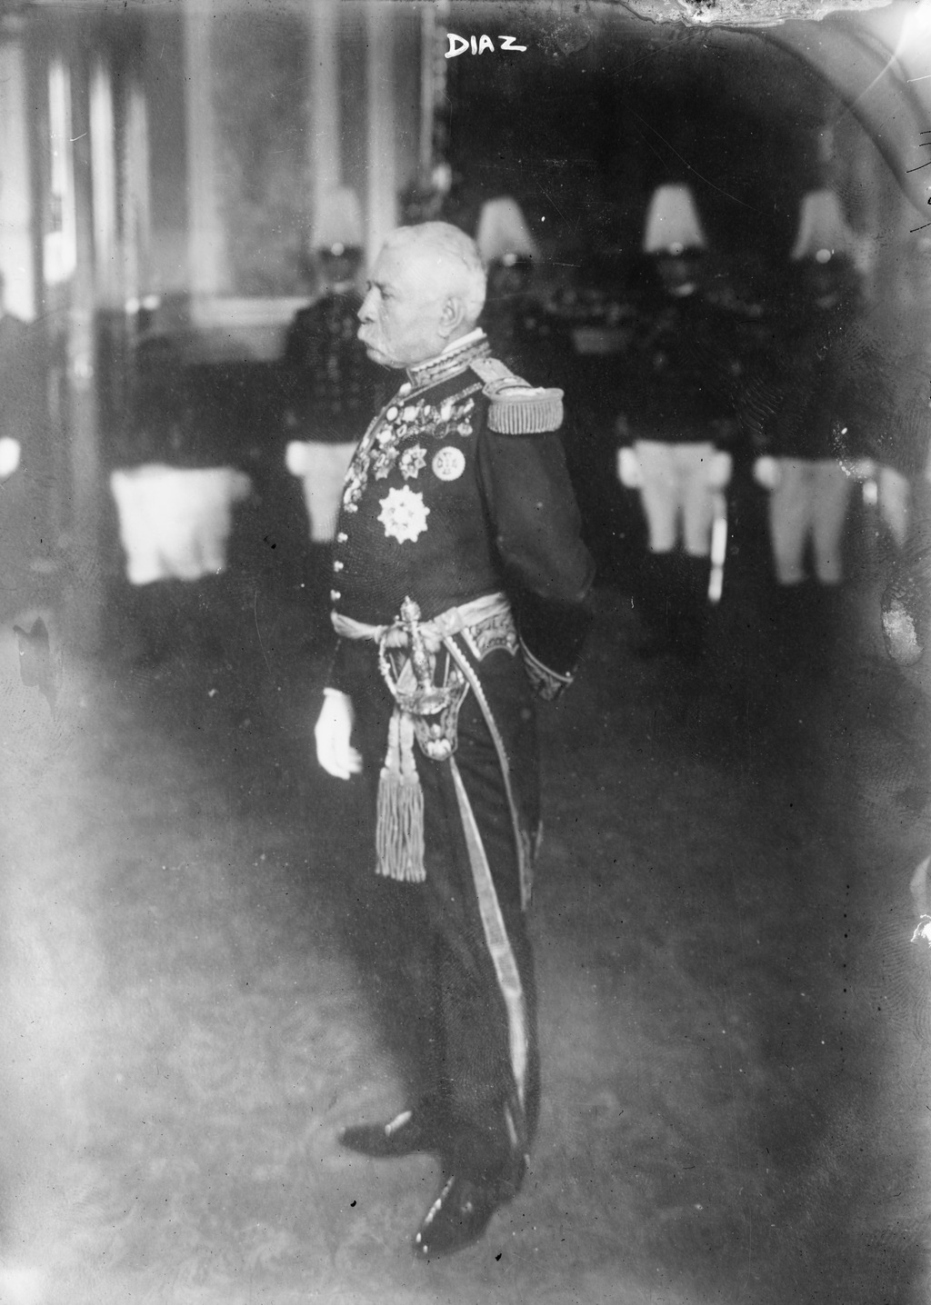
Turn of the Century
Porfirio Díaz 1877-1911 (almost)
‘Caudillo’ – former military general, comes to power in coup.
also ‘Liberal’ vision of modernisation. Slogan ‘order and progress’. Advisors & ministers = científicos: technocrats.
Accommodates foreign investment: e.g. US in minerals /petroleum; supports big landowners rather than small farmers.

Slide 5
Mexico in 1910
Porfirio Díaz had been in power since 1877: ‘the Porfiriato’. Took power through army, rigged elections, changed constitution.
Policy ‘order and progress’: pro-capitalist, technocratic, political stability to promote investment. Emphasis e.g. railways, mining. Generally benefits investors, not workers – poor conditions.
Legacy of 19th century: French interference through Maximilian III, history of wars with USA, loss of Texas.

Slide 6
Who Plays a Part?
Urban workers
The middle class
Rural, landless “peasants”

Slide 7
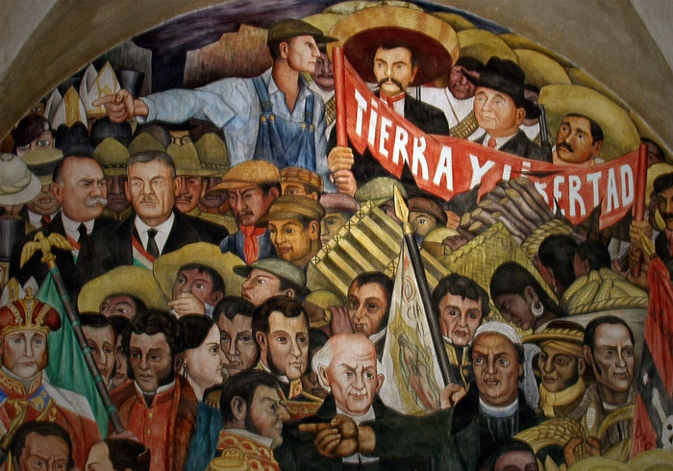
Land Rights
Foundational aspect of Latin American politics
Goes back to colonial period?
Ignored & made worse by C19th leaders in Mexico and elsewhere
Land redistribution: agrarian reform one of central aims of revolution

Slide 8
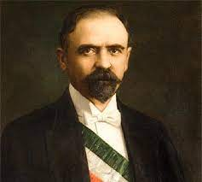
La Revolución - 1910
Vs.
Francisco Madero
Porfirio Díaz

Slide 9
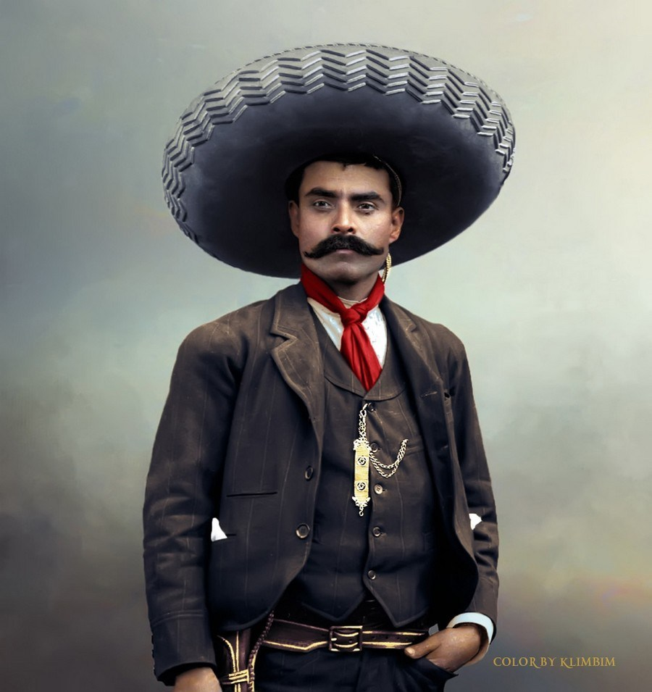
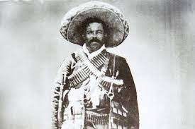
From Revolution to Civil War - 1911
Francisco “Pancho” Villa
Emiliano Zapata

Slide 10
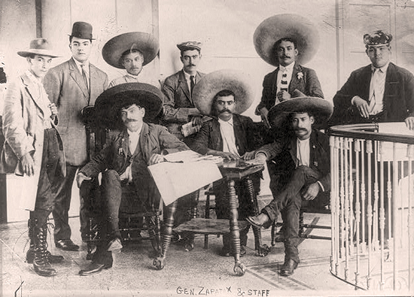
Plan de Ayala - 1911

Slide 12
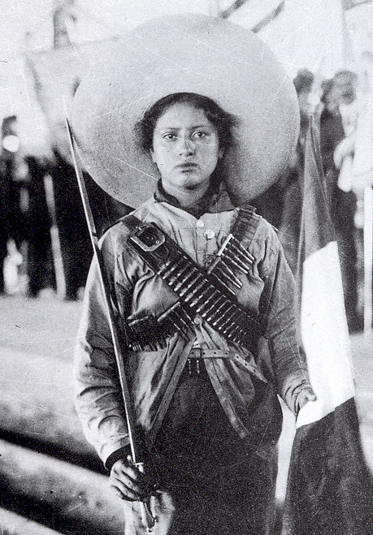
Adelitas / Soldaderas

Slide 13
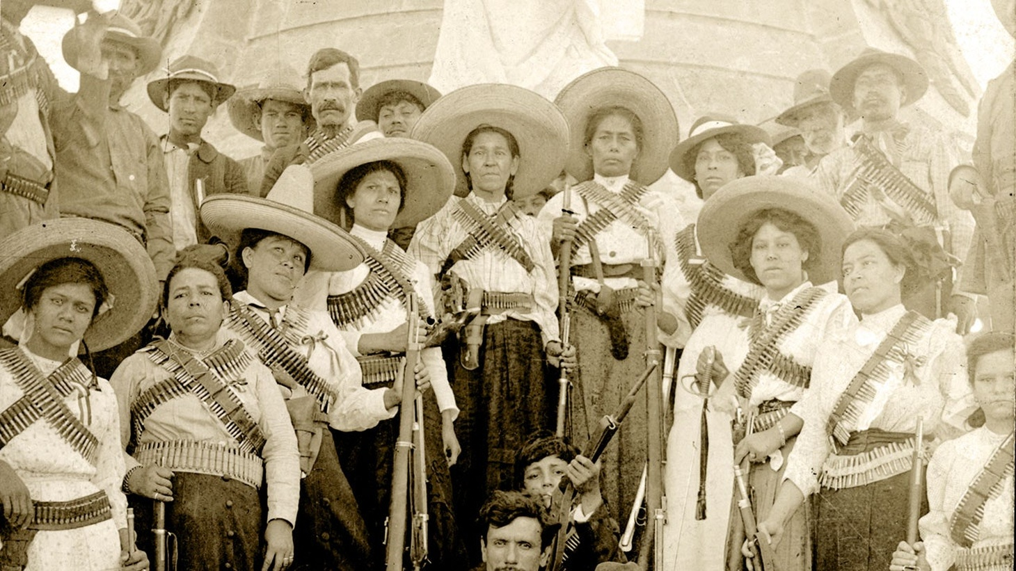

Slide 14
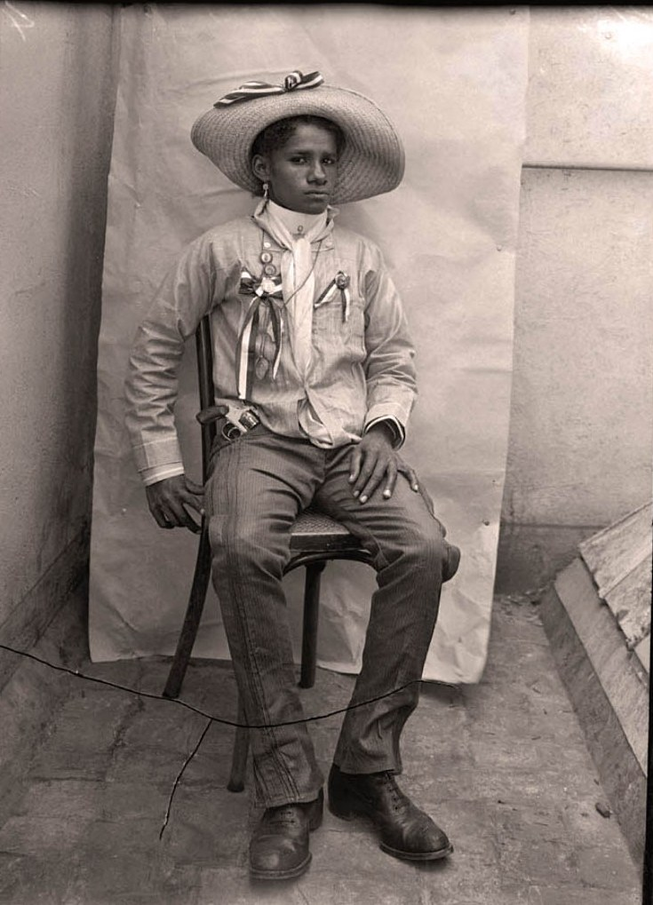
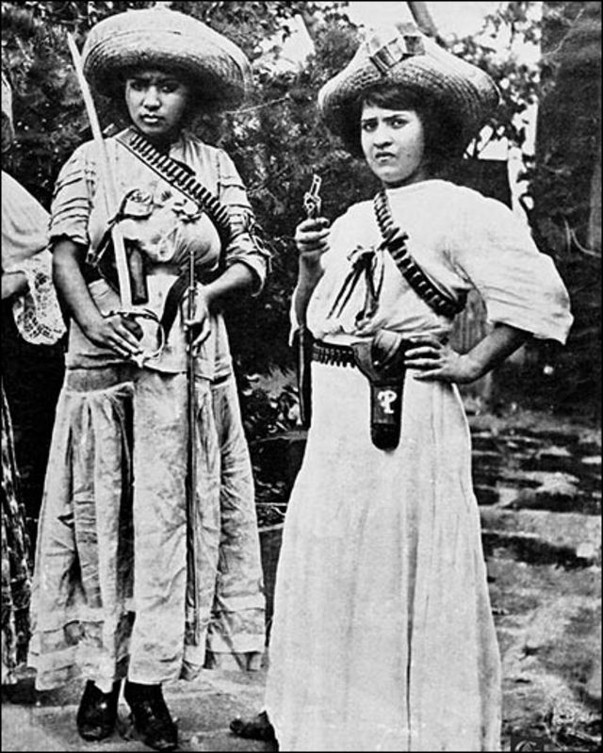

Slide 15
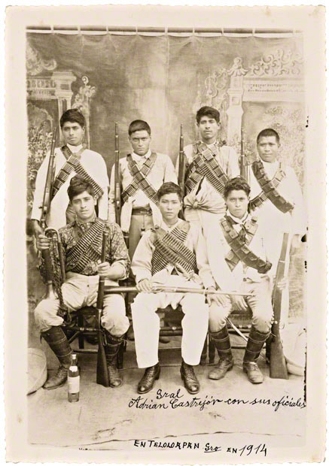
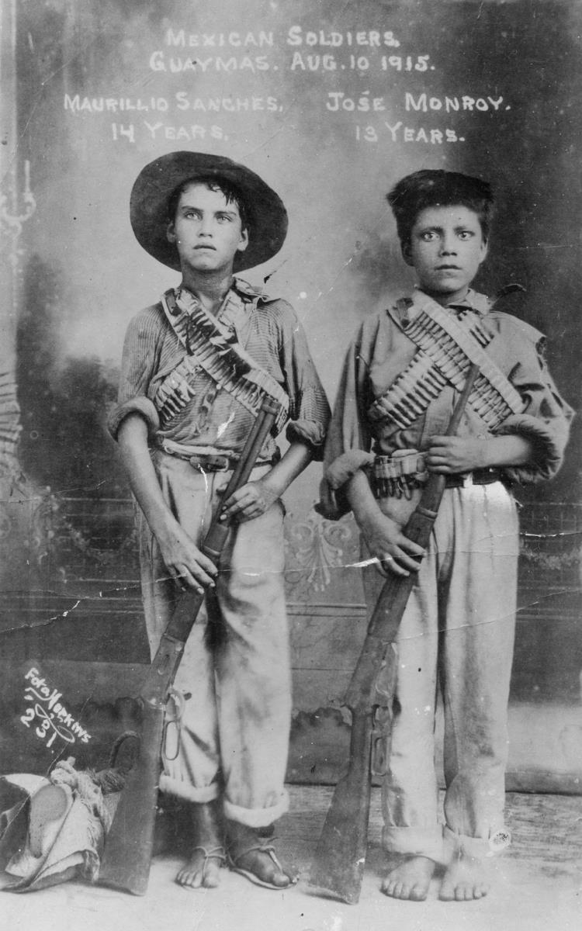

Slide 16
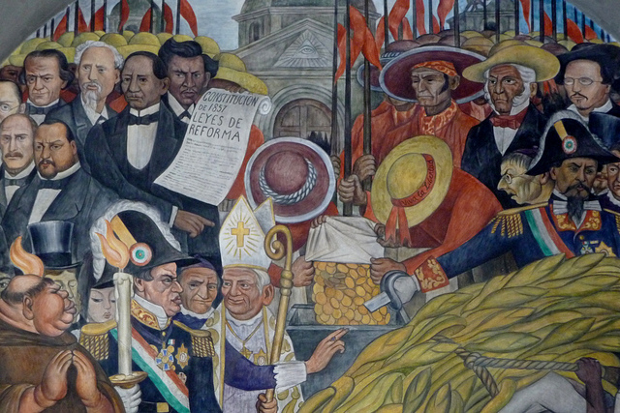
Results
1917: Mexican Constitution – secular, establishes free universal education, minimum wage and regulated work hours, return of peasant lands.
1920-4: President Álvaro Obregón: more stable period
Interpretations: Civil war? Coup? Myth? Authoritarian power-grab? Restoration of a preferred past (liberal 19th century) rather than upheaval? US influence?

Slide 17
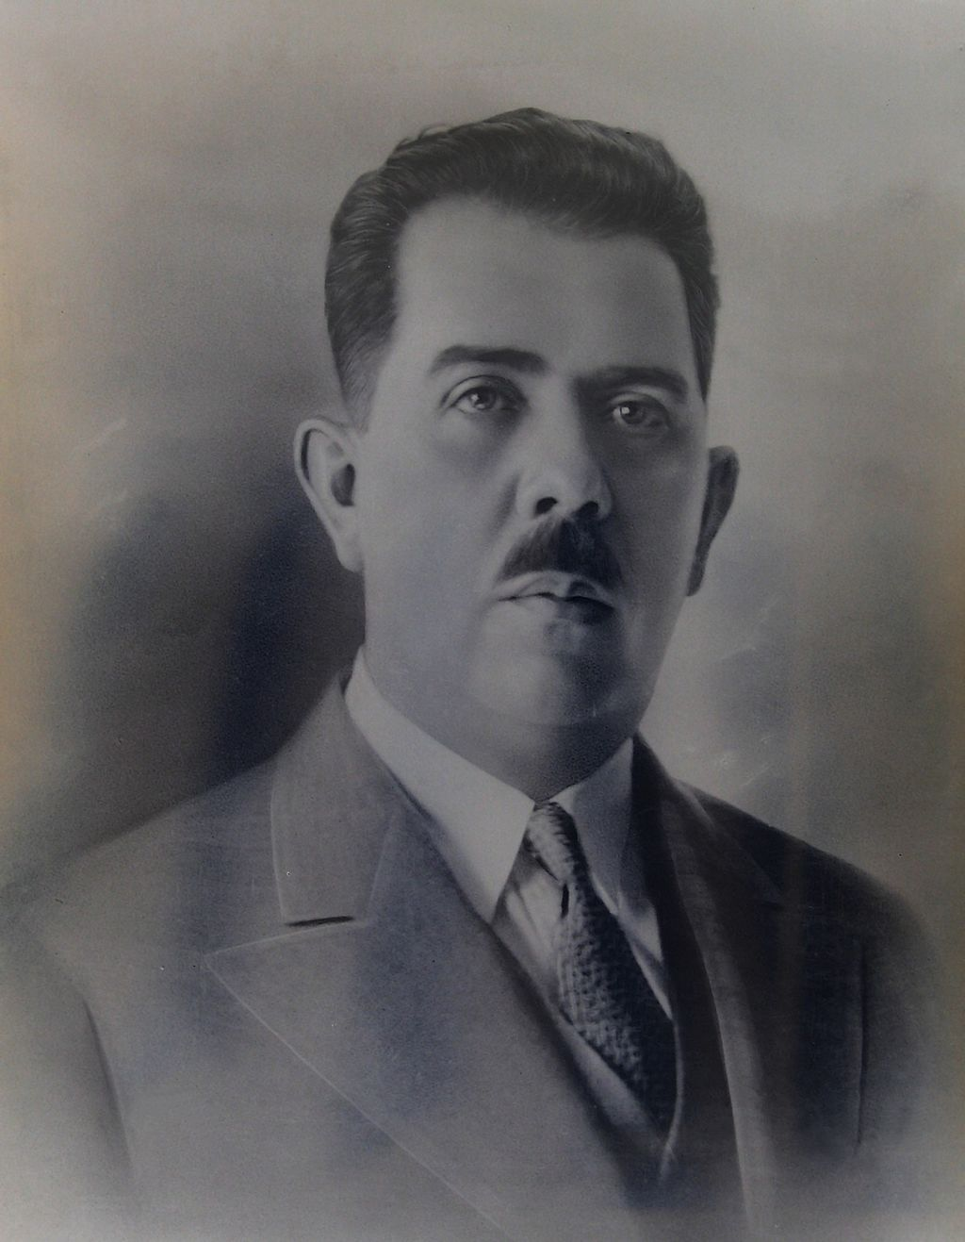
Post-Revolutionary Mexico
President Lázaro Cárdenas (1934-40)
Land reform: Agrarian Code of 1934. More land & freedoms for peasants, emphasis on farming
Education: literacy, history, agricultural progress. Doesn’t always tackle root inequality?
Indigenous rights & education: Department of Indigenous Affairs
Economic nationalism: nationalises petroleum
State organisation around presidential power: authoritarian?

Slide 18
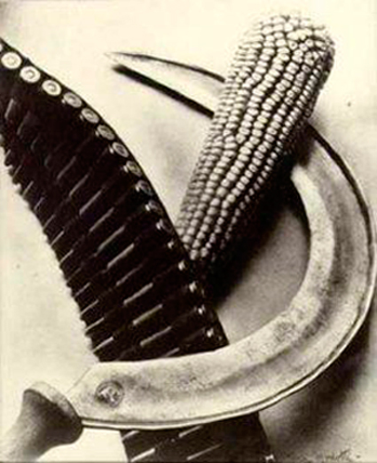
Communism and the Mexican Revolution
Not supporting international communism, but many supporters of new state influenced by communism / socialism. Party = ‘National Revolutionary Party’ PNR / PRI , but only from 1929
Welcomes exiles from Spanish Civil War
Trotsky lives in Mexico 1937-40, welcomed by President Cárdenas, eventually assassinated in Mexico City.
Unions supported and socialist / welfare policies adopted after revolution. Tensions between workers & peasants though?

Slide 19
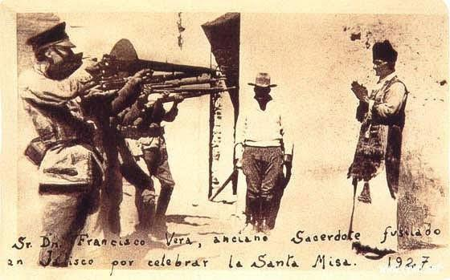
Cristero Wars

Slide 20
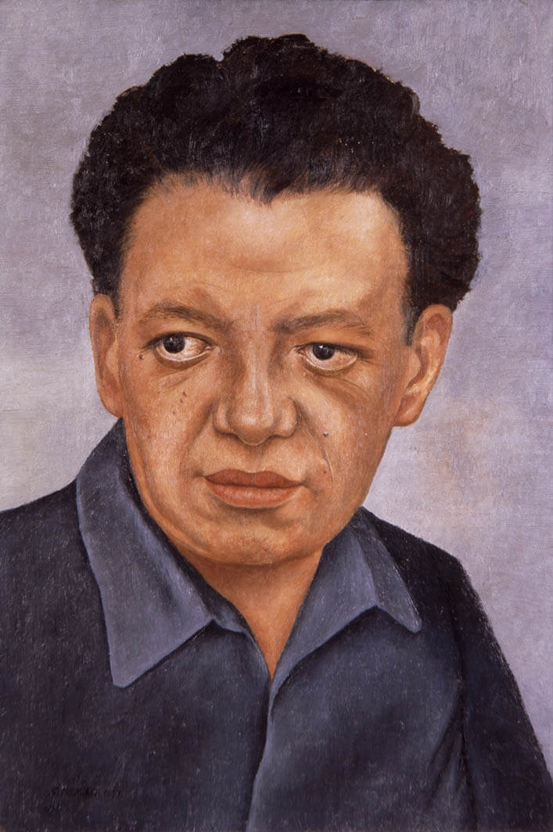
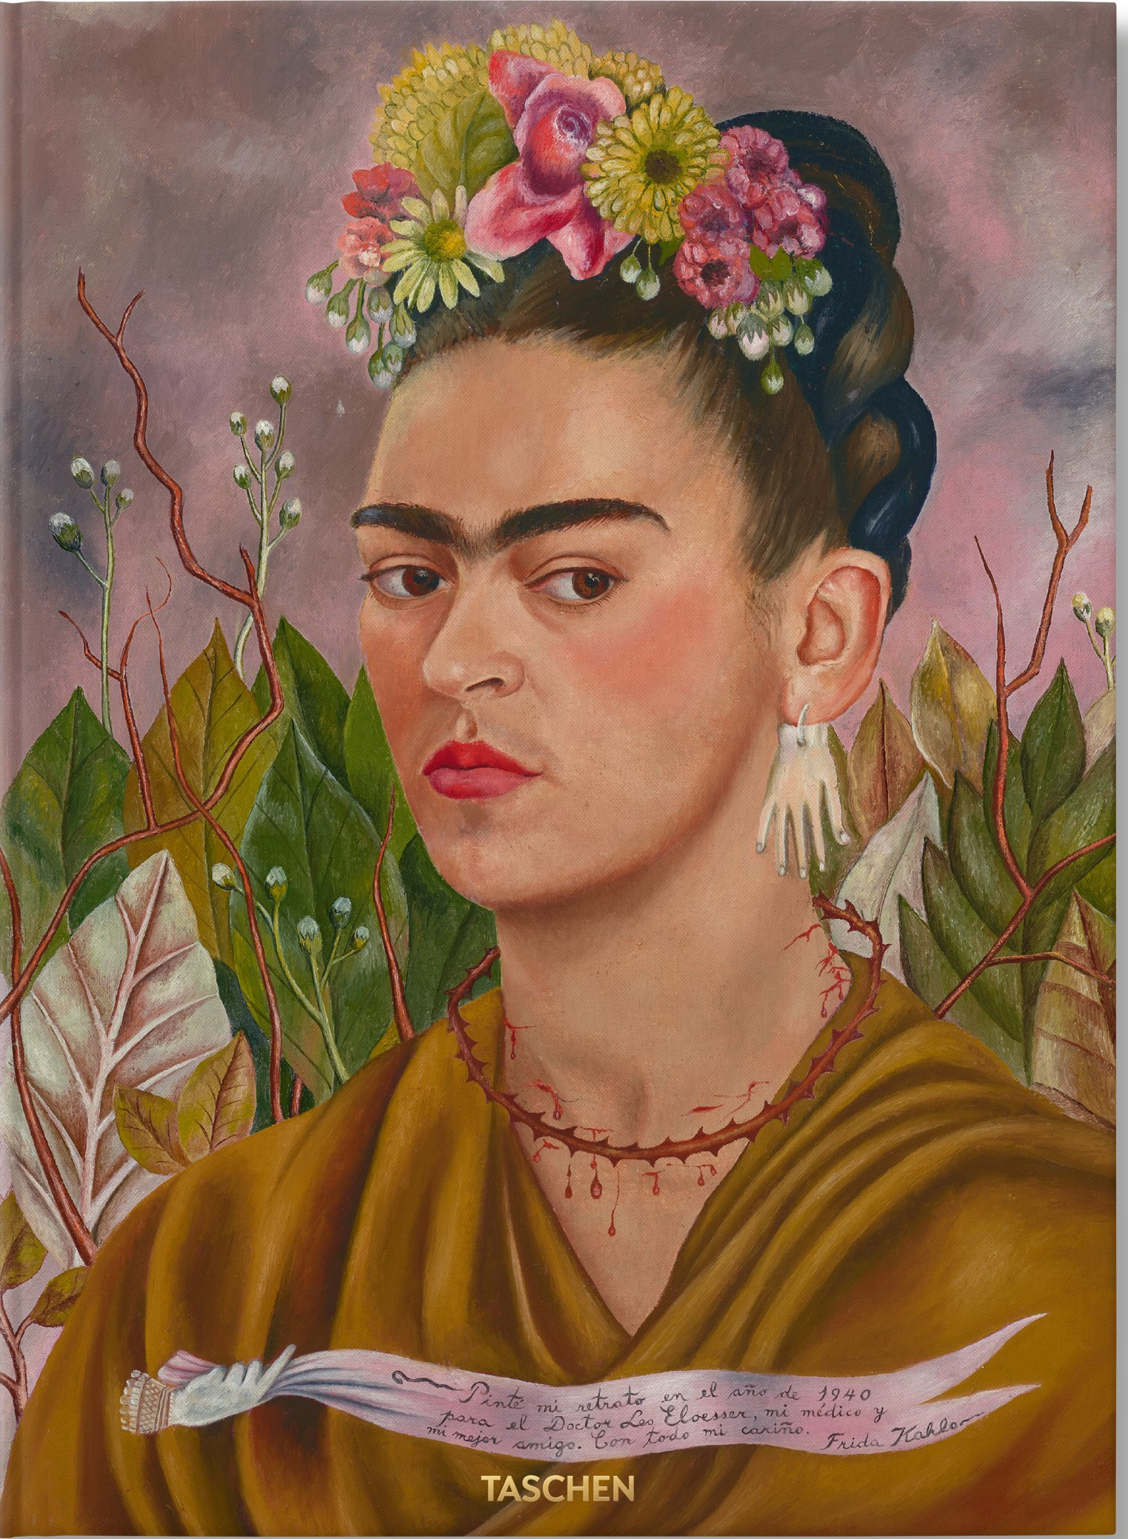
Cultural Legacies: Art
Muralists, art in newspapers and other popular print to reach illiterate population: art to create new vision of society, define national history
Diego Rivera: Murals in public buildings, especially Palacio Nacional
Frida Kahlo: indigenous / mestizo themes

Slide 21
