Slide 1
Mid-Twentieth-Century Latin America:
Corporatism, “Populism”, Nationalism & Labour
Dr Liana Beatrice Valerio

Slide 2
Economic Context
Economic nationalism from 1930: away from dependence on export economies
Industrialise, hence less reliance on imported goods: import substitution industrialisation (ISI)
Massive rural -> urban migration
Rural crisis
Urban sprawl: growth of slums and urban social problems still present today

Slide 3
Who had held power in Latin America?
Oligarchs: from late C19th; rule by small liberal elite; powerful families; haciendas linked to the export economies
Early C20th: gradual urbanisation and small-scale industrialisation
Pressure from urban middle classes for political representation.
E.g.: Argentina: 1912: Saenz Peña law widens the franchise to include urban MC;
→ 1916 election of the Radical Party (Yrigoyen) : urban interests in Argentinian politics

Slide 4
Politics of the Urban Working Class
Slow growth of socialism, anarchism associated with Spanish/ Italian immigrants
Communist Parties founded after 1917: Chile, Cuba, Brazil, Argentina, Mexico.

Slide 5

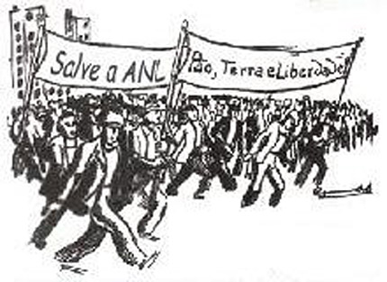
Latin American Communism

Slide 6
Politics of the Urban Working Class
Working people seek better conditions = STRIKES and labour protest.
Exacerbated by DEPRESSION from 1930.
National politicians have to INCORPORATE some of these demands…

Slide 7
Volatile politics in the 1930s
Radical politics on the Left
Radical groups on the Right: influenced by European fascism

Slide 8
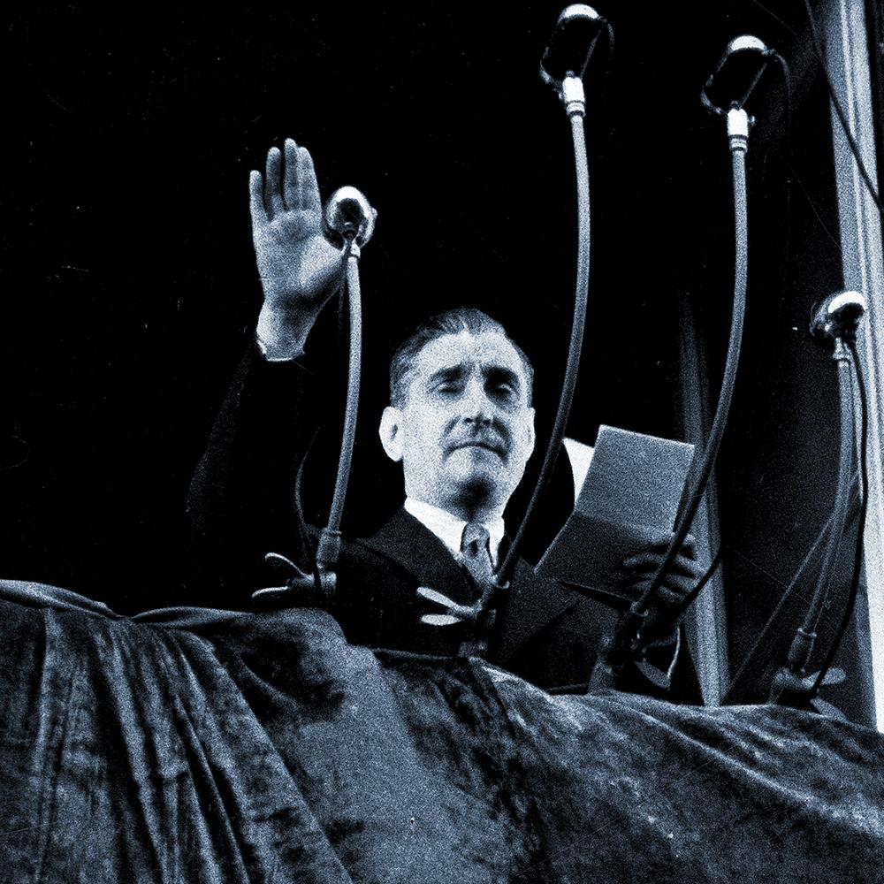
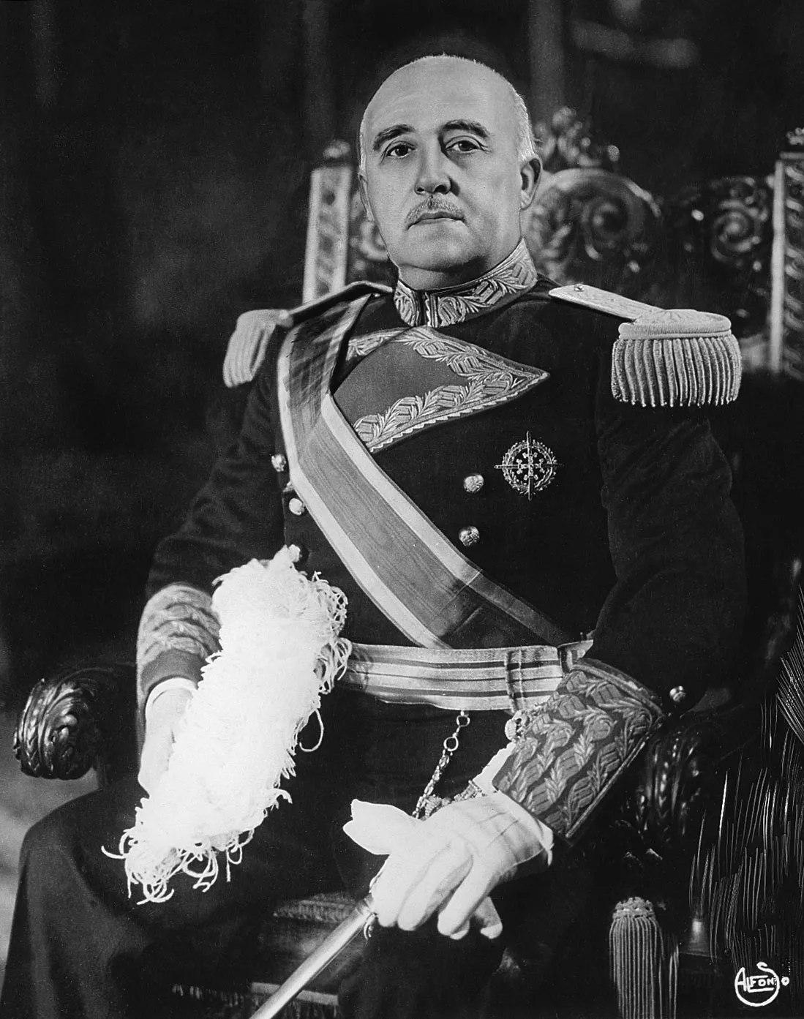
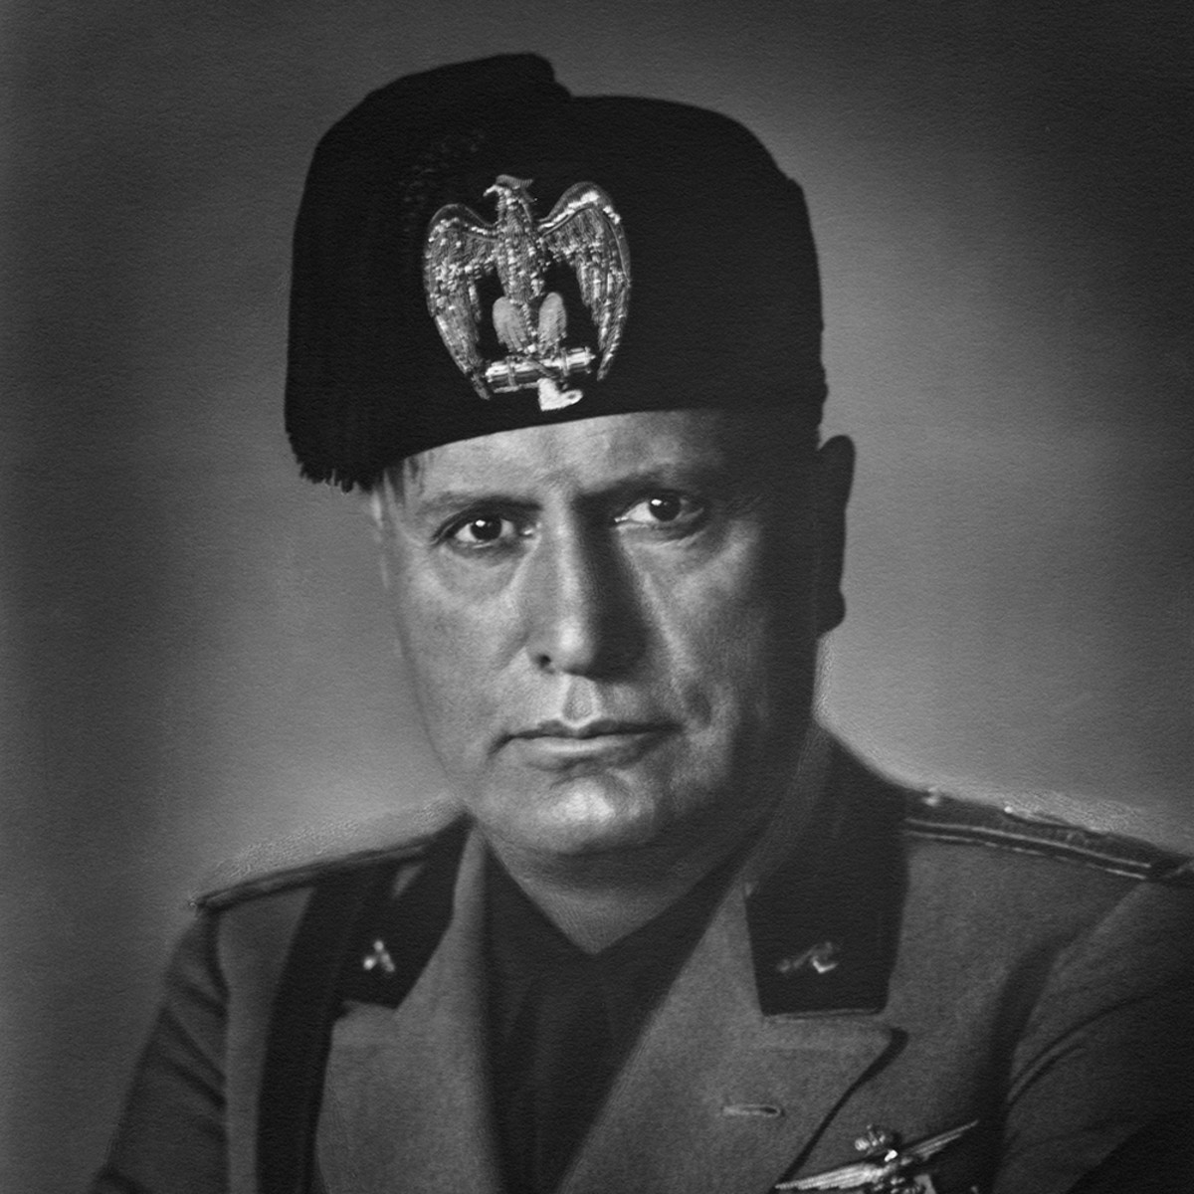
António de Oliveira Salazar
Francisco Franco
Benito Mussolini

Slide 9
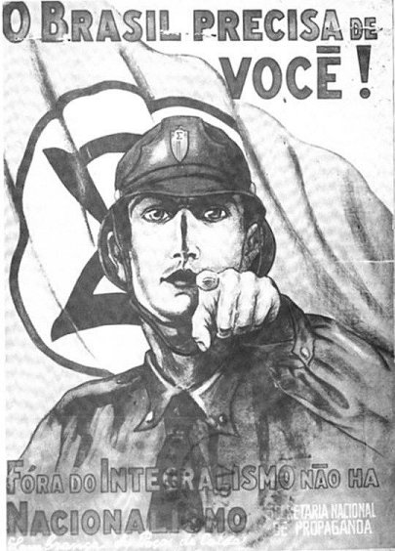
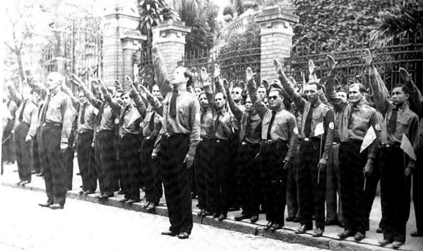
Latin American Fascism

Slide 10
Need to juggle working-class demands AND keep industrialists on side…

Slide 11
Corporatism
Bring different corporate entities (e.g. trade unions, industrialists’ associations, white-collar workers) into the bureaucratic apparatus of the state
These groups receive state favours and patronage
State is arbiter of conflict between competing groups but none can challenge the power of the state itself.
= Growth of the STATE
E.g. Vargas: trade unions gain benefits, but they can’t go on strike

Slide 12
Corporatism and Authoritarianism
Modelled on SOUTHERN EUROPEAN FASCIST/ AUTHORITARIAN STATES e.g. Spain, Portugal, Italy.
Often underpinned by force
e.g Vargas: full-blown DICTATORSHIP in Brazil: 1937-45 (Estado Novo)
e.g. “soft” authoritarianism in Mexico: unions, peasants groups etc controlled through state funding & patronage: (authoritarian tendencies but not full dictatorship like Brazil’s Estado Novo under Vargas.)

Slide 13
World War II: a Political Watershed
LA comes in on American side, supposedly supporting democracy over dictatorship
Defence & economic pacts with US
LA govts keen to show their democratic credentials
So former dictators go to the polls.
Vargas in Brazil; Batista in Cuba; and Perón in Argentina: all make use of ELECTIONS

Slide 14
Populism
‘The phenomenon whereby a politician tries to win power by courting mass popularity with sweeping promises of benefits and concessions to large interest-groups, usually drawn from the lower classes. Populist leaders lack a coherent programme for social change or economic reform, but try to manipulate the existing system in order to lavish favours on underprivileged sectors in return for their support.'
(Williamson)

Slide 15
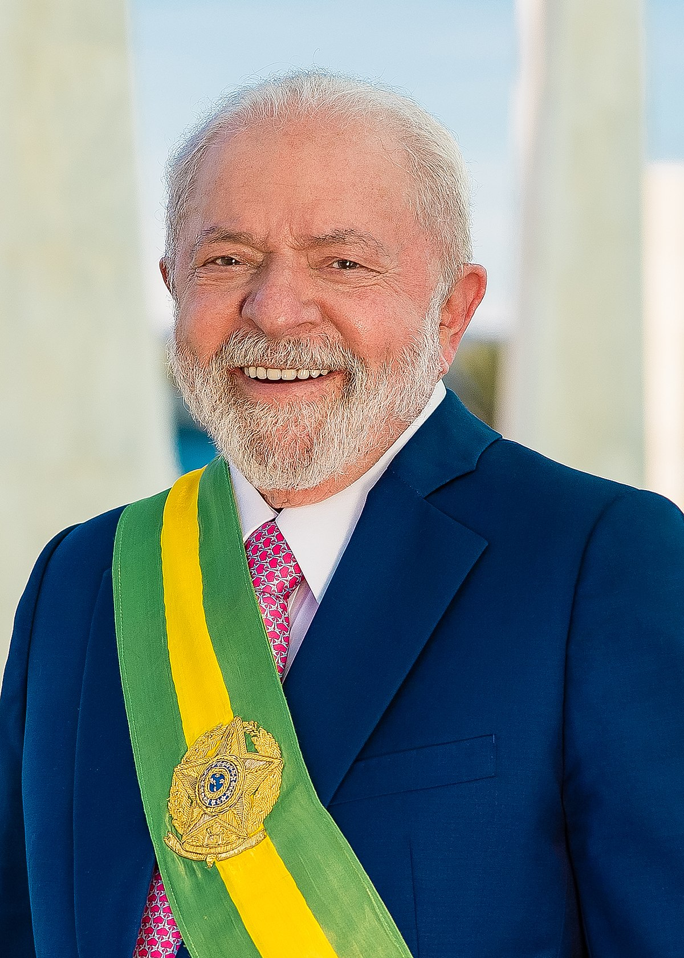
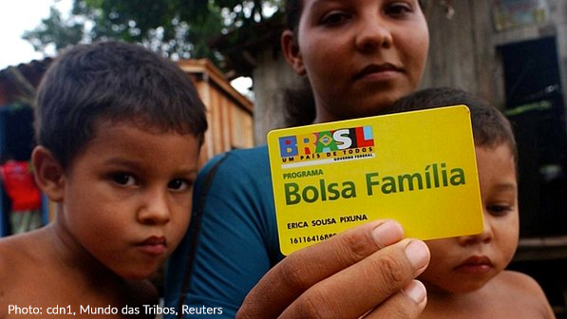
Lula Da Silva – Programa Bolsa Familia

Slide 16
Populism: a Problematic Term?
Way of dismissing working-class political aims?
Politicians aim at manipulation, but doesn’t mean this is all that is going on
Need to take working class political activity seriously…

Slide 17
Brazilian Labour History: Not Just Manipulation by Vargas
Labour movement long pre-dated Vargas
Activists avoided Vargas-controlled unions during Estado Novo (-37-’45)
Labour movement later decides to work WITH Vargas in democratic period
Organised labour pushes him to fulfil promises to workers…

Slide 18
‘Working people in São Paulo were not mobilized from above by politicians; they gave populists their votes in exchange for the populists’ support of their demands.’
Joel Wolfe, São Paulo and the Rise of Brazil’s Industrial Working Class (1993), p.194

Slide 19
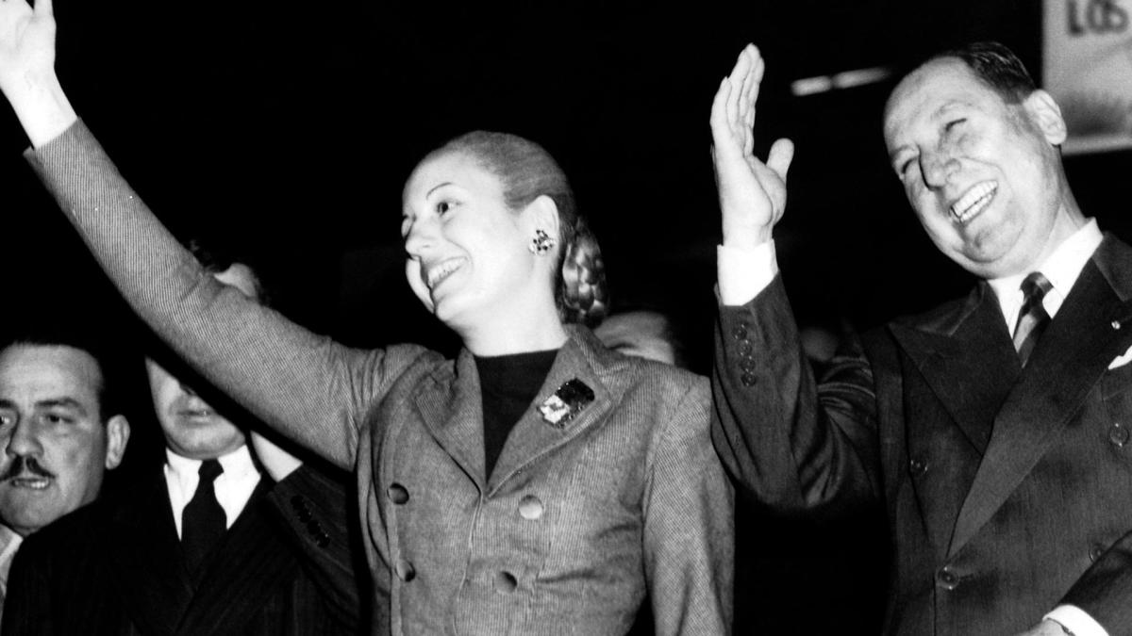
Argentina: Juan & Eva Perón

Slide 20
Juan & Evita
Juan Perón of Argentina (1946-55)…
Image as saviour of the poor - the descamisados or “shirtless ones”
Massive popularity through WELFARE BENEFITS: Eva Perón Foundation

Slide 21
Speech
https://www.youtube.com/watch?v=ayRWr1K0Mew

Slide 22
Mourning
https://www.youtube.com/watch?v=Ye-D4fnAXa8

Slide 23
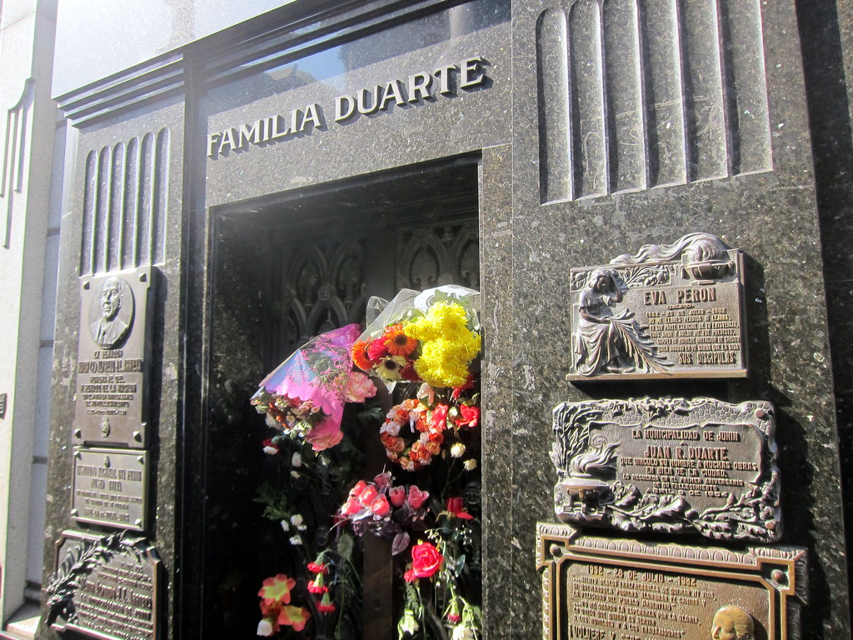
The Political
Lives of Dead
Bodies…

Slide 24
Nationalism
Economic nationalism
But also CULTURAL nationalism…
Rethink the “nation”…
E.g. in Brazil: Vargas helps incorporate popular, non-elite cultural phenomena like samba music to the mainstream…

Slide 25
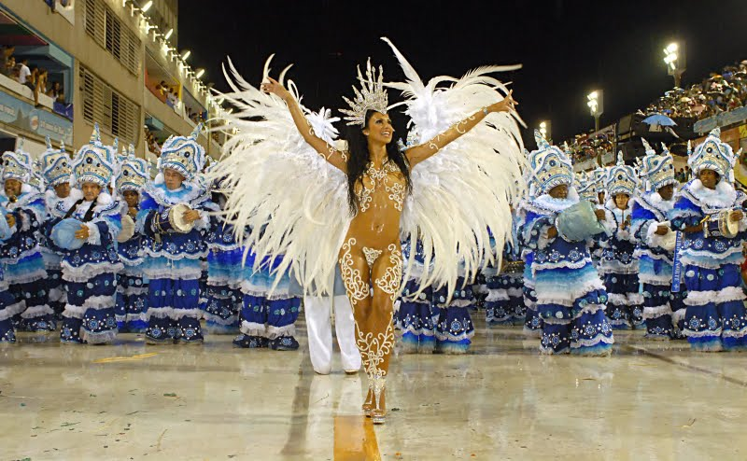
Samba

Slide 26
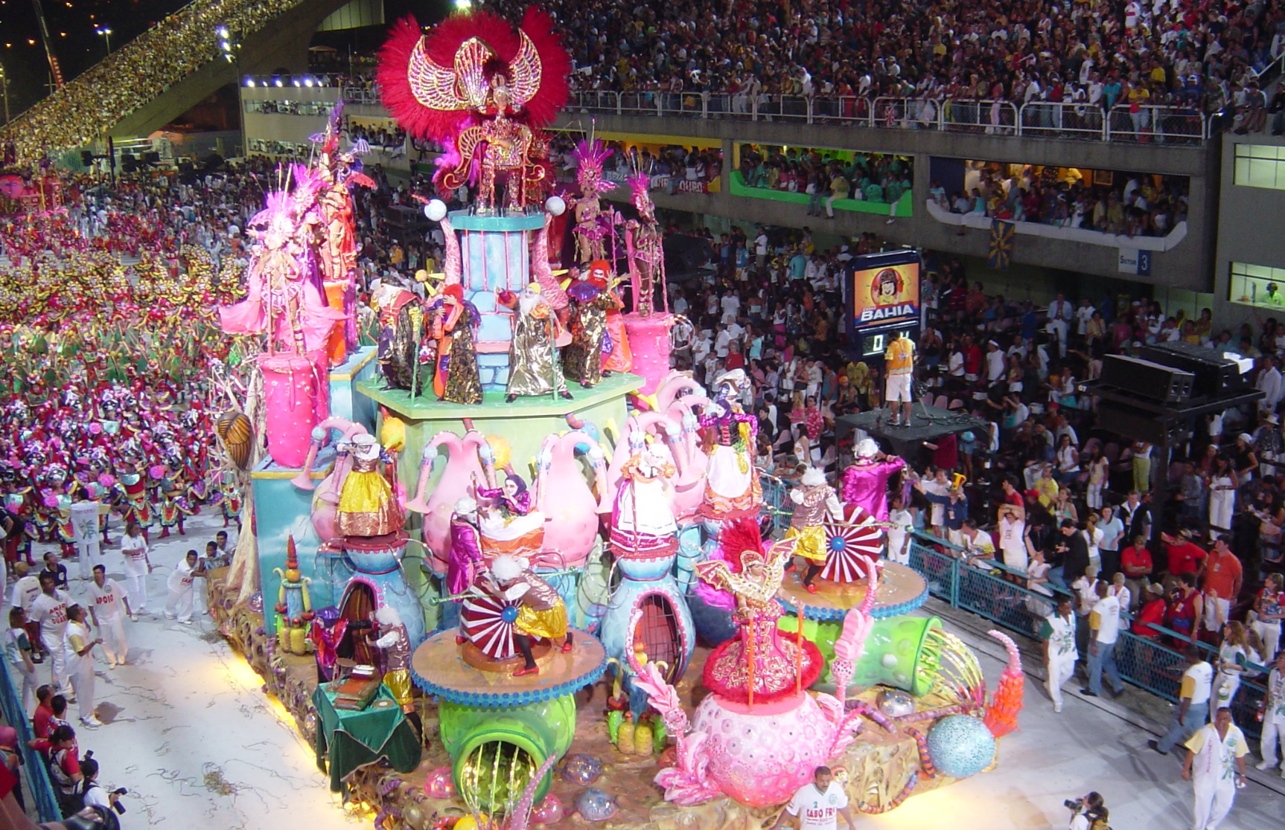

Slide 27

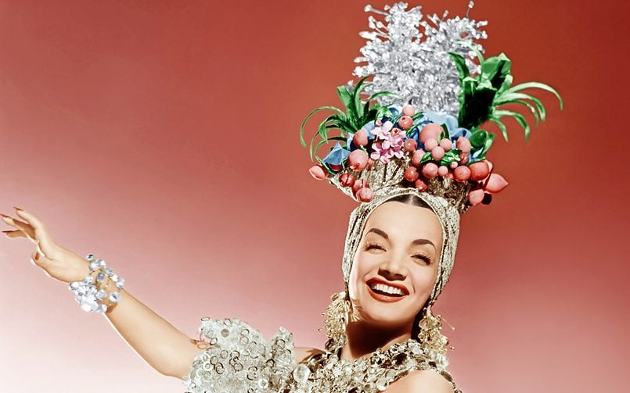
Carmen Miranda & the Exporting of Samba

Slide 28
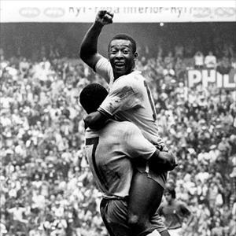
Brazilian Futebol: the First World Cup Win in 1958

Slide 29
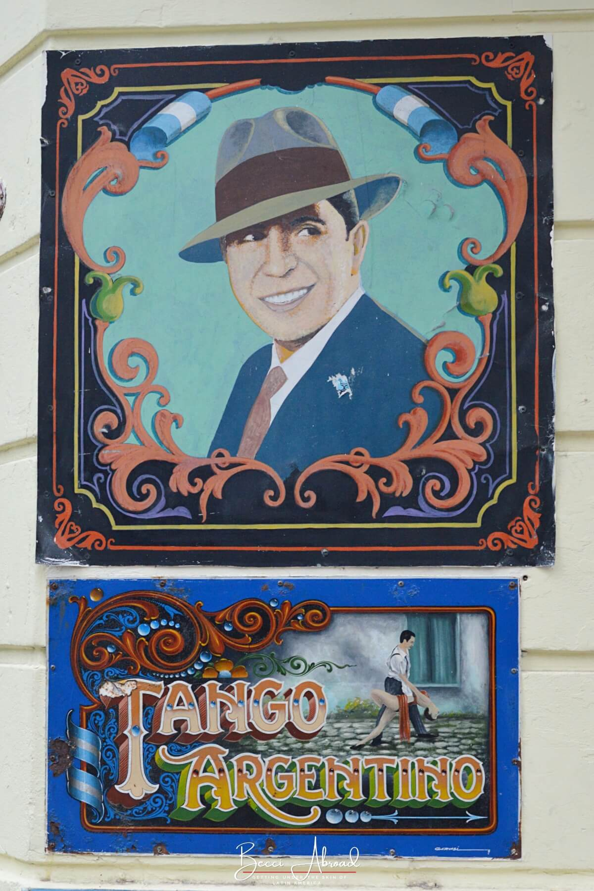
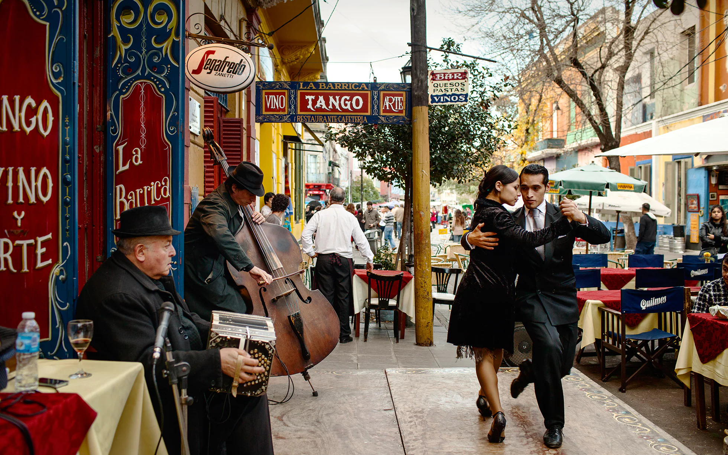
Tango

Slide 30
Latin America by 1959: the Demise of Populism?
Fragility of new order built on corporatism/ populism/ nationalism
Ongoing polarisation of politics
Stresses of industrialisation
Destabilising influence of Cold War internationally; spectre of Communism
Military always waiting in the wings…

Slide 31
Have any of these themes inspired you for your essays?
Samba, populism, football, labour strikes, Evita, Latin American communism, cultural nationalism, Carmen Miranda in the US, populism and workers’ political consciousness?

