Slide 1
Mid-Twentieth-Century Latin America: Corporatism, “Populism”, Nationalism and Labour

Slide 2
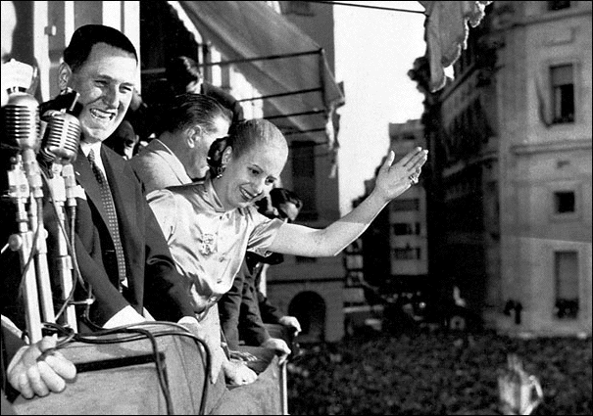
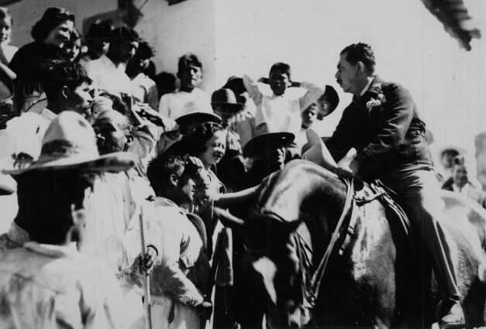
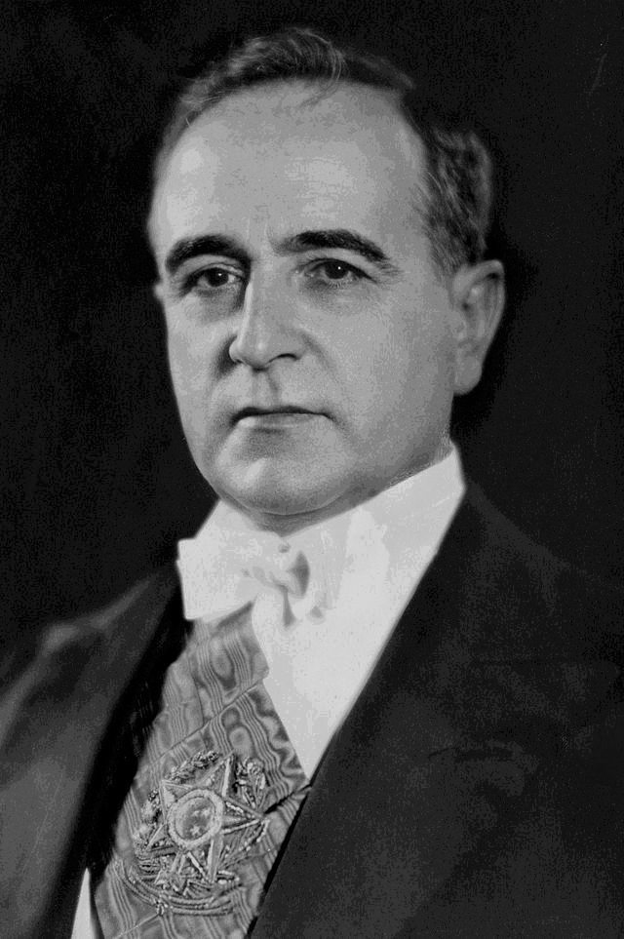
Who were the populist leaders?
Juan Peron, Argentina (1946-1955, 1973-1974)
Lázaro Cárdenas, Mexico (1934-1940)
Getúlio Vargas, Brazil (1930-1945, 1951-1954)

Slide 3
Economic Context
Economic nationalism from 1930: away from dependence on export economies
Industrialise by replacing imported goods: import substitution industrialisation (ISI)
Massive rural-urban migration
Rural crisis
Urban sprawl, growth of slums and urban social problems

Slide 4
Who has held power in Latin America previously?
Oligarchs: liberal consensus from late C19; rule by small elite; powerful families; haciendas linked to the export economies
Early C20: gradual urbanisation and small-scale industrialisation
Pressure from urban middle classes for political representation…
E.g.: Argentina: 1912: Saenz Peña law widens the franchise to include urban MC;
→ 1916 election of the Radical Party (Yrigoyen) : urban interests in Argentinian politics

Slide 5
Politics of the urban working class
Slow growth of socialism, anarchism
Associated with Spanish/ Italian immigrants and Mexican Revolution
Communist Parties founded after 1917: Chile, Cuba, Brazil, Argentina, Mexico.
Working people seek better conditions…
STRIKES and labour protest…
exacerbated by DEPRESSION from 1930
National politicians have to INCORPORATE some of these demands…

Slide 6
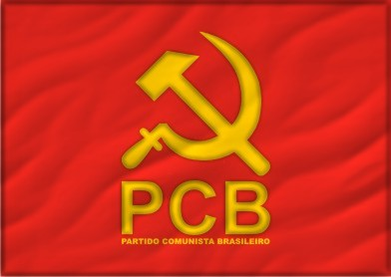
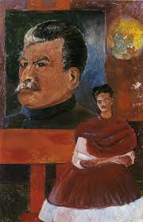
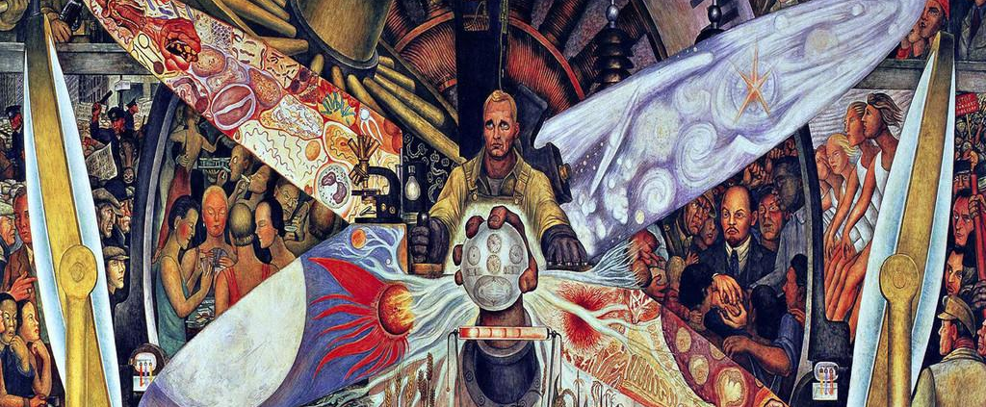
Latin American Communism

Slide 7
Volatile politics in the 1930s
Radical politics on the Left
Radical groups on the Right: influenced by European fascism
Need to juggle working-class demands AND keep industrialists on side…

Slide 8
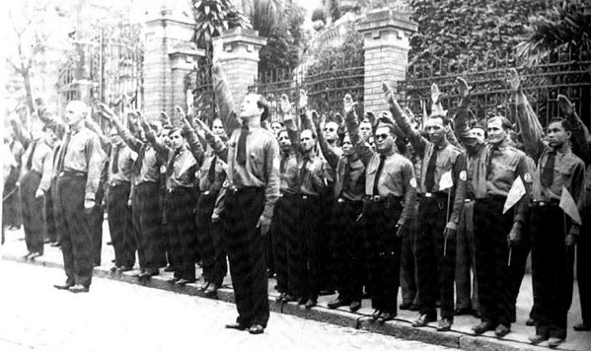
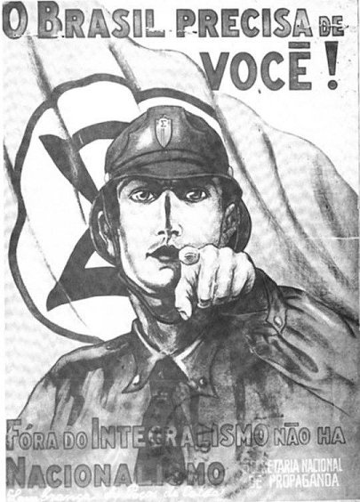
Latin American fascism

Slide 9
Corporatism
Bring different corporate entities (e.g. trade unions, industrialists’ associations, white-collar workers) into the bureaucratic apparatus of the state
These groups receive state favours and patronage
State is arbiter of conflict between competing groups; but none can challenge the power of the state itself.
→ Growth of the STATE
E.g. Vargas: trade unions gain benefits, but can’t go on strike

Slide 10
Corporatism and authoritarianism
Modelled on SOUTHERN EUROPEAN FASCIST/ AUTHORITARIAN STATES e.g. Spain, Portugal, Italy.
Often underpinned by force
e.g Vargas: full-blown DICTATORSHIP in Brazil from 1937-45 (Estado Novo)
E.g. “soft” authoritarianism in Mexico: unions, peasants groups etc controlled through state funding & patronage
Authoritarian tendencies but not full dictatorship like Brazil’s Estado Novo under Vargas.

Slide 11
World War II: a political watershed
Lat Am comes in on American side; supposedly support democracy over dictatorship
Defence & economic pacts with US
Lat Am governments keen to show their democratic credentials
So former dictators go to the polls.
Vargas in Brazil; Batista in Cuba; and Perón in Argentina: all make use of ELECTIONS

Slide 12
Populism
“the phenomenon whereby a politician tries to win power by courting mass popularity with sweeping promises of benefits and concessions to large interest-groups, usually drawn from the lower classes. Populist leaders lack a coherent programme for social change or economic reform, but try to manipulate the existing system in order to lavish favours on underprivileged sectors in return for their support” (Williamson)

Slide 13
Populism: a problematic term
Way of dismissing working-class political aims?
Politicians aim at manipulation, but doesn’t mean this is all that is going on
Need to take working class political activity seriously…
Ernesto Laclau, need to reclaim populist politics

Slide 14
… e.g. Brazilian labour history…not just manipulation by Vargas
Labour movement long pre-dated Vargas
Activists avoided Vargas-controlled unions during Estado Novo (-37-’45)
but labour movement later decides to work WITH Vargas in democratic period
Organised labour pushes him to fulfil promises to workers…

Slide 15
“Working people in São Paulo were not mobilized from above by politicians; they gave populists their votes in exchange for the populists’ support of their demands.”
Joel Wolfe, São Paulo and the Rise of Brazil’s Industrial Working Class (1993), 194

Slide 16
But, populist leaders do intend “manipulation”!
E.g. Juan Perón of Argentina (1946-55)…
image as saviour of the poor - the descamisados or shirtless ones
massive popularity through WELFARE BENEFITS: Eva Perón Foundation

Slide 17
Nationalism:
Economic nationalism
Top down nationalism
But also CULTURAL nationalism…
E.g. in Brazil: Vargas helps incorporate popular, non-elite cultural phenomena to mainstream…

Slide 18
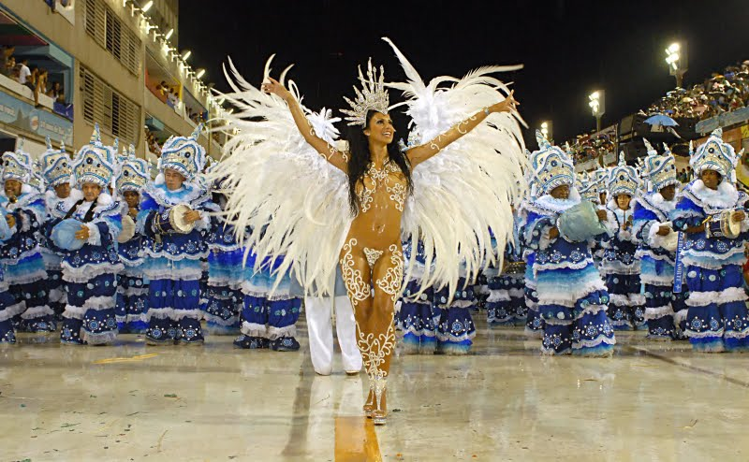
Carnival

Slide 19
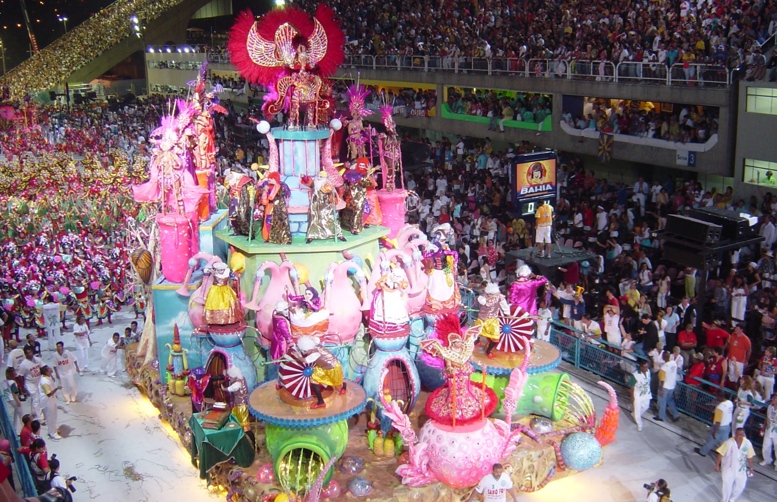
Carnival in Rio

Slide 20
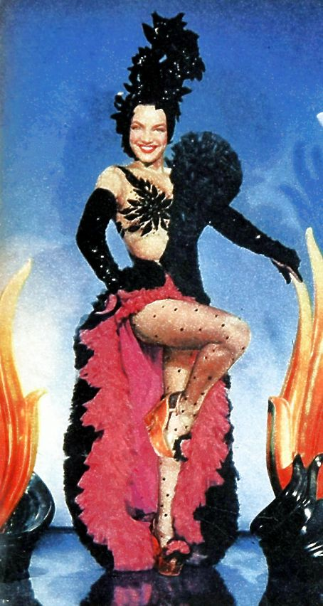
Carmen Miranda – the exporting of samba
Notes:
Carmen Miranda

Slide 21
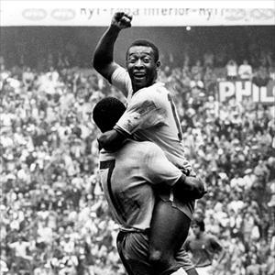
Brazilian futebol: the first world cup win in 1958

Slide 22
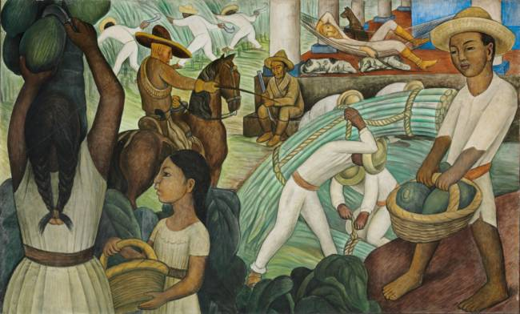
Indigenismo in Mexican Art

Slide 23
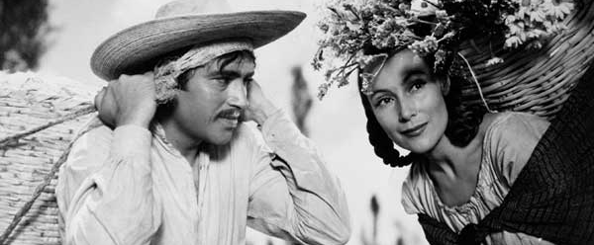
Indigenismo in Mexican Film (Work of Emilio “El Indio” Fernandez

Slide 24
Latin America by 1959: the demise of populism?
Fragility of new order built on corporatism/ populism/ nationalism
Ongoing polarisation of politics
Stresses of industrialisation
Destabilising influence of Cold War internationally; spectre of Communism
Military always waiting in the wings…

Slide 25
