Slide 1
Week 8: Corporatism, “Populism,” Nationalism, Labour

Slide 2
Reading
Juan Peron, Bill of Workers’ Rights,1947. (Translation in the MRC)
Interview with a group of members and leaders of Argentine trade unions, January 28 1947. MRC.
Secondary Sources:
Donna J Guy, Women Build the Welfare State: Performing Charity and Creating Rights in Argentina, 1880-1955 (Durham: Duke, 2009), chapter 6, At the Crossroads of Change,"
Robert M Levine, Father of the Poor? Vargas and his Era (Cambridge: Cambridge University Press, 1998) chapter 3, “The Estado Novo,” pp 50-74

Slide 3
Questions
What was corporatism? What was populism?
Were 'populist' rulers popular, and if so, with whom?
How did 'populist' governments try to incorporate the demands of organised labour? How successful were they?
What was the relationship between Peronism, welfare, and feminism in Argentina?
What was the Estado Novo (Brazil)?
Did Getulio Vargas deserve his title of "Father of the Poor"?
How did populism and nationalism affect your "adopted" country? How does it compare to the cases of Brazil and Argentina?

Slide 4
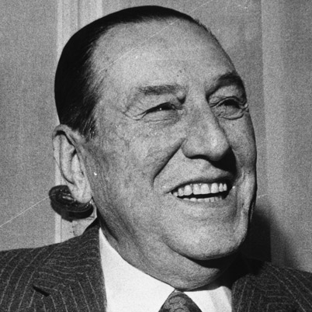
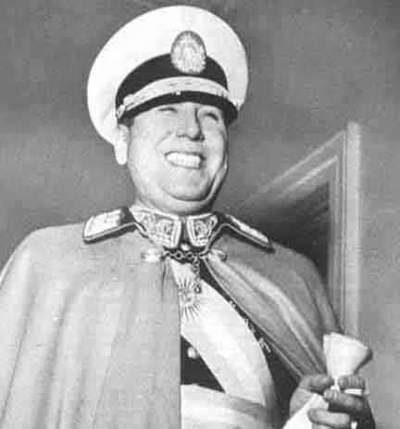
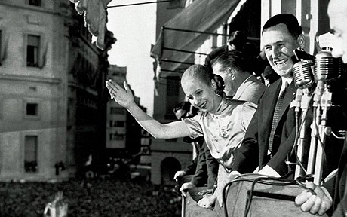

Slide 5
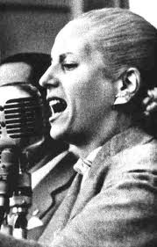
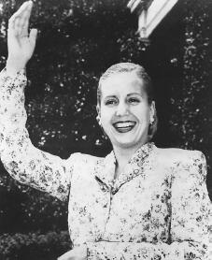
Notes:
Eva Peron

Slide 7
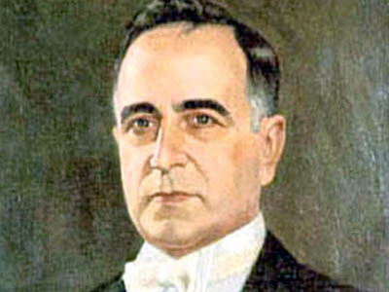
Getúlio Dornelles Vargas (1882-1954)

Slide 8
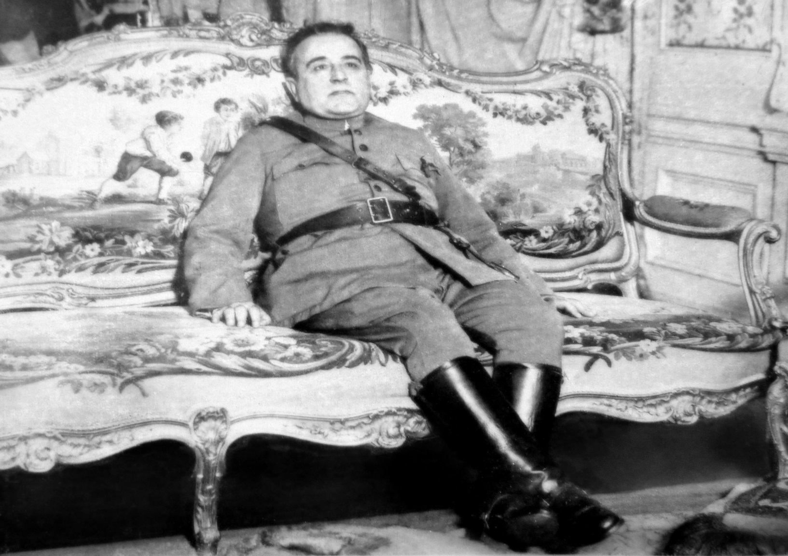
Former military man…

Slide 9
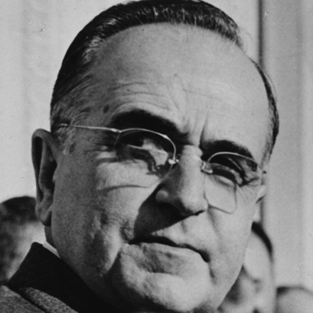
… and wily political operator

