Slide 1
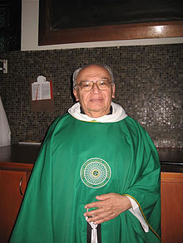
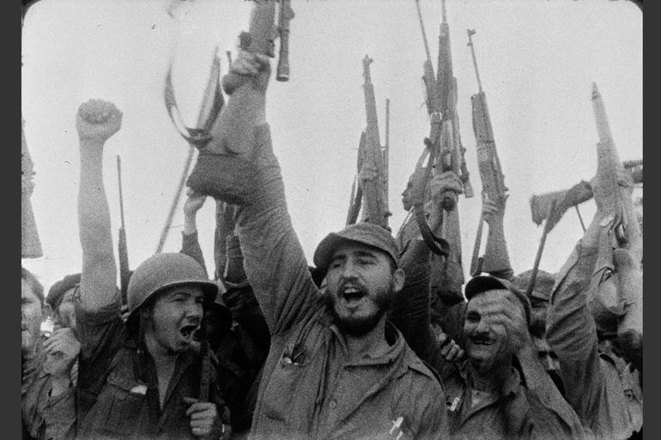
Week 9: Revolutionary Latin America

Slide 2
Readings
Primary source: Fidel Castro, "History will absolve me" defence speech, October 15 1953.
Primary source: Gutiérrez, Gustavo, “The Task and Content of Liberation Theology,” in The Cambridge Companion to Liberation Theology The Cambridge Companion to Liberation Theology, Christopher Rowland, ed., Cambridge University Press, Cambridge, 2007, pp. 19–38.
Aviva Chomsky, A History of the Cuban Revolution (Wiley, 2010), Introduction and Chapter 1.

Slide 3
Questions
How important was the Cuban Revolution?
What were the Cuban Revolution's main aims? Were they achieved? How much did the Revolution evolve over time?
What were the goals of liberation theology? How influential was it?
How different are Castro’s and Gutiérrez’s visions for the future of Latin America?

Slide 4
Documentary (2 parts) “Living Liberation Theology”
https://www.youtube.com/watch?v=cmzTqTXT1t0

Slide 5
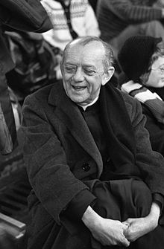
Dom Helder Camara of Brazil
"When I give food to the poor, they call me a saint. When I ask why they are poor, they call me a communist.”

Slide 6
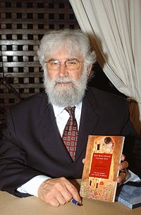
Leonardo Boff of Brazil
"One of the worst fundamentalisms is that of neoliberalism” [2000]

Slide 7
Gustavo Gutierrez, Peru
"Poverty is not fate, it is a condition; it is not a misfortune, it is an injustice. It is the result of social structures and mental and cultural categories, it is linked to the way in which society has been built..."

