Slide 1
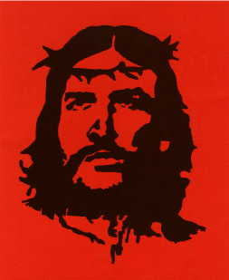
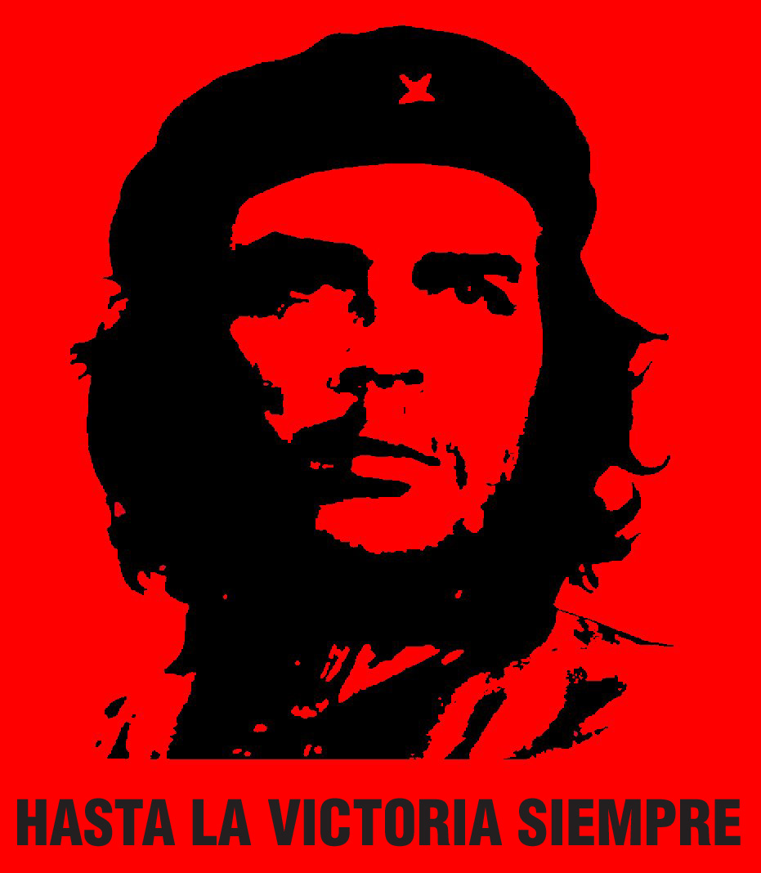
Revolutionary Latin America: The Cuban Revolution and Liberation Theology

Slide 2
U.S. in Post-WWII
Context of the Cold War
Political interference in countries with left-leaning governments e.g. Guatemala 1954 (Che Guevara was there)
Economic policy of developmentalism.

Slide 3
Two Reactions
Marxism and left-wing revolutionary movements: Cuban Revolution
Liberal theological movements in Catholic Church: Liberation Theology

Slide 4
Cuba
1952: Military Coup of Fulgencio Batista against Carlos Prio
Support of US economic interests – by 1959, US companies own 40% of sugar lands, 90% of minerals, 80% of utilities.
Widespread poverty throughout Cuba.
26th July 1953: Revolutionary group attacks Moncada Barracks in Santiago de Cuba, led by Fidel Castro
Marks beginning of Cuban Revolution

Slide 5
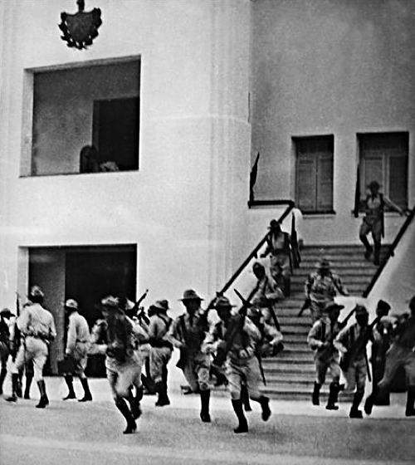
Moncada Barracks Attack

Slide 6
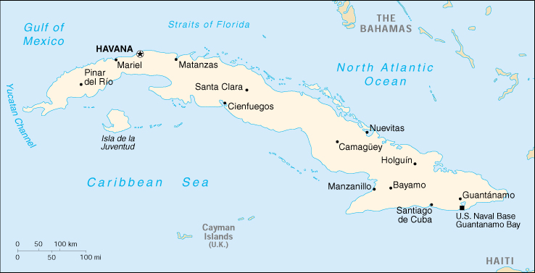
Moncada Barracks Attack

Slide 7
History will Absolve Me (La historia me absolverá)
Castro gives History Will Absolve Me Speech at defense in court
Sentenced to 15 years in prison
Attack on US-backed dictator Fulgencio Batista
Criticises economic disparity in Cuba. Cites 700,000 Cubans without work, 30% illiteracy
Demands economic reforms including:
Land reforms
right of industrial workers to 30% share in profits
right of sugar workers to 50% of profits

Slide 8
Cuban Revolution
1955: Castro released after amnesty by Batista
Travels to Mexico to plan new offensives
1956: Returns to Cuba with 80 other guerrilla fighters
Uses guerrilla “foco” strategy to defeat US-armed Batista forces
21 August 1958: After several failures, begin final offensive, taking cities on the way to Havana
2 January 1959: Revolutionaries take Havana

Slide 9
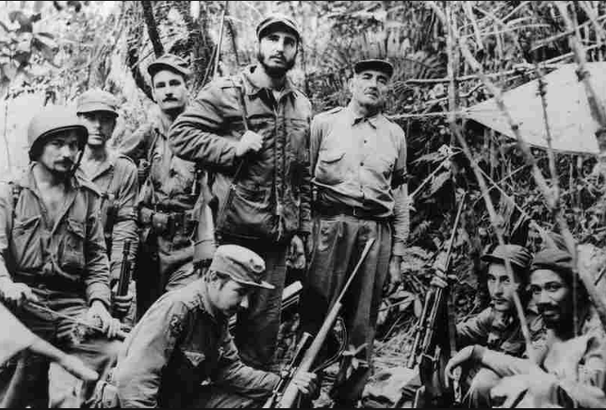

Slide 10
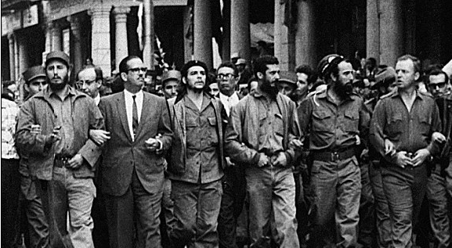

Slide 11
Castro’s Cuba
Progressive social reforms:
Racial equality for black Cubans
Women’s rights movements
Healthcare, hygiene and sanitation improved
Increased education and literacy rates
Economic reforms: Nationalises land (Ministry of Misappropriated Assets), imposes socialist economy
Repression of dissidents, Church, political opponents.

Slide 12
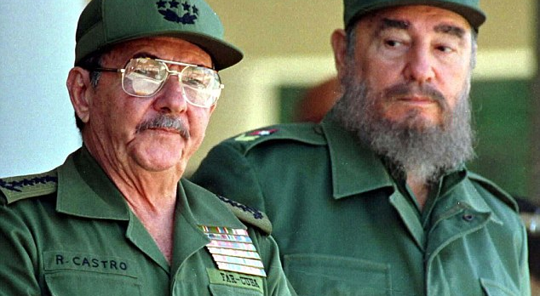

Slide 13
Latin American Reactions
Heralds new sense of self-determination: ‘Now we are the citizens of all humanity’ (Octavio Paz)
Inspires guerrilla foco movements throughout LA e.g. Douglas Bravo in Venezuela, FLN in Colombia, 1965 Ciudad Madera (Mexico) barracks attack
Initial political and creative optimism (‘Boom’ literature)
Some rejection after political oppression is revealed.

Slide 14
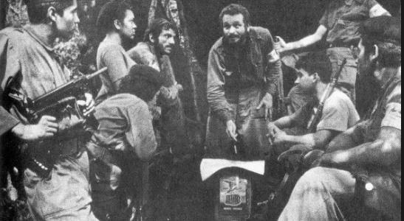

Slide 15
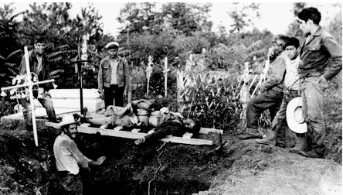

Slide 16
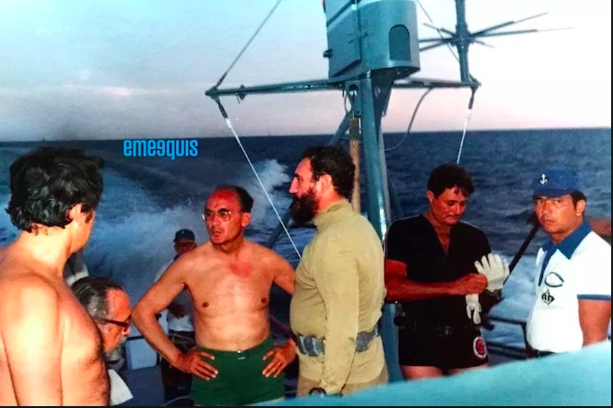

Slide 17
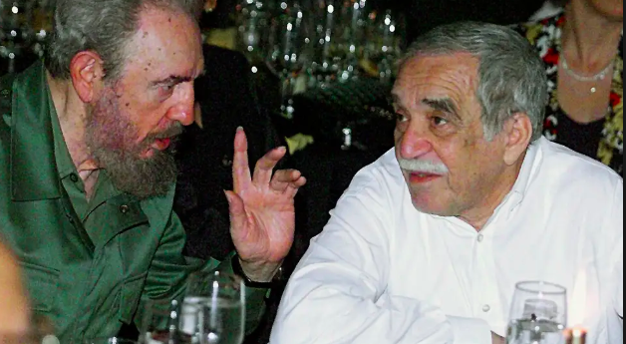

Slide 18
US Reactions
Cold War and fear of spread of Communism – Cuba is 90 miles from Florida coast
Economic and political sanctions
Florida becomes hub of Cuban refugees
U.S. training of Cuban paramilitaries
Bay of Pigs
Assassination Plots

Slide 19
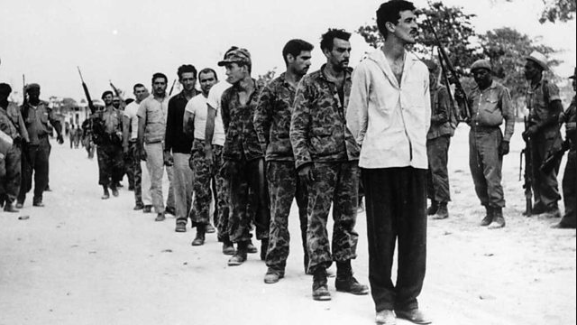

Slide 20
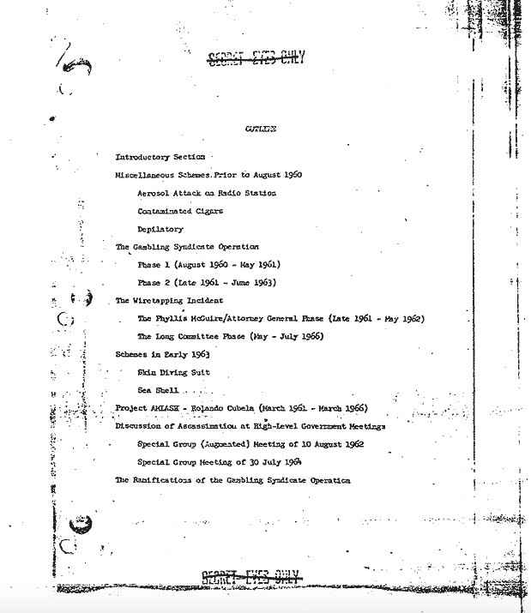
1967 CIA internal report on assassination attempts

Slide 21
Liberation Theology
Theological reaction to poverty and marginalisation in Latin America.
Hangs on question: How can one preach a gospel of love and hope in a context of poverty and suffering?
Best formulated by Gustavo Gutiérrez Teología de la Liberación (1971)
Brings together social analysis with Christian belief.

Slide 22
Context
Second Vatican Council (Vatican II) – 1962
Concern with secularism among labour movement
Recognition of importance of the poor to the Catholic Church
Particularly relevant to Latin American – both poor and highly Catholic
Concerns taken up by Conference of Latin American Bishops in Medellín (1968): Formulation of ‘preferential option for the poor’

Slide 23
Gustavo Gutiérrez
Born Peru, 1928. Of Quechua and Spanish descent.
Dominican priest
Vocation to work with the poor of Lima
Major work: A Theology of Liberation

Slide 24
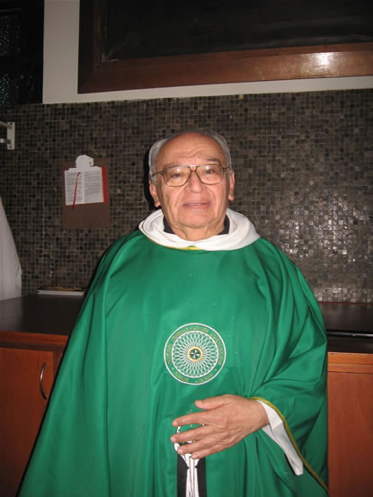
Gustavo Gutiérrez

Slide 25
Liberation Theology
This attitude is ‘the way’ described by Jesus
Grounded in both Old Testament, and Latin American tradition (Las Casas).
By ‘putting the poor first’ it communicates the love of God, and inaugurates a movement of liberation, against oppression and exploitation

Slide 26
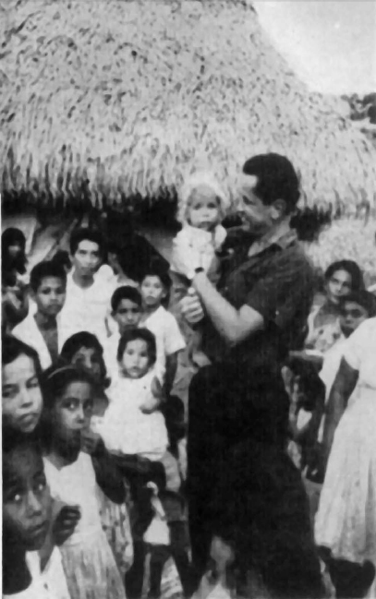
Camilo Torres and the FLN in Colombia

Slide 27
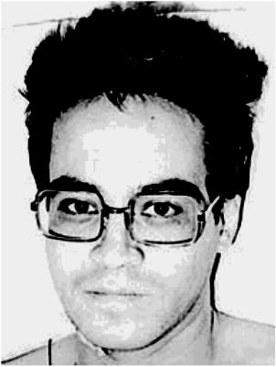
Ignacio Arturo Salas and the Liga Comunista 23 de Septiembre, Mexico

Slide 28
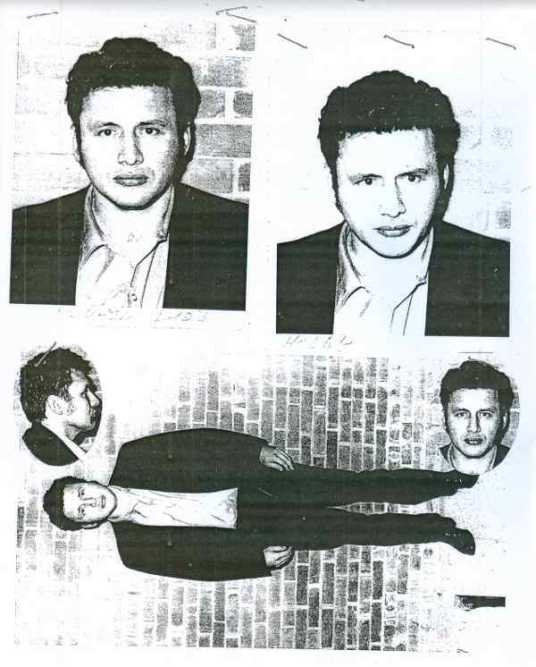
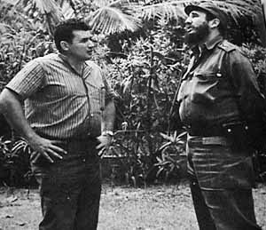
Mario Menendez and revolutionary journalism in Latin America

Slide 29
Legacy
Awareness of role of Global South in Catholic Church.
Pope Francis
Appointment of Global South Cardinals, including first Caribbean Cardinal
Emphasizes aspects of Liberation Theology and ‘preferential option for the poor’ – rejection of Papal trappings, emphasis on Church’s duty to poor.

Slide 30
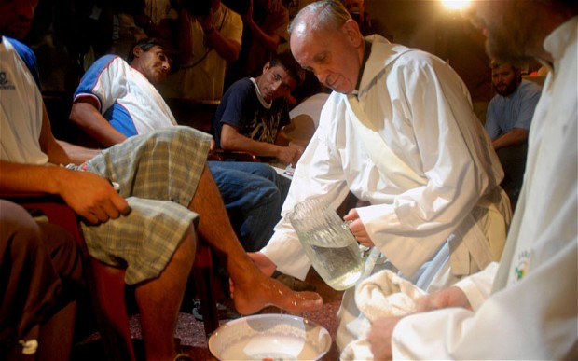
Preferential Option for the Poor

