Slide 1
The US, the Cold War, and the Latin American Right

Slide 2
Gabriel García Marquez Nobel Prize Speech, 1982
““We have not had a moment’s rest… There have been five wars and seventeen military coups; there emerged a diabolic dictator who is carrying out, in God's name, the first Latin American ethnocide of our time. In the meantime, twenty million Latin American children died before the age of one - more than have been born in Europe since 1970. Those missing because of repression number nearly one hundred and twenty thousand, which is as if no one could account for all the inhabitants of Uppsala. Numerous women arrested while pregnant have given birth in Argentine prisons, yet nobody knows the whereabouts and identity of their children who were furtively adopted or sent to an orphanage by order of the military authorities… One million people have fled Chile, a country with a tradition of hospitality - that is, ten per cent of its population. Uruguay, a tiny nation of two and a half million inhabitants which considered itself the continent's most civilized country, has lost to exile one out of every five citizens. Since 1979, the civil war in El Salvador has produced almost one refugee every twenty minutes. The country that could be formed of all the exiles and forced emigrants of Latin America would have a population larger than that of Norway.”
http://www.nobelprize.org/mediaplayer/index.php?id=1496 6.30

Slide 3
Democracy in Latin America
1930-1948
  Great depression
  World War II
  Relatively sympathetic US President, Franklin Roosevelt and institution of Good Neighbor Policy
Latin American countries embrace democracy and distribution of wealth, but not always, under populist leaders.
  Mexico under Lázaro Cárdenas
  Guatemala under Jacobo Arbenz
  Chile under Social Democrat Radical Party

Slide 4
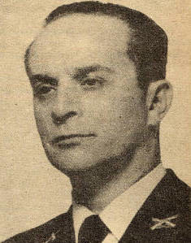
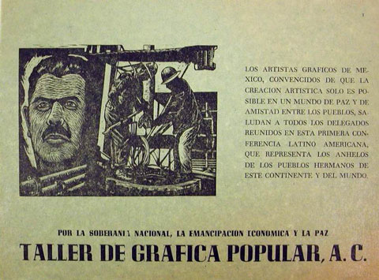
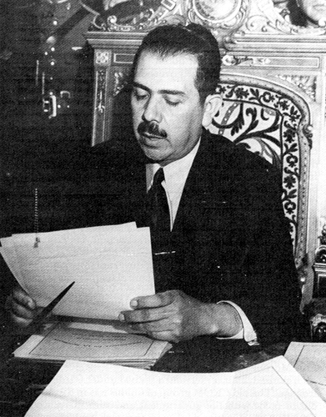

Slide 5
1948 onwards
  US increasingly paranoid about Soviet-backed communist infiltration.
  Increasing links between US corporations and US government (e.g. United Fruit, ASARCO mining company)
  Interventionist, Dwight D Eisenhower, becomes president of the US.

Slide 6
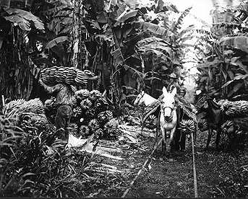
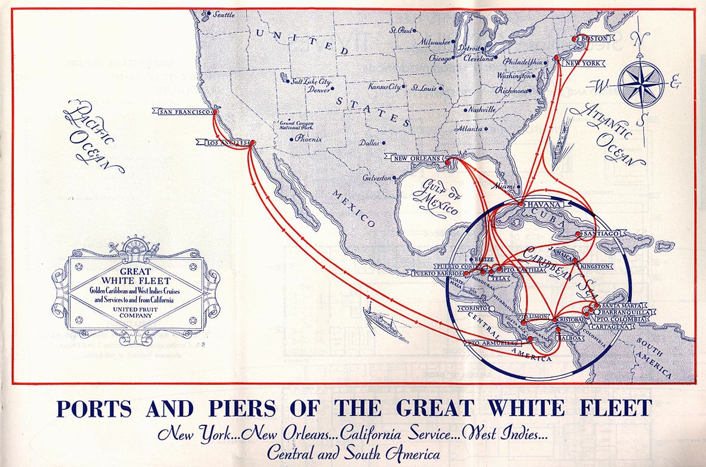
Guatemala

Slide 7
Guatemala 1954
Starting in Guatemala, US employs mixture of dirty tricks, psycho-ops, and military coups to overturn democratically elected, left-leaning governments.
E.g. Operation PB Success
https://www.youtube.com/watch?v=eJ3RzGoQC4s
1.31.00 ff
Psych ops, manipulation of the media
Support for small military group
Imposition of authoritarian regime
This becomes the model of US intervention in Latin America for next fifty years

Slide 8
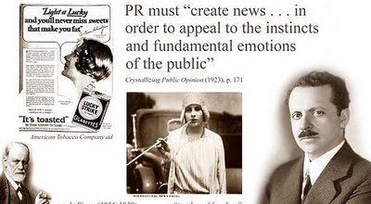

Slide 9
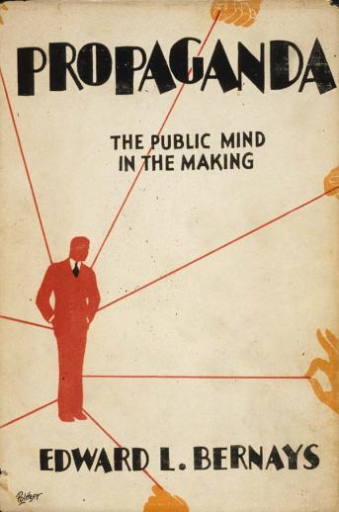
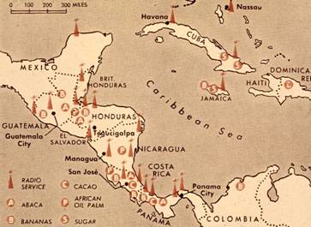

Slide 10
Blow back
Military rule effectively ends democracy.
Left-right divide imposes itself on Guatemalan racial divide.
Escalation of radicalism on both sides.
1960-1996 Guatemalan civil war leaves 200,000 dead. Military accounts for 90 percent.

Slide 11
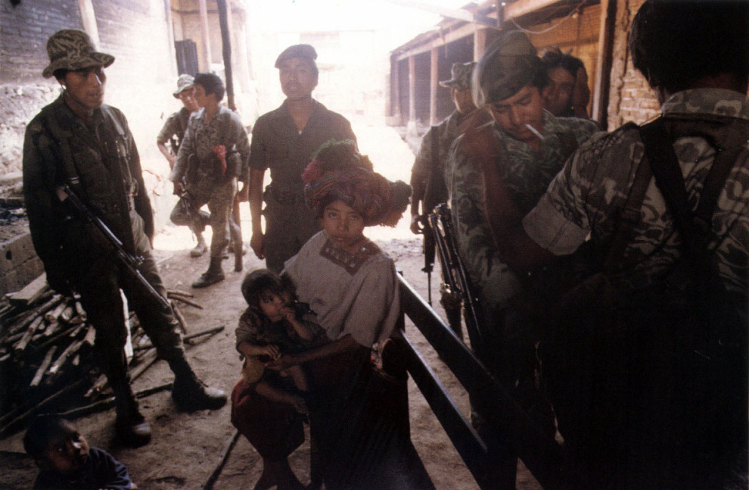
Militarized camps, 1982
“After having killed our wives, they brought out our children. They grabbed their feet and beat their heads against the house posts. I had six children. They all died, and my wife as well.. All my life my heart will cry because of it.” Sole survivor of Huehuetenango massacre.

Slide 12
1961 Bay of Pigs
US tries a version of PB Success in 1961.
Trains 1400 Cuban exiles in Florida and Panama, 1960-1961
Launches attack from US-supporting Guatemala
Supported by B26 Bombers (marked with Guatemalan Air Force insignia)
Defeated within 3 days by Cuban revolutionary militia and Cuban military.

Slide 13
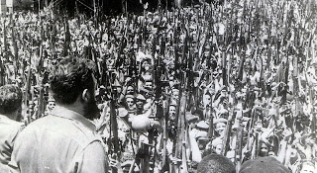

Slide 14
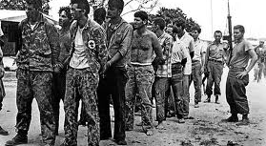

Slide 15
The regularization of US-right-wing influence
1961 Kennedy administration demands that School of the Americas in Georgia concentrates on training “anti-communist counter-insurgency techniques”
1961-1990, School of the Americas trains 55,000 Latin American soldiers.
Counter-insurgency techniques include lessons of torture and the extortion of information.
Former teacher, Major Joseph Blair:
“The doctrine that was taught was that if you want information you use physical abuse, you use false imprisonment, you use threats to family members, you use virtually any method necessary to get what you want... [including torture] and killing. If there's someone you don't want you kill them. If you can't get the information you want, if you can't get that person to shut up or to stop what they're doing you simply assassinate them, and you assassinate them with one of your death squads.”
https://www.youtube.com/watch?v=G5L1VdlktOw

Slide 16
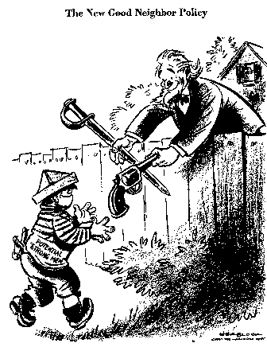
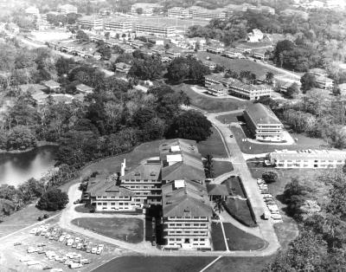

Slide 17
Chile 1970-1973
CIA has always claimed that not involved in overthrow of democratically elected leader, Salvador Allende, in 1973.
After failing to get Chilean congress to ratify opposition candidate, Jorge Allesandri, CIA attempts to stimulate military intervention by creating a “coup climate”
Economic pressure. President Nixon instructs CIA to “make economy scream”
Established ITT Corporation which funneled CIA funds towards efforts at destabilization
Propaganda, through US-backed newspaper El Mercurio
Armed Chilean militants who killed neutral army general René Schneider.
Supports destruction of state railroads, power plants and highways.
Offers support to Augusto Pinochet’s coup.
http://www.democracynow.org/2013/9/10/40_years_after_chiles_9_11 50.00 ff

Slide 18
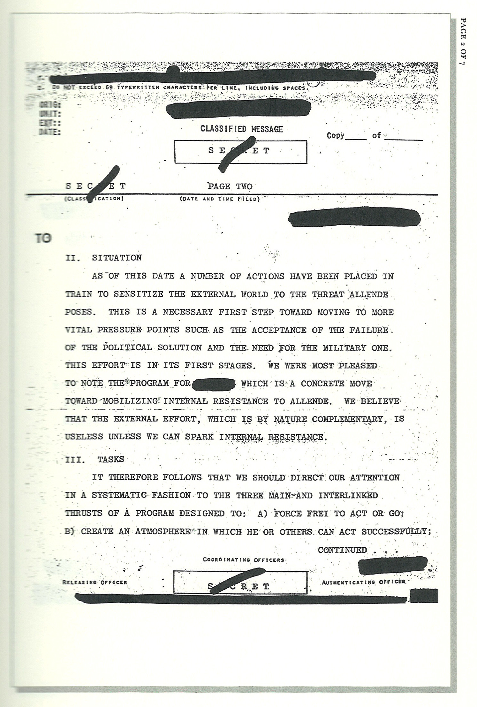

Slide 19
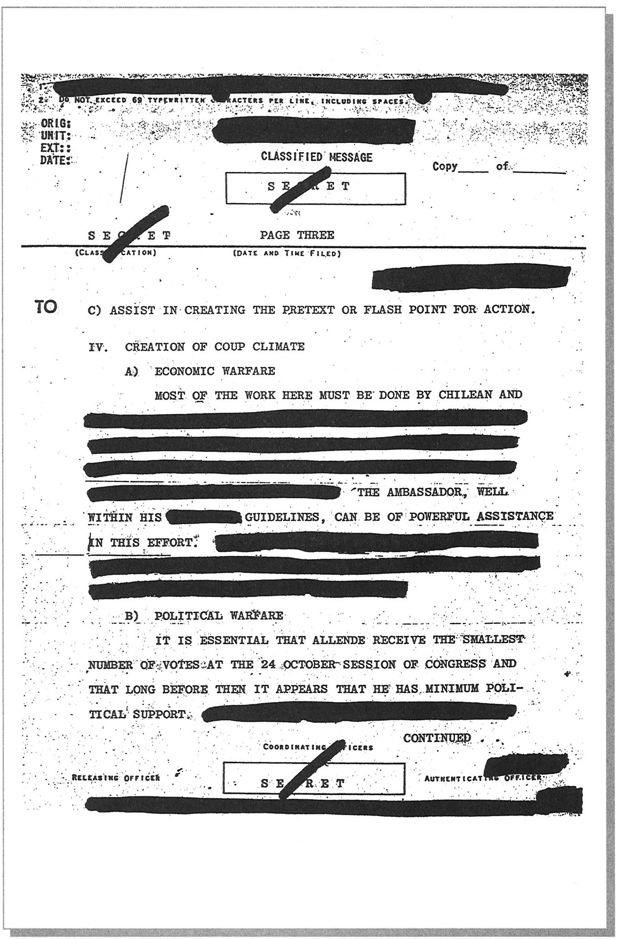

Slide 20
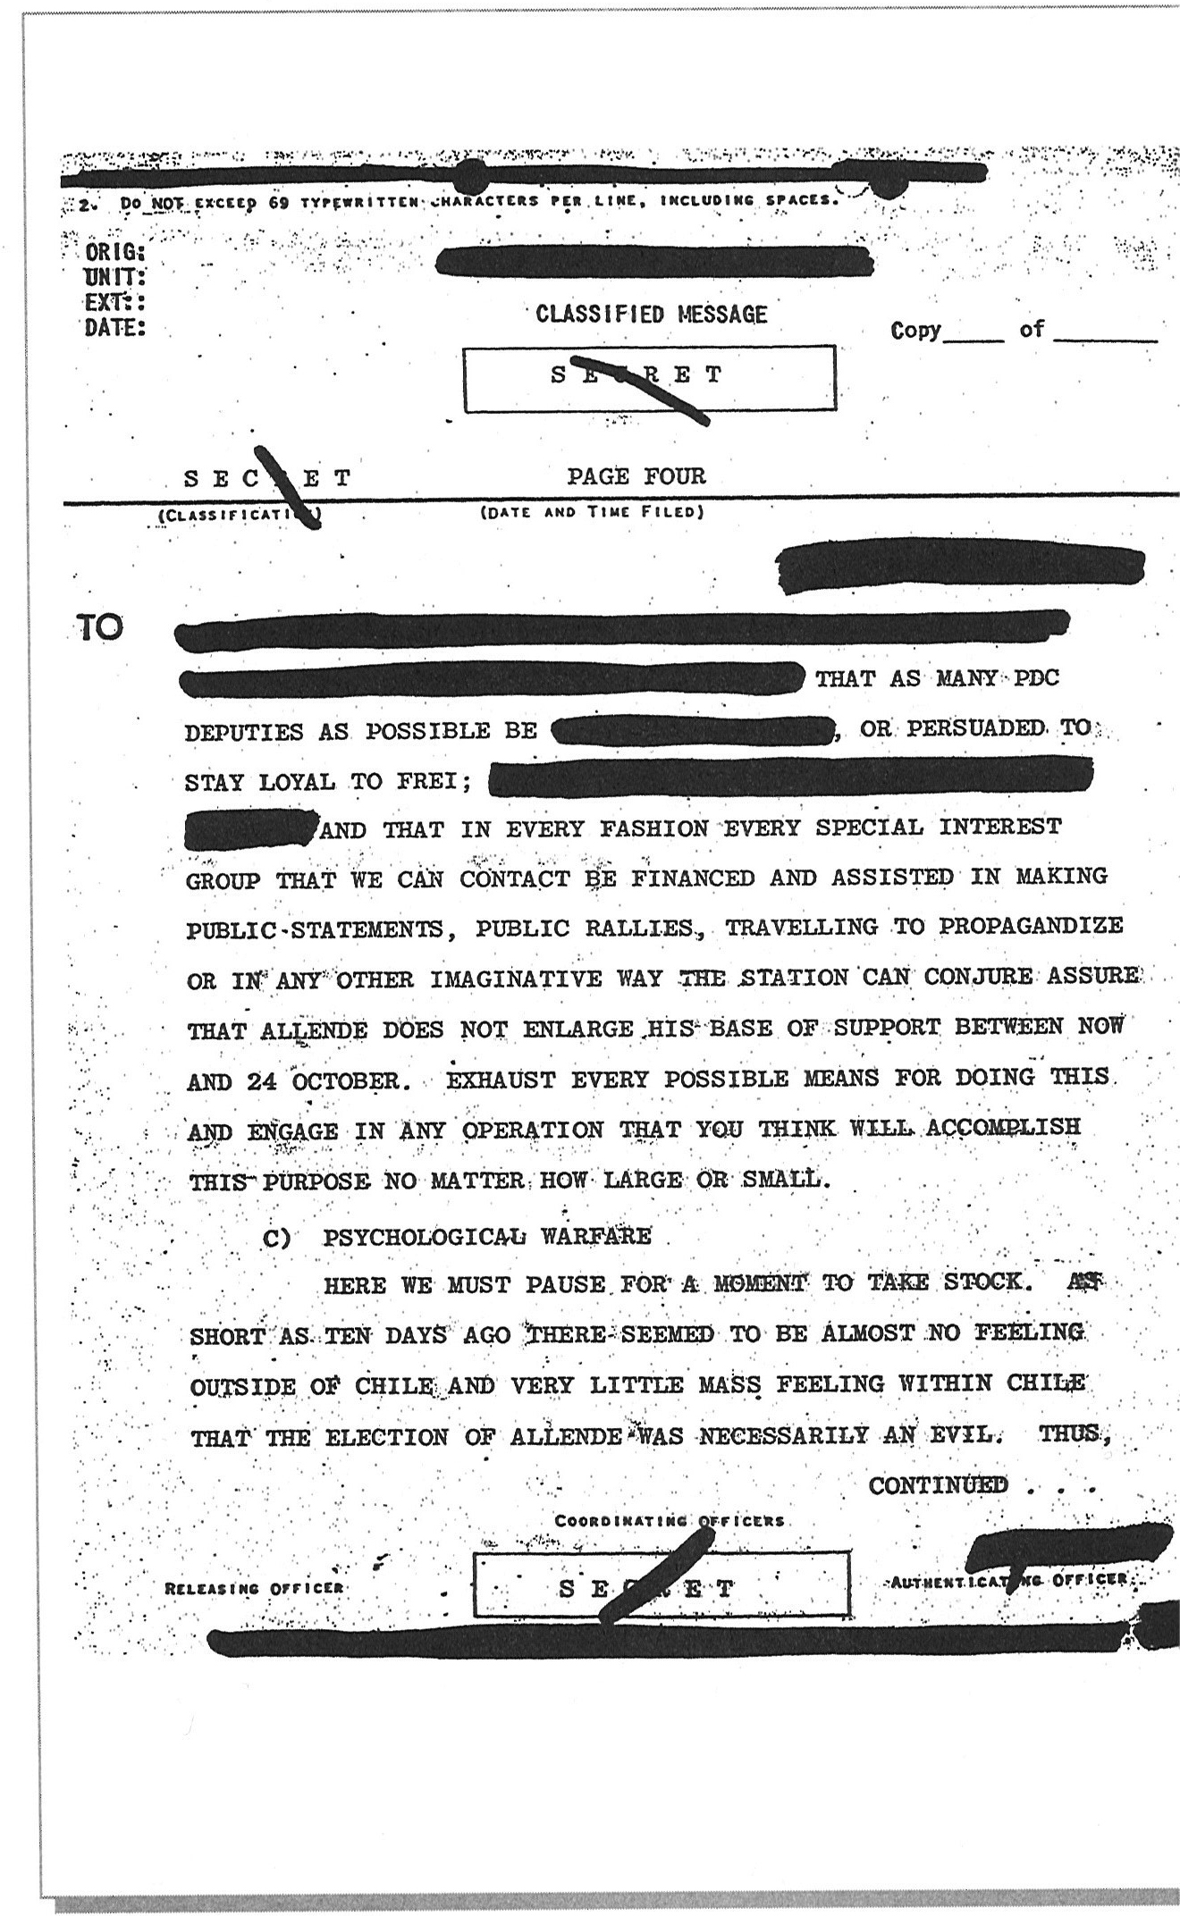

Slide 21
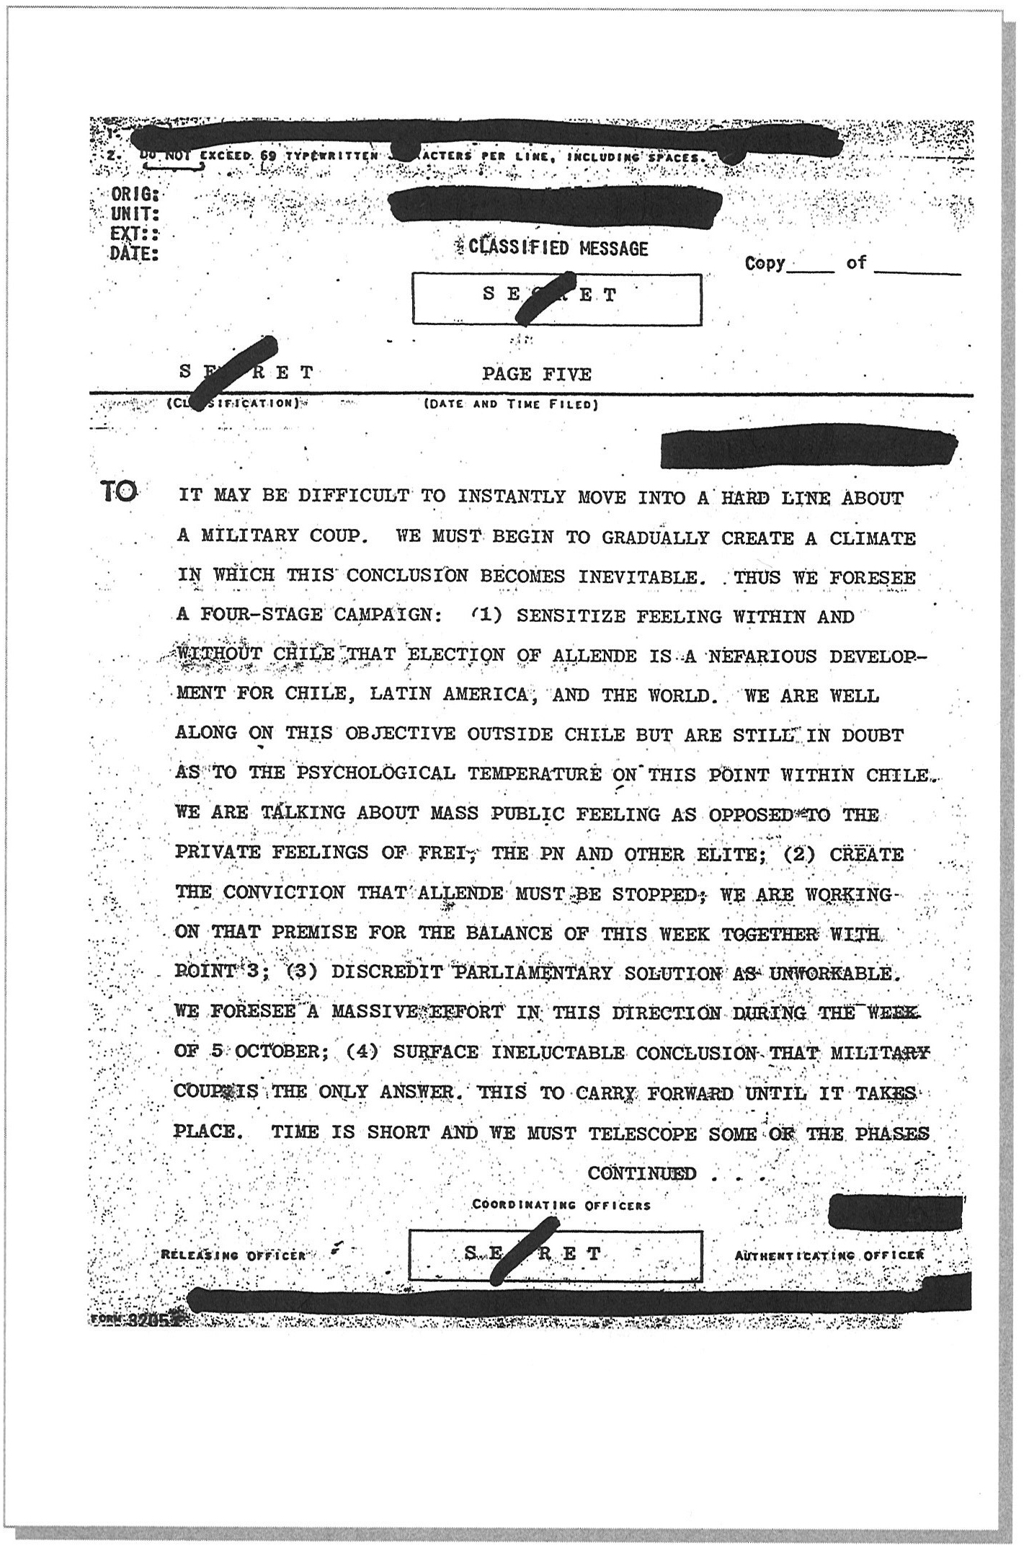

Slide 22
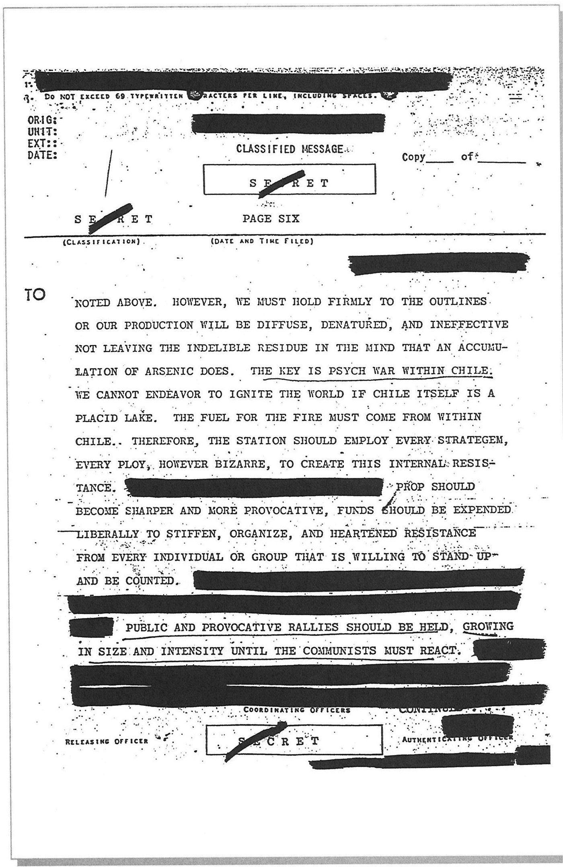

Slide 23
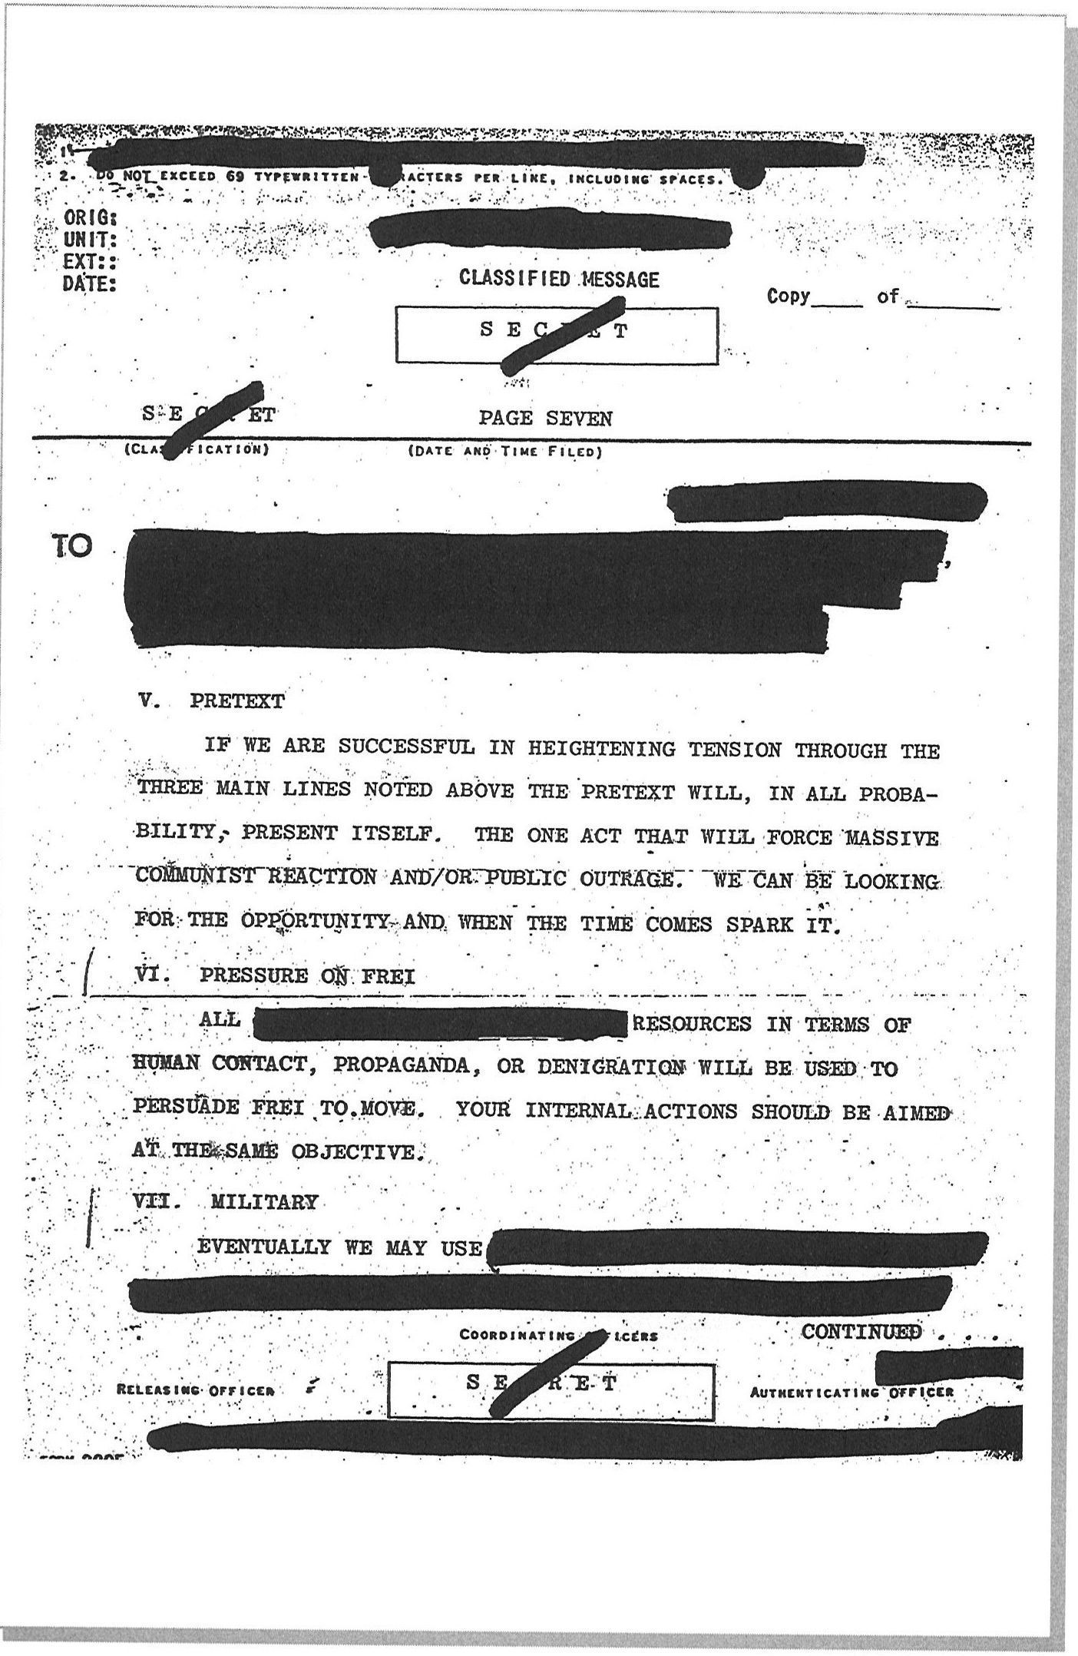

Slide 24
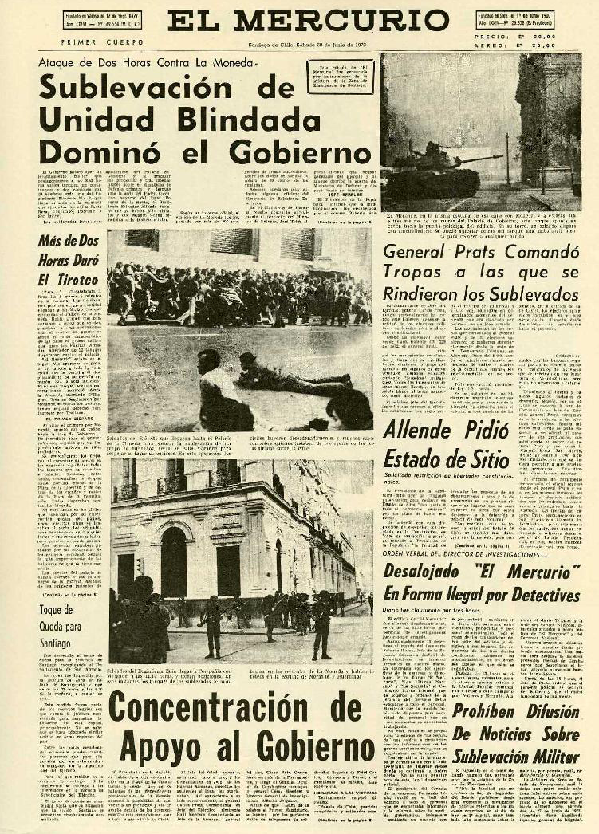

Slide 25
Operation Condor, 1974-1980
Military governments of Argentina, Chile, Uruguay, Paraguay, Bolivia, and Brazil instituted campaign of terror against left-leaning groups.
US supplied technical support, intelligence, and funding for campaign.
Henry Kissinger to Argentina’s foreign minister, 1976
“Look, our basic attitude is that we would like you to succeed. I have an old-fashioned view that friends ought to be supported. What is not understood in the United States is that you have a civil war. We read about human rights problems but not the context. The quicker you succeed the better… The human rights problem is a growing one. Your Ambassador can apprise you. We want a stable situation. We won't cause you unnecessary difficulties. If you can finish before Congress gets back, the better. Whatever freedoms you could restore would help.”
Over 60,000 died
Assassination of key left-wing leaders e.g. General Carlos Prats 1974 in Buenos Aires;
Erection of torture centers e.g. Automotores Orletti in Argentina.

Slide 26
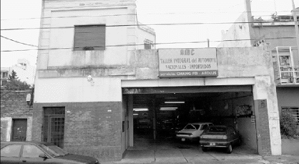

Slide 27
1980s Civil War in Central America, Colombia, and Peru
Election of Ronald Reagan (1981-1989). Move away form President Carter’s less interventionist foreign policy.
Increasing left-wing radicalism in Central America. Often, but not always, connected to indigenous groups
  1979 Sandinistas take over Nicaragua and depose dictator, Anastasio Samoza
  1980 Farabundo Martí National Liberation Front takes on government in El Salvador
  1980 Increasing guerilla insurgency in Guatemala e.g. Storming of Spanish embassy.
  1982 onwards, Increasing presence of guerilla forces in Colombia e.g. FARC
  1980 Establishment of Sendero Luminoso in Peru.

Slide 28
Military and paramilitary repression
Military repression continued. E.g. El Salvador, Guatemala, Peru
However, right-wing increasingly used unofficial paramilitary organizations to sow terror.
E.g. Contras in Nicaragua.

Slide 29
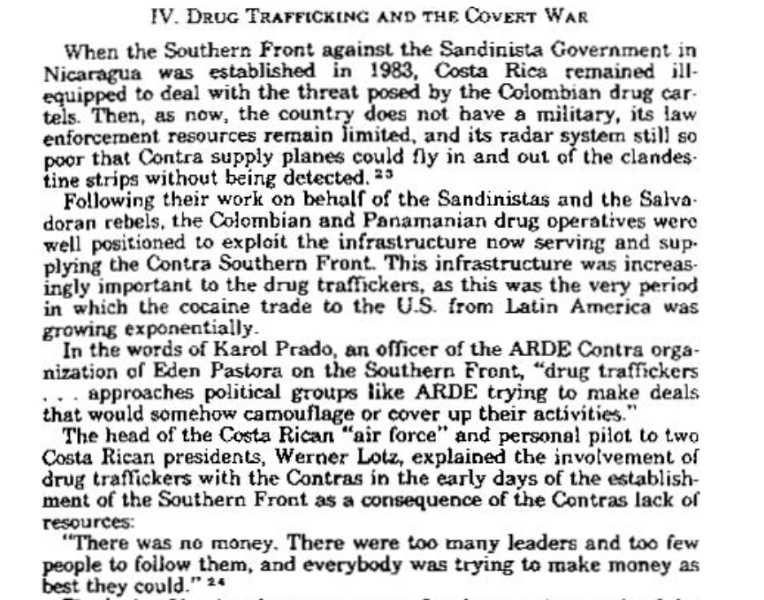
Senate Report on Covert War, 1988

Slide 30
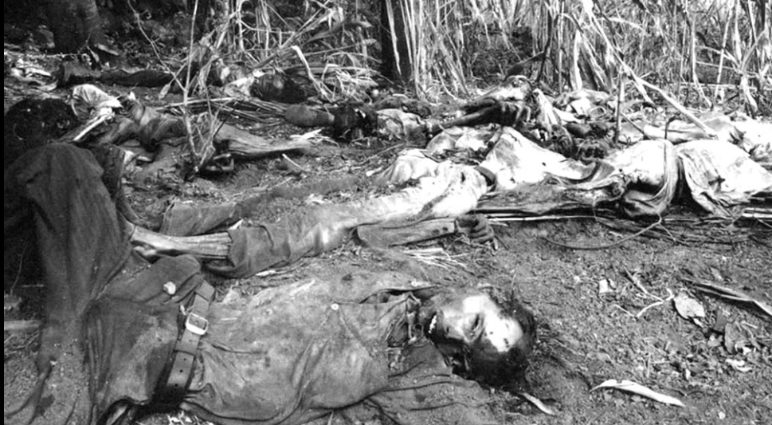
El Mozote Massacre, El Salvador, 1981
“Dozens of decomposing bodies still seen beneath the rubble and lying in nearby fields, despite the month that has passed since the incident... countless bits of bones—skulls, rib cages, femurs, a spinal column—poked out of the rubble” – Alma Guillermoprieta

Slide 31
Legacy of Cold War in Latin America
https://www.realclearpolitics.com/video/2019/02/13/rep_ilhan_omar_challenges_venezuela_envoy_elliott_abrams_about_iran-contra_past.html

