Slide 1
AM101: Latin American Themes and Problems
Iberians, Africans, and Peoples of the Americas
Dr. Rosie Doyle

Slide 2
Assessment
Essay Plan, Autumn Term Monday Week 7, 12 noon Short Essay, Spring Term, Monday Week 3, 12 noon Long Essay, Summer Term, Monday, Week 3, 12 noon
R.Doyle.1@warwick.ac.uk H027 Tues + Weds 9:30-10:30
Handbook https://warwick.ac.uk/fac/arts/history/students/handbooks/

Slide 3
Questions to think about for today’s lecture
Who were the peoples who would meet each other in the “New World”? Had any of them met before?
Were they entirely different from one another, or were there similarities?
What beliefs about each other had some of them already formed?
How might we expect their previous historical experiences to shape their encounter with each other?

Slide 4
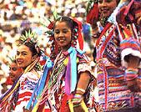
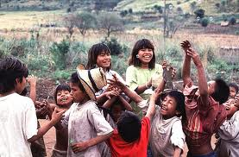
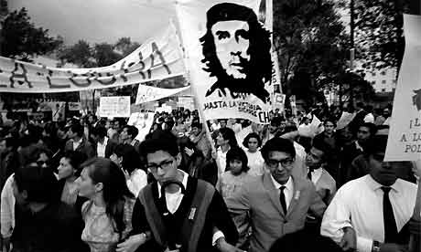
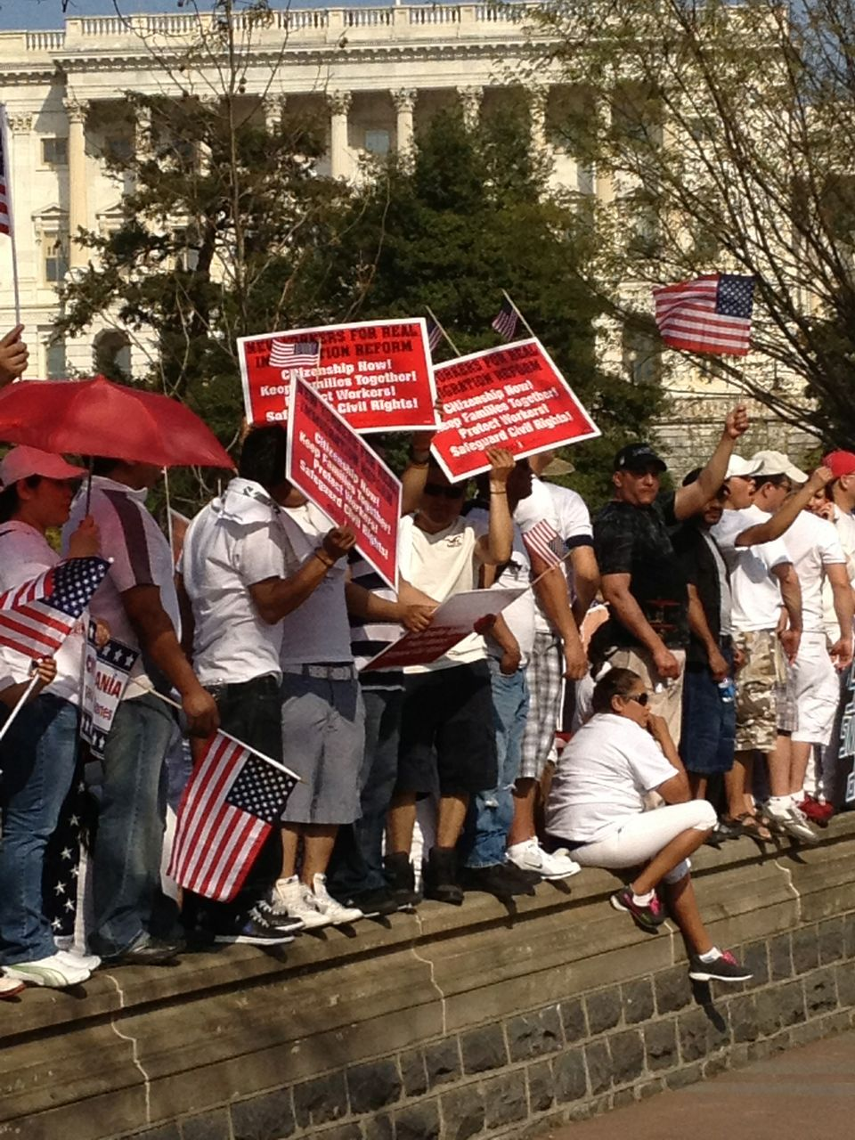
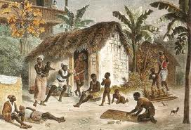
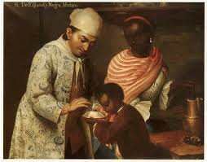
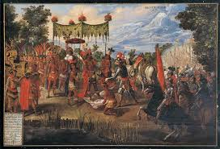

Slide 5
A key term: mestizaje (mixing)
Cultural and biological mixture
Applies to: Iberia pre-1492; Iberian Mediterranean and Atlantic pre-1492; Americas after 1492
To some extent, a natural process
But also could be imposed violently
Ideology of mestizaje used as a tool of nation-building in Latin America in the C19

Slide 6
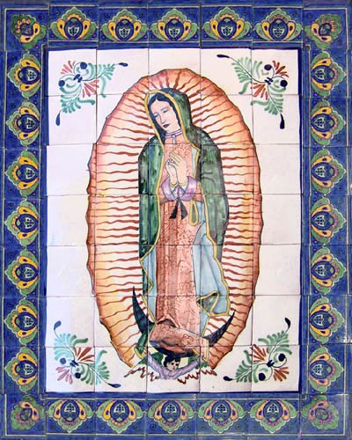

Slide 7
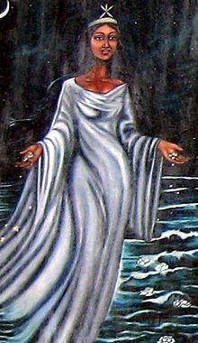
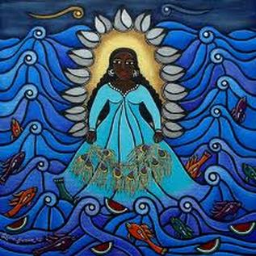
Yemayá/ Our Lady of Regla

Slide 8
PART 1: The Iberians

Slide 9
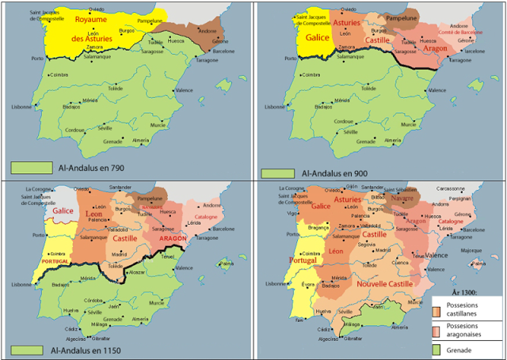

Slide 10
Reconquista as a historical process deeply marks the Iberian peninsula…
Helps create a frontier society: shapes process of land acquisition, population of new lands, spirit of religious crusade
Private adventurers, rewarded by Christian kings: receive wealth, land, status.
Population strategies: land grants, fueros (political/ judicial liberties)
Northern Castile: towns are strategy for colonisation (compare Americas)
South: large estates; sparse populations; latifundia; labour through tribute (compare Spanish American encomienda)

Slide 11
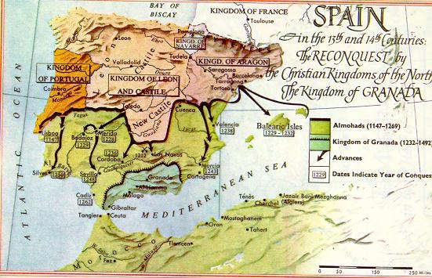
Iberia by the 13th century: Four kingdoms

Slide 12
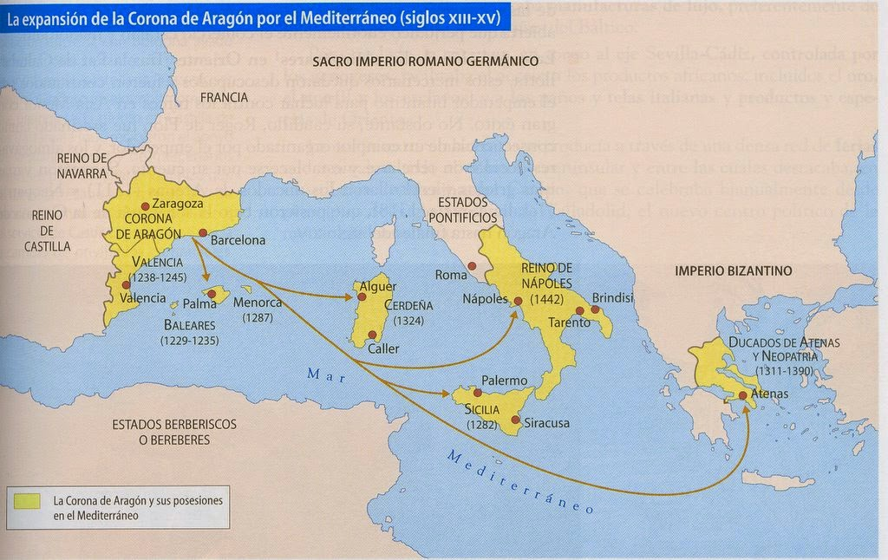
Aragonese expansion: the Mediterranean

Slide 14
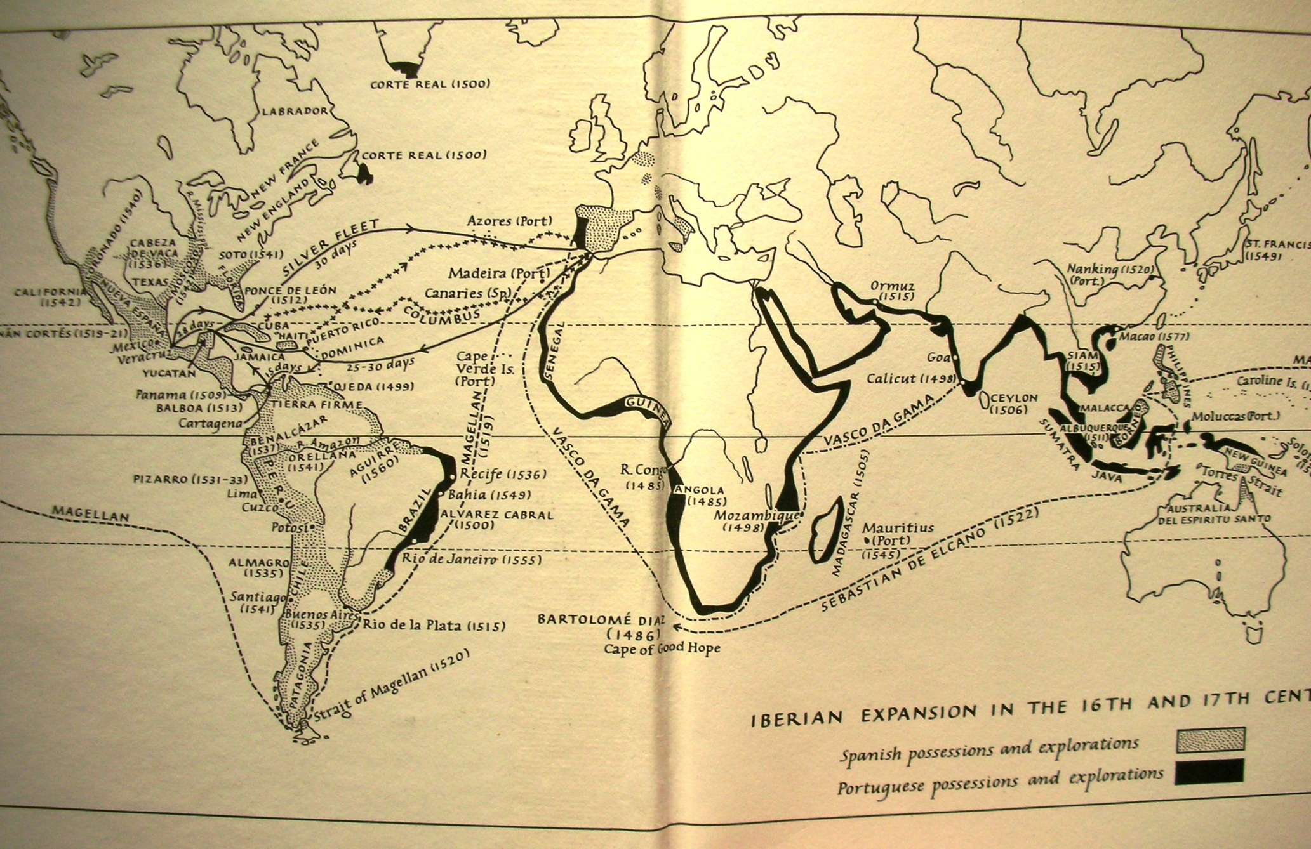
Notes:
Iberian expansion in 16th / 17th centuries (J Elliott, Imperial Spain)

Slide 15
Isabel (Castile) and Fernando (Aragon) to Pope Alexander VI
We neither are nor have been persuaded to undertake this war by desire to acquire greater rents nor the wish to lay up treasure. For had we wished to increase our lordship and augment our income with far less peril, travail, and expense, we should have been able to do so. But our desire to serve God and our zeal for the holy Catholic faith have induced us to set aside our own interests and ignore the continual hardships and dangers to which this cause commits us. And thus we may hope both that the holy Catholic faith may be spread and Christendom quit of so unremitting a menace as abides here at our gates, until these infidels of the kingdom of Granada are uprooted and expelled from Spain.

Slide 16
The “Catholic Monarchs”
1469: marriage of Ferdinand of Aragon and Isabel of Castile unifies what will later become Spain.
Reconquista ends: Granada besieged, and defeated by 1791.
Consolidation of the power of the monarchy
Aragonese territory in Italy, the Kingdom of Naples, the Canary Islands towards Africa is consolidated
A newly aggressive CHRISTIAN ideology: 1492 Jews expelled, Muslims forcibly converted; become disadvantaged minorities
Columbus’ first voyage in 1492: about both TERRITORY and CONVERSION OF SOULS FOR SPAIN.

Slide 17
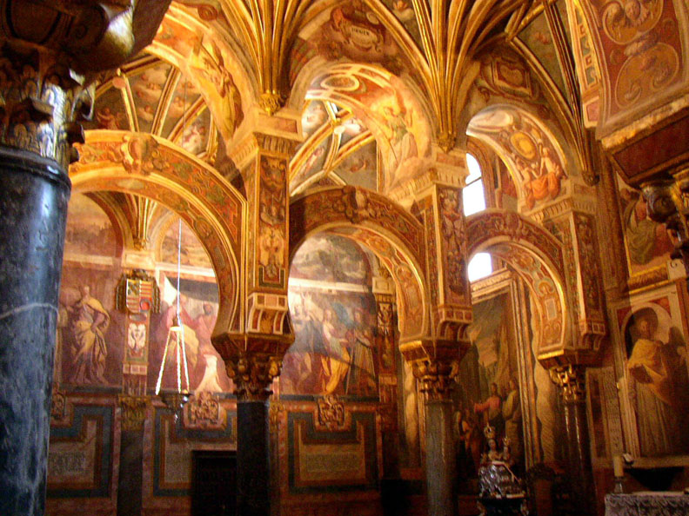
Great Mosque at Córdoba, Spain

Slide 18
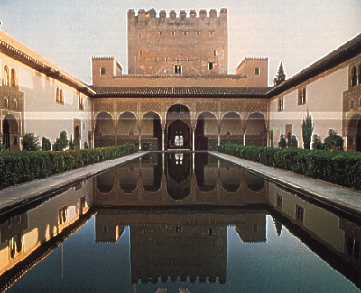
Alhambra Palace, Granada, Spain

Slide 19
PART II: Africans

Slide 20
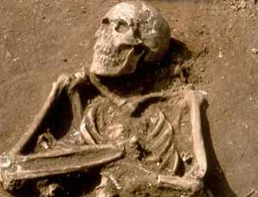
One of Columbus’s shipmates

Slide 21
Africans AND African-Iberians went to the Americas…
Africans were among the first arrivals to the “New World”: sailors, explorers, not only slaves
And, the “Iberians” who arrived had coexisted with or mixed with Africans
Slaves arrive in Iberia from mid-C15 from sub-Saharan Africa
People of African origin made up about 20% of the population of Seville in 1565; more were FREE than enslaved

Slide 22
Iberians were the first and last to enslaved Africans in the New World
Castilians: formative experiences of slavery in the CANARY ISLANDS; and for Portugal, in the Azores, Madeira
Portuguese semi-colonial presence in ANGOLA
an intimate, bilateral relationship between Brazil and Angola:
Jesuit friar Gonçalo João (1646): “Without Angola, there is no Brazil.”
Nearly half of all Africans taken to the Americas as slaves went to Latin America. 4% went to the US.

Slide 23
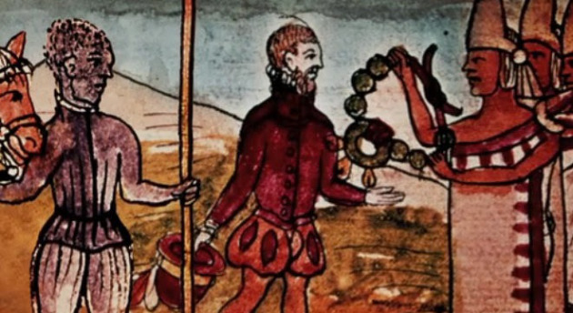
Juan Garrido (c. 1480-c. 1550), the Black Spanish Conquistador

Slide 24
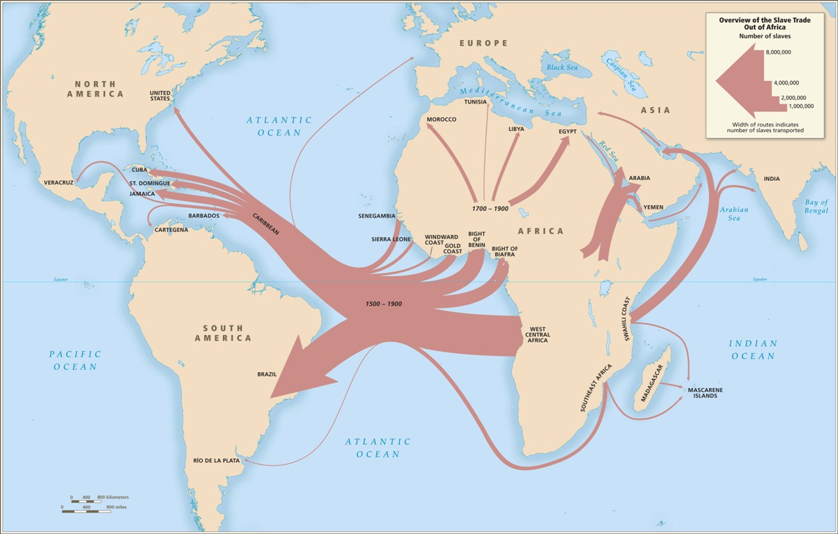

Slide 25
And did you know…
Before 1800, more Africans than Europeans went to the Americas.

Slide 26
Part 3: The Americas

Slide 27
The diversity of Latin America in 1492
Over 350 tribal groups; 15 cultural centres; over 160 language groups
Densely populated in places; altogether, 57 million people in Americas
Not “unified”
But, some links between them: through conquest, empires, overlap, cultural influences (ie processes of mixing happened in the pre-Iberian Americas too…)

Slide 28
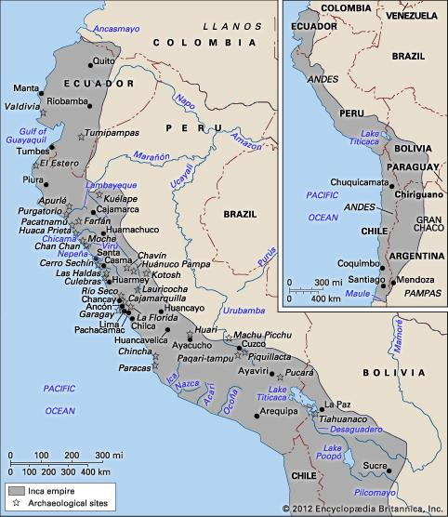
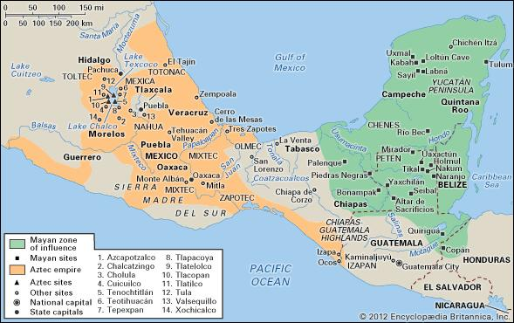
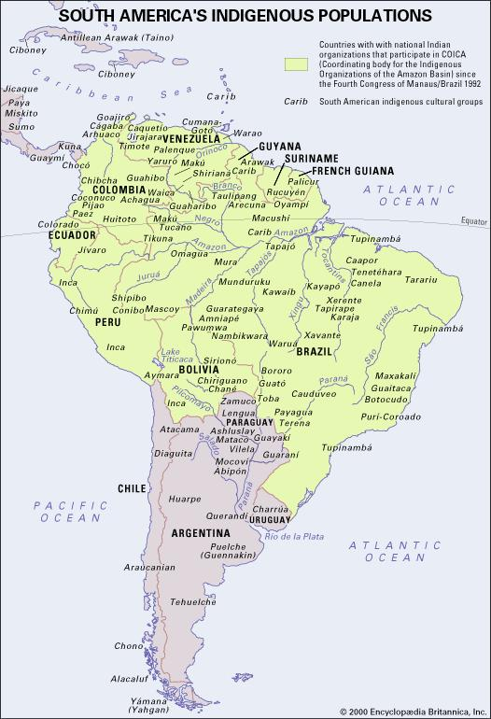
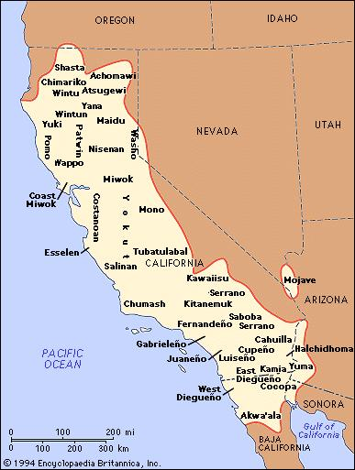
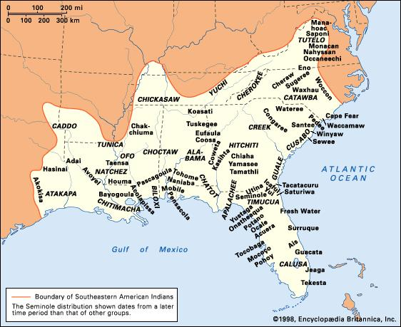
(Some) Pre-Columbian peoples of the Americas
Encyclopædia Britannica
Online. Web. 31 Oct. 2012.
Diverse geographically,
politically, socially,
linguistically

Slide 29
“Sedentary” societies
* permanent settlements: towns/ even major cities.
Agriculture to support dense populations
Recognisable political organisation: nobility, middle strata, and commoners. Incas/ Aztecs have even built empires.
Use of TRIBUTE (labour/ goods)
RECOGNISABLE to the Iberians; & potential supply of LABOUR.

Slide 30
“Semi-sedentary” and “non-sedentary” societies
Slash-and-burn agriculture or hunting/ gathering only
Temporary villages, or movement around hunting territory; little agriculture.
Low population densities.
Semi-sedentaries: northern Mexico; and forest/ wet areas: Brazilian & Caribbean coasts; Venezuela.
Non-sedentary: harsh environments: Mexican deserts; Argentine plains. Warlike bands; not clearly stratified societies; no tribute.

Slide 31
An important clarification…
The division into “sedentary,” “semi-sedentary”, “non-sedentary” is helpful in thinking about patterns of Iberian colonisation in the New World…
But is also a tremendous generalisation
It should NOT be seen as a value judgement about differing levels of ‘civilisation’, but as reflecting a range of human adaptations to the challenges of the natural environment across this geographically diverse continent

Slide 32
Concluding thoughts
While the peoples of the Americas, Iberians, and Africans differed, some of them also had either shared experiences or surprising similarities.
These points of potential connection – which often also became terrible misunderstandings – are a good place to start when thinking about processes of colonisation and mestizaje after 1492.

