Slide 1
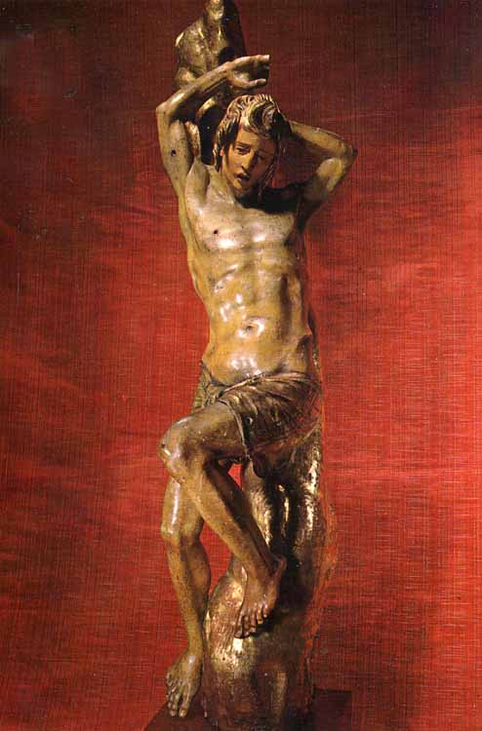
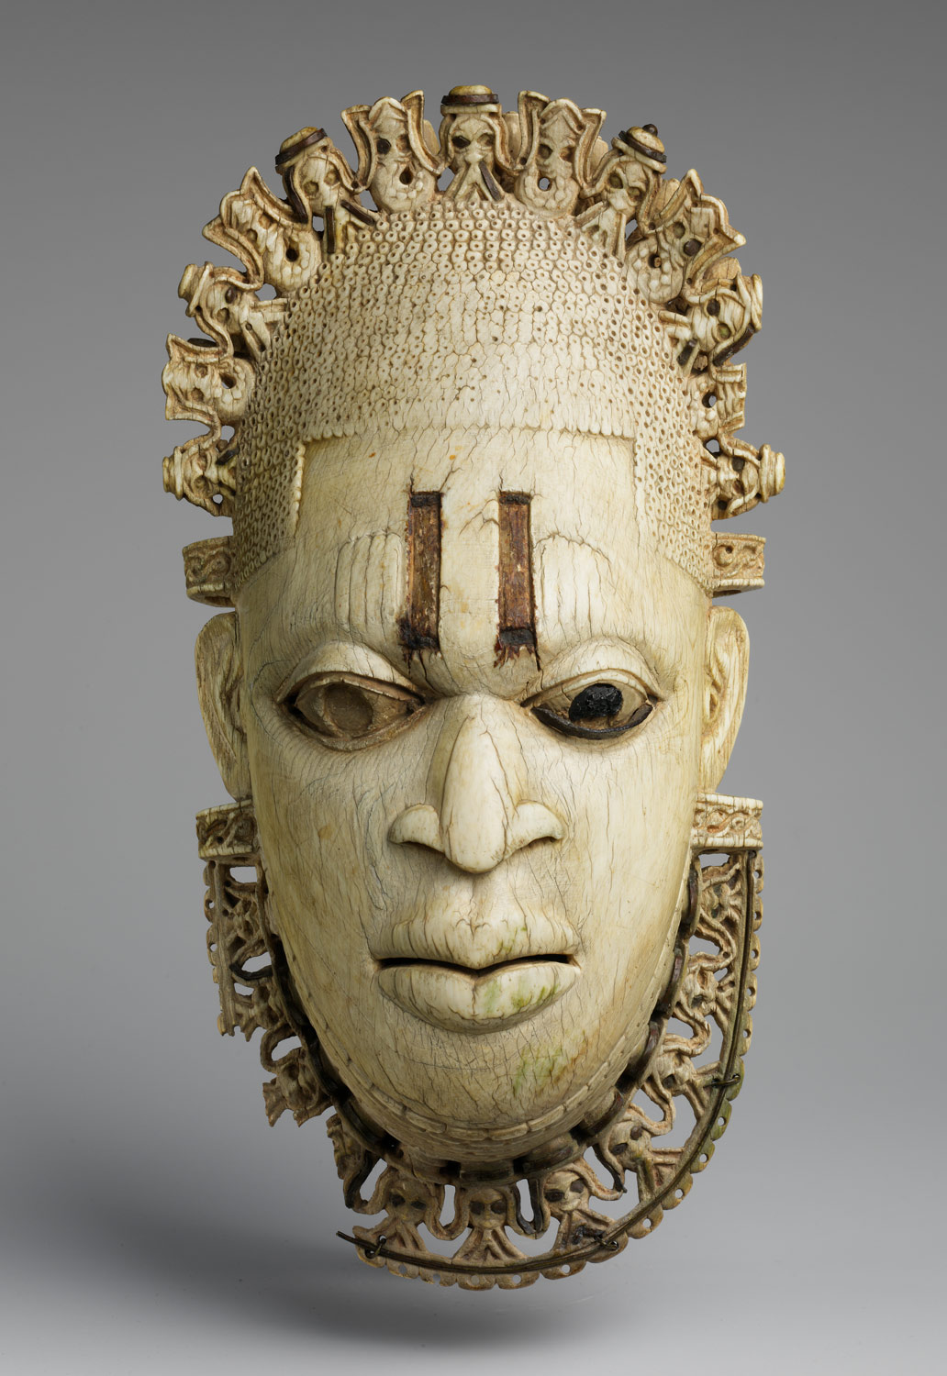
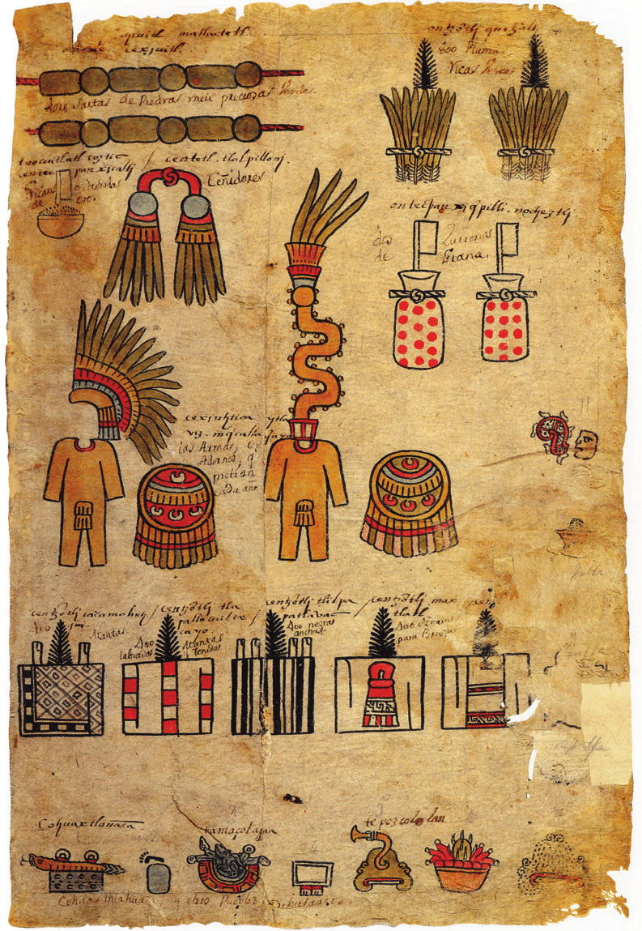
Before 1492:
Iberia, Africa, and the Americas
Latin America: Themes and Problems (HI115-30)

Slide 2
Questions to consider:
Who were the peoples who would meet each other in the New World? Were they entirely different from one another, or were there similarities? Economic, political, social, or cultural.
How might we expect their previous historical experiences to shape their encounter with each other?
How did Iberians’ ongoing involvement with the African continent shape the Iberian encounter with the Americas?
How does our view of fifteenth-century Spanish society influence our understanding of the Conquest of the Americas?

Slide 3
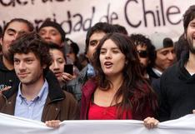
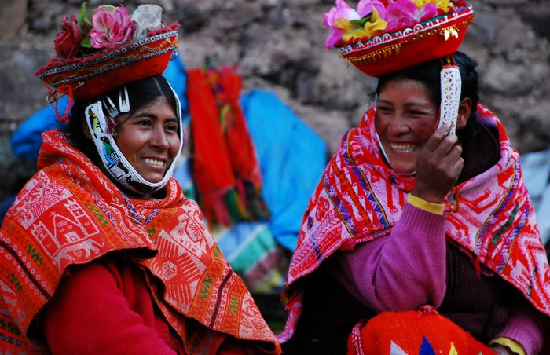
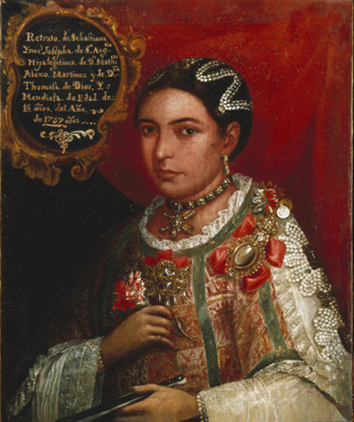
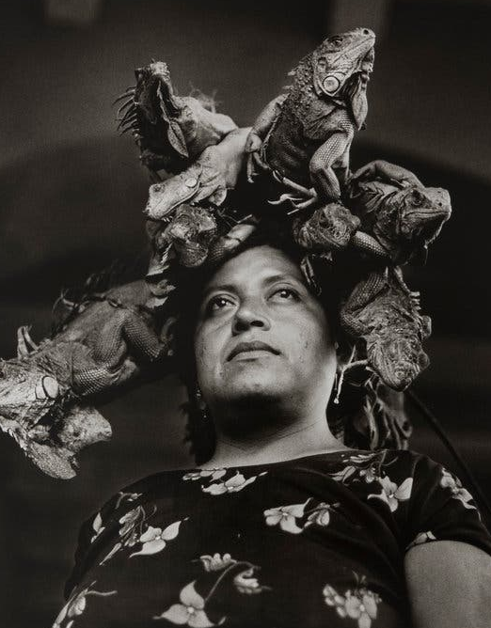
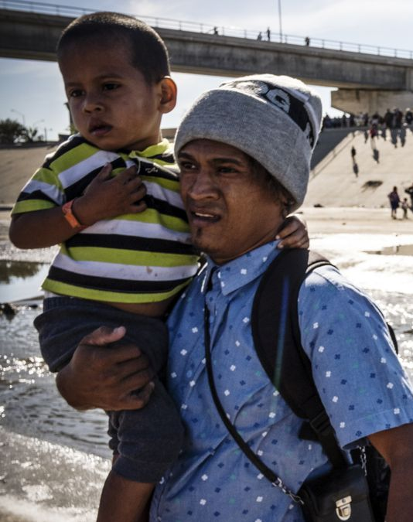
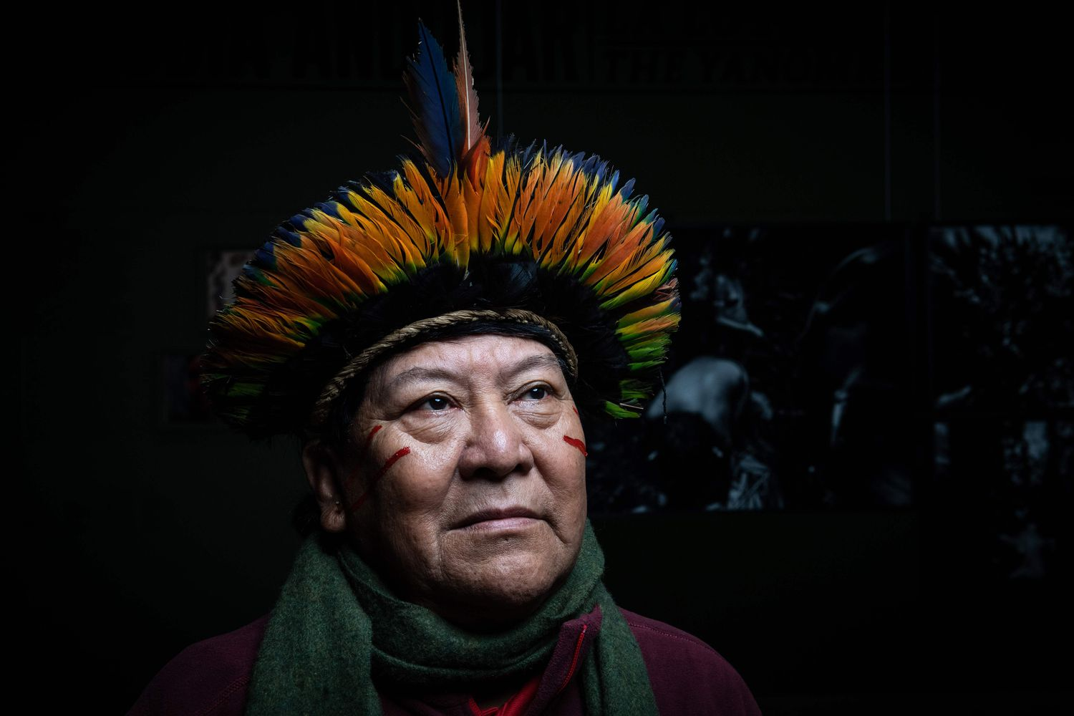
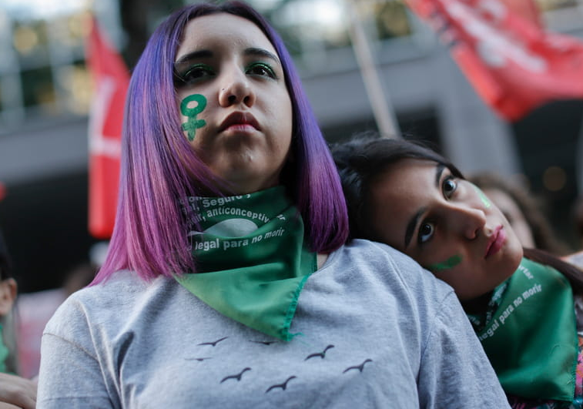

Slide 4
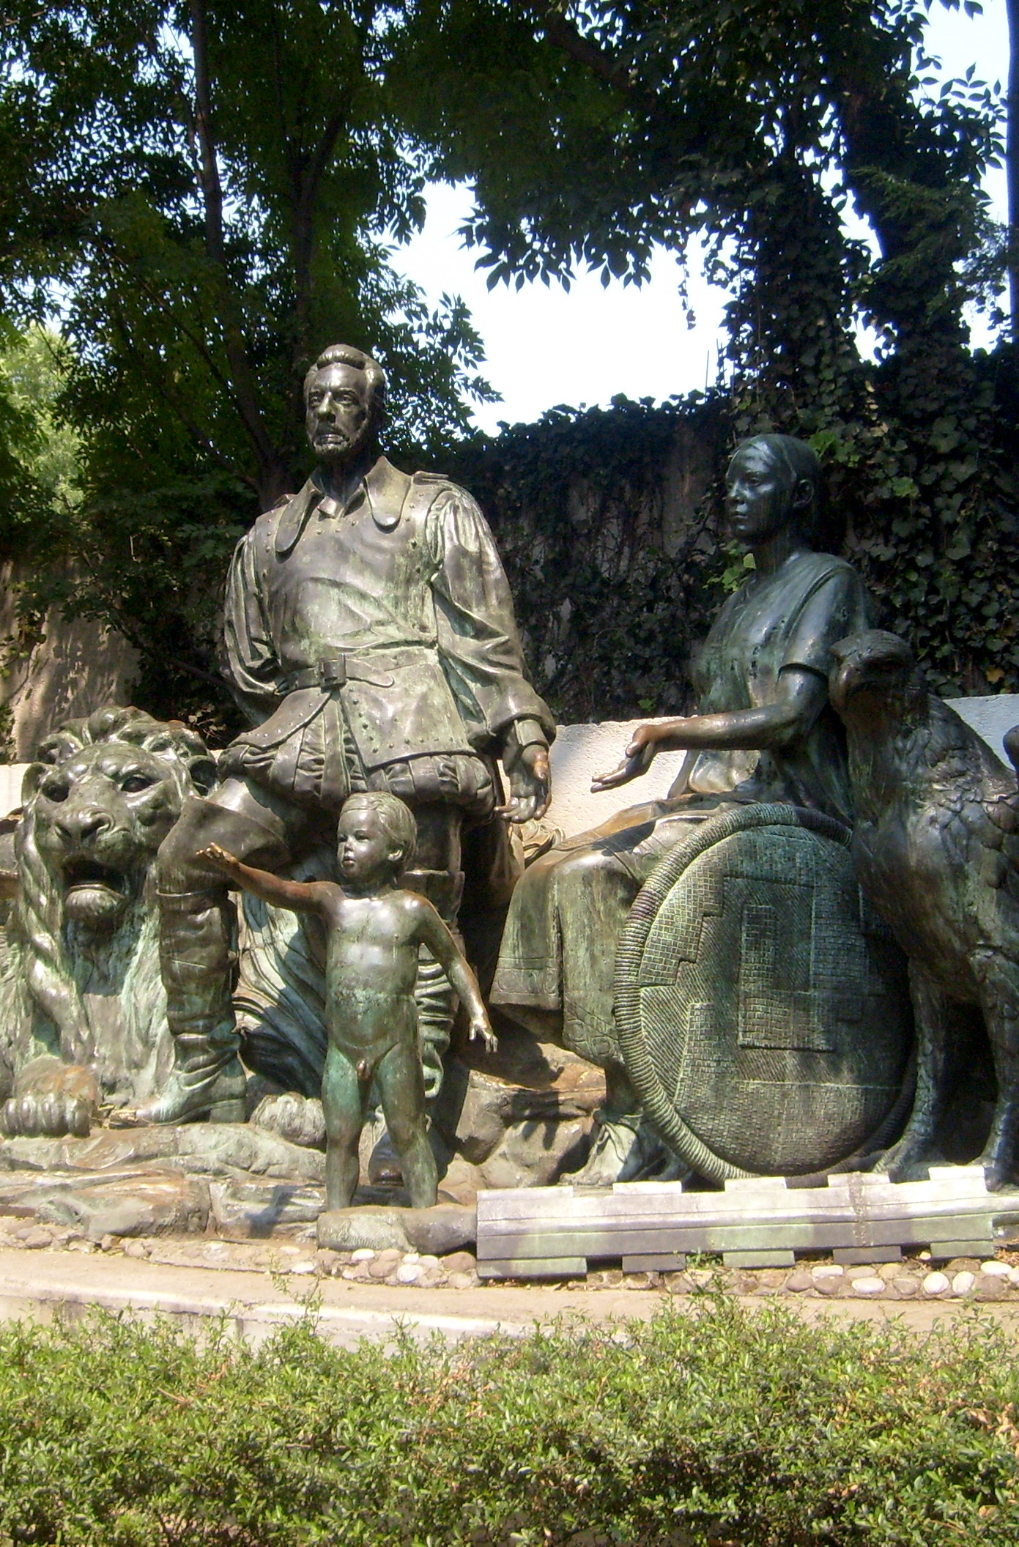
A key term: mestizaje
Cultural and biological interchanges
To some extent, a natural process
Also one that developed as a result of violent evangelization, conquest and colonization
Ideology of mestizaje used as a tool of nation-building in Latin America in the C19

Slide 5
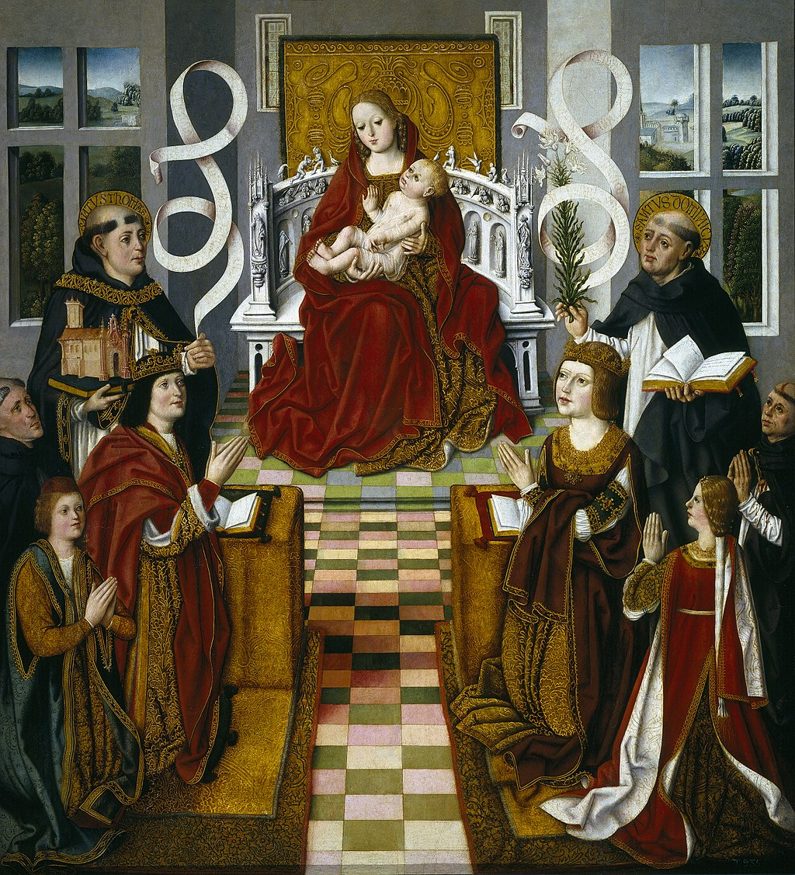
PART 1:
IBERIA

Slide 6
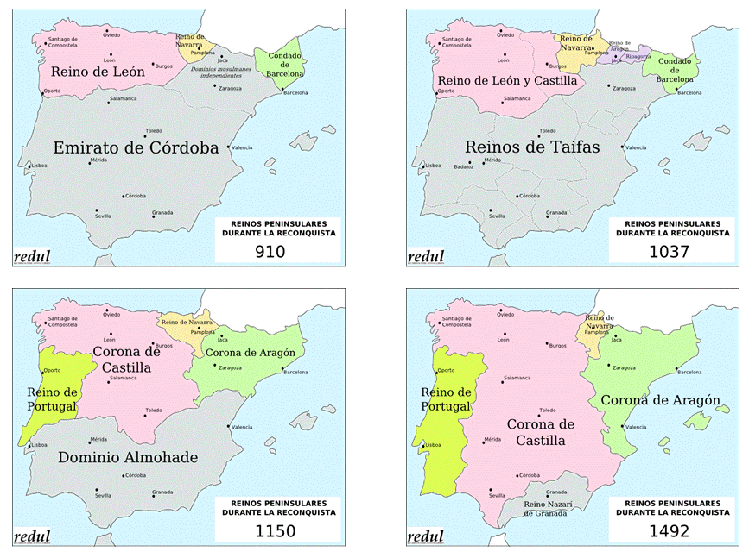
THE RECONQUISTA (711-1492)

Slide 7
Reconquista as a historical process deeply marks the Iberian peninsula…
Helps create a frontier society: shapes process of land acquisition, population of new lands, spirit of religious crusade
Private adventurers, rewarded by Christian kings: receive wealth, land, status.
Population strategies: land grants, fueros (political/ judicial liberties)
Northern Castile: towns are strategy for colonisation
South: large estates; sparse populations; latifundia; labour through tribute (compare Spanish American encomienda)

Slide 8
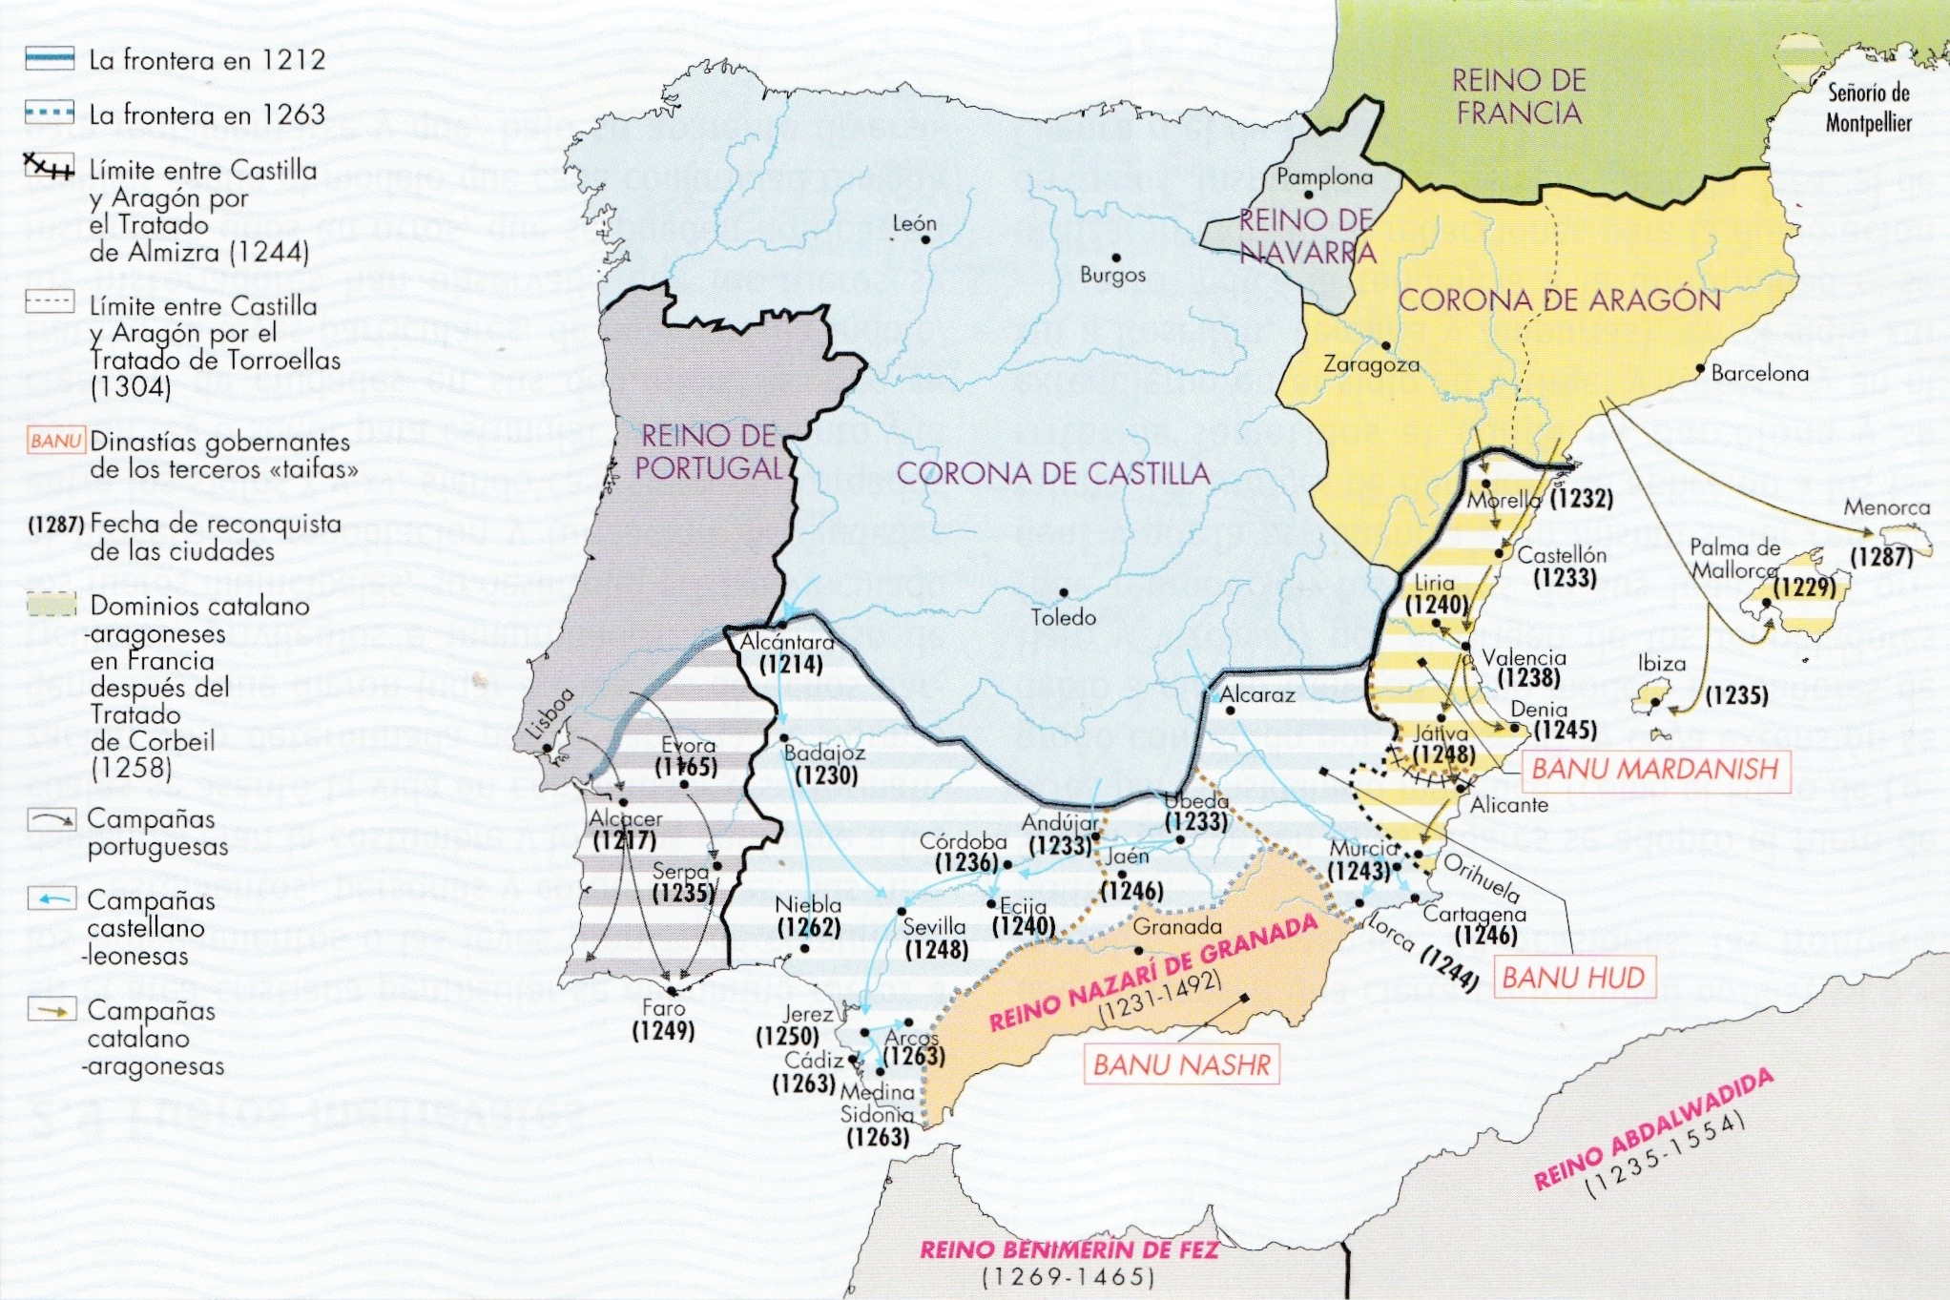

Slide 9
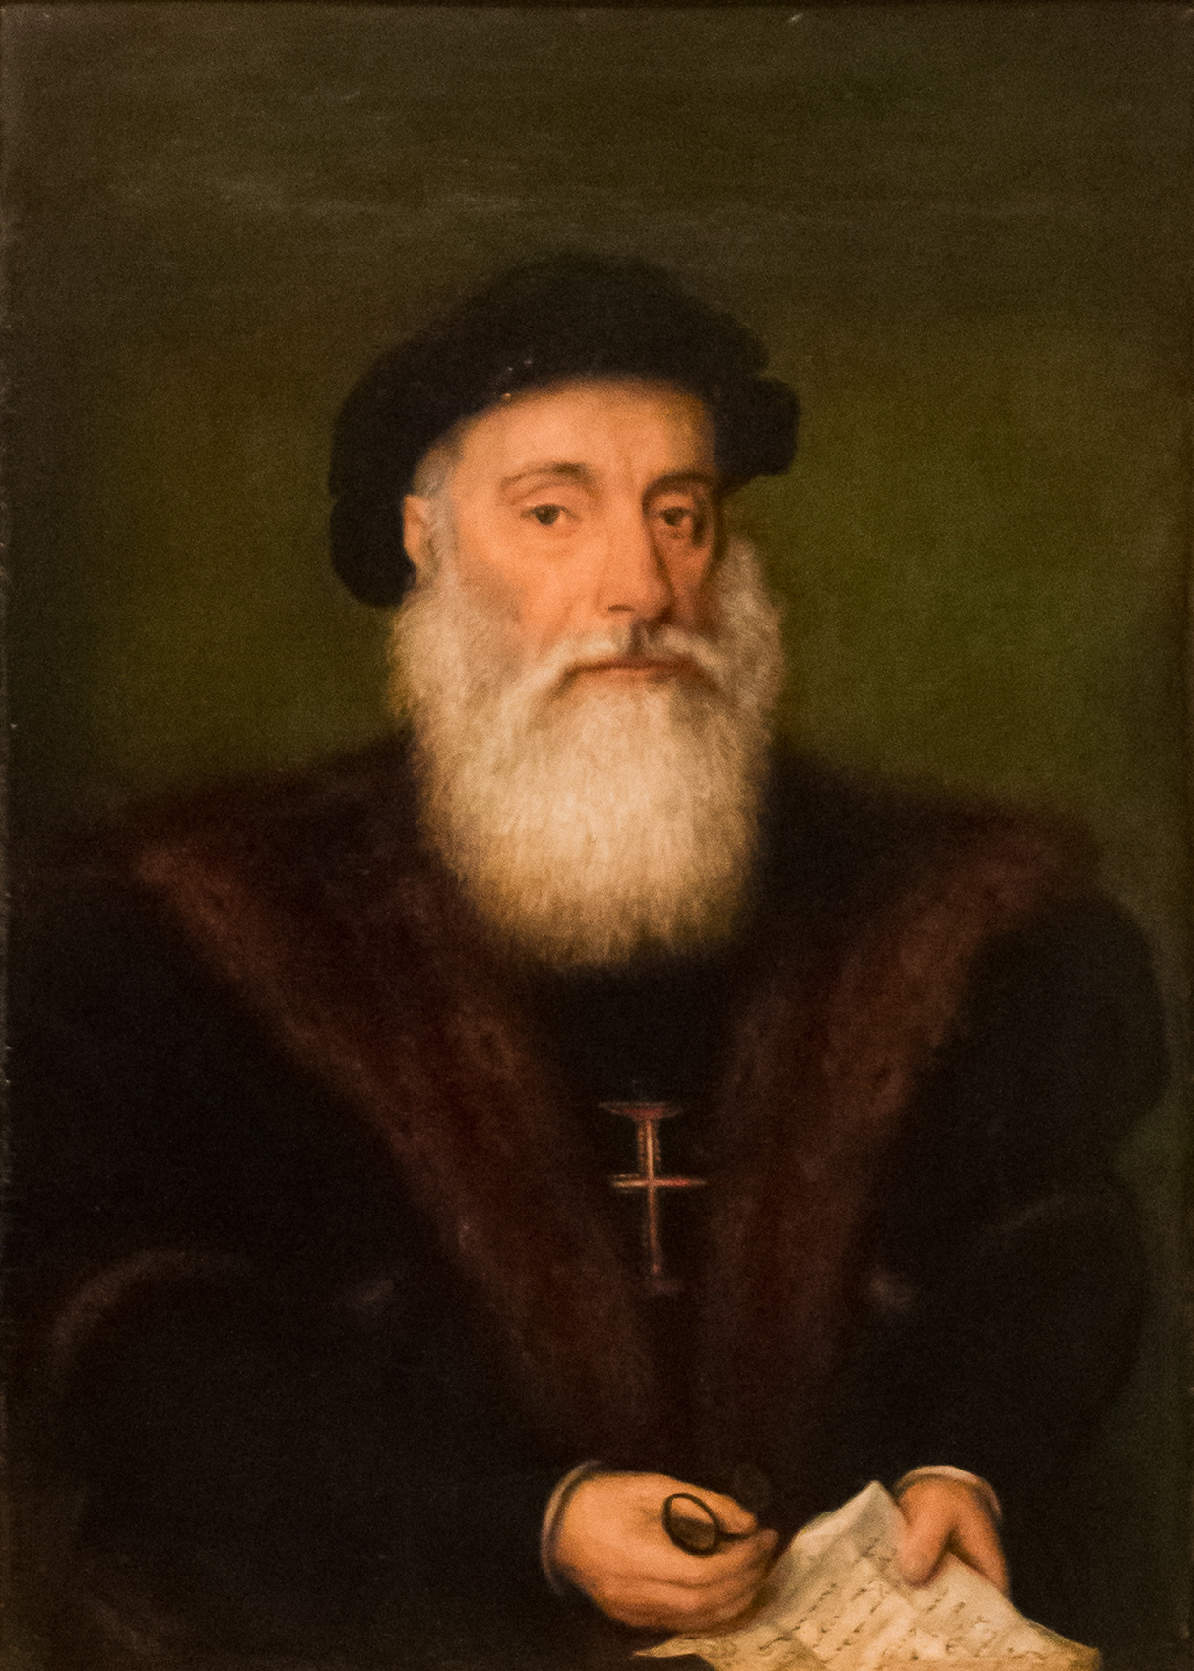
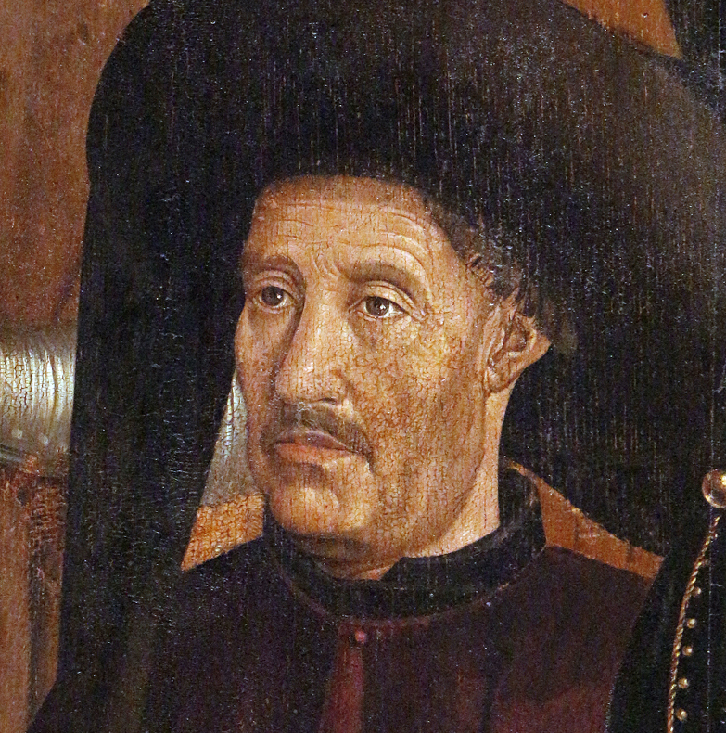
PORTUGAL

Slide 10
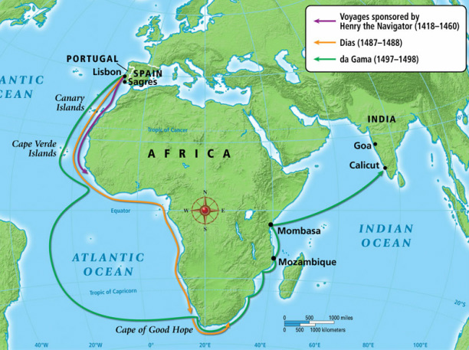
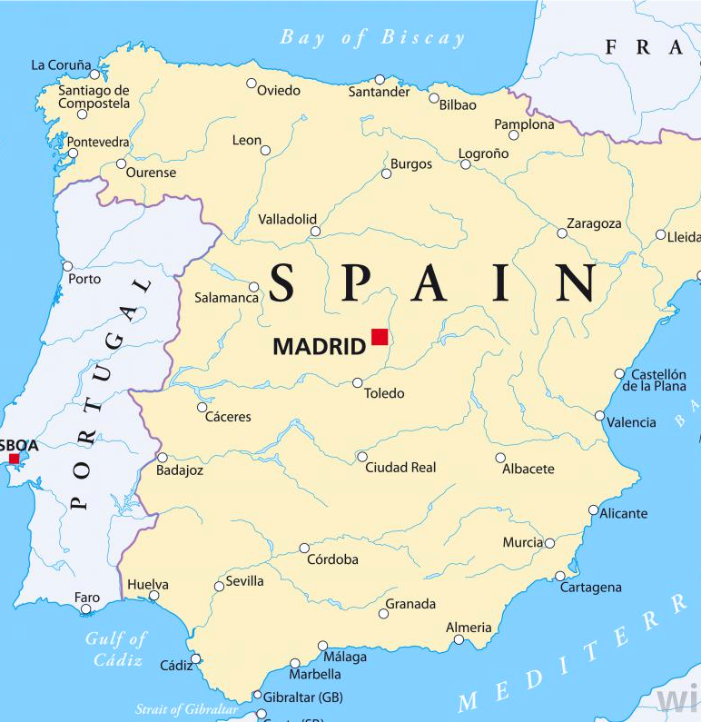

Slide 11
CATALAN ATLAS
*1375
ARAGON

Slide 12
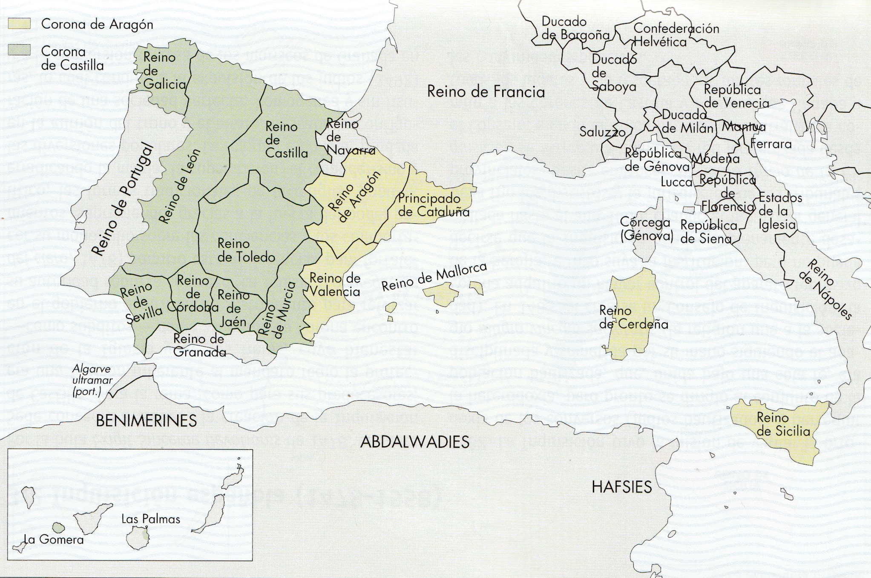

Slide 13
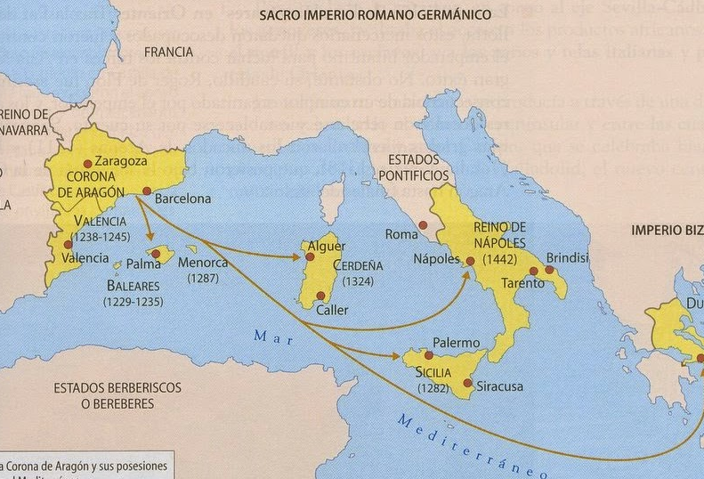
ARAGONESE EXPANSION IN THE MEDITERRANEAN

Slide 14
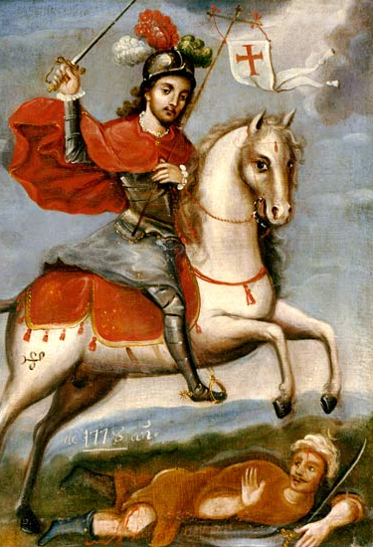
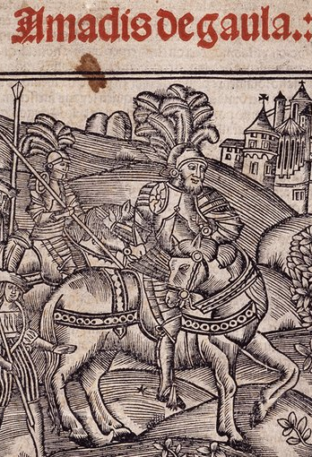
CASTILE

Slide 15
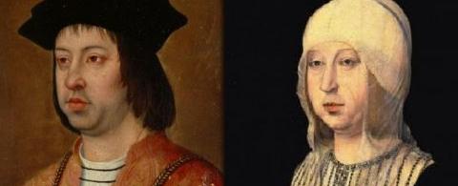
The “Catholic Monarchs” ‘Yet nothing can alter the fact that Ferdinand and Isabella created Spain.’ John Elliott
1469: marriage of Ferdinand of Aragon and Isabel of Castile unifies what will later become Spain.
Consolidation of the power of the monarchy
Aragonese territory in Italy, the Kingdom of Naples, the Canary Islands towards Africa is consolidated

Slide 16
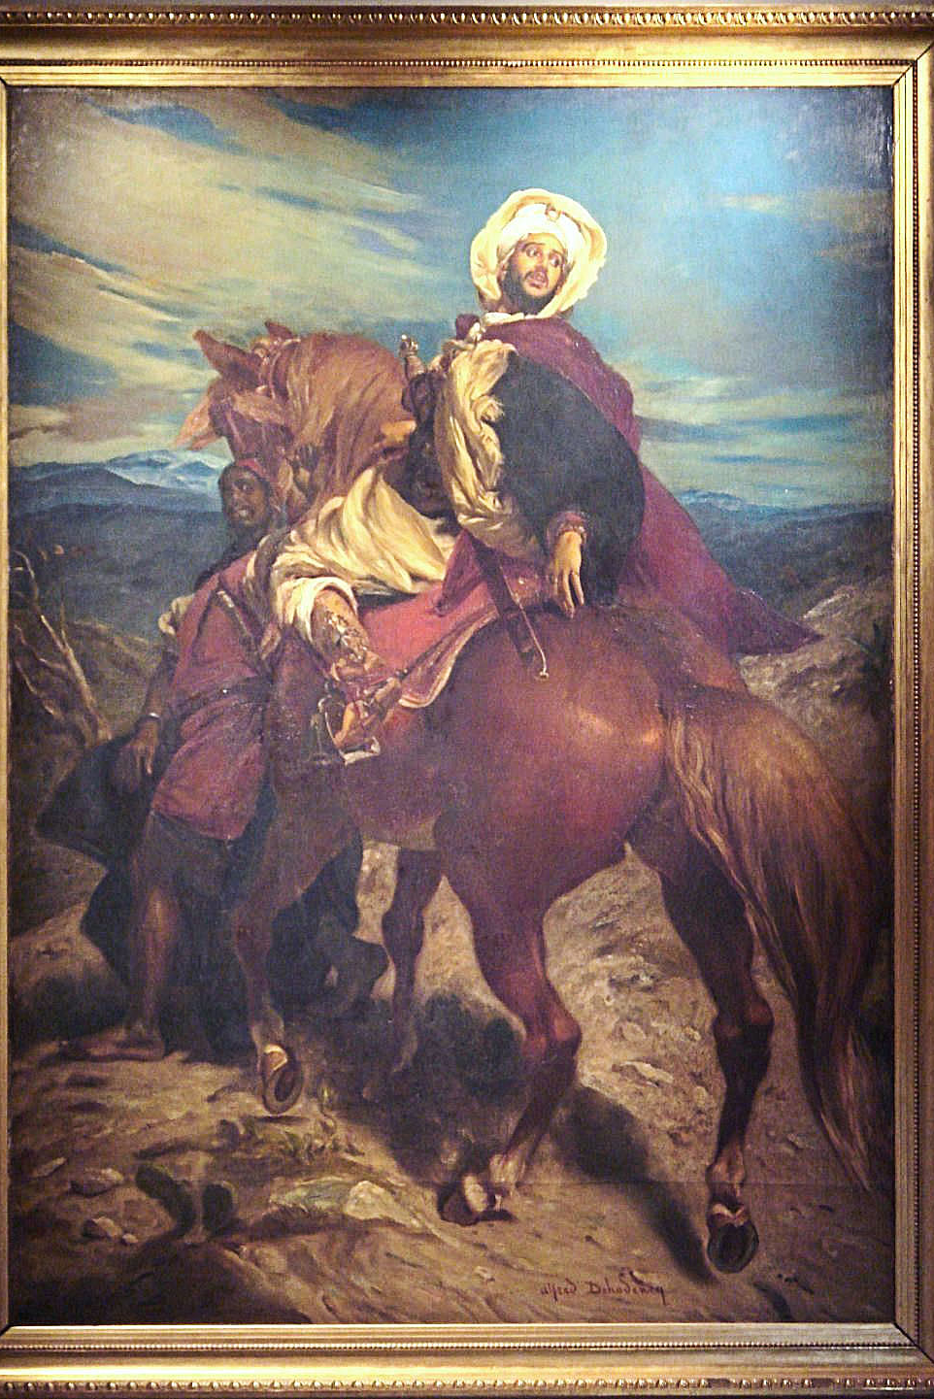
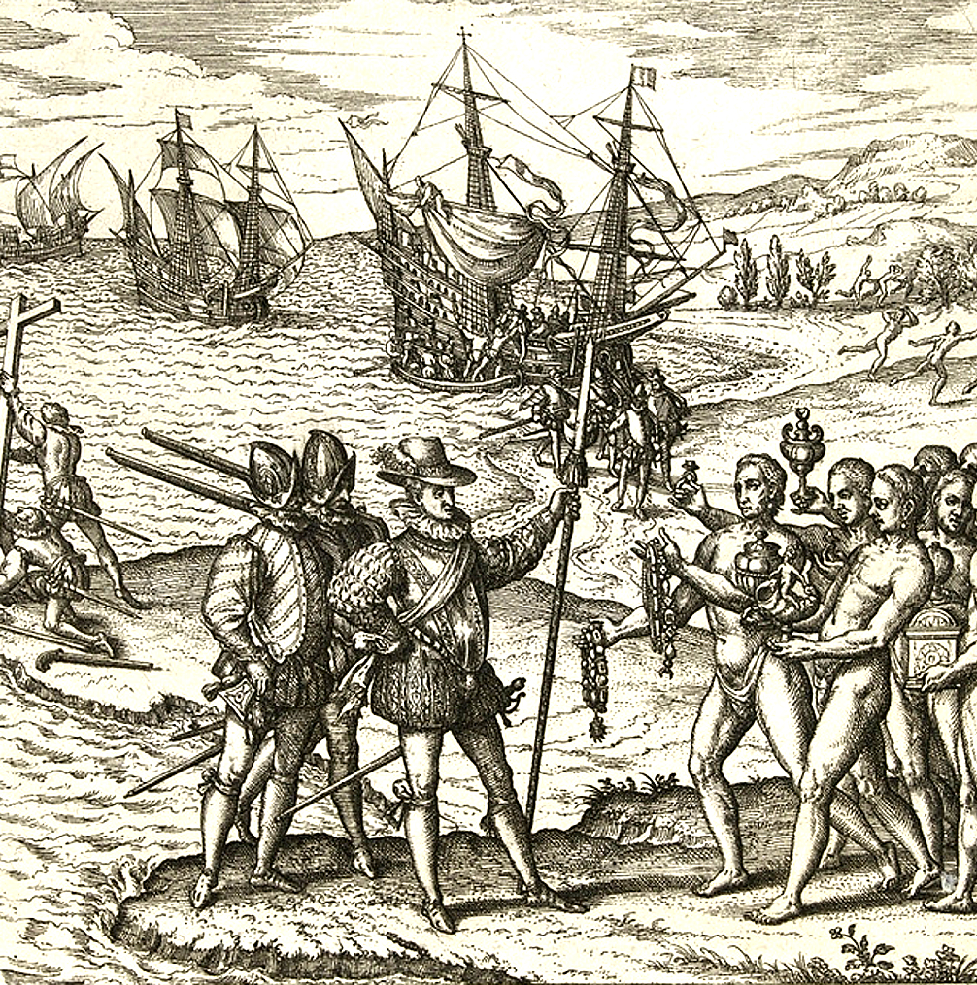
1492

Slide 17
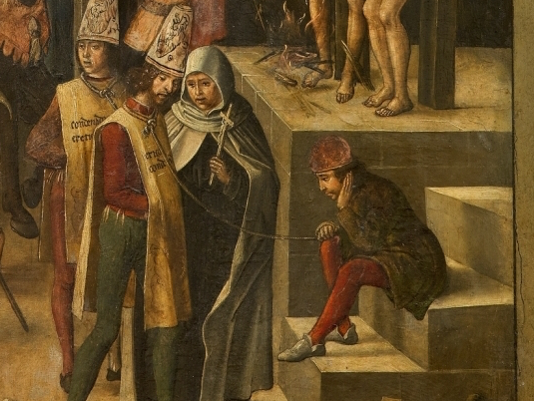
A newly aggressive Christian ideology
1478: Inquisition
3.1492: The Jews of Spain are given four months to convert, leave, or face execution.
1502: Muslims forcibly converted
Creation of two disadvantaged minorities: Conversos and Moriscos

Slide 18
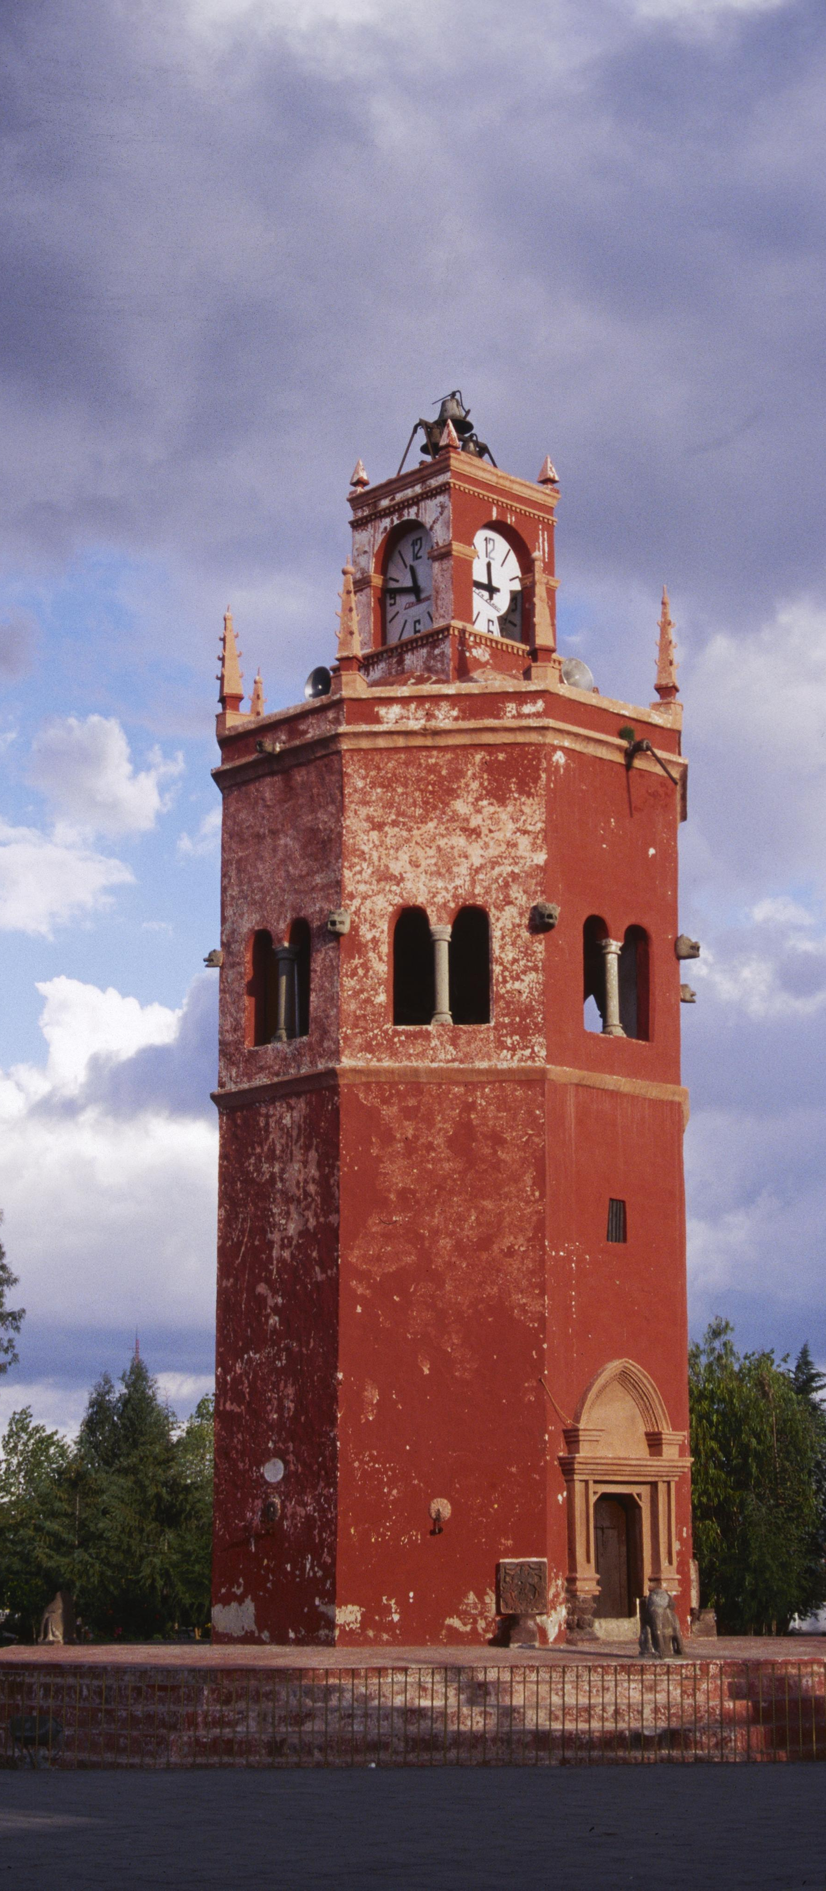
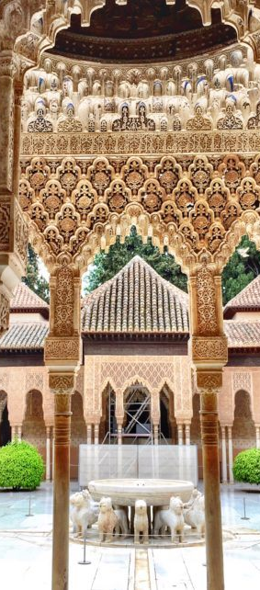
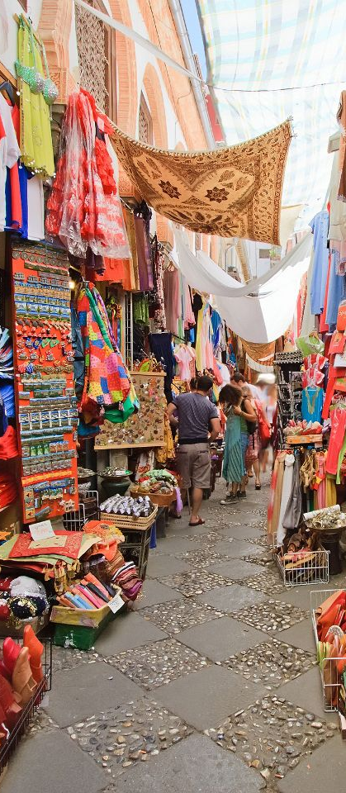

Slide 19
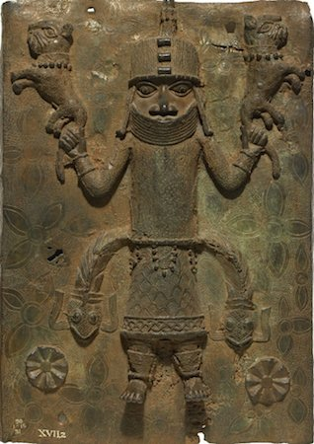
PART 2:
AFRICA

Slide 20
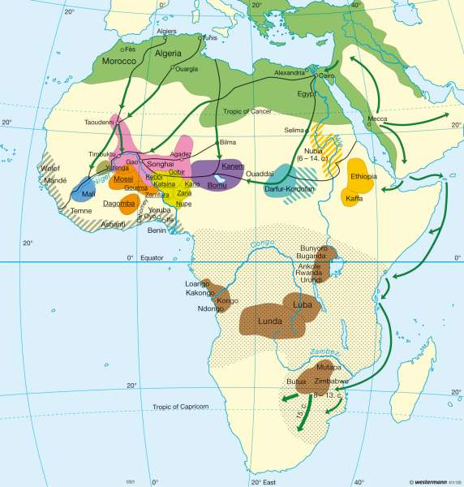
Africa XV-XVI centuries
North: Fathimid Califate, Carthaginian Empire
West: Ghana Empire, Mali Empire, Kanem Empire, Yoruba Empire, Benin Empire. Trade, agriculture, gold
South: Bachwezi Empire, Great Zimbabwe Empire, Kingdom of Congo (1491) after the conversion of King Nzinga Nkuwu (1470-1509)
Europeans Rui de Pina, Joao de Barros, and Gomes Hernaes Zurara reporting on these regions had a normative view.
Muslim
African / Christian
Christian Christian

Slide 21
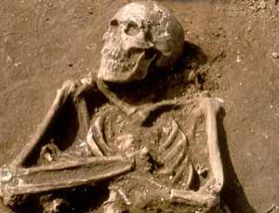
One of Columbus’s shipmates

Slide 22
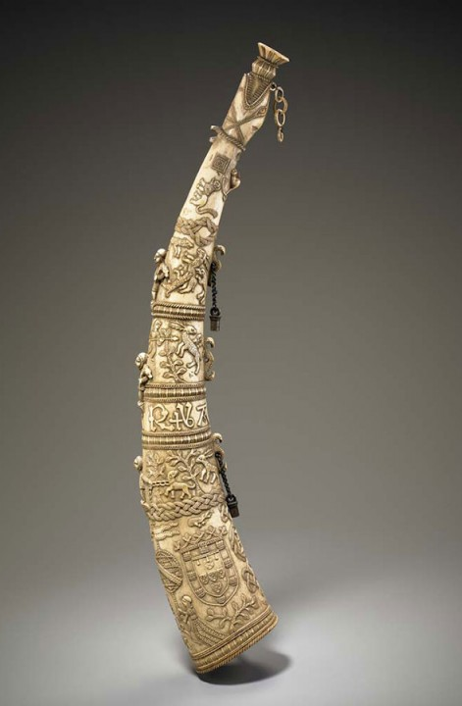
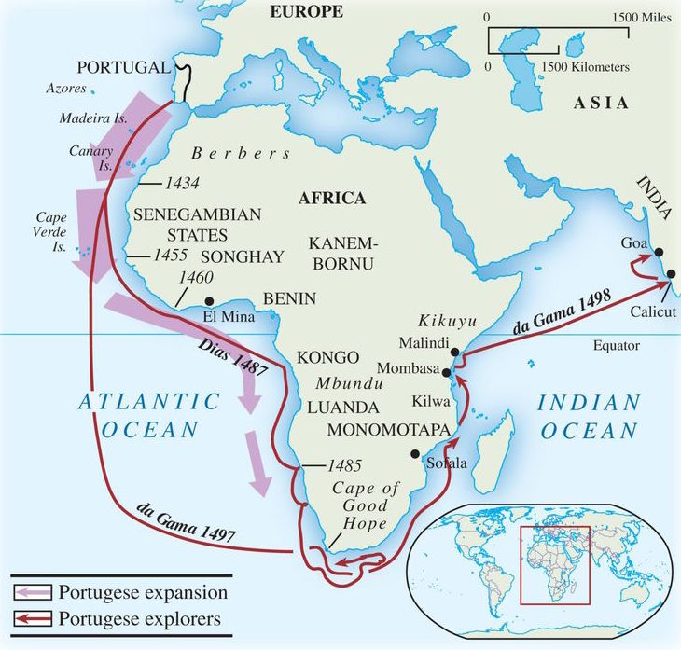
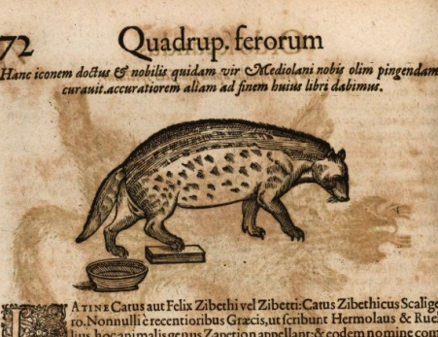

Slide 23
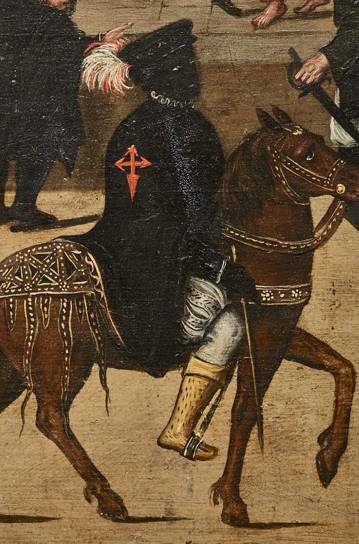
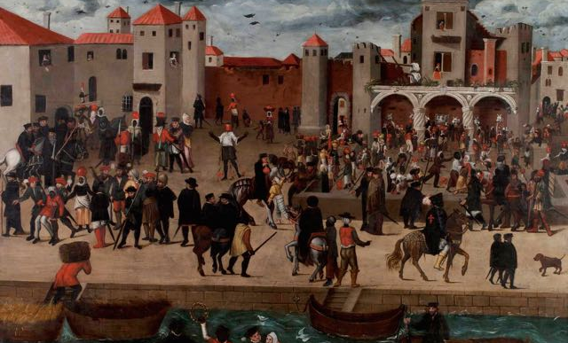

Slide 24
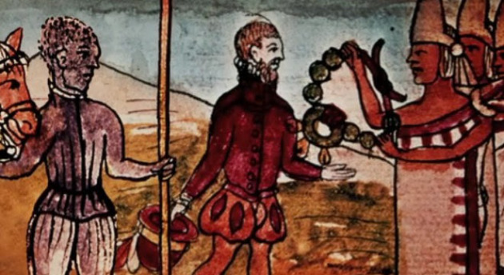
Juan Garrido (c.1480 - c.1550) Spanish Conquistador

Slide 25
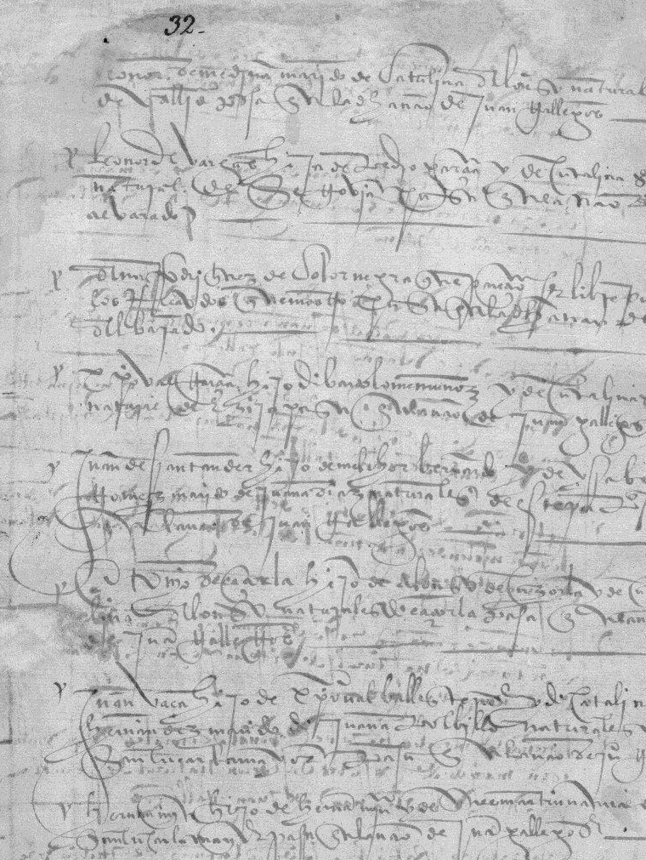
Ana Rodríguez, de color negra… libre
Catalogue of passengers to the Indies, 1526

Slide 26
Africans in Iberia and the Americas
People of African origin made up about 20% of the population of Seville in 1565; more were FREE than enslaved
Africans (free and enslaved) were among the first arrivals to the “New World”: sailors, conquistadores, explorers…
Before 1800, more Africans than Europeans went to the Americas.

Slide 27
Iberia and Atlantic Slavery
Castile: formative experiences of slavery in the Canary Islands; for Portugal: the Azores, Madeira
Slaves arrived in Iberia from mid-C15 from sub-Saharan Africa
By 1492, as many as 35,000 people from West Africa—primarily from Senegambia and the Gulf of Guinea— had been sold into slavery on the peninsula.
Nearly half of all Africans taken to the Americas as slaves went to Latin America. 4% went to the US.

Slide 28
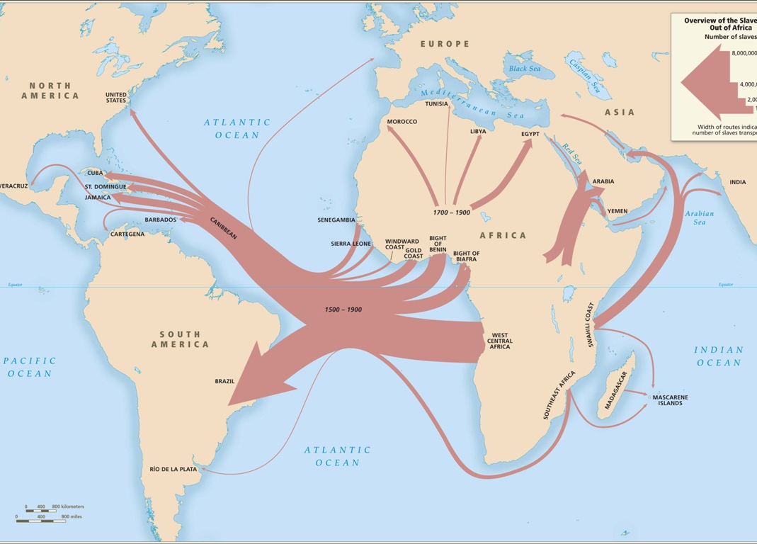

Slide 29
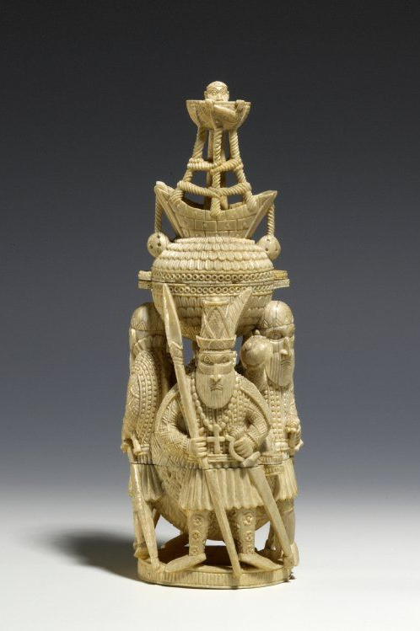
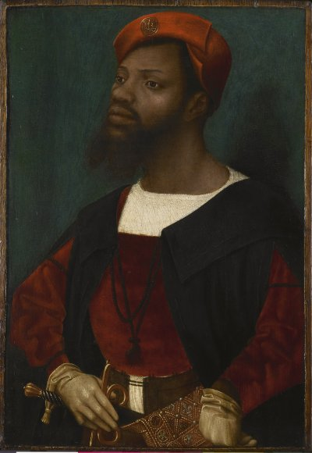

Slide 30
PART 3:
THE AMERICAS

Slide 31
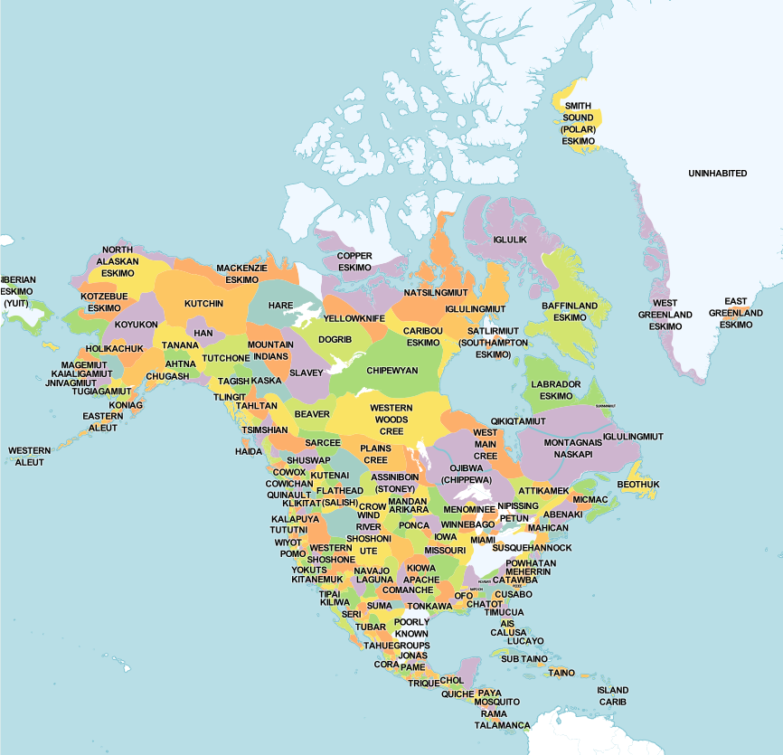
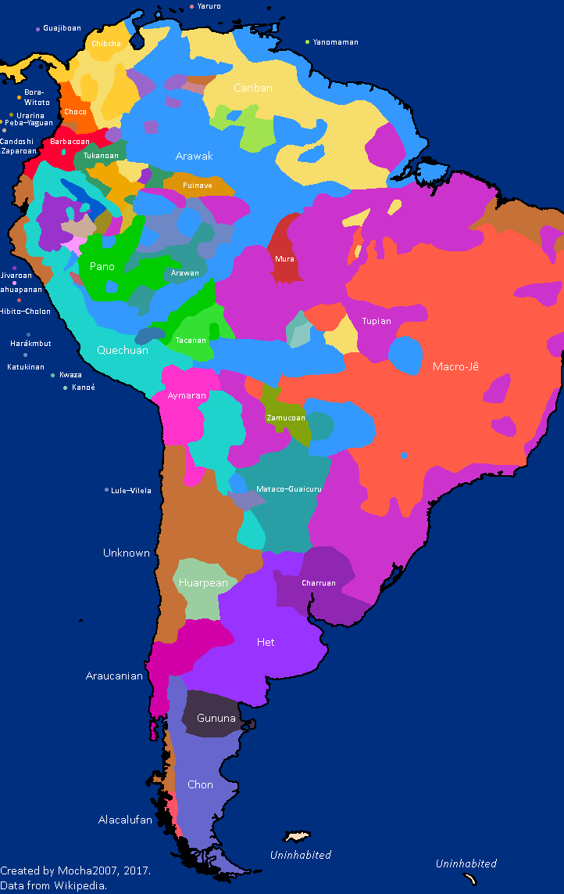
In 1492, an estimated 57 million people in the Americas

Slide 32
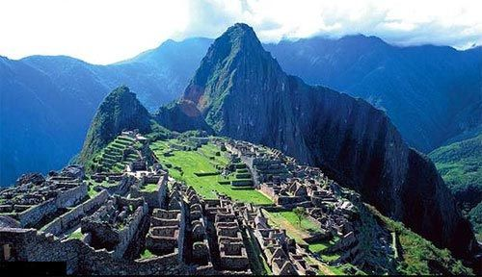
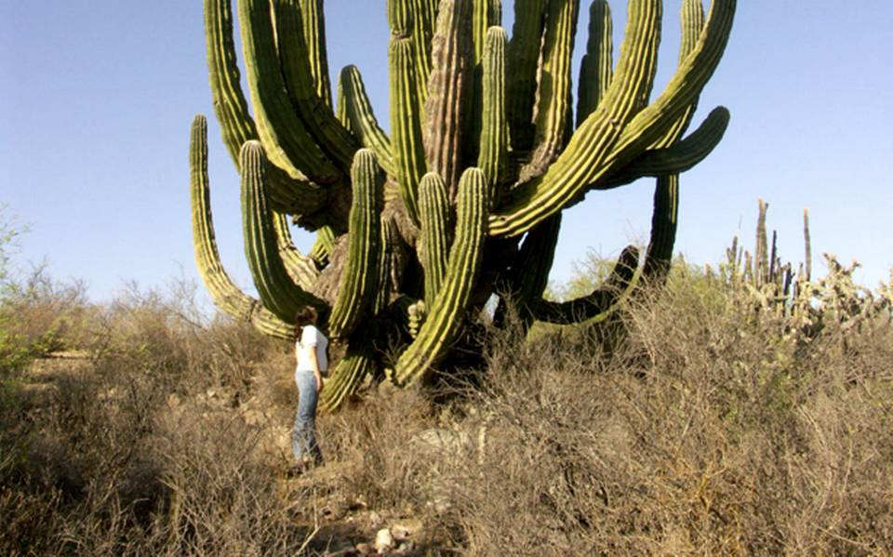
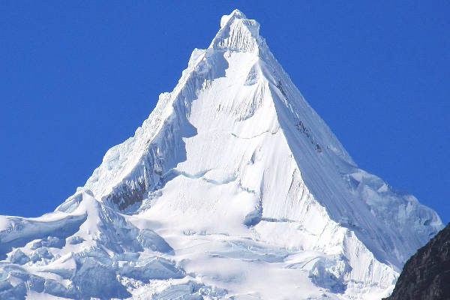
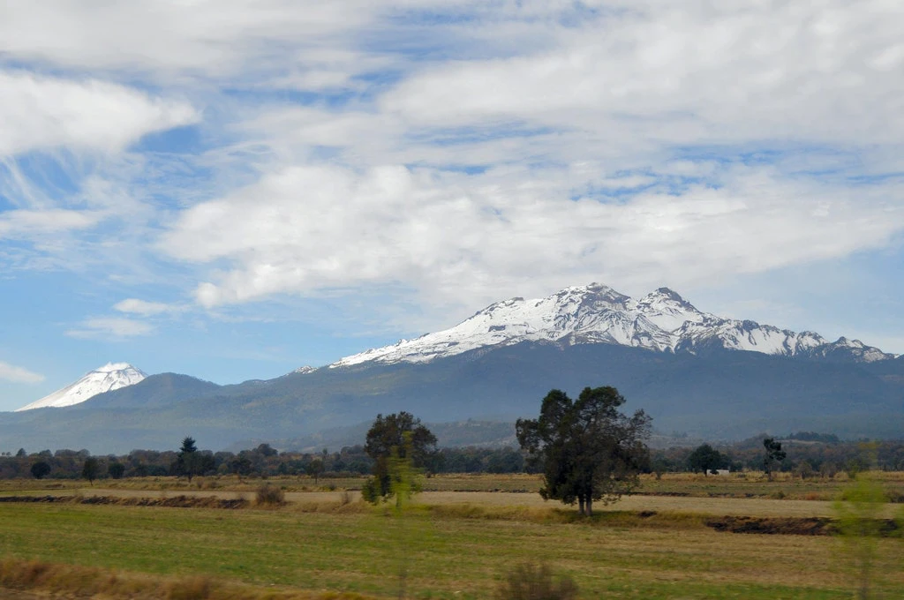
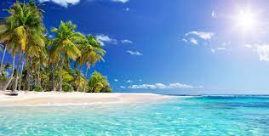
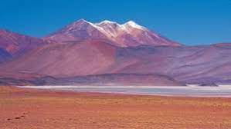
Landscapes
Machu Pichu, Peru
Mexican Baiío.
Alpamayo, Peru.
Volcanoes Popocatepetl and Iztaccihuatl, Central Mexico.
Caribbean
Atacama, Chile

Slide 33
Semi-sedentary and Nomadic societies
Slash-and-burn agriculture or hunting/ gathering only
Temporary villages, or movement around hunting territory; little agriculture.
Low population densities.
Semi-sedentary: northern Mexico; and forest/ wet areas: Brazilian & Caribbean coasts; Venezuela.
Nomadic: harsh environments: Mexican deserts; Argentine plains. Warlike bands; not clearly stratified societies; no tribute.

Slide 34
“Sedentary” societies
Permanent settlements: towns/ even major cities.
Agriculture to support dense populations
Stratified societies: nobility, middle strata, and commoners.
Use of TRIBUTE (labour/ goods)
RECOGNISABLE to Iberians. Dense populations will also supply labour for Colonial project

Slide 35

Similar characteristics across Ancient American Empires
Process 150 to 200 years of a consolidation of territorial expansive empires
Sun god associated with eagles, jaguar and strength
Taxation
Army
Maize as a crop related to territoriality
Aggregation of gods under the imperial theogony
Important difference: Incan emperor assumed he embodied the god Viracocha, the creator god of culture, while Mesoamerican emperors personified and acquired ‘parts of gods’.
Guaman Poma de Ayala, Chronica y buen gobierno…

Slide 36

The Aztec Empire
1427-1519

Slide 37


Slide 38
Features of the Aztec Empire:
Based on village units: calpulli. Empire built by adding these units.
Very stratified society: elite are warriors/ priests etc; live in Tenochtitlán & claim tribute from other parts of the empire
Religion is central and not separable from politics. Descent from god Huitzilopochtli justifies rule
Syncretism: calpulli continue to worship own deities but incorporate Huitzilopochtli
Major cultural achievements. Temples; cosmology, education, writing using pictorial/ glyphs system

Slide 39



Slide 40


The Inca Empire
Tahuantinsuyu

Slide 41
Features of the Inca Empire
Stratified society
Based on exacting tribute.
Village units: ayllu; but also, a centralised bureaucratic state.
Redistribution and reciprocity in Andean society to cope with CLIMATE.
Central warehouses for population in times of hunger
Mit’a – a system of rotational labour service that will be maintained in modified form under Colonial rule
Religion intertwines with state. Local people also keep own huacas (shrines) as well as Inca religion.
No writing; knotted strings (quipus)

Slide 42





Slide 43
The Aztec and Inca empires were very different, but they shared important common traits:
Dense, often urban populations;
Settled agriculture;
Complex social hierarchies;
A central connection between religious belief and social and political structures;
Systems of tribute
Empire-building: subject peoples under a central ruling group;
Parts of these empires only RECENTLY created/incorporated; local rivalries and tensions

Slide 44
An important clarification…
The division into “sedentary,” “semi-sedentary”, “non-sedentary” is helpful in thinking about patterns of Iberian colonisation in the New World…
But it is also a tremendous generalisation
It should NOT be seen as a value judgement about differing levels of ‘civilisation’, but as reflecting a range of human adaptations to the challenges of the natural environment across this geographically diverse continent

Slide 45

Concluding Thoughts
While the peoples of the Americas, Iberians, and Africans differed, some of them also had either shared experiences or surprising similarities.
These points of potential connection – which often also became terrible misunderstandings – are a good place to start when thinking about processes of colonisation and mestizaje after 1492.

