Slide 1
Democratic Transitions and New Social Movements
Latin America: Themes and problems
Term 3, week 1

Slide 2
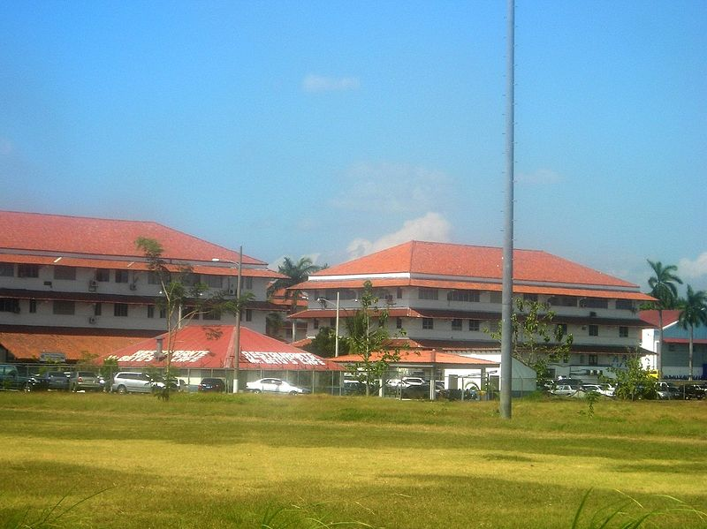
1. Important backgrounds: the right wing in Latin American Cold War
The installation of right-wing military dictatorships between 1954 and 1990 in the Southern Cone: the US intervention for destabilization (School of the Americas, CIA supporting, etc), the ideologies of military and the long lasting “anticommunism” (older than Cold War).
Paraguay (1954-1989)
Brazil (1964-1985)
Bolivia (1971-[1978]1982)
Uruguay (1973-1985)
Chile (1973-1990)
Argentina (1976-1983)
https://es.wikipedia.org/wiki/Instituto_del_Hemisferio_Occidental_para_la_Cooperaci%C3%B3n_en_Seguridad#/media/Archivo:Panam%C3%A1_-_Escuela_de_las_Americas_-_2006.JPG

Slide 3
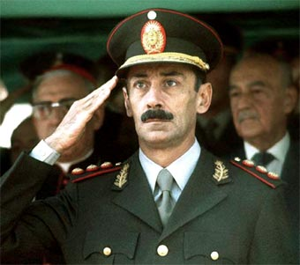
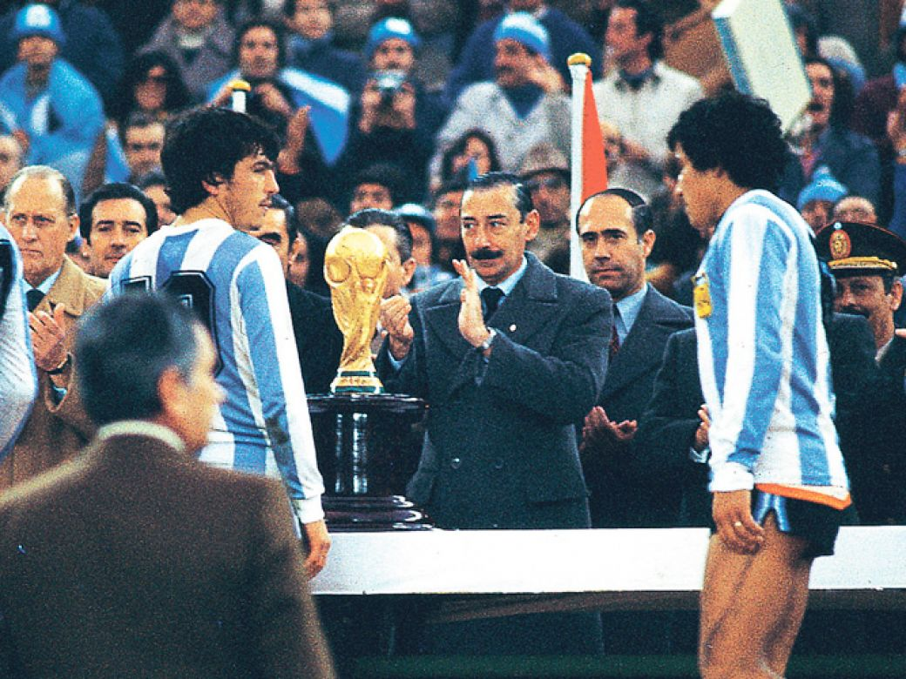
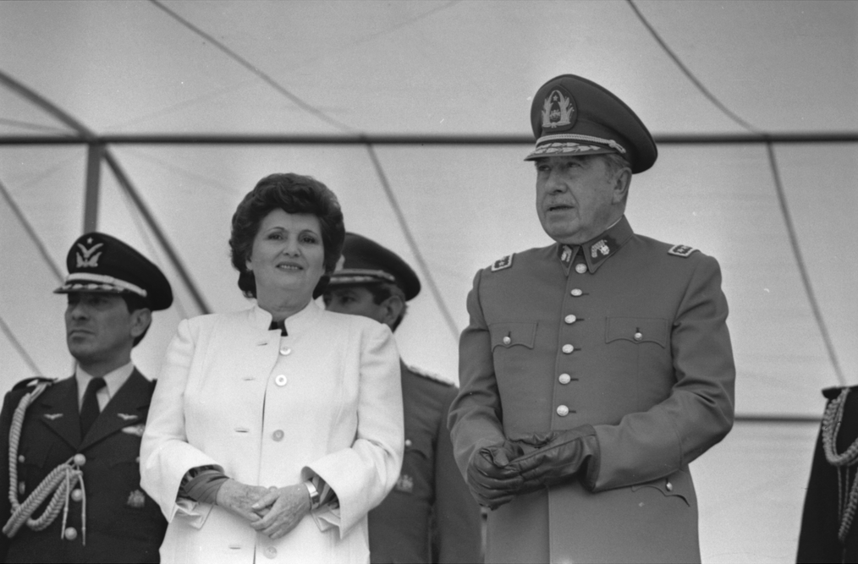
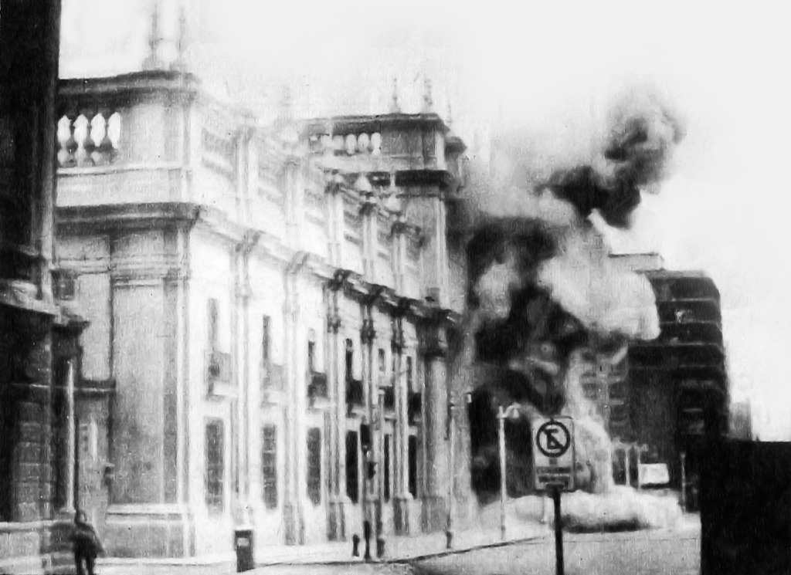
Military dictatorships
Argentina: “Proceso de Reorganización Nacional”: military “Juntas”’ regime. “Guerra Sucia”: extermination (e.g.: “vuelos de la muerte”), dissapearing, systematic tortures in “Centros Clandestinos de Detención” by the “Grupos de Tareas”, abduction.
Chile: Pinochet’s regime as a re-foundational authoritarianism. The coup was supported both by the US intervention, the upper-class and some middle-classes reacting to Allende’s redistributive policies. Executions, abductions, disappearing and torture by the DINA and CNI. Exile, censorship.
https://www.biografiasyvidas.com/biografia/v/videla.htm
https://www.perfil.com/noticias/elobservador/politica-y-futbol-cuando-la-dictadura-decidio-explotar-el-mundial-de-1978-20140518-0068.phtml
Collections on the Argentine Dictatorship between 1976 and 1979 at the Warwick’s Modern Record Centre: https://mrc-catalogue.warwick.ac.uk/records/TUC/D/12/26/3/2 and https://mrc-catalogue.warwick.ac.uk/records/IST/4/4/1
https://es.wikipedia.org/wiki/Augusto_Pinochet#/media/Archivo:Augusto_Pinochet_y_Luc%C3%ADa_Hiriart.png
https://es.wikipedia.org/wiki/Golpe_de_Estado_en_Chile_de_1973#/media/Archivo:Golpe_de_Estado_1973.jpg

Slide 4
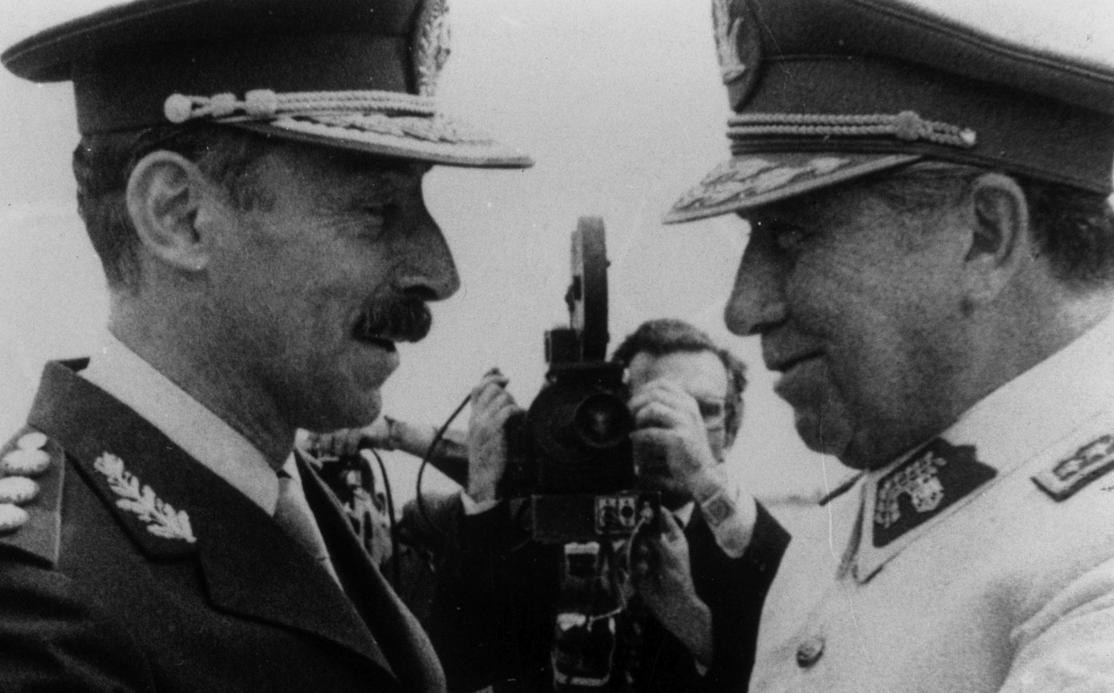
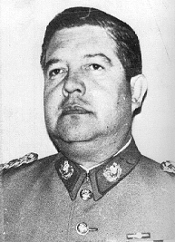
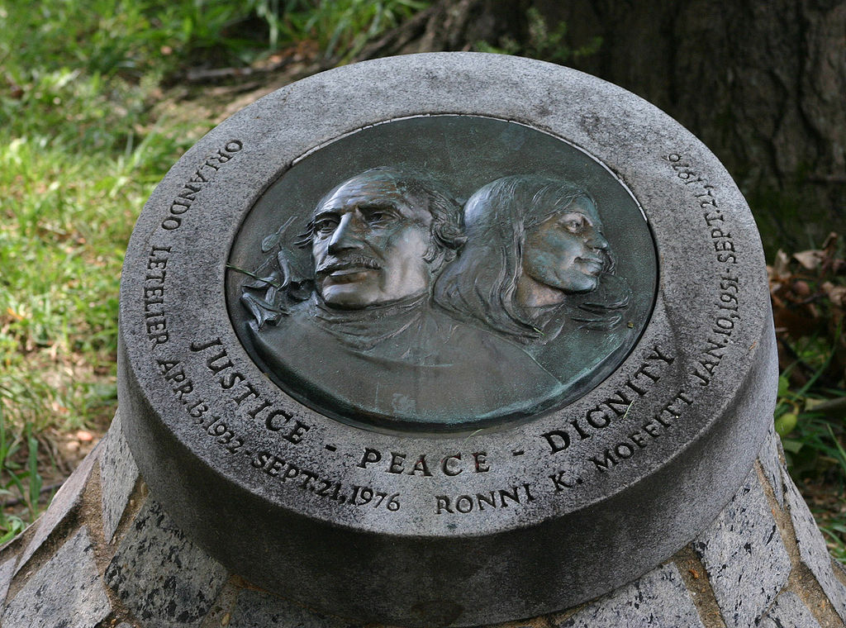
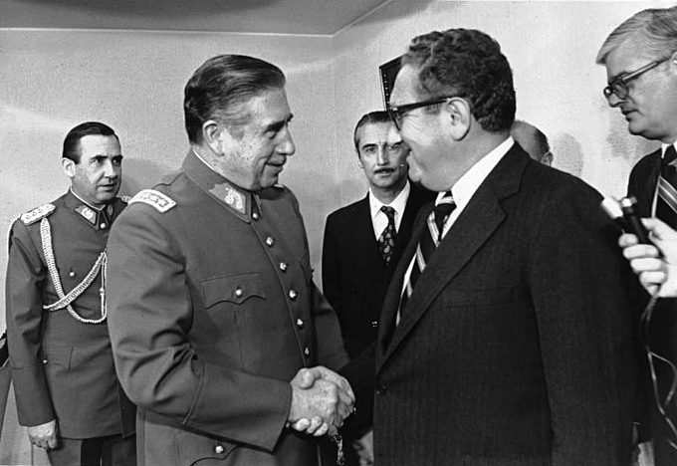
Operation Condor: an international network of assassination and state terrorism.
https://www.biobiochile.cl/noticias/artes-y-cultura/libros/2021/10/09/libro-definitivo-de-operacion-condor-ahonda-en-la-cia-y-paso-por-europa-alistan-serie-estilo-narcos.shtml
https://es.wikipedia.org/wiki/Orlando_Letelier#/media/Archivo:Orlando_Letelier_&_Ronni_K_Moffit_Memorial_28375046.jpg
https://es.wikipedia.org/wiki/Manuel_Contreras#/media/Archivo:Manuel_mamo_contreras.PNG
Reading:
Patrice McSherry, Tracking the Origins of a State Terror Network: Operation Condor Latin American Perspectives, Vol. 29, No. 1, Brazil: The Hegemonic Process in Political and Cultural Formation (Jan., 2002), pp. 38-60
https://es.wikipedia.org/wiki/Archivo:Reuni%C3%B3n_Pinochet_-_Kissinger.jpg

Slide 5
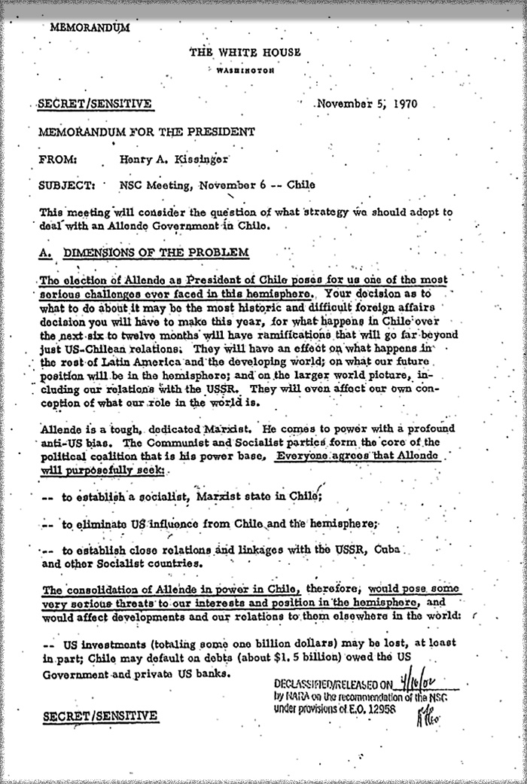
Tips to know more, see “National Security Archive”:
https://nsarchive.gwu.edu/briefing-book/chile/2020-11-06/allende-inauguration-50th-anniversary
https://nsarchive.gwu.edu/sites/default/files/thumbnails/image/1-1_0.jpg

Slide 6
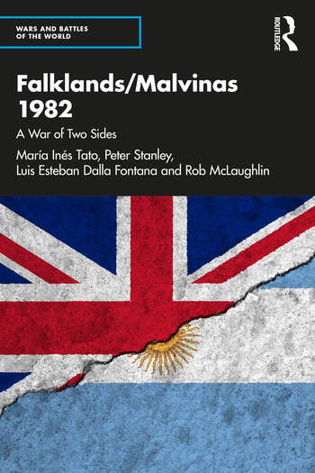
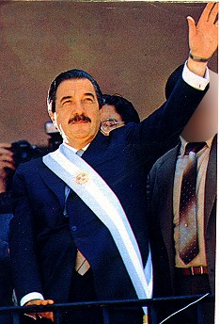
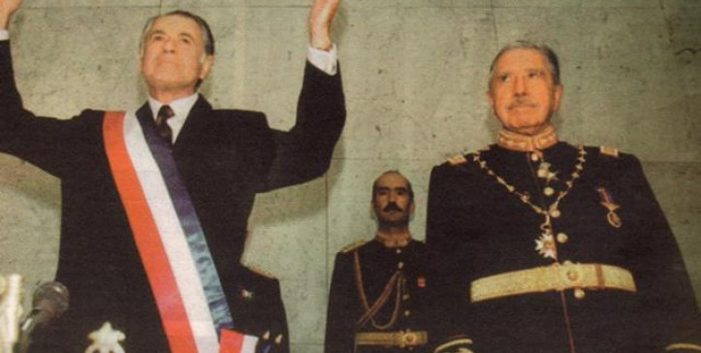
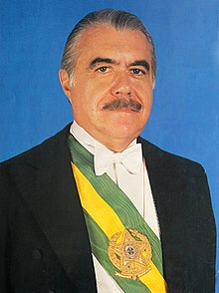
2. Transitions to democracies
Argentina: the disaster of Malvinas (Falkland Islands) and bad economic situation made pressure for elections in 1983.
Brazil: gradual process of political reopening until 1985.
Chile: plebiscite in 1988 (“No”) and elections in 1989.
The US: started to support democracies in the 1980s.
https://www.elquintopoder.cl/politica/chile-y-la-eterna-transicion/
https://en.wikipedia.org/wiki/Jos%C3%A9_Sarney
https://commons.wikimedia.org/wiki/File:Alfonsin_with_presidential_band.jpg

Slide 7
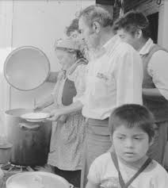
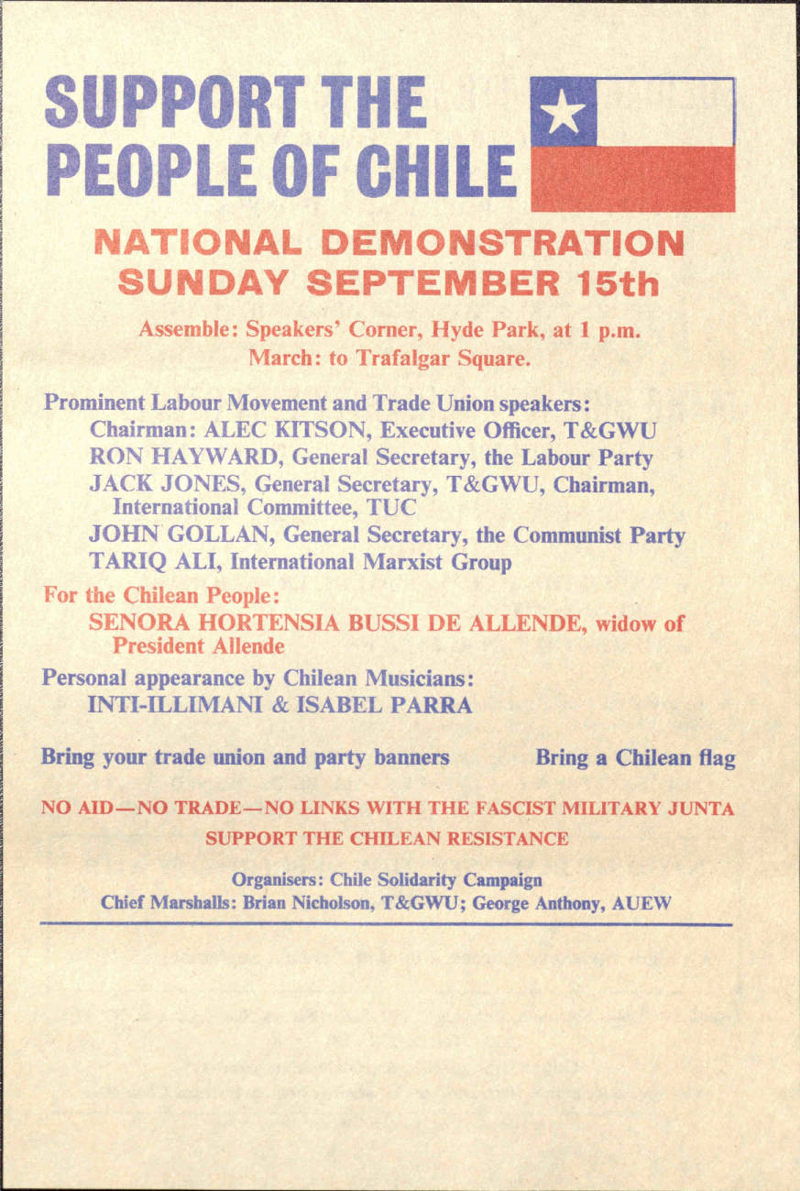
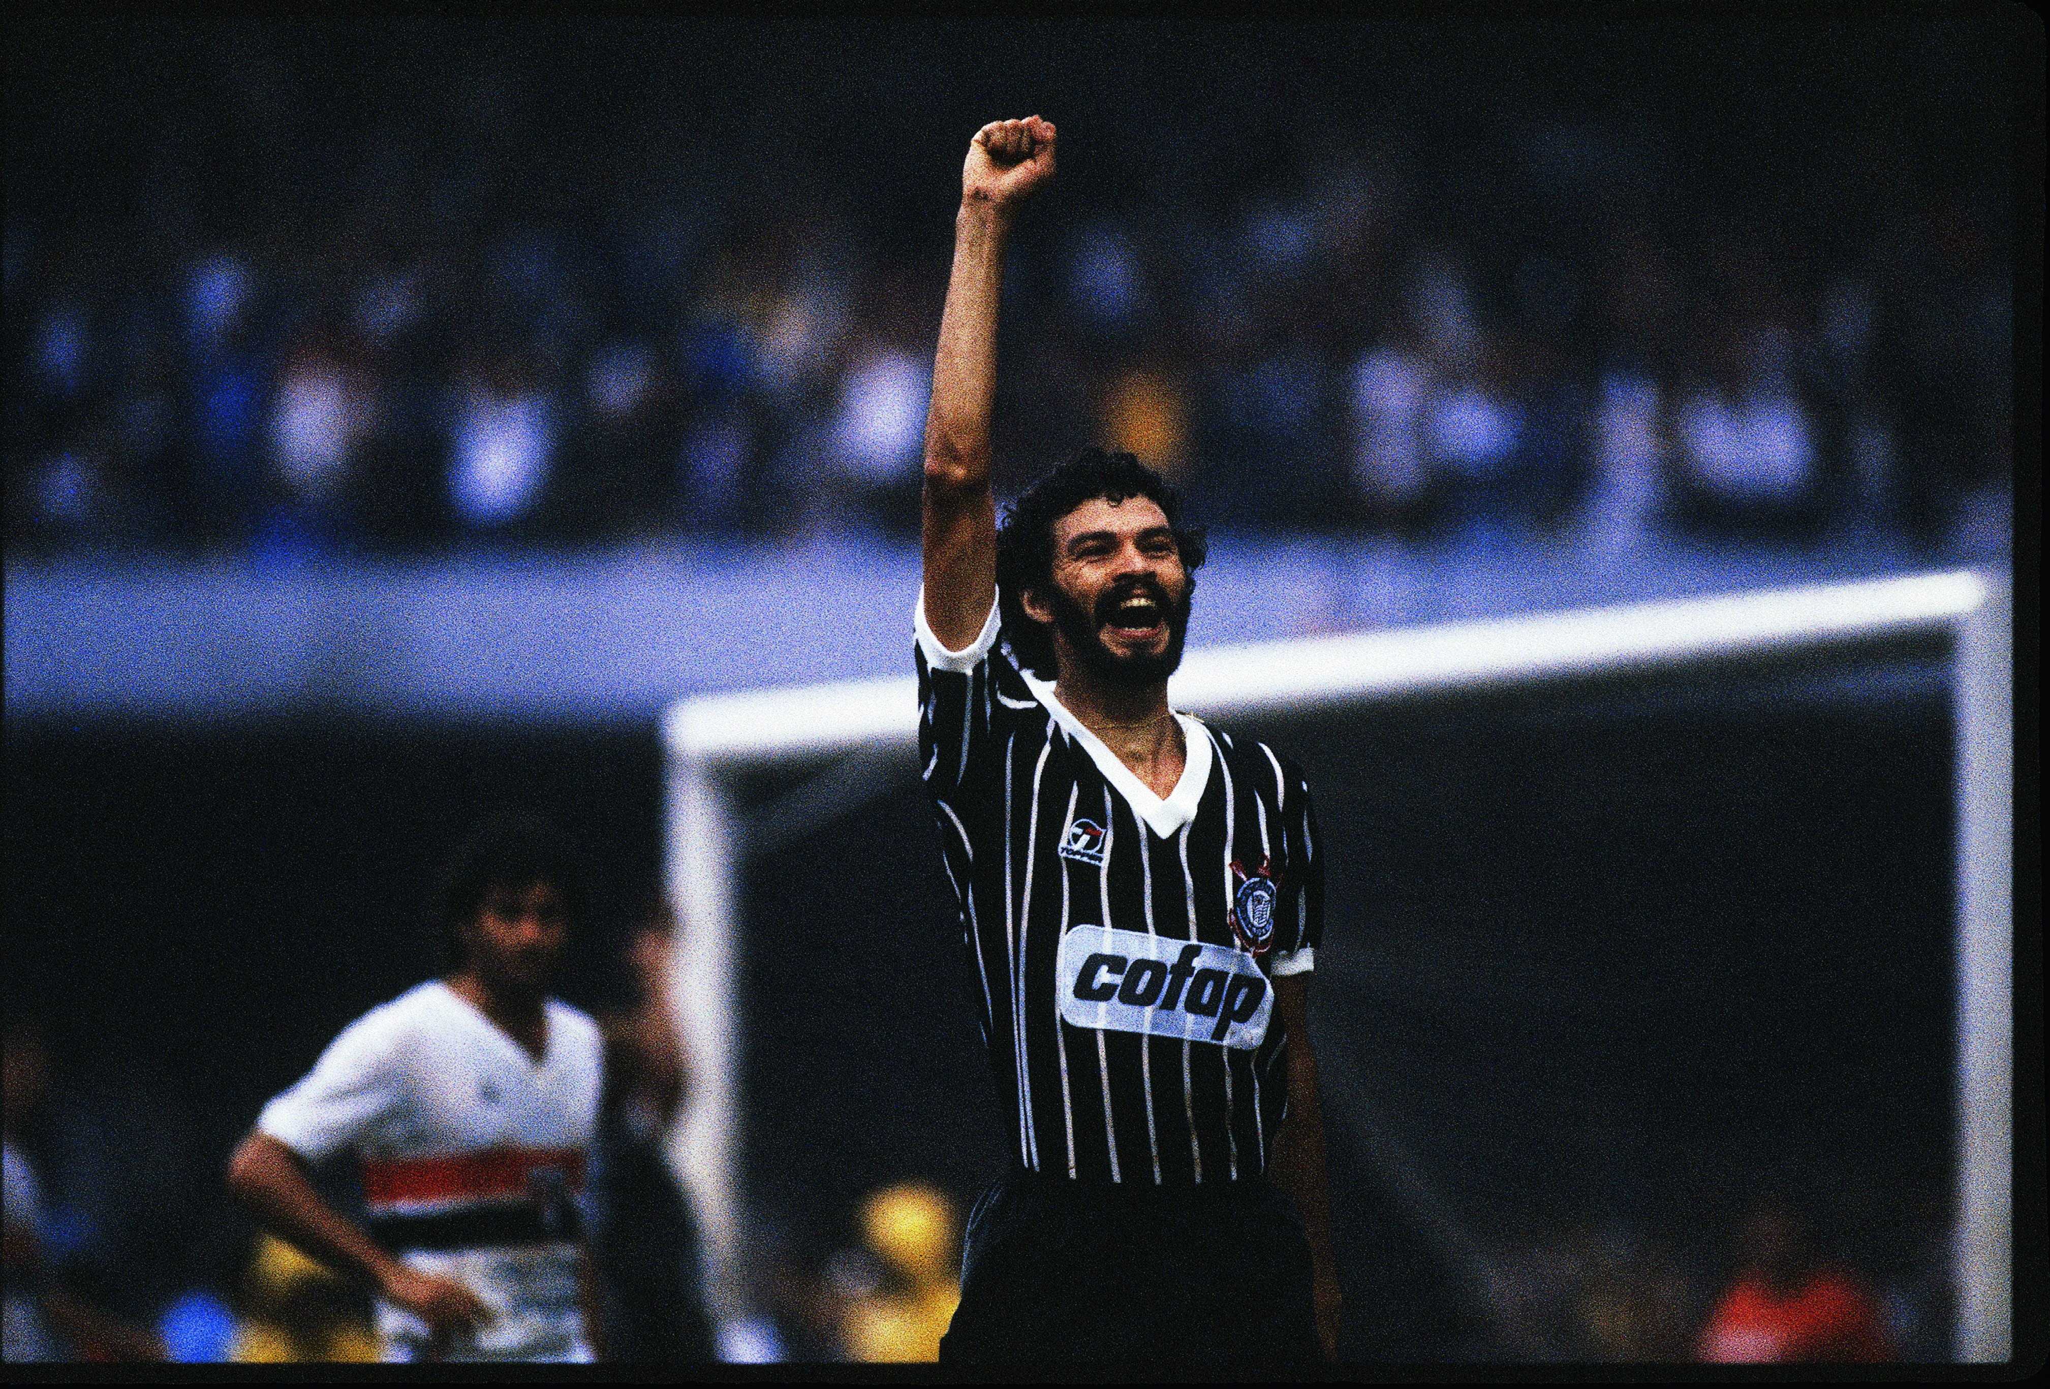
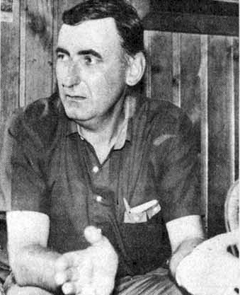
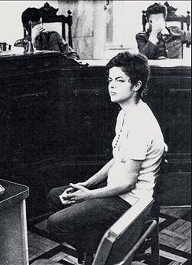

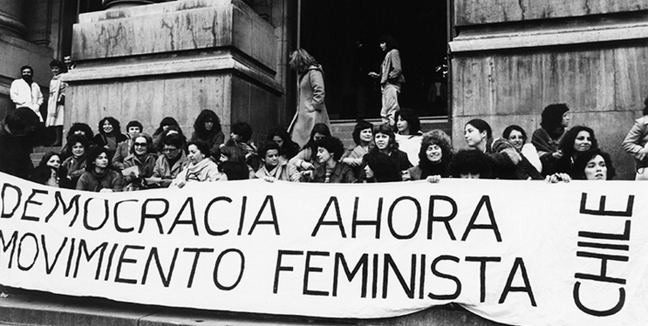
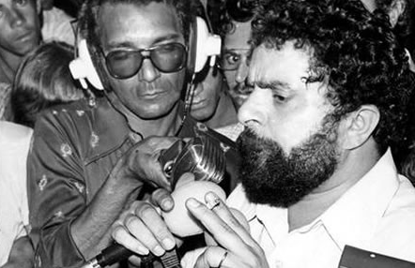
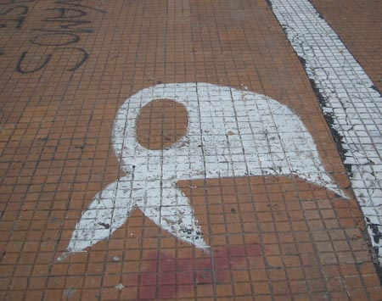

Visit the “Chile Solidarity” digital collection at the Warwick’s Modern Record Centre: https://wdc.contentdm.oclc.org/digital/collection/chile
The role and resistance of the social movements and the oppositions.
https://web.museodelamemoria.cl/Informate/cocina-publica-por-el-rescate-de-la-memoria-de-las-ollas-comunes-en-dictadura/
https://notesontheamericas.wordpress.com/tag/andre-jarlan/
In: https://super.abril.com.br/mundo-estranho/o-que-foi-a-democracia-corintiana/
https://wdc.contentdm.oclc.org/digital/collection/chile/id/232/rec/8
https://www.eluniverso.com/2011/12/07/1/1361/fotografia-muestra-joven-dilma-rousseff-durante-dictadura.html/
https://en.wikipedia.org/wiki/Manuel_Rodr%C3%ADguez_Patriotic_Front
https://es.wikipedia.org/wiki/Madres_de_Plaza_de_Mayo#/media/Archivo:Madres_de_Plaza_de_Mayo_(1).jpg
https://memoriasdaditadura.org.br/biografias-da-resistencia/luiz-inacio-lula-da-silva/
https://www.archivonacional.gob.cl/616/w3-article-93709.html?_noredirect=1

Slide 8
Resistance and memory through music
Find out some songs of resistance and memory about the Argentinean and Chilean dictatorships:
https://open.spotify.com/playlist/5bPqgp6Zyziq3gT9gdB2hi?si=b154269585e14c57
https://www.argentina.gob.ar/noticias/leon-gieco-70-anos-del-musico-argentino
https://www.npr.org/2009/10/05/113496521/remembering-argentine-singer-mercedes-sosa?t=1650837034268

Slide 9
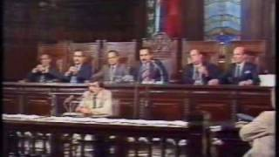
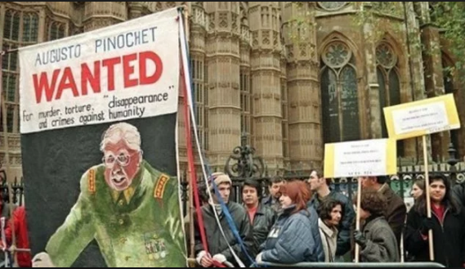
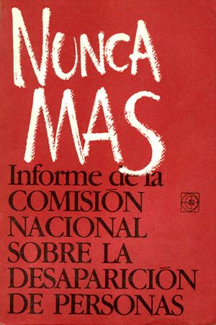
3. Trial and justice.
"Señores jueces, quiero utilizar una frase que pertenece ya a todo el pueblo argentino: Nunca más"
"Judges, I would like to use a phrase that already belongs to the entire Argentinean people: Never again".
The trial to the Juntas.
Impunity: died without incarceration.
https://www.youtube.com/watch?v=i18FQPnsyPc&t=26s
https://www.youtube.com/watch?v=9UN8vM2YHZ8
https://www.elmostrador.cl/destacado/2018/11/30/la-ensenanzas-de-la-captura-de-pinochet-20-anos-despues/
https://es.wikipedia.org/wiki/Nunca_m%C3%A1s#/media/Archivo:Nunca_mas.jpg

Slide 10
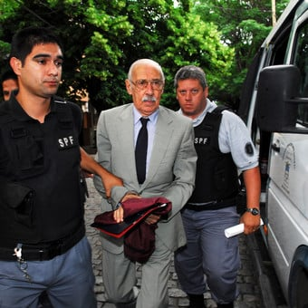
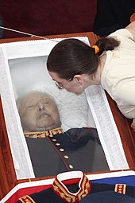
https://www.clarin.com/politica/murio-dcitador-jorge-rafael-videla_0_BJrX-XdoP7e.html
https://en.wikipedia.org/wiki/Augusto_Pinochet

Slide 11
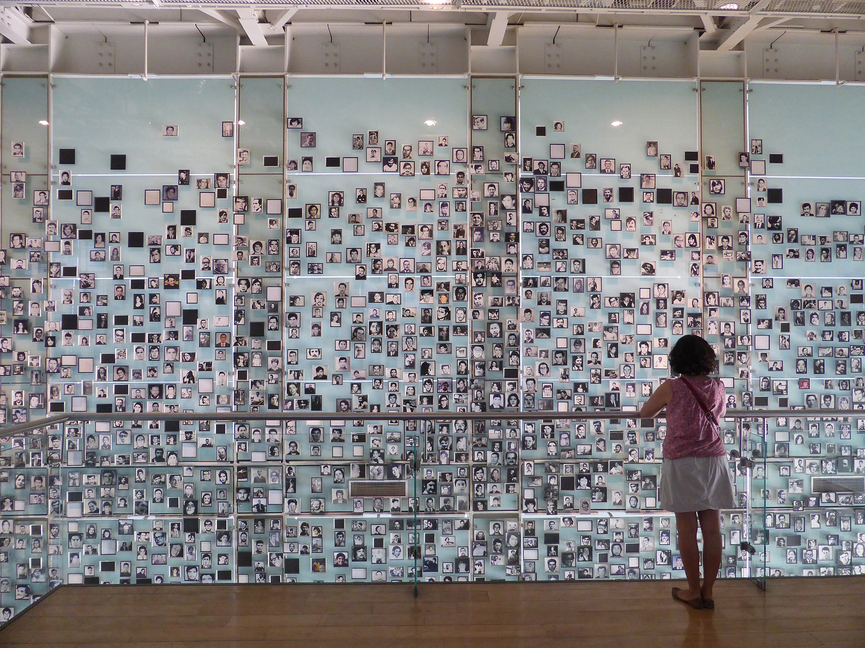
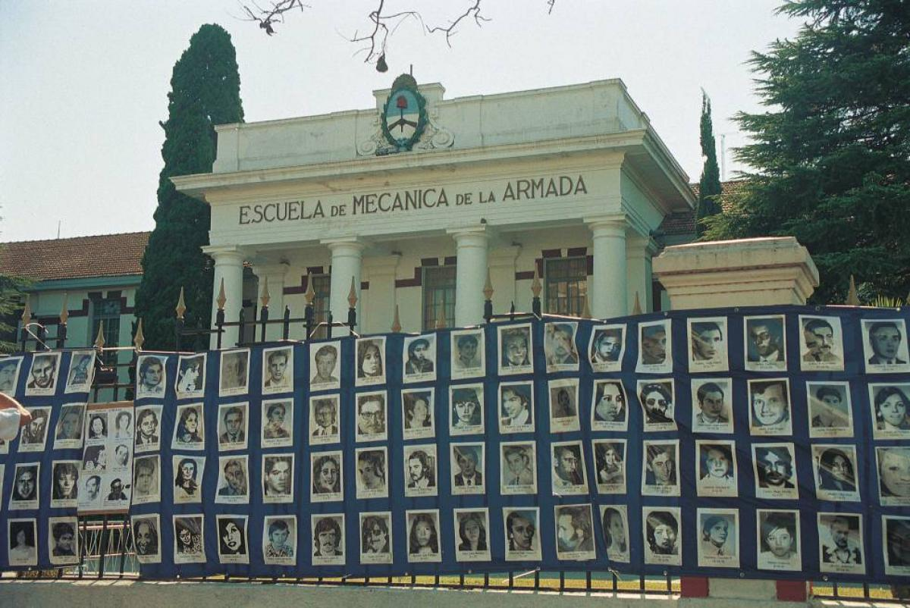
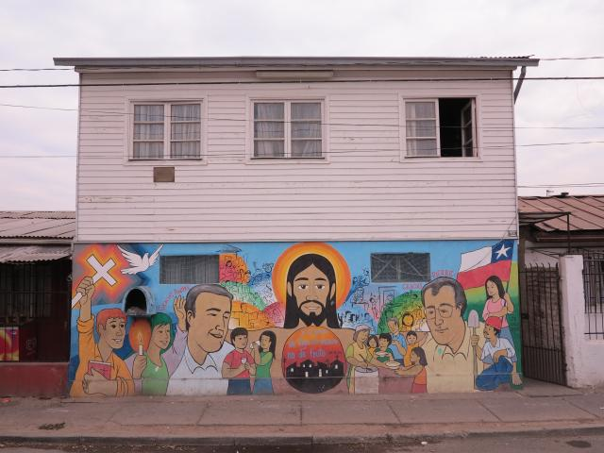
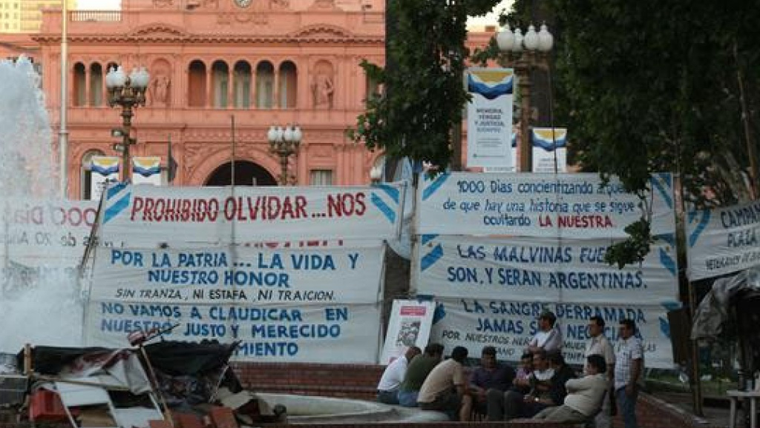
4. Memory, trauma and repair
Resonances: various memory carriers, sometimes with social and political divisions that still remains.
“Everything is stuck in the memory.
Thorn of life and history.”
León Gieco. “La Memoria” (2001)
Museo Sitio de Memoria ESMA: http://www.museositioesma.gob.ar/en/
Museo de la Memporia y los Derechos Humanos: https://mmdh.cl/
List of ”sitios de memoria”:
Argentina: https://www.argentina.gob.ar/derechoshumanos/sitiosdememoria/centrosclandestinos
Chile: https://www.patrimoniodechile.cl/688/w3-article-76773.html?_noredirect=1
https://en.wikipedia.org/wiki/Augusto_Pinochet
https://www.monumentos.gob.cl/monumentos/monumentos-historicos/casas-andre-jarlan-pierre-dubois
https://diariohoy.net/interes-general/los-veteranos-de-malvinas-cumplieron-9-anos-de-acampe-en-plaza-de-mayo-89911
https://www.anabad.org/que-el-museo-de-la-ex-esma-sea-patrimonio-mundial-de-la-unesco/

Slide 12
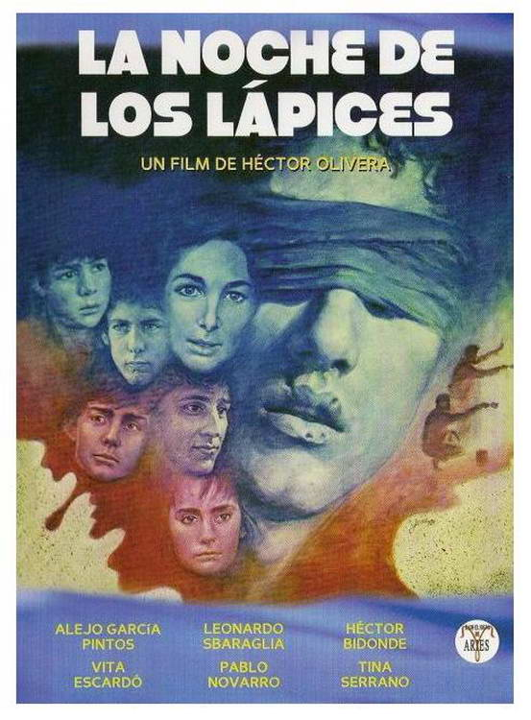

Films as representations of trauma and memory
La Noche de los Lápices
La Historia Oficial: https://www.youtube.com/watch?v=4IbHh9ixyxQ
Iluminados por el Fuego: https://www.youtube.com/watch?v=c3Pyou7P4DU
Argentina 1985: https://www.youtube.com/watch?v=a4iiyPOM6rA
La Batalla de Chile: https://archive.org/details/the-battle-of-chile
Machuca: https://www.youtube.com/watch?v=5N_XKFA1RLg
Nae Pasarán!: https://www.youtube.com/watch?v=VD6d0xKZNRg
Historia de un Oso (Bear Story): https://www.youtube.com/watch?v=-sUYg7WZSqc
https://www.sensacine.com/peliculas/pelicula-174147/
https://imagenes.t13.cl/images/original/2015/08/1439955059-bearstory2lowind.jpg?width=1200&height=675&position=top

Slide 13
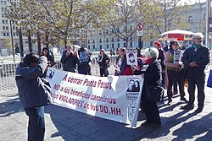
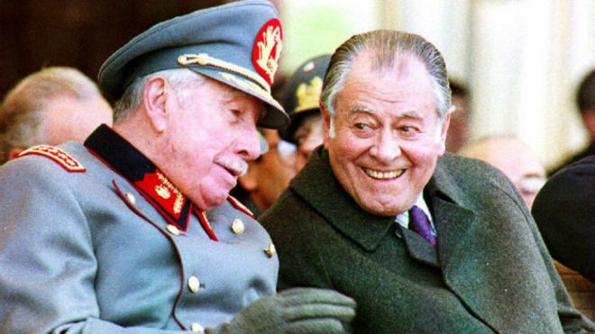
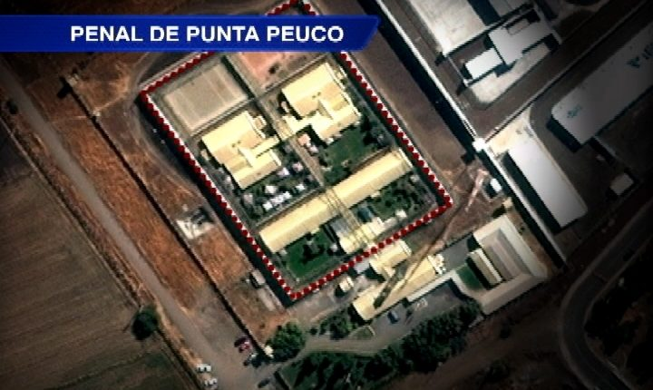
5. The legacies
Argentina and the weakness of the military role.
Chile and the authoritarian rules in democracy: “en la medida de lo posible”. A supervised democracy (democracia tutelada).
https://es.wikipedia.org/wiki/Penal_de_Punta_Peuco
https://eldiariony.com/2016/04/19/patricio-aylwin-el-presidente-de-la-transicion-tras-era-pinochet/
https://edition.cnn.com/pais/estos-son-algunos-de-los-ex-uniformados-recluidos-en-punta-peuco_20130927/

Slide 14
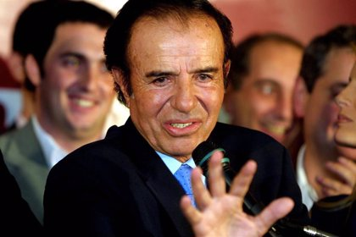
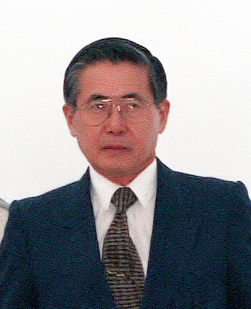

Latin America under neoliberalism from the 1990s
What is “neoliberalism”?
Washington Consensus (1989): the roles of the International Monetary Fund and the World Bank.
Dictatorships, democratic and populist governments implementing the model.
Authoritarianism, deindustrialization and inequalities. The concept of “economic miracle” (because of high grow rates) challenged and emergence of oppositions to the system.
https://www.notimerica.com/politica/noticia-amp-argentina-muere-90-anos-expresidente-argentino-carlos-menem-quien-convirtio-peronismo-neoliberal-20210214182020.html
https://icarusfilms.com/if-boys
https://en.wikipedia.org/wiki/Alberto_Fujimori

Slide 15
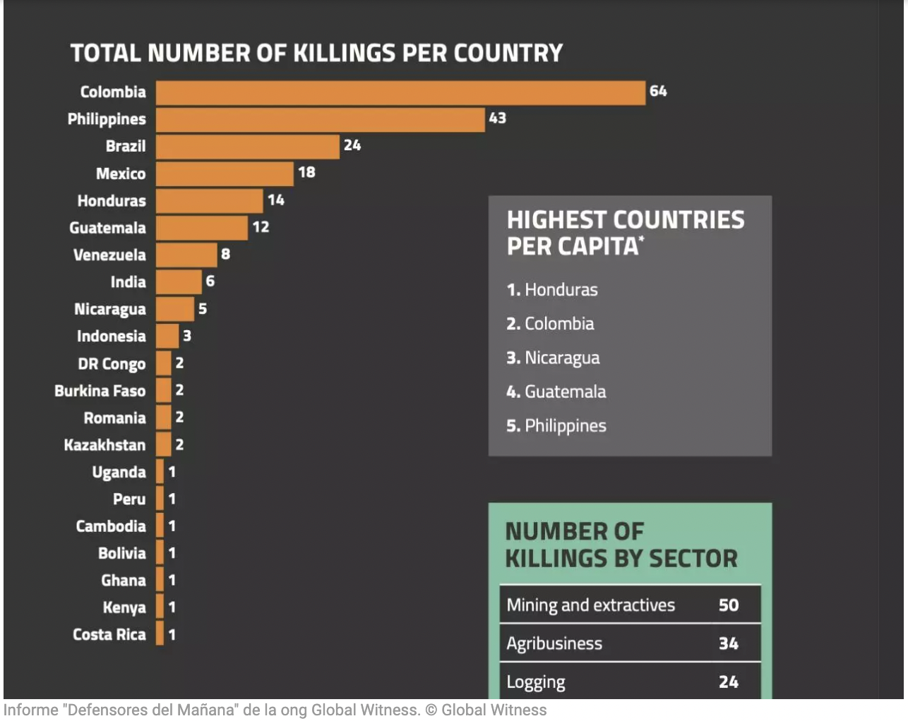
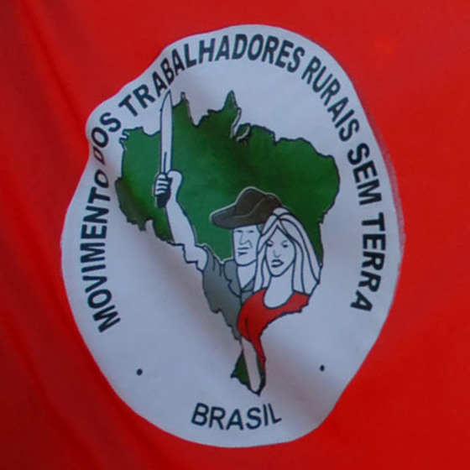
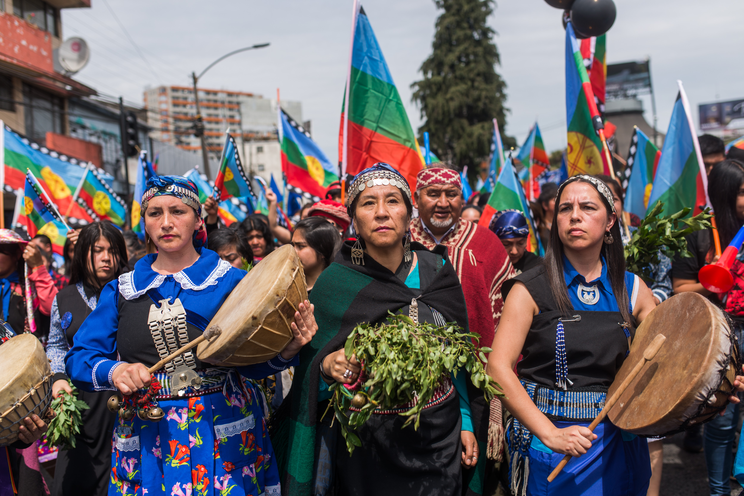
5. Social and political agents nowadays
MST (Brazil) and political activism from the rural spaces.
Piqueteros (Argentina).
New or renovated political parties.
Indigenous activism (e.g.: Mapuche in Chile and Argentina).
Environmental activism.
Feminism.
However, a new wage of reaction against wills of changes. E.g.: Bolsonaro in Brazil; killings against environmental activists.
https://en.wikipedia.org/wiki/Landless_Workers%27_Movement
https://www.ciperchile.cl/2020/08/10/a-quienes-beneficia-el-odio-racial-en-wallmapu/

