Slide 1
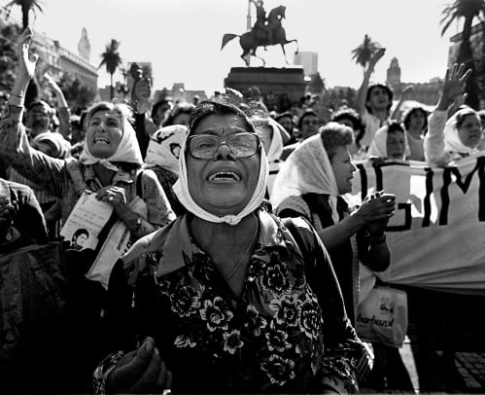
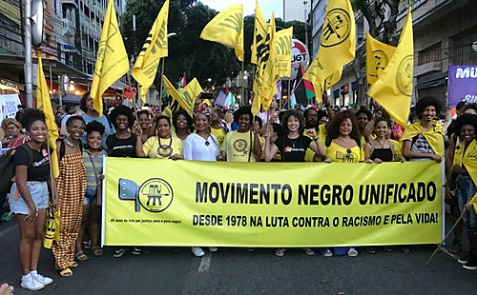
Week 1: Military Dictatorships and Democratic Transitions, 1960s-1980s
Notes:
Images depict the protests of the Mothers of the Plaza de Mayo (Argentina) and the Movimento Negro Unificado (Brazil)

Slide 2
Last time we talked about…
the Cold War in Latin America and influence of US
Role of direct interventions by United States, e.g. Guatemala 1954; Bay of Pigs 1961, later the contras in Nicaragua and El Salvador
Paranoia in Washington about spread of communism and “subversion”
very destabilising effect across the region

Slide 3
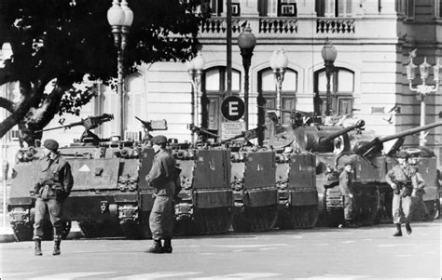
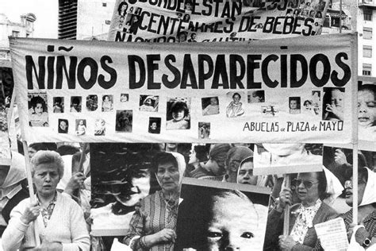
This week:
Three Southern Cone military dictatorships:
Brazil: 1964-85
Argentina: 1976-1983
Chile: 1973-1989
How the military take power
Features of military rule – especially economic policy and neoliberalism
Role of civil society activism and protest in ending dictatorships and constructing new democratic societies

Slide 4
The military: a major political institution in Latin America
Professionalism; strong corporate identity; nationalism; and sense of national “duty” develop during C20
Role as “power broker”: ushers in, gets rid of, or significantly influences “civilian” governments
E.g. PRI in Mexico incorporates military figures
E.g. Peron and Vargas both military men, both brought down by military in the end

Slide 5
The military: a range of political ideologies
Not monolithic: differences within each country, and change over time
By 60s / 70s: moderates want a finite period of military rule to revitalise economy and political life (e.g. Jorge Videla in Argentina)
Hard line want sustained period of military rule, significant economic transformations (e.g. Gen. Galtieri in Argentina, from 1981)
Well-funded at national level; national training/ institutions
But also international funding and training (significant influence of Washington after Second World War)

Slide 6
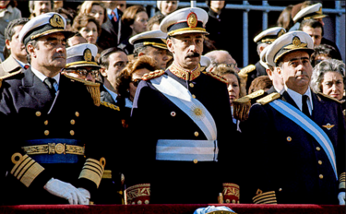
Jorge Videla, 1976-81 (Argentina)

Slide 7
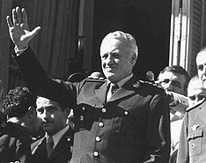
General Galtieri (Argentina): “a hard line” military leader (from 1981)

Slide 8
Why did the military take power?
Impact of Cold War on NATIONAL as well as international politics:
Political polarisation between left and right; little centre ground
Populist tactics look “subversive”: e.g. Joao Goulart in Brazil 1963-4: doubles wages, enfranchises illiterates, arouses military suspicion
Economic crises: debt, inflation (result of rapid industrialisation); populists can’t easily implement austerity to tackle these problems
US funds right-wing parties and military-civilian coalitions; destabilises left-wing leaders; backs military coups

Slide 9
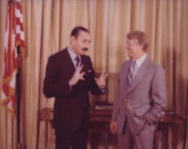
Jorge Videla meeting Jimmy Carter at the White House, 1977

Slide 10
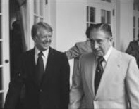
Pinochet with Jimmy Carter at the White House, 1977

Slide 11
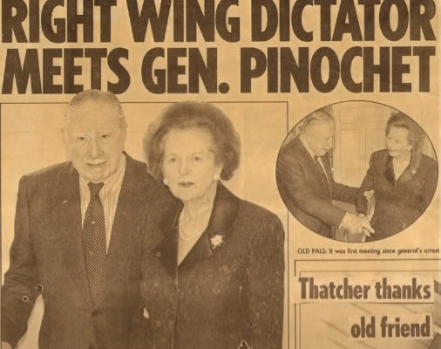
Pinochet with Margaret Thatcher

Slide 12
Features of military dictatorships
Repression of civil liberties and political opposition; exile, imprisonment, and torture of opponents and “subversives”
Differing degrees: Brazil: slow build to “full” dictatorship; congress remains open but is “purged” and controlled;
Chile: one in 100 Chileans arrested at least once; at least 6 concentration camps
Argentina: congress closed indefinitely; 30,000 “disappeared”

Slide 13
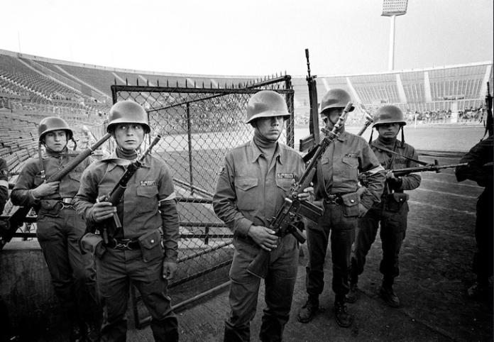
Chile’s National Stadium became one of at least 6 concentration camps

Slide 14
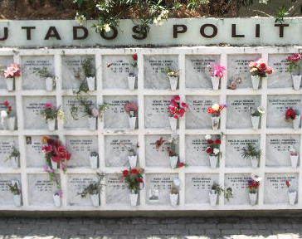
Funeral urns of political activists executed by the Chilean military dictatorship (cemetery in Santiago de Chile)

Slide 15
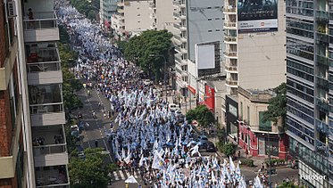
Argentineans commemorate victims of the dictatorship (2017)
http://www.youtube.com/watch?v=Ln2lcBj-rS0

Slide 16
The economy under the dictatorships
Broadly “neoliberal”: - associated with University of Chicago economists; promote free market; cut public spending; privatise state companies; and encourage foreign trade, slash import taxes
Broadly: initial success in tackling inflation
But: unpopular, socially destructive measures: wage freezes, cuts in social spending
Chile: extremely neoliberal: state spending slashed, privatisation of most state companies
Brazil: austerity combined plus state-led investment programmes: heavy industry, agribusiness

Slide 17
“Economic miracles”?
Initial high growth rates, e.g. 11% per year in Brazil 1968-73
But: huge increase in inequality:
Argentina: urban real wages fall by 40%, 1976-79
Chile: - the wealthiest 20% increase their share of national income from 51% to 60%;
middle sectors (60% of population) share falls from 44% to 35%;
poorest 20% have only 4% of national income
Brazil: economic disparity, growth of land inequality
“Bubble” bursts in all three cases – partly due to 1970s oil crises

Slide 18
Transitions to democracy
Economic crisis undermines military legitimacy
Human rights violations become international concern
Internal struggles within military leadership: e.g. moderate leader Costa e Silva in power in Brazil from 1974
Significant civil society protest despite repression…

Slide 19
Protest and resistance: the Church
Catholic Church protests and helps shelter dissident groups
E.g. Dom Helder Camara in Brazil: helps found Liberation Theology through weekly radio broadcasts
E.g. Vicariate of Solidarity in Chile

Slide 20
Women’s movements
Argentina/ Chile: “social motherhood” and protest over disappeared in Argentina/ Chile – e.g. Mothers of the Plaza de Mayo
Other demands by women e.g. reproductive rights, joint custody…
Economic demands by e.g. Housewives of the Country in Argentina: women disproportionately hit by economic crisis

Slide 21
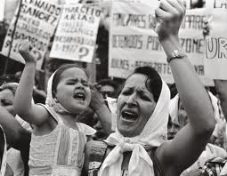
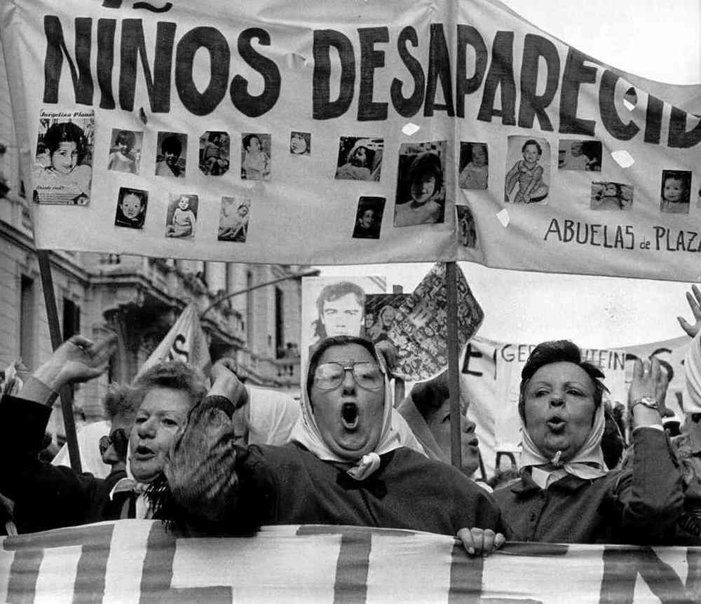
Notes:
Mothers and grandmothers of Plaza de Mayo

Slide 22
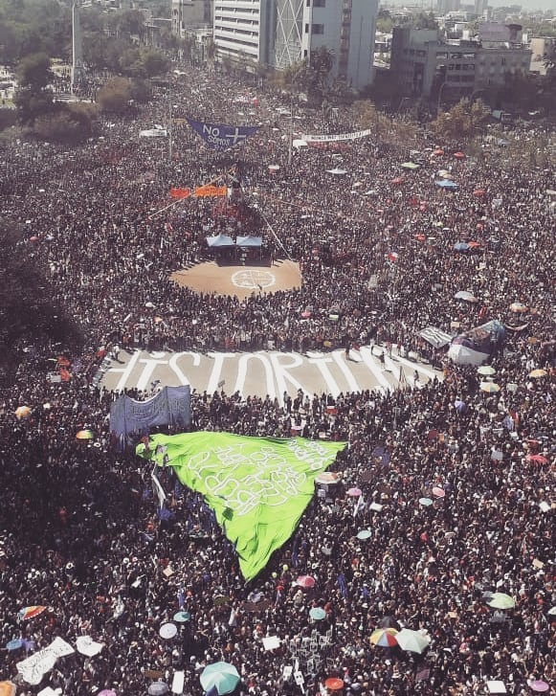
International Women’s Day in Santiago de Chile, 2020

Slide 23
New social movements in Brazil
Landless movement (Movimento dos Sem Terra, MST) founded 1980s to combat rural crisis
Indigenous organise to protest destruction of communities/ lands – first indigenous congressman, Mario Juruna, early 1980s
Urban organising e.g. Benedita da Silva
Link with Partido dos Trabalhadores (PT) which eventually produces presidents Lula and Dilma Rousseff

Slide 24
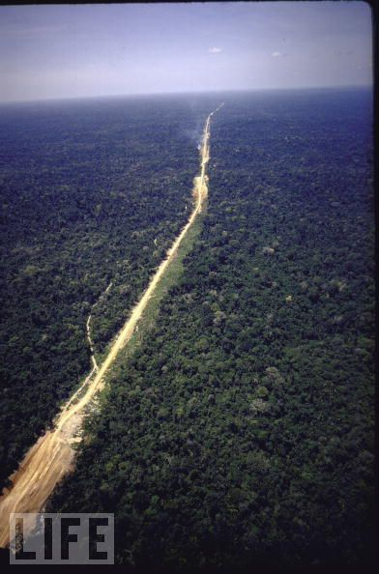
Notes:
Transamazon Highway.

Slide 25
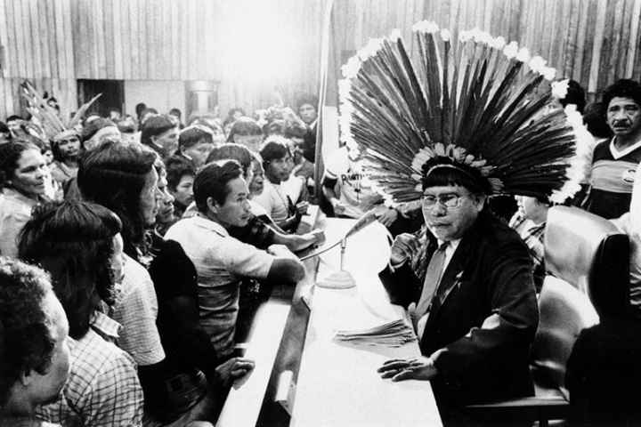
Mario Juruna: Brazil’s first indigenous congressman

Slide 26
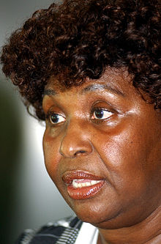
Benedita da Silva: Brazil’s first black woman senator
- Active in PT (Workers’ Party) in Rio favelas from late 70s
Elected mayor of Rio de Janeiro, 1982
Elected to congress 1986
Elected to Senate, 1994
Campaigns for women’s rights (maternity leave; equal wages for equal work)
Campaigns for rights of Afro-Brazilians

Slide 27
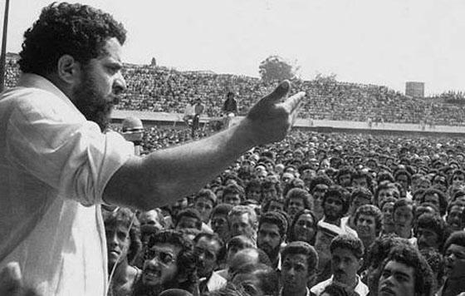
The Workers’ Party: Union organising in Sao Paulo, 1980
Luiz Inacio “Lula” da Silva, later President of Brazil

Slide 28
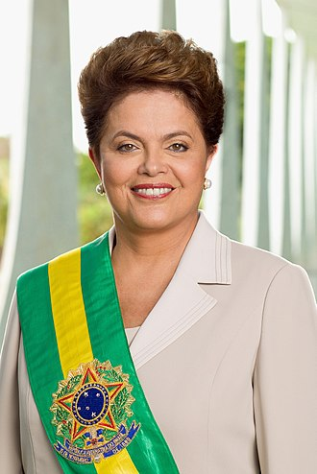
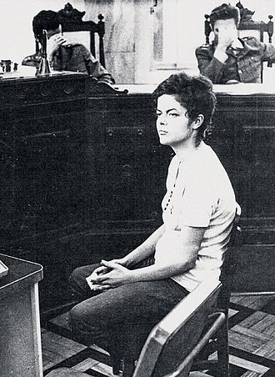
Dilma Rousseff, PT, Brazil (president 2011-2016)
On trial in a military court in 1970 for subversion…
President from 2011

Slide 29
Transitions back to democracy
Military themselves gradually cede ground for civil society protest; civil society fills this space:
e.g. Brazil: campaign for direct elections 1984-5: hundreds of thousands march; eventual democratic elections 1985
Chile: union and civil society organising around Pinochet plebiscite (promised 1980; held 1988): campaign to say “no”…successful
Argentina: military discredited after Falklands/ Malvinas disaster, 1982; elections 1983: won by Alfonsin (active human rights campaigner under dictatorship)

Slide 30
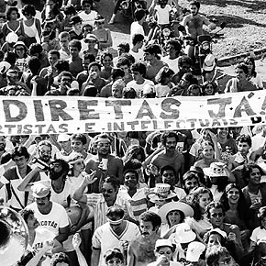
Campaigns for direct elections in Brazil, 1984-5

Slide 31
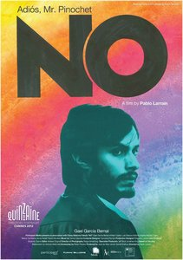
2012 film “No” about 1988 Chilean plebiscite
Directed by Pablo Larrain
Stars Gael Garcia Bernal

Slide 32
Back to democracy: how much really changed?
Neoliberal policies continue despite new political reality
Inequality, social problems, urban sprawl and violence; plus drugs
1980s a “lost decade” in Latin America?
Amnesty for military in Brazil; ongoing Pinochet influence in Chile; tricky attempts to put military on trial in Argentina
BUT: Newly-revived civil society groups; new ways of doing politics;
1988 Constitution in Brazil: rights for marginalised groups

