Slide 1
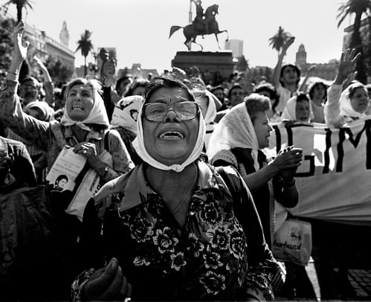
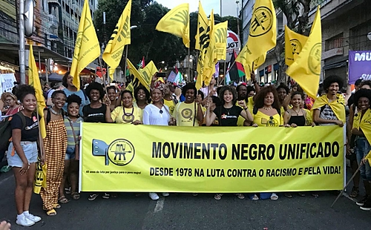
Week 1: Military Dictatorships and Democratic Transitions, 1960s-1980s
Notes:
Images depict the protests of the Mothers of the Plaza de Mayo (Argentina) and the Movimento Negro Unificado (Brazil)

Slide 2
A choice of reading…
David Pion-Berlin, "Between Confrontation and Accommodation: military and Government Policy in Democratic Argentina," JLAS, 1991 [on how newly democratic governments dealt with the legacy of military rule]
Weyland, Kurt, “Neoliberalism and Democracy in Latin America: A mixed record,” LAPS 2004, [on the relationship between neoliberal economics and democracy]
Benedita da Silva, Benedita da Silva: An Afro-Brazilian Woman’s Story of Politics and Love (1997), Introduction; chapter 5, "Feminism"; chapter 6, “Exploding the Myth of Racial Harmony”
Primary sources: Landless Movement (MST), “The Reality of the Brazilian Countryside,” in The Brazil Reader and: choose articles and news on MST website [version in English]

Slide 3
Tell your fellow students about the reading you chose. Then talk about (some of) these questions...
How did dictatorships transform into democracies?
How democratic were the “transitions to democracy”?
How did democratic governments tackle the legacy of military rule?
What was the relationship between politics and economics?
What role did civil society groups (women, the indigenous, black movements, church groups, landless workers) play in the process? Were there links/ conflicts between the activism of these different groups?

