Slide 1
Week 4
The Conquest of the Mainland: Mexico and Peru

Slide 2
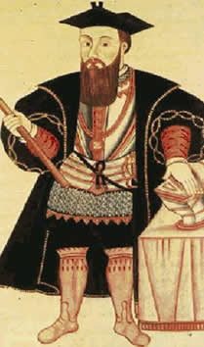

Slide 3
Terms and Concepts
Meztizaje, Creolization, diasporas in the Atlantic World
‘Conquest’ , ‘Encounter’, ‘Invasion’?
‘New’ World?
‘Spanish’ (or ‘Latin’) America?
‘Fusion’ or ‘Appropriation?
‘New’ World?
Indian (indio)? Native/American?

Slide 4
Questions to think about this week
How did each side interpret the first meetings? What shaped their worldview?
How can we write a history that incorporates the view of the vanquished as well as that of the conquerors? What sources are available to us as historians? What problems do they present?

Slide 5
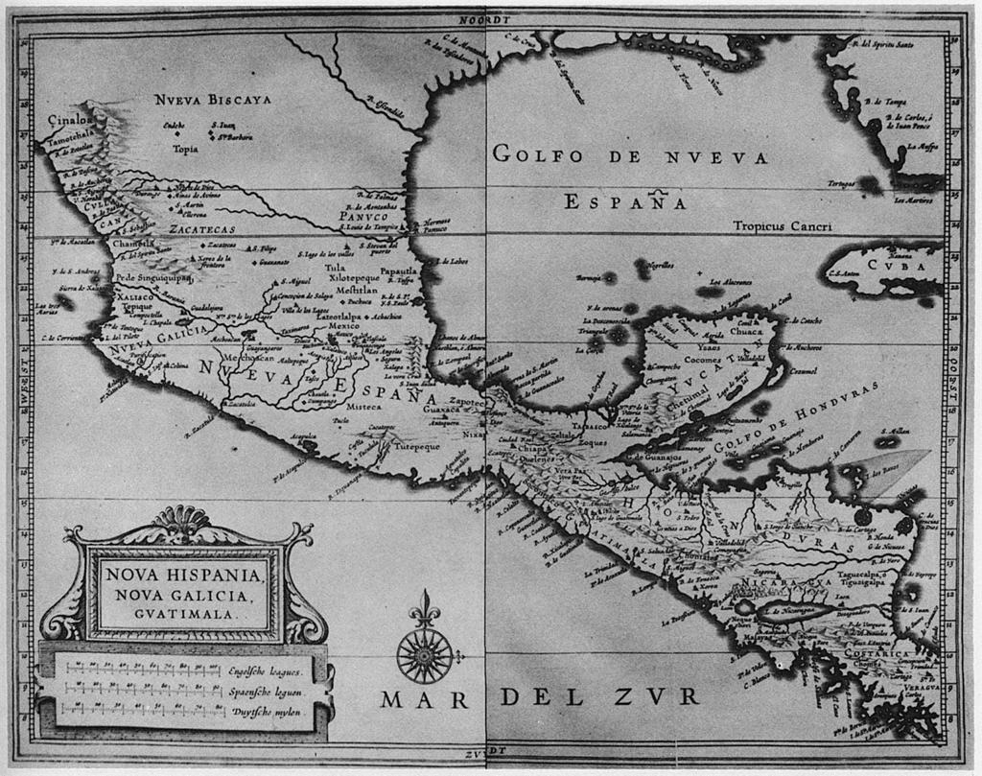
Mesoamerica

Slide 6
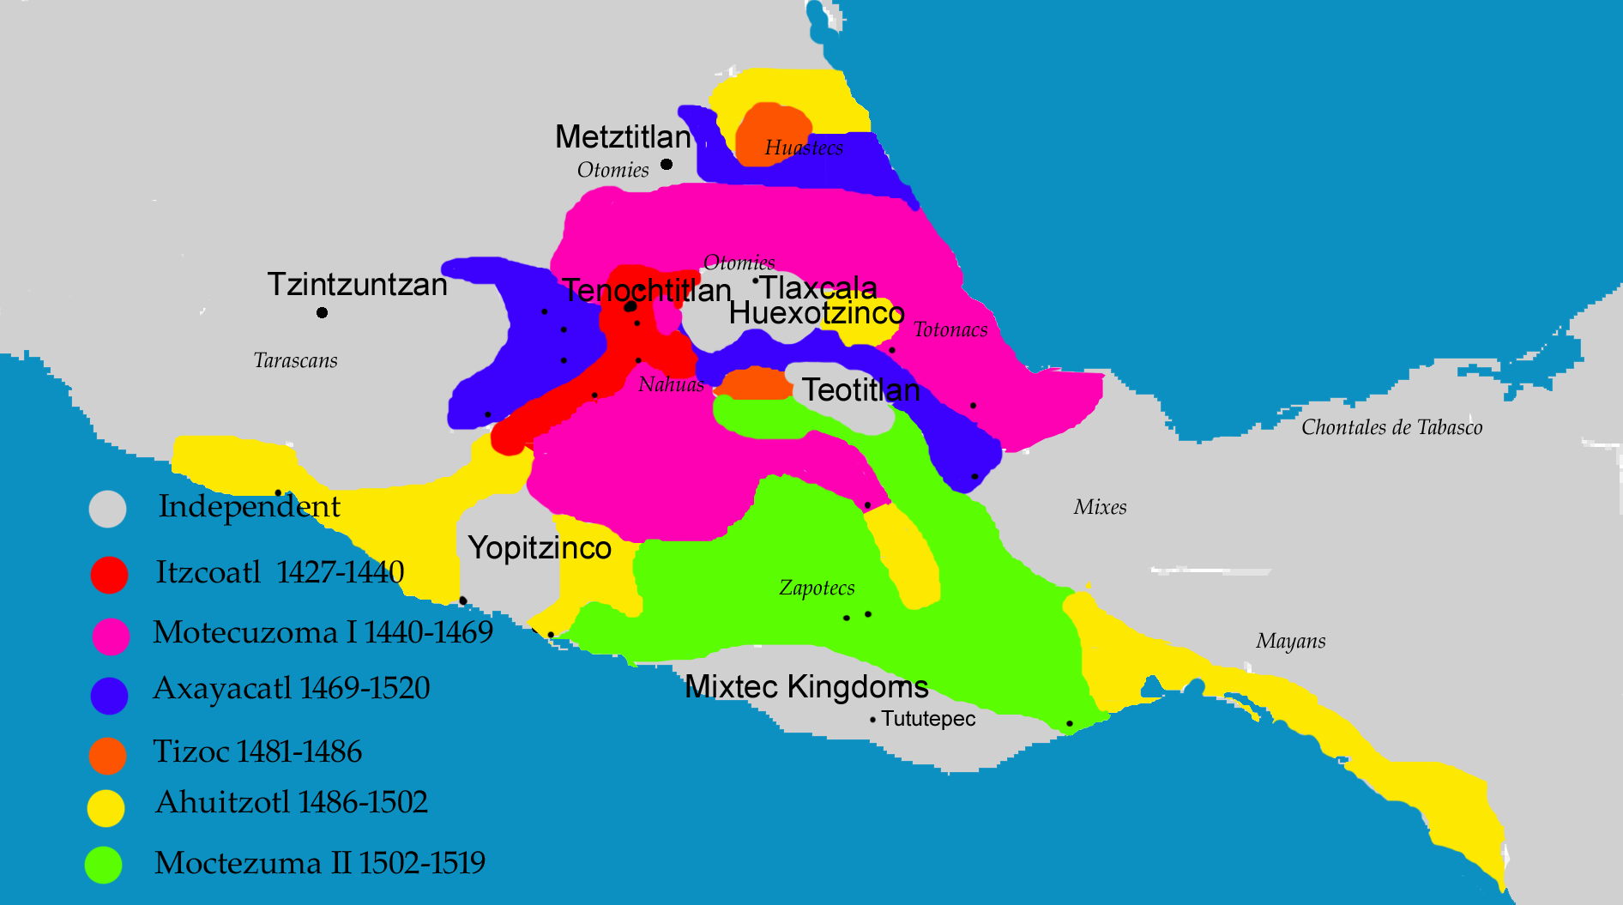
Aztec Empire, 1427-1519

Slide 7
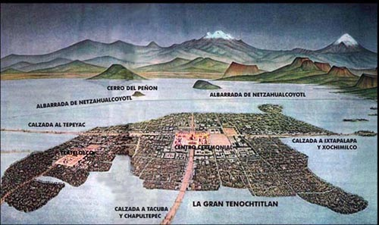

Slide 8
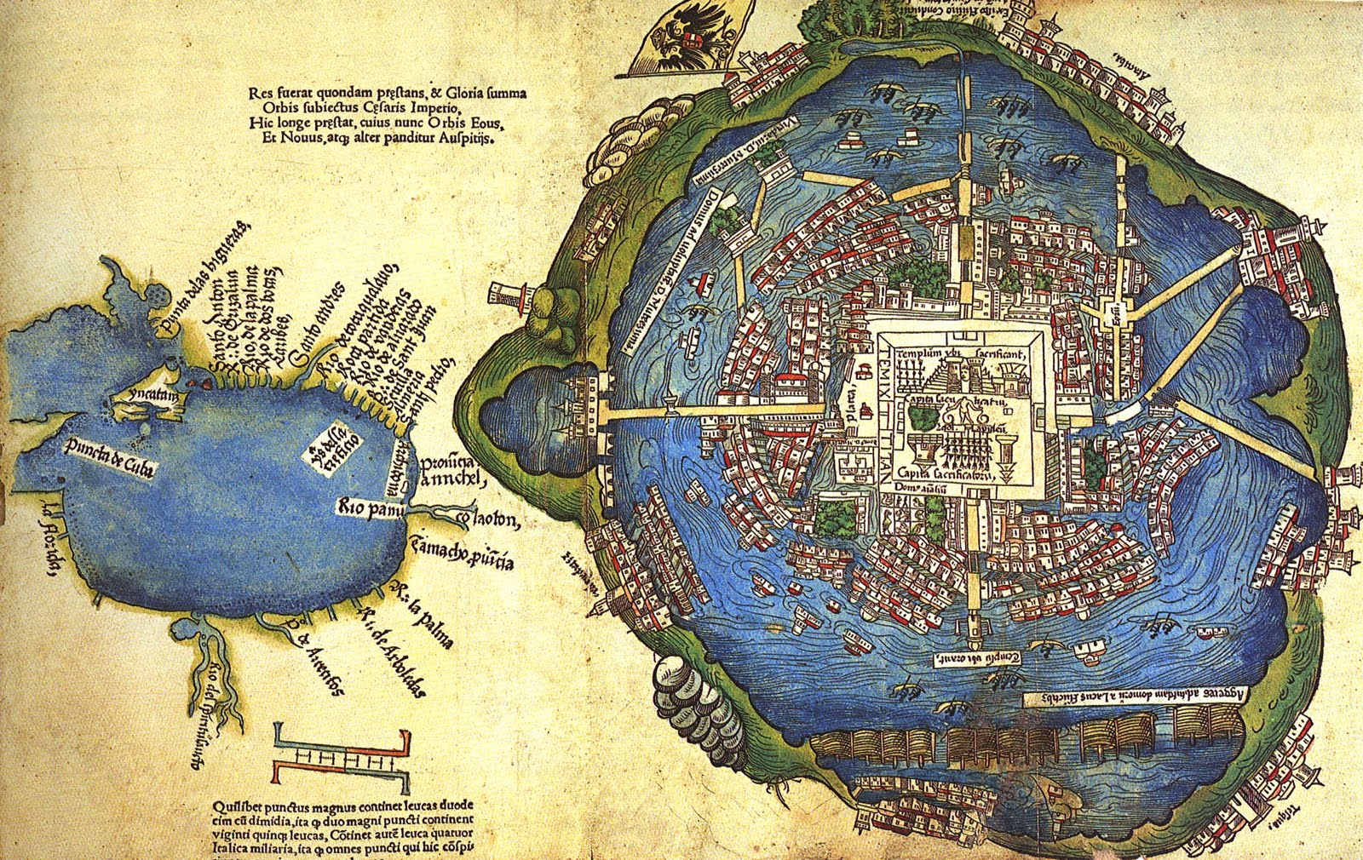
Tenochtitlán and the Gulf of Mexico, unknown artist, 1524. Based on map presented to Cortes by Mexica peoples in 1519-1521. Library of Congress

Slide 9
The rise of the Aztecs in central Mexico
Alliance of 3 different peoples
Mexica are dominant: capital at Tenochtitlán on Lake Texcoco, from 1325.
They ally with two of their neighbours: the city states of Texcoco and Tlacopan → Aztecs conquer Valley of Mexico by 1428.
1502 under Montezuma II: huge empire, centred on Tenochtitlán. Several hundred thousand residents in Tenochtitlán alone; 1.5 million in Valley of Mexico.
Some areas and peoples are NOT conquered and become enemies/ rivals: e.g. the Tlaxcalans.

Slide 10
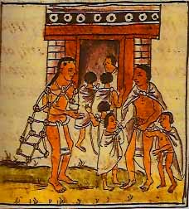
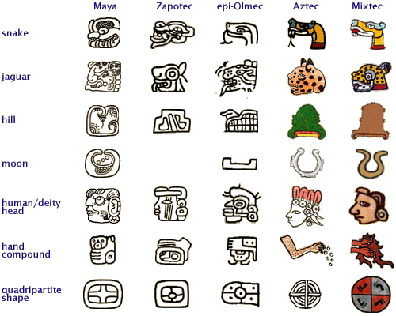
Features of Aztec Empire
Based on village units: calpulli. Empire built by adding these units.
Very stratified society: elite are warriors/ priests etc; live in Tenochtitlán & claim tribute from other parts of the empire
Religion is central and not separable from politics. Descent from god Huitzilopochtli justifies rule
Syncretism: calpulli continue to worship own deities but incorporate Huitzilopochtli
Major cultural achievements. Temples; cosmology, education, writing using pictorial/ glyphs system

Slide 11
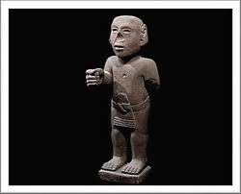
Social structure of Aztec empire

Slide 12
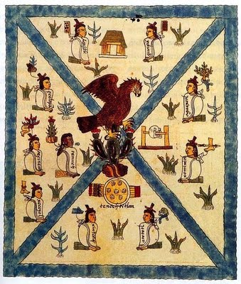
From Codex Mendoza c. 1541
Bodleian Library Oxford

Slide 13
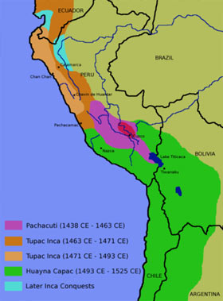
Inca Empire, 1438-1525

Slide 14
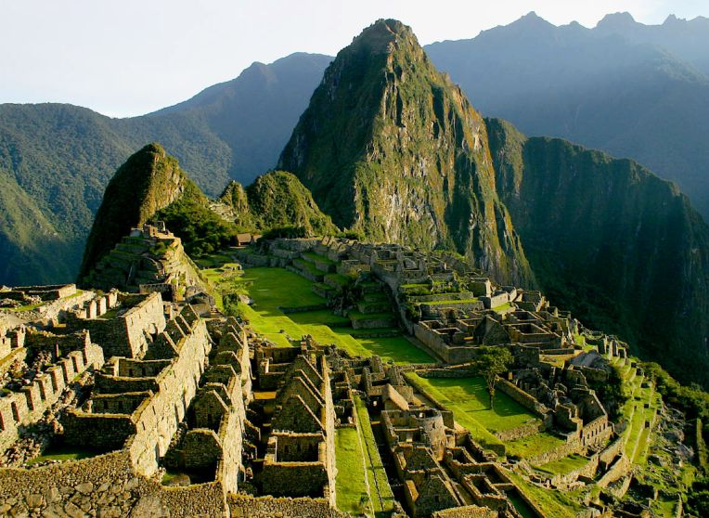
Machu Picchu, Peru

Slide 15
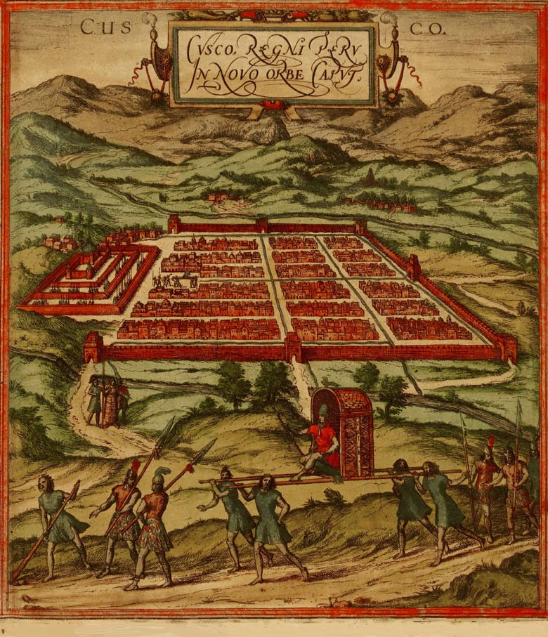

Slide 16
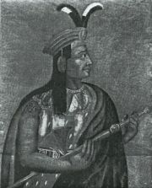
Atahuallpa

Slide 17
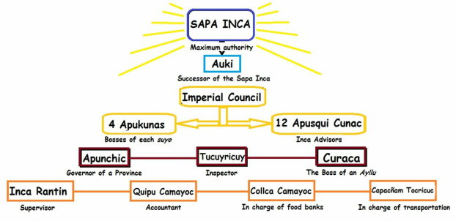

Slide 18
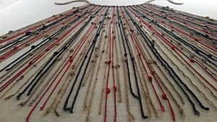
Features of Inca Empire
Based on exacting tribute.
Village units: ayllu; but also, a centralised bureaucratic state.
Redistribution and reciprocity in Andean society to cope with CLIMATE.
Central warehouses for population in times of hunger
Mita – a system of rotational labour service that will be maintained in modified form under the Spanish
Religion intertwines with state. Local people also keep own huacas (shrines) as well as Inca religion.
No writing; knotted strings (quipus)

Slide 19
The Aztec and Inca empires are very different, but they share important common traits:
dense, often urban populations;
settled agriculture;
complex social hierarchies;
a central connection between religious belief and social and political structures;
systems of tribute
Empire-building: subject peoples under a central ruling group; syncretism
Parts of empires only RECENTLY created; local rivalries and tensions

Slide 20
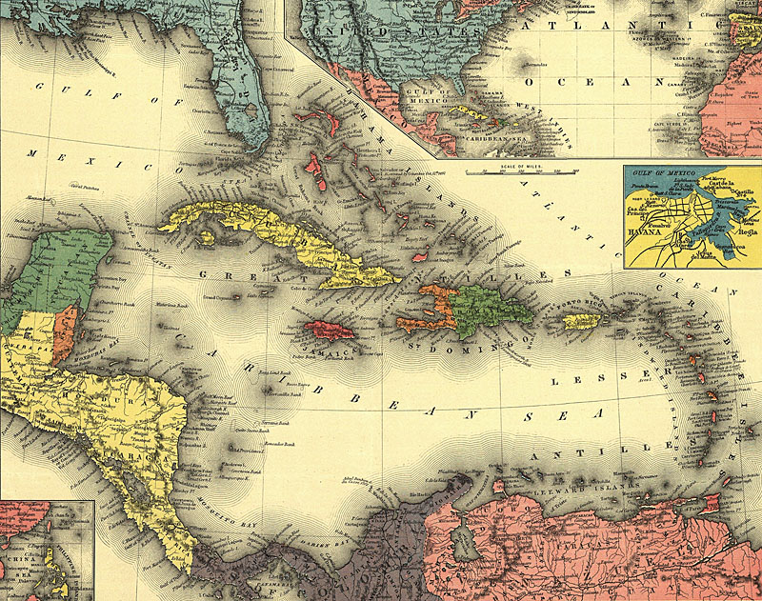
Notes:
Caribbean (in 1898!)

Slide 21
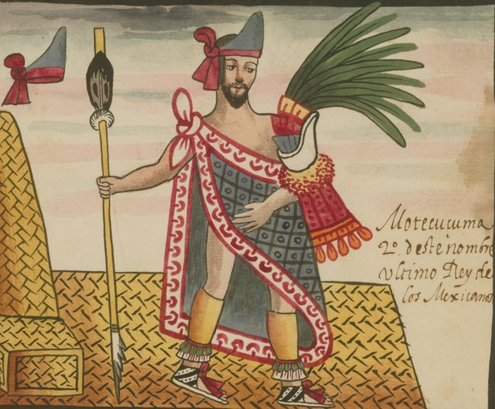
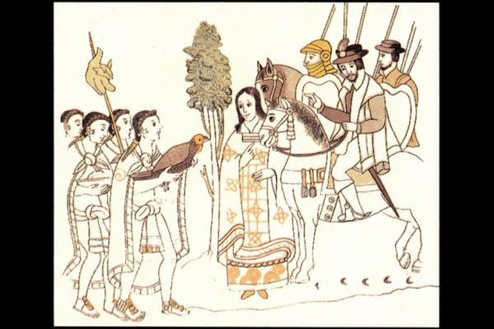
Moctezuma
From the The Tovar Codex, attributed to the 16th-century Mexican Jesuit Juan de Tovar, contains detailed information about the rites and ceremonies of the Aztecs (also known as Mexica).
Malintzin
From the: Lienzo de Tlaxcala

Slide 22
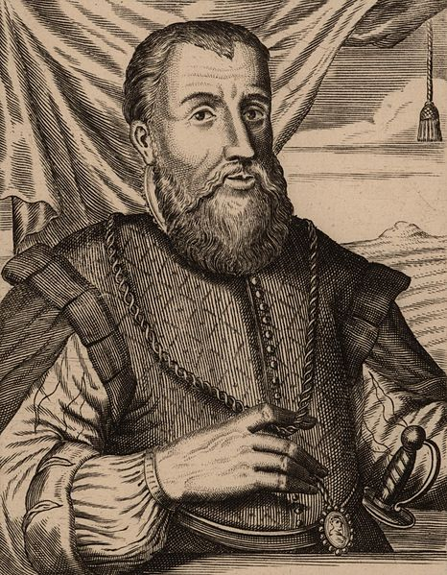
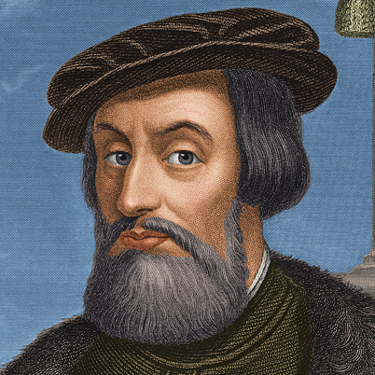
Hernán Cortés
Governor Diego Velázquez

Slide 23
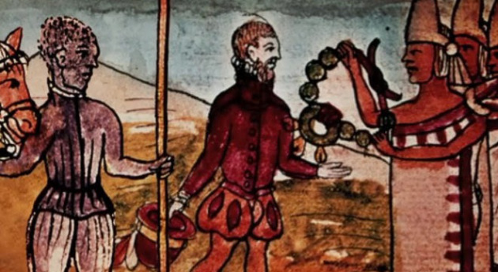
Juan Garrido (c. 1480-c. 1550), the Black Spanish Conquistador
See Peter Gerhard, “A Black Conquistador in Mexico” The Hispanic American Historical Review, 1978

Slide 24
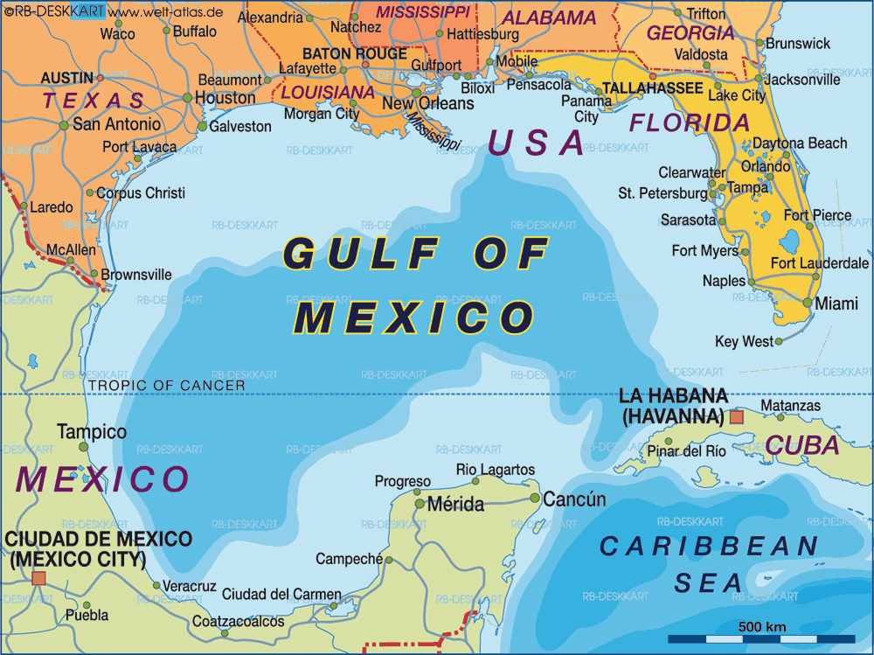

Slide 25
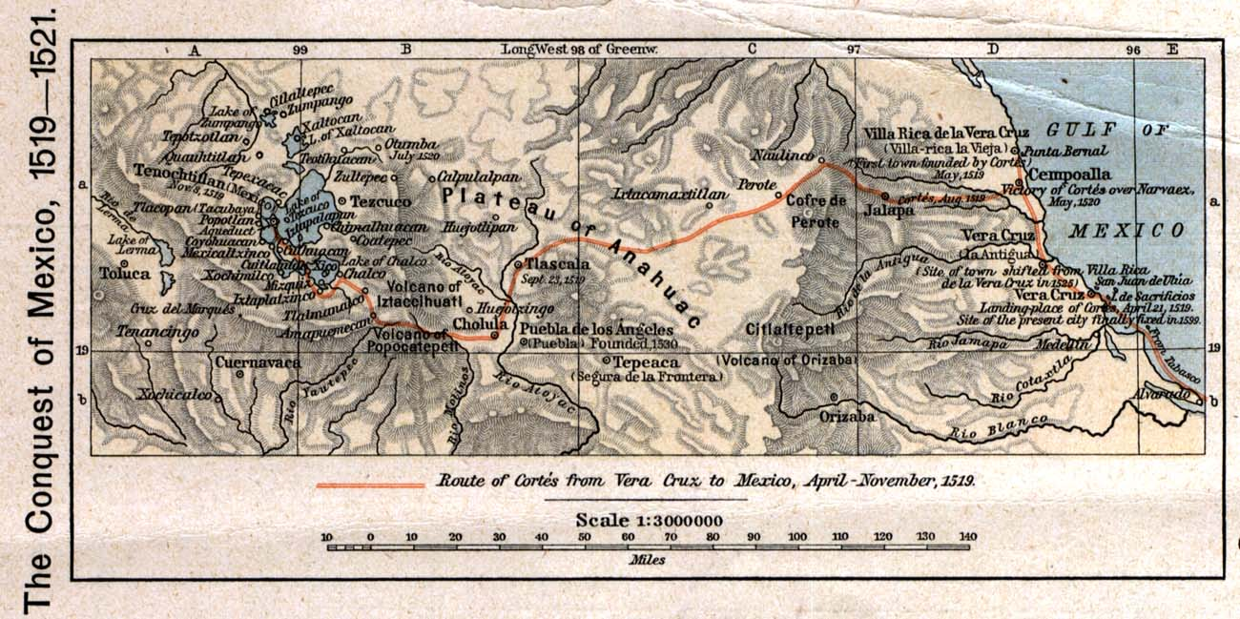
Cortés’s route through Mexico

Slide 26
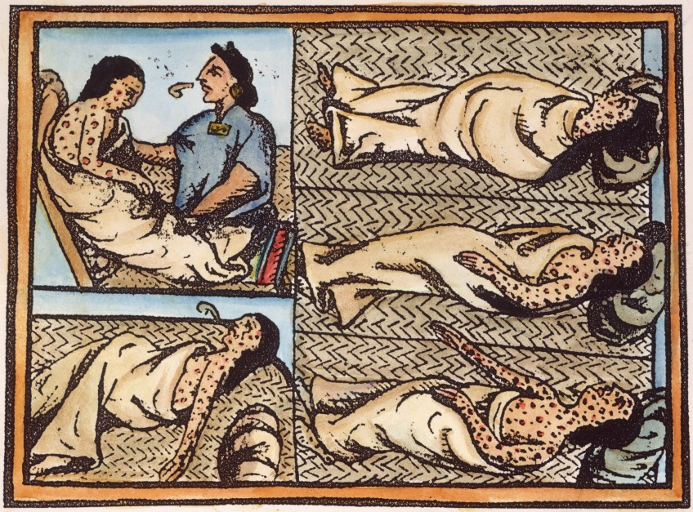
American victims of small pox. Source: Florentine Codex

Slide 27
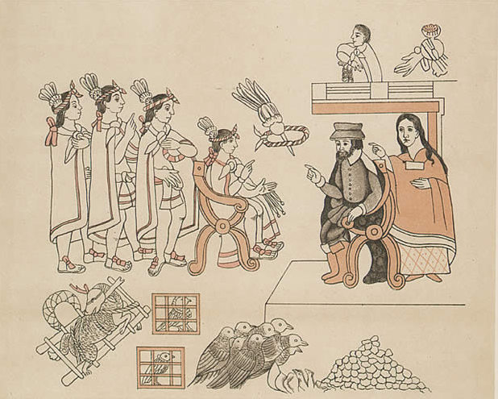
Hernán Cortés meets Moctezuma. Source: Lienzo de Tlaxcala

Slide 28
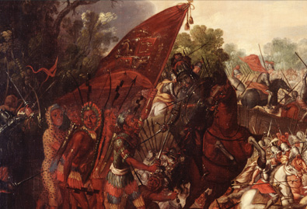
Use of horses in conquest of Tenochtitlán. Source: Library of Congress

Slide 29
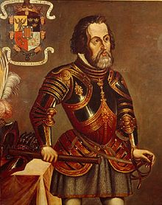
Hernán Cortés

Slide 30
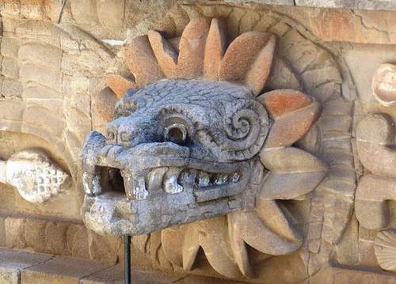
Quetzalcoatl – The Feathered Serpent

Slide 31
Sources for the Conquest of Mexico
Letters of Hernán Cortés (1522-1525)
Juan Ginés de Supúlveda (1540s)
Fray Bernardino de Sahagún Florentine Codex (1585)
Bernal Díaz del Castillo, The True History of the Conquest of New Spain (1576)
Diego Durán’s account, The History of the Indies and New Spain (1581)
‘I believe that this document teaches me this: May I trust it to do that?’ (Paul Veyne cited in Clendinnen, 1991)

Slide 32
The Conquest of The Mainland (1): Mexico
From Cuba: Diego Velázquez reconnoitres Yucatán; rivalry with Cortés
Hernán Cortés founds Veracruz, 1519 (in Aztec territory)
Exploitation of rivalries (alliance with Tlaxcalans, among others)
Arrival in Tenochtitlán; leaves to quell attack at Veracruz ordered by Velázquez
Returns to chaos; Montezuma has died
Comes back with Caribbean soldiers but also thousands of indigenous recruits
Siege and destruction of Tenochtitlán
Aztecs defeated by European technology; alliances with rival peoples; disease (and its psychological impact)
Cortés becomes governor; later replaced by royal official

Slide 33
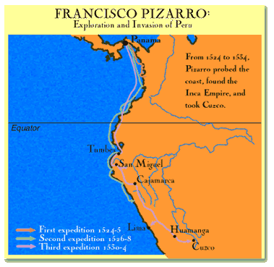
The Andean Region, Peru

Slide 34
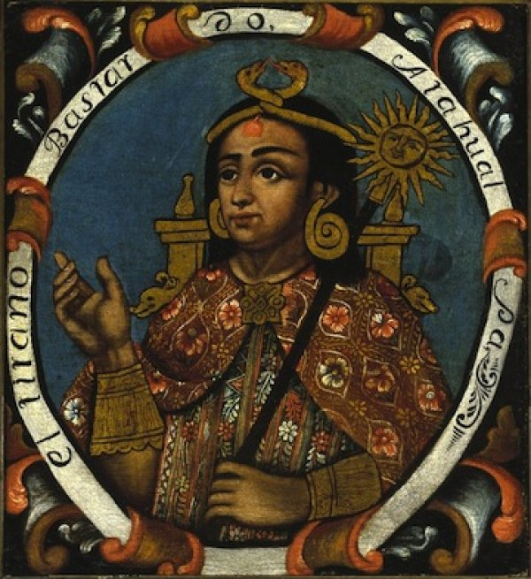
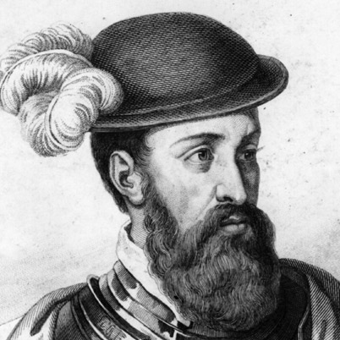
Atahualpa
Mid-C18 Portrait, Brooklyn Museum
Francisco Pizarro

Slide 35
Problems with writing the history of conquest and pre-conquest
Power: the “voices of the victors”
Most people in Europe, but especially the Americas, don’t WRITE. Written texts are left mainly by the most powerful (in each culture)
Disproportionate influence of go-betweens/ translators/ acculturated indigenous people
Demographic collapse: who survived to tell the tale? How can we measure pre-conquest populations?
Aims and audience of the person writing
Apparent “translatability” but total misunderstandings in reality; and we tend to get the European interpretations not the indigenous ones
Problem of European preconceptions and imaginings about New World, e.g. chivalric ballad tradition…

Slide 36
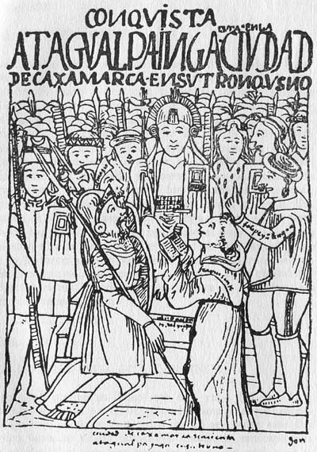
Atahualpa
Pizarro
Dominican Friar, Fray Vicente Valverde
El Requerimiento 1513
A written document that justifies the conquest of New World
“read to trees and empty huts” (Hanke, 1949)
See Patricia Seed, “Failing to Marvel”: Atahualpa’s Encounter with the Word”, Latin American Research Review, 26:1, 1991.
Atahualpa.
From Guaman Poma, Chronicles 1560s 70s

Slide 37
The Conquest of the Mainland (2): Peru
1513 Panama conquered by Pedrarias Dávila
1530 Francisco Pizarro leaves Panama; arrives in Tumbes (North coast of Inca Empire, today’s Peru)
Atahuallpa imprisoned, huge ransom in gold paid;
But, later executed; slaughter of indigenous
Like Mexico: Spanish exploit indigenous divisions (alliance with Atahuallpa’s rival Huascar)
1533 Pizarro & his ally Diego Almagro conquer Cuzco; later found Lima (more accessible)

Slide 38
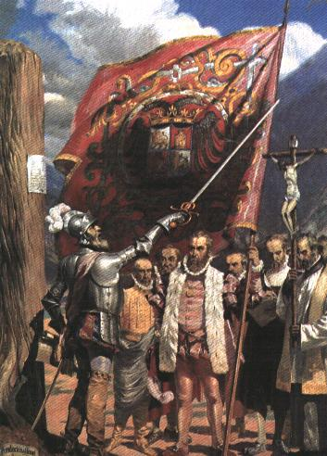
Pizarro founding Lima

Slide 39
Continuing Strife in Peru, 1530s-70s
Conquest of northern Inca territories (Quito)
Continuing Inca resistance: Manco Inca besieges Cuzco & Lima, 1536
Rivalries between Almagro and Pizarro; civil war between Pizarros and Almagristas
Independent Inca state established; Tupac Amaru rebellion in 1571 (repudiation of Christianity); becomes “myth” of Inca resistance
1570s: Viceroy Toledo finally pacifies Peru

Slide 40
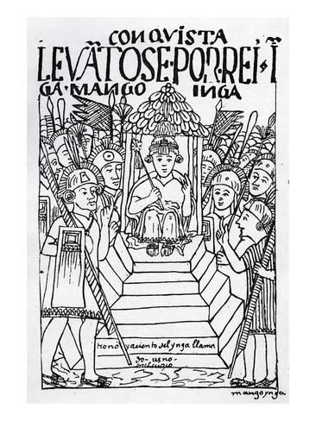
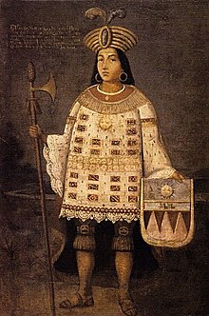
Manco Inca
From Guaman Poma,
Chronicles, 1560s 70s
Tupac Amaru.
The last Sapa Inca of Vilcabamba

Slide 41
Sources for the Conquest of Peru
Francisco de Jerez, Verdadera relación de la conquista de Perú, 1534
Miguel de Estete, Noticia del Peru, 1535
Titu Cusi Yuquapanqui, Relación de la conquista del Perú, 1570
Garcilasco de la Vega, Comentarios reales de los Incas, 1617
Guaman Poma, Nueva crónica de buen gobierno, 1615
Patricia Seed, “Failing to Marvel”: Atahualpa’s Encounter with the Word”, Latin American Research Review, 26:1, 1991. (On how they all interpret the encounter with Atahualpa, Pizarro and Valverde)

Slide 42
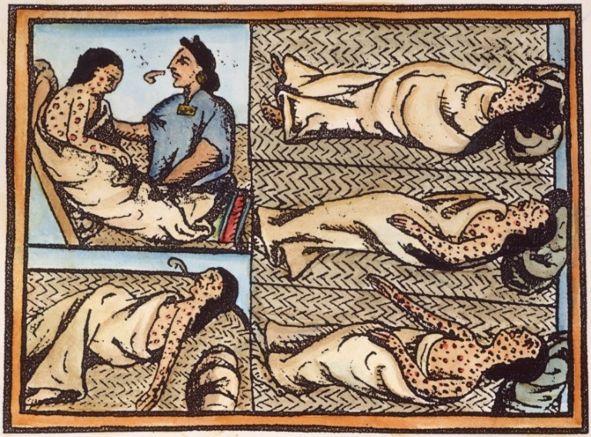
How was it possible for the Spanish to conquer the central areas so quickly? Were they really conquered and colonised so quickly and completely? How have these explanations been revised and reconsidered?
  Myth and religious belief
  Military technology
  Centralised indigenous governments
  Divisions and resistance
  Disease

Slide 43
Problems with writing the history of conquest and pre-conquest
Power: the “voices of the victors”
Most people in Europe, but especially the Americas, don’t WRITE. Written texts are left mainly by the most powerful (in each culture)
Disproportionate influence of go-betweens/ translators/ acculturated indigenous people
Demographic collapse: who survived to tell the tale? How can we measure pre-conquest populations?
Aims and audience of the person writing
Apparent “translatability” but total misunderstandings in reality; and we tend to get the European interpretations not the indigenous ones
Problem of European preconceptions and imaginings about New World, e.g. chivalric ballad tradition…

Slide 44
Atahuallpa

Slide 45
Bernal Diaz, True History of the Conquest of New Spain (1576)
“When we saw all those cities and villages built in the water, and other great towns on dry land, and that straight and level causeway leading to Mexico, we were astounded. These great towns and temples and buildings rising from the water, all made of stone, seemed like an enchanted vision from [the chivalric ballad of] Amadís. Indeed, some of our soldiers asked whether it was not all a dream.”

Slide 46
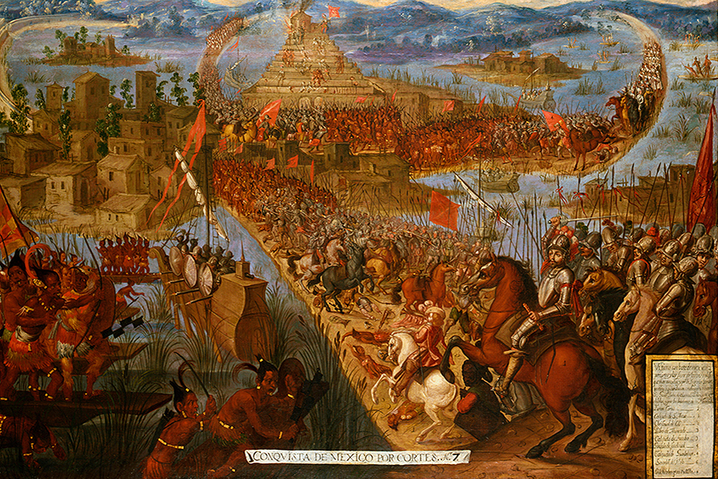
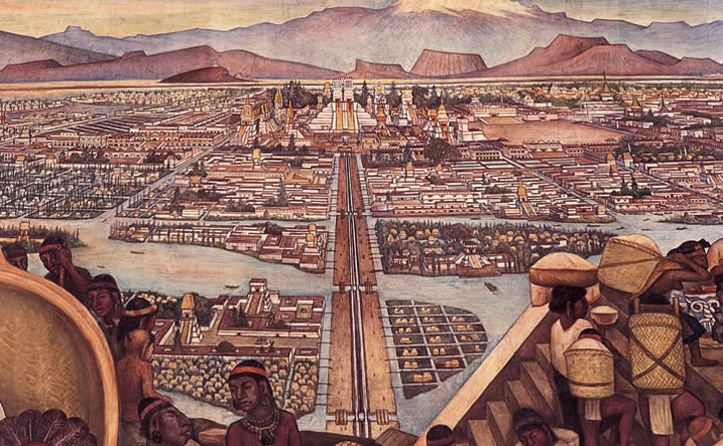

Slide 47
‘Conquest History’
Before 1520s-c1990 “triumphalist narrative” “the traditional tale of conquistadors and friars” Restall, 2012 or “The Epic Spanish Conquest” and “The Spiritual Conquest” Susan Schroeder in Matthew, L and M.R.Oudjik, Indian Conquistadors, 2007.
Hernan Cortés
Bernal Diaz del Castillo, 1576
William H. Prescott, 1843
Robert Ricard, The Spiritual Conquest, 1966
1970s and 1980s
James Lockhart, The Men of Cajamarca, (1972), Karen Spalding, Huarochiri, (1984), Inga Clendinnen, Ambivalent Conquests, (1987)

Slide 48
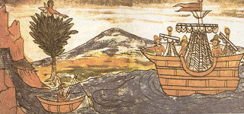
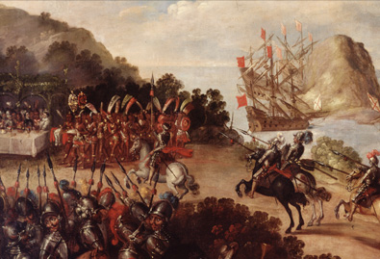
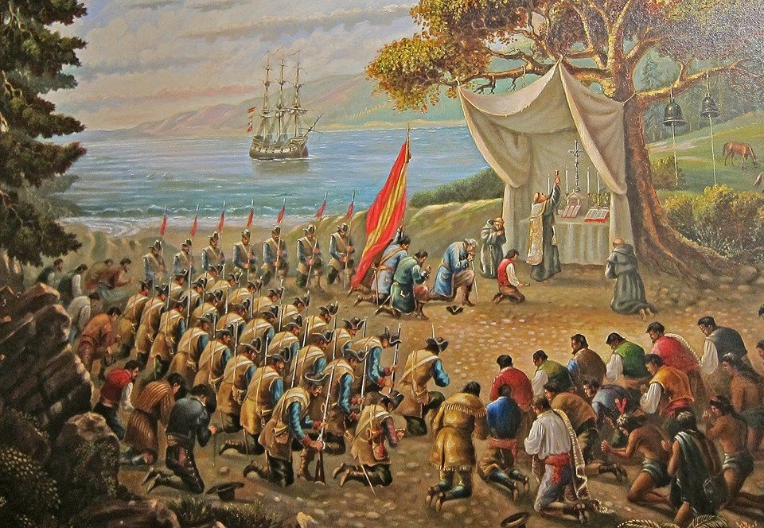
“conquistadors and friars”
The Arrival of Cortés at Veracruz and the Reception by
Moctezuma’s Ambassadors
Source: Library of Congress

Slide 49
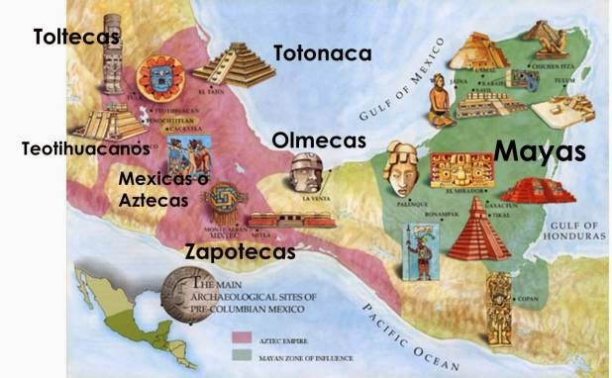
James Lockhart,
We People Here: Nahuatl Accounts of the Conquest of Mexico,
1993
Matthew Restall,
Maya Conquistador,
1998
Victoria Bricker,
Indian Christ, Indian King,
1981.
Michel R Oudijk, 2000

Slide 50
New Conquest History
Since 2000 five core approaches:
Revisitation (re-reading old sources, motivations etc.)
Paleography (learning to read sources left unread)
Protagonists (forgotten Spaniards, women, settlers of African descent, indigenous people)
Indigenous perspectives (indigenous conquistadors, indigenous diaspora)
Boundaries (a- of space away from centres of empire. b-of discipline-History, Anthropology, Ethno-History to Art History, Geography, Literature)
Matthew Restall, “New Conquest History,” History Compass, 2012

