Slide 1
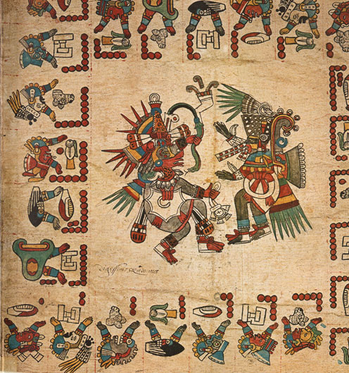
WEEK 5
The Conquest of the Mainland: Mexico and Peru

Slide 2
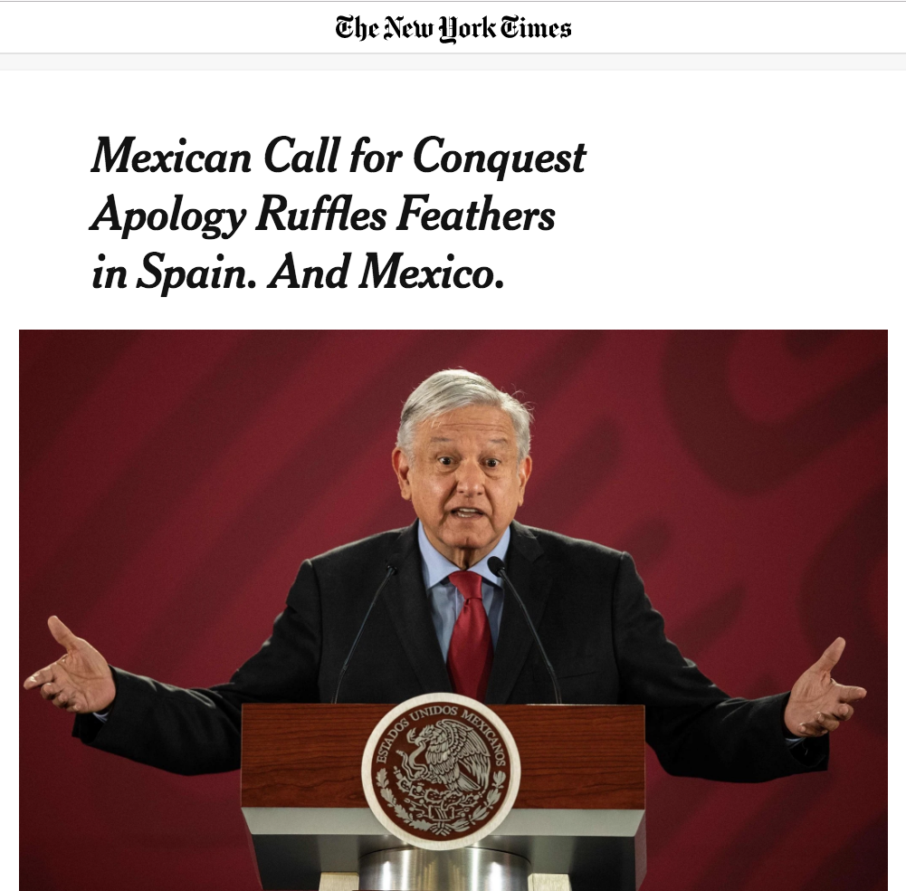
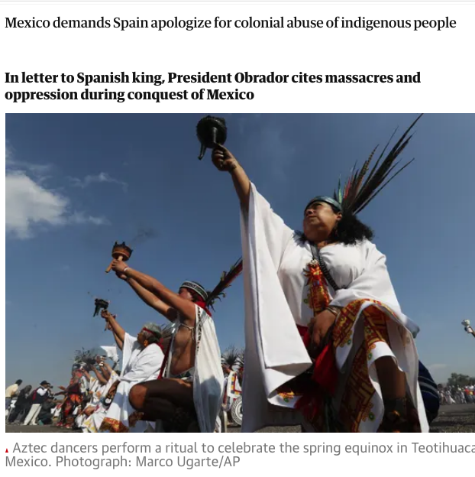
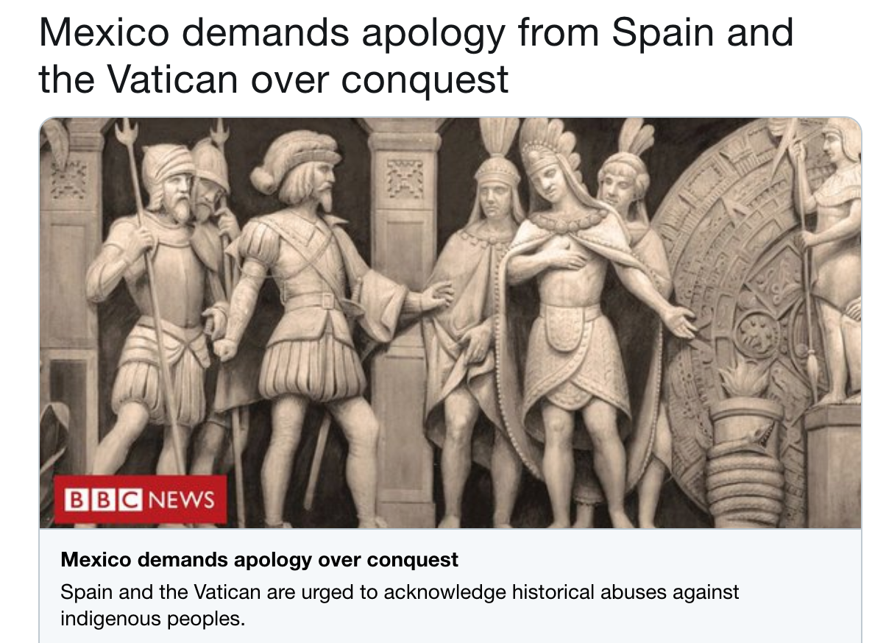
1519-2019

Slide 3
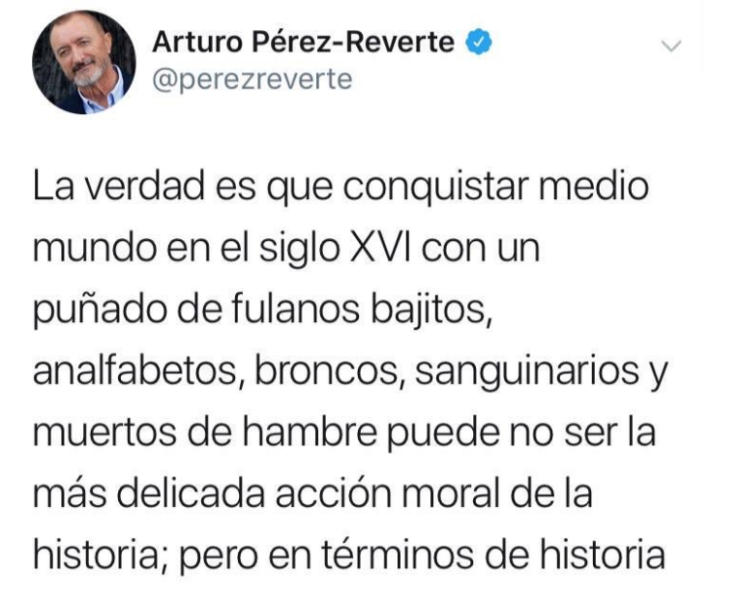

‘The truth, is that conquering half the world in the 16th century with a handful of short, illiterate, rough, bloodthirsty, and starving blokes may not be the most delicate moral action in history; but in terms of objective, global history, is an awesome feat.’

Slide 4
‘How was it that a motley bunch of Spanish adventurers, never numbering much more than four hundred or so, was able to defeat an Amerindian military power on its home ground in the space of two years? What was it about Spaniards, or about Indians, that made so awesomely implausible a victory possible?’
Inga Clenndinnen

Slide 5

TODAY’S LECTURE
Mexico
The Andes
Explanations for Success
Writing the History of the Conquest:
Sources
Challenges
Themes and Approaches

Slide 6
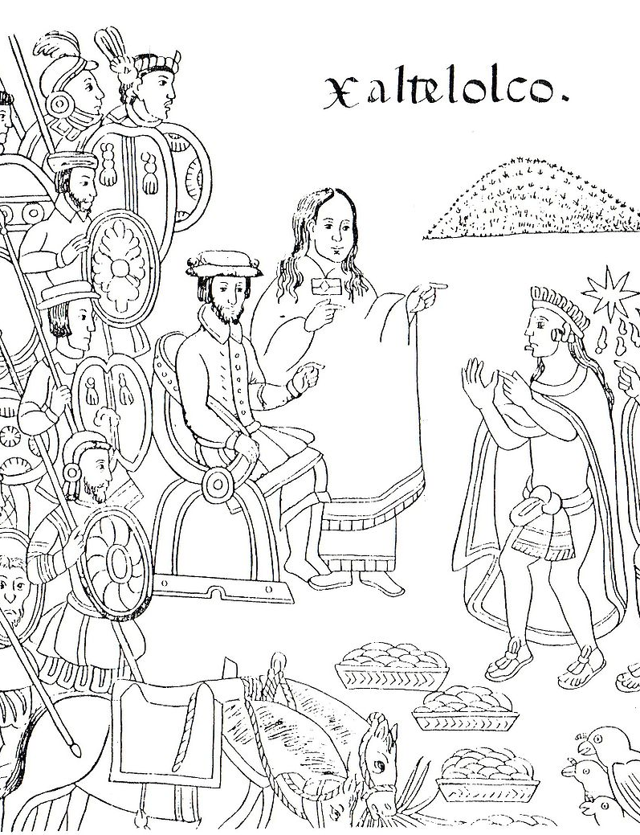
Questions to think about this week:
How did each side interpret the first meetings? What shaped their worldview?
How can we write a history that incorporates the view of the vanquished as well as that of the conquerors? What sources are available to us as historians? What problems do they present?

Slide 7
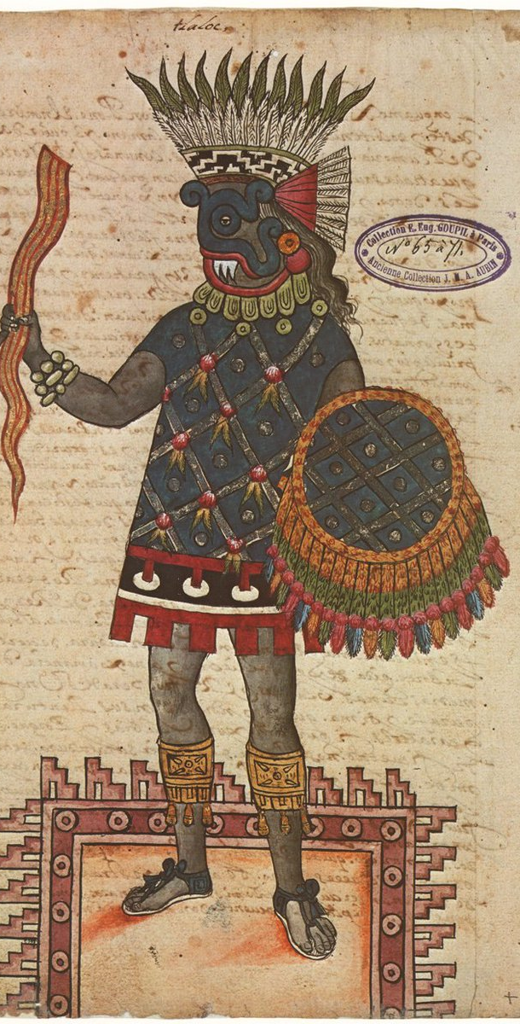
The Aztec Empire
Alliance of 3 different peoples
MEXICA are dominant
Capital at TENOCHTITLAN, on Lake Texcoco, from 1325.
They ally with two of their neighbours: the city states of Texcoco and Tlacopan → Aztecs conquer Valley of Mexico by 1428.
1502 reign of Moctezuma II
Huge empire. Several hundred thousand residents in Tenochtitlán alone; 1.5 million in Valley of Mexico.
Some areas and peoples are NOT conquered and become enemies/ rivals: e.g. the Tlaxcalans.

Slide 8
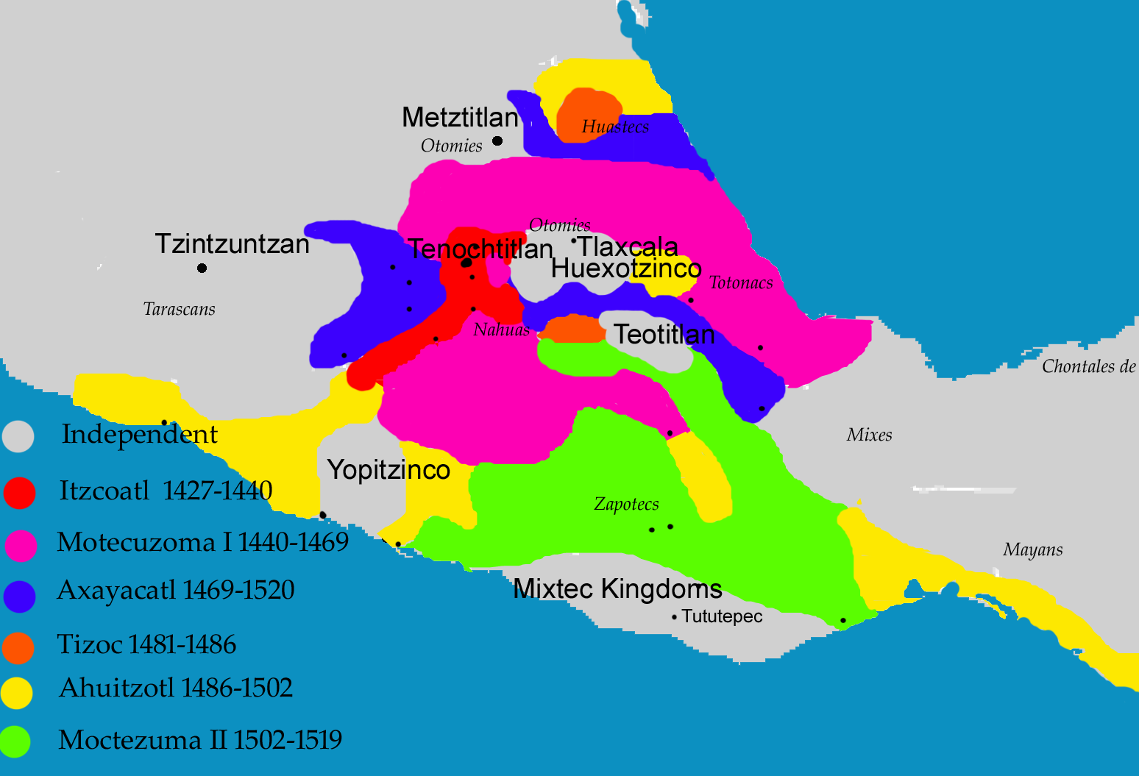

Slide 9
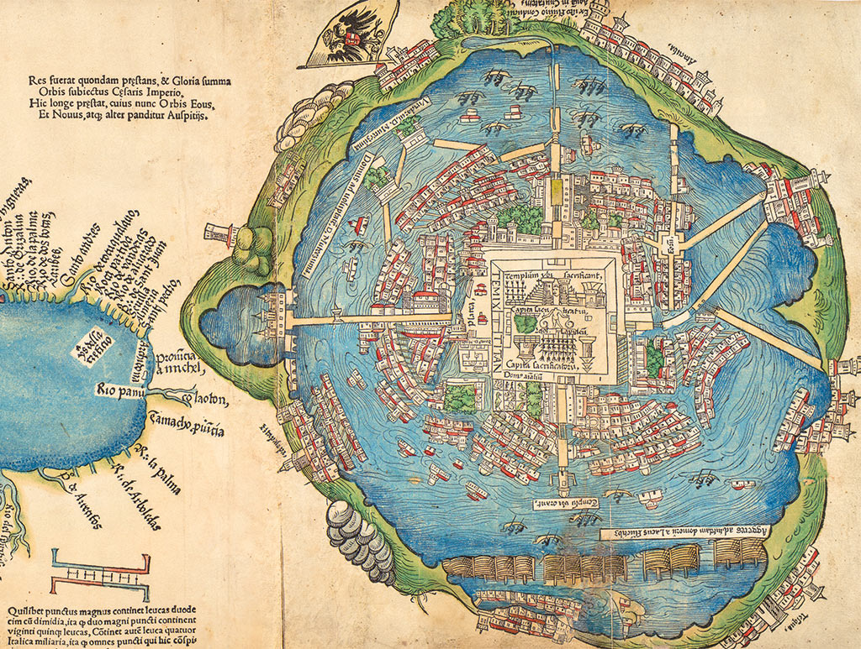
Tenochtitlán and the Gulf of Mexico, unknown artist (1524). Based on a map presented to Cortés by the Mexica. Library of Congress

Slide 10
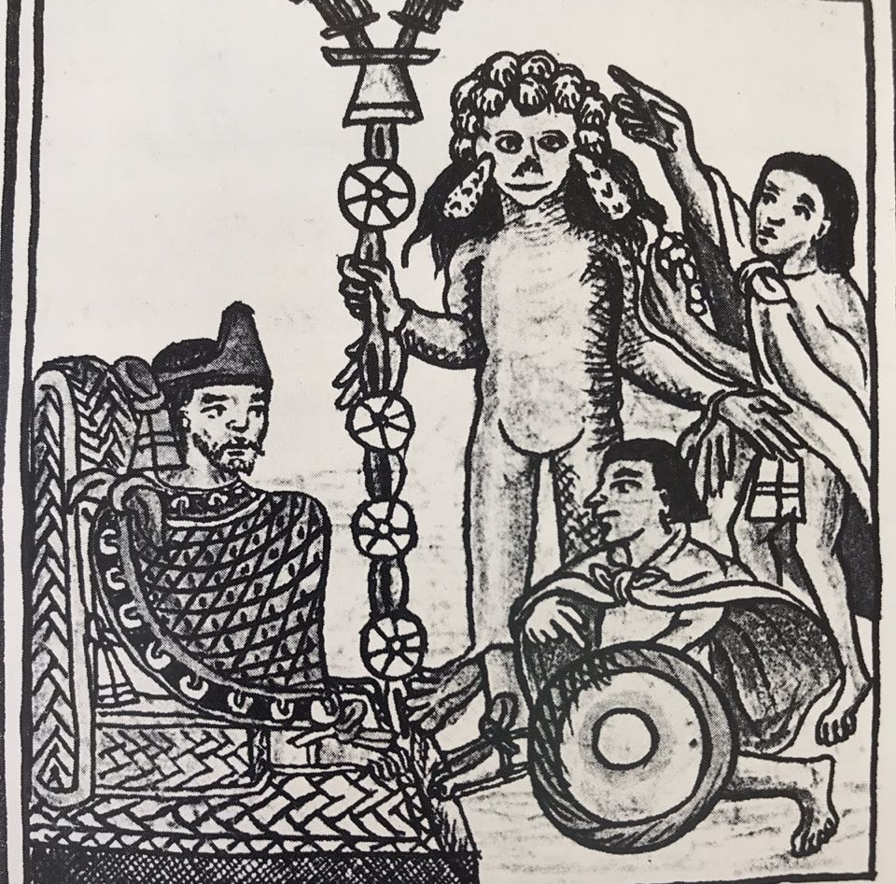
?
?
?
?
?
?

Slide 11
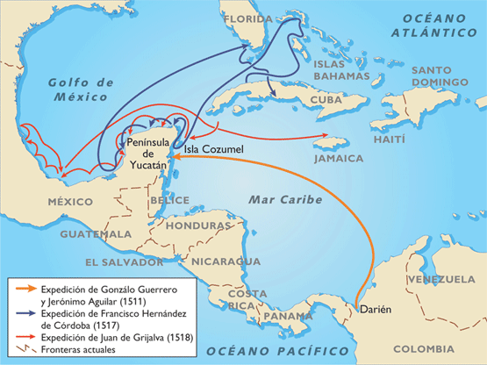
Reconnaissance
1511-1518

Slide 12
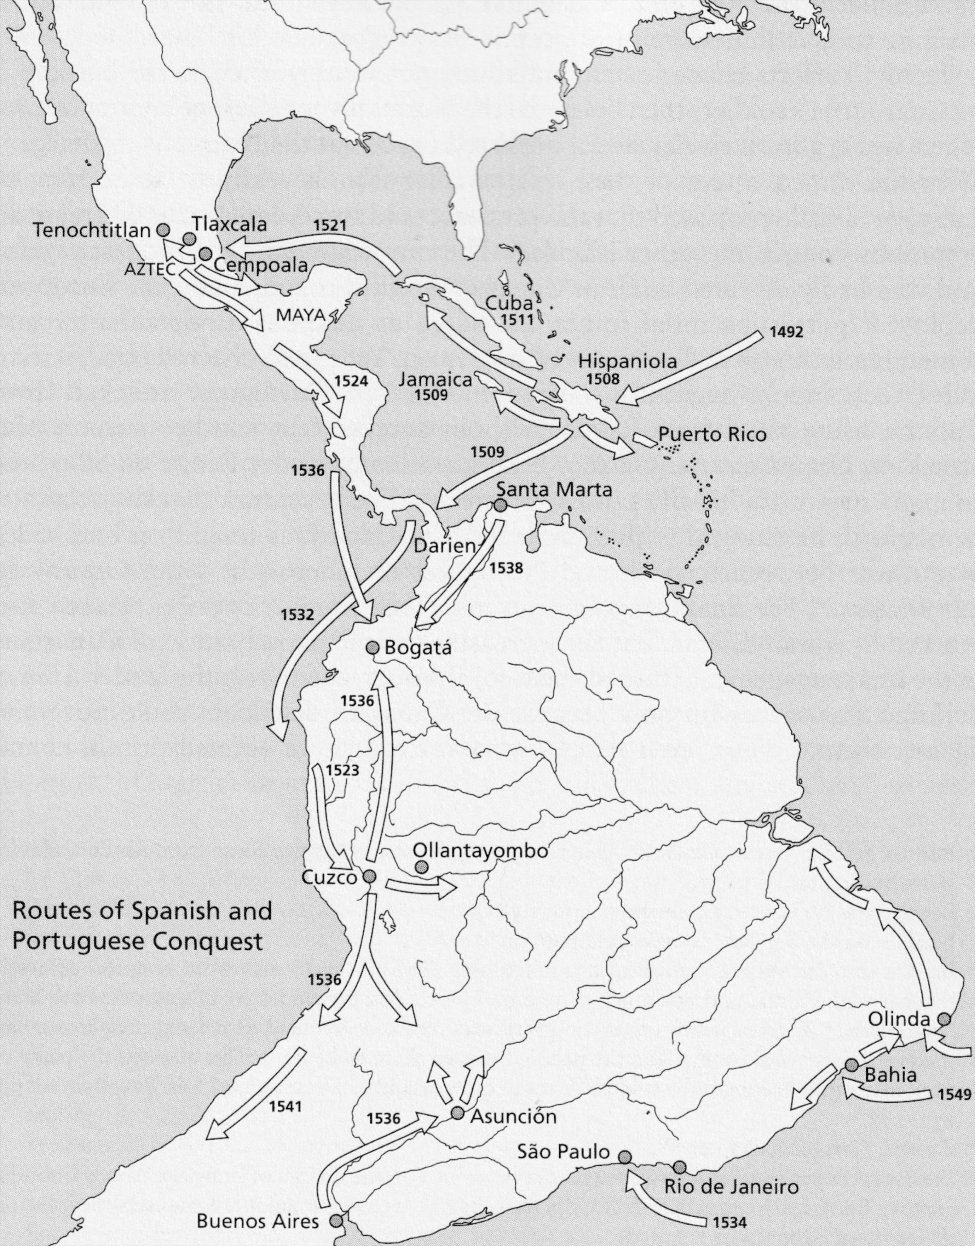

Slide 13
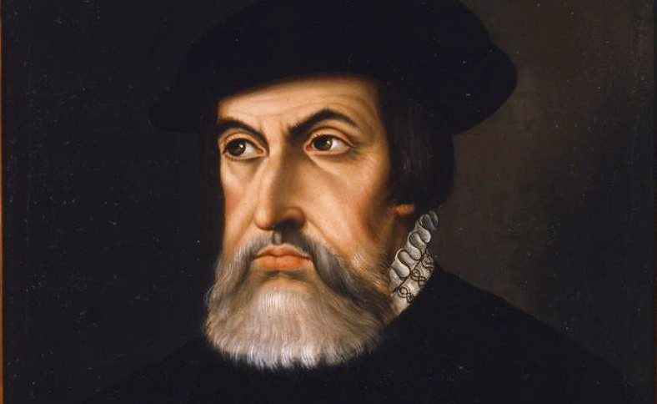
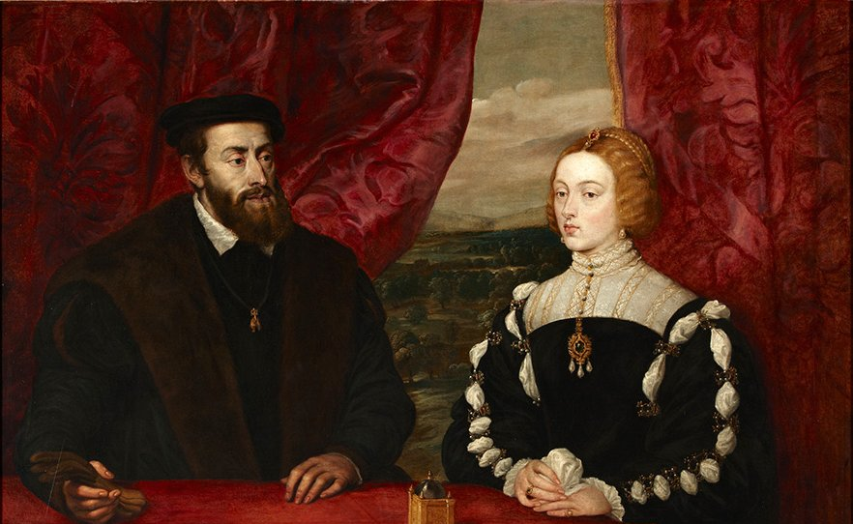
The Conquest of
MEXICO
1516-1518: Reconnaissance missions to the mainland. From Cuba: Diego Velázquez reconoitres Yucatán. rivalry with Cortés
1518: Hernán Cortes departs for the mainland
22 April 1519: Arrives in Pontonchán.
Cortes founds Veracruz
Exploitation of rivalries (alliance with Tlaxcalans, among others)

Slide 14
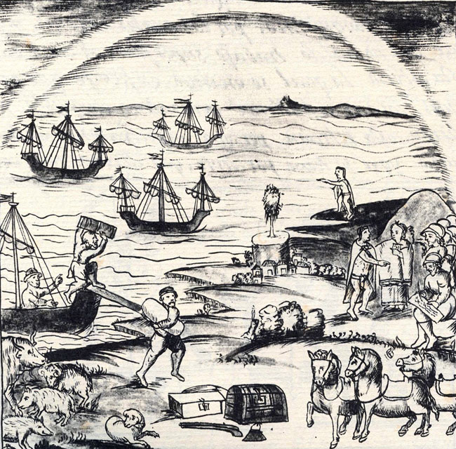

Slide 15
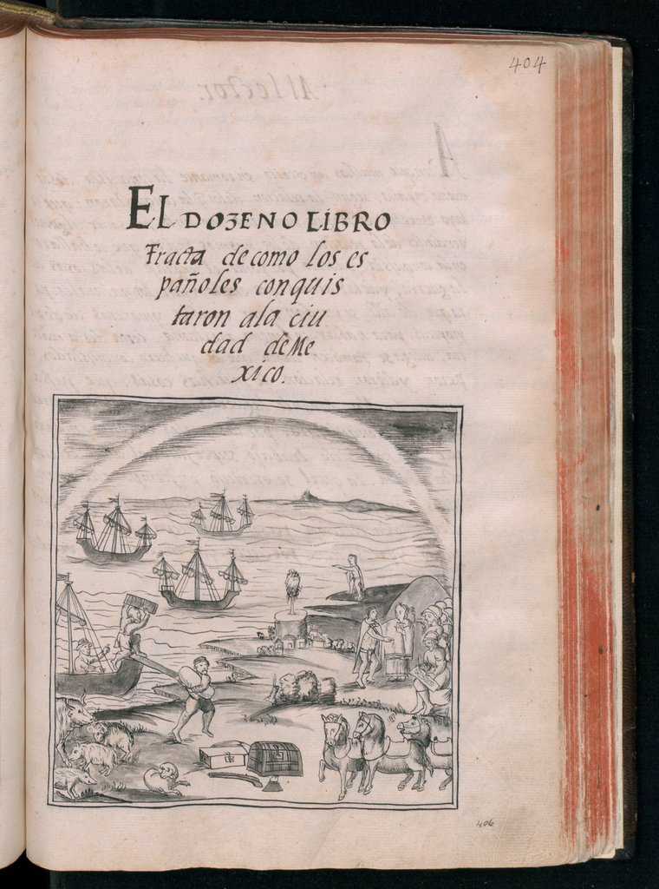
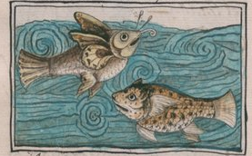
The Florentine Codex

Slide 16
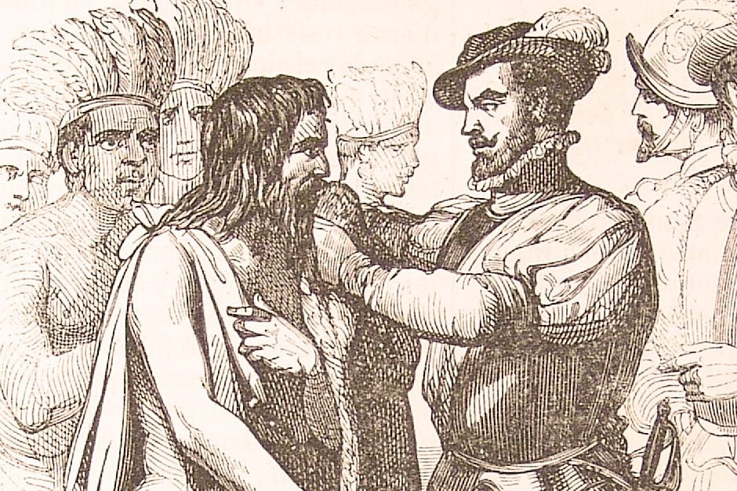
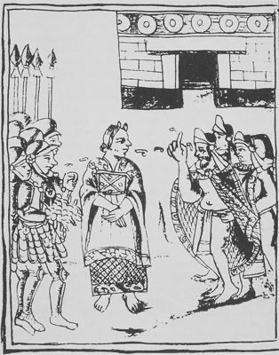
Jerónimo de Aguilar
Malintzin

Slide 17

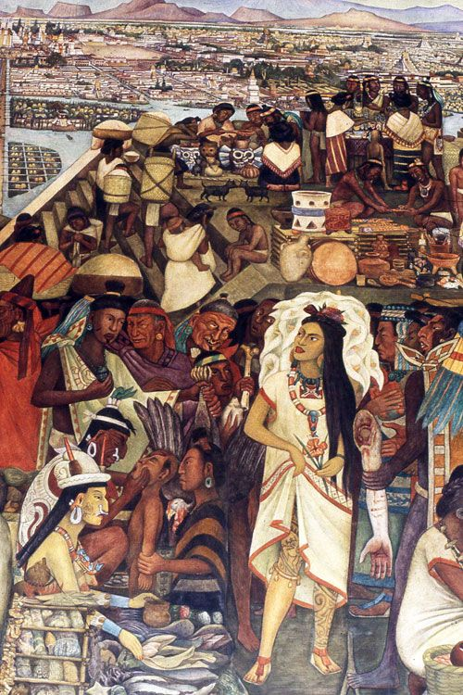
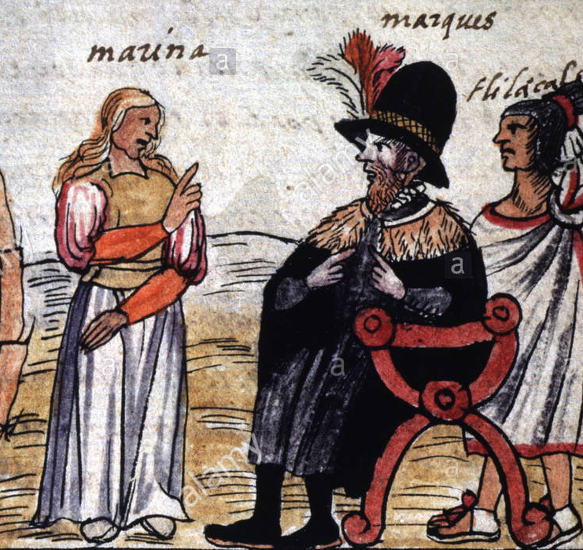
Malintzin
Doña Marina
La Malinche

Slide 18
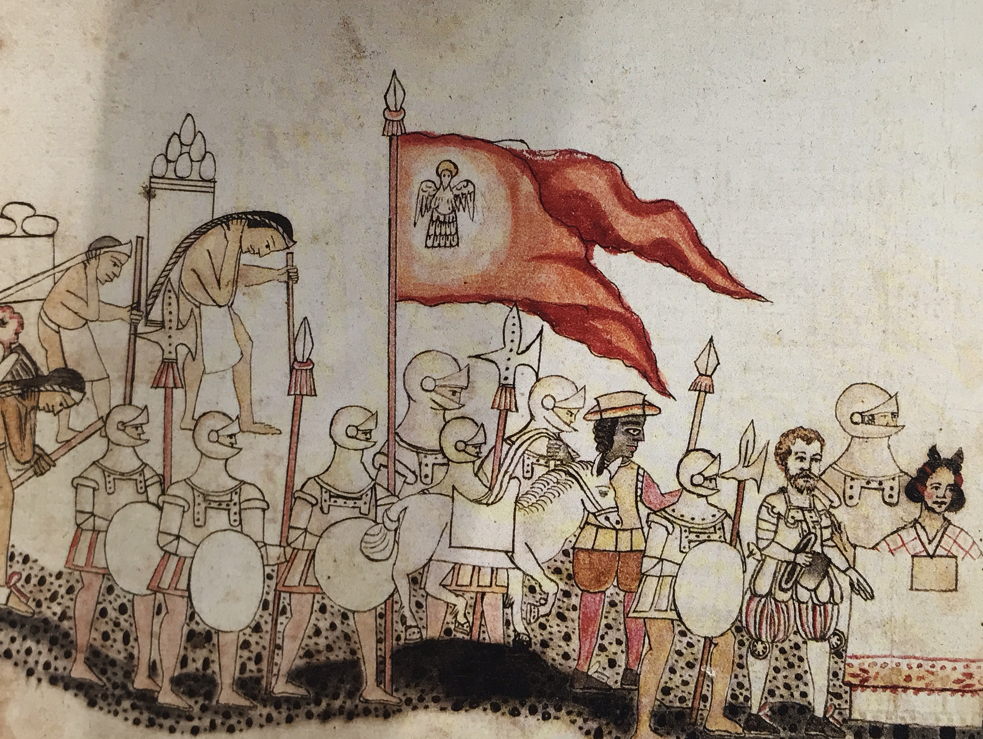
The march to Tenochtitlán

Slide 19
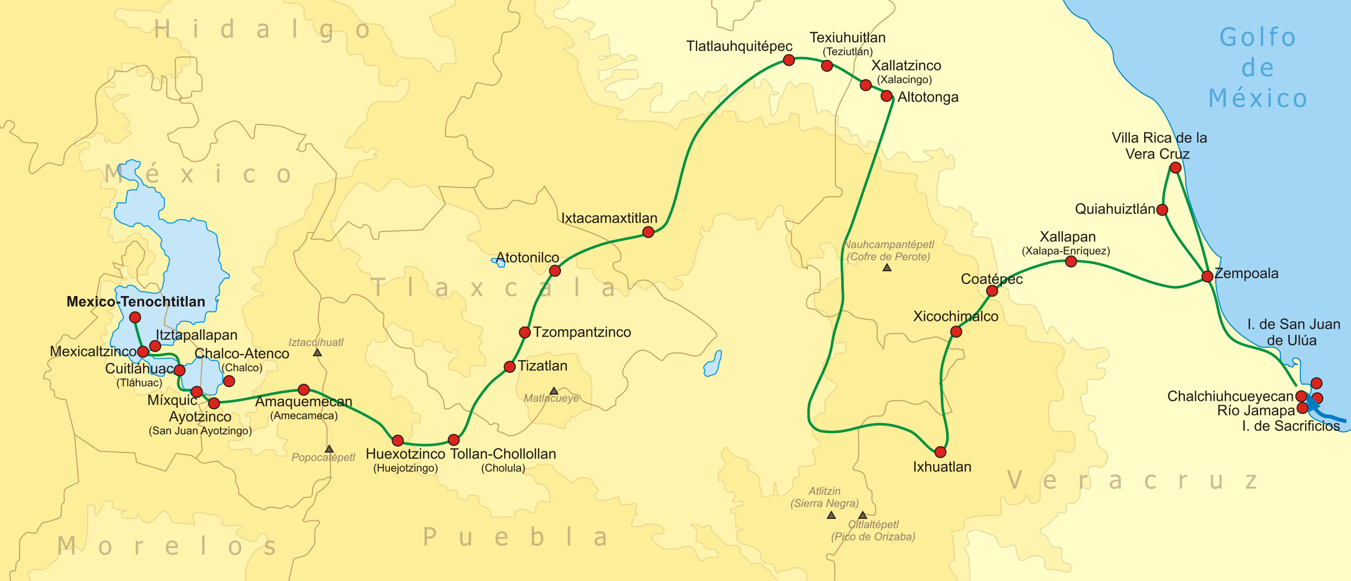

Slide 20
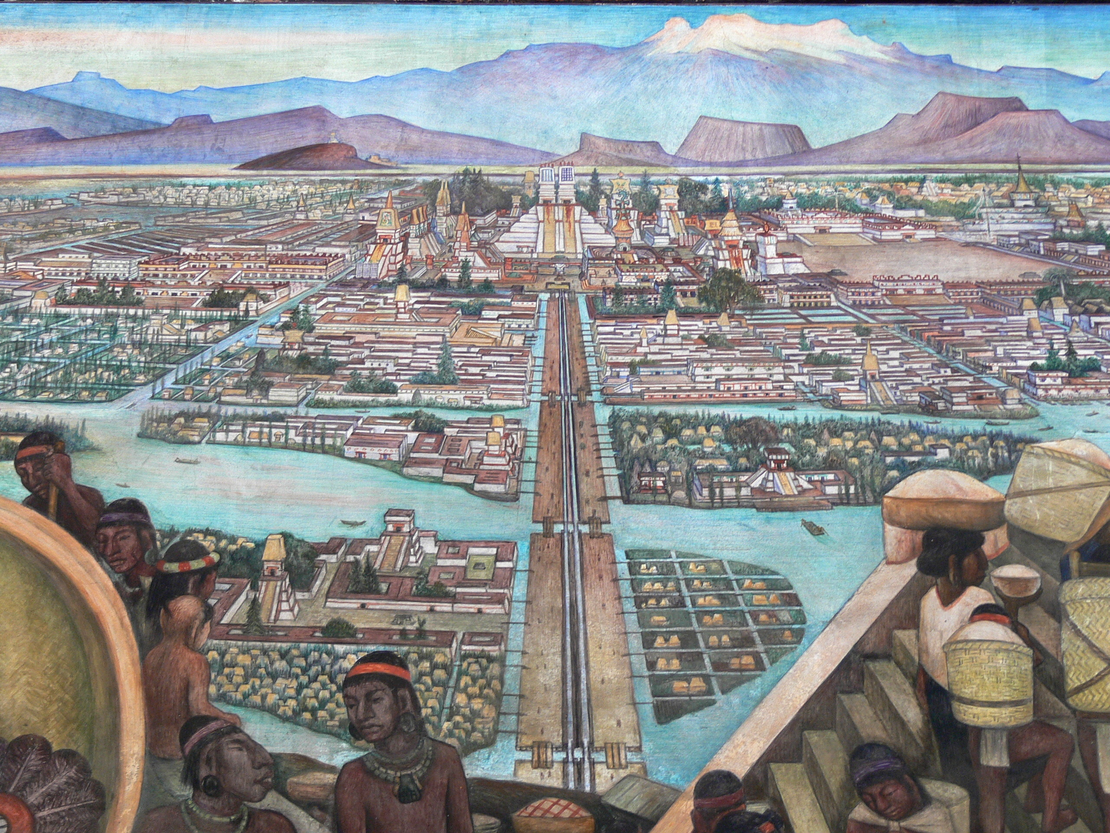
8 November 1519: Cortés enters Tenochtitlán
April 1520: Departs for the coast to quell attack ordered by Velázquez
Leaves Pedro de Alvarado in command

Slide 21
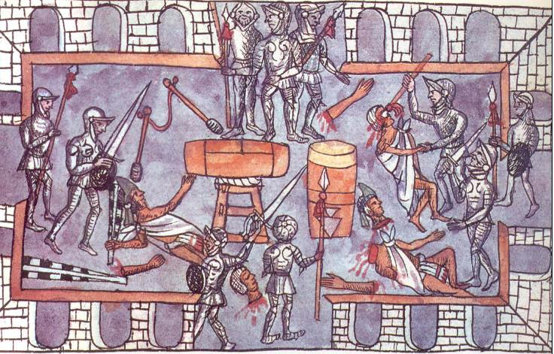
22 May 1520: Massacre at the Great Temple

Slide 22
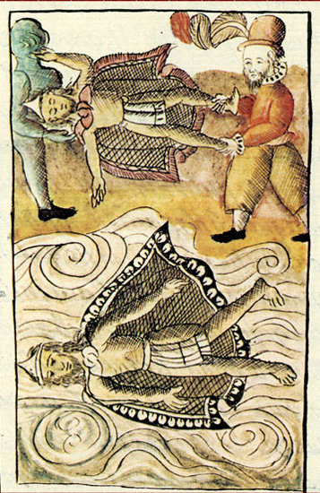
June 1520: Cortés returns to chaos…
Comes back with Caribbean soldiers and thousands of indigenous recruits. But Alvarado has lost control.
Aztecs have chosen a new ruler: Cuauhtémoc
Death of Moctezuma

Slide 23
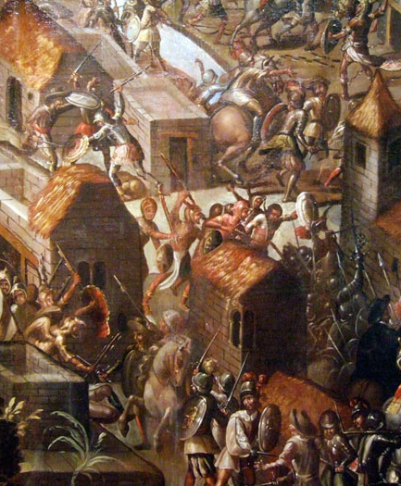
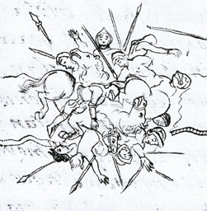
30 June 1520
Noche Triste

Slide 24
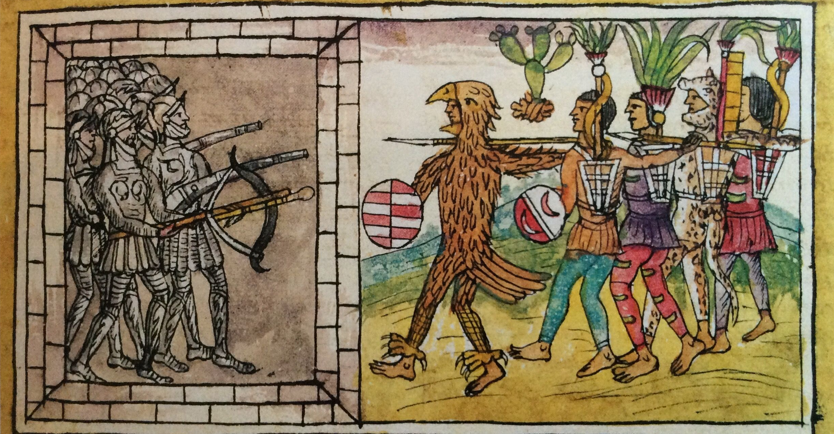
The Mexican Counterattack, Duran Codex, mid-16THC

Slide 25
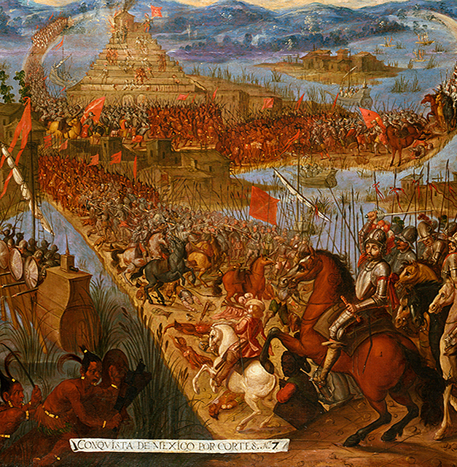
1520-1521: Siege and destruction of Tenochtitlán
13 August 1521: Spanish regain control of the Aztec capital

Slide 26
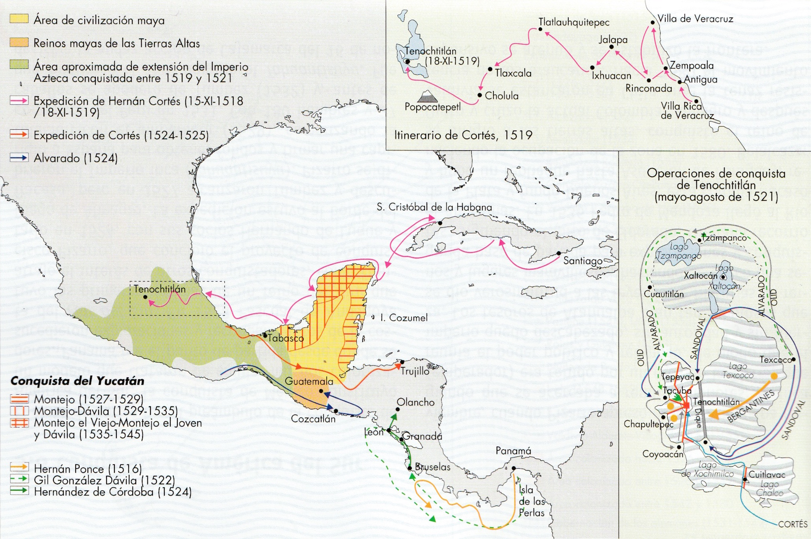
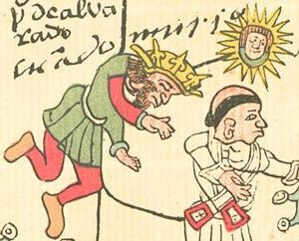

Slide 27
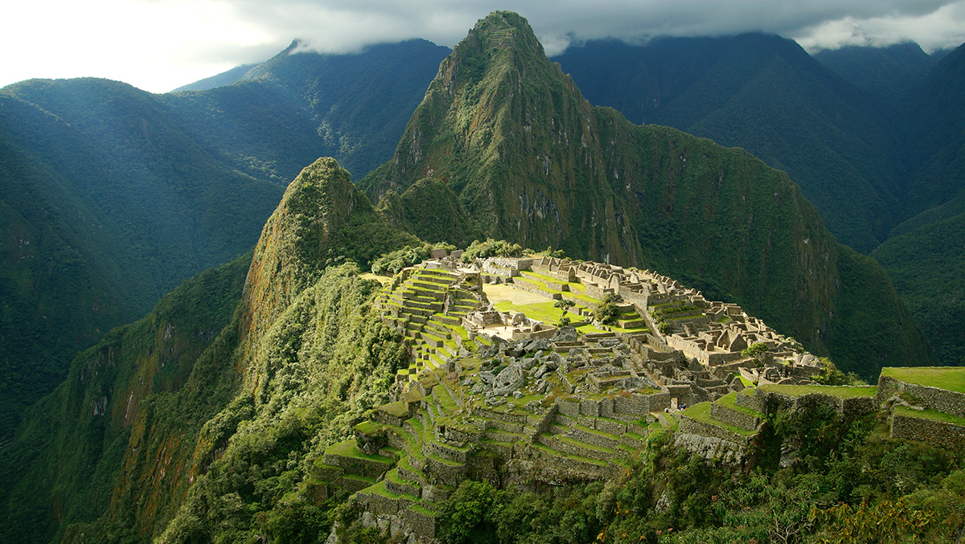
The Inca Empire - Tahuantinsuyu

Slide 28
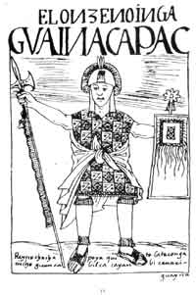
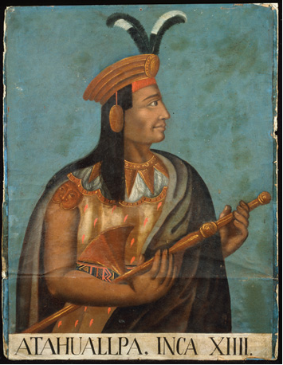
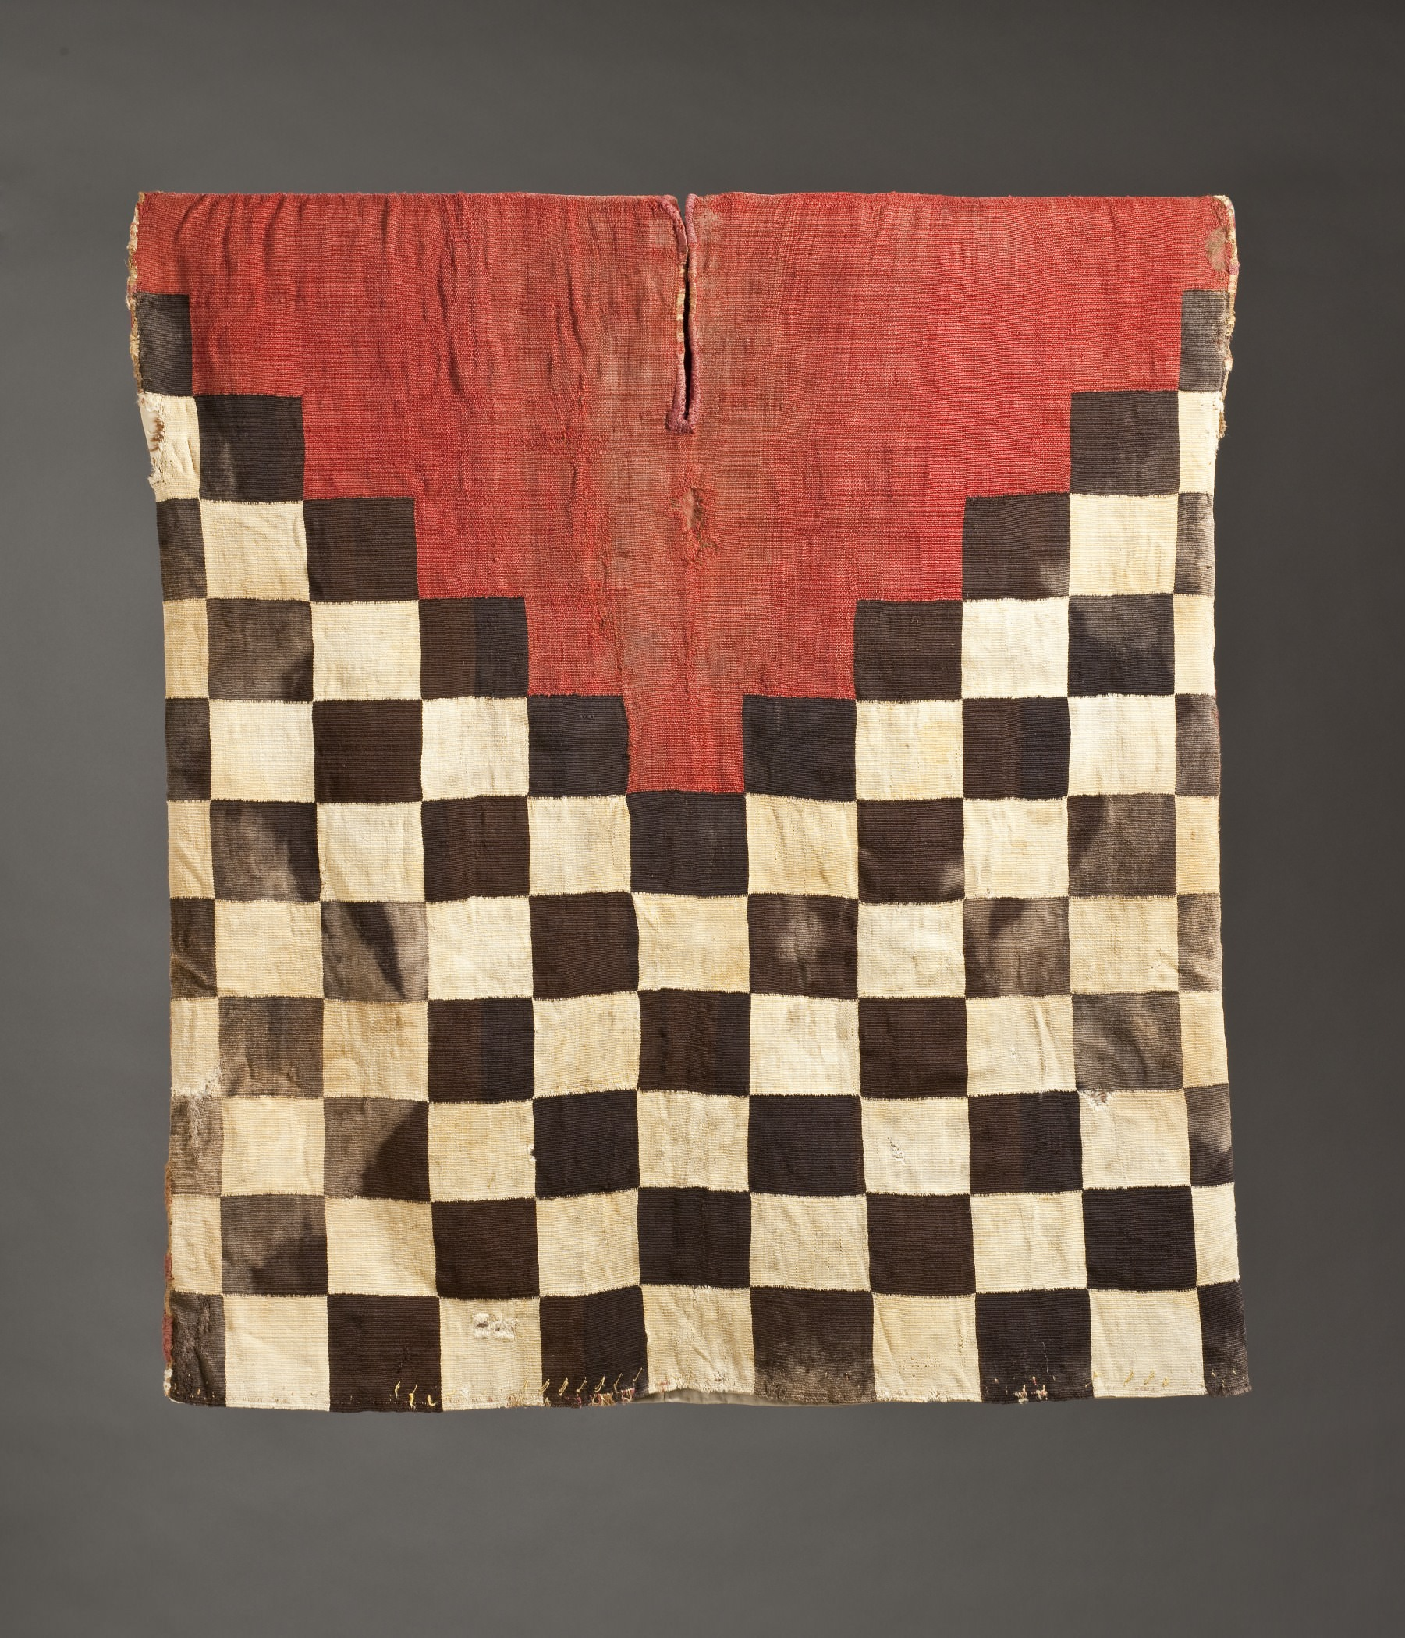

Slide 29
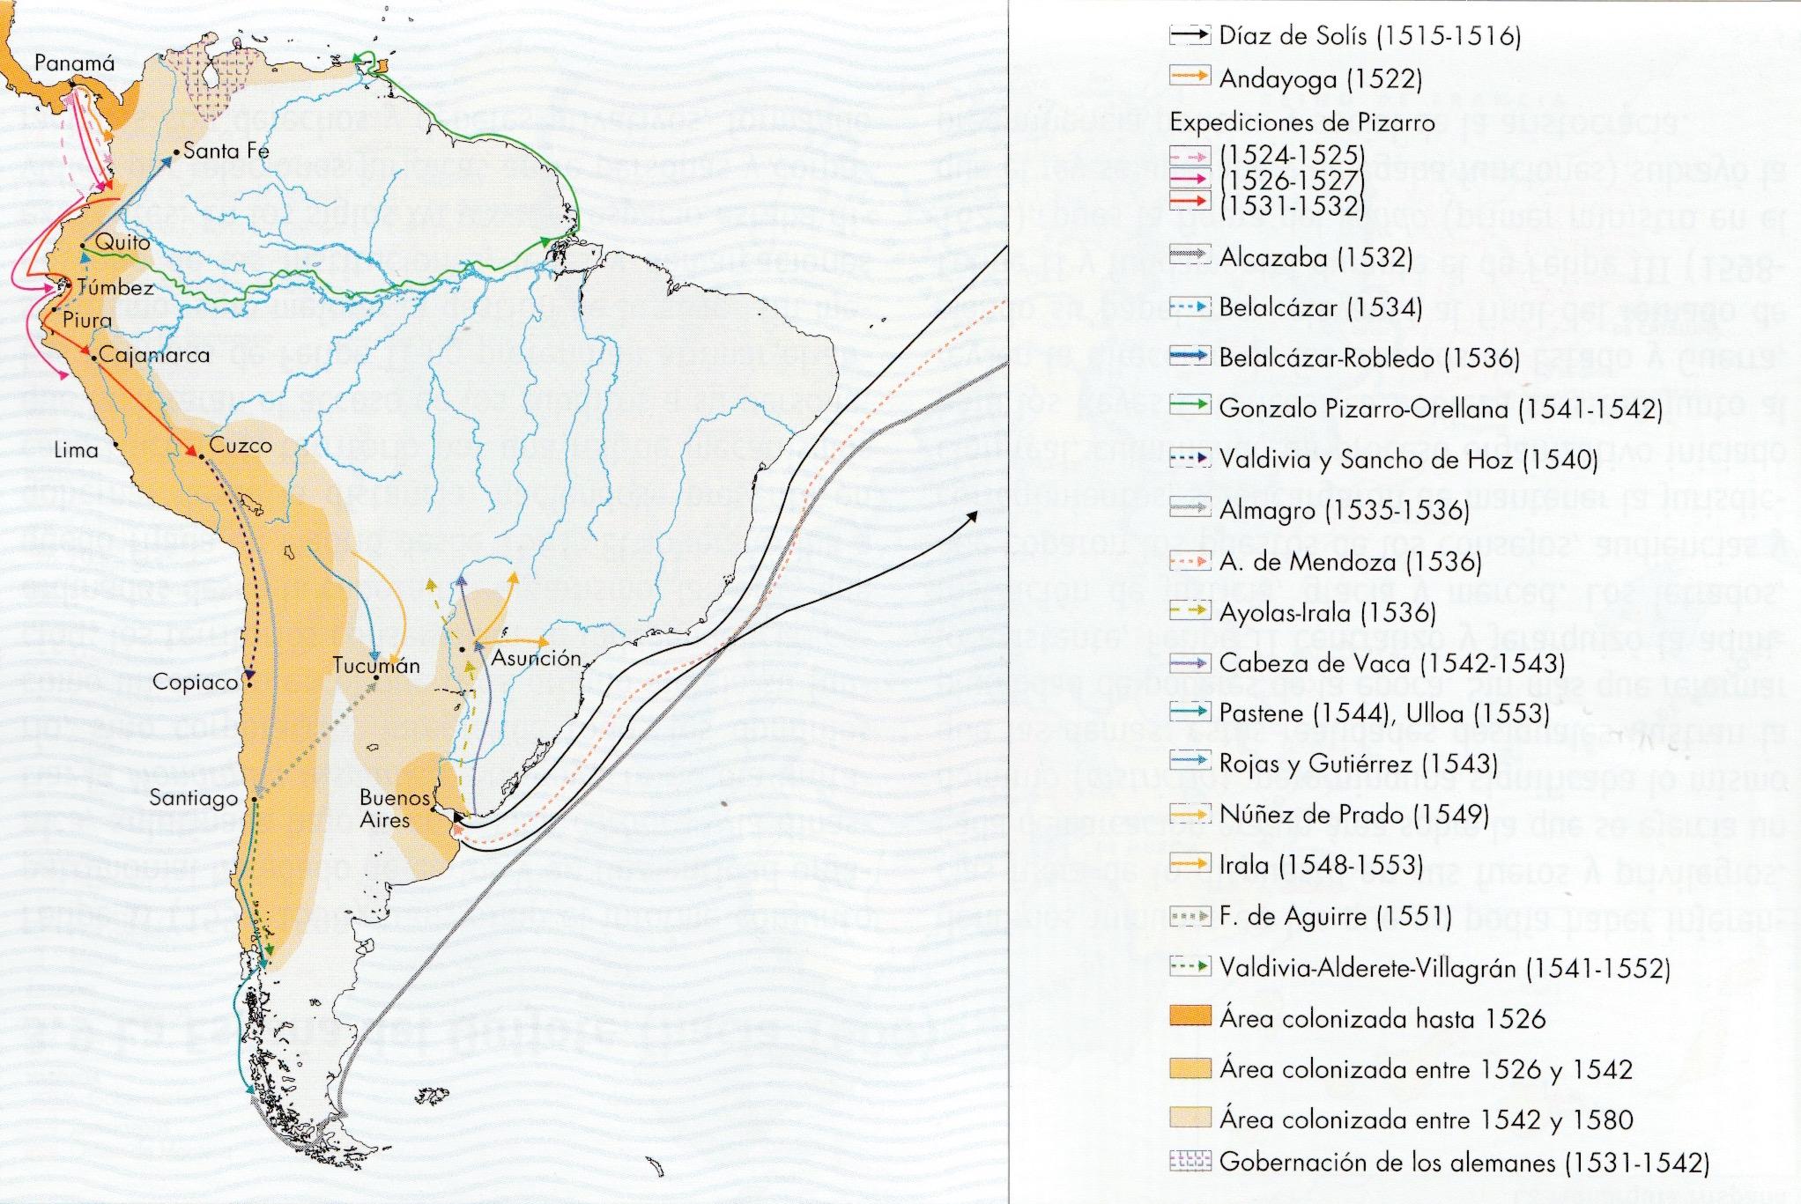

Slide 30
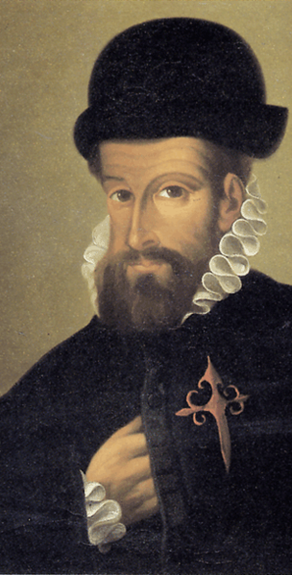
1513 First settlement and conquest of panama (Vasco Nuñez de Balboa, Pedro Arias Dávila)
1530 Francisco Pizarro leaves Panama; arrives in Tumbes (North coast of Inca Empire, today’s Peru)
November 16, 1532: Battle of Cajamarca
Atahualpa imprisoned, huge ransom in gold is paid; but later executed
1533 Pizarro & Diego de Almagro take residence in Cuzco
1535 Foundation of Lima (more accessible)

Slide 31
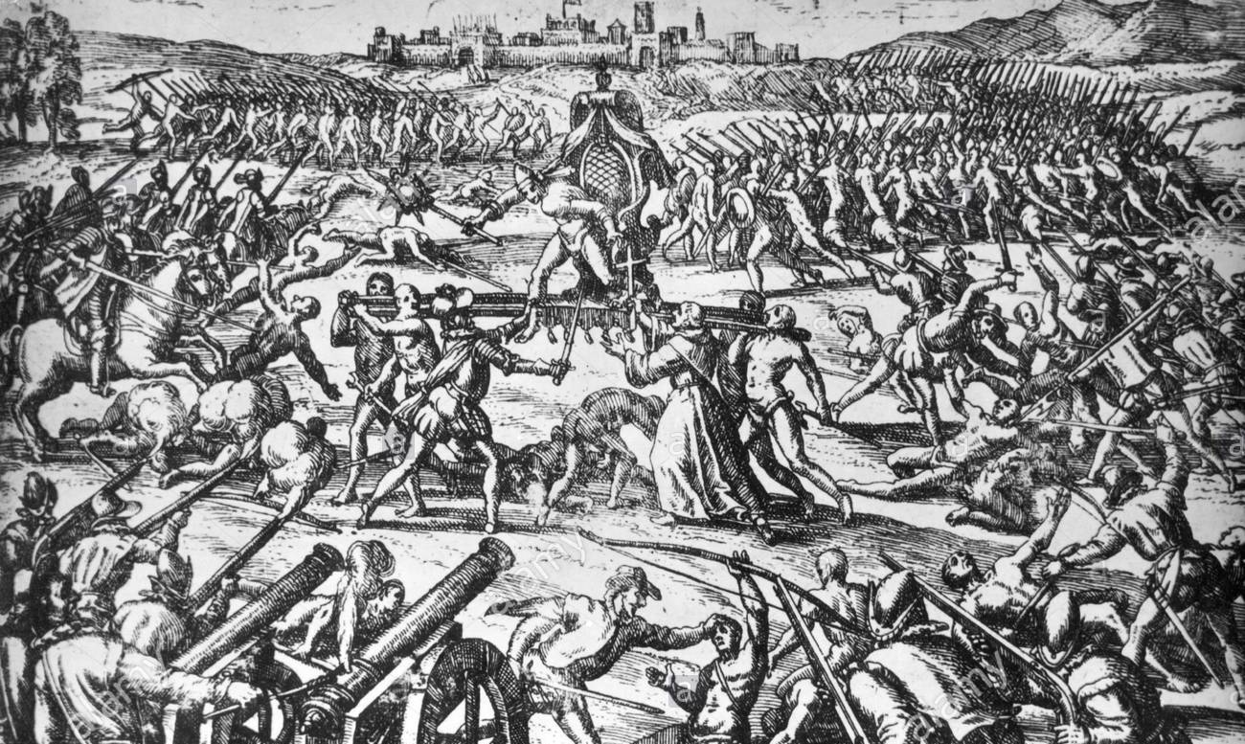

Slide 32
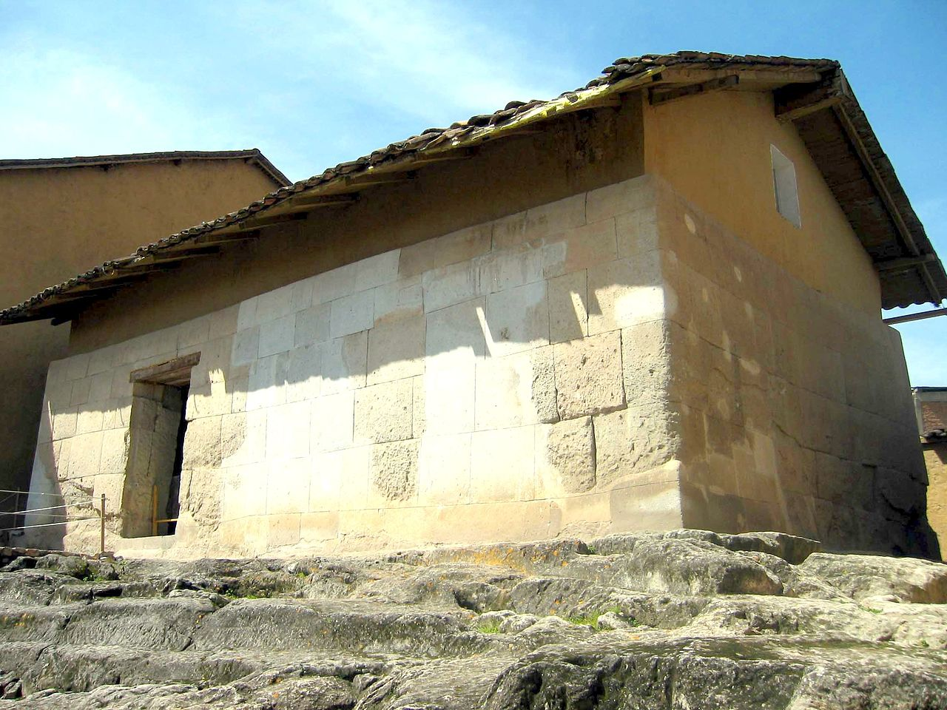
U$S 232.000.000

Slide 33
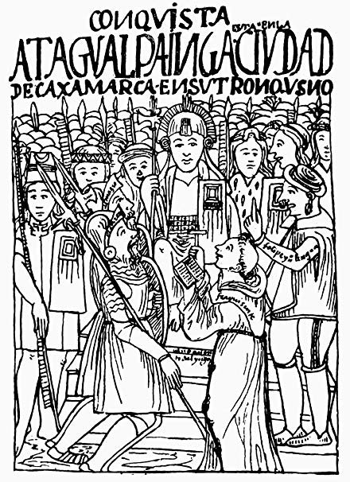
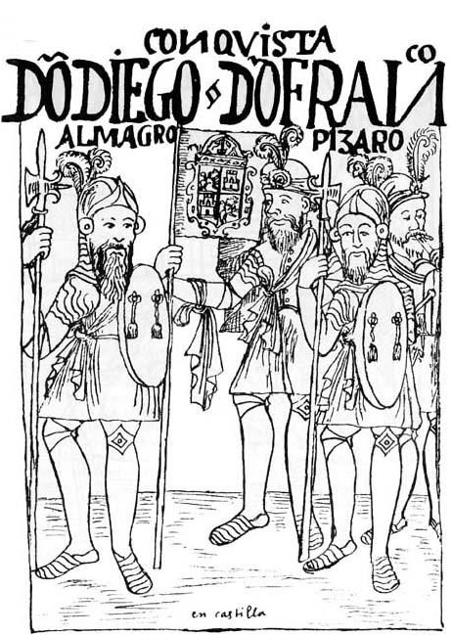
Felipe Guaman Poma de Ayala, Nueva crónica de Buen Gobierno (1615)

Slide 34
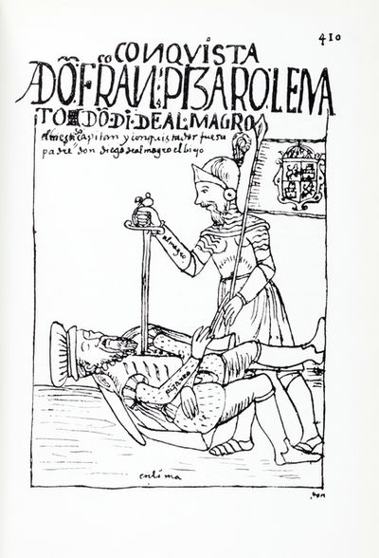
Continuing Strife in Peru, 1530s-70s
Conquest of northern Inca territories (Quito)
Continuing Inca resistance: Manco Inca besieges Cuzco & Lima, 1536
Rivalries between Almagro and Pizarro; civil war between Pizarros and Almagristas
Independent Inca state established
Tupac Amaru rebellion in 1571 (repudiation of Christianity); SYMBOL AND MYTH of Inca resistance
1570s: Viceroy Toledo finally pacifies Peru

Slide 35
3. Explanations for success
Providence
Military Technology
Disease
Centralised indigenous government
Division and resistance
When, in Ancient or Modern times have such huge enterprises of so few succeeded against so many?
Francisco de Jerez, 16thC

Slide 36
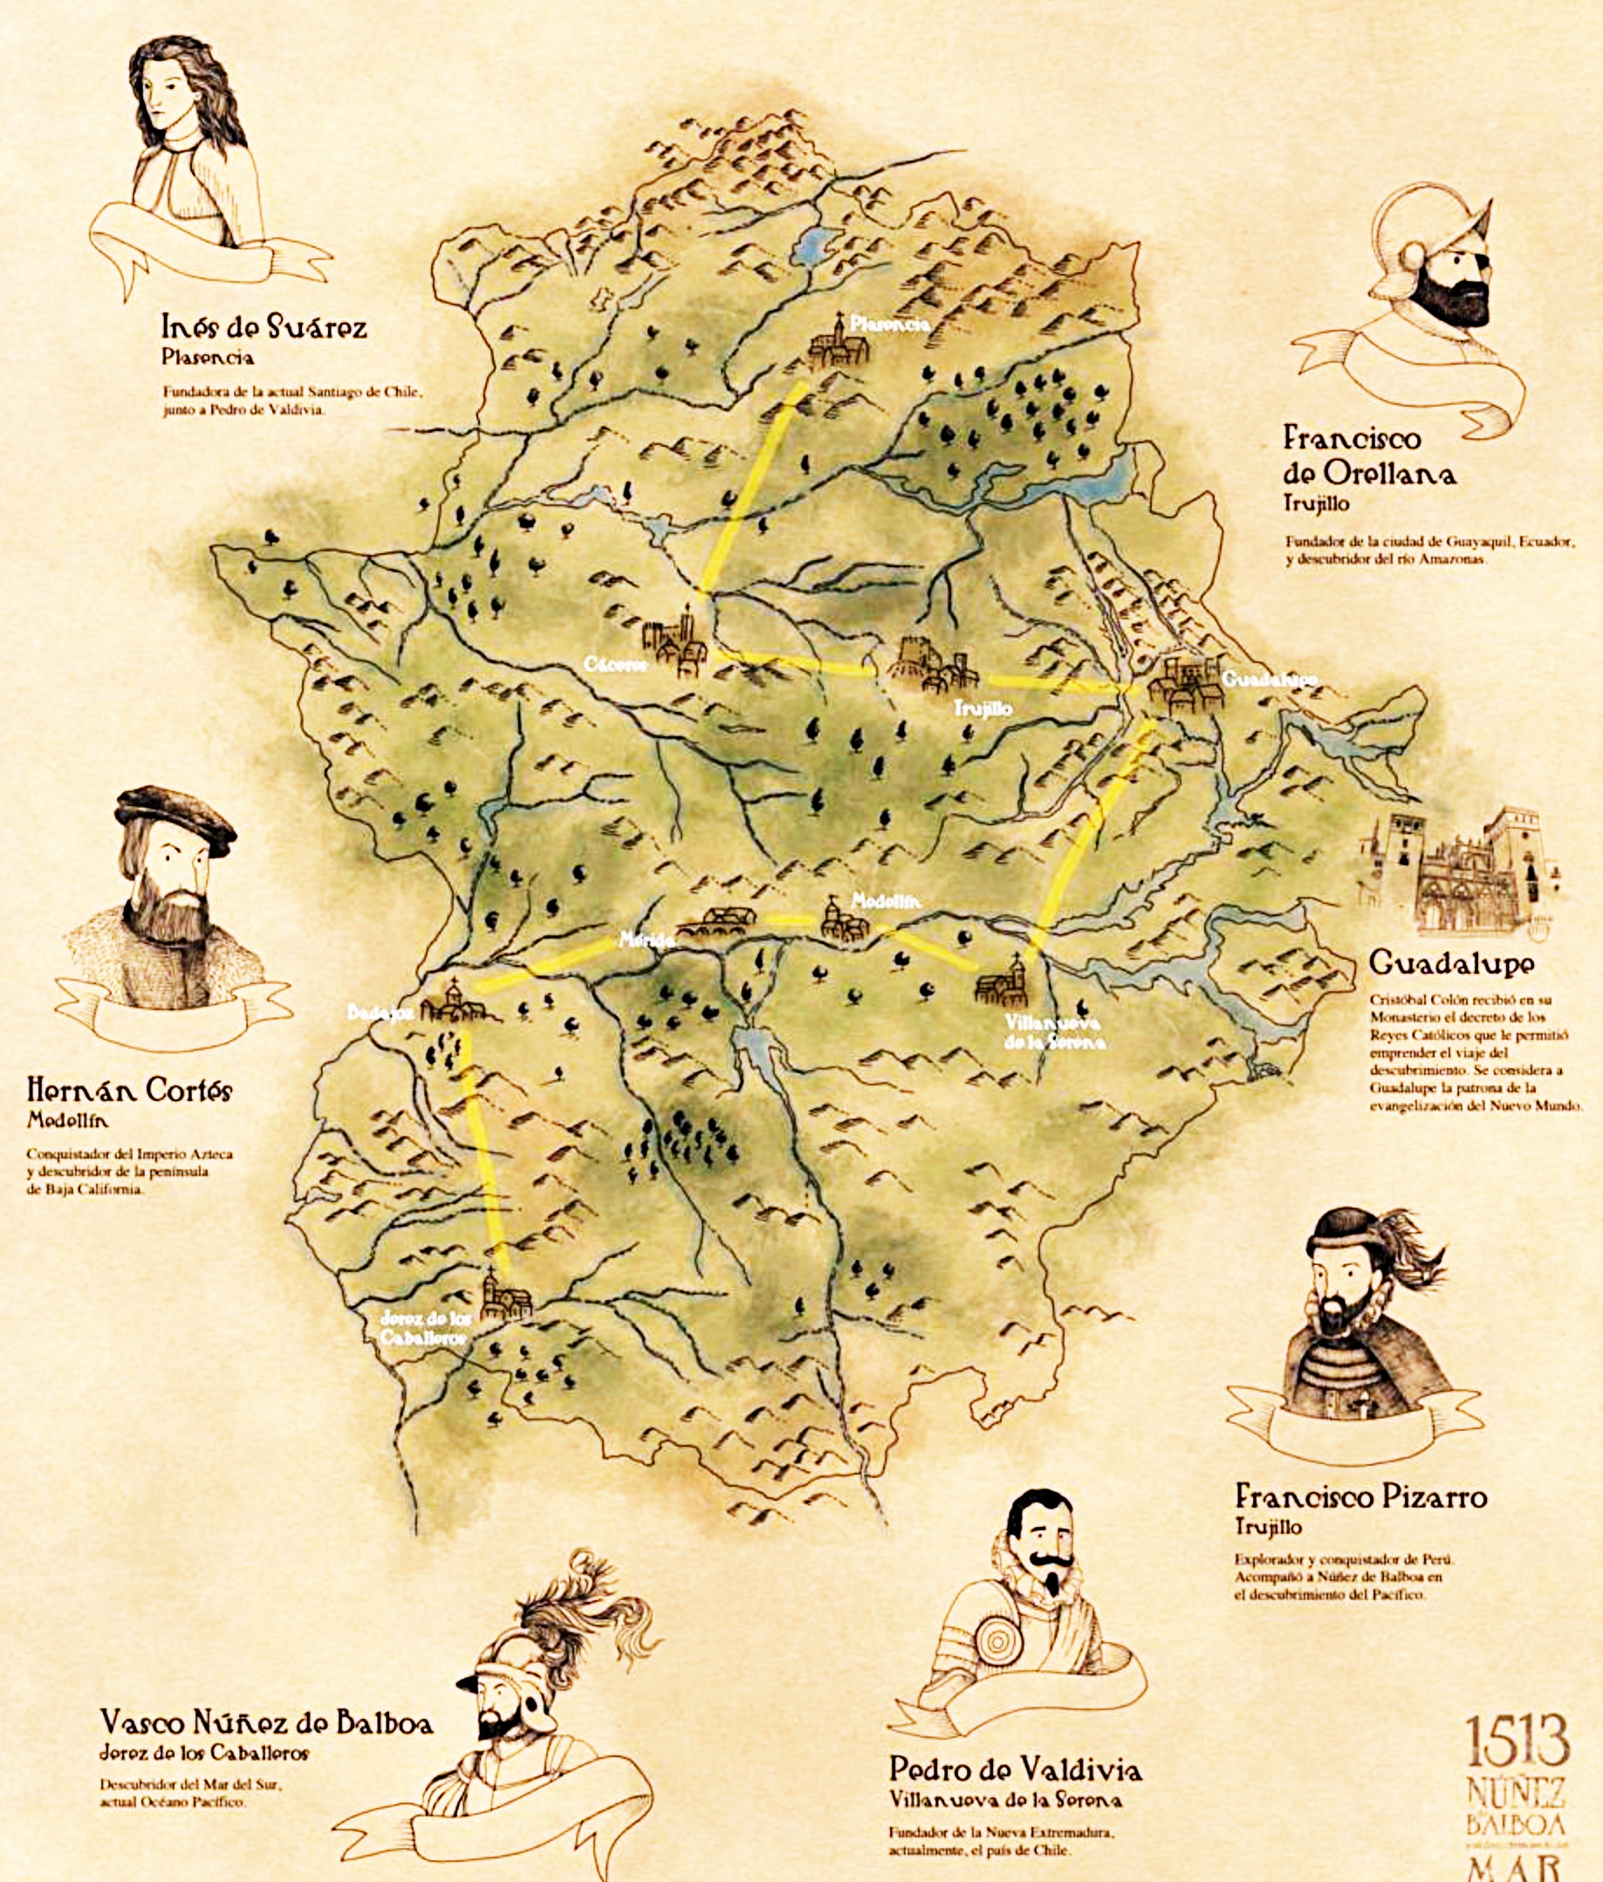
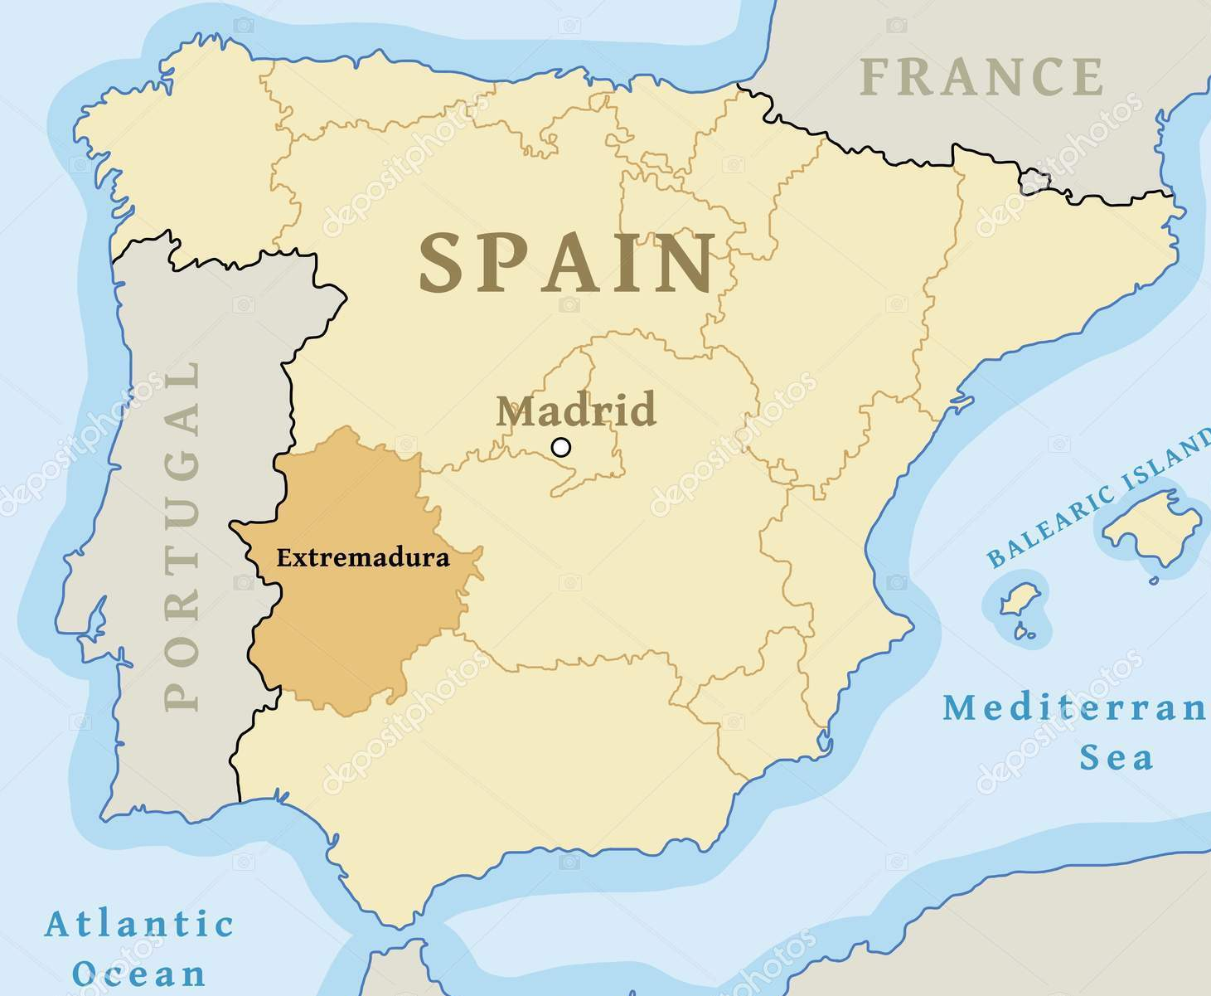
THIS MOTLEY CREW…

Slide 37
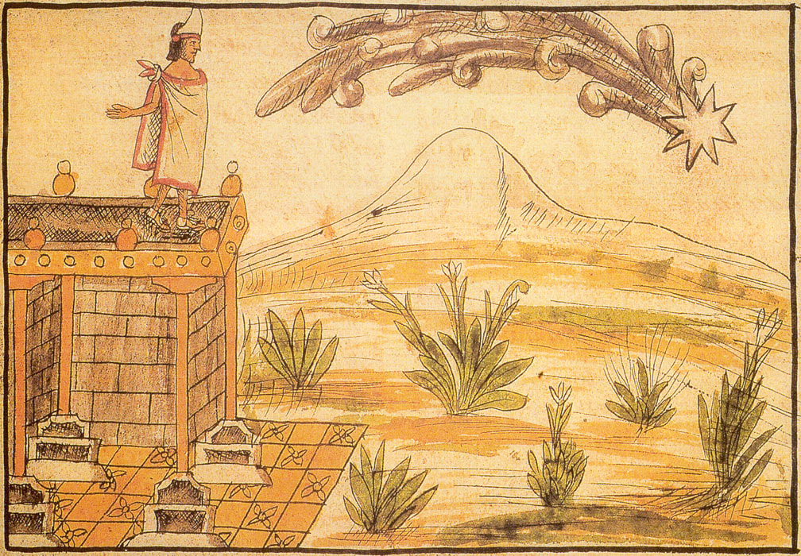
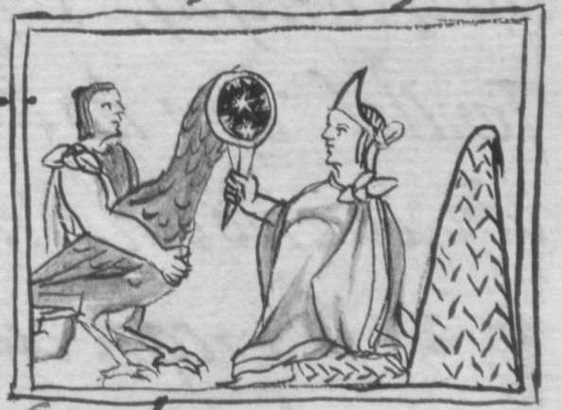
Providence
The Myth of Quetzalcoatl

Slide 38
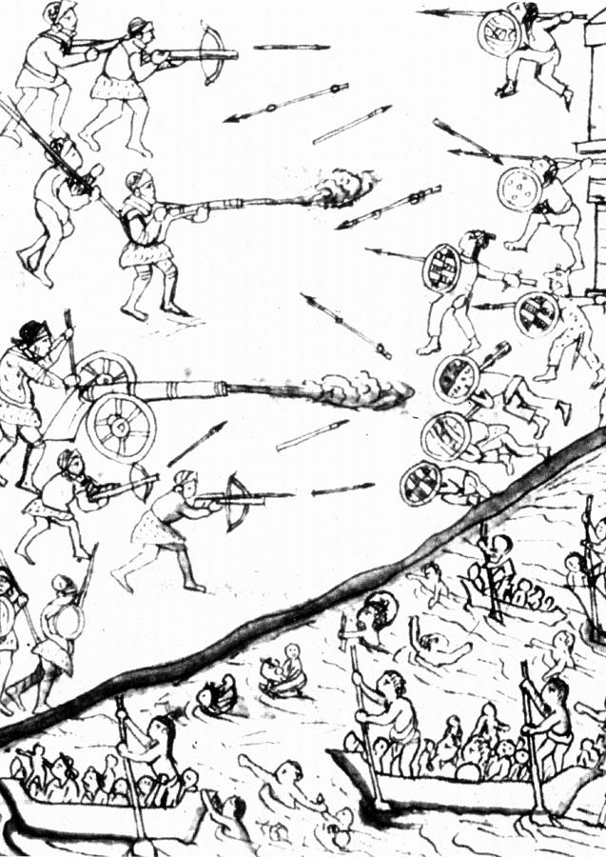
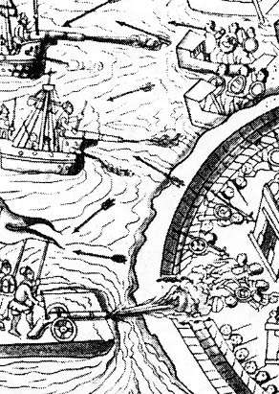
2. Military Technology
Horse & Mastiff
Spanish steel (swords & armour)
Muskets and Arquebus
Cannon
Brigantines (Lake Texcoco)

Slide 39
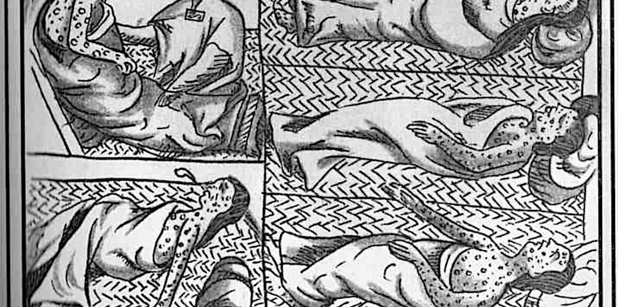
‘Especially in densely-populated regions like Central Mexico, the part played by epidemics in sapping both the ability and the will to resist goes a long way towards explaining the suddenness and the completeness of the Spanish Success.’ John Elliott
3. Disease

Slide 40
‘If the Black Death had been accompanied by the arrival of Genghis Khan’s hordes, miraculously plague-proof, the story would have been very different. If, by the way, the plague and the Mongols had arrived in tandem, I think it is unlikely that I would be writing this preface in an Indo-European language.’ Alfred Crosby
‘This sore affliction entered so deep into the minds of men and women that, in the horror thereof, brother was forsaken by brother, nephew by uncle, brother by sister and, oftentimes, husband by wife; nay, what is more and scarcely to be believed, fathers and mothers were found to abandon their own children, untended, unvisited, to their fate, as if they had been strangers…’
From Boccaccio, The Decameron

Slide 41


4. Centralised indigenous government
5. Division and Resistance

Slide 42


Slide 43

4. Writing the History of the Conquest
SOURCES
CHALLENGES
THEMES AND APPROACHES

Slide 44
Sources for the Conquest of Mexico
Letters of Hernán Cortés (1522-1525)
Juan Ginés de Supúlveda (1540s)
Fray Bernardino de Sahagún Florentine Codex (c.1585)
Bernal Díaz del Castillo, The True History of the Conquest of New Spain (1576)
Diego Durán’s account, The History of the Indies and New Spain (1581)

Slide 45
Sources for the Conquest of Peru
Francisco de Jerez, Verdadera relación de la conquista de Perú, 1534
Miguel de Estete, Noticia del Peru, 1535
Titu Cusi Yuquapanqui, Relación de la conquista del Perú, 1570
Garcilasco de la Vega, Comentarios reales de los Incas, 1617
Guaman Poma, Nueva crónica de buen gobierno, 1615
See also: Patricia Seed, “Failing to Marvel”: Atahualpa’s Encounter with the Word”, Latin American Research Review, 26:1, 1991. (On how they all interpret the encounter with Atahualpa, Pizarro and Valverde)

Slide 46

Problems with writing the history of the conquest:
Power: the “voices of the victors”
Most people in Europe, but especially the Americas, don’t WRITE. Written texts are left mainly by the most powerful (in each culture)
Disproportionate influence of go-betweens/ translators/ acculturated indigenous people
Demographic collapse: who survived to tell the tale? How can we measure pre-conquest populations?

Slide 47

‘It is in the nature of conquest itself that the voices of the victors resound more loudly than those of the vanquished.’
John Elliott
Burning the Idols, Descripción de Tlaxcala

Slide 48
Problems with writing the history of the conquest cont.:
Aims and audience of the person writing
Apparent “translatability” but total misunderstandings in reality; and we tend to get the European interpretations not the indigenous ones
Problem of European preconceptions and imaginings about New World, e.g. chivalric ballad tradition…

Slide 49
Bernal Díaz del Castillo, True History of the Conquest of New Spain (1576)
“When we saw all those cities and villages built in the water, and other great towns on dry land, and that straight and level causeway leading to Mexico, we were astounded. These great towns and temples and buildings rising from the water, all made of stone, seemed like an enchanted vision from [the chivalric ballad of] Amadís. Indeed, some of our soldiers asked whether it was not all a dream.”

Slide 50


Slide 51

“I want to see Hernán Cortés in a Mexico City plaza so that we rid ourselves of this complex. There is no reason to negate the father, the mother, or the brother. We accept all that we are. I want to see a statue. I would love to. We are children of the prostitute, of the Conquistador, of la Malinche.”
Carlos Fuentes

Slide 52
Conquest History
1520s-c1990: “triumphalist narrative”
Letters of Hernan Cortés
Bernal Diaz del Castillo, 1576
William H. Prescott, 1843
Robert Ricard, The Spiritual Conquest, 1966
1970s and 1980s: James Lockhart, The Men of Cajamarca, (1972), Karen Spalding, Huarochiri, (1984), Inga Clendinnen, Ambivalent Conquests, (1987)

Slide 53


1492- 1992

Slide 54


Slide 55
New Conquest History
Since 2000 five core approaches:
Revisiting (re-reading old sources, motivations etc.)
Paleography (learning to read sources left unread)
Protagonists (forgotten Spaniards, women, settlers of African descent, indigenous people)
Indigenous perspectives (indigenous conquistadors, indigenous diaspora)
Boundaries
a. Of space away from centres of empire
b. Of discipline: History, Anthropology, EthnoHistory to Art History, Geography, Literature)

Slide 56





Slide 57



Juan Garrido (c.1480 - c.1550)
See Peter Gerhard, “A Black Conquistador in Mexico” The Hispanic American Historical Review, 1978

Slide 58

VISUAL AND MATERIAL HISTORY
Have played key role in efforts to approach the surviving evidence with a Native, rather than European lens.
This has meant prioritizing images, and learning to “read” them.
The importance of colour.

Slide 59

Codex Mendoza
c. 1550
Map of Tenochtitlán

Slide 60






Slide 61

Epilogue
‘To some 6 million subjects of the crown of Castile, and another million in the Crown of Aragon, they now added some 50 million (before disease took its toll)…’
J. Elliott
Can we create a single, coherent history of the 'Spanish conquest of America'?

Slide 62


