Slide 1
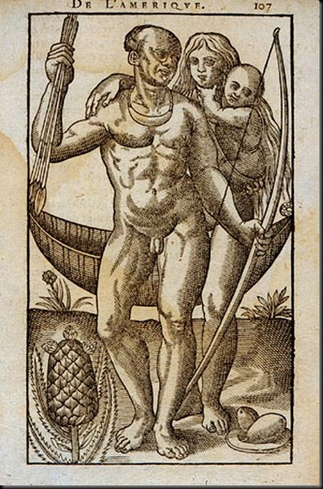
The Invasion of the American Mainland
Rebecca Earle

Slide 2
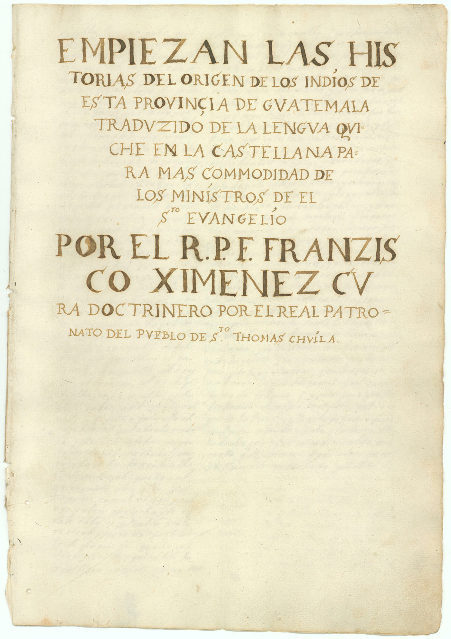
The Popol Vuh
The Popol Vuh is a collection of stories and legends of the K’iche’ Maya people, who live in what is now Guatemala. It is sometimes called the ‘K’iche’ Bible’. These stories were probably written down some time in the mid-16C, in the K’iche’ language. We know them from a copy made in the early 18C by a Dominican priest named Francisco Ximénez.
Ximénez’s manuscript is in the Newberry Library, Chicago.

Slide 3
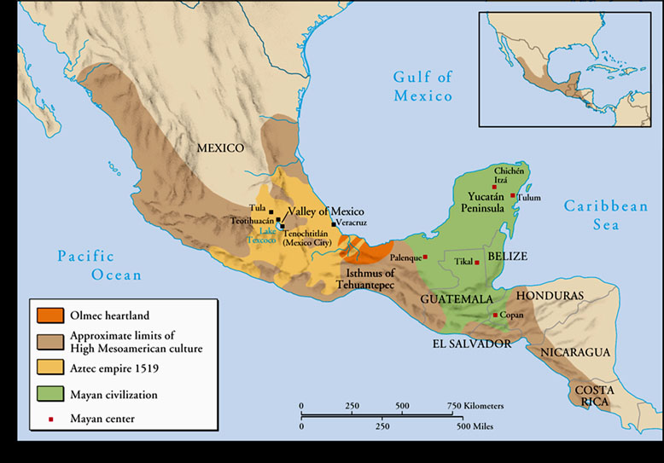
Meso-America

Slide 4
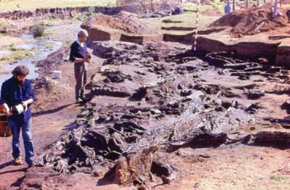
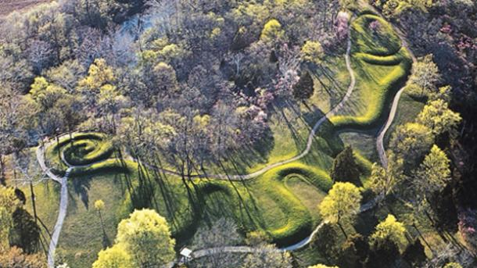
Settlement and Exploration of the Americas:
Migrations from Eurasia
Excavations at Monte Verde (Chile), c.16,500 BCE
Began around 15,000 years ago
Over the Bering straight? Across the Pacific?
A single migration from north to south or multiple processes?
Great serpent mound (Ohio, USA), c.1000 CE

Slide 5
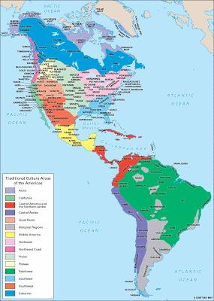
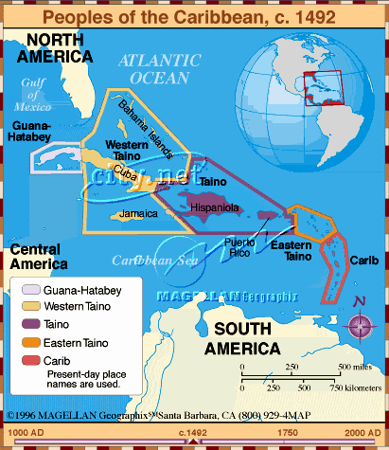
Cultures of the Americas

Slide 6
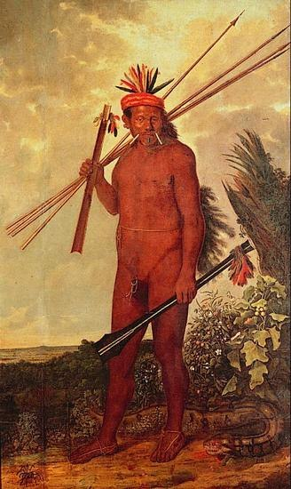
Cultures of the Americas
An anonymous 1578 illustration of Inuit peoples from the far north
Albert Eckhout’s painting of a Brazilian man, c. 1640

Slide 7
The Mexica
(aka Aztecs or Nahua)

Slide 8
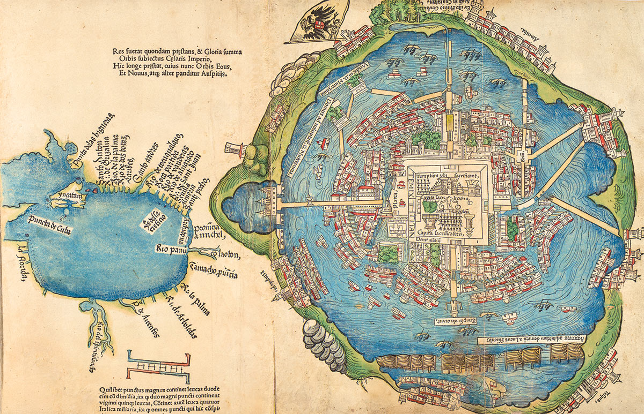
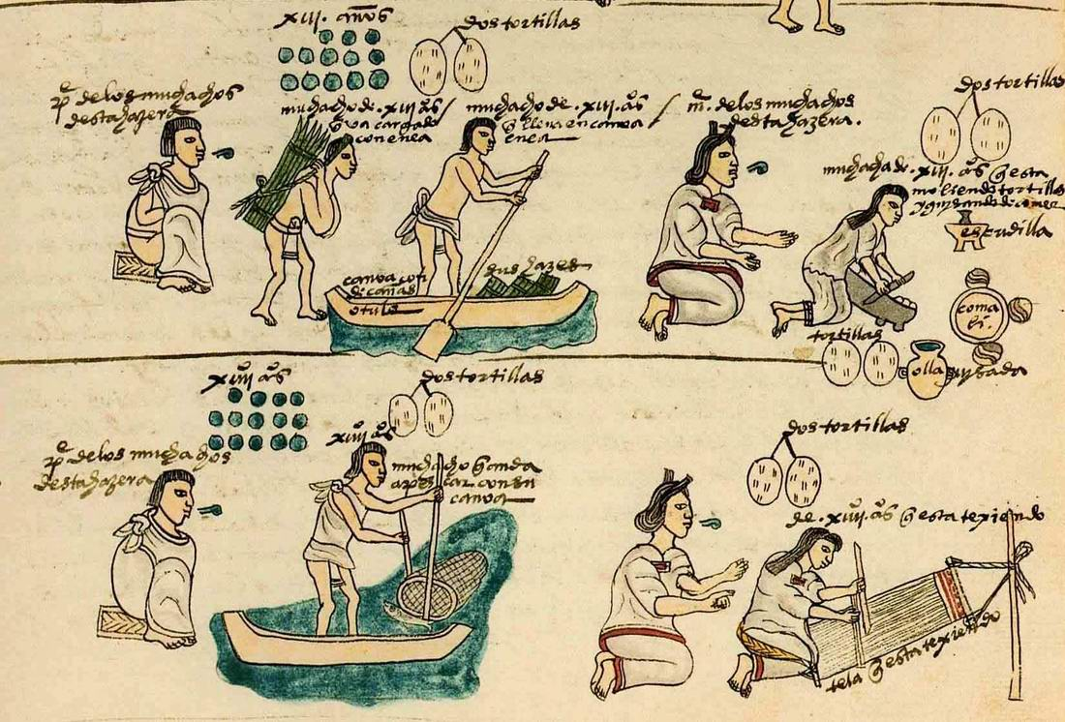
The Mexica of Central Mexico
The capital city of Tenochtitlán from a 1524 map
Mexicas preparing food, etc., from the Codex Mendoza, c.1540

Slide 9
The Spanish conquistadors arrive in Tenochtitlán
(from Bernal Díaz del Castillo, The True History of the Conquest of New Spain, c.1568)
‘And when we saw all those cities and villages built in the water, and other great towns on dry land, and that straight and level causeway leading to Mexico, we were astounded. These great towns and temples and buildings rising from the water, all made of stone, seemed like an enchanted vision from the tale of Amadis. Indeed, some of our soldiers asked whether it was not all a dream. . . It was all so wonderful that I do not know how to describe the first glimpse of things never heard of, seen or dreamed of before… But today all that I then saw is overthrown and destroyed; nothing is left standing.’

Slide 10
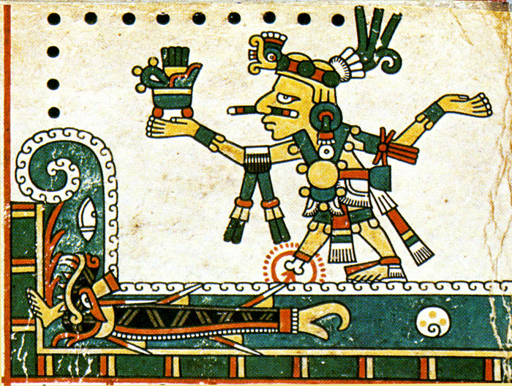
Tezcatlipoca (‘Smoking Mirror’)
From the Codex Féjérvary-Mayer

Slide 11
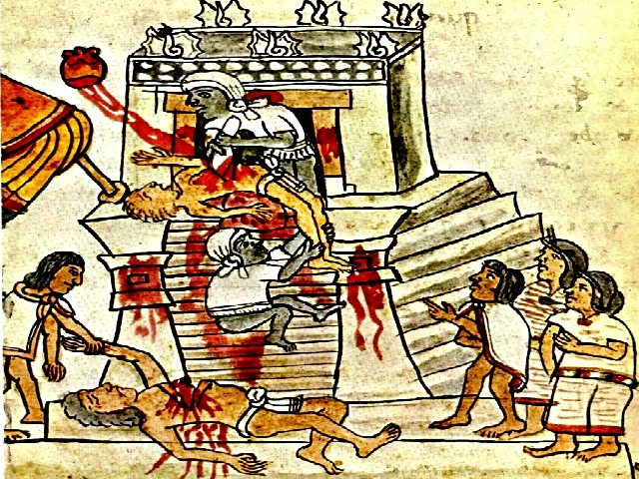
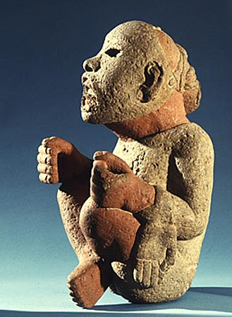
Human sacrifice, from the Florentine Codex, c.1569
A priest taking on the role of Xipe Totec, the Flayed God, dressed in a flayed human skin

Slide 12
The Inca

Slide 13
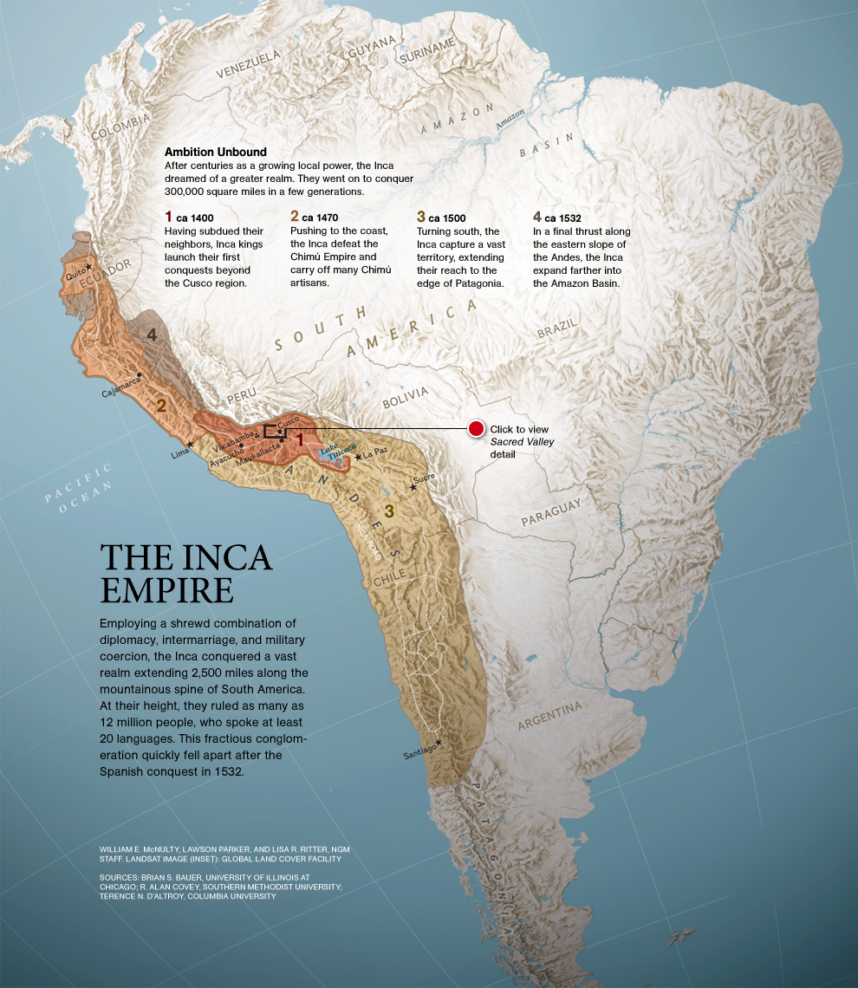
Tahuantinsuyu
The ‘Place of the Four Quarters’

Slide 14
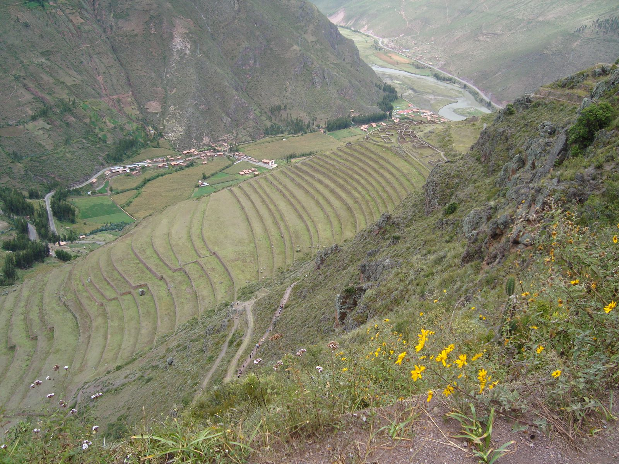
Inca Terraces at Pizac

Slide 15
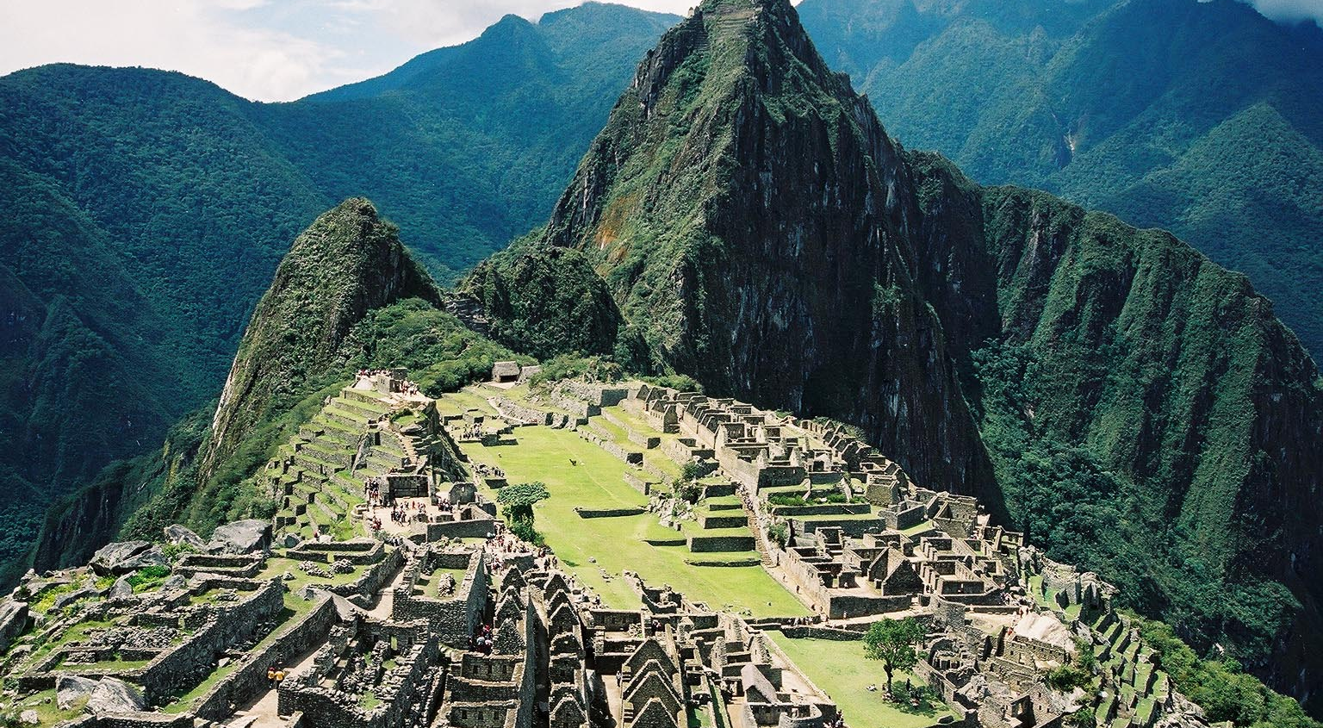
Machu Picchu
Terraces

Slide 16
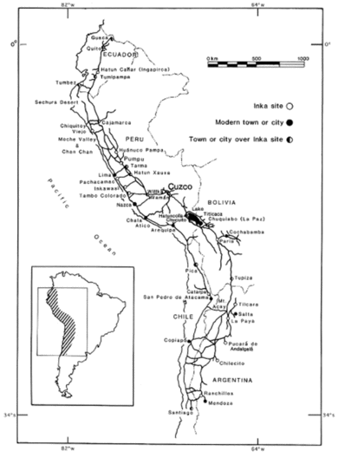
Inca Road Network

Slide 17
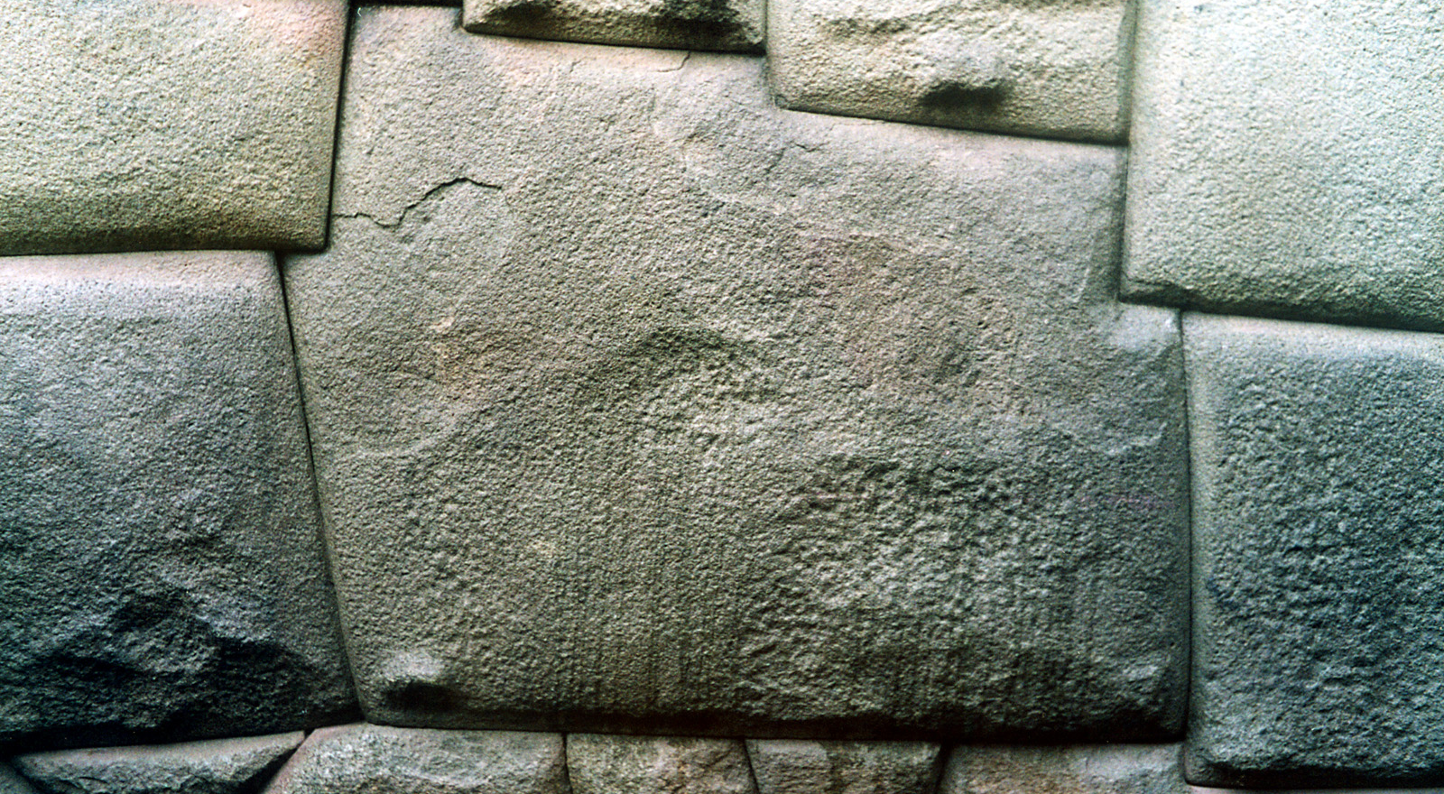
Inca Stonework (Cuzco)

Slide 18
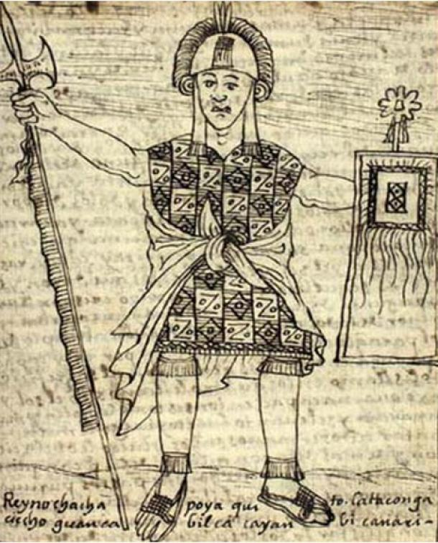
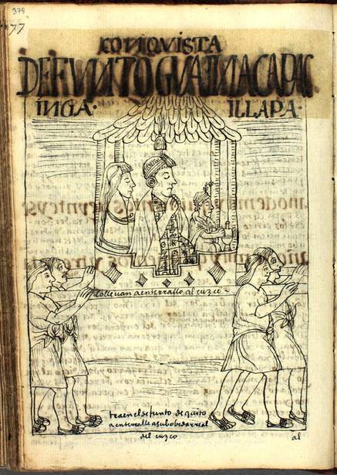
Inca emperor Huayna Capac (1493-1524)
Drawings by Felipe Guaman Poma de Ayala, c. 1615

Slide 19
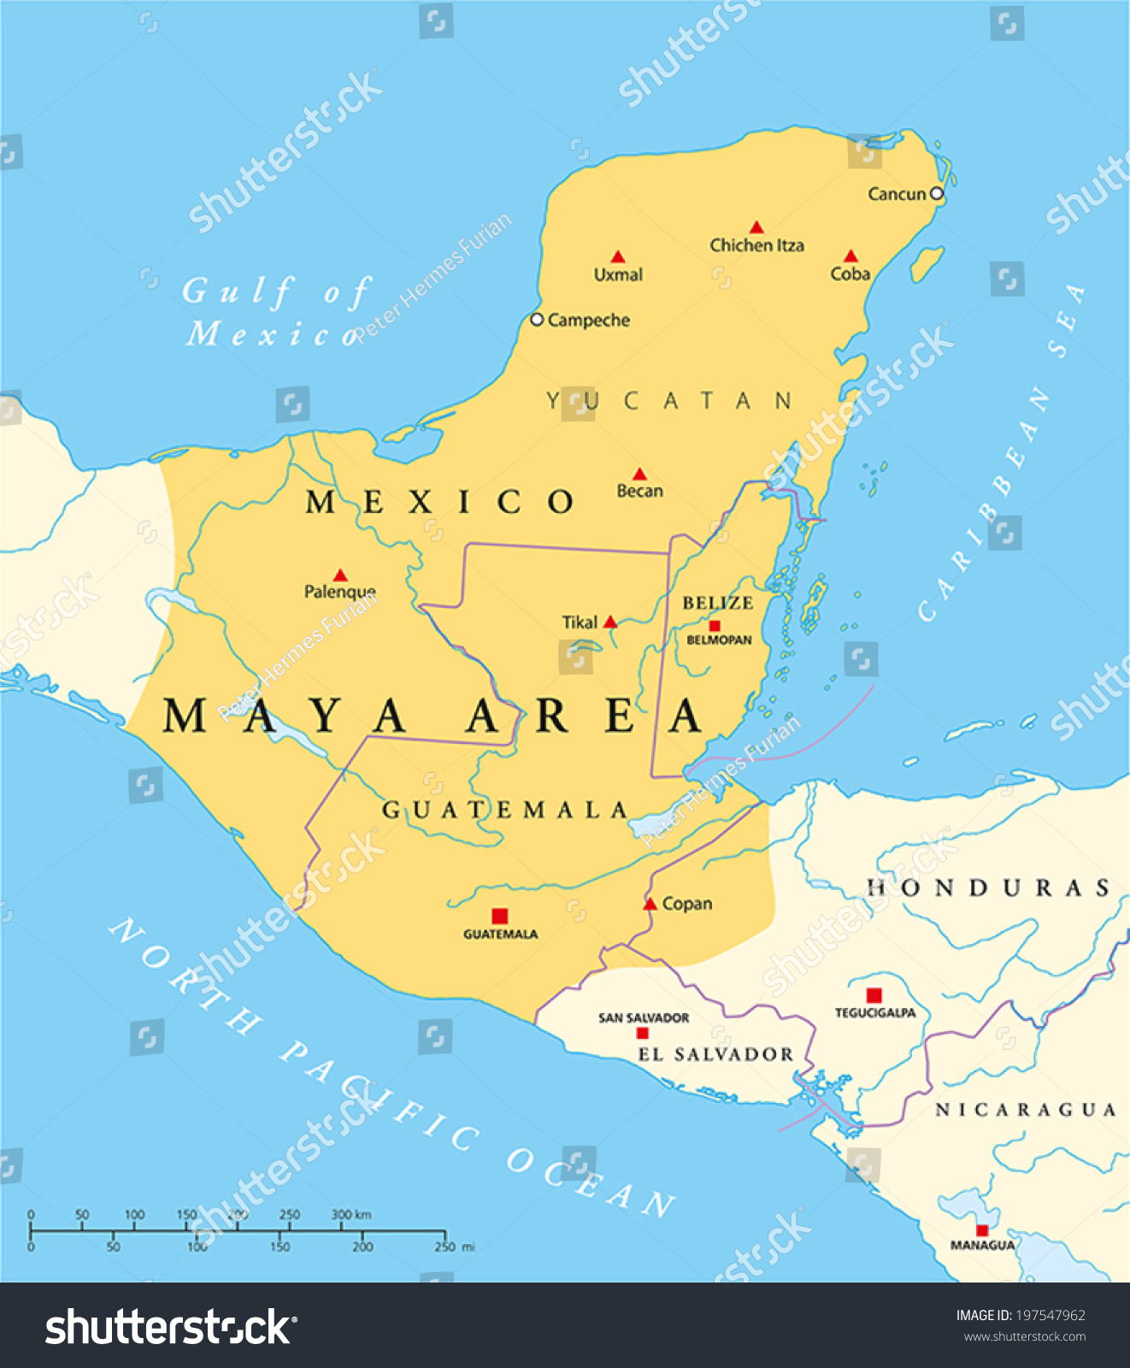
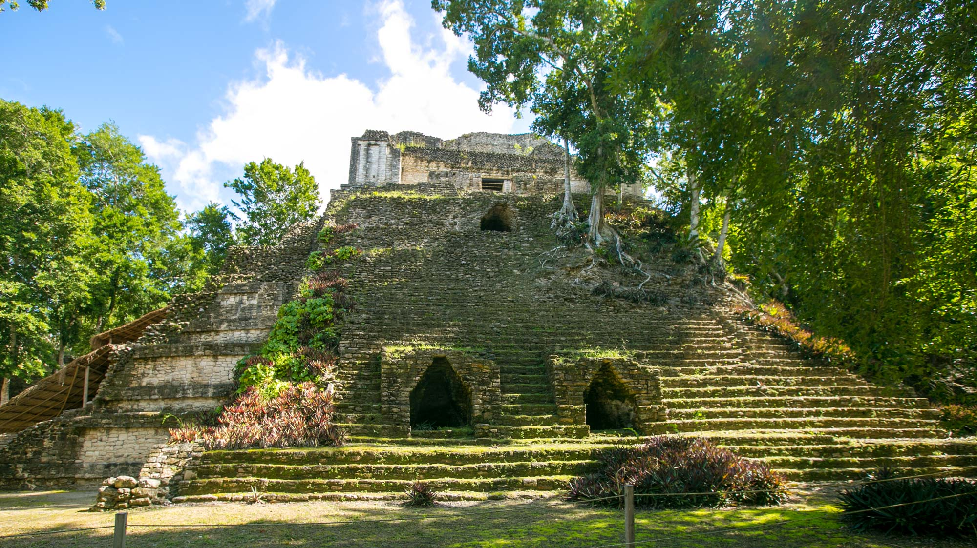
The Maya World
Dzibanche (c.600?)

Slide 20
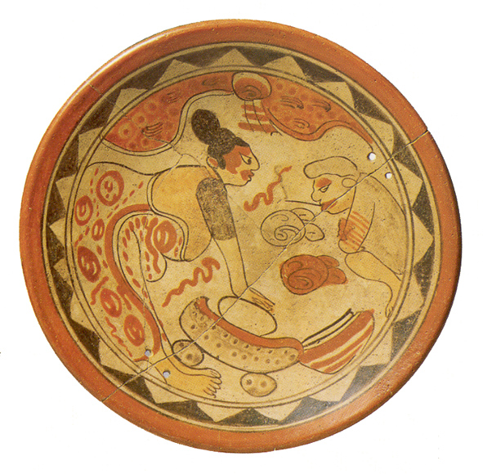
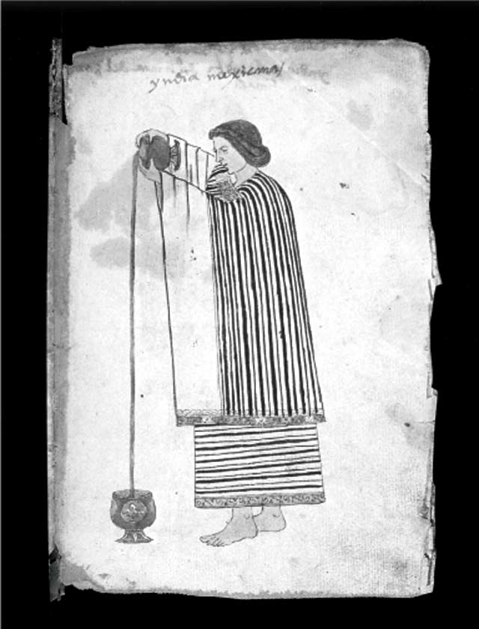
The Maya World
Woman grinding maize on a metate (grinding stone), c.600-900
Pouring hot chocolate to develop a froth
Codex Tudela, c.1553

Slide 21
Sources for the study of indigenous history

Slide 22
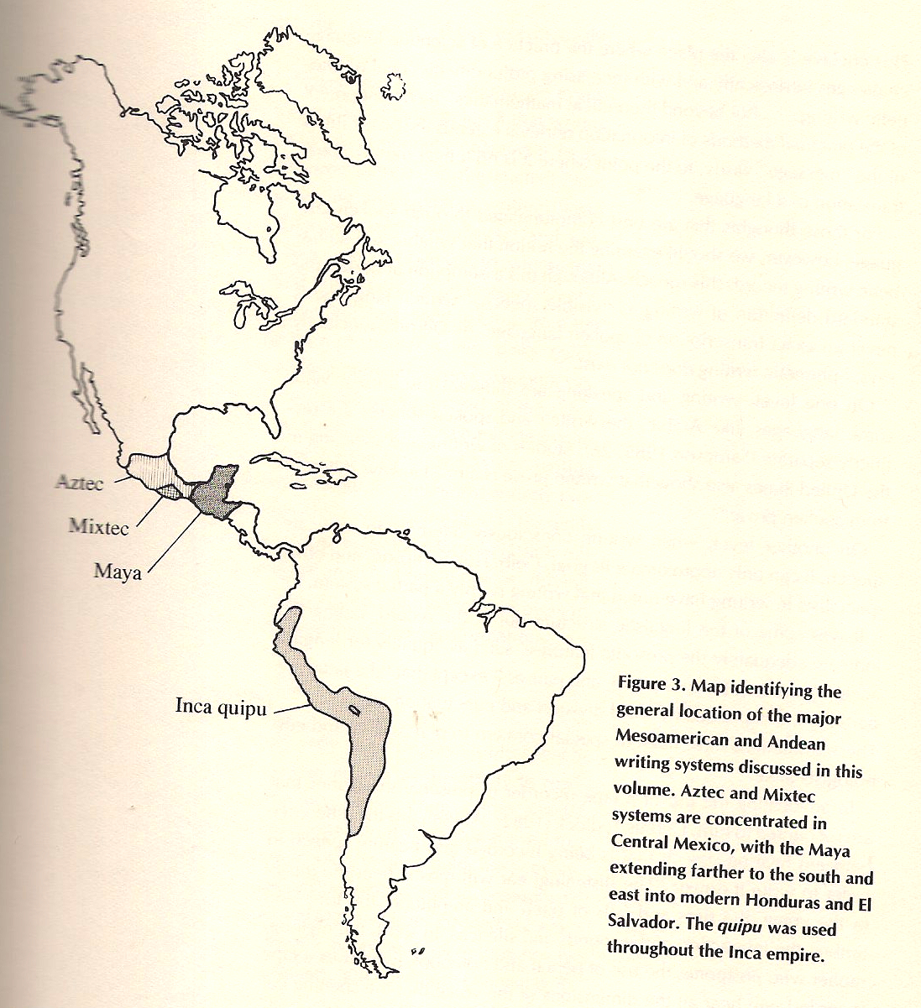
Indigenous writing systems from the Americas

Slide 23
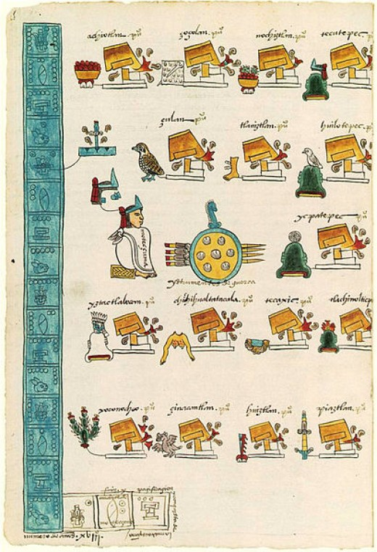
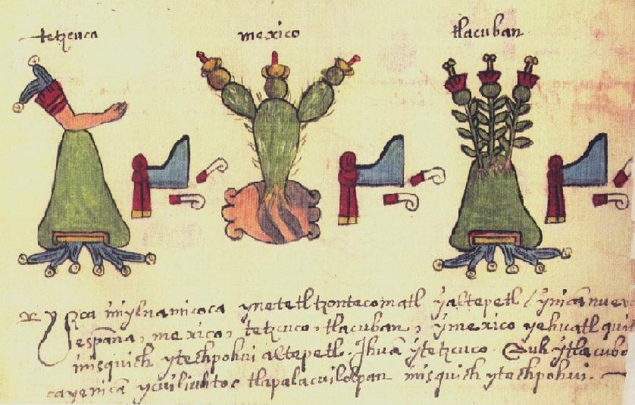
Indigenous writing systems from the Americas
Mexica pictographs

Slide 24
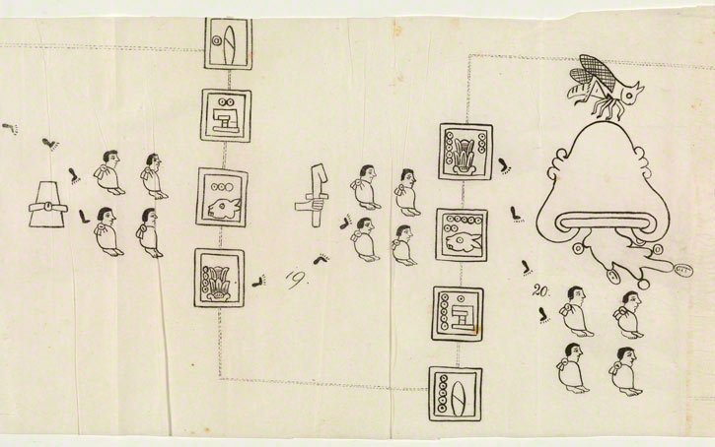
Indigenous writing systems from the Americas
Mexica pictographs

Slide 25
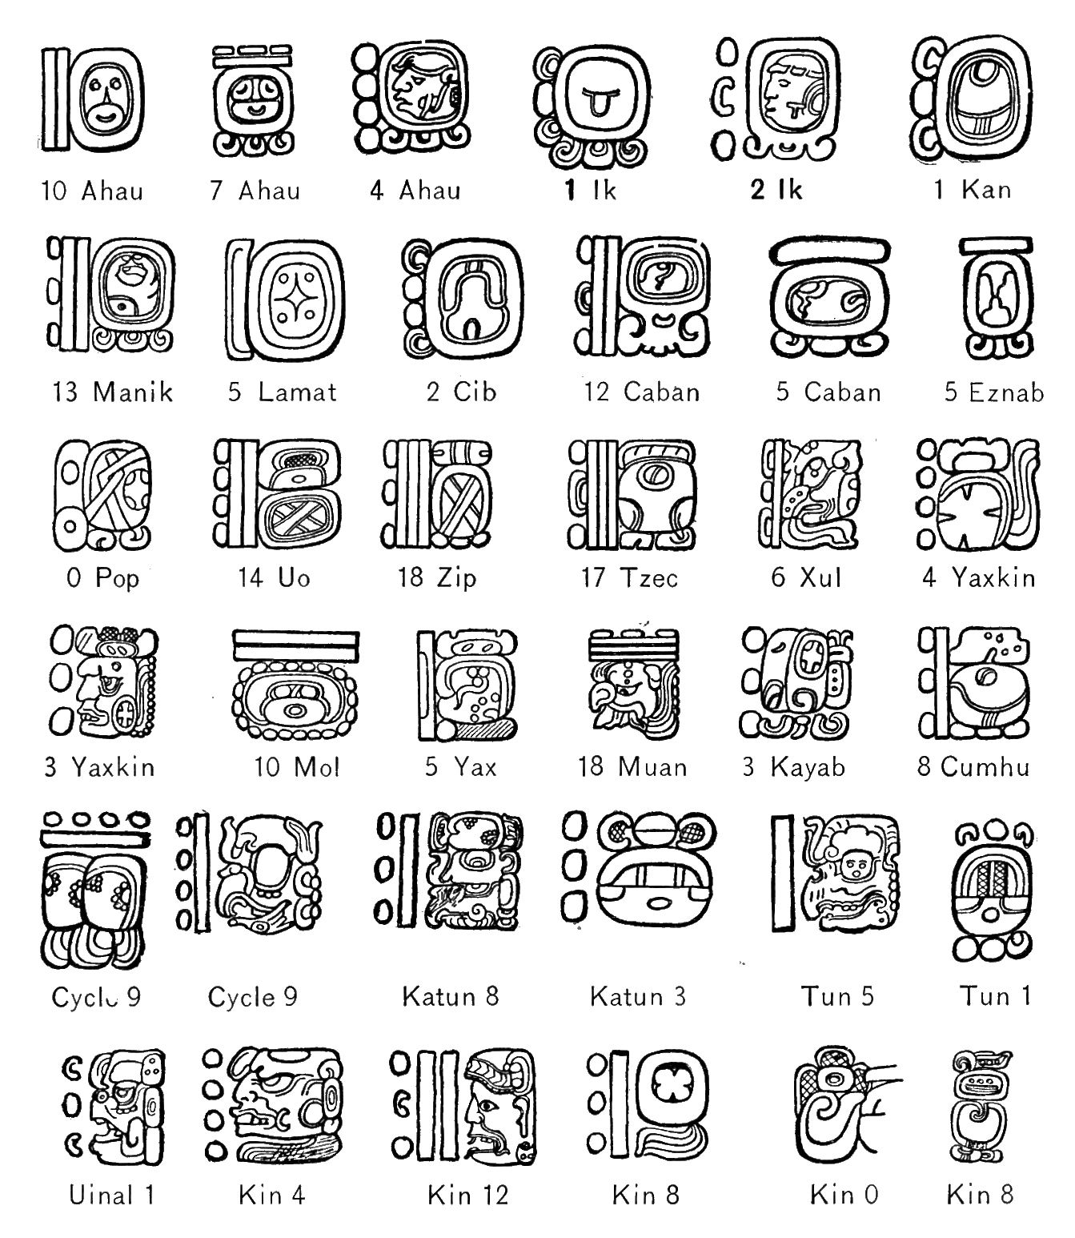
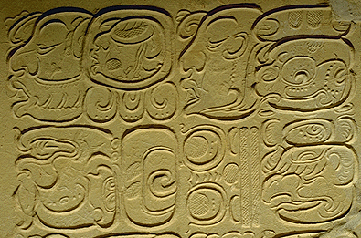
Indigenous writing systems from the Americas
Maya glyphs

Slide 26
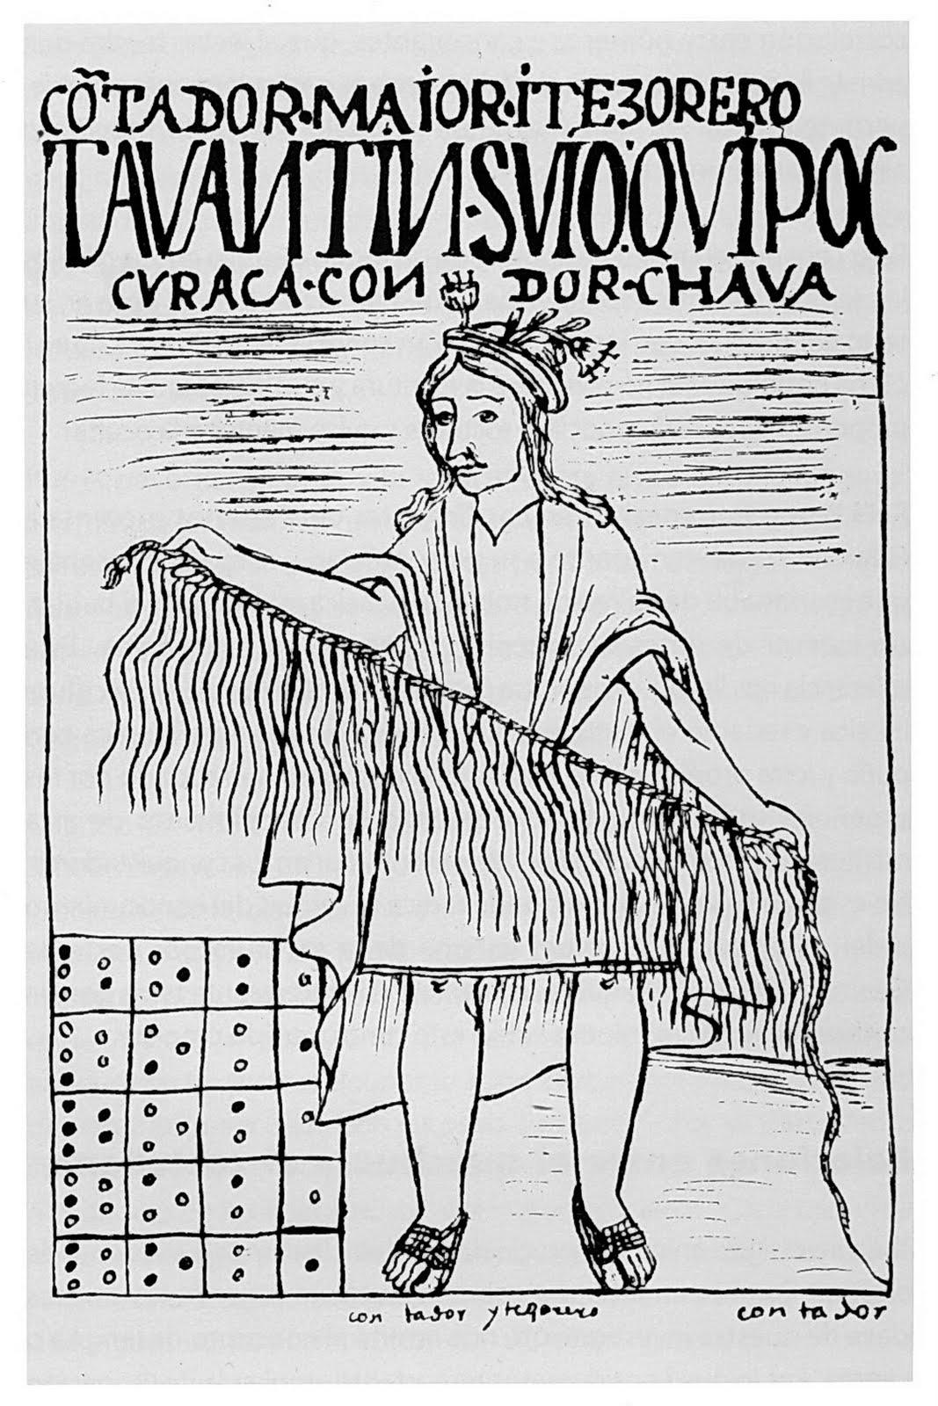
Indigenous writing systems from the Americas:
The Incan Quipu

Slide 27
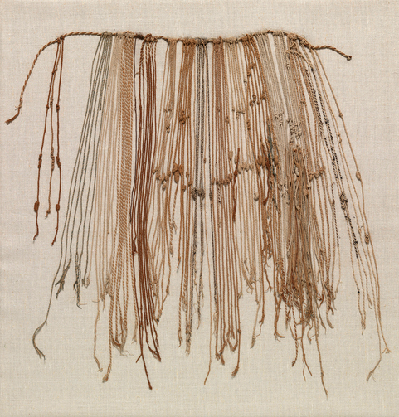
Indigenous writing systems from the Americas:
The Quipu

Slide 28
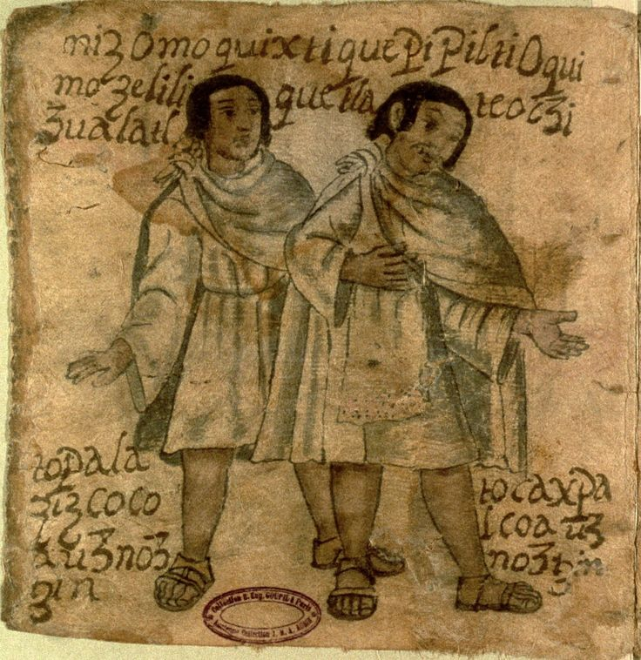
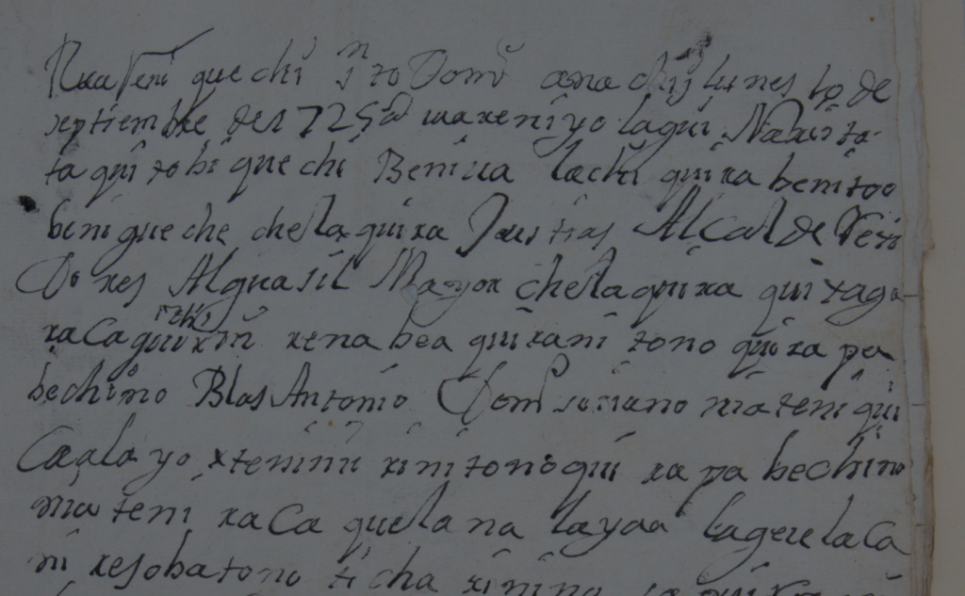
Post-conquest writings by indigenous people
Techialoyan Codex, 1685-1703, written in Nahuatl.
18th-century Complaint from Santo Domingo del Valle written in the Zapotec language.
(from the Archivo Histórico de Tlacolula de Matamoros, Mexico)

Slide 29
The Invasion of the Aztec Empire

Slide 30
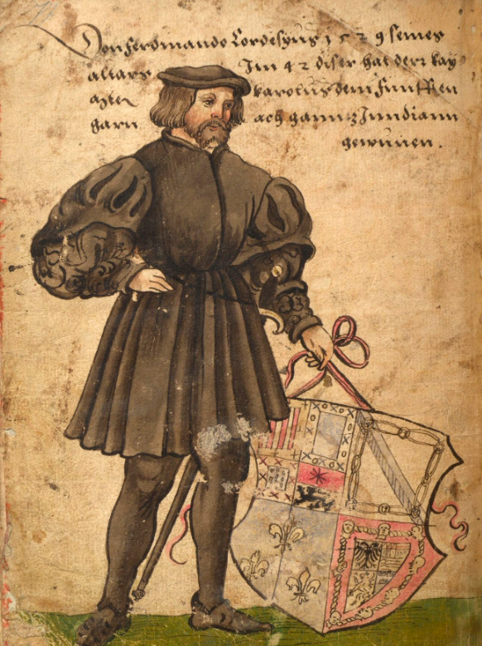
Hernán Cortés
Drawing by Christoph Weiditz (16th century).

Slide 31
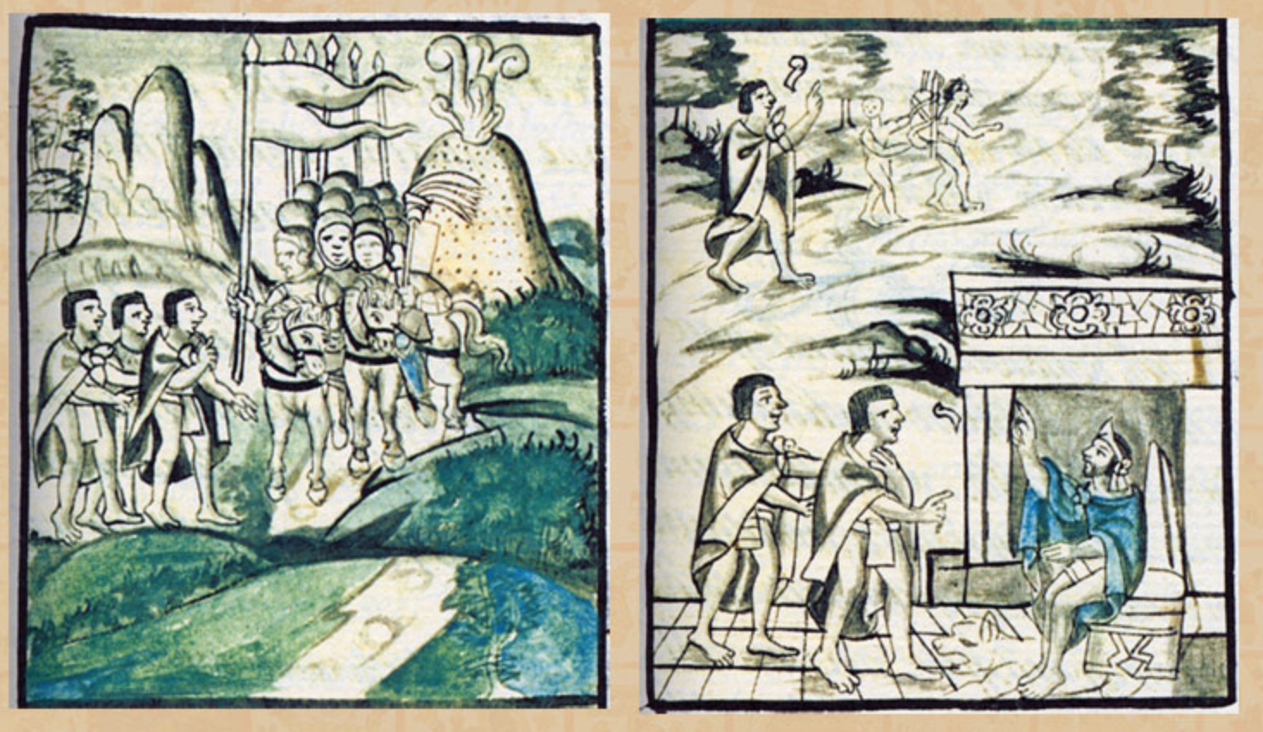
Moctezuma’s envoys meet the invaders and report back to the emperor.
From the Florentine Codex (16th Century)

Slide 32
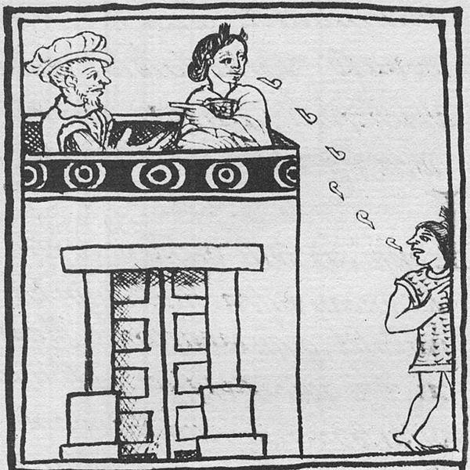
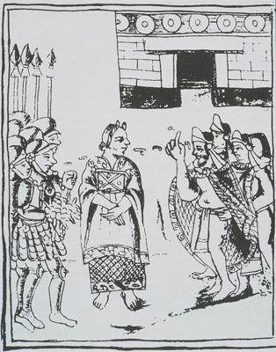
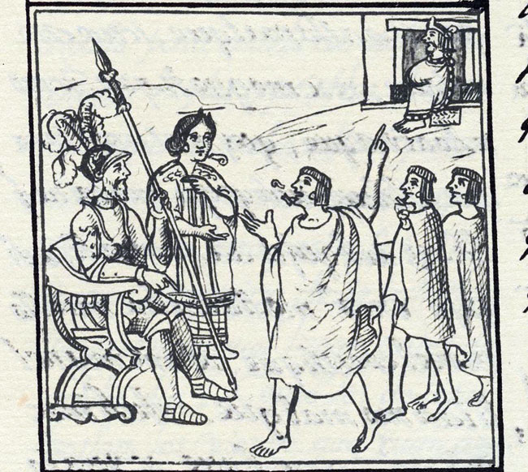
Malintzin
Florentine Codex, c. 1580

Slide 33
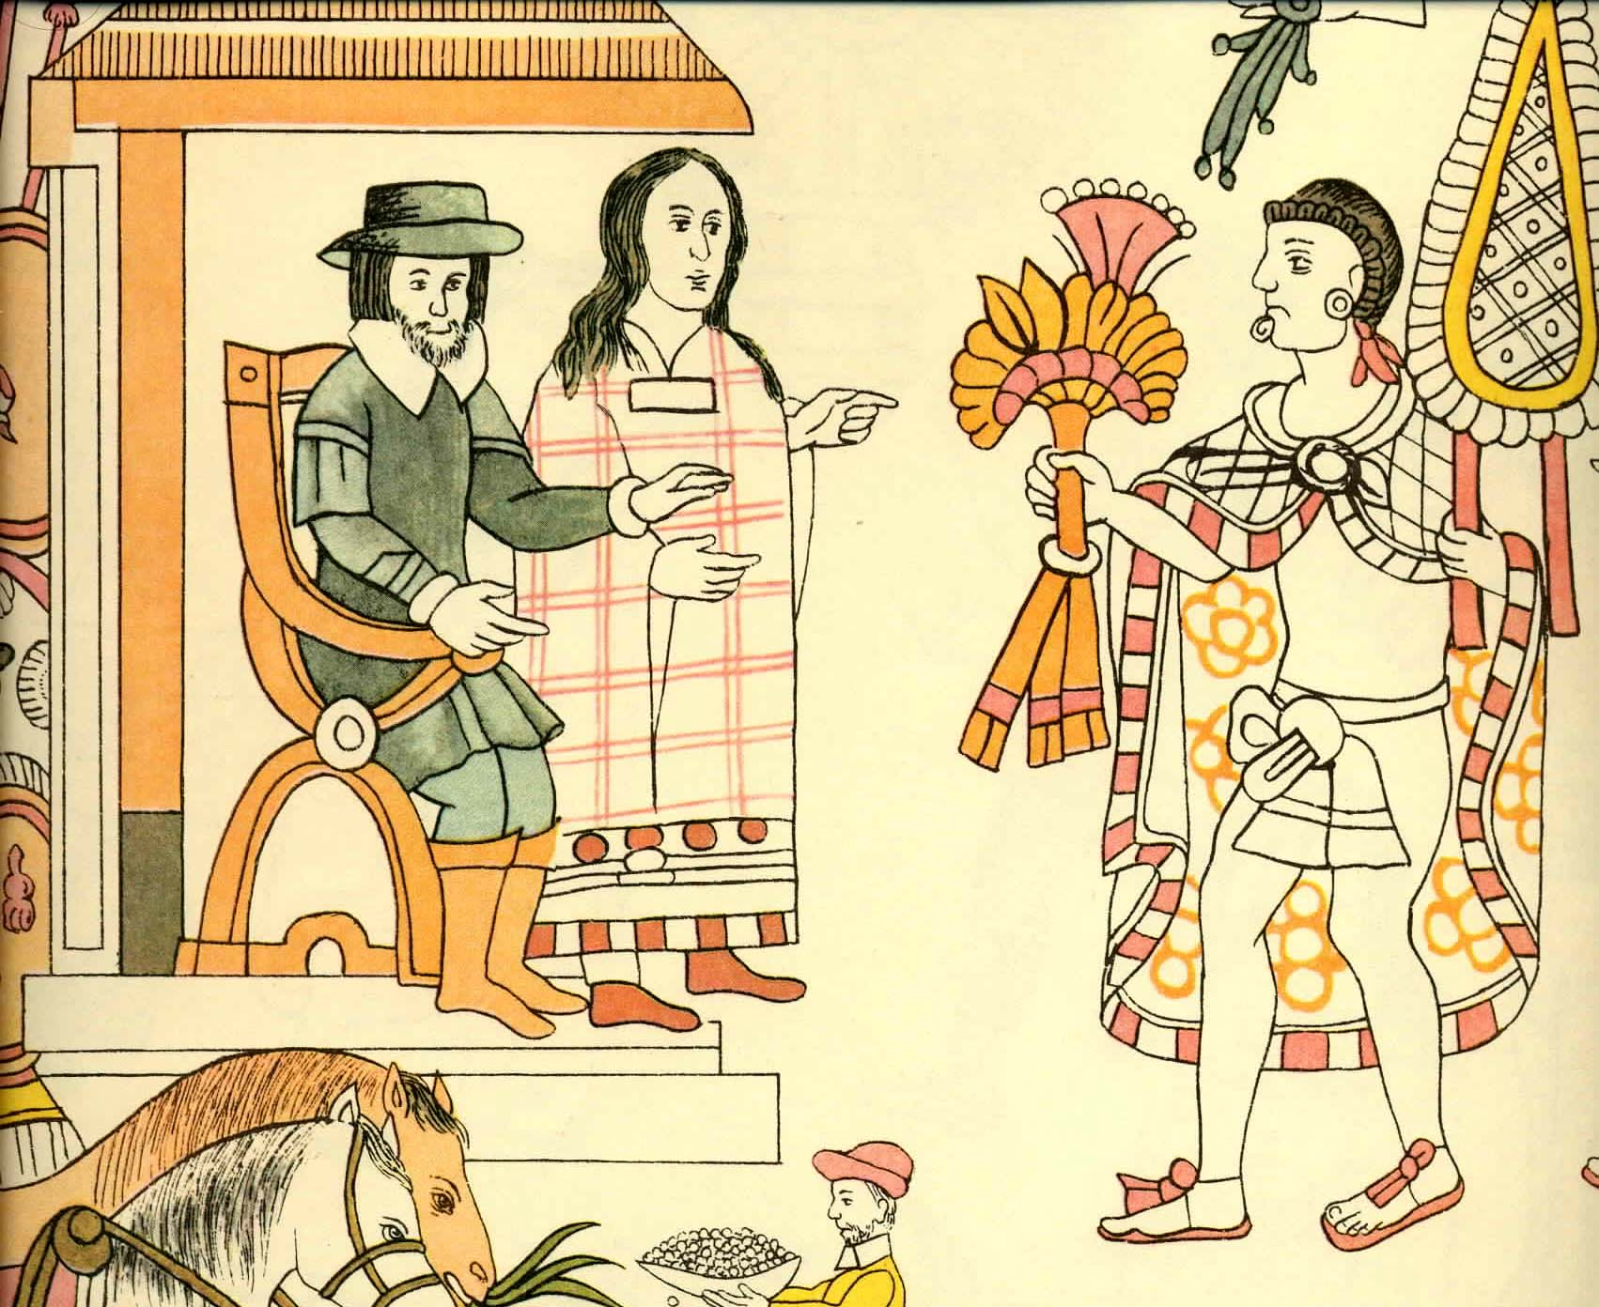
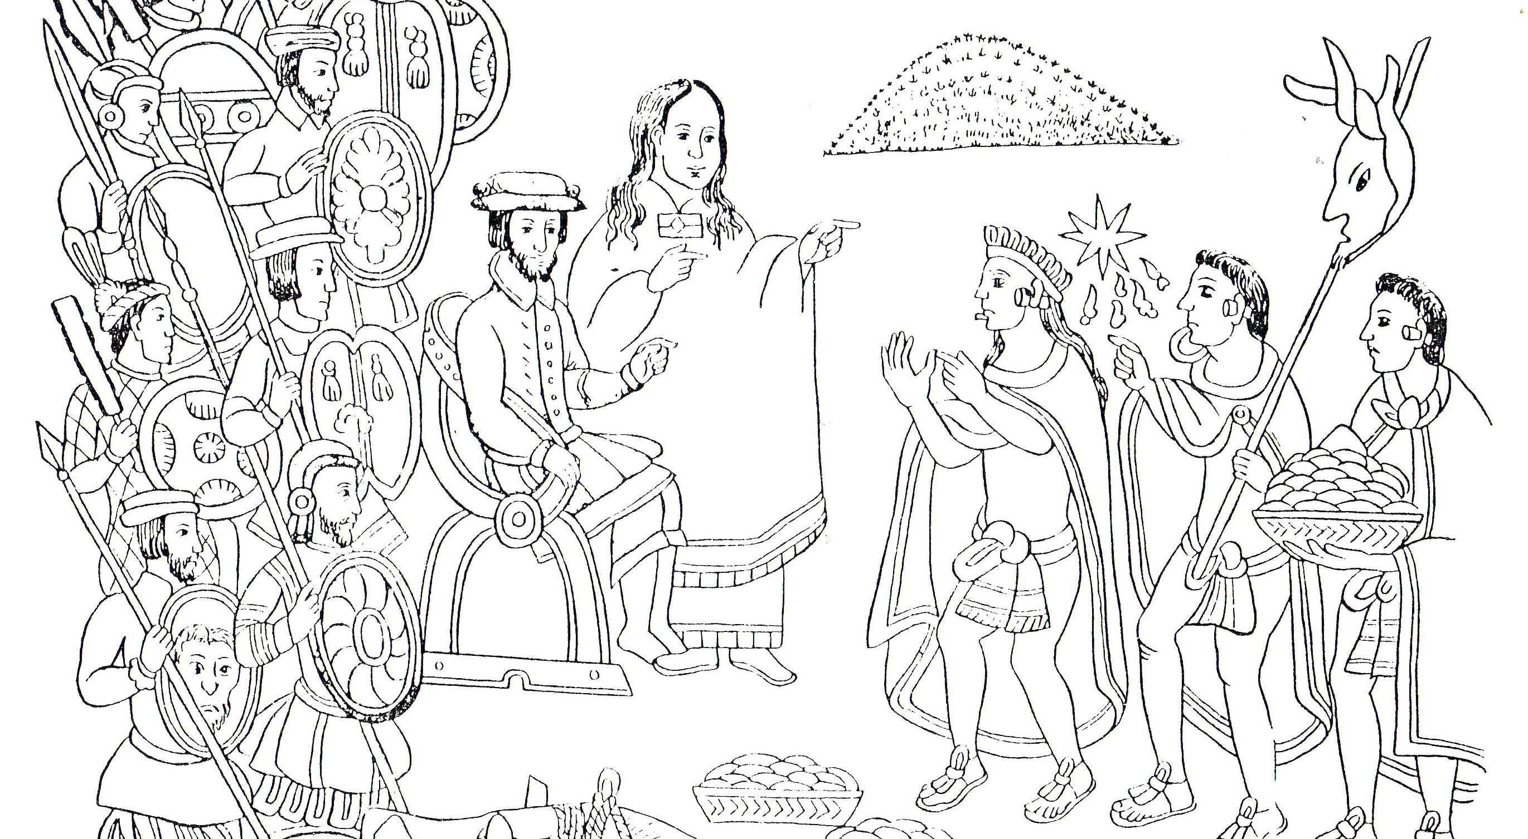
Malintzin
Lienzo de Tlaxcala, c. 1550

Slide 34
The Overthrow of the Inca State

Slide 35
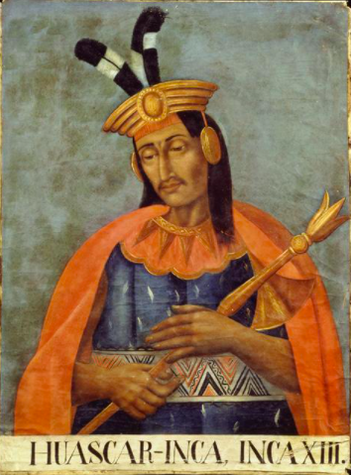
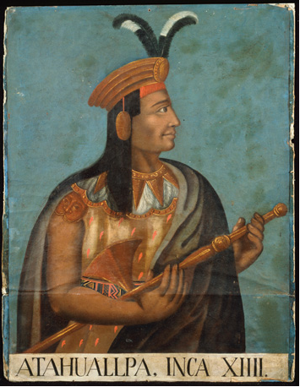
Huascar and Atahualpa
(heirs to the Inca throne)
Eighteenth-century portraits of Huascar and Atahualpa

Slide 36
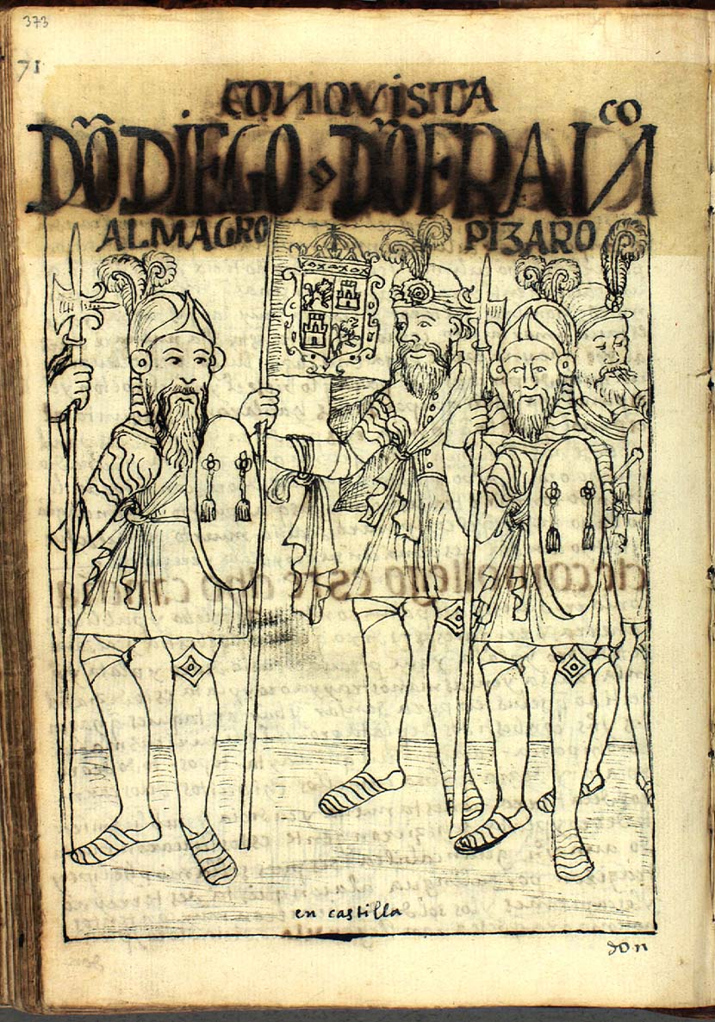
Diego de Almagro and Francisco Pizarro
From the 17th-century manuscript by the indigenous writer Felipe de Guaman Poma

Slide 37
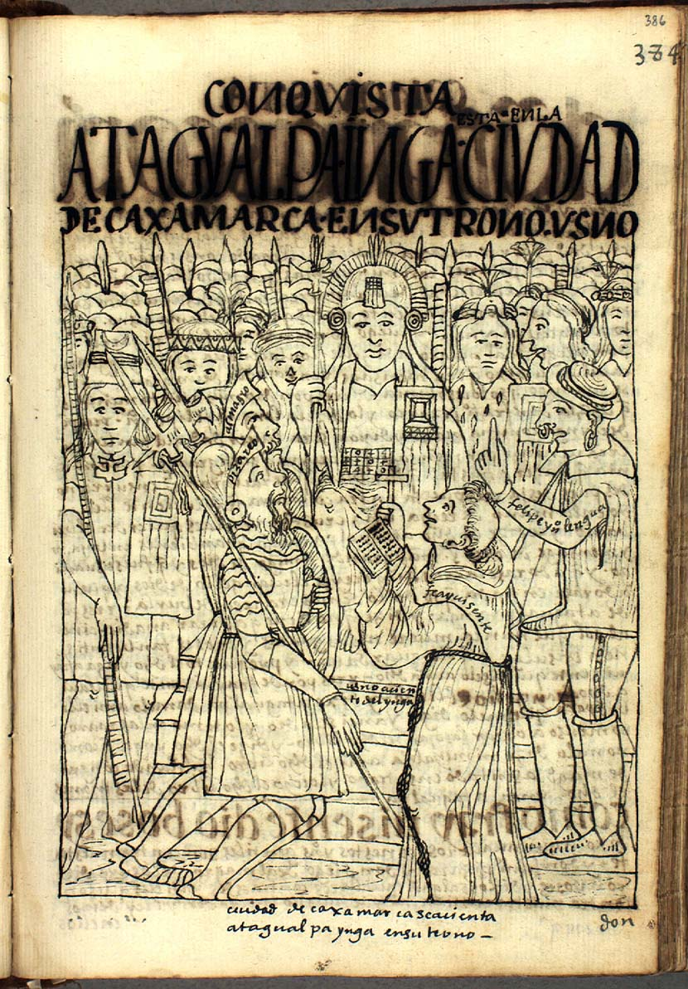
Atahualpa meets the Spaniards at Cajamarca
From the 17th-century manuscript by the indigenous writer Felipe de Guaman Poma

Slide 38
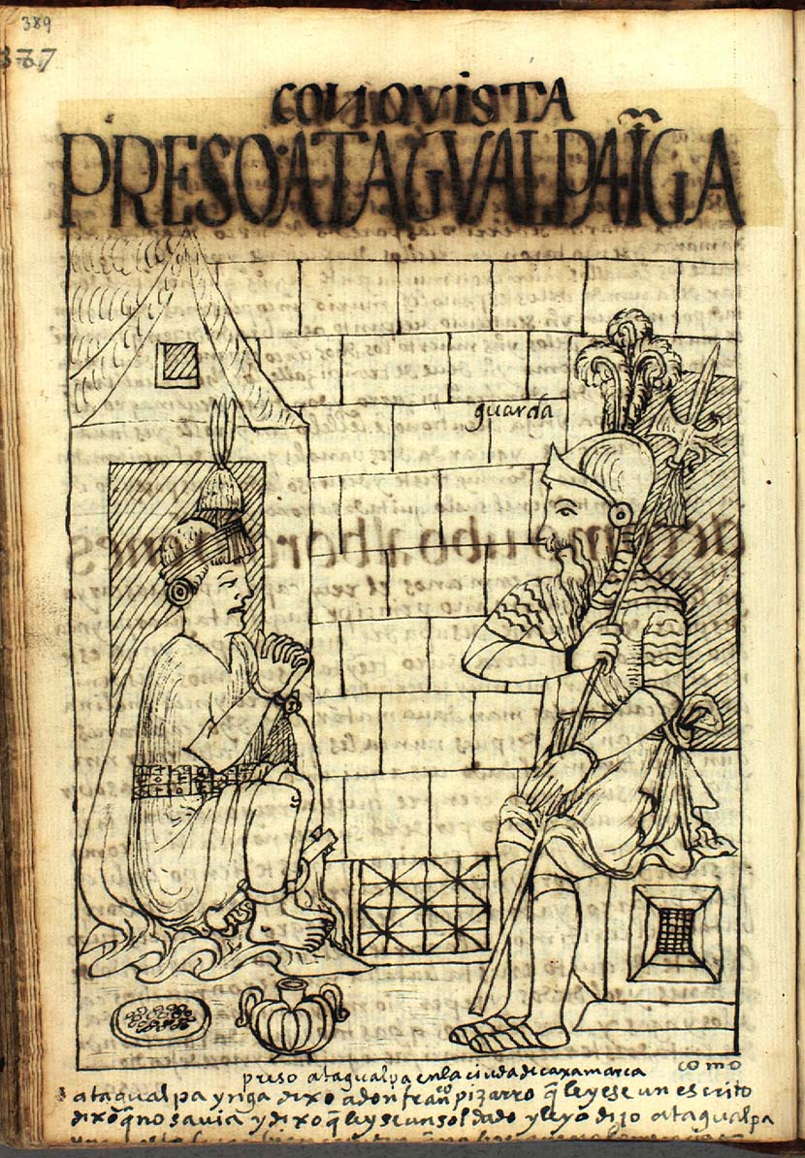
Atahualpa in Prison
From the 17th-century manuscript by the indigenous writer Felipe de Guaman Poma

Slide 39
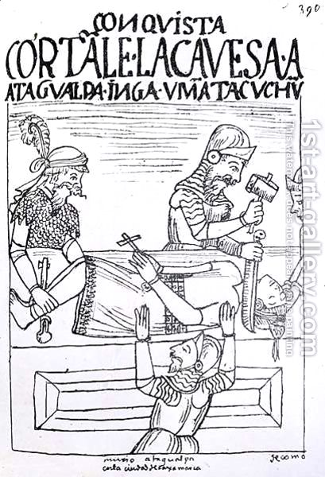
The Execution of Atahualpa
(Atahualpa was in fact garrotted, rather than beheaded.)
From the 17th-century manuscript by the indigenous writer Felipe de Guaman Poma

Slide 40
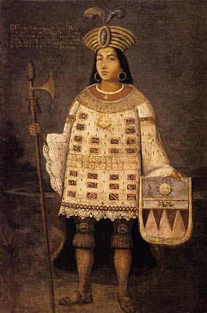
Túpac Amaru
The Last Inca Emperor
An 18th-century imagined portrait of the 16th-century Inca emperor Túpac Amaru

Slide 41
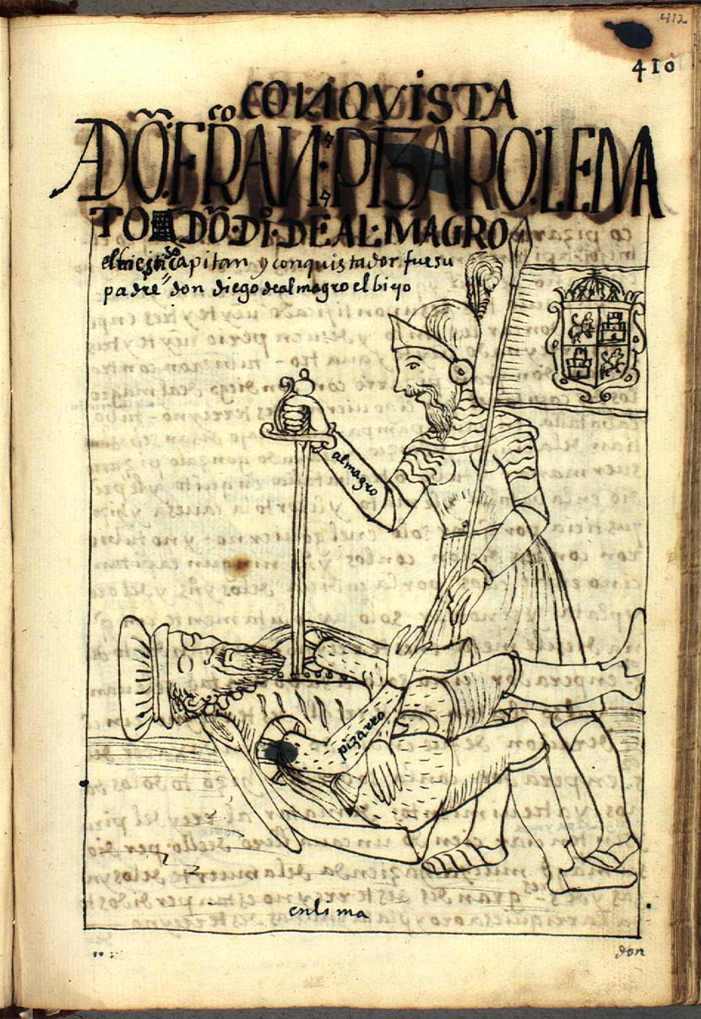
Francisco Pizarro killing Diego de Almagro
From the 17th-century manuscript by the indigenous writer Felipe de Guaman Poma

Slide 42
Indigenous Memories

Slide 43
From the Cantares Mexicanos
(16th century poems by indigenous authors)
Nothing but flowers and songs of sorrow
are left in Mexico and Tlatelolco,
where once we saw warriors and wise men.
We wander here and there
in our desolate poverty.
We are mortal men.
We have seen bloodshed and pain
where once we saw beauty and valour.
We are crushed to the ground:
we lie in ruins.
There is nothing but grief and suffering
in Mexico and Tlatelolco,
where once we saw beauty and valour.
Have you grown weary of your servants?
Are you angry with your servants,
O Giver of Life?

