Slide 1
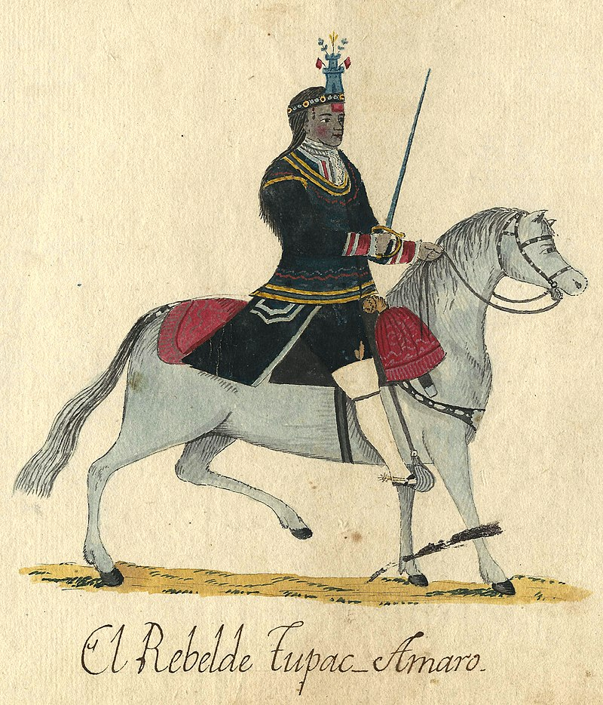
The Eighteenth Century
The Andean Rebellions
What changes were made by the Spanish in their American colonies in the eighteenth century? Why?
How had colonial demographies, economies, and societies changed by the eighteenth century?
Why were there so many riots and rebellions in 18th century Latin America? Were they a sign that Spain and Portugal were losing control of their colonies?
What historical use can scholars make of riots and rebellions? How have they used E.P. Thompson's ideas about "moral economy" to interpret riots in colonial Spanish America?
Watercolor portraying José Gabriel Condorcanqui, alias Túpac Amaru, anonymous c. 1784-1806

Slide 2
Terence Renaud on E. P. Thompson’s Moral Economy
In 1971 the British Marxist historian E. P. Thompson published an article in Past & Present called “The Moral Economy of the English Crowd in the Eighteenth Century,” in which he argued that the current understanding of the term “riot” as a spasmodic outbreak of irrational sentiments among the masses was a gross misunderstanding of what actually goes on during a riot. Taking the pre-industrial food riots of the 17th and 18th centuries as his example, Thompson showed that the motivations and conduct of the rioters could be reduced neither to economic despair (i.e. starvation) nor to spontaneous irrationality. Rioters actually demonstrated a high degree of organization, discipline, and restraint. They may not have planned in advance their protests against millers and farmers whom they suspected of withholding grain, but they did act according to certain rules of conduct and to a particular “moral economy” that dated back centuries. The popular consensus was that bread prices should be kept at a reasonable level with respect to the subsistence of the population and that if they got too high, then the people have a right to set them back to normal, by violent means if necessary. Involved in the food riots of early modern England was therefore a moral understanding about prices and consumption that had not yet been replaced by the free market ethos of Smithian political economy. Even in the 19th century, when industrialization changed forever the social composition of England, the old moral economy of the poor survived in various guises, not least of which was the organized labor movement. The point is that riots are complex events that draw on both new and traditional fears, hopes, and demands for justice that sometimes run contrary to the moral assumptions of the state and ruling classes.
https://terencerenaud.com/2011/08/12/the-moral-economy-of-the-english-crowd-in-the-twenty-first-century/

Slide 3
Primary Source
Areche, José Antonio de, “All Must Die,” 1781, in The Peru Reader: History, Culture, Politics, eds. Orin Starn, Carlos Iván Degregori and Robin Kirk, Duke University Press (Durham, 1995), pp. 157-161.
https://ebookcentral.proquest.com/lib/warw/reader.action?docID=1168454&ppg=172
In pairs or small groups read half the text each )e.g. 1. From the beginning to “family members.” p.158 2. From “To this same end” p.158 to the end).
What does the source tell us about the Bourbon Reforms, the Andean Rebellions and late-eighteenth century Latin America? What does it not tell us? Where else might you look to further your research.

