Slide 1
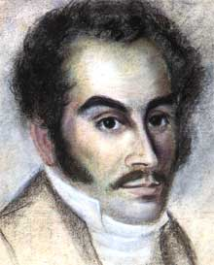
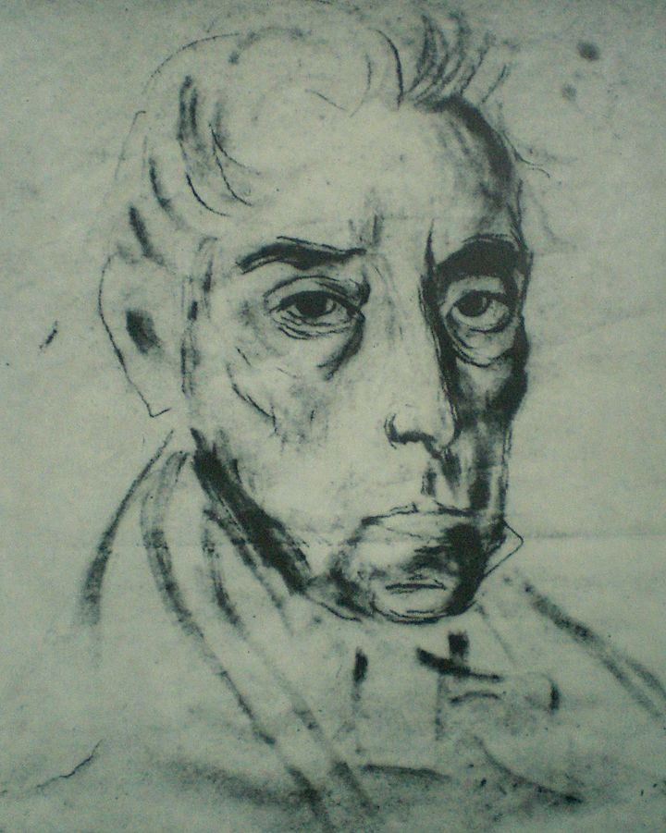
portrait of Simón Bolívar around the time of his death, by José María Espinosa, 1830
Independence in the Americas
Simón Bolívar around 1815

Slide 2
Version 1
Buildup of anti-Spanish feeling (late 18th century) . . .

Slide 3
Version 1
Buildup of anti-Spanish feeling (late 18th century) . . .
leads to anti-Spanish independence movements in 1810

Slide 4
version 1
the significance of the Enlightenment:
--circulation of ideas and discourses across the Atlantic (republicanism, natural laws, citizenship)
--emergence of new identities (creole patriotism)

Slide 5
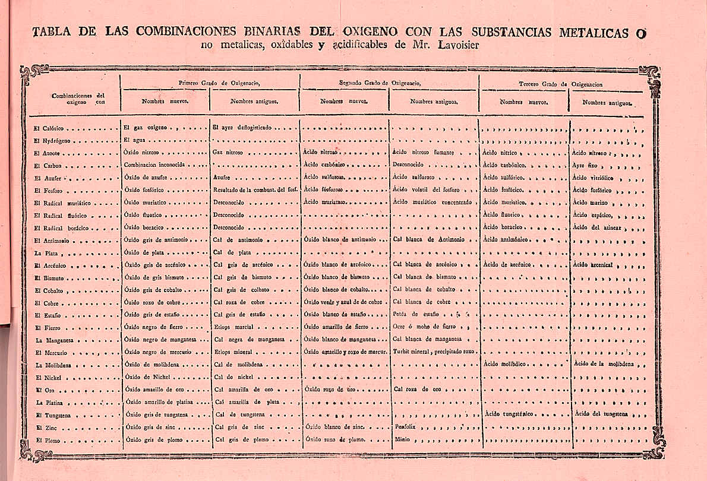
The circulation of ideas in the 18th century Atlantic world: an example The Mercurio Peruano republished Lavoisier’s system of binomial nomenclature (1791)

Slide 6
version 1
Bourbon reforms eroded the ‘colonial pact’ and led to widespread dissatisfaction with Spanish rule
proto-nationalism
leading to a breakdown in colonial hegemony and the start of the wars of independence

Slide 7
version 2
Napoleonic wars, and especially Napoleon’s invasion of the Iberian Peninsula in 1808. . .

Slide 8
version 2
Napoleonic wars, and especially Napoleon’s invasion of the Iberian Peninsula in 1807 . . .
led to breakdown in political consensus in the Hispanic world

Slide 9
One version stresses the antecedents to the actual outbreak of independence.
The other stresses the contingent, conjunctural nature of the collapse of colonial rule.

Slide 10
Start with the contingent, conjunctural events—
crisis in the Hispanic world:

Slide 11
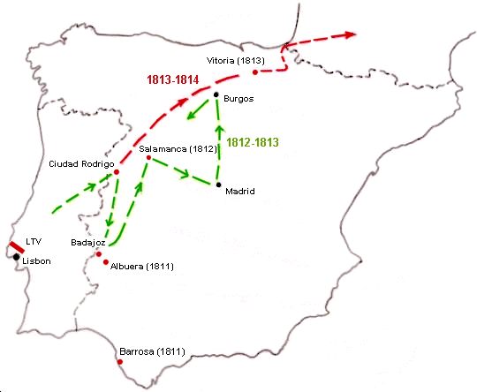
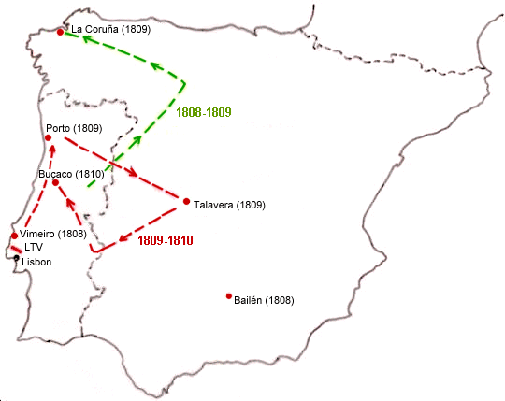
Crisis in the Iberian world
1807: Napoleonic troops invaded the Iberian peninsula, leading to the Peninsular War (1808-14)

Slide 12
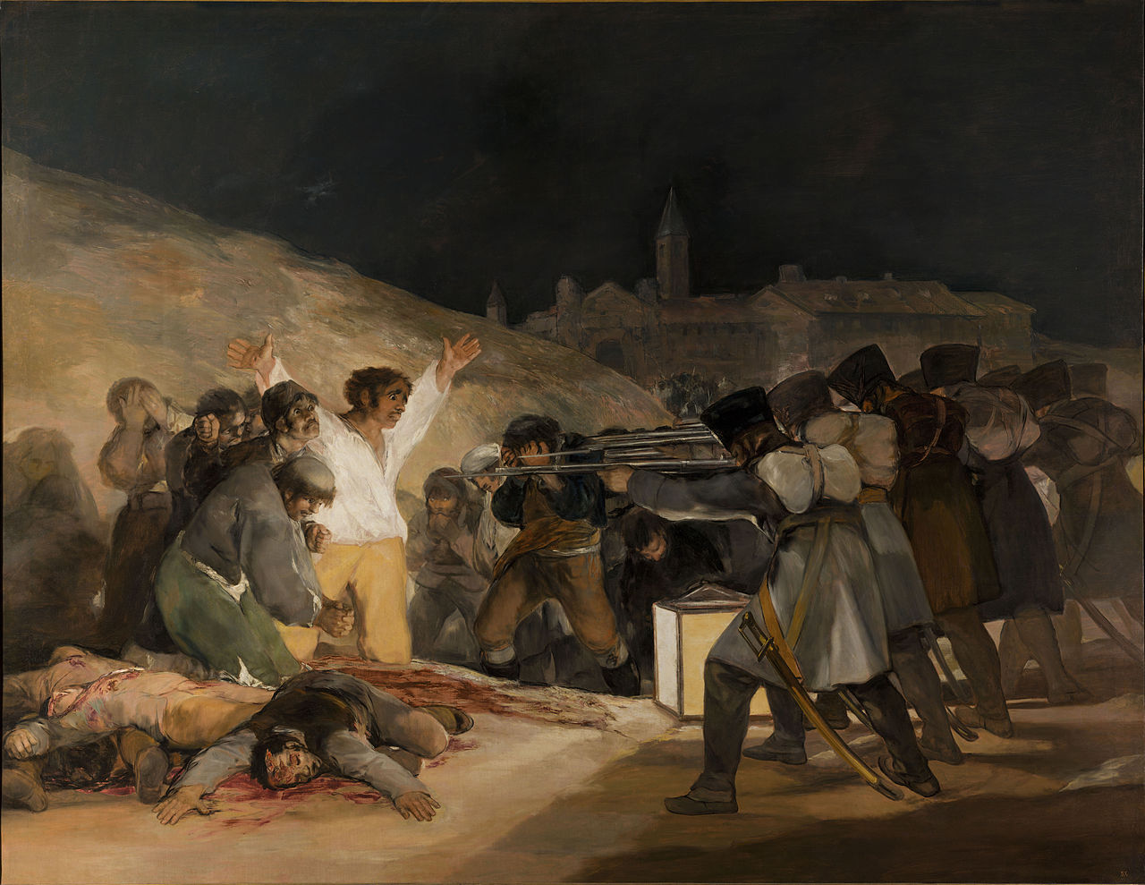
Francisco Goya, The Third of May, 1808 (1814)

Slide 13
Crisis in the Iberian world
Two consequences:
1.
In 1807 the Portuguese royal family fled to safety in Brazil.
Portugal was governed from Brazil until the defeat of Napoleon.

Slide 14
Crisis in the Iberian world
2.
Breakdown in colonial authority in Spanish America

Slide 15
‘Crisis of authority’ in the Americas.
As news that in 1808 French forces had captured the entire Spanish royal family reached the Americas, different colonial administrations reacted differently:
--Some cities set up ‘juntas’ (local governing bodies) to govern until the return of the ‘legitimate’ Bourbon monarchs.

Slide 16
‘Crisis of authority’ in the Americas
--in other regions colonial authorities maintained control and condemned the juntas as illegitimate.
Conflict quickly broke out between these different groups.

Slide 17
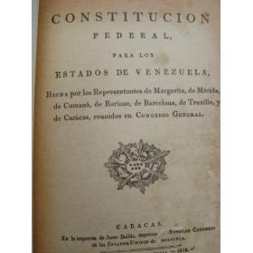
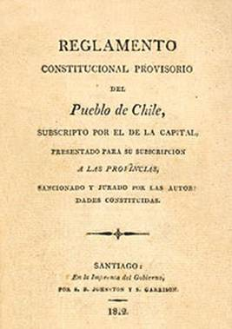
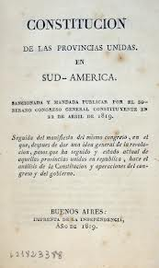
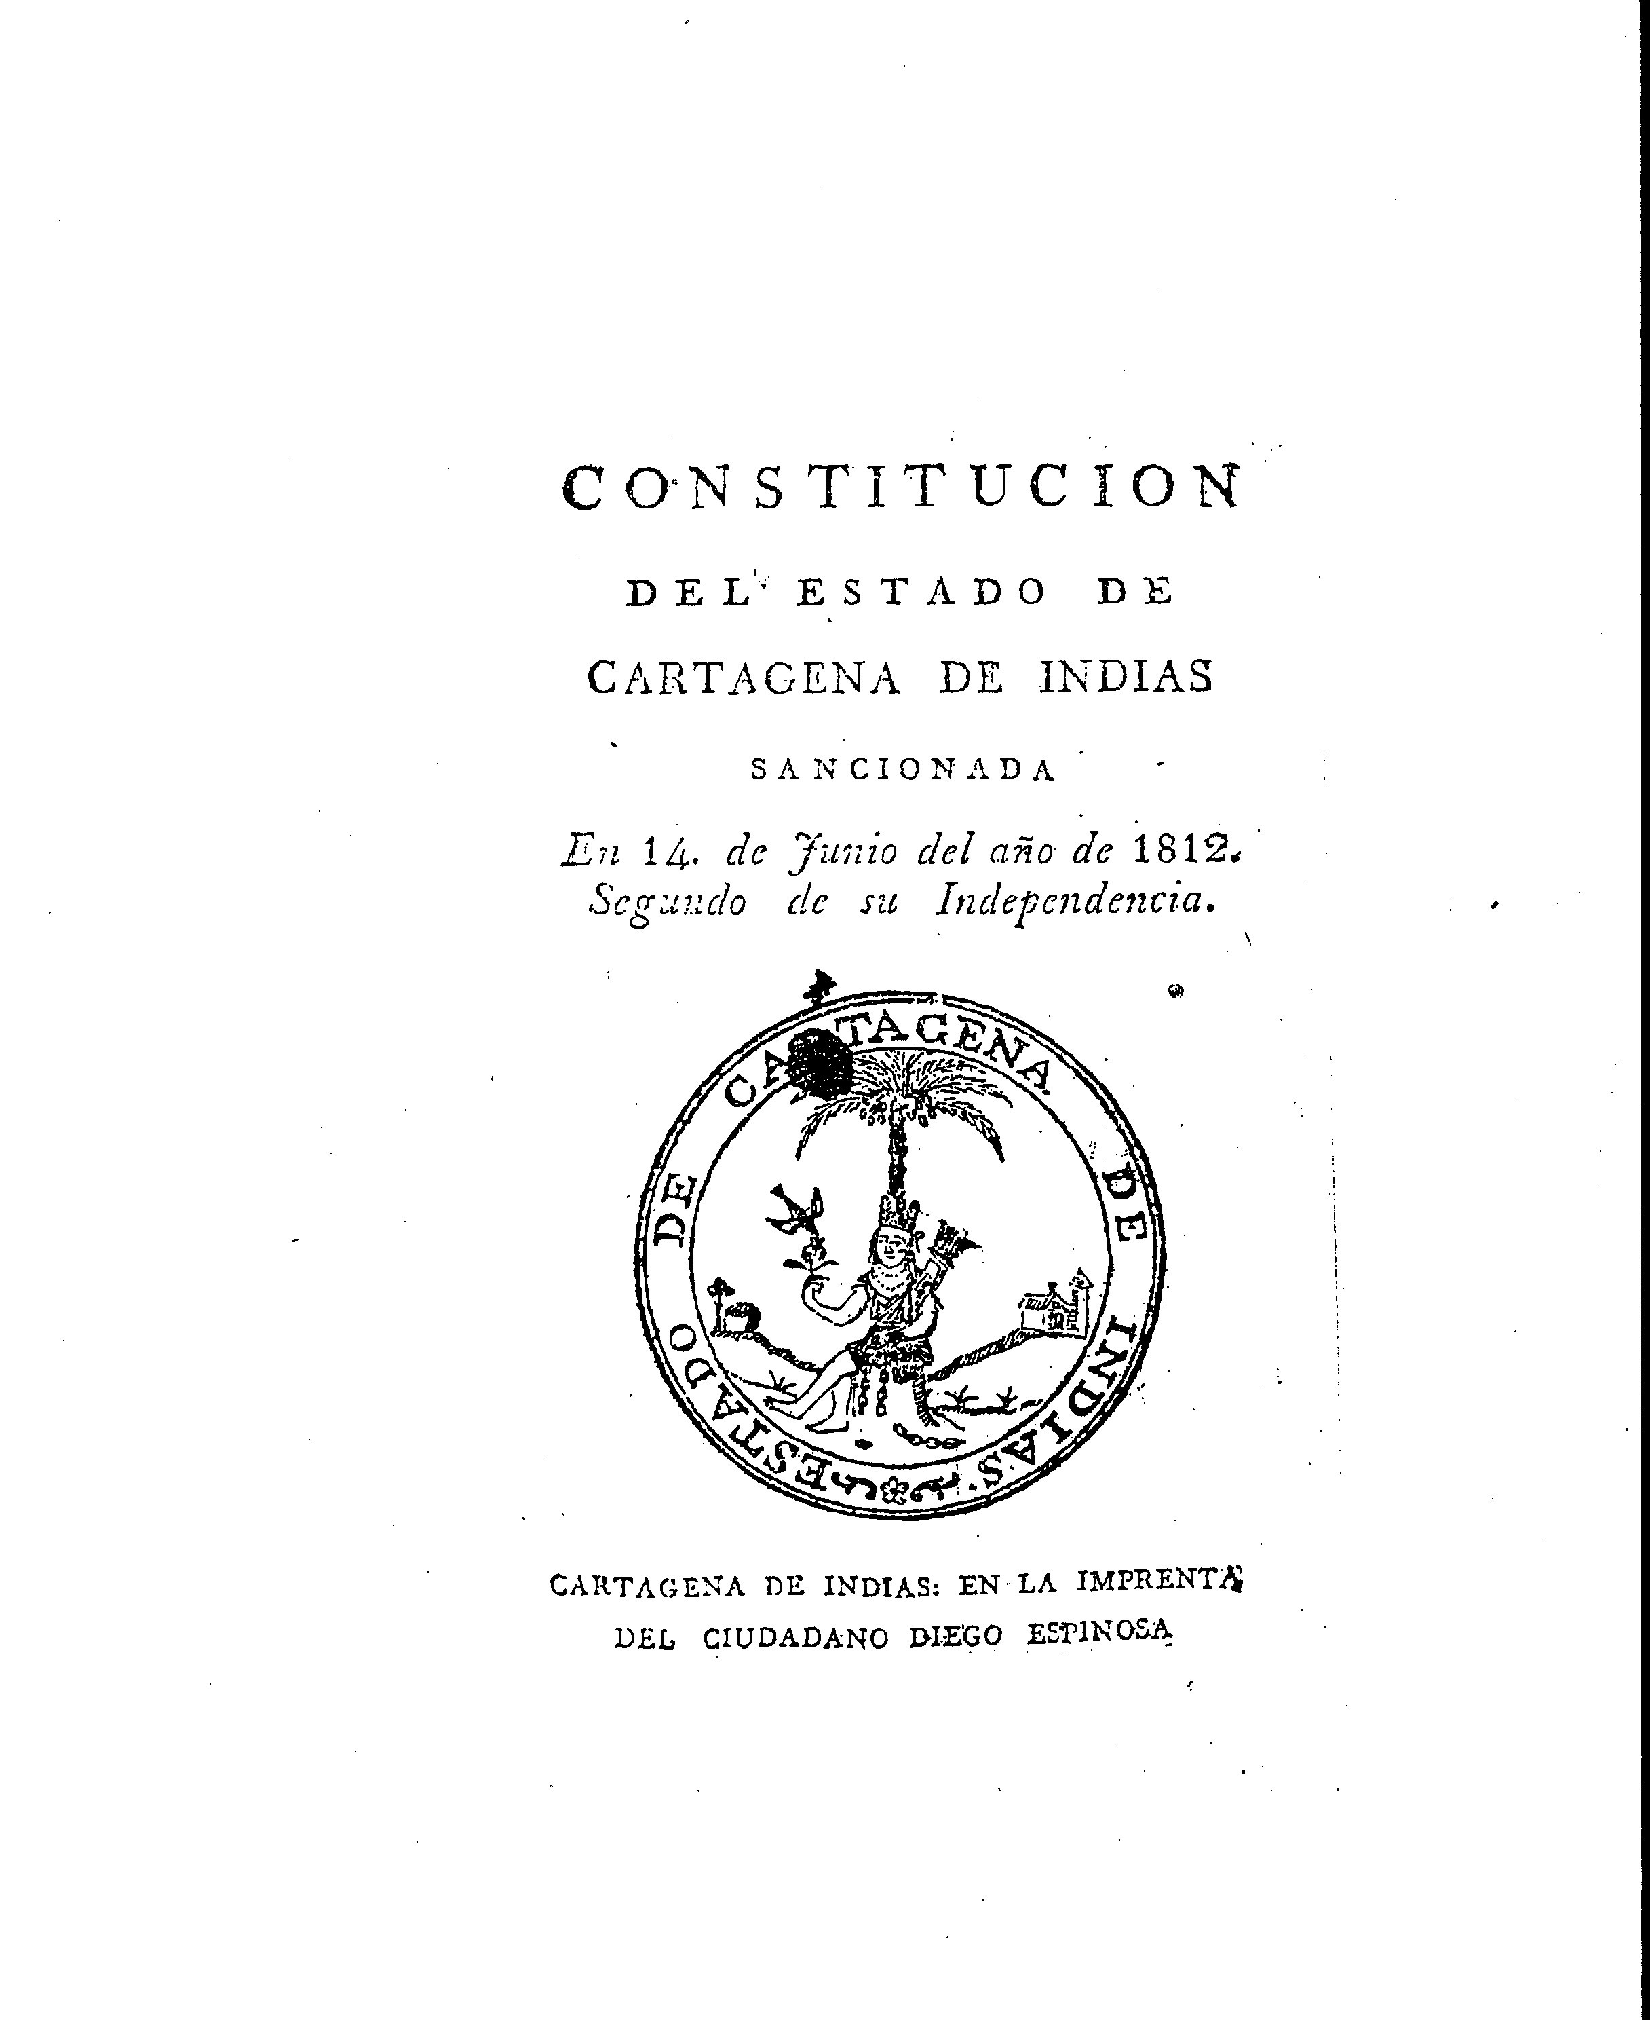
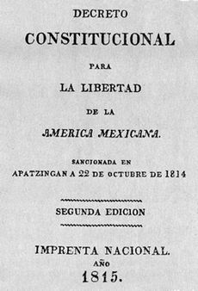
‘Crisis of authority’ in the Americas.
By 1812 many regions had declared outright independence from Spain.

Slide 18
‘Crisis of authority’ in the Americas.
The period from 1810 to 1815 was characterised by outright civil war between loyalists and insurgents.

Slide 19
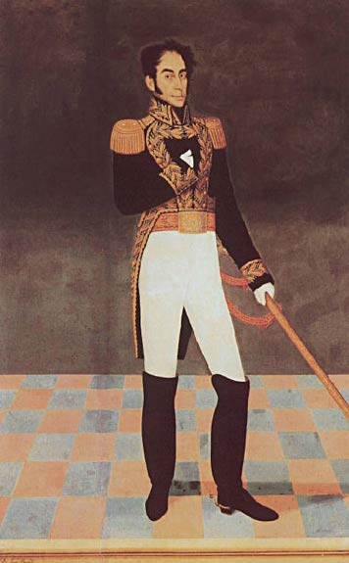
Simón Bolívar, a wealthy creole from Venezuela, led insurgent forces in northern South America.
José Gil de Castro, portrait of Simón Bolívar

Slide 20
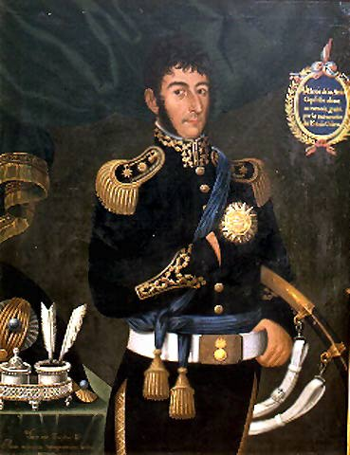
José de San Martín, a professional solider, led the insurgent campaign in southern South America
José Gil de Castro, Portrait of José de San Martín (1818)

Slide 21
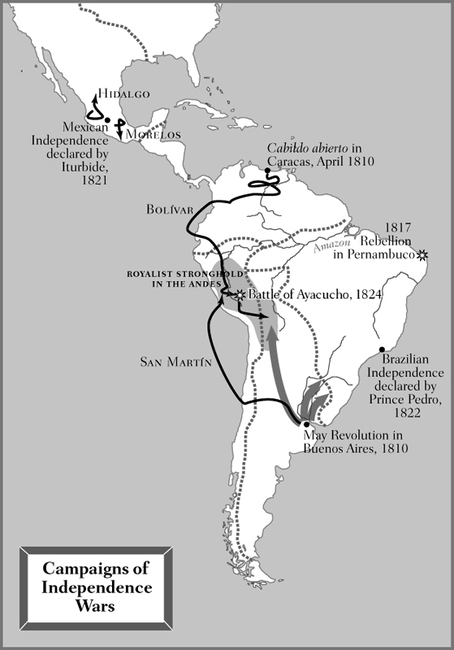

Slide 22
Spanish South America
Spanish reconquest, 1815-1821
ultimate military victory by insurgent forces
‘last’ battle: Battle of Ayacucho (1824)

Slide 23
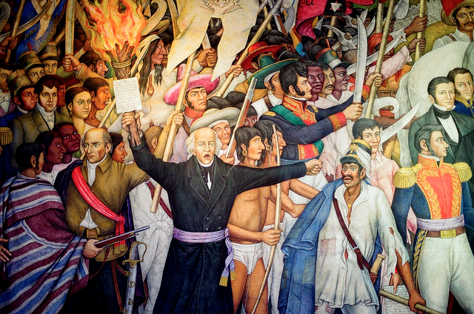
Mexico
Miguel Hidalgo, parish priest
‘Grito de Dolores’
(1810)
Juan O’Gorman’s mural of Miguel Hidalgo’s uprising, circa 1960

Slide 24
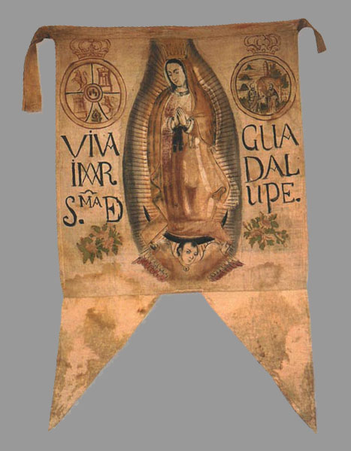
Hidalgo’s flag, showing the Virgin of Guadalupe

Slide 25
Mexico
Hidalgo executed in 1811
Rebellion continued under other leaders such as . . .

Slide 26
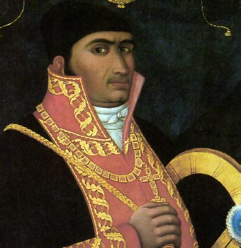
José María Morelos

Slide 27
Mexico
1821 Treaty of Córdoba ends conflict.
Agustín de Iturbide, former royalist officer turned insurgent, became emperor of a newly independent Mexico.

Slide 28
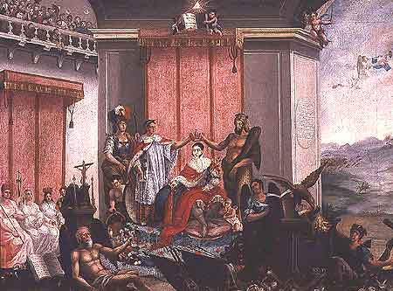
Coronation of Iturbide as Agustín I of Mexico (1822)

Slide 29
Brazil
Royal family resided in Rio de Janeiro until the defeat of Napoleon.
Anti-Napoleonic forces that remained loyal of the House of Braganza then asked the royal family to return to Portugal.
All returned aside from the crown prince Pedro.

Slide 30
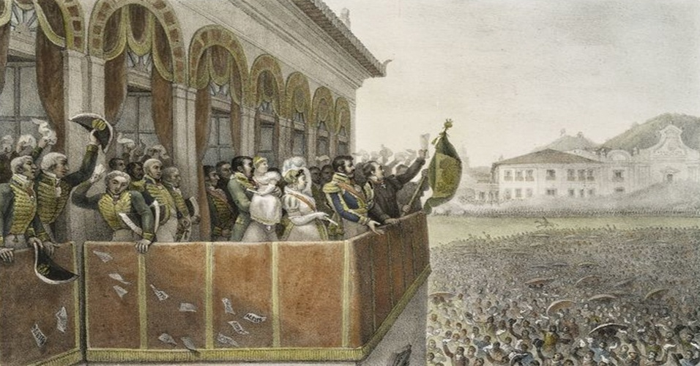
The ‘Fico’ (1822)

Slide 31
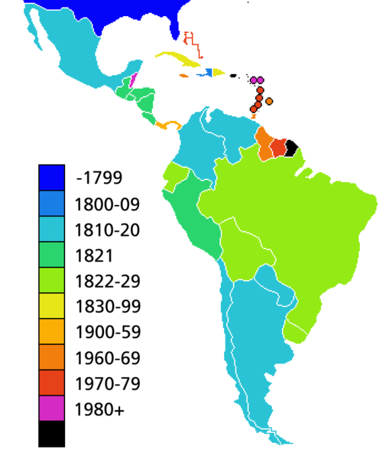
Timing of Political Independence

Slide 32
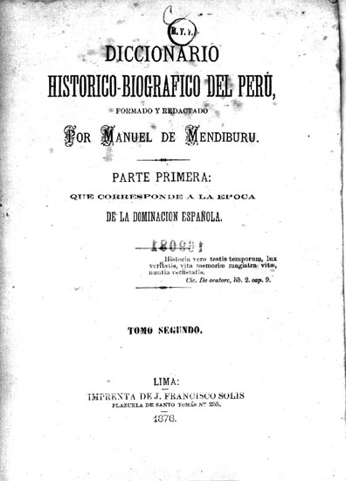
How Have Historians Approached the Wars of Independence?
Nationalist historiographies focused on creating a pantheon of national heroes and founding fathers, producing grand, romantic narratives, and naturalising the nation state as the unit of analysis.
--written from the 1820s onwards
--search for ‘precursors’ and
‘antecedents’

Slide 33
How Have Historians Approached the Wars of Independence?
2. Structural analyses of underlying economic and political forces.
--breakdown of the ‘colonial pact’ through the Bourbon reforms.
--late colonial riots not as precursors but as disputes about the moral economy.
--less focused on the nation; more interested in class
--written particularly from the 1960s onwards

Slide 34
How Have Historians Approached the Wars of Independence?
2. Structural analyses continued
--these works often viewed independence not as a triumph of nationalism or decolonialism but as a crisis in the ancien régime caused by the inability of existing economic models to cope with capitalism or modernity.

Slide 35
How Have Historians Approached the Wars of Independence?
3. Analyses of political culture
--focus on the development of modern political structures such as elections and constitutions, and the rise of a public sphere.
--finds evidence for widespread engagement with these new political practices.
--view Spain and its colonies holistically: all experienced the advent of modernity.

Slide 36
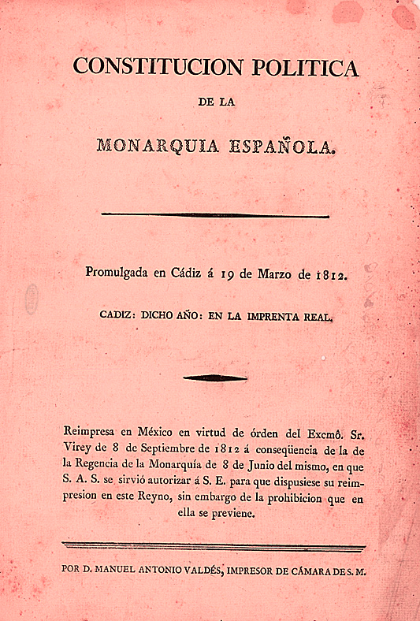
How Have Historians Approached the Wars of Independence?
3. Analyses of political culture continued
--particular emphasis on the rise of electoral democracy during the Peninsular War.
Constitution of Cádiz (1812)

Slide 37
How Have Historians Approached the Wars of Independence?
4. Social histories of independence
--a ‘history from below’ focused on the experiences of non elite groups such as enslaved people or indigenous communities.
--questions whether political independence resulted in significant change to social structures.
--challenges the importance of independence as a watershed (1750-1850)

Slide 38
How Have Historians Approached the Wars of Independence?
current areas of interest:
-- the rise of new political practices such as elections and the extent to which these practices were embraced by non-elites.
--changes in social structures such as those related to gender norms

Slide 39
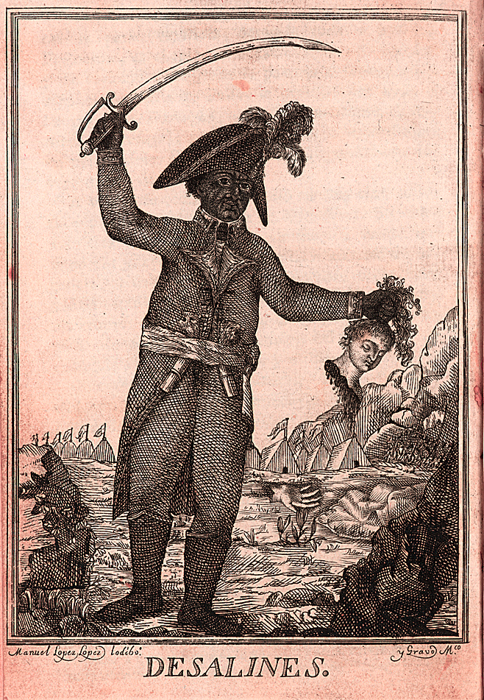
How Have Historians Approached the Wars of Independence?
current areas of interest, continued:
--the importance of the Atlantic context: the US war of independence, the French Revolution and the Haitian Revolution

Slide 40
How Have Historians Approached the Wars of Independence?
current areas of interest, continued:
--legacies, commemorations, resonances

Slide 41
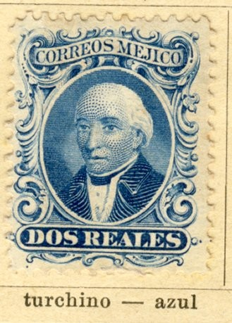
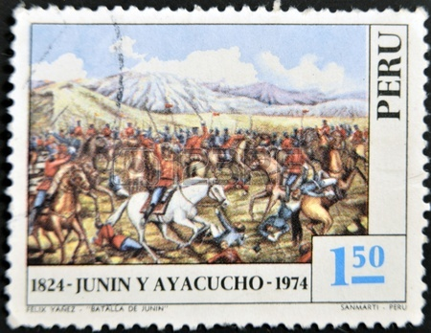
State commemoration: 1865 Mexican Hidalgo stamp and 1974 Peruvian Junín and Ayacucho stamp

Slide 42
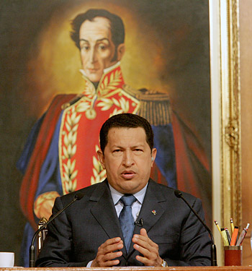
political appropriation: Venezuelan president Hugo Chávez in front of a portrait of Simón Bolívar

Slide 43

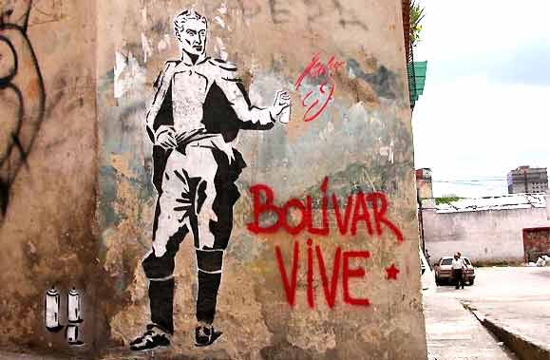
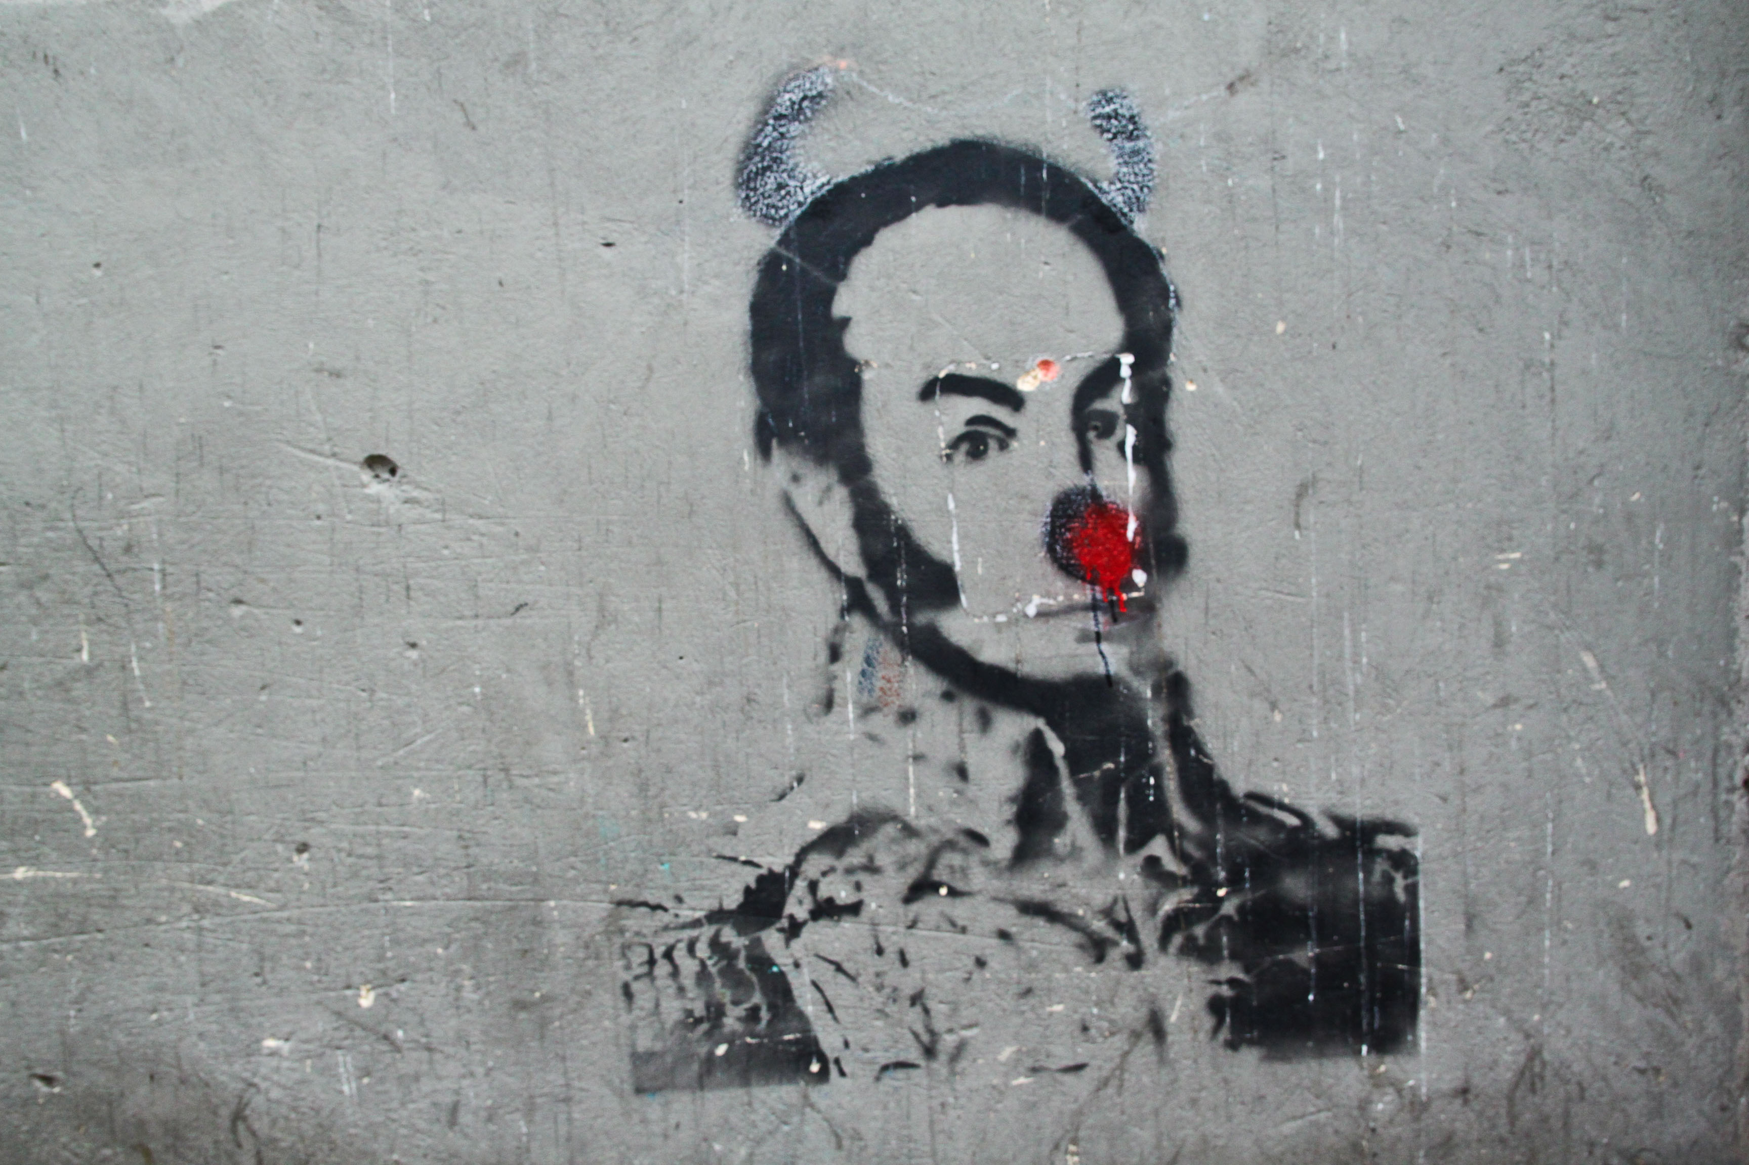
popular memories—or political appropriation?
graffitis in Bogotá (Colombia)
graffiti in Caracas (Venzuela)

Slide 44
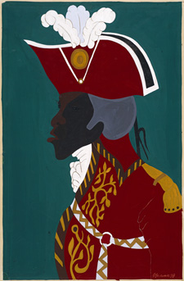
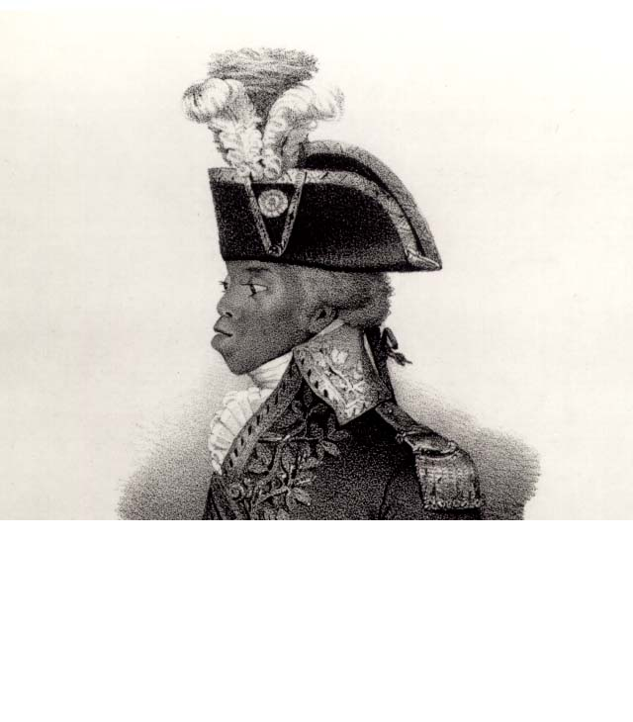
Popular memories: Toussaint L’Ouverture
Nicolas-Eustache Maurin lithograph of Toussaint L’Ouverture, early 19th century
Jacob Lawrence, from the Toussaint L’Ouverture Series, 1936-38

