Slide 1
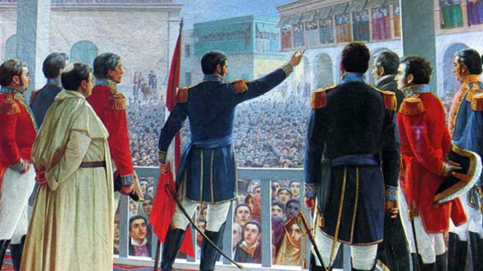
Independence in the Americas
Seminar
Proclamation of the Independence of Peru (1821), by Juan Lepiani

Slide 2
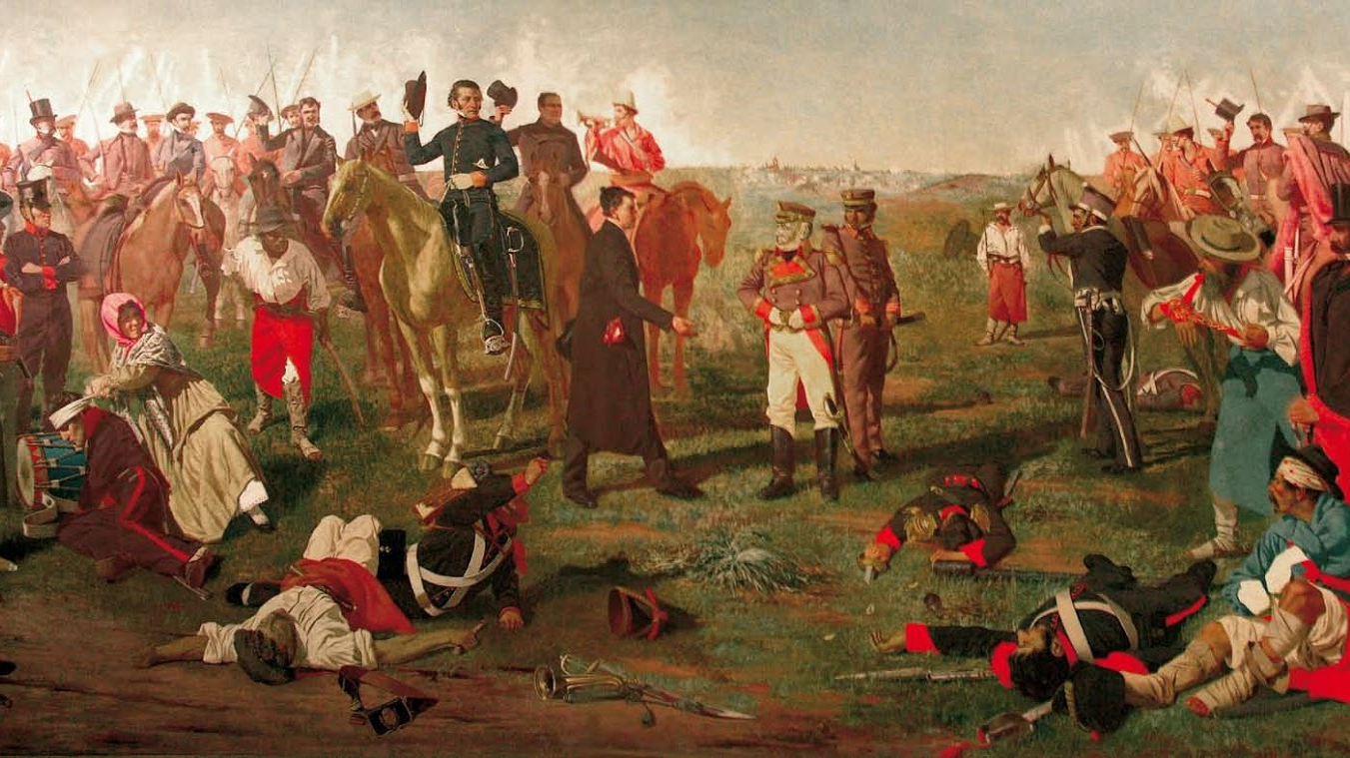
Seminar Questions
What did Simón Bolívar identify as the causes of the wars of independence?
What was the an 'age of Atlantic revolutions' and what impact did it have in Latin America?
What role did “ordinary people” play in these revolutions? Were they revolutions from "above" or "below"?
How similar or different was Brazil's process of independence? How much of a role did ordinary people play?
Were the independence movements in Latin America triggered by long-term imperial problems, or shorter-term crises?

Slide 3
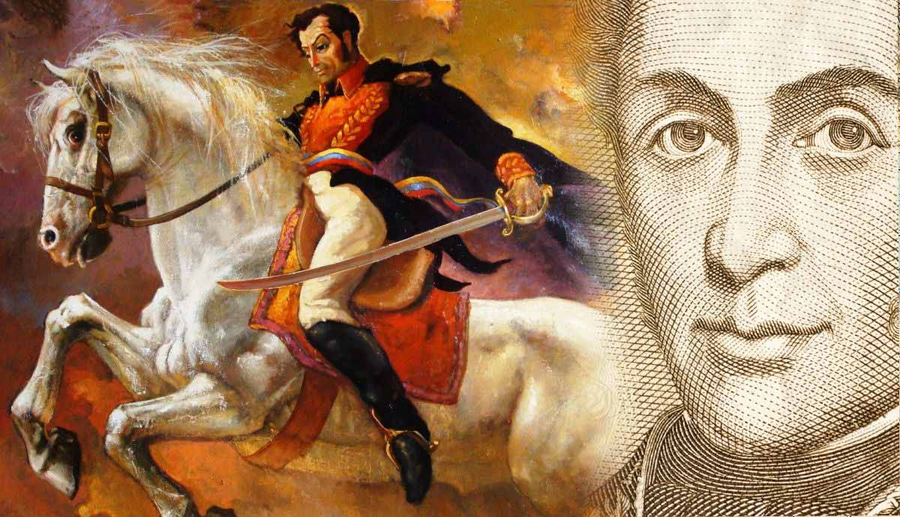
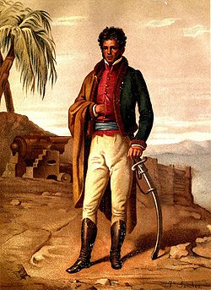
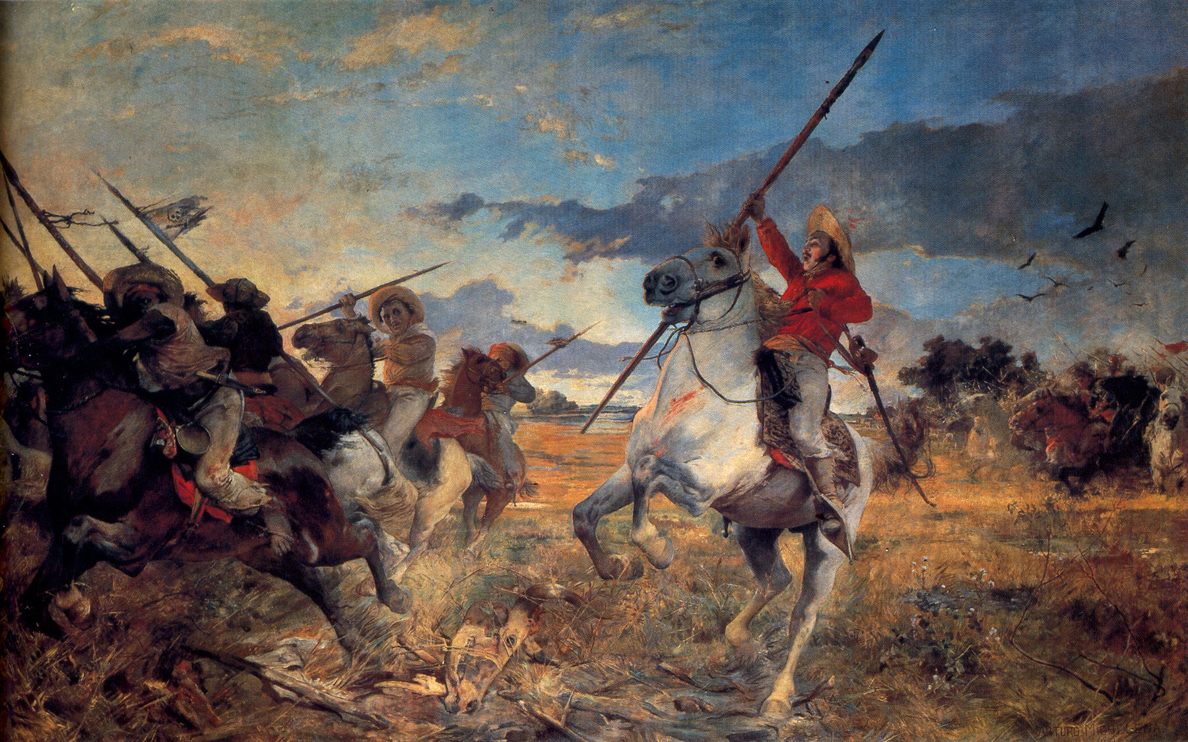

Slide 4
Himno de Riego
https://www.google.com/search?sca_esv=588287231&rlz=1C1GCEJ_enGB863GB863&sxsrf=AM9HkKnnEsGZ8saFqCCkvQgBk0lRMUoLjw:1701846900265&q=himno+de+riego&tbm=vid&source=lnms&sa=X&sqi=2&ved=2ahUKEwj66s7fofqCAxWoWUEAHceZCwQQ0pQJegQIEhAB&biw=1264&bih=627&dpr=1.5#fpstate=ive&vld=cid:2edc62c7,vid:IqarvkV3puI,st:0
Lyrics: Evaristo Fernández de San Miguel, 1820
Composer: José Melchor Gomis
Music: José Melchor Gomis, 1820

Slide 5
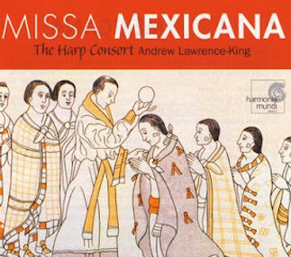
Mexican Villancicos
https://www.youtube.com/watch?v=gbIYS-fxFNE

