Slide 1
BARBADOS

Slide 2
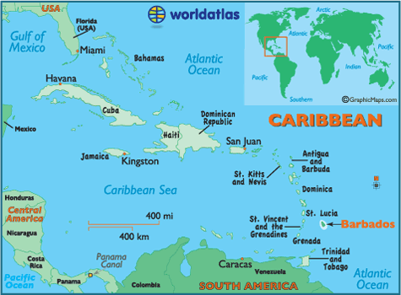
WHERE IS IT ???
Barbados is the easternmost island in the Caribbean, and is part of the lesser Antilles
It is 210 miles north-east of Trinidad and Tobago
Barbados is often referred to as the tear drop island, due to its shape.

Slide 3
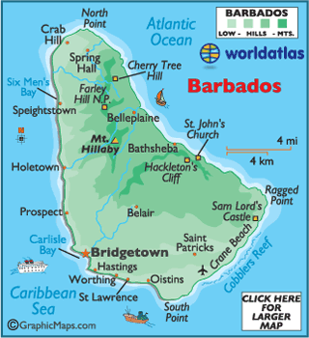
BACKGROUND INFO
The capital city of Barbados is Bridgetown, it is the largest city and is located in the parish of Saint Michael
The official language spoken in Barbados is English, however the local dialect spoken is Bajan creole

Slide 4
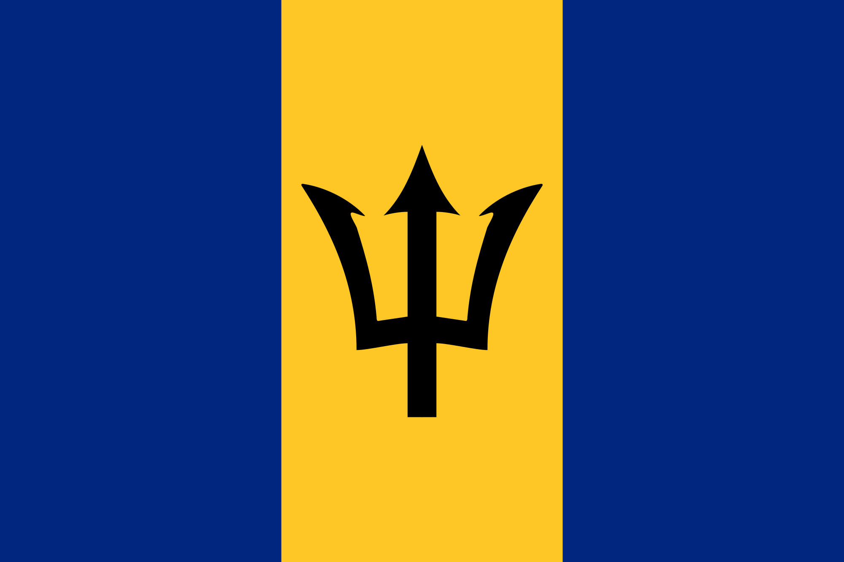
INDEPENDENCE AND STATUS
The Barbados Independence Act 1966 is an act of parliament that granted independence to Barbados from the United Kingdom
The Act provided for the establishment of a new constitution to take effect upon independence
At independence Barbados became a member of the British commonwealth
Independence on November 30th 1966

Slide 5
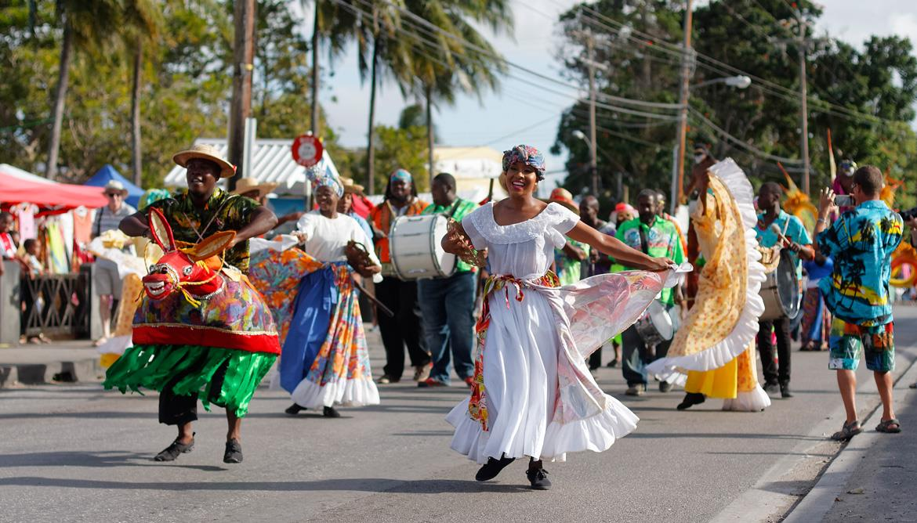
CROPOVER
Crop over is a traditional harvest festival held in Barbados from June until the First Monday in August
Its origins are tied to the slavery era when a celebration was held signalling the end of the yearly sugar cane harvest
The festival has evolved since to incorporate calypso music and street parties
However, traditional elements can be seen in the Tuk band and parade characters
British slave masters in 1600s Barbados passed a law forbidding slaves to beat their drums for fears it would incite a revolt
the Tuk Band provided an “acceptable” musical alternative, as slaves beat their drums to mimic the music of the British fife and drum corps

