Slide 1

Suriname
A presentation

Slide 2
GeographY
Suriname is bordered by Guyana and French Guiana
It is technically in south America (geographically)
Smallest country in South America (size and population)
The capital city is Paramaribo
tHE OFFICIAL LANGUAGE IS Dutch (9 recognized languages)

Slide 3
constitutional status
Previously colonised by the Dutch
Currently a Presidential Republic
Gained Independence from the Netherlands in 1975
Became a Presidential republic on September 30 1987

Slide 4
Population
27% Indian (Hindustani)
22% Maroon
16% creole
14% Javanese
14% Mixed
4% Indigenous Amerindian
2% Chinese
1% European

Slide 5
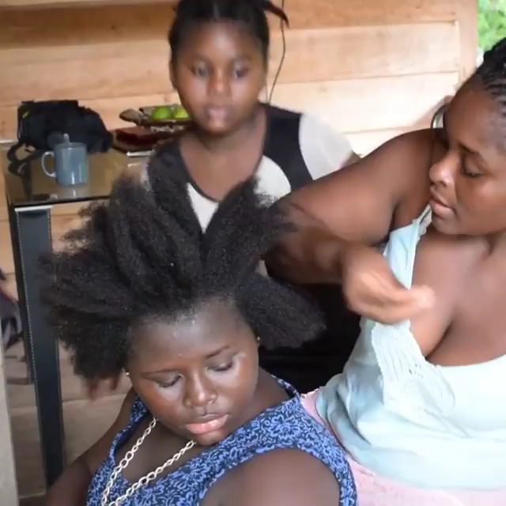
Hairstyle continued by the maroons from their west African ancestors

