Slide 1
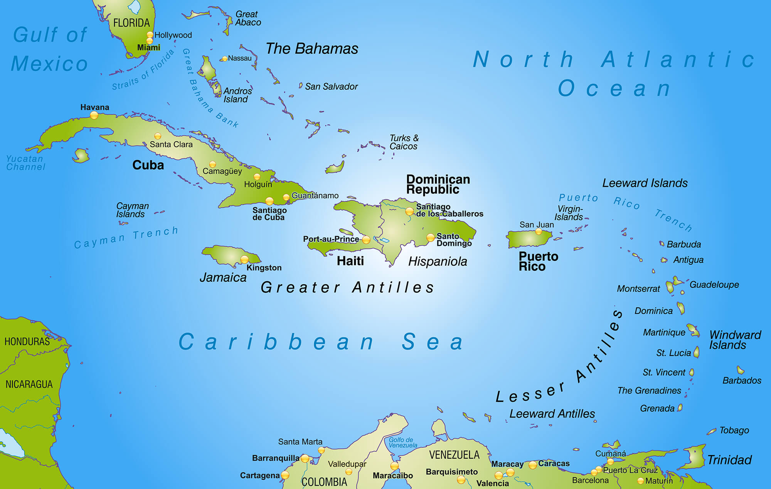
Cuba

Slide 2
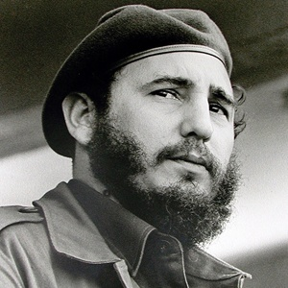
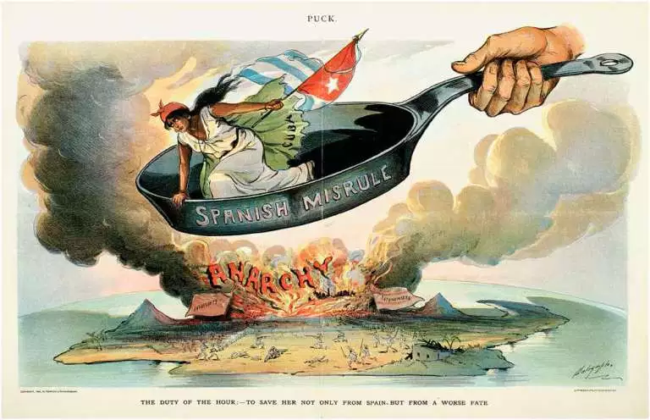
Key facts
Official language: Spanish
Year Cuba becomes a Republic: 1902
Fidel Castro
Year Cuba becomes a Communist State: 1959
‘Out of the Frying Pan’ by Louis Dalrymple, 1898

Slide 3
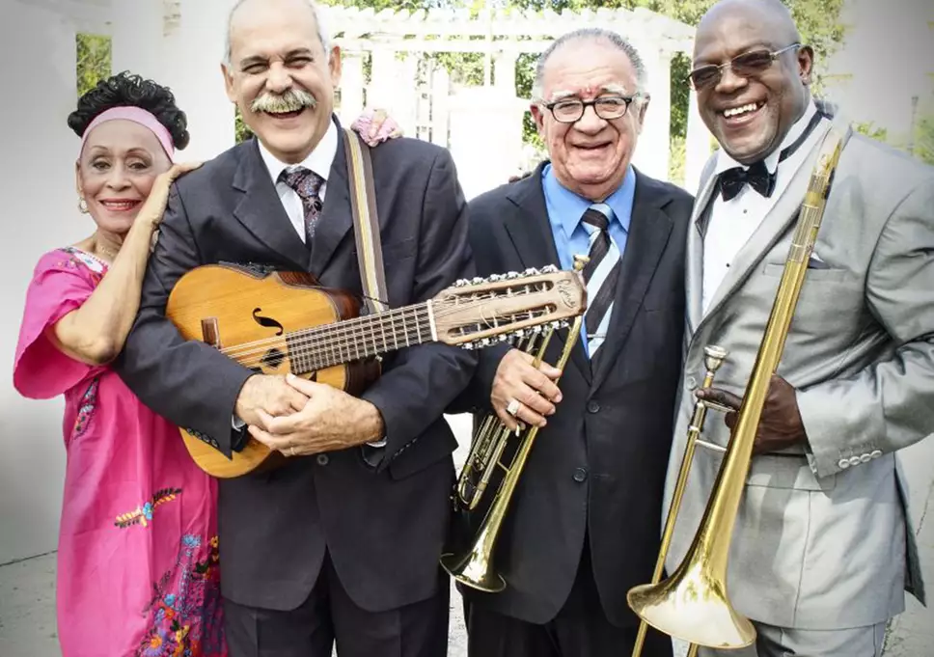
My interesting fact
The musical genre ‘Son Cubano’
The Buena Vista Social Club

