Slide 1
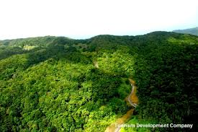
TOBAGO
.

Slide 2
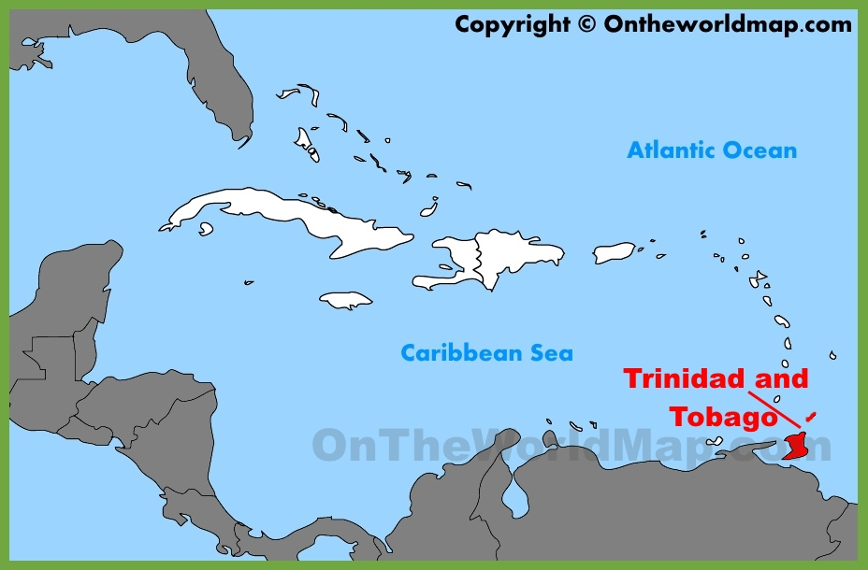
Tobago
35 km northeast of Trinidad, 160km off Venezuela
Present day capital is Scarborough, which is also its largest city
Official language is English, though Tobagonian Creole is also spoken (different to Trinidadian creole- closer links to West African dialect)
Trinidad and Tobago became independent in 1962, and a republic in 1976

Slide 3
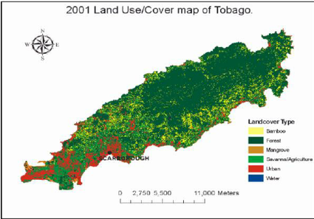
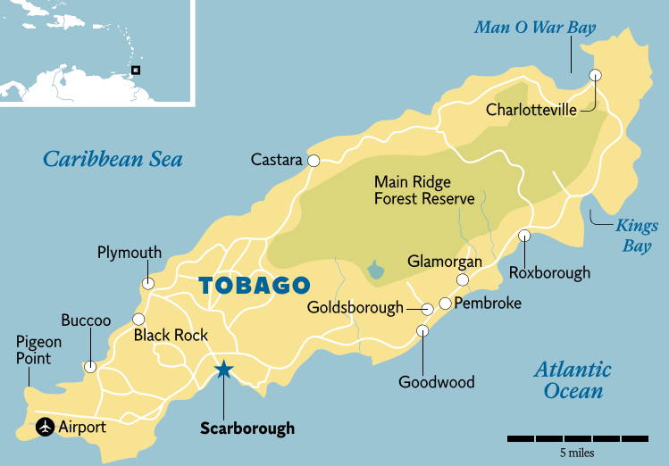
Nature & Wildlife
Tobago has the oldest protected rainforest in the Western hemisphere. In 1776, the Tobago Main Ridge Forest Reserve was made a protected crown reserve. The Main Ridge cuts across two thirds of the land and acts as a backbone for the island. It provides a habitat for a considerable number of animals, including 200 species of birds, 12 species of mammals and 36 species of snakes and lizards. Covering 3958 hectares, the reserve covers a huge part of Tobago.

