Slide 1
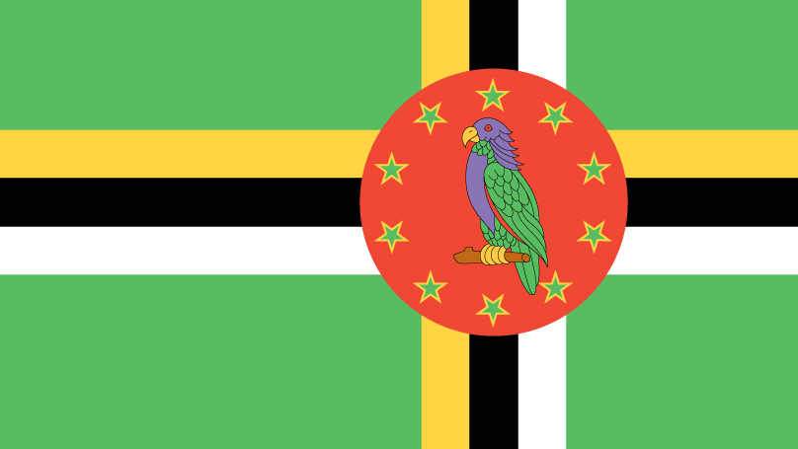
Dominica
Michael Candy

Slide 2
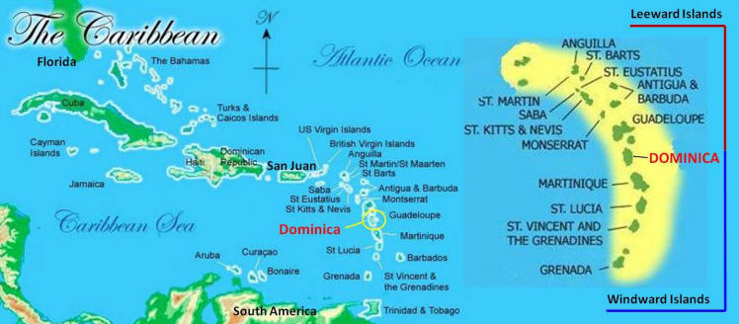
Capital: Roseau
Official language: English
Year of Independence: 1978

Slide 3

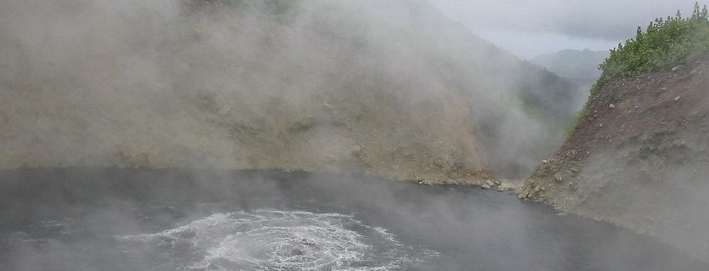
Facts!
The name is derived from the Latin word for Sunday because Columbus found the island on a Sunday
World’s second largest hot spring, Boiling Lake
61 % population is Roman Catholic

