Slide 1
Guyana

Slide 2
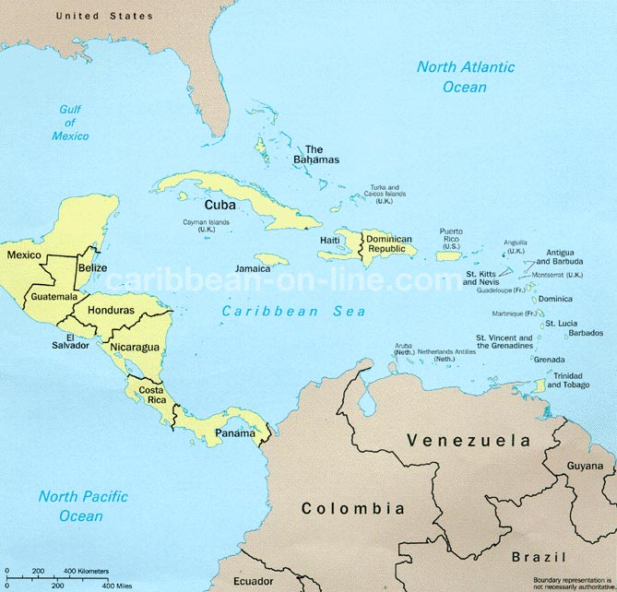

Slide 3
Key facts
Full name: Co-operative Republic of Guyana
Capital: Georgetown
Official language: English – regarded as part of the Caribbean due to its close ties with the Anglophone islands in the region. Guyanese Creole spoken commonly.
Population: 747,884 (2012 census)
Sovereign state but member of the Commonwealth – unitary presidential constitutional socialist republic.

Slide 4
Fun facts
Member of CARICOM with the headquarters of the organisation situated in the capital.
Largest ethnic group: Indian (39.8%)
Largest religion: Christianity (63%)
Gained independence in 1966.
Education compulsory up to the age of 15 meaning nearly total literacy among the population.

