Slide 1
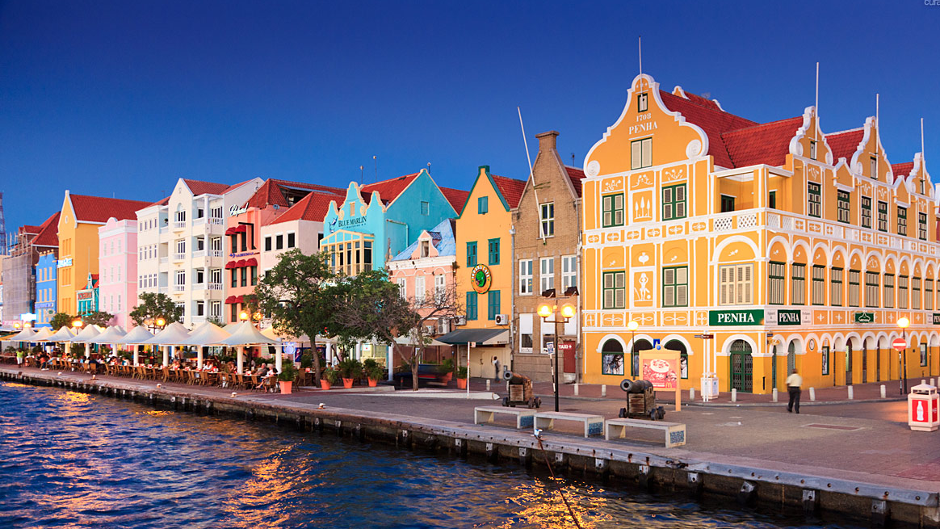
Curaçao
“With its delightful Dutch colonial architecture, bustling commercial capital and excellent history museums, go-go Curaçao feels like a little piece of Europe on the edge of the Caribbean.” – Lonely Planet website Feb 2019

Slide 2
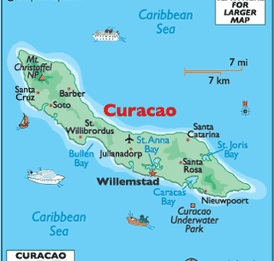
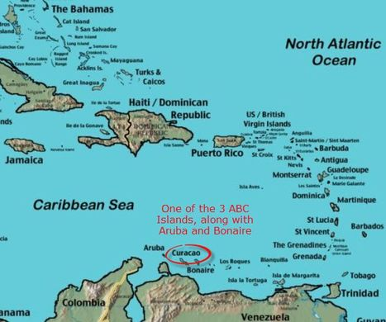
Capital: Willemstad
Official Language: Dutch, majority speak Papiamentu and English
Constitutional Status: since 2010 constituent country of the Kingdom of the Netherlands. Head of state is the Dutch monarch, who is represented by the governor of Curaçao. The head of the government is an elected PM.

Slide 3
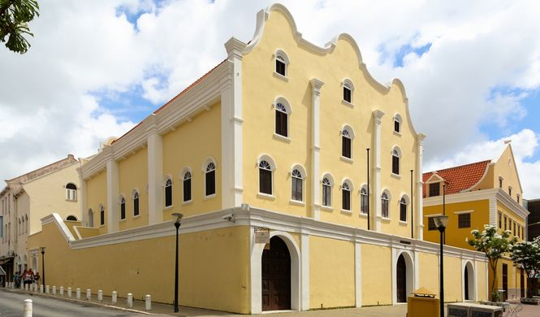
The Spanish deported the entire indigenous population as slaves to Hispaniola in 1515.
Curaçao is the home of the oldest continuously inhabited Jewish community in the Western Hemisphere, originally formed by Sephardic Jews from Amsterdam, who had immigrated from Portugal in the 1500s.
The first Jew to arrive was Samuel Cohen in 1634 who was an interpreter on a Dutch ship.
Synagogue: Congregation Mikvé Israel-Emanuel, oldest Synagogue in continuous use in the Americas

