Slide 1
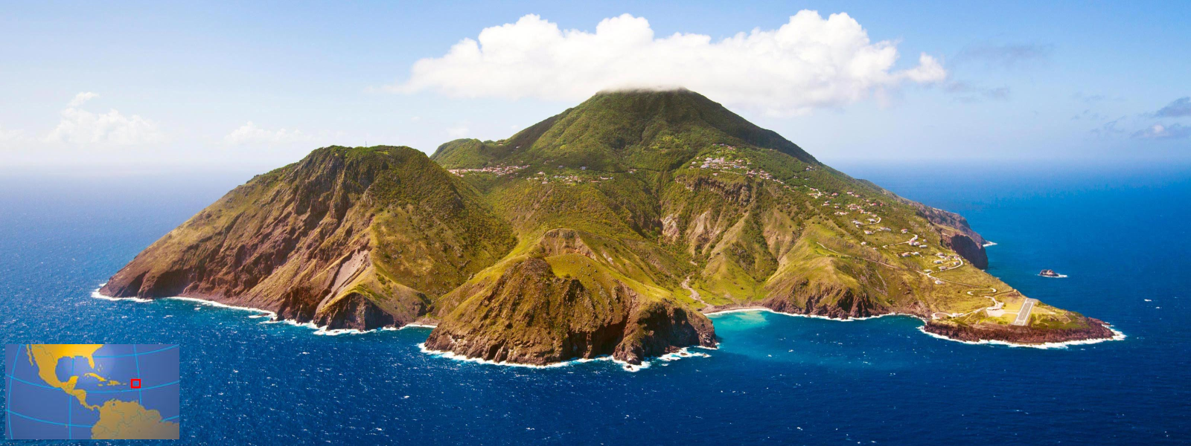
Saba

Slide 2
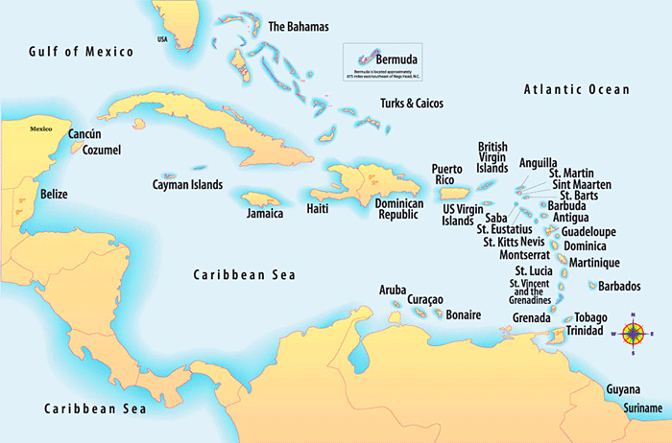

Slide 3
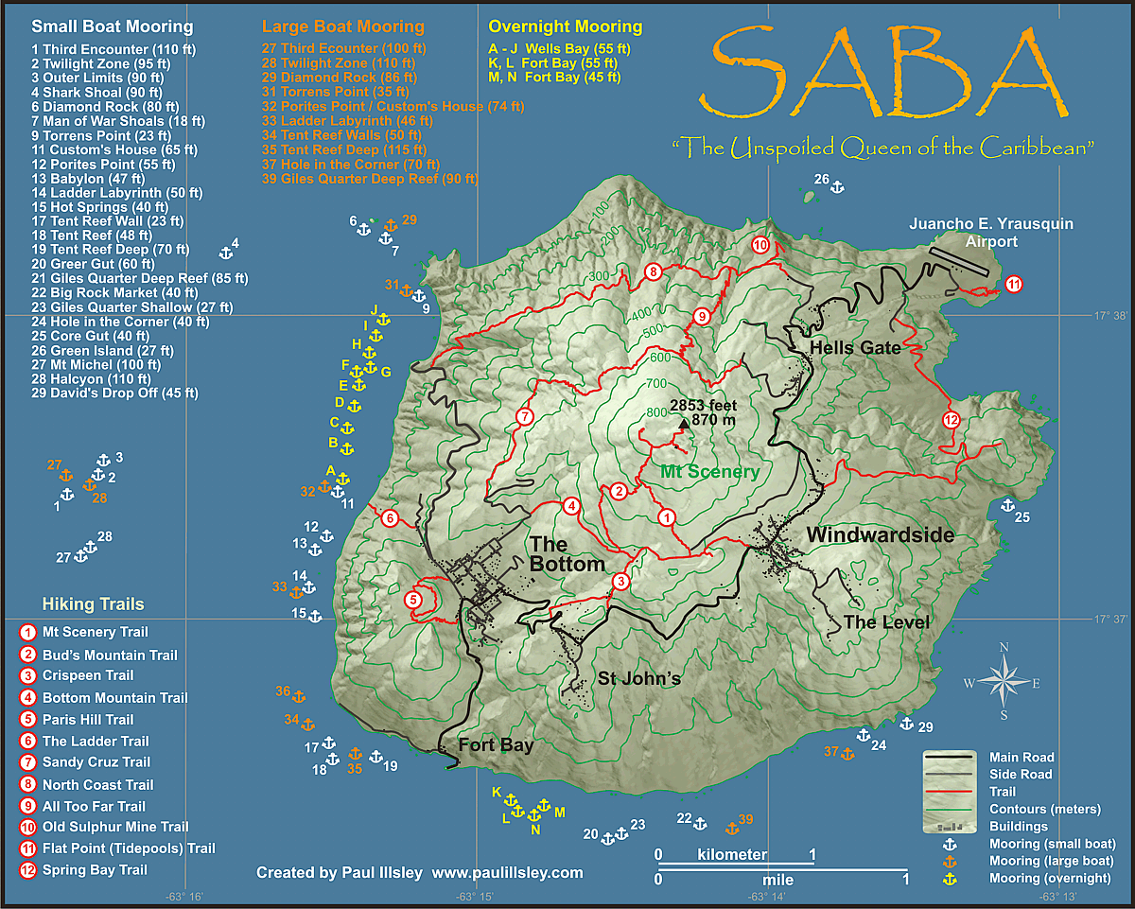
Location

Slide 4
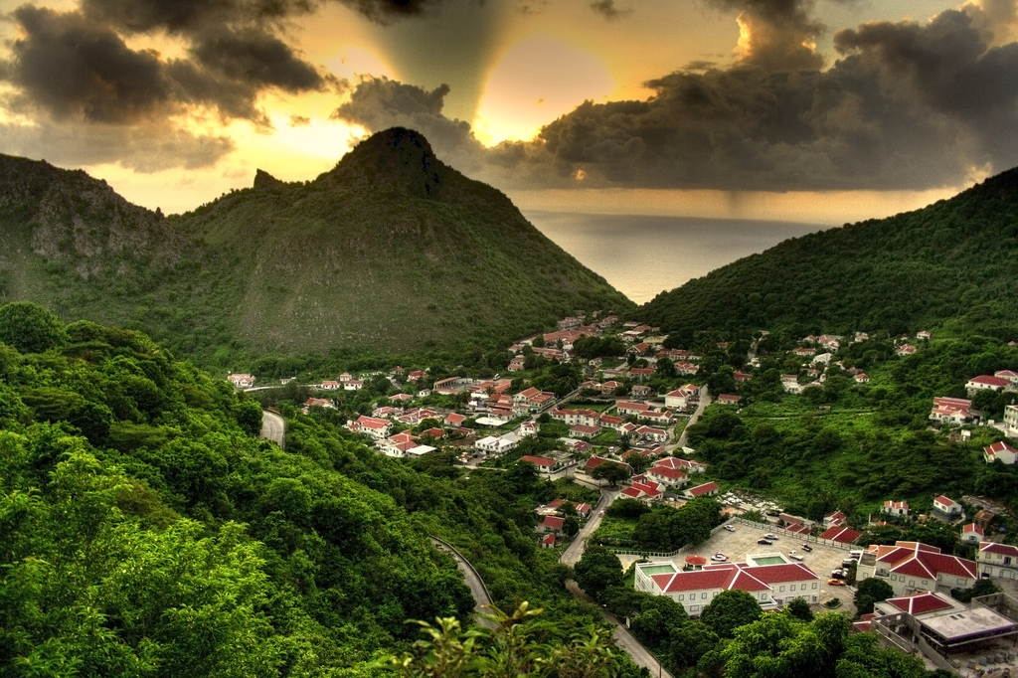
About Saba
Capital: The Bottom
Language: Dutch and English
Fact: Saba rests on a potentially active volcano – Mount Scenery

