Slide 1
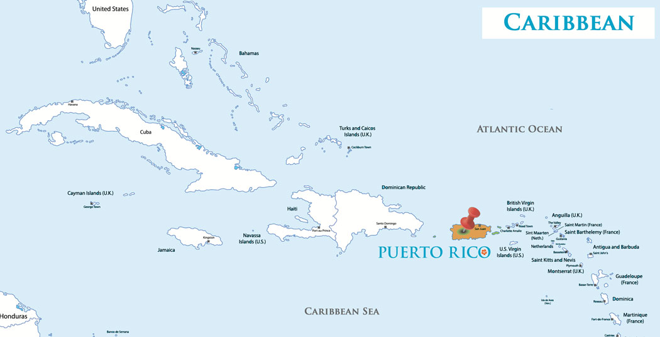
Puerto Rico

Slide 2
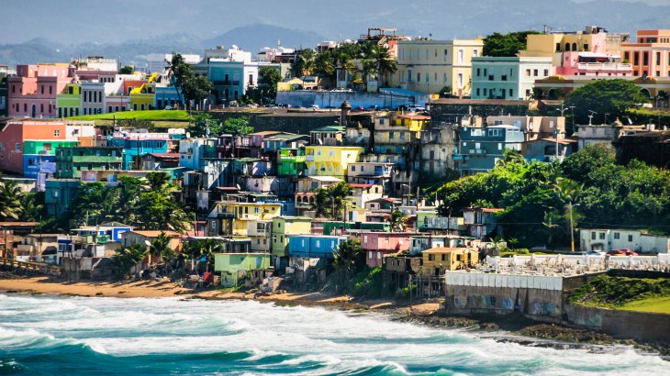
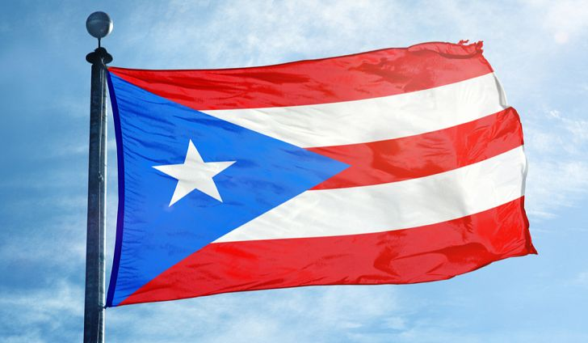
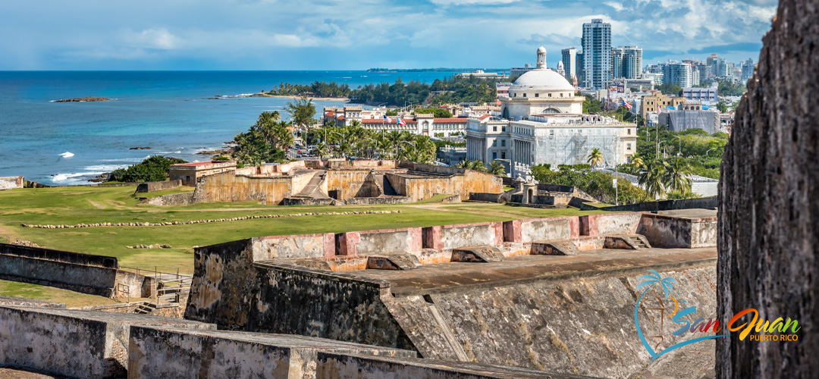
Puerto Rico
Capital: San Juan
Population: 3.6 million
Official languages: Spanish and English (predominantly Spanish).

Slide 3
Puerto Rico
Colonial authority transferred from Spain to US in 1898.
Technically an ‘unincorporated organized territory of the US’, official name is ‘Commonwealth of Puerto Rico’.
Government is ‘a self-governing commonwealth in political association with the US’.
Citizens are technically American citizens.
‘The result of what has been said is that, while in an international sense Porto Rico was not a foreign country, since it was subject to the sovereignty of and was owned by the United States, it was foreign to the United States in a domestic sense, because the island had not been incorporated into the United States, but was merely appurtenant thereto as a possession.’ (Downes v. Bidwell, 1901).
Drawbacks:
Cannot declare bankruptcy ($75B debt).
Cannot vote in presidential elections.

Slide 4
Puerto Rico
93.6% urban population; population San Juan roughly 2.5 million.
Pina Coladas invented in San Juan in 1963.
60% of the island is mountainous.
Poverty rate 43% (compared to 14% US).
Barcelonita has the world’s largest pharmaceutical complex.

