Slide 1
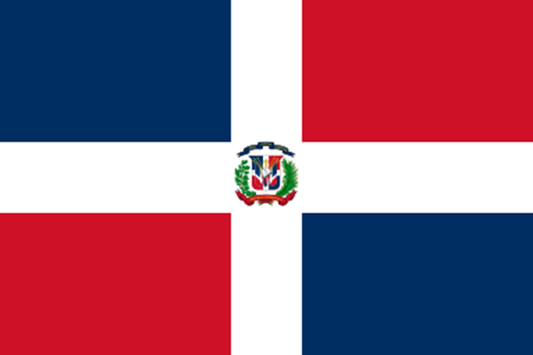
The Dominican Republic

Slide 2
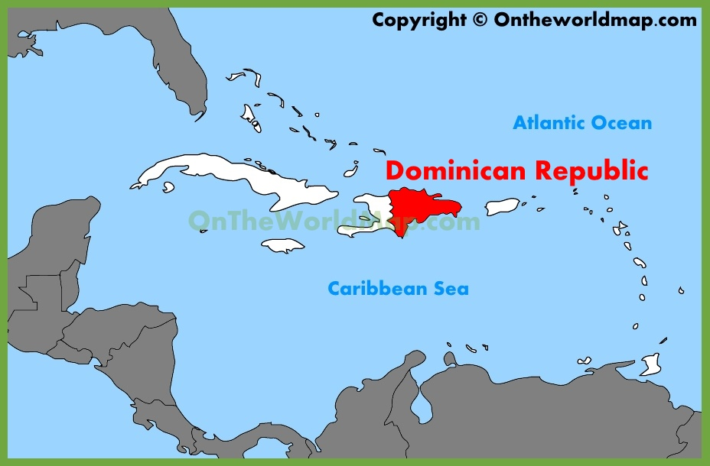
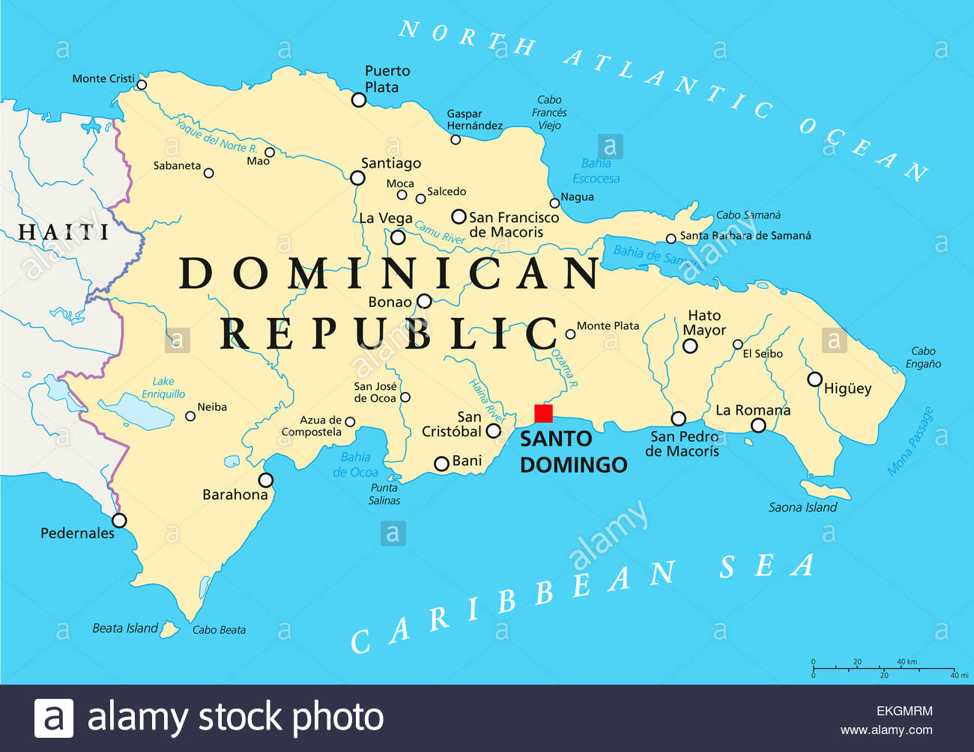

Slide 3
Capital: Santo Domingo
Official language: Spanish
Columbus, December 1492
1821 Haitian rule
1844 independence (War of Dominican Independence)
Members of armed forces and police are ineligible to vote

