Slide 1
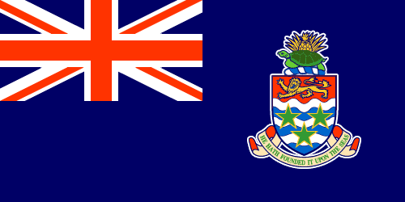
THE CAYMAN ISLANDS
Afia Headley

Slide 2
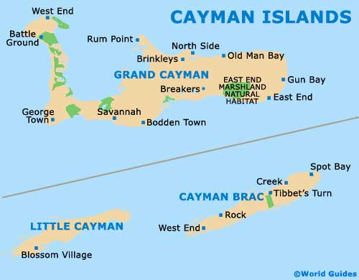
THE CAYMAN ISLANDS
A British overseas territory, consisting of 3 islands.
From largest to smallest:
GRAND CAYMAN
CAYMAN BRAC
LITTLE CAYMAN
INHABITANTS OF THESE ISLANDS: Approximately one-fifth of Caymanians are European, predominantly of British lineage. Another fifth are black, descendants of African slaves, as well as two-fifths being a mixture of the two; both of African and European ancestry. The remaining occupants of these islands are of other mixed descent or are settlers.
The average life expectancy for its population is 81!

Slide 3
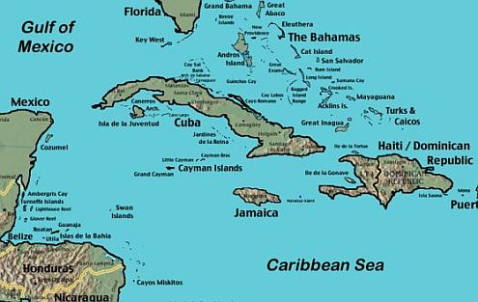
KEY INFORMATION
LOCATION
British overseas territory and island chain, located in the western Caribbean Sea.
Positioned approximately180 miles (290km) northwest of Jamaica.
In-between Jamaica and the Yucatán Peninsula.
PRESENT DAY CAPITAL
George Town, Grand Cayman, where more than half its population live.
OFFICIAL LANGUAGE/S
English, but spoken in a variety of dialects.
Spanish being the second most commonly spoken language.
YEAR OF INDEPENDENCE/CURRENT CONSTITUTIONAL STATUS
Its current Constitution was appointed by a statutory instrument of the United Kingdom in 2009. This enabled internal autonomy, but under a Governor.
Government is appointed by the monarch in England , with a Governor being elected as the British representative of this region. The governor is thus an emblem of the British monarchy.
BACKGROUND:
Non-independent since 1962. This region chose to remain under British rule when former British colony and dependency Jamaica, chose to become independent, in this year.
However, this region has been under the influence of Britain since 1670, when under the Treaty of Madrid (1670), many islands of the Caribbean had to give up power.

Slide 4
FUN FACT
Bodden Town, the former capital city, supposedly has its name derived from the number of individuals with the surname ‘Bodden’.
EXTRA FACT:
Despite its tiny size, there are four airports here.

