Slide 1
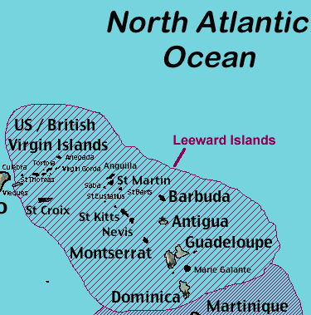
Antigua

Slide 2
Became an independent state within the Commonwealth of Nations on 1 November 1981
capital city- St. John‘s
official language- English

Slide 3
History
First inhabited by the Guanahatabey people. Eventually, the Arawak migrated from the mainland, followed by the Caribs .
In 1632 a group of English colonists left St. Kitts to settle on Antigua and Sir Christopher Codrington, established the first permanent European settlement and turned it into profitable sugar colony.
The island was considered Britain's "Gateway to the Caribbean".

Slide 4
The highest point of the island is Mount Obama renamed on Barack Obama’s 48th birthday on August 4 2009

