Slide 1
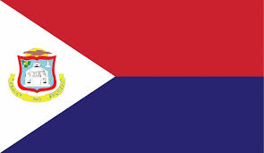
SINT MAARTEN

Slide 2
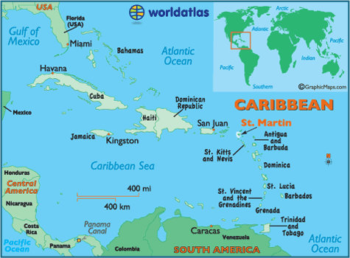
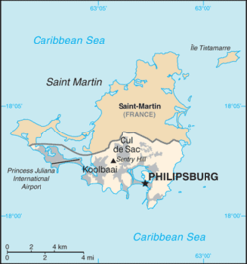
Capital: philipsburg language: dutch & English
CONSTITUTIONAL status: constituent country of the kingdom of netherlands
Notes:
Regional govt that has its own representative parliamentary democracy, with the monarch represented by a Governor and a Prime Minister

Slide 3
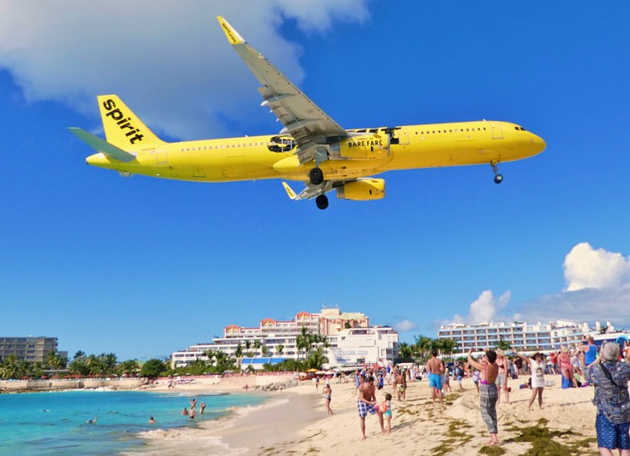
Sint marten is the smallest landmass in the world to be shared between two countries
Notes:
Regional govt that has its own representative parliamentary democracy, with the monarch represented by a Governor and a Prime Minister

