Slide 1
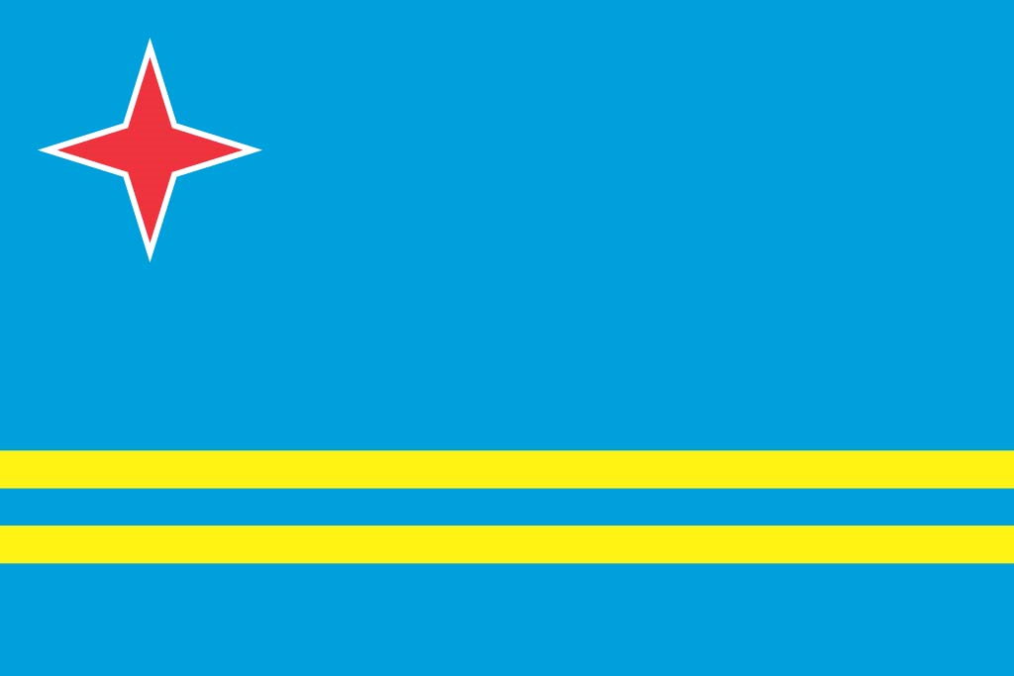
ARUBA
Located in the Lesser Antilles Southern Caribbean

Slide 2
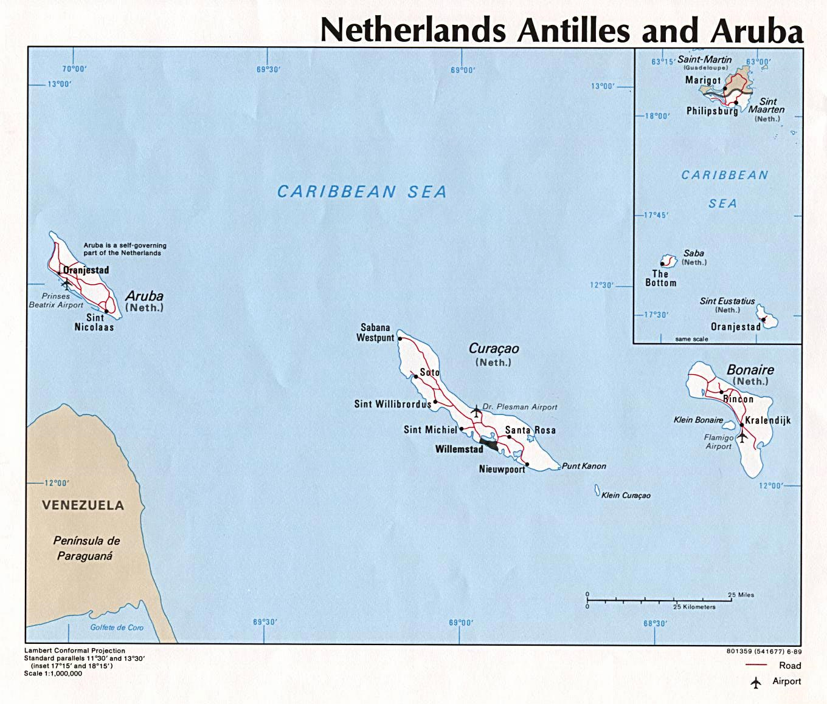
Aruba
Capital: Oranjestad
Its around 18 miles from Venezuela
Aruba, together with Bonaire and Curacao, forms a group of islands called the ABC islands
Independence?
Aruba is one of four countries that form the Kingdom of the Netherlands (Netherlands, Curacao and Saint Maarten)
The nationality of the citizens of Aruba is Dutch

Slide 3
Language
Official languages: Dutch and Papiamento
But on average Arubans speak four languages- typically the official two and also Spanish and English

Slide 4
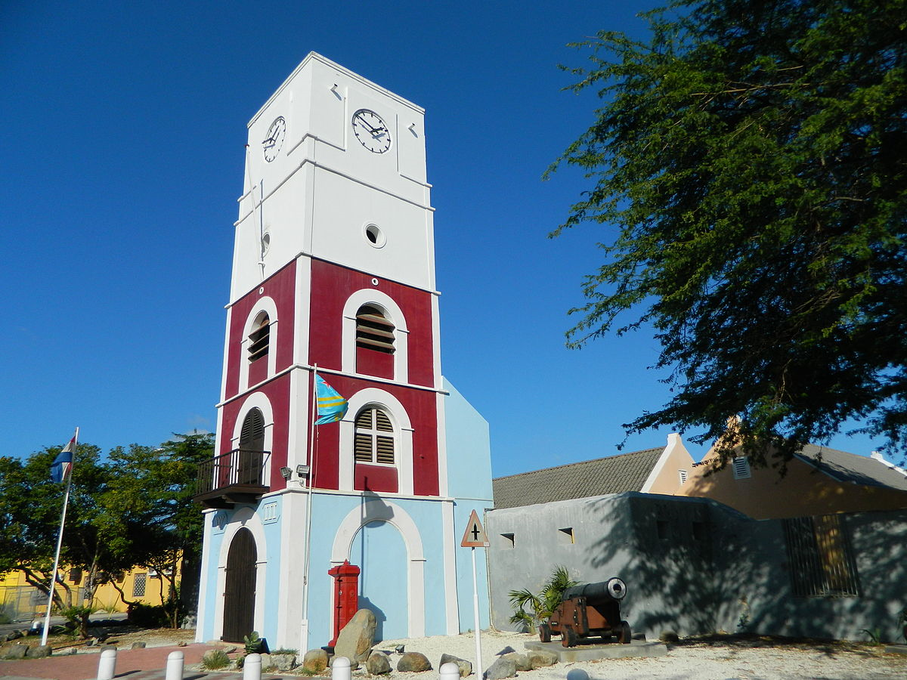
Fun Fact
Fort Zoutman is Aruba’s oldest building (1798) and was built to protect the capital from pirates

