Slide 1

Trinidad

Slide 2
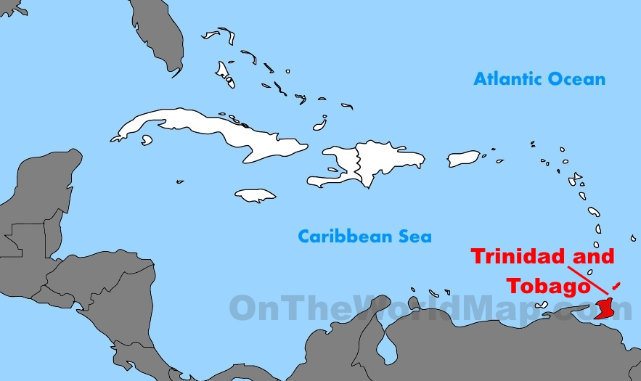
Location
7 miles north of Venezuela: geographically part of the South American continent, but socio-economically the southernmost island in the Caribbean.
Fifth largest island in the Caribbean.

Slide 3
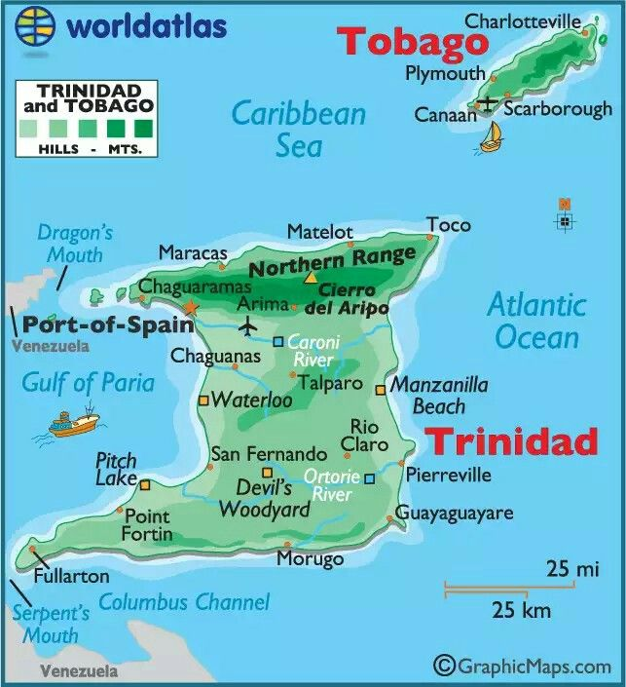
Present-day capital is Port of Spain.
The official language is English, although Trinidadian creole and Spanish are also spoken.
Achieved independence from the U.K. in 1962 as Trinidad and Tobago, becoming a republic within the Commonwealth (1976).

Slide 4
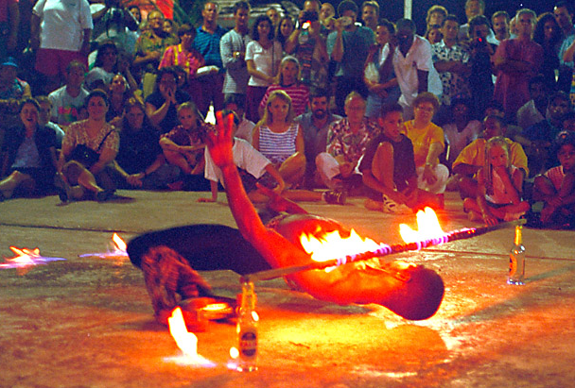
Limbo (dance)
Dates back from 19th century Trinidad, symbolising slaves entering the galleys of a slave ship, or a spirit crossing over into the after-world.
Popularised in the 1950s and 60s.
The world record for lowest limbo dance is held by Shemika Campbell, from Trinidad, who danced under a bar only 8.5 inches above the ground in 2010.

