Slide 1
St Vincent

Slide 2
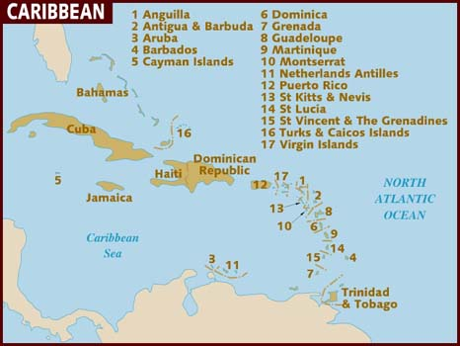
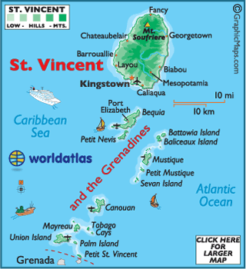

Slide 3
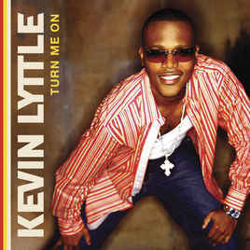
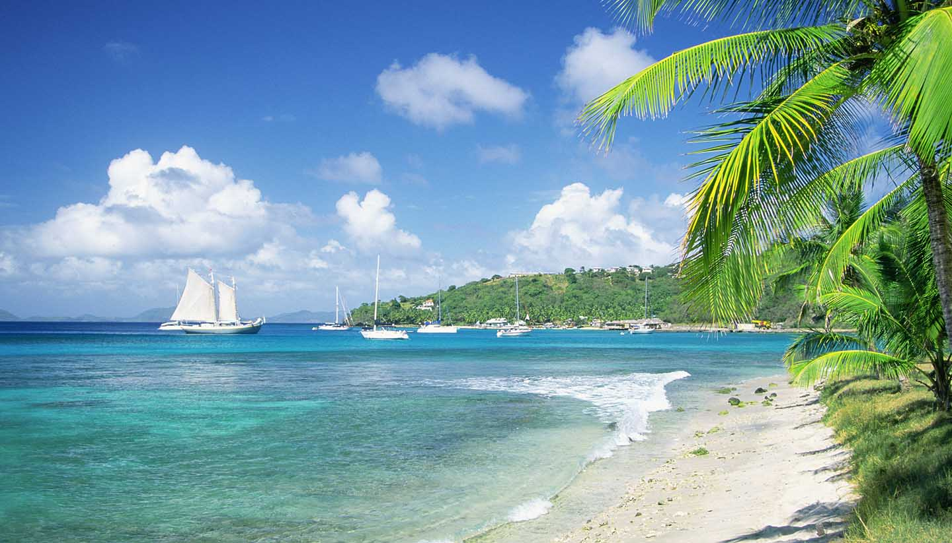
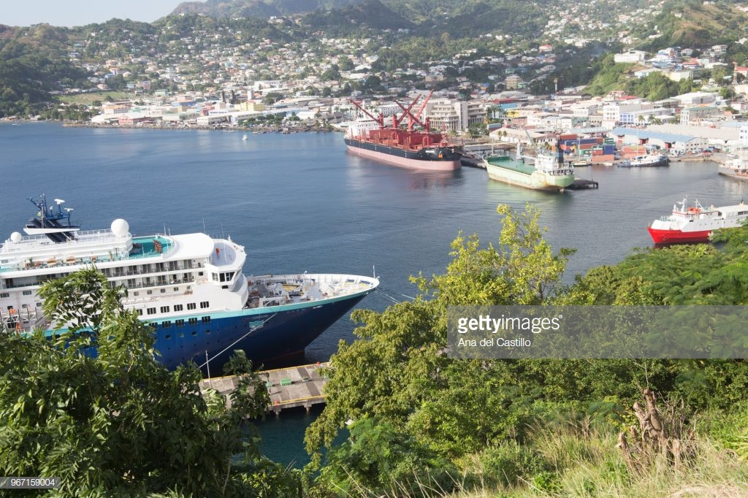
St Vincent
Capital: Kingstown
Constitutional Status: Independent constitutional monarchy
Official Language: English
Year of Independence: 1979

