Slide 1
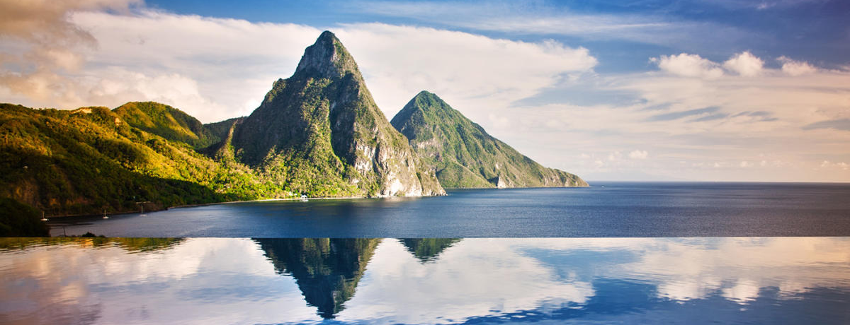
Saint Lucia
Aiysha Southon

Slide 2
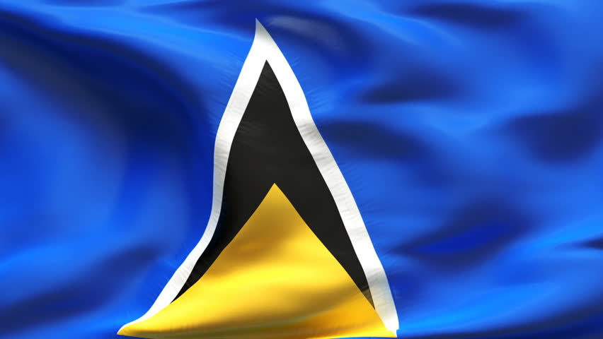
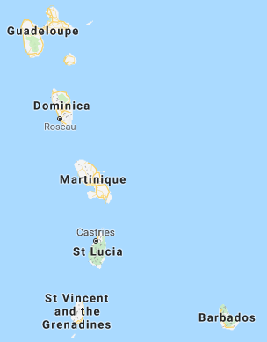
Where is Saint Lucia?
North West from Barbados.
Underneath Matinique.
Apart of the Lesser Antilles.
Population of 178,844.
Capital of Sant Lucia is Castries.

Slide 3
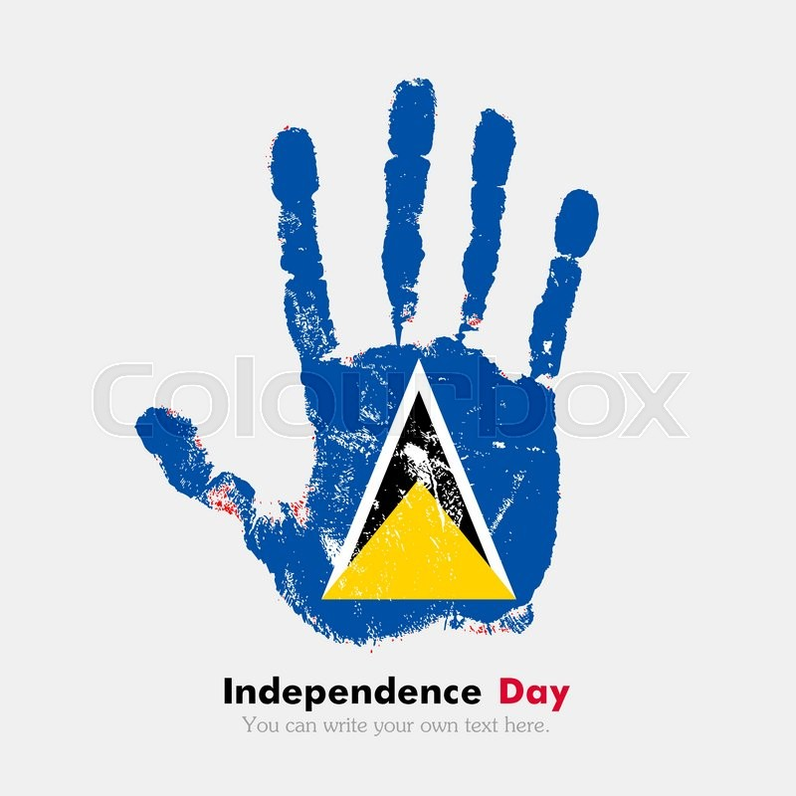
Independence
The exact date of discovery – not known – around 1500.
First attempts of colonisation made by the British in 1605 and 1638 – stopped by the Caribs.
First successful settlement In 1650 by the French from Martinique.
1814 – British colonised Saint Lucia.
Independence finally achieved in 1979.

Slide 4
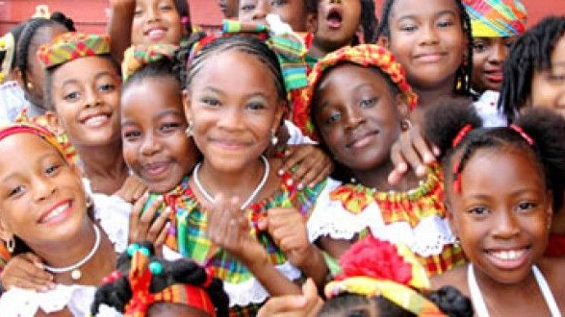
The People
Official language is English.
But 95% of population speak Saint Lucian Creole French, Patois.
Most people are Roman Catholic but there are other religions including Islam, Buddhism and Judaism.

Slide 5
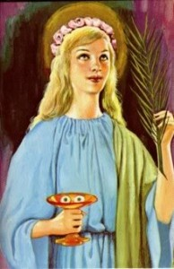
Interesting Fact
Saint Lucia is the only country in the world that is named after a woman.
Named after Saint Lucy of Syracuse by the French.
Saint Lucy was a Christian martyr who died during the Diocletianic Persecution.
Feast day, known as Saint Lucy’s Day, celebrated on the 13th December.
Honoured in the Middle Ages and remained a saint in early modern England.
She was executed in Syracuse, Sicily.

