Slide 1
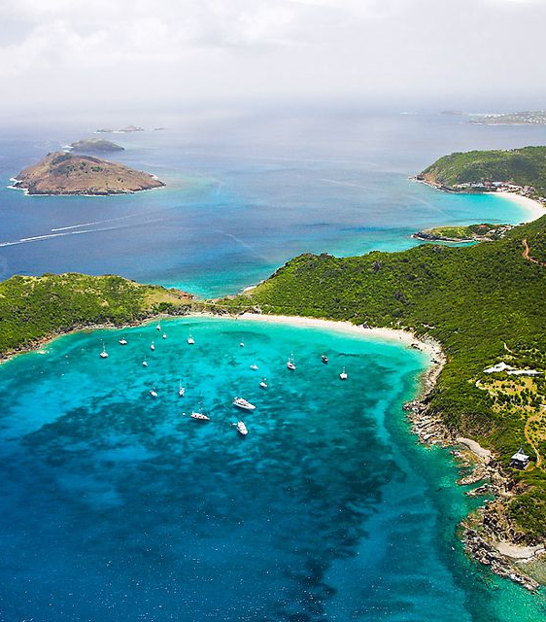
Saint Martin

Slide 2
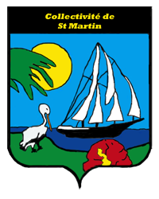
Political Status
Overseas collectivity of France. Has the French flag and its own coat of arms. A local English-based creole language is spoken.
It was a French commune, forming part of Guadeloupe and having the status of an overseas région and départment of France.
In 2003 the French part of the island voted in favour of secession to form an overseas collectivity of France. In 2007 French parliament passed a bill granting this status.
First session of the Territorial Council on 15 July 2007.
Current President of the Territorial Council is Daniel Gibbs.

Slide 3
The Island, Its People and Geography
The southern 40% of the island is taken up by Sint Maarten, a constituent country of the Kingdom of the Netherlands. This is the only place in the world where France borders the Netherlands.
There are no customs formalities between the Dutch and French sides. The boundaries are simply marked by "welcome'' signs on each side.
Marigot is the main town and capital of the French Collectivity. Originally a small fishing village on a swamp for which it was named it has since grown after being ‘awakened to tourism’.
Population of 36,286 (as of 2011)
It covers area of 53.2 square kilometers, taking up the northern 60% of the divided island. It also takes up some neighbouring islets, the largest of these is Ile Tintamarre.

Slide 4
Economy and Work
GDP: 1% agriculture, 15% industry and 84% services (tourism). Around four fifths of the labour force is engaged in tourism. Most foodstuffs, energy and manufactured goods are imported.
The island offers duty free shopping and there are few business restrictions.
French side of the island is largely falling behind economically because Sint Maartin has the main airport, casinos and ports for large cruise ships.
Is the only overseas collectivity of France with the status of being an outermost region of the EU.
The Euro is legal tender and the currency of Saint Martin. Still, it remains outside of the Schengen Area (passports) but is also outside of the EU VAT area.

Slide 5
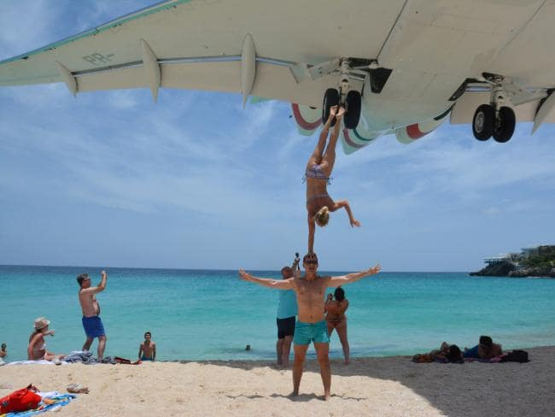
Princess Juliana International Airport and Maho Beach

Slide 6
Saint Martin and today’s topic of tourism
‘Discover a tropical paradise with holidays in Saint Martin’
(reinforced ideas of “discovery” are common)
‘With a massive range of activities, some of the best beaches in the world, an incredible landscape and a whole host of diverse cities, towns and villages to explore, holidays to Saint Martin have something for everyone.’
‘Spearheading a number of promotional campaigns, Saint Martin’s natural riches have become a mainstay of tourist guides. Walks and horse rides, bicycle touring and quad bike trails are yet another way to discover this paradise island and return home with lasting memories of landscapes, history and encounters with the locals.’

